Slide 1

About OMICS Group
OMICS Group International is an amalgamation of Open Access publications and worldwide international science conferences and events. Established in the year 2007 with the sole aim of making the information on Sciences and technology ‘Open Access’, OMICS Group publishes 400 online open access scholarly journals in all aspects of Science, Engineering, Management and Technology journals. OMICS Group has been instrumental in taking the knowledge on Science & technology to the doorsteps of ordinary men and women. Research Scholars, Students, Libraries, Educational Institutions, Research centers and the industry are main stakeholders that benefitted greatly from this knowledge dissemination. OMICS Group also organizes 300 International conferences annually across the globe, where knowledge transfer takes place through debates, round table discussions, poster presentations, workshops, symposia and exhibitions.

Slide 2
About OMICS Group Conferences
OMICS Group International is a pioneer and leading science event organizer, which publishes around 400 open access journals and conducts over 300 Medical, Clinical, Engineering, Life Sciences, Pharma scientific conferences all over the globe annually with the support of more than 1000 scientific associations and 30,000 editorial board members and 3.5 million followers to its credit.
OMICS Group has organized 500 conferences, workshops and national symposiums across the major cities including San Francisco, Las Vegas, San Antonio, Omaha, Orlando, Raleigh, Santa Clara, Chicago, Philadelphia, Baltimore, United Kingdom, Valencia, Dubai, Beijing, Hyderabad, Bengaluru and Mumbai.

Slide 3




DEVELOPMENT OF A NEW POWERTRAIN CONCEPT BASED ON THE INTEGRATION OF ELECTRIC GENERATION, ENERGY RECOVERY AND STORAGE
Estefanía Hervás Blasco José Miguel Corberán Emilio Navarro Peris Alex Rinaldi
Alberto Merlo

Slide 4
Contents
Motivation
Organization chart
Concept and Objectives
Dynamic model
ICE engine optimization
Heat recovery
Beltless engine concept based on 48V board net architecture
Power pack integration
Expected results
Project timing and next steps
Conclusions

Slide 5
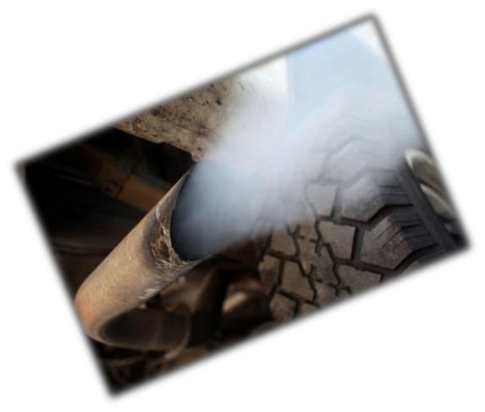



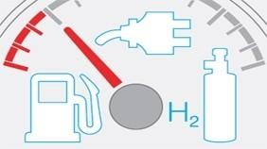



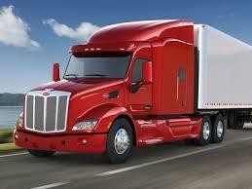
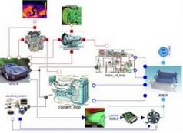

Motivation
To support research and
enhance a better future:
GASTone is one of the project that belongs to
International Conference and Exhibition on Automobile Engineering (OMICS), Valencia 2015 ^{the FP7-transport}
GASTONE consortium is the sole owner of this document. It cannot be copied or given to third parties without permission.

Slide 6
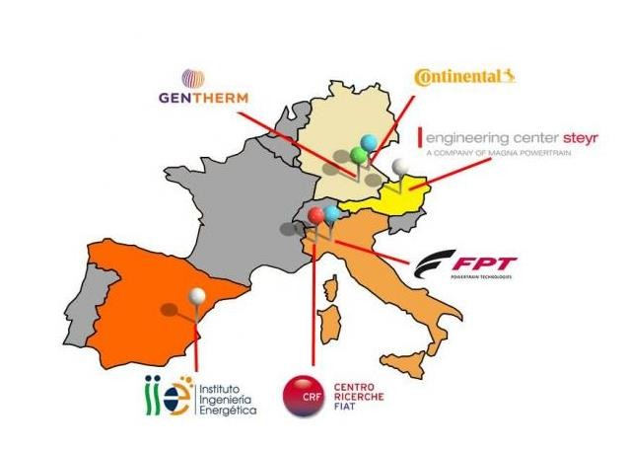
Organization chart
GASTone is a collaborative Project between six partners:

Slide 7
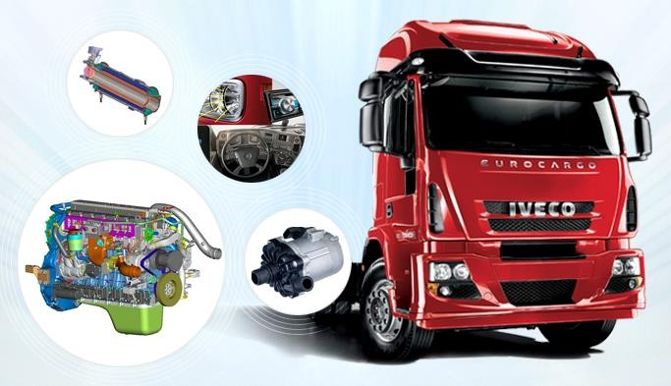
Concept and Objectives
The main goal of the Project is the development of a new powertrain concept based on the integration of:
Energy recovery and storage
System control strategies
η > 50 %
At vehicle level
Natural Gas engine
Electric generation

Slide 8
Concept and objectives
This target will be mainly reached based on the following three streams:
₍₁₎ The energy recovery from the exhaust gases heat with a cascade approach thanks to the
adoption of an advanced thermoelectric generator and a turbo-generator.
The integration of a smart kinetic energy recovery system to substitute the alternator and
⁽²⁾ generate electricity during decelerations improving the efficiency of the engine.
The electrification and control of the main auxiliaries (coolant pump, oil pump, auxiliary e-
⁽³⁾ supercharger and air conditioning compressor) by using the produced electric energy.
The system includes sizing and development of an appropriate energy storage system as well as the adoption of electrified auxiliaries.
To optimize and evaluate the integration of the whole system and the control strategy, a dynamic model has been developed.
The project results will be demonstrated at bench level while the benefits of the control strategies will be evaluated at vehicle level thanks to advanced dynamics
InternationmaloCodnefelsre.nce and Exhibition on Automobile Engineering (OMICS), Valencia 2015
GASTONE consortium is the sole owner of this document. It cannot be copied or given to third parties without permission.

Slide 9
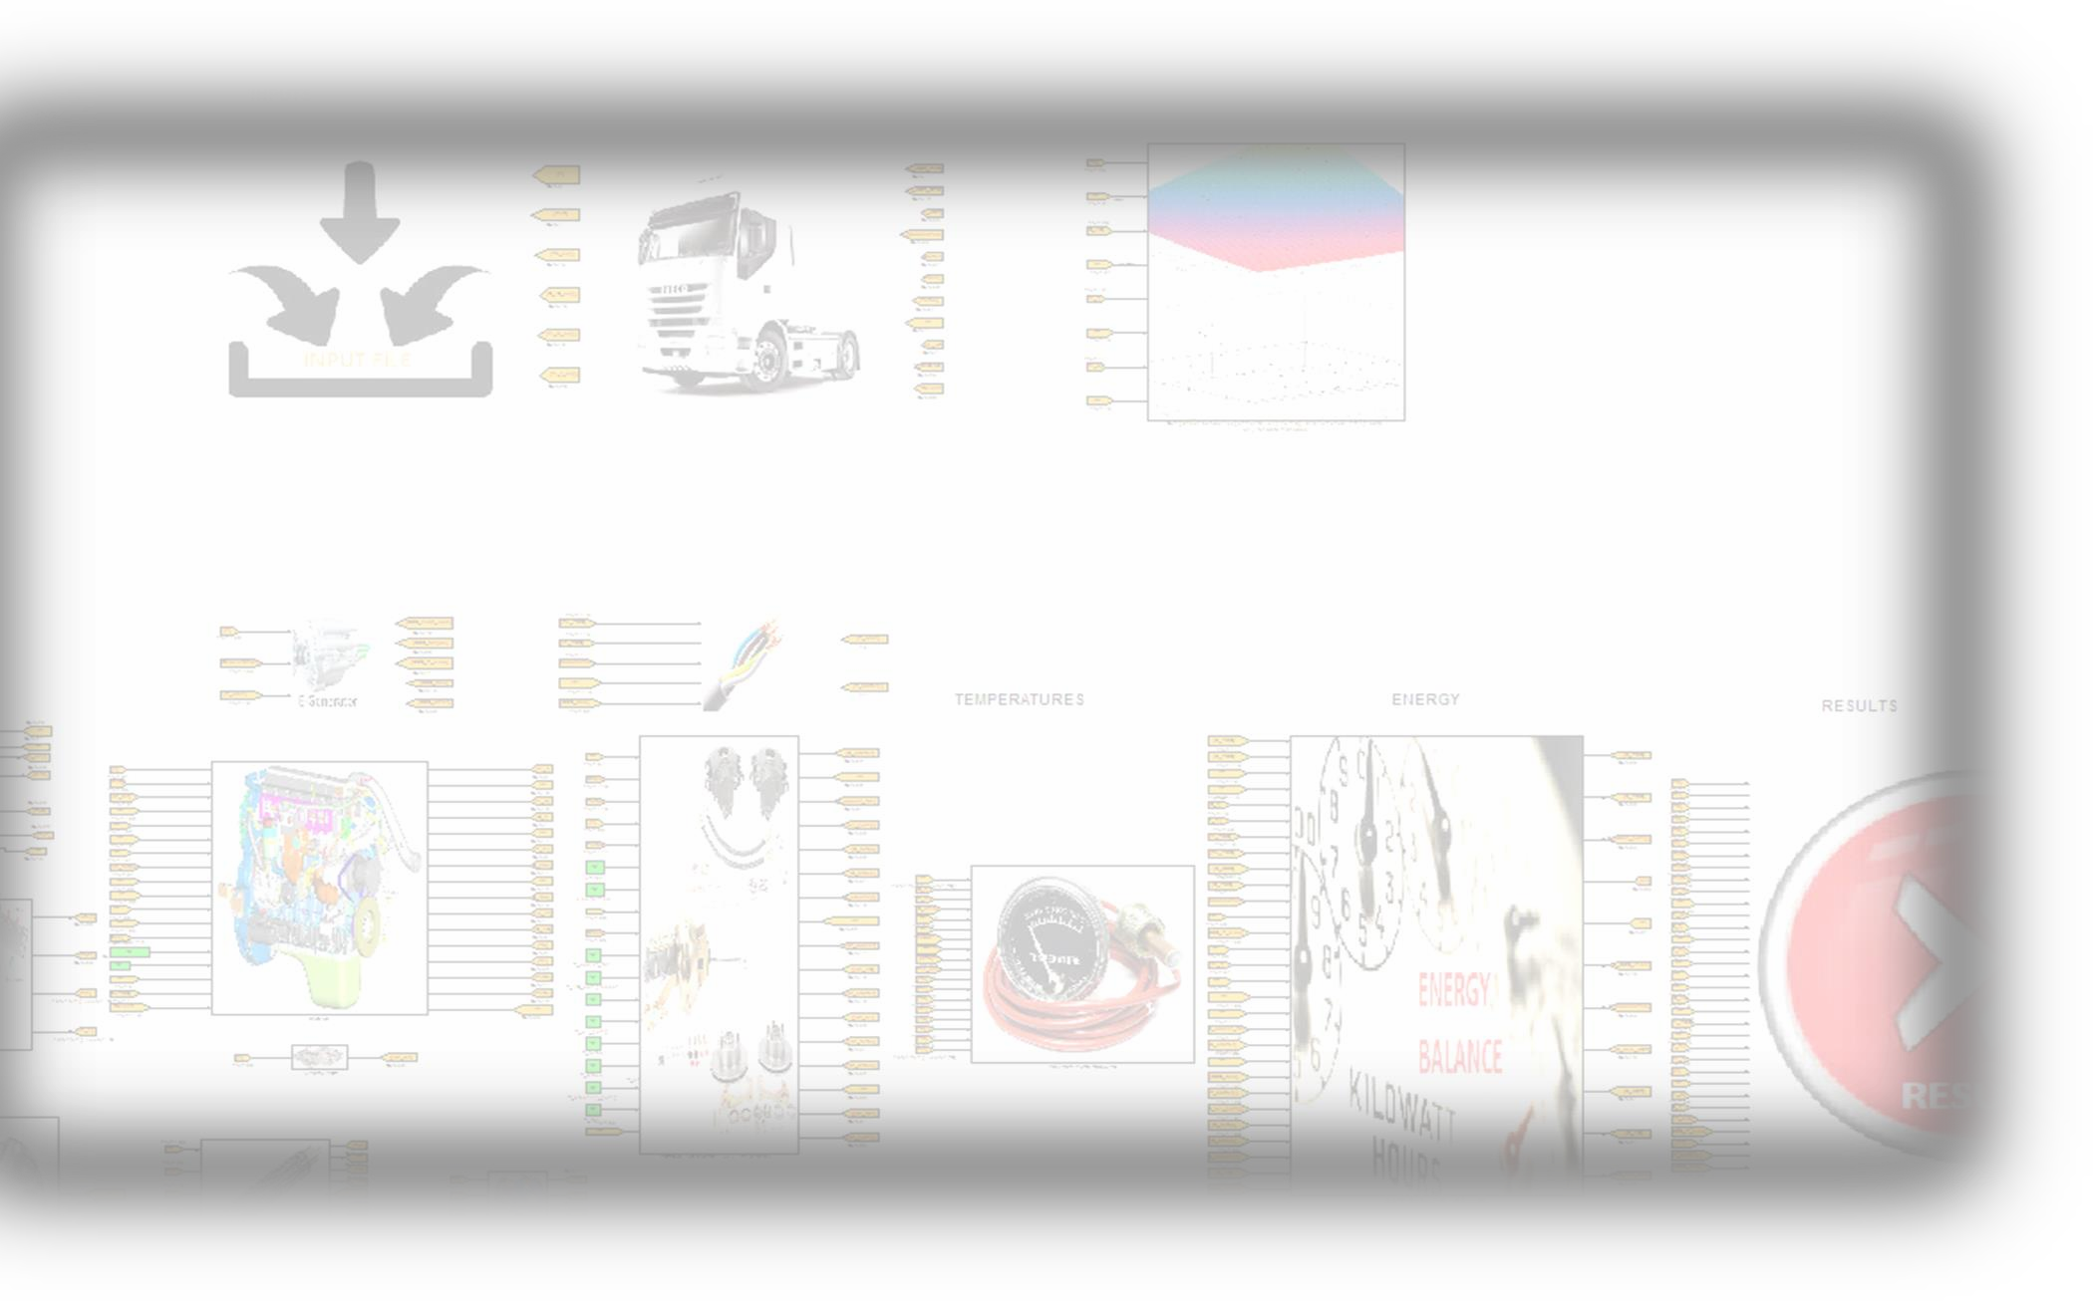
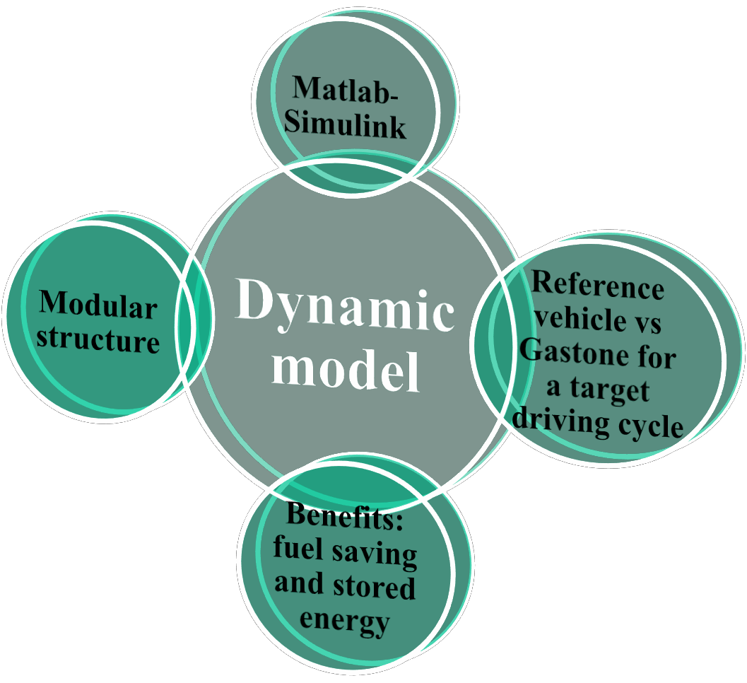

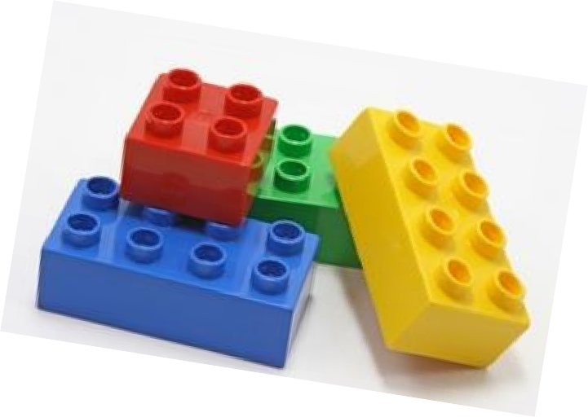
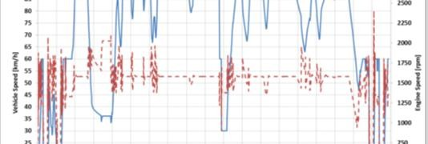

Dynamic model
Target of the model:
Estimate the total fuel consumption over the
driving cycle
Estimate the energy balance of the system:
Production vs consumption
Estimate the temperatures and pressures in each relevant point
Comparison between the reference vehicle and
the Gastone concept
%

Slide 10
Concept and objectives
(1)
The energy recovery from the exhaust gases heat with a cascade
approach thanks to the adoption of an advanced thermoelectric generator and a turbo-generator.
The integration of a smart kinetic energy recovery system to substitute the alternator and generate electricity during decelerations improving the efficiency of the engine.
The electrification and control of the main auxiliaries (coolant pump, oil pump, auxiliary e- supercharger and air conditioning compressor) by using the produced electric energy.

Slide 11
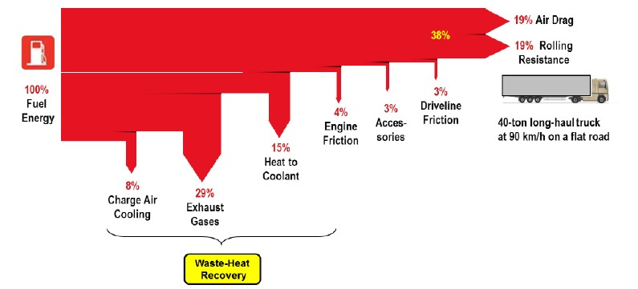
(1) Heat recovery
Almost 2/3 of the fuel energy of a today long distance truck is dissipated energy
available as heat:
  1/3 a high temperature from the exhaust gas system
  1/3 dissipated to the coolant system
In addition, these vehicles often operate for long periods of time under pretty constant conditions:
  Energy recovery systems can be designed to work regularly (beltless driven)
  The electric energy generated would be used almost immediately

Slide 12
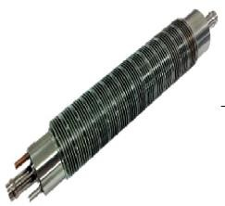
(1) Heat recovery
Thermoelectric generator (TEG)
  Electric generation from certain materials that can generate electric power from a temperature difference (Seebeck effect) and can provide active cooling or heating when powered by electricity (Peltier effect).
  Increase of the generation thanks to a bigger temperature differences conditions.
  Optimum sizing and dimensioning (number of TEGs modules, arrangement,
placement).
Turbogenerator
  Considered as mature technology.
  It will not be investigated in this Project but used.

Slide 13
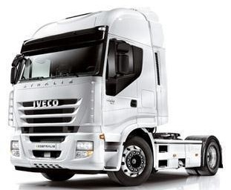
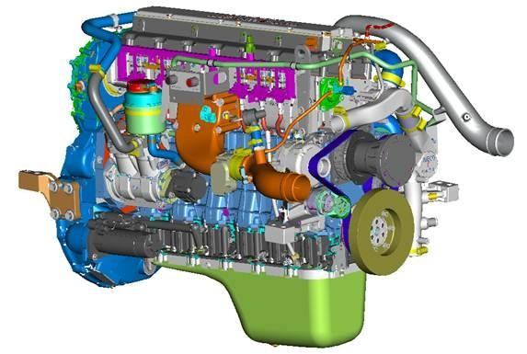
(2) ICE engine optimization
A relevant engine and powertrain efficiency improvement will be achieved thanks to the combined effect of the following innovations:
More powerful turbo: higher torque, higher performance, lower pumping losses, down-speeding strategies,
eliminate turbocharger lag at low exhaust gas flow levels.
A liquid cooled charge air cooler
Substitution of the alternator by a kinetic energy recovery system
Natural gas engine: higher exhaust gas temperatures and simpler after-treatment system.

Slide 14
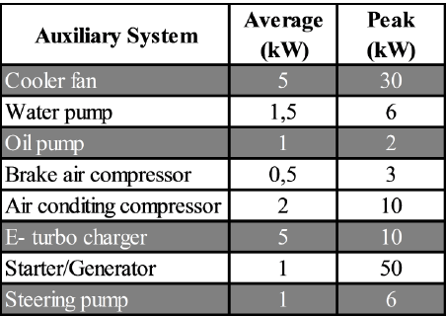
(3) Beltless engine concept based on 48V
board net architecture
Development of:
Additional DC/DC 24V to ensure the conventional net service.
Efficient and Smart solution to generate and store electric power using a 48V battery.
Efficient e-auxiliaries:
  based on 48V level and board net architecture with central integrated control.
  e-auxiliaries beltless driven.
  Not need to run all of them under full load -> flexibility -> control strategies.

Slide 15
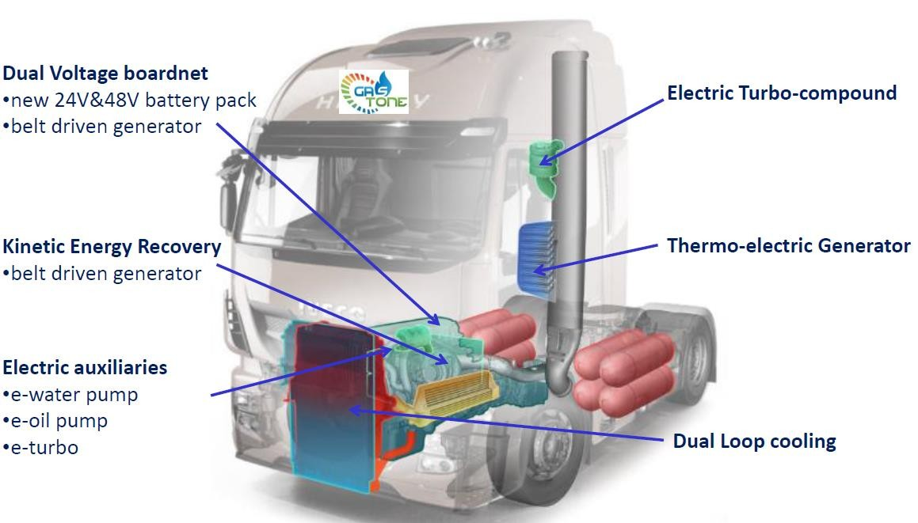
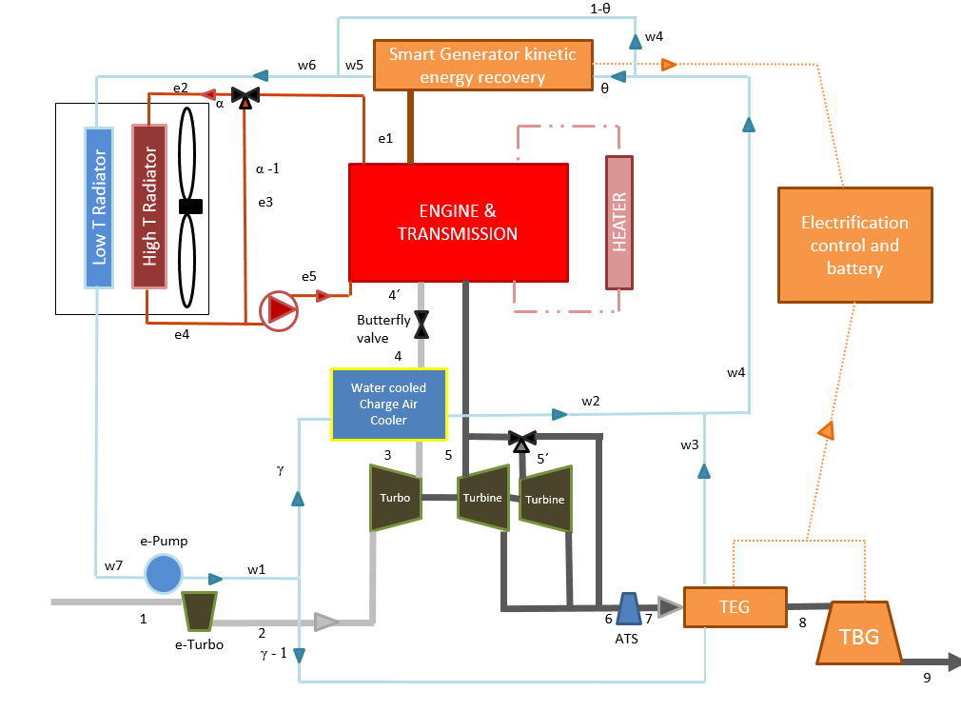
(3) Power pack integration
Challenge: get the optimum integration of the whole system

Slide 16

Project expected results
The GASTone Concept expectation is the improvement of the efficiency at vehicle level:
Current efficiency | 38 %
Natural Gas engine improvement | +4%
Liquid Charge Air Cooler | +1%
e- water pump + e-oil pump | +2%
e- energy management | +1%
Exhaust Heat Recovery (TEG+TBG) | +7%
e- turbocharger | Needs to be evaluated
Expected improved efficiency | 53%
This is the project goal and the final achievement will depend on the design, performance, specification of the components as well as the control strategy and the different economic viable improvements finally made and based on the evaluation in the dynamic system modeled and after presented.

Slide 17
Projet timing and next steps
Now
PROJECT TIMING
Month
3 6 9 12 15 18 21 24 27 30 33 36 39 42
Concept selection (definition of the reference vehicle, system concept design, benefit estimation,…)
Beltless Engine development (electric and electronic design, e-auxiliaries, control strategies development…) 3 Thermoelectric Generator development (desgin, sizing, prototyping, …)
Power pack integration (exhaust system adaption, electric and electronic integration, control strategies,…)
Experimental evaluation
Technological feasibility
Dissemination and exploitation
Finish the collection of data for auxiliaries, the TEG and the TBG in order to implement
them as electric.
Define and evaluate different control strategies.
Close the TEG size and design decision to start the prototyping development.
Integrate and adapt the system based on the optimal control developed.
Create the system prototype, evaluate it and study its technological feasibility.

Slide 18
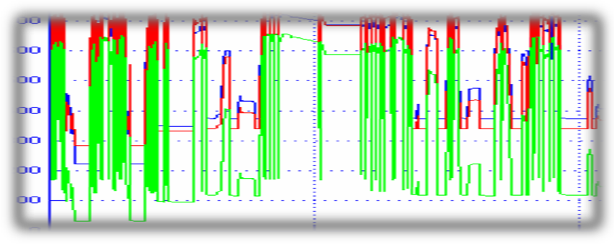
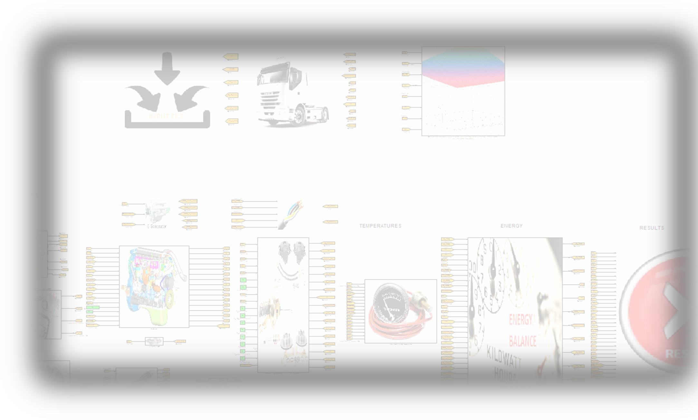
Conclusions
Currently, we are defining the size and the specifications of the components.
After the collection of the data, the auxiliaries will be electrified and an optimal control strategy will be investigated.
The models of the components are already developed and waiting for validation.

Slide 19

New powertrain concept based on integration of waste energy recovery, storage and re-use
Thank you very much
for your attention!

