Slide 1

About OMICS Group
OMICS Group International is an amalgamation of Open Access publications and worldwide international science conferences and events. Established in the year 2007 with the sole aim of making the information on Sciences and technology ‘Open Access’, OMICS Group publishes 400 online open access scholarly journals in all aspects of Science, Engineering, Management and Technology journals. OMICS Group has been instrumental in taking the knowledge on Science & technology to the doorsteps of ordinary men and women. Research Scholars, Students, Libraries, Educational Institutions, Research centers and the industry are main stakeholders that benefitted greatly from this knowledge dissemination. OMICS Group also organizes 300 International conferences annually across the globe, where knowledge transfer takes place through debates, round table discussions, poster presentations, workshops, symposia and exhibitions.

Slide 2
About OMICS Group Conferences
OMICS Group International is a pioneer and leading science event organizer, which publishes around 400 open access journals and conducts over 300 Medical, Clinical, Engineering, Life Sciences, Pharma scientific conferences all over the globe annually with the support of more than 1000 scientific associations and 30,000 editorial board members and 3.5 million followers to its credit.
OMICS Group has organized 500 conferences, workshops and national symposiums across the major cities including San Francisco, Las Vegas, San Antonio, Omaha, Orlando, Raleigh, Santa Clara, Chicago, Philadelphia, Baltimore, United Kingdom, Valencia, Dubai, Beijing, Hyderabad, Bengaluru and Mumbai.

Slide 3




MODEL OF A NEW POWERTRAIN CONCEPT BASED ON THE INTEGRATION OF ELECTRIC GENERATION, ENERGY RECOVERY AND STORAGE
Estefanía Hervás Blasco José Miguel Corberán Emilio Navarro Peris Alex Rinaldi
IIE

Slide 4
Contents
Motivation
Concept and Objectives
Engine description
Driving cycle
Modelling
Results
Project timing and next steps
Conclusions

Slide 5
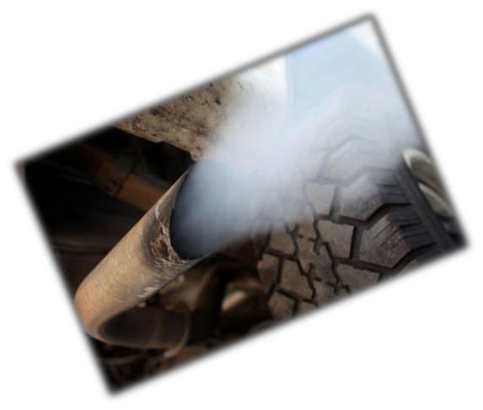



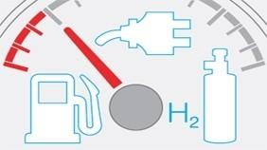


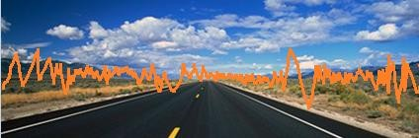
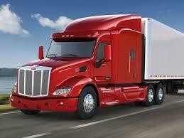
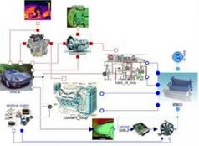

Motivation
To support research and
enhance a better future:
GASTone is one of the project that belongs to
International Conference and Exhibition on Automobile Engineering (OMICS), Valencia 2015 ^{the FP7-transport}
GASTONE consortium is the sole owner of this document. It cannot be copied or given to third parties without permission.

Slide 6
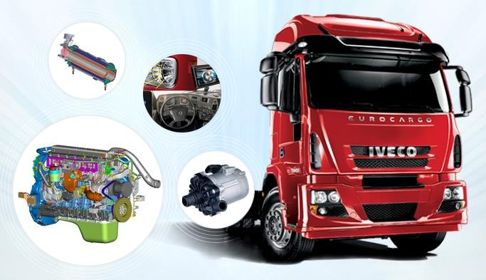
Concept and Objectives
The main goal of the Project is the development of a new powertrain concept based on the integration of:
Energy recovery and storage
System control strategies
η > 50 %
At vehicle level
Natural Gas engine
Electric generation

Slide 7
Concept and objectives
This target will be mainly reached based on the following three streams:
₍₁₎ The energy recovery from the exhaust gases heat with a cascade approach thanks to the
adoption of an advanced thermoelectric generator and a turbo-generator.
The integration of a smart kinetic energy recovery system to substitute the alternator and
⁽²⁾ generate electricity during decelerations improving the efficiency of the engine.
The electrification and control of the main auxiliaries (coolant pump, oil pump, auxiliary e-
⁽³⁾ supercharger and air conditioning compressor) by using the produced electric energy.
The system includes sizing and development of an appropriate energy storage system as well as the adoption of electrified auxiliaries.
To optimize and evaluate the integration of the whole system and the control strategy, a dynamic model has been developed.
The project results will be demonstrated at bench level while the benefits of the control strategies will be evaluated at vehicle level thanks to advanced dynamics
InternationmaloCodnefelsre.nce and Exhibition on Automobile Engineering (OMICS), Valencia 2015
GASTONE consortium is the sole owner of this document. It cannot be copied or given to third parties without permission.

Slide 8
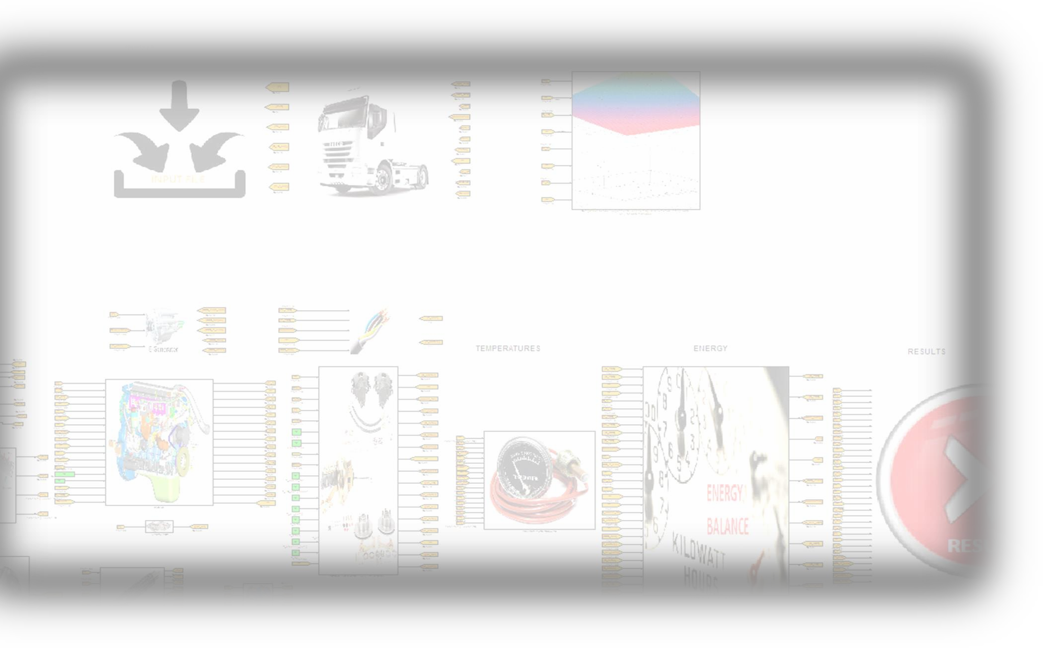
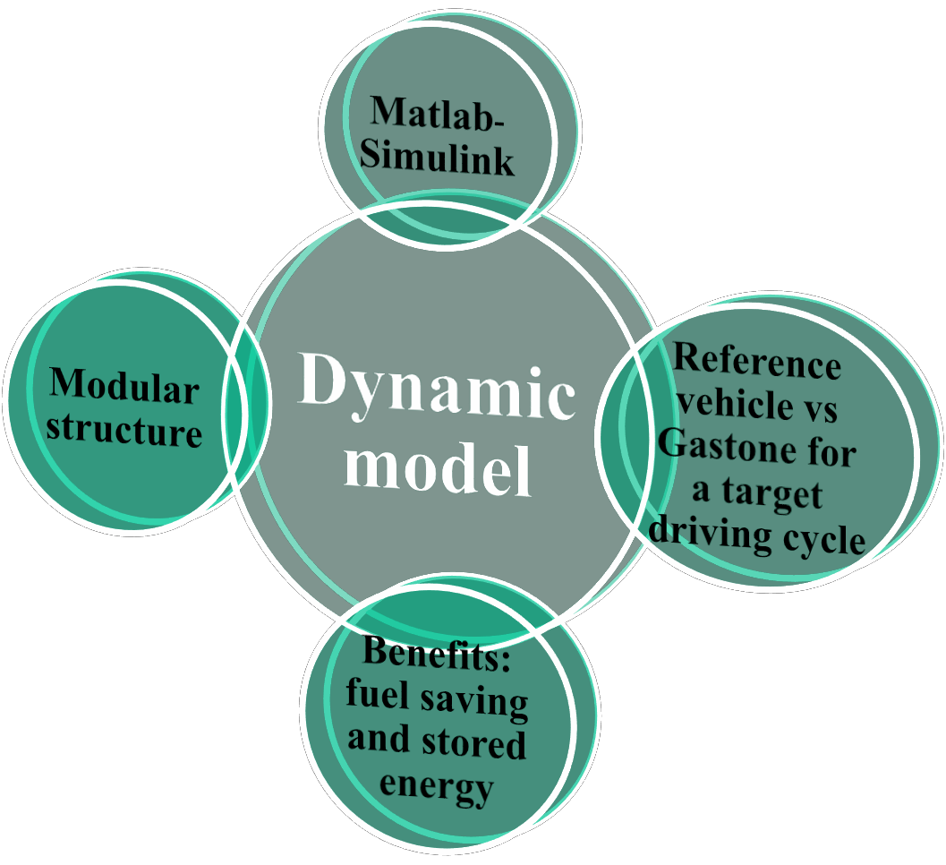


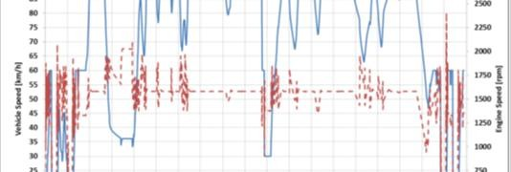
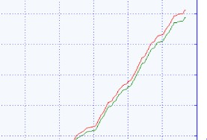
Dynamic model
Target of the model:
Estimate the total fuel consumption over the
driving cycle
Estimate the energy balance of the system:
Production vs consumption
Estimate the temperatures and pressures in each relevant point
Comparison between the reference vehicle and
the Gastone concept
%

Slide 9
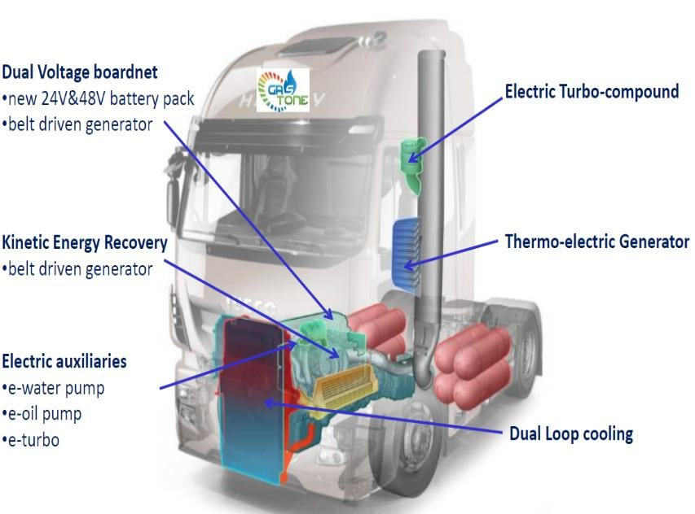
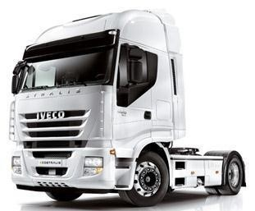
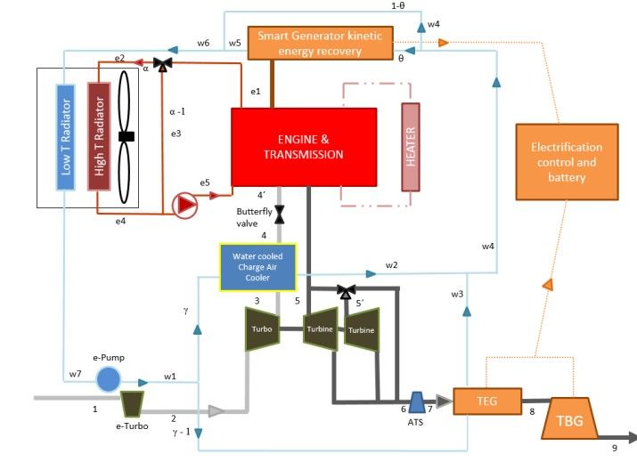
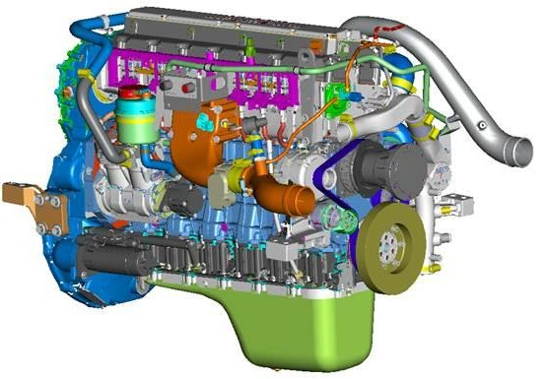
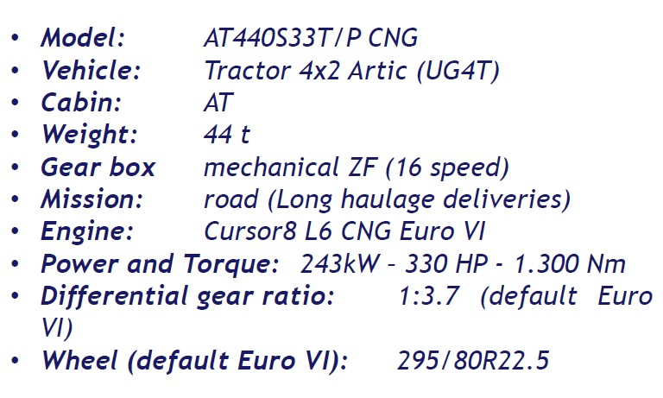
Engine Description
REFERENCE VEHICLE: the reference vehicle is IVECO STRALIS CNG MY2014 , the reference engine is Cursor8 CNG Euro VI and the experimental data for it is given by one of the partners.
GASTONE CONCEPT:
vs.

Slide 10
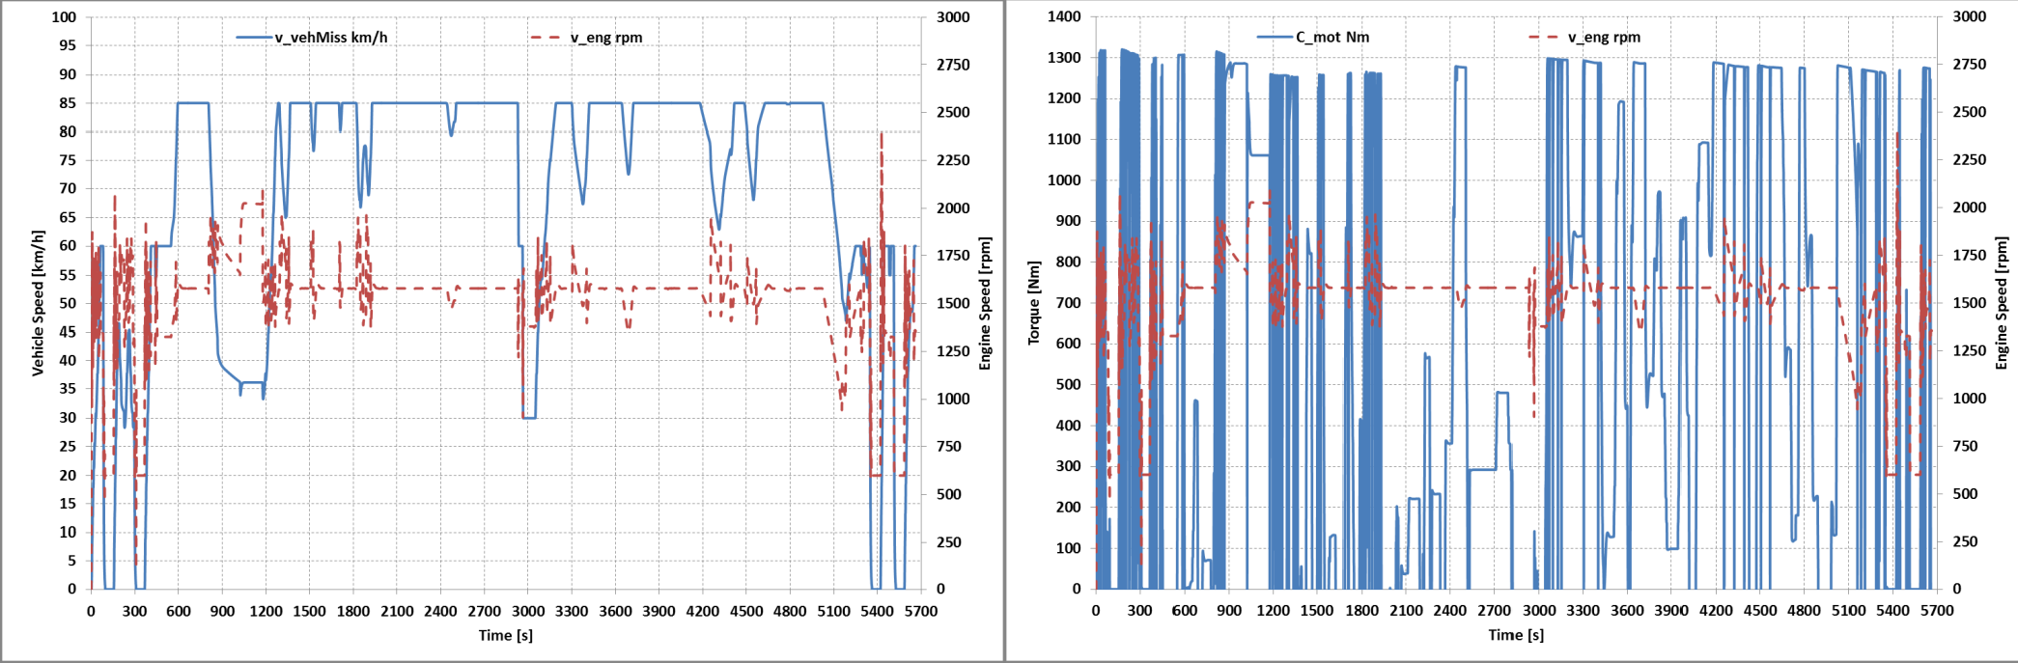
Reference driving cycle: ACEA cycle
The reference mission is the ACEA long haul and its duration is 5662 seconds.
Torque (Nm) Engine speed (rpm)
Vehicle speed (km/h)
Engine speed (rpm)
Vehicle Speed Profile
Torque Profile

Slide 11
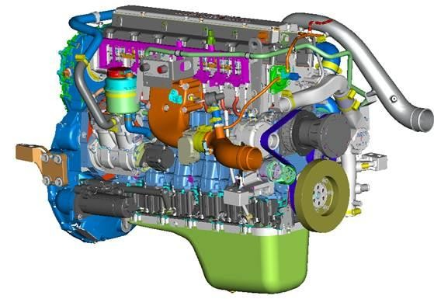
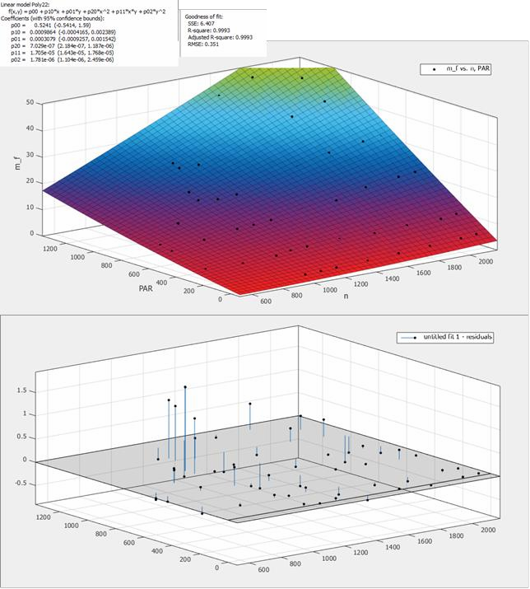
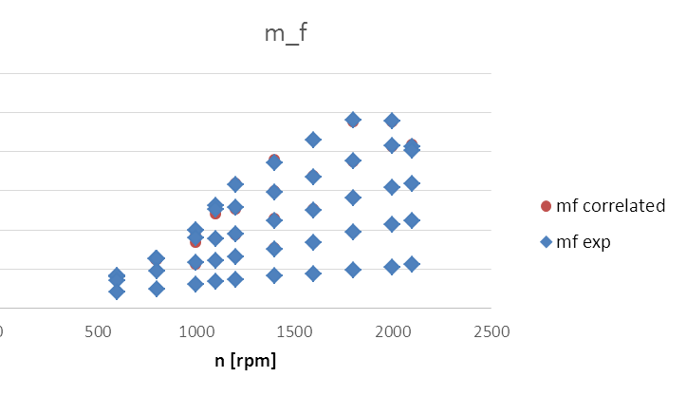
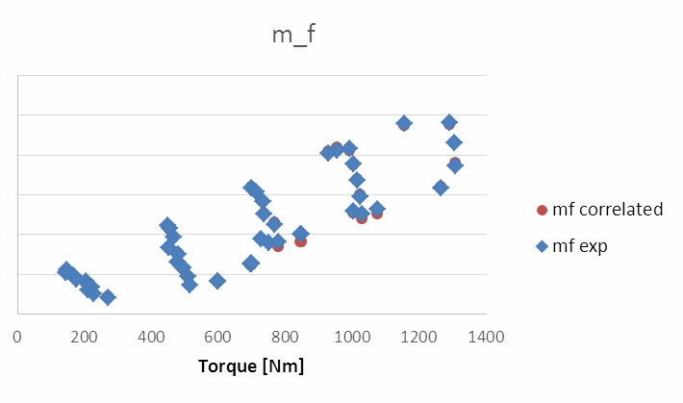
Engine
The engine has been modeled based on real data for the “reference vehicle”.
The torque and the engine speed in each of the cycle points are the
inputs:
φ_{i} = φ_{i} (n, M )
While the outputs are:
Mechanical Power [kW]
Fuel mass flow rate [kg/s]
Air mass flow rate [kg/s]
Total engine power
The heat loss to exhausted gas [kW]
Heat loss to ambient [kW]
Q disipated by the radiator
Heat transfer removed by the AC
Exhaust temperature
Temperature after the ATS
mf (Torque, n)

Slide 12
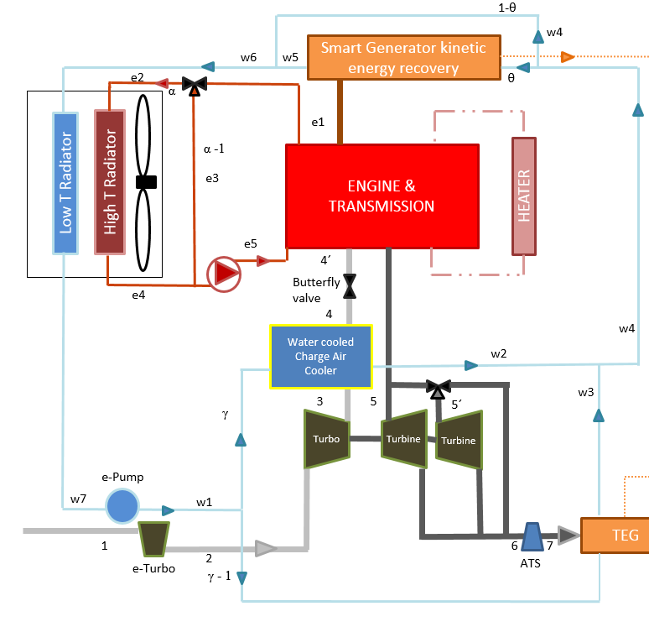
Low and high temperature water circuits
Models:
WCAC (heat transfer and pressure drop)
TEG (Heat transfer, electric production, pressure drop)
KER (Electric production,
pressure drop)
LTR (Heat transfer, pressure drop)
- HTR (Heat transfer,pressure drop)
Low temperature circuit
High temperature circuit

Slide 13






Radiators model
The following methodology has been used:
Effectiveness model
LTR,HTR and IC
ESDU 86018, Effectiveness – NTU Relationships for the Design and Performance Evaluation of Two-Stream Heat Exchangers (1991); Engineering Science Data Unit 86018 with amendment A, July 1991, pp. 92–107, ESDU International plc, London.

Slide 14
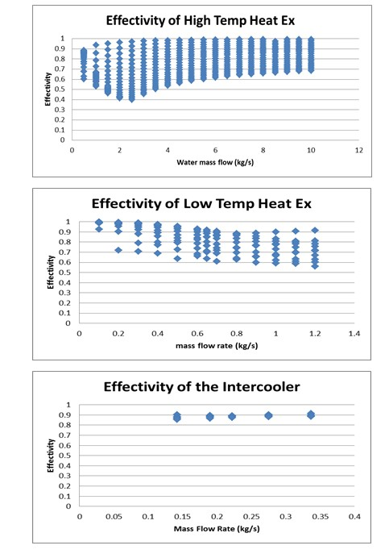
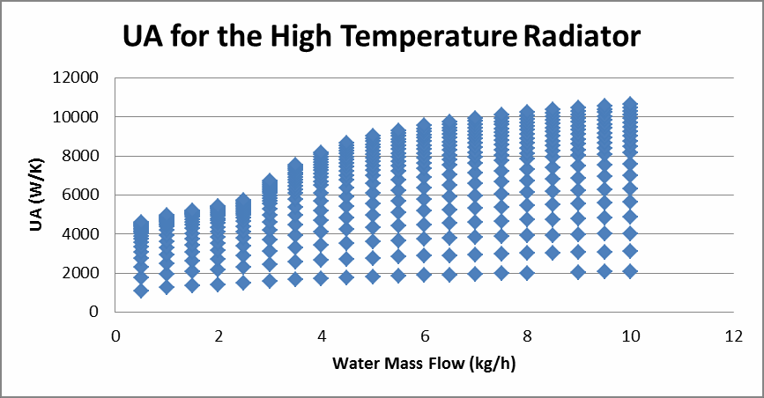
Heat exchangers model (Heat Exchange)
Constant | Radiator high temperature circuit Laminar/Turbulent |  | Low temperature circuit | Intercooler
K1 | 7940 | 5241 | 16587 | 9141449.7
n1 | 0.22 | 0.76 | 0.52 | 0.3
K2 | 3639 | 4435 | 4105 | 2887.9
n2 | 0.67 | 0.76 | 0.68 | 1.1
Error in effectiveness is lower than 2% for all the
cases

Slide 15
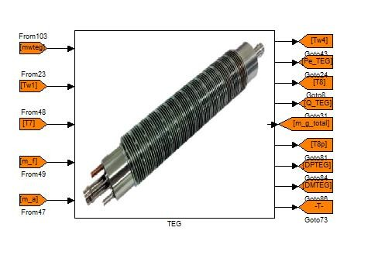
Thermoelectric Generator (TEG)
Inputs
Water mass flow rate
Water inlet Temperature
Gas inlet temperature
Fuel mass flow rate
Air mass flow rate
Outputs
  Back-pressure
  Water pressure drop
  Water outlet Temperature
  Gas oulet temperature
  Heat transfer
  Power production

Slide 16
Low temperature water circuit
TEG-Thermal problem
The value of UA can be estimated from the experimental data as:
Q DMLT
UA = f (m_{hg} ,T_{hg} ,T_{w} ) =
UA =
= 0.0018m^{0.1062} + 4.2703⋅10⁻⁷ T + 9.9135 ⋅10⁻⁷ T
hg hg w
Effectiveness correlation for cross flow heat exchangers:
NTU = ^{UA}
mCp_{min}
1
ε = 1 − exp(
C
(NTU
0.22 0.78
₌ mCp_{min}
max
(exp( −C_{r} NTU
) −1)))
C
r
mCp
r
Q = εmCp_{min} (T_{hgin} − T_{win} )
Q
Hot Gas outlet temperature
120
T = + T
700
wout
mCp
win
Meas Gas Outlet Temp (ºC)
600
100
w
500
80
Q mCp
400
60
T
= T
hgout
hgin
300
40
hg
200
20
200
300 400 500
600
700
20
40
60
80
100
120
Model Gas Outlet Temp (ºC)

Slide 17
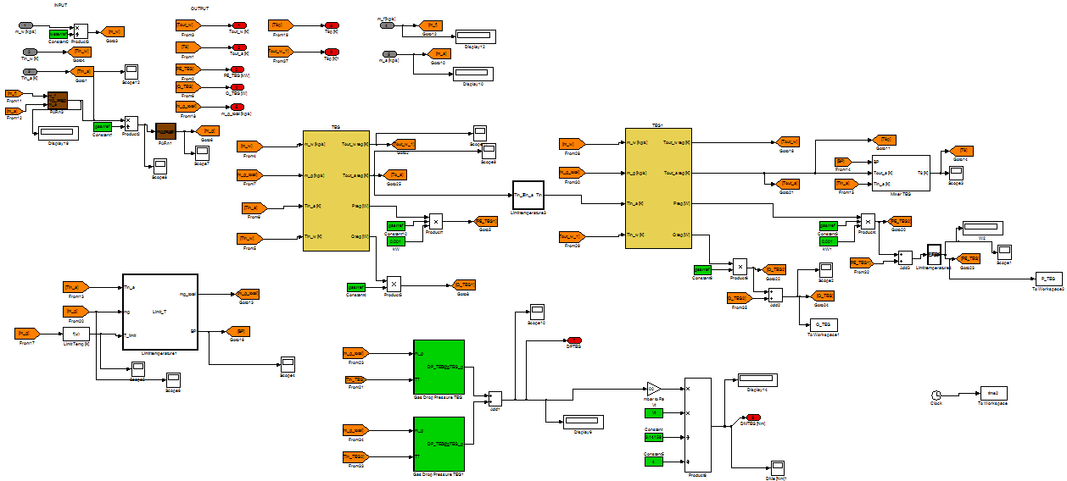
TEG-model
First row
Second row
Total production and heating
Control limit temperature
Backpressure of each row

Slide 18
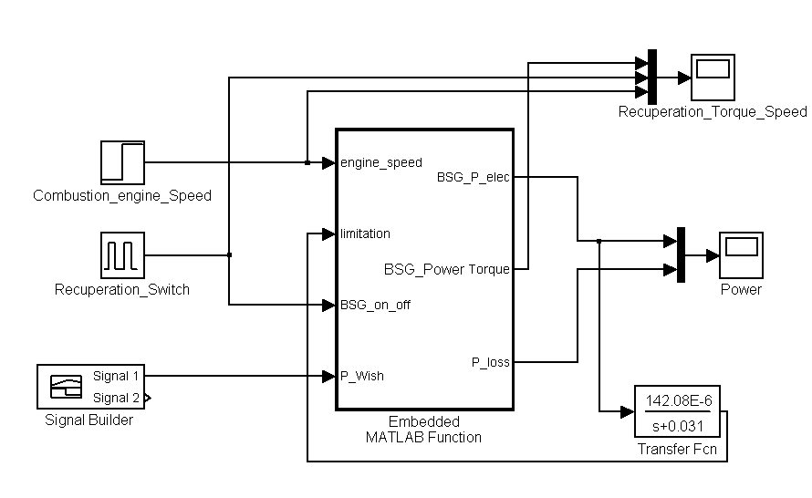
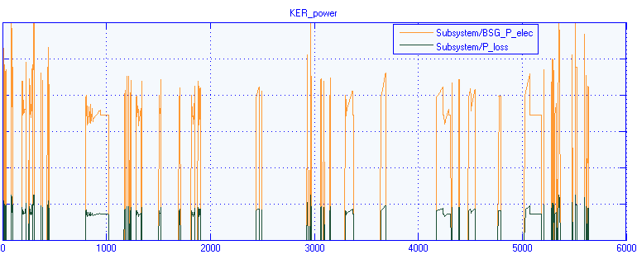
Kinetic Energy Recovery System-KER
Inputs
Engine speed
Deceleration periods
Electric demand
Outputs
Electric production
Torque increase
Heat loss

Slide 19
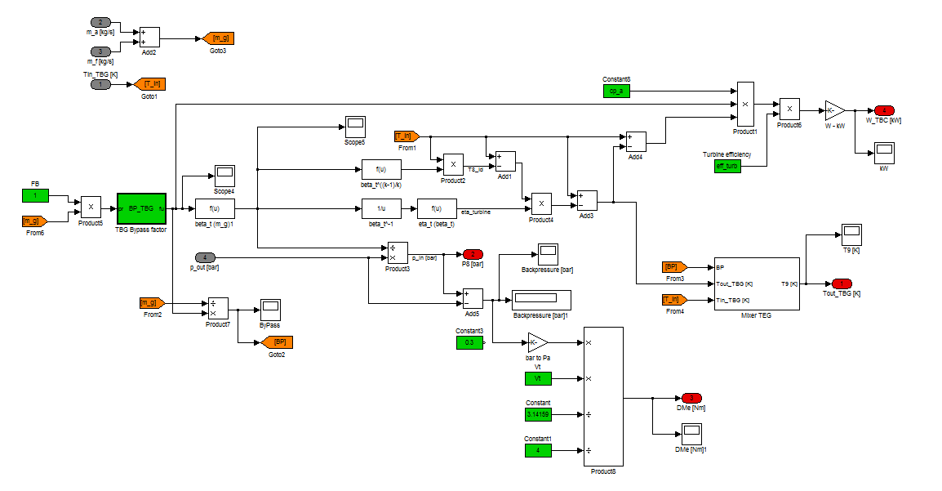
Turbogenerator: TBG
Turbogenerator: TBG
Inputs
Outputs
Gas inlet temperature
Gas mass flow rate
Oulet pressure
Gas oulet temperature
Back pressure
Inlet pressure
Electric generation
International Conference and Exhibition on Automobile Engineering (OMICS), Valencia 2015
GASTONE consortium is the sole owner of this document. It cannot
be copied or given to third parties without permission.
17

Slide 20
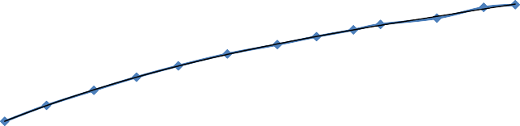
TBG-modeling
Methodology: The TBG is modeled based on the
turbine equations and the correlations has been found
from experimental data.
0,16
0,15
0,14
β = ^{p8} = 1 − 1.839 ⋅ m + 15.31⋅ m² − 93.48 ⋅ m³
WT (kg/s)
0,13
t g
g g
p₇
0,12
k −1 ⎞⎤
y = 2,77x³ - 11,203x² + 15,212x - 6,7833 R² = 0,9995
⎡
⎛
0,11
T = T ⋅ 1−η ⎜1− β
k
⎟
8 7
⎢
t ⎜
t
⎟⎥
0,1
⎢⎣ ⎠⎥⎦
1,18
1,2
1,22
1,24
1,26
1,28
1/β
1,3
1,32
1,34
1,36
1,38
⎝
^{W}TBC
= m _{g} c_{p,a} (T₇ − T₈ )
0,7
y = 55,287x³ - 216,6x² + 282,3x - 121,82 R² = 0,9284
0,6
0,5
0,4
k=1.391
0,3
0,2
0,1
eff
1,18
1,2
1,22
1,24
1,26
1,28
1,3
1,32
1,34
1,36
1,38
1/β
International Conference and Exhibition on Automobile Engineering (OMICS), Valencia 2015
GASTONE consortium is the sole owner of this document. It cannot
be copied or given to third parties without permission.
18

Slide 21
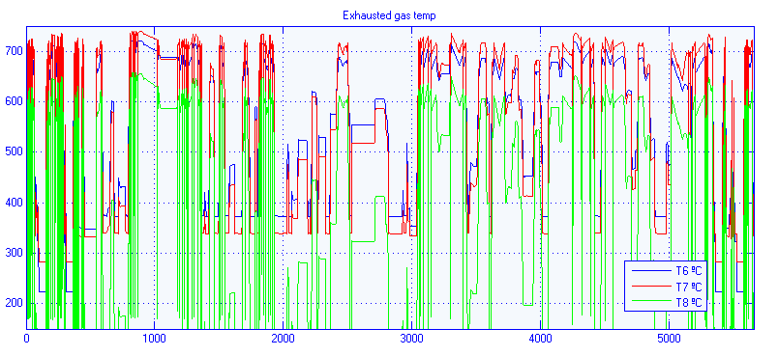
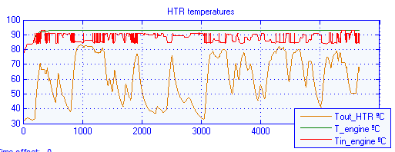
Results
Temperature at different points of the ACEA cycle for the powertrain

Slide 22
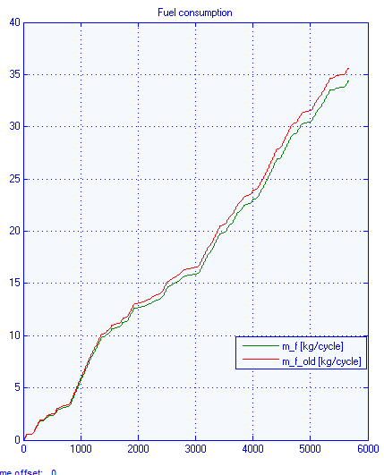
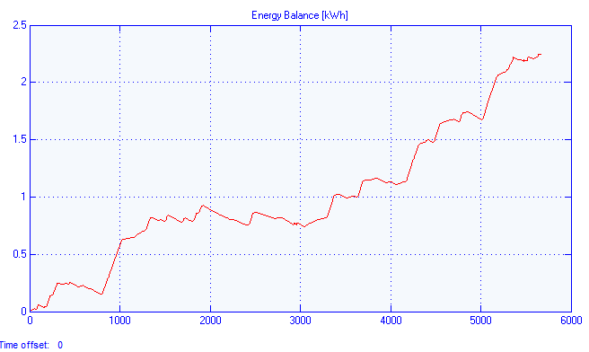
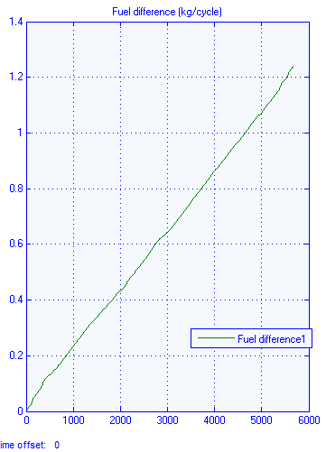
Results
Fuel consumption comparison between the Gastone concept and the reference vehicle
Energy balance
Fuel difference
Fuel consumption

Slide 23
Model preliminary results
Nominal point
 | Electric energy (kWh) | Average Power (kW)
TEG | 0.7094 | 0.4562
KER | - | -
TBG | 2.113 | 1.3944
Total produced | 2.8224 | 1.8506
Total consumed | 2.6888 | 1.7096
Stored energy | 0.1344 | -
Fuel saved | 1.99%
Cycle time 5662sec
ACEA driving cycle
 | Electric energy (kWh) | Average Power (kW)
TEG | 0.7962 | 0.5062
KER | 2.4620 | 1.5653
TBG | 1.6990 | 1.0802
Total produced | 4.9572 | 3.1496
Total consumed | 2.6888 | 1.7096
Stored energy | 2.2684 | -
Fuel saved | 3.472%
Results strongly depend on the components perfomance and sytem management.

Slide 24

Model expected results
Definition of the thermal characteristics (temperature, pressure) at any point of the system.
The possibility of the comparison between different control strategies.
The study of the influence of changes in different parameters under an
overall point of view as well as at the subsystem level.
Flexibility in the considered components.
The benefit measured in terms of fuel saving
and stored energy.
Optimization of the electric energy production (energy stored and production out of the deceleration periods).
The possible study for different driving cycles.

Slide 25
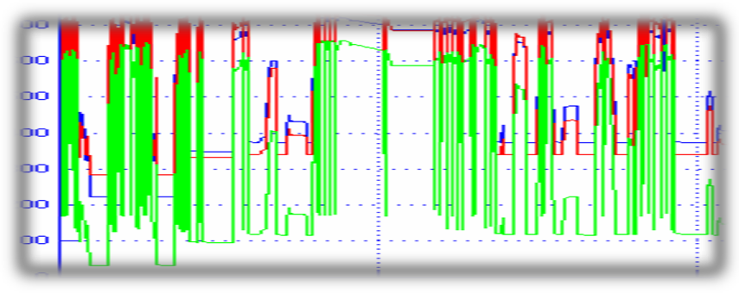
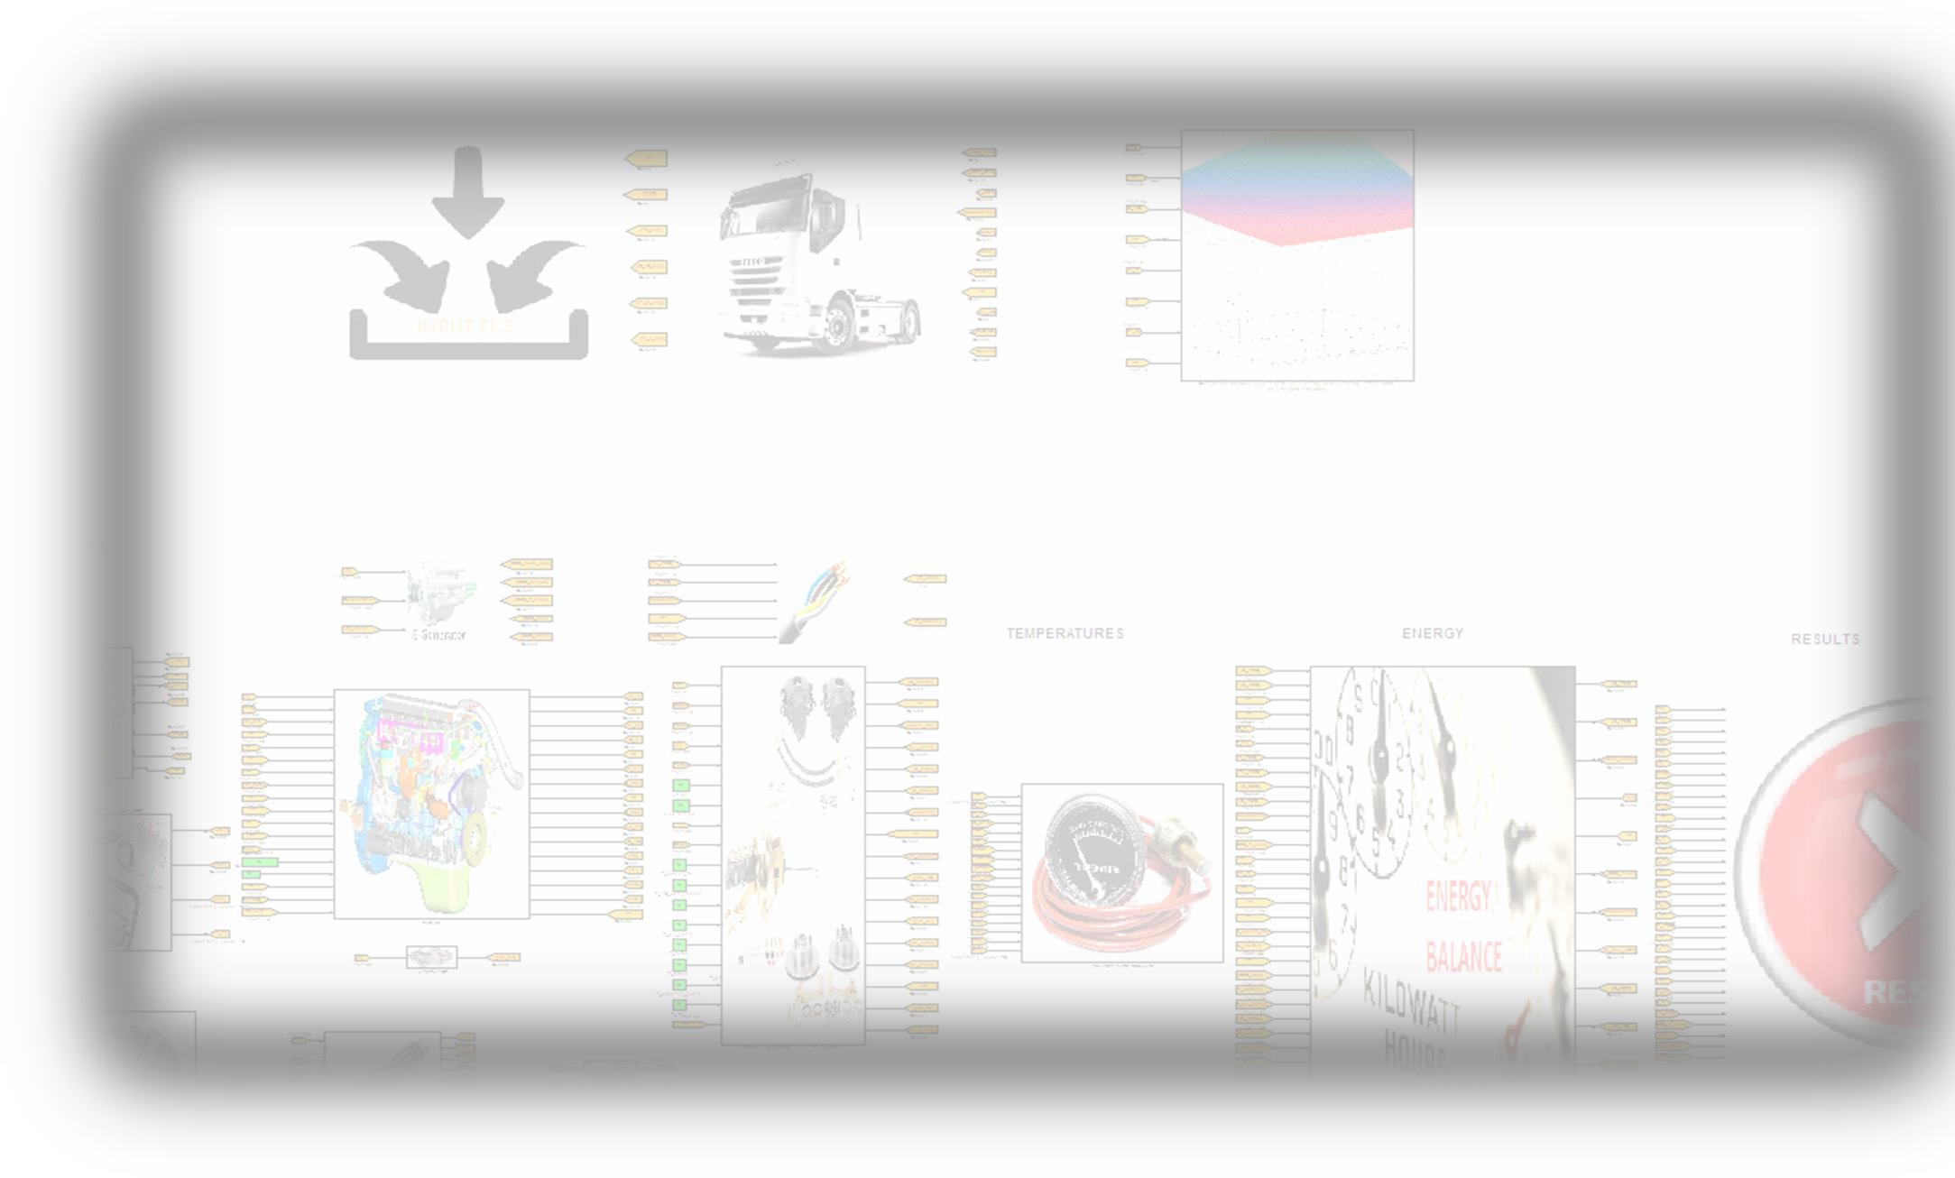
Conclusions
The model is successfully working as the temperature and pressure conditions can be seen.
It is possible to define and evaluate different control strategies.
The models of the components are already developed and waiting for
validation.
Currently, we are defining the size and the specifications of the components.
After the collection of the data, the auxiliaries will be electrified and an optimal control strategy will be investigated.

Slide 26

MODEL Of A New Powertrain Concept Based On The Integration Of Electric Generation, Energy Recovery AND Storage
Thank you very much
for your attention!

