Slide 1


3D Simulation of Human-like Walking and Stability Analysis for Bipedal Robot with Distributed Sole Force Sensors
Authors : Chao SHI and Eric H. K. Fung
Presenter : Dr. Eric H. K. Fung
Department of Mechanical Engineering
The Hong Kong Polytechnic University

Slide 2
Objective :
Study the human-like walking of bipedal robot and analyze its stability with distributed force sensor model.

Slide 3
1. Related literature
Li et al. [1] achieved a human-like walking with straightened knees, considering toe-off and heel-strike and different gait lengths.
Ogura et al. [2] achieved human-like walking with knee stretched, heel-contact and toe-off motion with robot which has a passive DoF in each foot.
The Zero Moment Point (ZMP) by Vukobratovic and Borovac [3], is used in bipedal robot stability analysis and control, regardless of different walking patterns.

Slide 4
Chevallereau et al. [4] manipulates the ZMP of the bipedal robot considering the walking with foot rotation.
Nikolic et al. [5] assumed the point contact as a 2D spring-damper model and the foot ground interaction as a matrix of single point contact.

Slide 5
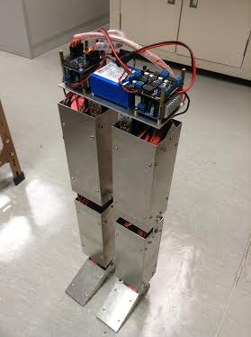
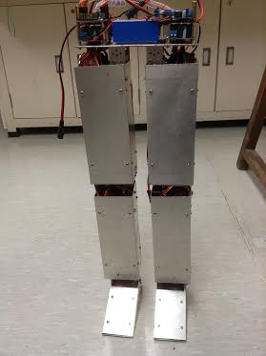
2. Simulation models
Features of bipedal robot :
1. Ten DoFs
2. Mass property can be derived from SolidWorks
3. Human-like thigh-shank length ratio

Slide 6
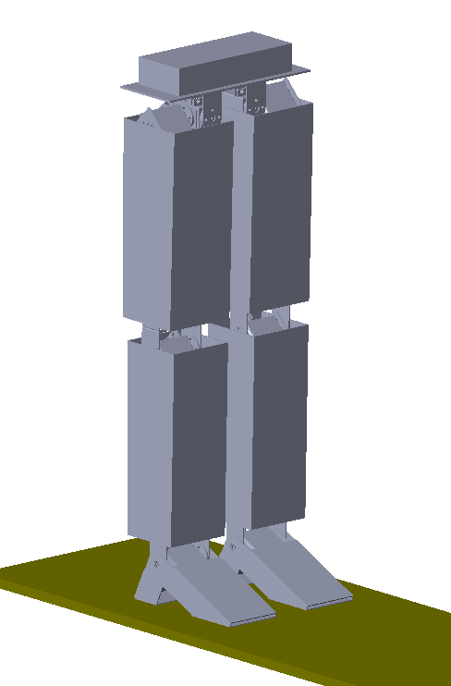
SimMechanics model for bipedal robot
Features:
1. Same mass and dimensional property as physical robot
2. Kinematic variables for each body part can be obtained
3. Easy to analyze its stability during walking

Slide 7
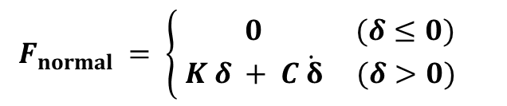
Ground contact model
Features:
1. Normal force : Spring-damper model
2. Frictional force: LuGre model
$$F_{normal} = \left\{\begin{aligned} 0 (δ≤0) \\ K δ + C\dot{ δ} (δ>0) \end{aligned}\right.$$
Normal force equilibrium established for four different points

Slide 8
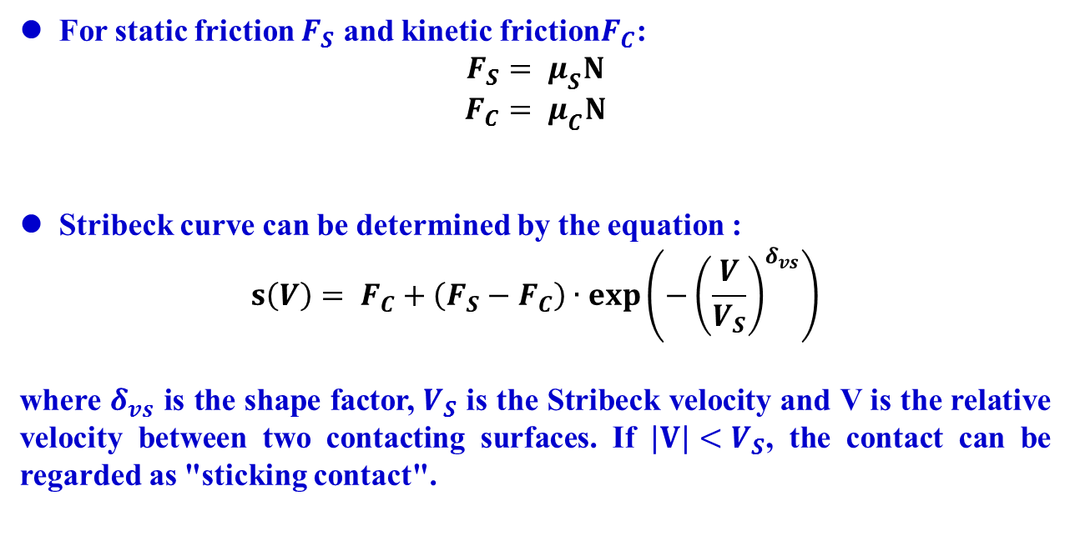
For static friction $F_{S}$ and kinetic friction$F_{C}$:
$$F_{S}= μ_{S}N$$
$$F_{C}= μ_{C}N$$
Stribeck curve can be determined by the equation :
$$s\left(V\right)= F_{C}+\left(F_{S}−F_{C}\right)∙exp\left({−\left(\frac{V}{V_{S}}\right)}^{δ_{vs}}\right)$$
where $δ_{vs}$ is the shape factor, $V_{S}$ is the Stribeck velocity and V is the relative velocity between two contacting surfaces. If $|V|<V_{S}$, the contact can be regarded as "sticking contact".

Slide 9
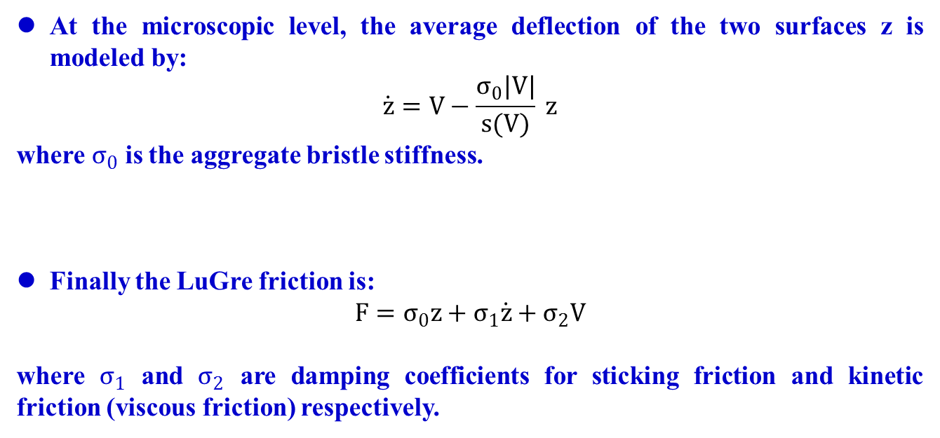
At the microscopic level, the average deflection of the two surfaces z is modeled by:
$$\dot{z}=V−\frac{σ_{0}|V|}{s(V)} z$$
where $σ_{0}$ is the aggregate bristle stiffness.
Finally the LuGre friction is:
$$F=σ_{0}z+σ_{1}\dot{z}+σ_{2}V$$
where $σ_{1}$ and $σ_{2}$ are damping coefficients for sticking friction and kinetic friction (viscous friction) respectively.

Slide 10
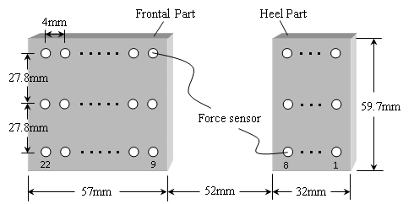
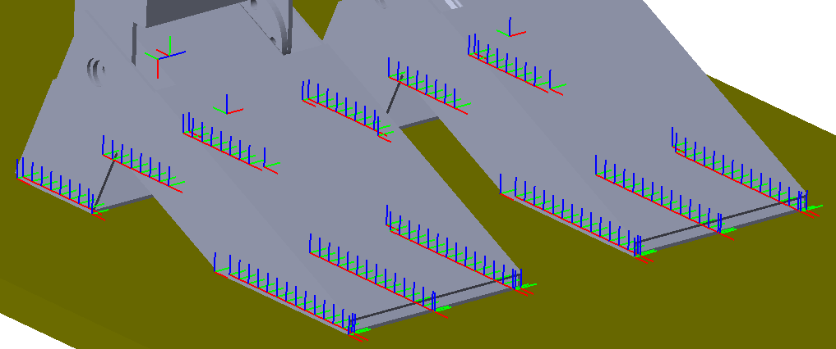
Distributed force sensor model
Features:
1. Distributed force can reflect the real world
2. Distributed force profile is used in stability analysis

Slide 11
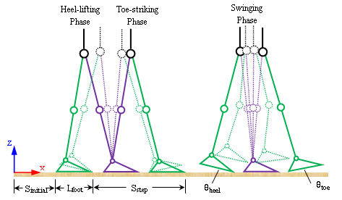
3. Simulation method
Foot trajectory
Features:
Three different walking phases:
heel-lifting phase swinging phase toe-striking phase

Slide 12
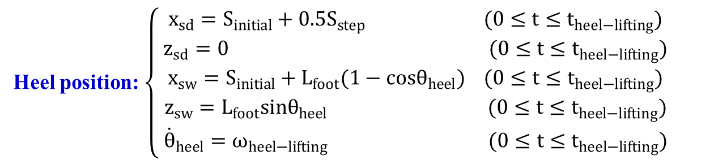
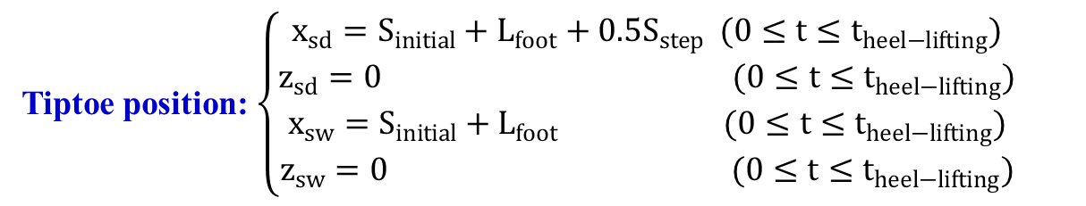
Heel-lifting phase
constraints:
Tiptoe position: $\left\{\begin{aligned}x_{sd}=S_{initial}+L_{foot}+0.5S_{step} (0≤t≤t_{heel−lifting}) \\ z_{sd}=0 (0≤t≤t_{heel−lifting}) \\ x_{sw}=S_{initial}+L_{foot} (0≤t≤t_{heel−lifting}) \\ z_{sw}=0 (0≤t≤t_{heel−lifting})\end{aligned}\right.$
Heel position: $\left\{\begin{aligned}x_{sd}=S_{initial}+0.5S_{step} (0≤t≤t_{heel−lifting}) \\ z_{sd}=0 (0≤t≤t_{heel−lifting}) \\ x_{sw}=S_{initial}+L_{foot}(1−cosθ_{heel}) (0≤t≤t_{heel−lifting}) \\ z_{sw}=L_{foot}sinθ_{heel} (0≤t≤t_{heel−lifting}) \\ {\dot{θ}}_{heel}=ω_{heel−lifting} (0≤t≤t_{heel−lifting})\end{aligned}\right.$

Slide 13
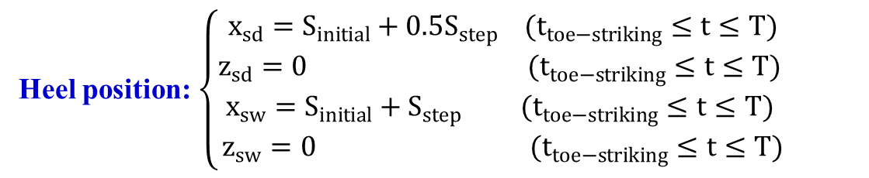
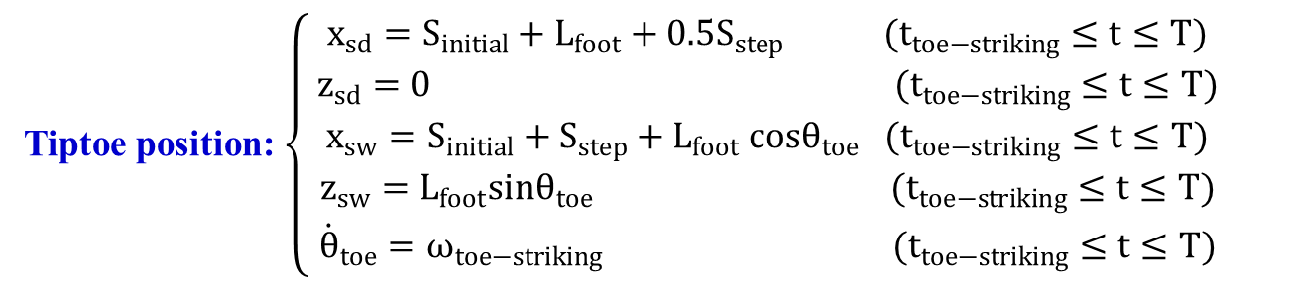
Toe-striking phase
constraints:
Tiptoe position: $\left\{\begin{aligned}x_{sd}=S_{initial}+L_{foot}+0.5S_{step} (t_{toe−striking}≤t≤T) \\ z_{sd}=0 (t_{toe−striking}≤t≤T) \\ x_{sw}=S_{initial}+S_{step}+L_{foot} cosθ_{toe} (t_{toe−striking}≤t≤T) \\ z_{sw}=L_{foot}sinθ_{toe} (t_{toe−striking}≤t≤T) \\ {\dot{θ}}_{toe}=ω_{toe−striking} (t_{toe−striking}≤t≤T)\end{aligned}\right.$
Heel position: $\left\{\begin{aligned}x_{sd}=S_{initial}+0.5S_{step} (t_{toe−striking}≤t≤T) \\ z_{sd}=0 (t_{toe−striking}≤t≤T) \\ x_{sw}=S_{initial}+S_{step} (t_{toe−striking}≤t≤T) \\ z_{sw}=0 (t_{toe−striking}≤t≤T)\end{aligned}\right.$

Slide 14
Swinging phase
The trajectory of the tiptoe in swinging phase is generated by using a fifth-order polynomial, which is sufficient to make the trajectory smooth
$$z=−79.3172{t_{swing}}^{5}+272.6738{t_{swing}}^{4}−273.6946{t_{swing}}^{3}+100t_{swing}$$
where $t_{swing}$ is the swinging time span and ${0≤t}_{swing}≤t_{toe−striking}−t_{heel−lifting}$.
Trajectory of swinging foot tiptoe

Slide 15
For both heel-lifting and toe-striking phase, the knees of two legs are all stretched, and for the swinging phase, only the knee from the standing leg is stretched.
Knee constraints for three walking phases:
Knee angles: $\left\{\begin{matrix}θ_{knee st}=0 (0≤t≤T) \\ θ_{knee sw}=0 (0≤t≤t_{heel−lifting}, t_{toe−striking}≤t≤T)\end{matrix}\right.$

Slide 16
Trajectory of six different joints
pink: heel-lifting phase blue: swinging phase green: toe-striking phase

Slide 17
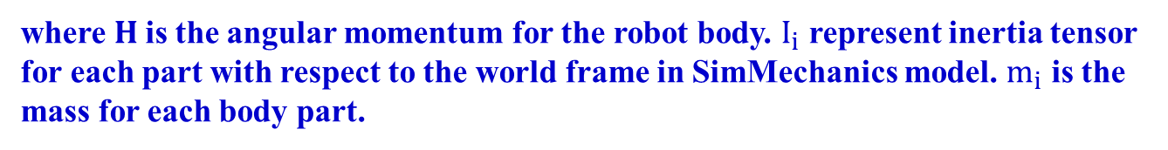
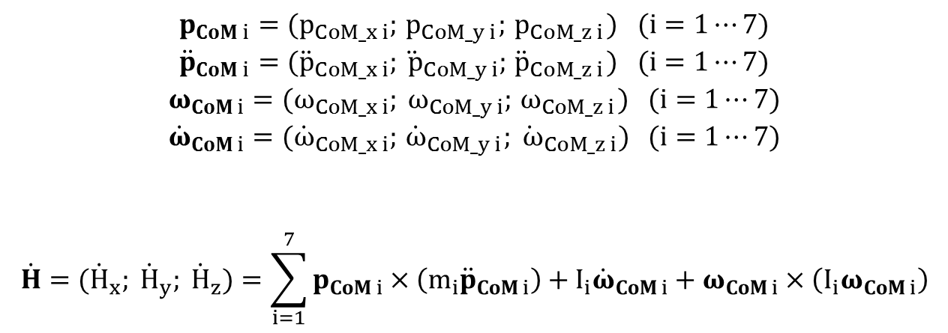
ZMP calculation
For each part :
$$p_{CoM i}=(p_{CoM_x i};{ p}_{CoM_y i};{ p}_{CoM_z i}) (i=1⋯7)$$
$${\ddot{p}}_{CoM i}=({\ddot{p}}_{CoM_x i};{\ddot{ p}}_{CoM_y i};{ \ddot{p}}_{CoM_z i}) (i=1⋯7)$$
$$ω_{CoM i}=(ω_{CoM_x i}; ω_{CoM_y i};{ ω}_{CoM_z i}) (i=1⋯7)$$
$${\dot{ω}}_{CoM i}=({\dot{ω}}_{CoM_x i};{ \dot{ω}}_{CoM_y i};{\dot{ ω}}_{CoM_z i}) (i=1⋯7)$$
$$\dot{H}=({\dot{H}}_{x}; {\dot{H}}_{y}; {\dot{H}}_{z})=\sum_{i=1}^{7}{p_{CoM i}×\left(m_{i}{\ddot{p}}_{CoM i}\right)}+I_{i}{\dot{ω}}_{CoM i}+ω_{CoM i}×\left(I_{i}ω_{CoM i}\right)$$
where$H$ is the angular momentum for the robot body. $I_{i}$ represent inertia tensor for each part with respect to the world frame in SimMechanics model. $m_{i}$ is the mass for each body part.

Slide 18


ZMP for the robot body is calculated as follows :
$$x_{zmp}=\frac{\sum_{i=1}^{7}{(m_{i}g_{z}p_{CoM_x i})−}{\dot{H}}_{y}}{\sum_{i=1}^{7}{m_{i}(g_{z}+{\ddot{p}}_{CoM_z i})}}$$
$$y_{zmp}\frac{\sum_{i=1}^{7}{(m_{i}g_{z}p_{CoM_y i})+}{\dot{H}}_{x}}{\sum_{i=1}^{7}{m_{i}(g_{z}+{\ddot{p}}_{CoM_z i})}}$$
$$z_{zmp}=0$$
where $g_{z}$ is the gravitational acceleration in z direction.${ z}_{zmp}=0$ means that the world coordinate is placed on the ground.

Slide 19
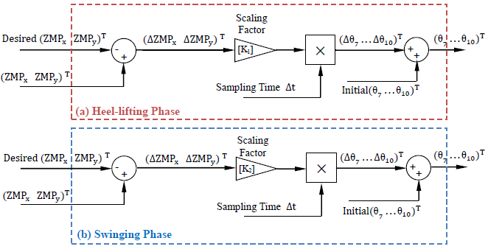
ZMP feedback
ZMP feedback mechanism

Slide 20
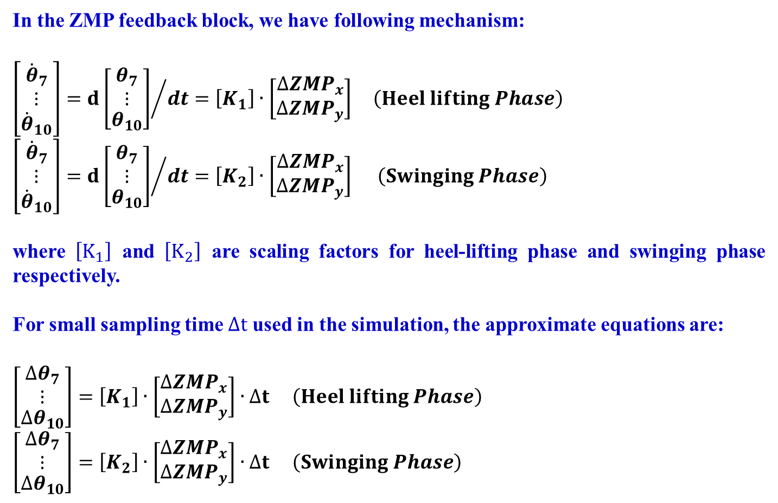
In the ZMP feedback block, we have following mechanism:
$${\left[\begin{matrix}\begin{matrix}{\dot{θ}}_{7} \\ ⋮\end{matrix} \\ \begin{matrix}{\dot{θ}}_{10}\end{matrix}\end{matrix}\right]=d\left[\begin{matrix}\begin{matrix}θ_{7} \\ ⋮\end{matrix} \\ \begin{matrix}θ_{10}\end{matrix}\end{matrix}\right]}/{dt}=\left[K_{1}\right]∙\left[\begin{matrix}{∆ZMP}_{x} \\ {∆ZMP}_{y}\end{matrix}\right] \left(Heel lifting Phase\right)$$
$${\left[\begin{matrix}\begin{matrix}{\dot{θ}}_{7} \\ ⋮\end{matrix} \\ \begin{matrix}{\dot{θ}}_{10}\end{matrix}\end{matrix}\right]=d\left[\begin{matrix}\begin{matrix}θ_{7} \\ ⋮\end{matrix} \\ \begin{matrix}θ_{10}\end{matrix}\end{matrix}\right]}/{dt}=\left[K_{2}\right]∙\left[\begin{matrix}{∆ZMP}_{x} \\ {∆ZMP}_{y}\end{matrix}\right] \left(Swinging Phase\right)$$
where $\left[K_{1}\right]$ and $\left[K_{2}\right]$ are scaling factors for heel-lifting phase and swinging phase respectively.
For small sampling time $∆t$ used in the simulation, the approximate equations are:
$$\left[\begin{matrix}\begin{matrix}{∆θ}_{7} \\ ⋮\end{matrix} \\ \begin{matrix}{∆θ}_{10}\end{matrix}\end{matrix}\right]=\left[K_{1}\right]∙\left[\begin{matrix}{∆ZMP}_{x} \\ {∆ZMP}_{y}\end{matrix}\right]∙∆t \left(Heel lifting Phase\right)$$
$$\left[\begin{matrix}\begin{matrix}{∆θ}_{7} \\ ⋮\end{matrix} \\ \begin{matrix}{∆θ}_{10}\end{matrix}\end{matrix}\right]=\left[K_{2}\right]∙\left[\begin{matrix}{∆ZMP}_{x} \\ {∆ZMP}_{y}\end{matrix}\right]∙∆t \left(Swinging Phase\right)$$

Slide 21
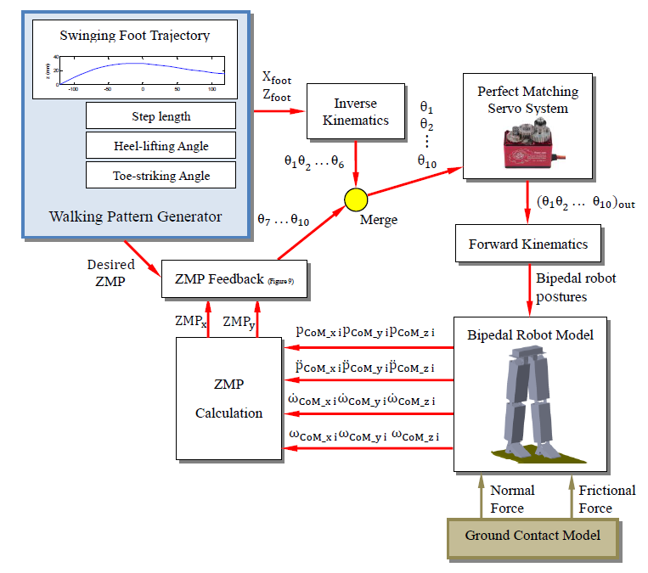
Overall simulation diagram

Slide 22
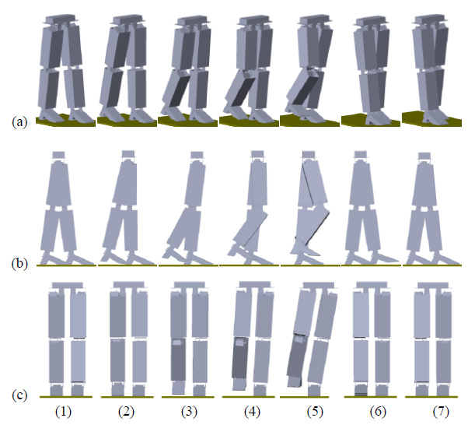
4. Simulation results
(1)-(2) : heel-lifting phase
(2)-(6): swinging phase
(6)-(7): toe-striking phase
Snapshots of one step
(a) isometric view (b) side view (c) front view

Slide 23
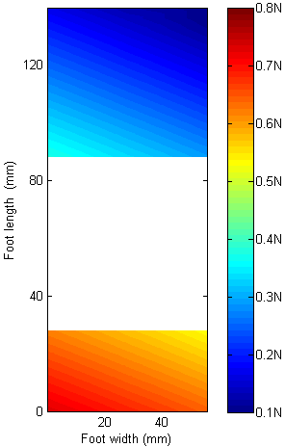
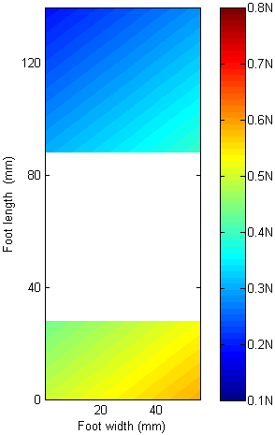
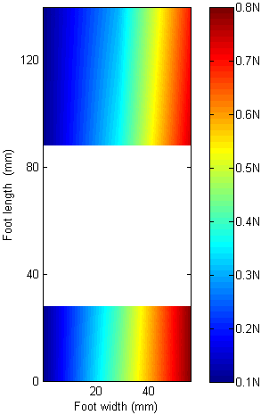
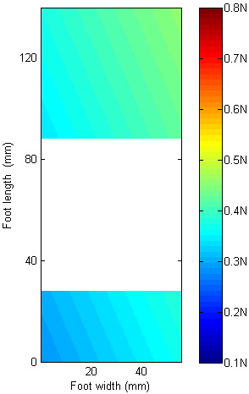
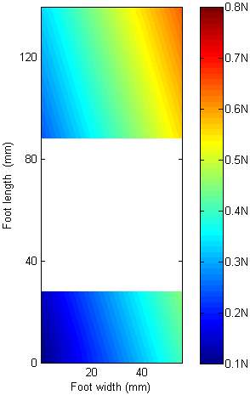
Color maps of the distributed normal force during swinging phase
(a)$t=0$ (b)${t=0.25t}_{swing}$ (c)${ t=0.5t}_{swing} \text{(}\text{d}\text{)} {t=0.75t}_{swing} \text{(}\text{e}\text{)}{ t=t}_{swing}$

Slide 24
to (b) shows the process of (2) to (3)
Force is evenly distributed along foot width direction because tilting is not severe in this period.
Pressure center moved forward along the foot length direction as the body starts to swing forward.

Slide 25
(b) to (c) shows the process of (3) to (4)
Pressure center moves to middle part along the foot length direction.
It also moves to the inside edge of the foot.
HIGH RISK to fall.

Slide 26
(c) to (d) shows the process of (4) to (5)
Normal force is evenly distributed due to the tilting effect.
LEAST RISK to fall.

Slide 27
(d) to (e) shows the process of (5) to (6)
Pressure center moves to inside edge of the foot again as body tilts back.
Pressure for the front part is larger than the heel because the center of mass has already moved forward.

Slide 28
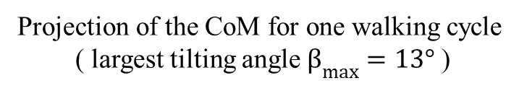
CoM and ZMP trajectory
Projection of the CoM for one walking cycle
( largest tilting angle $β_{max}=13°$ )

Slide 29
CoM during one walking cycle
in x direction
CoM during one walking cycle
in y direction

Slide 30
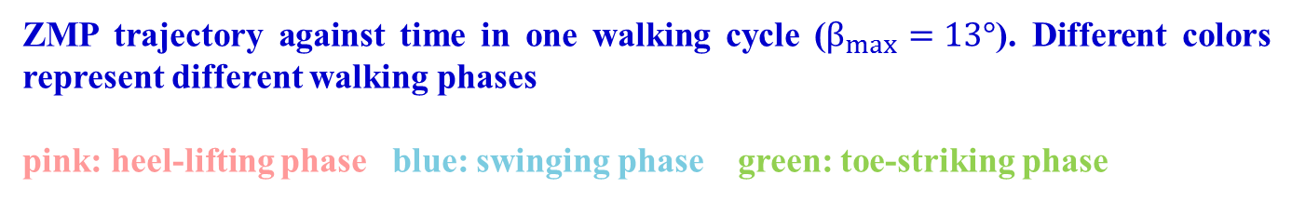
ZMP trajectory against time in one walking cycle ($β_{max}=13°$). Different colors represent different walking phases
pink: heel-lifting phase blue: swinging phase green: toe-striking phase
ZMP during one walking cycle
in x direction
ZMP during one walking cycle
in y direction

Slide 31
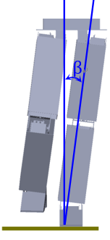
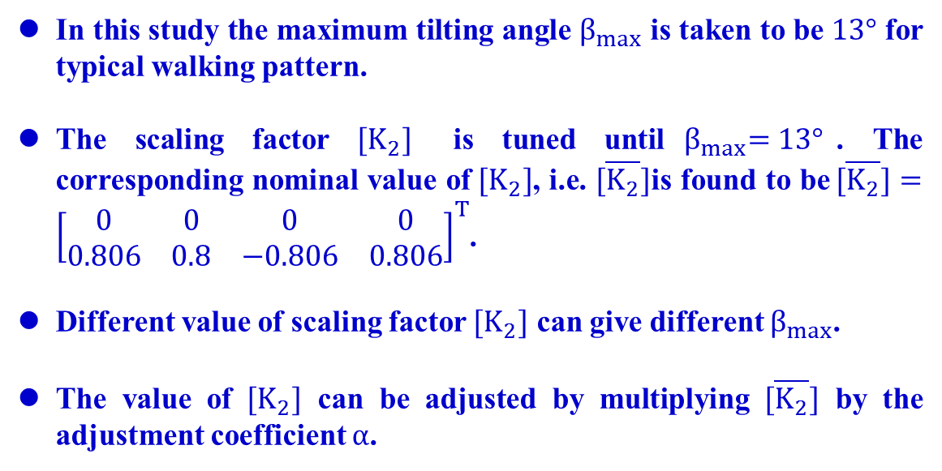
In this study the maximum tilting angle $β_{max}$ is taken to be $13°$ for typical walking pattern.
The scaling factor $[K_{2}]$ is tuned until${ β}_{max}=13°$. The corresponding nominal value of$[K_{2}]$, i.e. $[\overline{K_{2}}]$is found to be$[\overline{K_{2}}]={\left[\begin{matrix}\begin{matrix}0 & 0 & 0 \\ 0.806 & 0.8 & −0.806\end{matrix} & \begin{matrix}0 \\ 0.806\end{matrix}\end{matrix}\right]}^{T}$.
Different value of scaling factor $[K_{2}]$ can give different $β_{max}$.
The value of $[K_{2}]$ can be adjusted by multiplying $[\overline{K_{2}}]$ by the adjustment coefficient $α$.
Tilting angle definition

Slide 32


The results are given in the following pairs $(α[\overline{K_{2}}], β_{max})$:
$$\left(0.8\left[\overline{K_{2}}\right], 10.4°\right)$$
$$\left(0.9\left[\overline{K_{2}}\right], 11.7°\right)$$
$([\overline{K_{2}}], 13.0°)$ (default)
$$\left(1.1\left[\overline{K_{2}}\right], 14.3°\right)$$
$$(1.2[\overline{K_{2}}], 15.6°)$$
$(1.3[\overline{K_{2}}], 16.9°)$.
$β_{max}$ against adjustment coefficient $α$

Slide 33
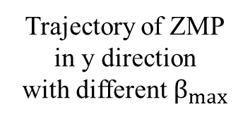
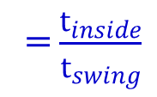


$$t_{swing}$$
$$t_{inside}$$
Trajectory of ZMP
in y direction
with different $β_{max}$
Percentage of swinging phase time for ZMP inside the support polygon
=$\frac{t_{inside}}{t_{swing}}$

Slide 34
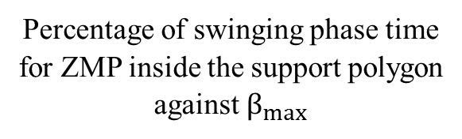
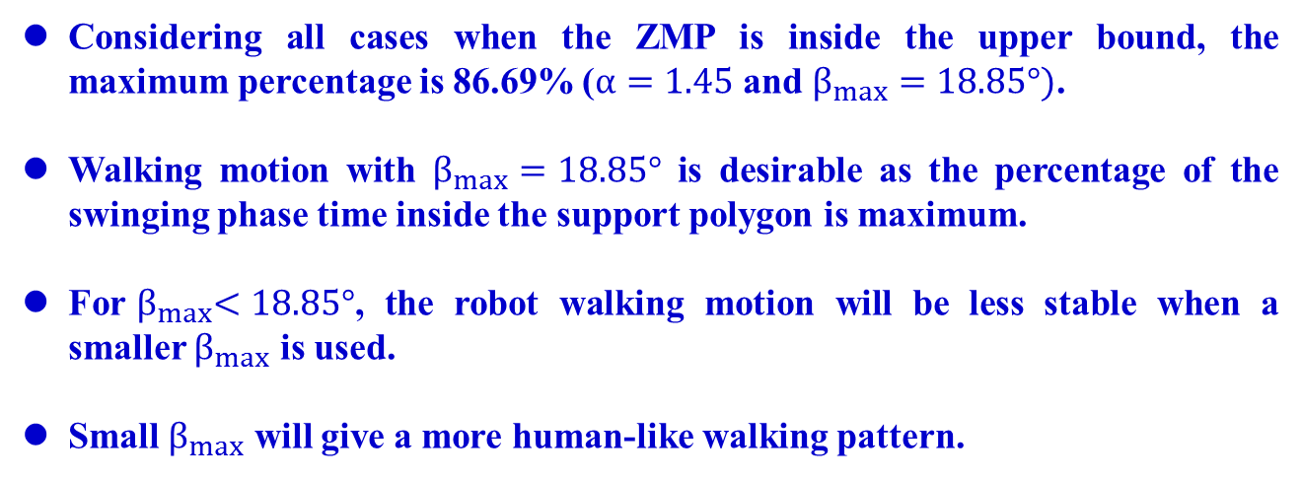
Considering all cases when the ZMP is inside the upper bound, the maximum percentage is 86.69% ($α=1.45$ and $β_{max}=18.85°)$.
Walking motion with $β_{max}=18.85°$ is desirable as the percentage of the swinging phase time inside the support polygon is maximum.
For${ β}_{max}<18.85°$, the robot walking motion will be less stable when a smaller $β_{max}$ is used.
Small $β_{max}$ will give a more human-like walking pattern.
Percentage of swinging phase time
for ZMP inside the support polygon
against $β_{max}$

Slide 35
5. Conclusion
With the 3D bipedal model and the ground contact model established in SimMechanics, the bipedal robot can walk stably with a given walking pattern.
The walking pattern is human-like, which includes heel-lifting phase, swinging phase and toe-striking phase.
By using the distributed force sensor model and ZMP criteria, the stability for the proposed walking pattern is successfully analyzed.
The relation between robot stability and the maximum tilting angle during swinging phase can also be obtained.

Slide 36


Acknowledgement
This research is funded by the Department of Mechanical Engineering of The Hong Kong Polytechnic University. The authors would like to thank the department for providing the facilities for this research.

Slide 37


