Slide 1
Come my friend. Let’s forget the cares of tomorrow
And instead enjoy this moment of our life
For tomorrow when we have left this ancient abode
We shall be equal to all the seven thousand year olds

Slide 3
Resequencing of KLF14 Gene in a Population Based Family Study With Type 2 Diabetes
Presented by: Ensieh Shahvazian
Ensieh Shahvazian^{1a}, Mohammad Bagher Mahmoudi^{2a}, Ehsan Farashahi Yazd²*, Saba Gharibi¹, Bahram Moghimi²
^{1.} Department of Genetics, Faculty of Medicine, International Campus, Shahid Sadoughi University of Medical Sciences, Yazd, Iran
^{2.} Department of Genetics, Faculty of Medicine, Shahid Sadoughi University of Medical Sciences, Yazd, Iran
^{a.} These authors contributed equally to this study
Corresponding author
*Dr. Ehsan Farashahi Yazd; Email: ehsanfarashi@gmail.com

Slide 4
Introduction

Slide 5
Resequencing Study
The loci identified in GWAs range from 10 to 100 kb,
It does not cover causal variants and genes
To find new susceptibility associated with T2D

Slide 6
Population based family Study
Robustness to the influence of population stratification,
Detectable genotyping error,
Checking the effect of imprinting gene on phenotypes
Determining the inherited or de novo Allele

Slide 7
KLF14 Locus at other studies
rs972283 | Associated with T2D China, Pakistan, United state (African –American population), Europe, Japan,
rs13234269 | African- American
rs4731702 | No significant results
rs1562398 | Associated with TG in women
rs3800561 | No significant results
rs3800562 | No significant results
rs3800563 | No significant results
rs3800564 | No significant results
rs3807137 | No significant results
rs3807139 | No significant results

Slide 8
KLF14 Gene card
7q23.3
1480bp
Intron less
BTEB5
GC content around 75%
Master Transcription factors of fat tissue
Transcriptional co-repressor & co activator

Slide 9
Material & Methods

Slide 10
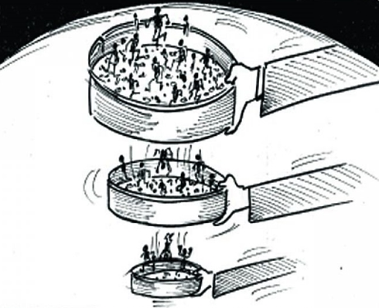
Sample collection
>35
2064 individuals of Project YDS
DiagnosingT2D
fasting glucose≥126 mg/dL
2-h oral glucose tolerance test glucose≥ 200 mg/dL
random glucose ≥200 mg/dL
HbA1C ≥6
Nuclear family
At least one parent
Probands
Siblings (if available )
At least one control
150 Individuals

Slide 11
KLF14 Amplifying
First Part of KLF14 genes, PCR Program
No | Description | Cycles
Step 1 | 95°c, 7 min | 1
Step 2 | 95°c,1min 63°c, 30 Sec 72°C, 1min & 50 Sec | 35
Step 3 | 72°C, 1min 4°C | 1
Second Part of KLF14 genes, PCR Program
No | Description | Cycles
Step 1 | 95°c, 7 min | 1
Step 2 | 95°c,1min 61°c, 30 Sec 72°C, 1min & 50 Sec | 35
Step 3 | 72°C, 1min 4°C | 1

Slide 12
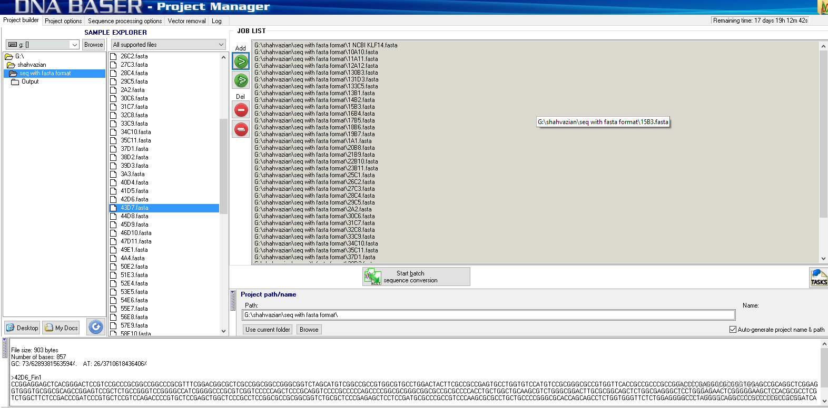
1
Sequencing results are converted to Multi-FASTA format

Slide 13
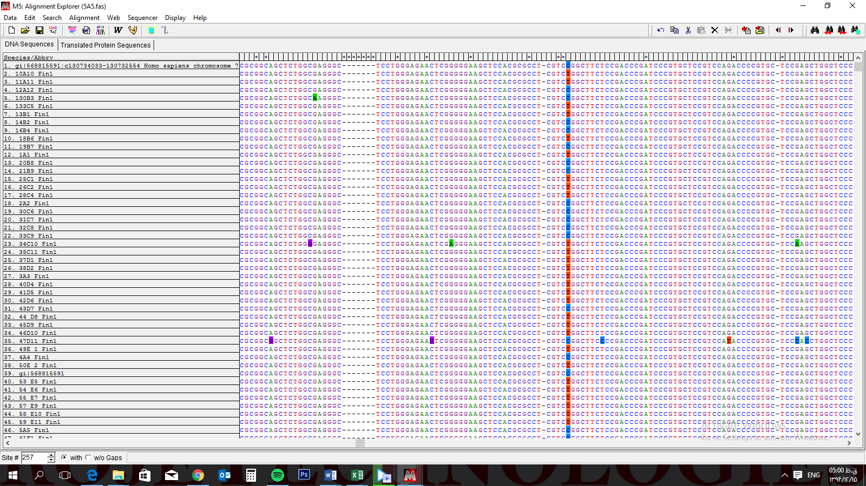
2
Alignment by ClustalW
3
Togle conserved sites

Slide 14
Statistical analysis
Applying an exact test for deviation from Hardy–Weinberg equilibrium (HWE)
The proportions of genotypes or alleles were compared by the chi square (χ²) test.
SNP× T2D associations were assessed using odds ratios and 95% confidence intervals derived from logistic regression models including all members, adjusting for age and sex.

Slide 15
Results

Slide 16
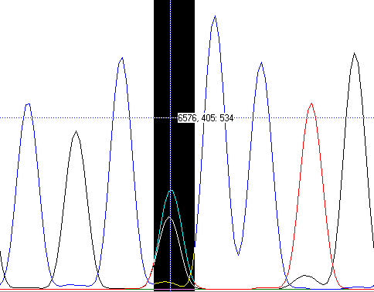
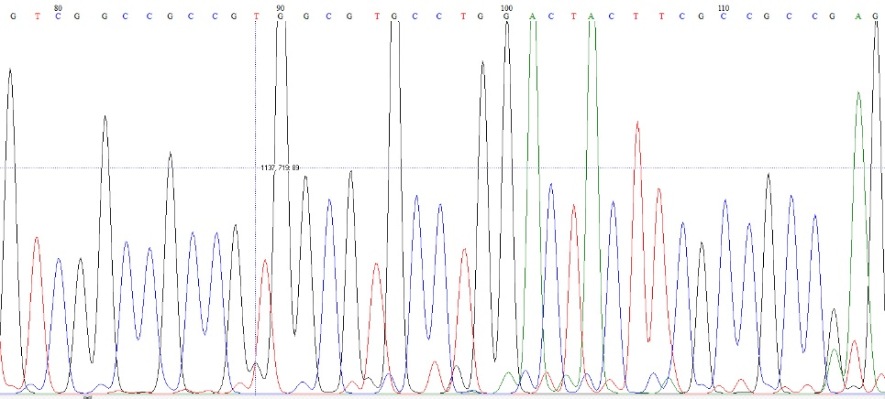
Sequencing results of KLF14 by bioedith Software

Slide 17
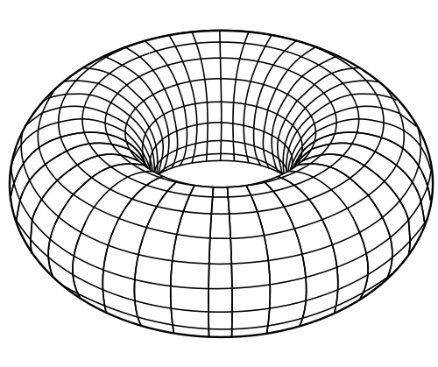
rs76603546
rs111731678
rs782564043
Diversity in variants
rs782812309
rs782397250
rs782600478
rs782239344
rs782814368
rs781938532
rs782453618
rs782680939
rs782341176
rs374764906
220 variants
rs558210393
rs781831902
rs782488811
rs781788513
rs782488811
rs558210393

Slide 18
Hardy-Weinberg equilibrium Results
SNP | Chi Square | P-value
rs76603546 | 3.84 | 0.04
rs111731678 | 0.48 | 0.48
rs782564043 | 2.2 | 0.13

Slide 19
Genotyping and Allele frequencies of rs76603546
Genotype | Case | Control | OR (95%CI) | P-value
CC | 0.5 | 0.33
TT | 0.18 | 0.37 | 0.33(0.1-1.1) | 0.06
TC | 0.32 | 0.27 | 0.72(0.22-2.29) | 0.57
Allele
C | 0.66 | 0.48 | 2.15 (1.08- 4.30) | 0.02
T | 0.34 | 0.518

Slide 20
Genotyping and Allele frequencies of rs111731678
Genotype | Case | Control | OR (95%CI) | P-value
AA | 0.73 | 0.78
TT | 0.043 | 0 | ---
AT | 0.23 | 0.21 | 1.15 | 0.82
Allele
A | 0.84 | 0.89 | 0.63( 0.29 -1.77) | 0.38
T | 0.16 | 0.11

Slide 21
Genotyping and Allele frequencies of rs782564043
Genotype | Case | Control | OR (95%CI) | P-value
GG | 0.45 | 0.57
AA | 0. | 0 | --- | ----
GA | 0.54 | 0.43 | 1.6(0.62-4.16) | 0.33
Allele
G | 0.73 | 0.78 | 0.7(90.33 - 1.61) | 0.43
A | 0.27 | 0.21

Slide 22
Discussion

Slide 23
Adipocyte
HDL,TG,BMI,INS, T2D
Nuclease
Out come
NINJ2, KLF13, GNB1, MYL5,TPMT, ARSD, PRMT2, APH1B,C8orf82, SLC7A10
KLF14

Slide 24
rs76603546

Slide 25
Conclusion
The association of KLF14 SNP, rs76603546 With T2D , may be due to LD with SNP out side of gene
Higher Odd ratio of rs76603546 SNP with T2D compared to other SNPs in the locus might be either because of incomplete LD between these SNPs or simply it might be because of differences in the gene pool of different population
Another possible assumption can consider rs76603546 as an independent SNP from previously studied SNPs
Based on our bioinformatics studies rs76603546 is a methylated nucleotide when the C allele is present
This study needs to be reproduced in a larger scale and functional studies should be conducted , which is in progress

Slide 26
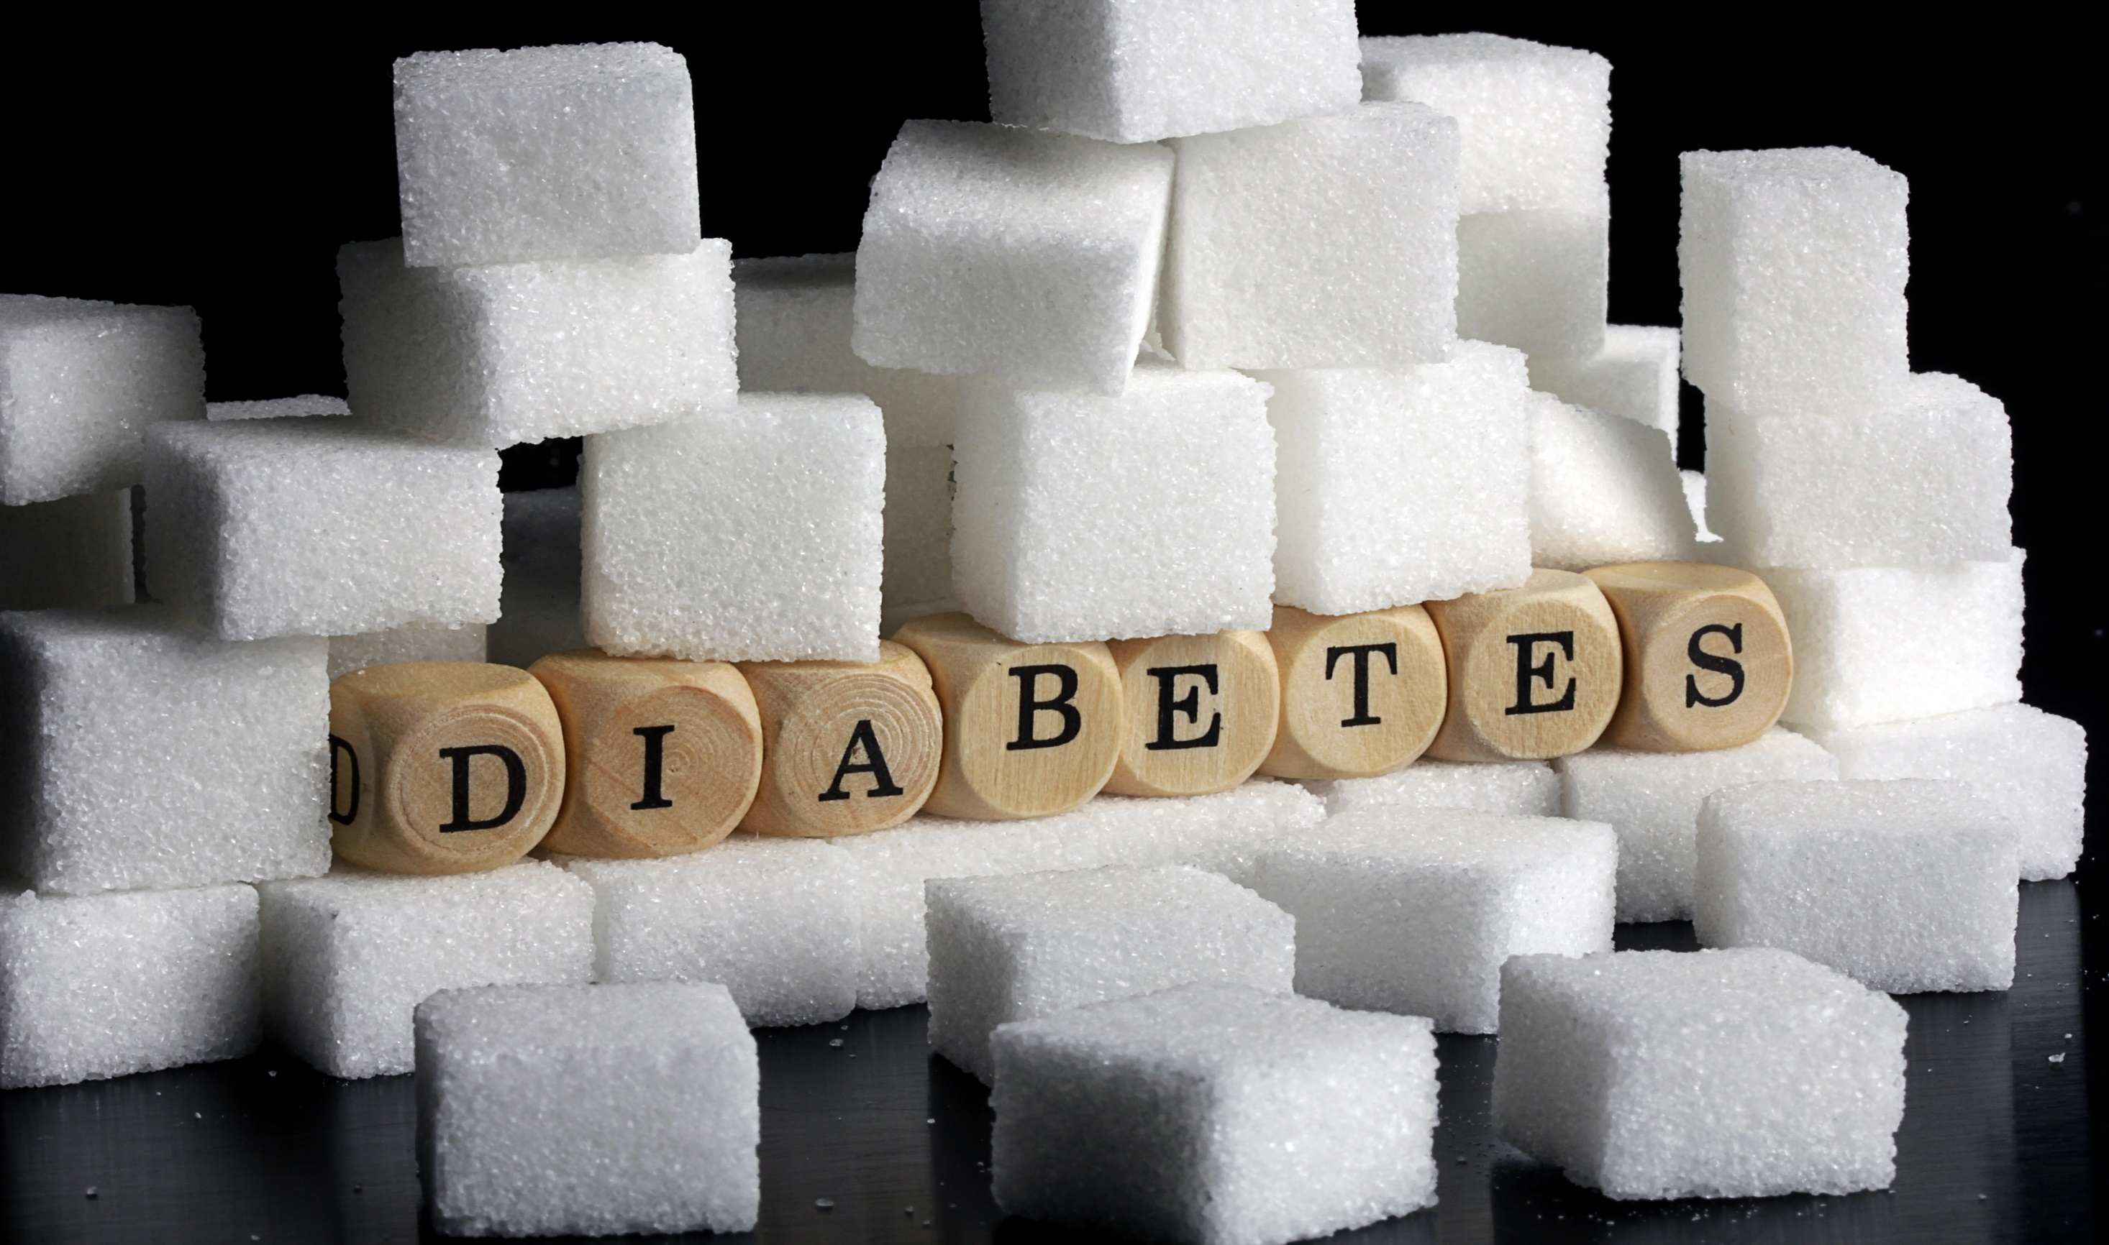
Your
you
for
Attention
Thank

