Slide 1
Human beings are members of a whole
In creation of one essence and soul
If one member is afflicted with pain
Other members uneasy will remain
If you've no sympathy for human pain
The name of human you cannot retain

Slide 3
Heritability And Familiality of Type 2 Diabetes in Yazd Population, Iran
Presented By : Ensieh Shahvazian
Ensieh Shahvazian^{1a}, Mohammad Bagher Mahmoudi^{2a*}, Saba Gharibi¹, Ehsan Farashahi Yazd³
^{1.} Department of Genetics, Faculty of Medicine, International Campus, Shahid Sadoughi University of Medical Sciences, Yazd, Iran
^{2.} Department of Genetic Research, ROJETechnologies, Yazd, Iran
³. Department of Genetics, Faculty of Medicine, Shahid Sadoughi University of Medical Sciences, Yazd, Iran
a. These authors contributed equally to this work
Corresponding author
*Mohammad Bagher Mahmoudi; Email: mahmoudi@rojetechnologies.co

Slide 4
Introduction

Slide 5
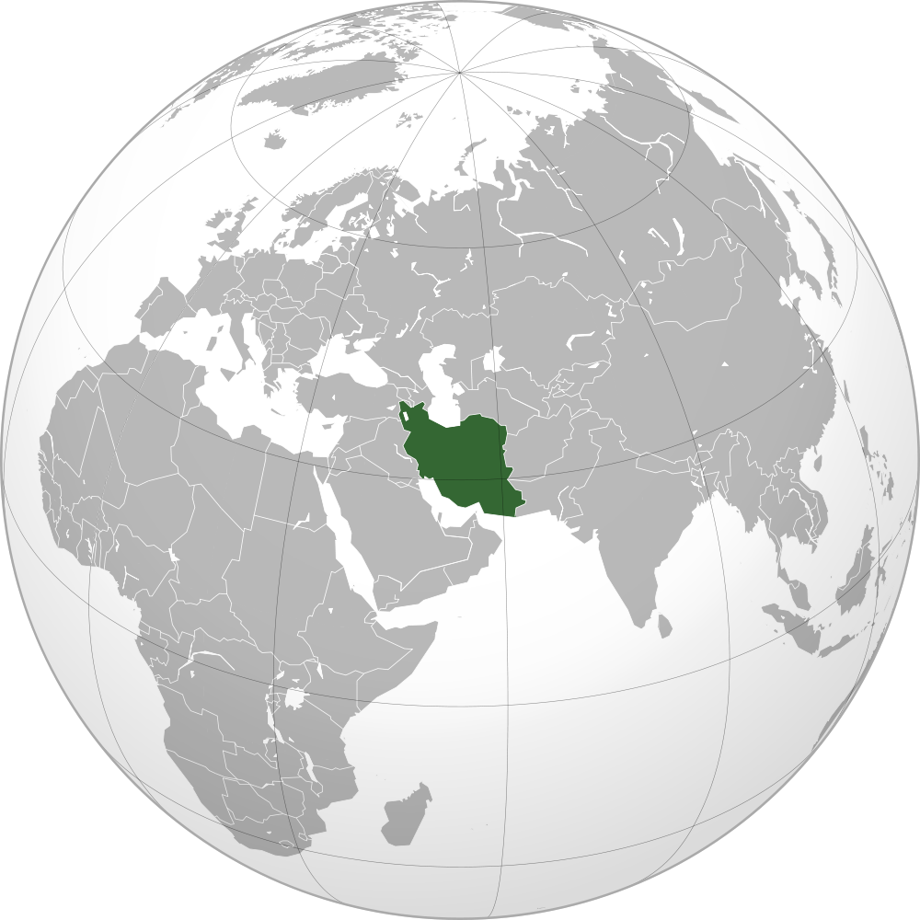
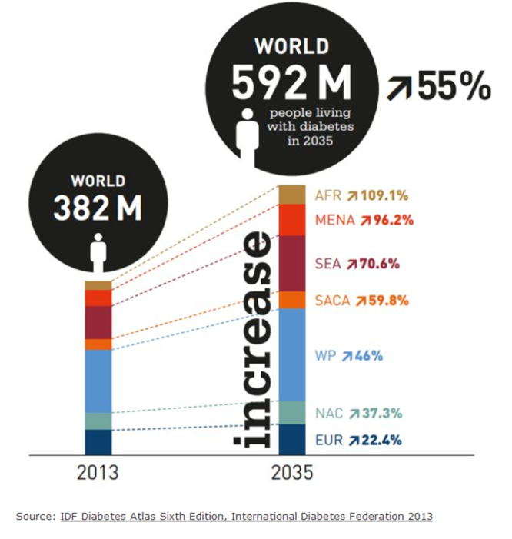
First step in genetic study is to estimate heritability
Heritability (h2) is estimated as the ratio of the phenotypic variance explained by additive polygenic effects at the particular time, age and on specific population.

Slide 6
Yazd Population
High level of consanguineous marriage
low relocation rates
A relatively high standard of living
large family sizes

Slide 7
Materials
&
Methods

Slide 8
Subject selection
Subjects’ recruitment were started since 2012. Written informed consent was obtained from all individuals before participation and the study protocols were approved by local ethics committees. The diagnosis of type 2 diabetes for all participants was based on clinical characteristics and WHO 1998 criteria. A structured valid questionnaire of 100 parameters including smoking habits, diets, physical activity and clinical assessment were collected from all participants.

Slide 9
Probands
Adults-onset diabetes were selected randomly from records of Yazd Diabetic Research Center.
Family member
The first- , second- and third- degree family member of probands, aged≥20 were interviewed door to door. If another diabetic individual was identified in the family, the family was expanded further to include that person’s family members similar as others.

Slide 10
Measurements
Height (to the nearest cm without shoes) and weight (to the nearest kg in light indoor clothing) were recorded. BMI was calculated as the weight (kg) divided by the height (m) squared. Although, expanded pedigree for each family was recorded.

Slide 11
Data Analysis & Heritability Calculation
Heritability was calculated for Type2diabetes in SOLAR software package and was adjusted for common covariates (age, sex, age × sex, age2 and BMI).
It was estimated using a liability threshold model implemented in SOLAR.
Sibling, nuclear family and expanded family relative risk was calculated as risk of diabetes in respectively, siblings, nuclear family and expanded family of patients with type2 diabetes compared with background population.
The parent-offspring correlation for diabetes was calculated to assess the difference of transmission of disease from mother or father.

Slide 12
Results

Slide 13
Parent- offspring correlations
for type2 diabetes
Father | Mother | Male Diabetic offspring/total male | Female Diabetic offspring/total male | OR(95%CI) | P-value
Non-Diabetic | Diabetic | 0.4 | 0.27 | 1.73(1.06-2.81) | 0.027
Diabetic | Non-Diabetic | 0.38 | 0.43 | 0.8(0.43-1.42) | 0.43
Diabetic | Diabetic | 0.25 | 0.34 | 0.64(0.33-1.23) | 0.18
λs | λR (Nuclear Family) | λR
3.14 | 3.42 | 2.4

Slide 14
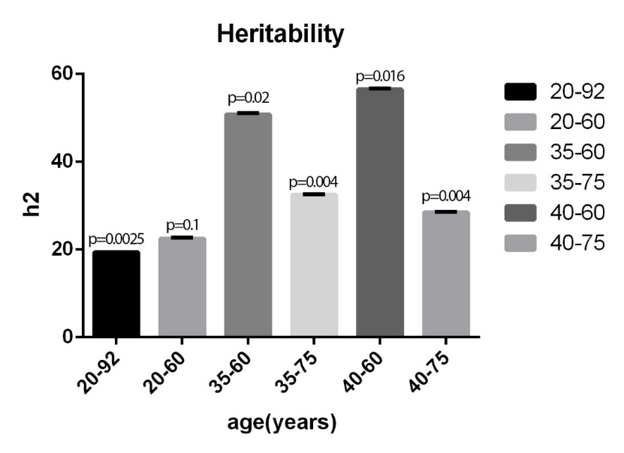
Heritability of type 2 diabetes
Age Range | H²±SE | Pvalue | Loglike | Kullback-leibler R-squared
20-92 | 01935580±0.07 | 0.0025124 | -867.9068 | 0.1551934
20-60 | 0.2245±0.200 | 0.1146199 | -671.183130 | 0.2118744
35-60 | 0.5080729±0.27 | 0.0209104 | -535.531924 | 0.2692349
40-60 | 0.564569±0.28 | 0.0165230 | -474.447756 | 0.0362839
35-75 | 0.3249571±0.11 | 0.0004070 | -738.814603 | 0.0506107
40-75 | 0.2847715±0.11 | 0.0039717 | -732.045135 | 0.0307852

Slide 15
Discussion

Slide 16
h2 is the resemblance between children and their parents and ranges from 0.0 to 1.0
h2 : environmental factors x genetic factors.
High heritability : represented that phenotype is related to genotype
!
By knowledge of genotype we could not predict phenotype due to environmental factors influence
In population with high h2, it is possible to find gene with large influence on phenotype of disease
!
When h2 is low, we could not understand that additive genetic have a small role on the phenotype

Slide 17
h2 is used either for comparison of traits across the population or in different age groups of a population, also compression of different traits, which could be different phenotypes of a disease, in one population
The heritability of type2 diabetes is ranging from 0.19 to 0.56 in different age groups (20-85 years) at the under study population. However, the h2 in botany study in 16-75 years is in range of 0.25 to 0.69

Slide 18
Conclusion
Our study indicated that h2 estimates of 40-60 years age range shows a higher value, compared to other age groups (56±0.28)
These results may be due to higher influence of environmental factors in 60-75 age groups
On the other hand lower h2 in individuals younger than 40 years, may be due to incomplete penetrance of T2D
These results also lead us to the best age group for genetic studies , which is 40- 60 age range

Slide 19
After a deep understanding on high risk genetic factors, discovery of low risk genetic factors can more easily be accomplished in individuals older than 60 years old
Finally, heritability estimates in Yazd population showed us that environmental factors play a pivotal role in etiology of T2D as well as genetic factors and it is probable to observed genetic risk factors with OR≥2

Slide 20
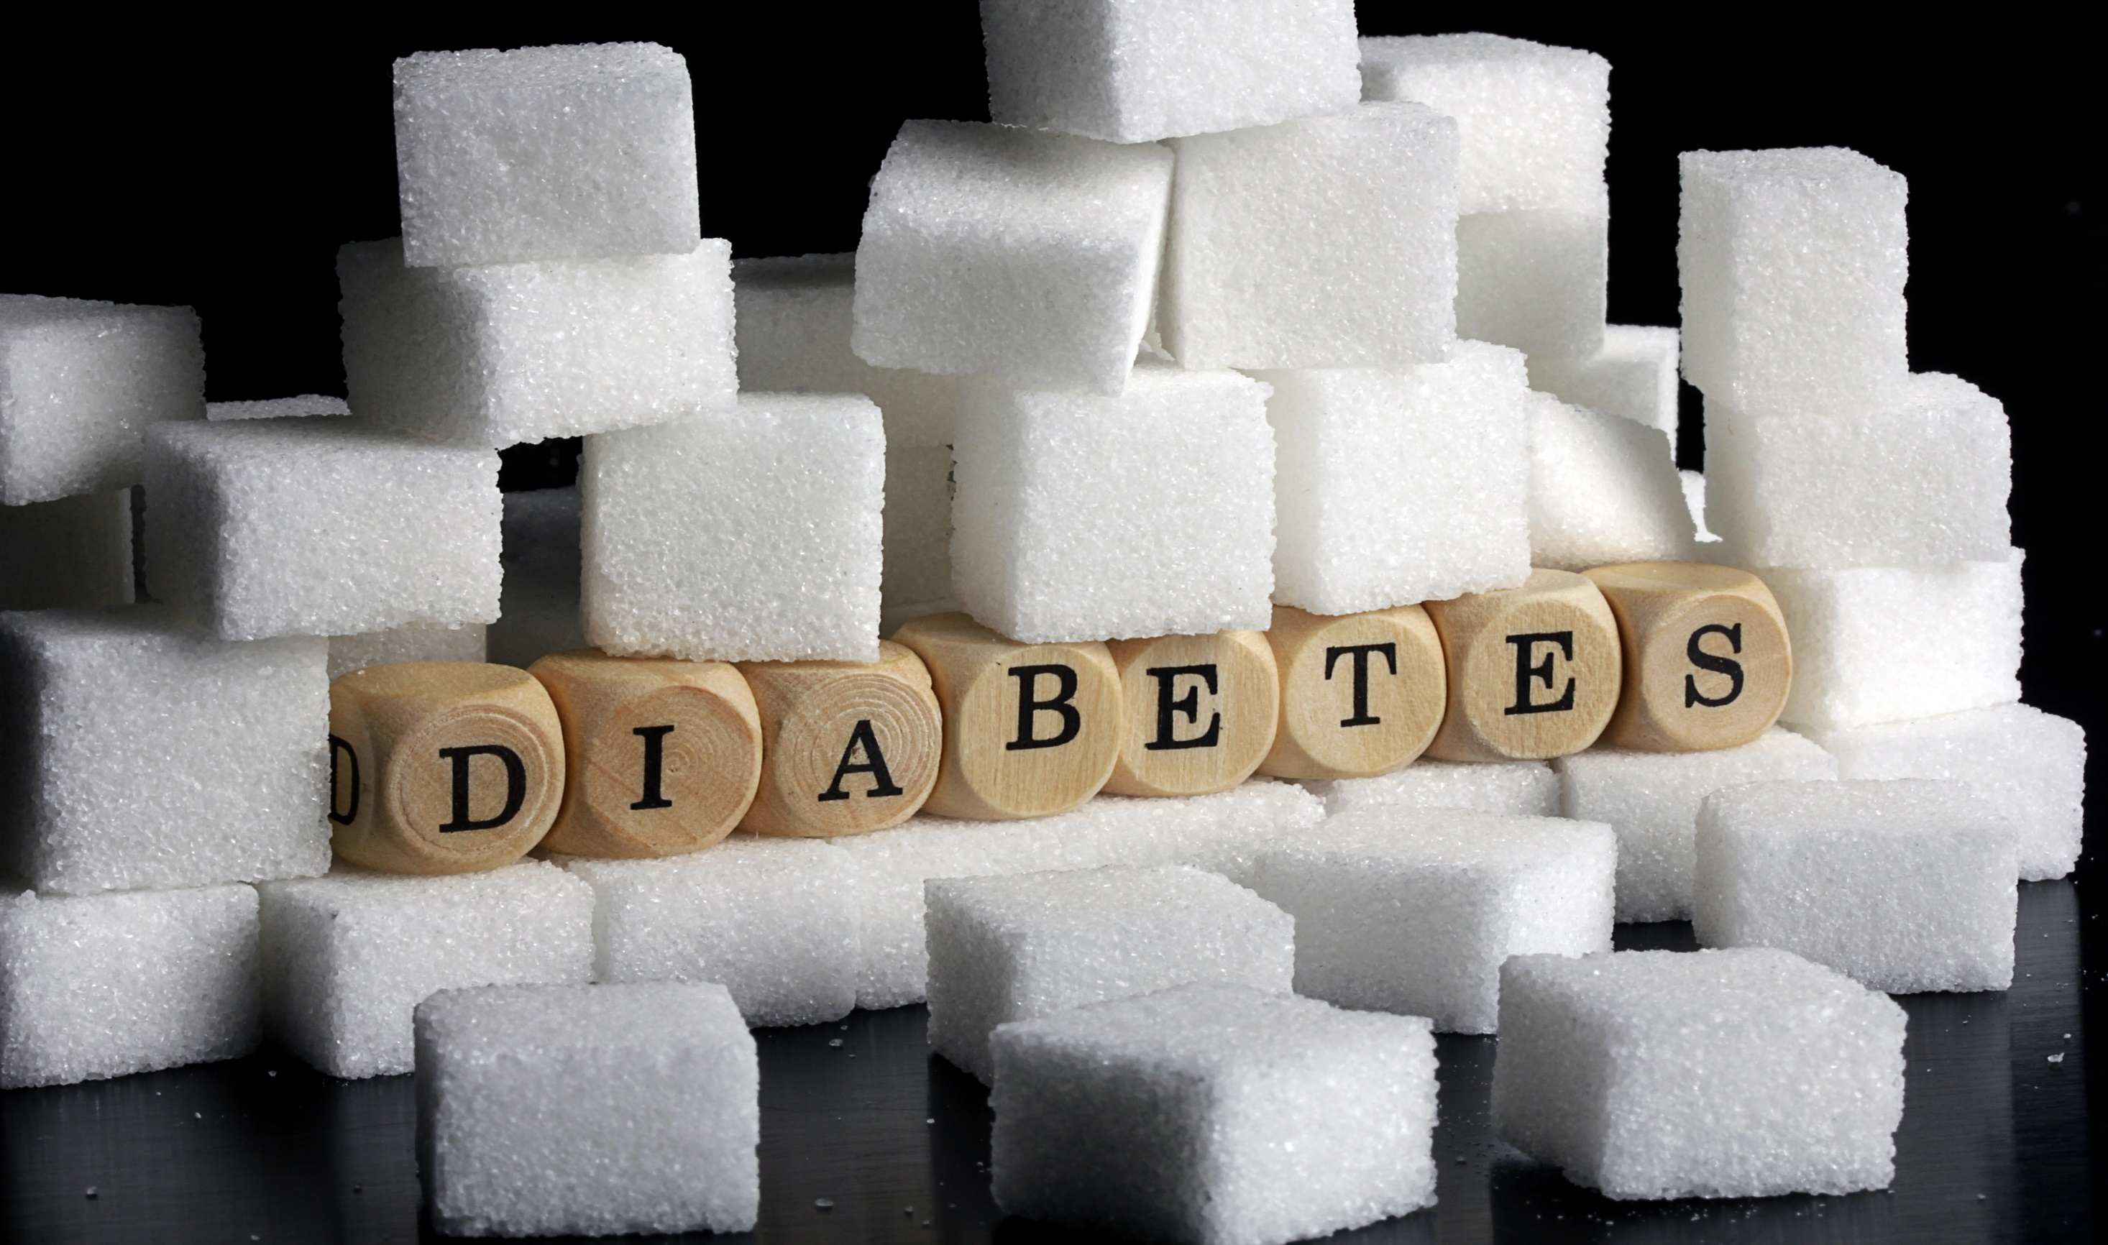
Your
you
for
Attention
Thank

