Slide 1
About OMICS Group
OMICS Group International is an amalgamation of Open Access publications and worldwide international science conferences and events. Established in the year 2007 with the sole aim of making the information on Sciences and technology ‘Open Access’, OMICS Group publishes 400 online open access scholarly journals in all aspects of Science, Engineering, Management and Technology journals. OMICS Group has been instrumental in taking the knowledge on Science & technology to the doorsteps of ordinary men and women. Research Scholars, Students, Libraries, Educational Institutions, Research centers and the industry are main stakeholders that benefitted greatly from this knowledge dissemination. OMICS Group also organizes 300 International conferences annually across the globe, where knowledge transfer takes place through debates, round table discussions, poster presentations, workshops, symposia and exhibitions.

Slide 2
About OMICS Group Conferences
OMICS Group International is a pioneer and leading science event organizer, which publishes around 400 open access journals and conducts over 300 Medical, Clinical, Engineering, Life Sciences, Phrama scientific conferences all over the globe annually with the support of more than 1000 scientific associations and 30,000 editorial board members and 3.5 million followers to its credit.
OMICS Group has organized 500 conferences, workshops and national symposiums across the major cities including San Francisco, Las Vegas, San Antonio, Omaha, Orlando, Raleigh, Santa Clara, Chicago, Philadelphia, Baltimore, United Kingdom, Valencia, Dubai, Beijing, Hyderabad, Bengaluru and Mumbai.

Slide 3
An application of electron beam lithography: location of metallic nanostructures based on .
Enrique Samano
CNyN-UNAM, Ensenada, B.C., México
3rd International Conference on Materials Science & Engineering-2014

Slide 4
OUTLINE
is the carrier of genetic information. It is also “brick and mortar” for building at the nanoscale (N. Seeman, Nature 421, 427- 431 (2003)).
DNA belongs to the nanometer scale, its diameter is approximately 2 nm and one full turn of the helix is about 3.5 nm (~ 10.5 bp long). Complex materials with micron-scale dimensions and nanometer-scale feature resolution can be created via engineered DNA self-assembly.
These assemblies are increasingly being exploited as templates for the programmed assembly of functional inorganic materials.
A scheme has been recently proposed to apply these bioinspired DNA templates towards the fabrication of composite materials for use in photonics, medicine, etc. (E. Samano et al., Soft Matter (2011)).
A method for producing metallic nanostructures with a programmable design based on the specific positioning of AuNPs (5 nm size) on DNA origami is shown. The AuNPs can be enlarged by coalescence of Ag in a controlled manner by metallization (E. Samano et al., Nano Lett. (2011)).

Slide 5
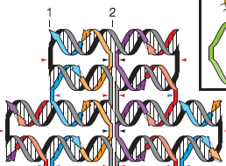
DNA ORIGAMI
Origami is the Japanese art of paper folding. Flat sheets can be folded into 3d-shapes.
DNA origami is a 2d-nanostr. based on the ss-M13mp18 viral genome with 7 249 bases.
This plasmid is folded in a planned and accurate manner by ~200 specific complement. “staple” strands of DNA (P. Rothemund, Nature 440, 297-302 (2006)).

Slide 6
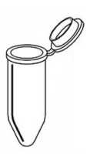
DNA ORIGAMI
90 °C for 5 min
in thermal cycler
b) 4 °C ( -1 °C/min)
c) Stored at 4 °C
M13mp18
+
225 fold excess
helper strands in
TAE/Mg²⁺(1x, pH8)
2 nm height
Purification
Microcon YM-100 Centrifugal Filter Unit,100K MWCO.
90 nm
DNA
origami
Soln.
70 nm
Self-assembly of Rectangular DNA Origami

Slide 7
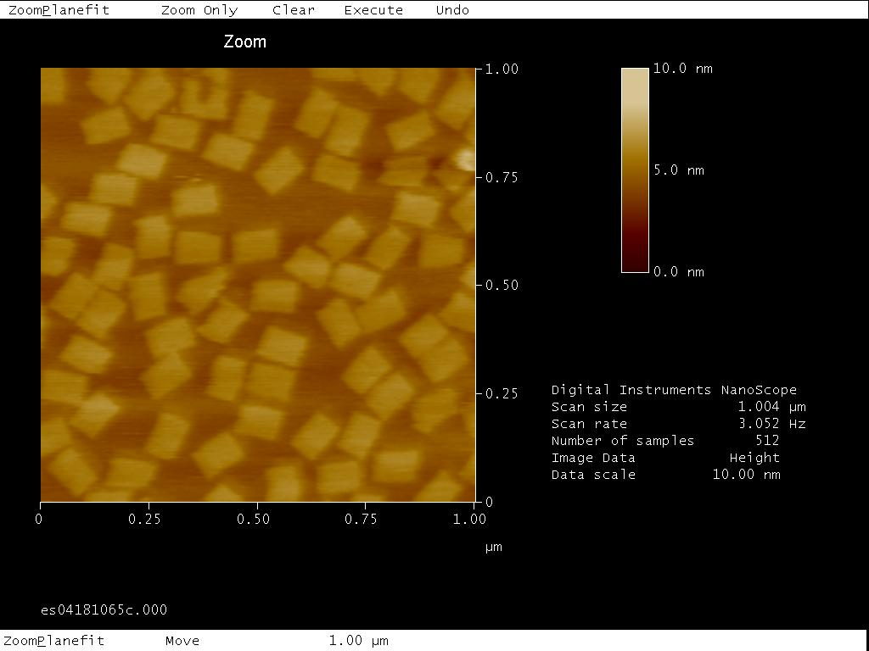
DNA ORIGAMI IMAGING
AFM imaging of origami on mica in liquid (5 µl of 4 nM DNA origami)

Slide 8
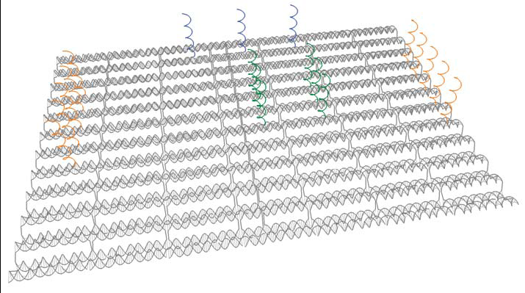
AuNP:DNA ORIGAMI CONJUGATES
Strategy on rectangular
origami to organize :
Biological materials
and other chemical groups
Quantum dots and
Magnetic nanoparticles
Carbon nanotubes
Metal nanoparticles (NPs)

Slide 9
AuNP:DNA ORIGAMI CONJUGATES
DNA origami has the potential to act as a template for the accurate array of AuNP to produce precisely engineered DNA nanostructures.
This is possible because the “sticky ends” from the origami can be extended at binding sites enabling the attachment of complementary DNA-functionalized AuNPs; i.e, modified DNA origami is conjugated.
Later, the size of the AuNP bound to DNA origami can be enlarged by reducing Ag ions using a kit (initiator, moderator and activator) at R.T.

Slide 10
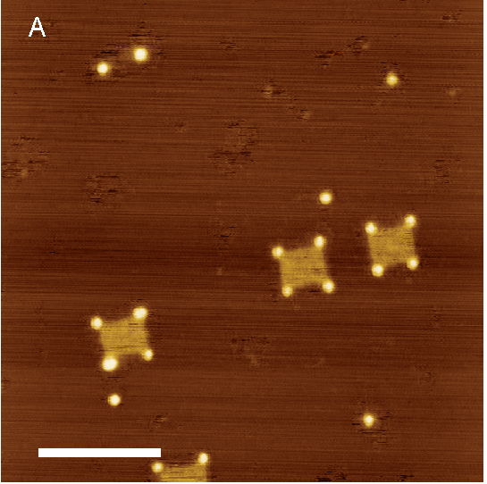
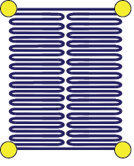
ORIGAMI + AuNP ON EACH CORNER
AFM image of AuNP + DNA (1.4:1) on SiO₂ in air. Each particle is attached to origami by two binding sites. Scale bar, 250 nm.

Slide 11
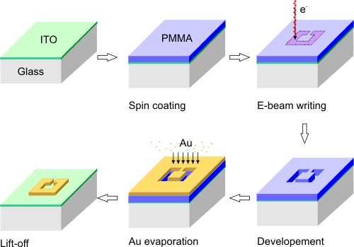
PATTERN GENERATION BY e-BEAM
The Nanometer Pattern Generation System (NPGS) has been designed to delineate complex structures with sizes from nanometers up to microns.
There are three basic steps to generate a pattern by e-beam lithography:
Pattern design, ii. Parameter run file creation, iii. Pattern writing.
SiO₂
Si
Scheme to generate the alignment marks and electrical leads by NPGS

Slide 12
PATTERN GENERATION BY e-BEAM
Design of a 100 µm x 100 µm pattern to write 100 nm x 80 nm rectangles, 5 µm apart, by e-beam lithography to place metallized DNA origami in each.

Slide 13
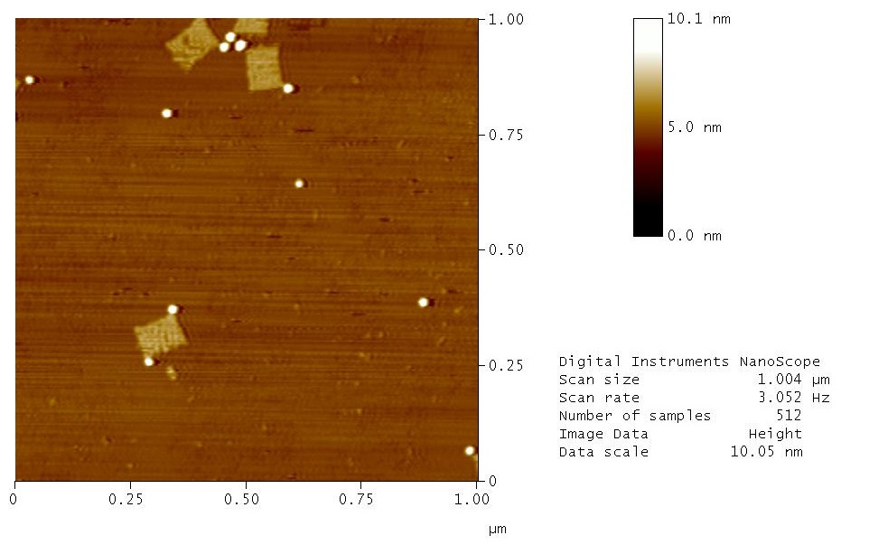
ORIGAMI + 2 AuNP ON 2 CORNERS
AFM image of AuNP + DNA (1.5:1) on SiO₂ in air for plasmonics exper. Each particle is attached to origami by two binding sites.

Slide 14
ORIGAMI + 2 AuNP ON 2 CORNERS
SEM image showing the 100 nm x 80 nm rectangles, 5 µm apart, carved on SiO₂ in order to immobilize Au NPs after 10 min. of metallization (~ 40 nm size).

Slide 15
PLASMONICS
There is a great interest in the study of the optical properties of metallic nanoparticles and their aggregates in the nanoscale vicinity.
Plasmon is a collective oscillation of the valence electrons in a metallic particle. The resonance frequency depends on the material composition (mainly electron density) and the surrounding dielectric medium.
In particular, Ag and Au exhibit d → s interband transition in the UV region that mixes with the plasmon resonance and shifts it to the visible.
In nanoparticles (NPs), the plasmons strongly couple to optical fields, producing intense light-scattering spectra. The intensity of the spectra from noble-metal NPs is highly dependent to particle size and shape.
The light-scattering spectrum from a single noble-metal NP of 20 nm or larger can be readily observed by dark-filed microscopy. As two metal NPs are brought together, their plasmons couple and the resonance freq. changes as a function of particle separation. A red shift will occur due to constructive interference between the enhanced fields of each NP.

Slide 16
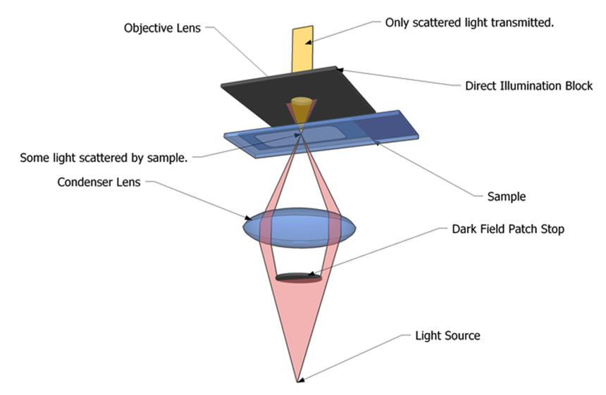
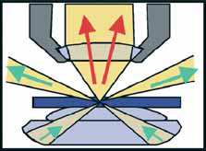
DARK FIELD MICROSCOPY
Experimental conditions:
Unpolarized white light from a tungsten lamp.
The sample is placed on a glass slide.
A 5 µm size aperture is used to collimate the transmitted light.

Slide 17
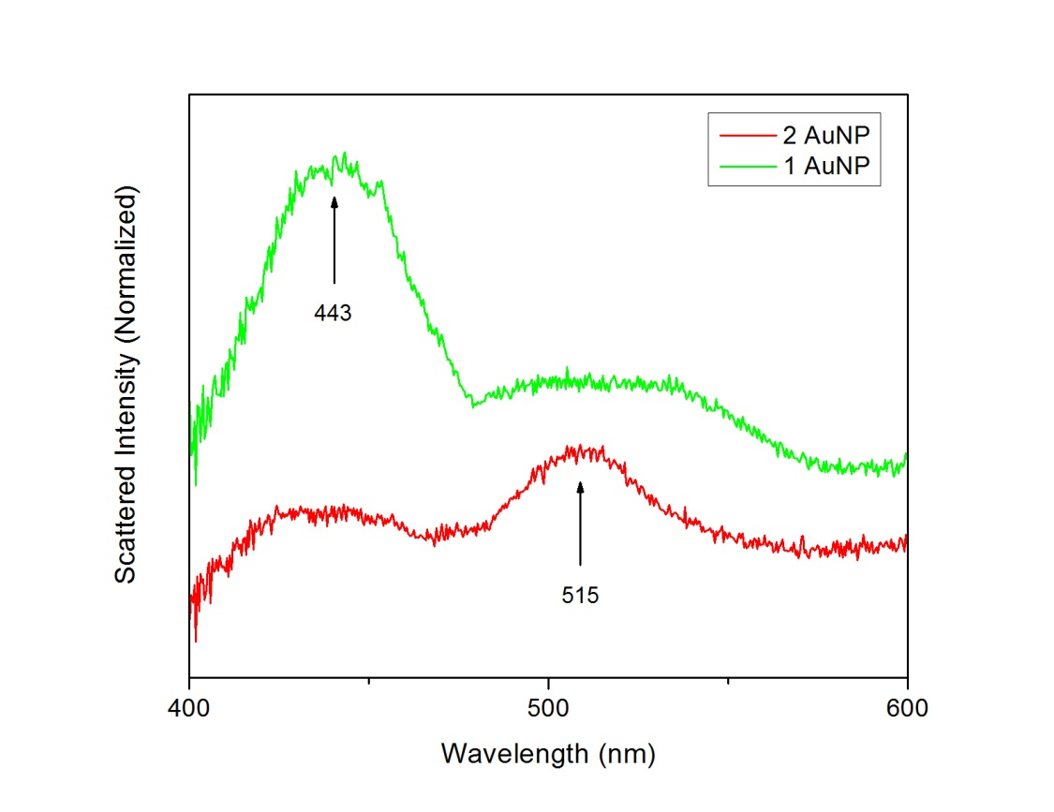
2 METALLIZED AuNP ON CORNERS

Slide 18
METALLIZED AuNP

Slide 19
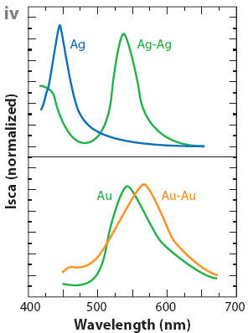
PLASMONICS RESULTS
P. A. Alivisatos et al., Nature Biotech 23, 741-745 (2005)

Slide 20
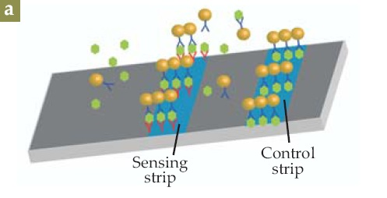
PLASMONICS APPLICATIONS
Sensing. The spectral red shift of localized plasmonic resonances due to the aggregation of metal NPs can be applied in sensing, HPT.
M. I. Stockman, Phys Today (Feb), 39-44 (2011)

Slide 21
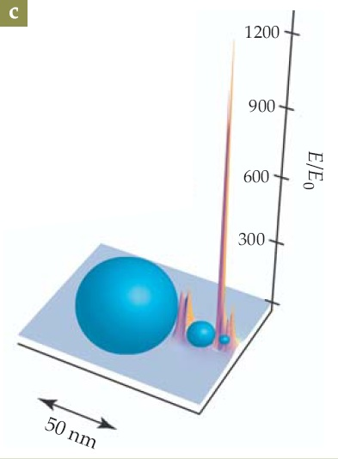
PLASMONICS APPLICATIONS
Sensing. The spectral red shift of localized plasmonic resonances due to the aggregation of metal NPs can be applied in sensing, HPT.
Nanolens. “Hot spots” in a system composed of 3 Ag NPs in a row whose sizes form a decr. geometric series. “Hot spots” are spikes of intense and highly localized fields.
M. I. Stockman, Phys Today (Feb), 39-44 (2011)

Slide 22
SUMMARY
Controlled placement of NPs on DNA-Origami
Controlled Ag metallization of NPs placed on DNA-Origami
Plasmon coupling for two Ag metallized NPs on DNA-Origami

Slide 23
Let Us Meet Again
We welcome you all to our future conferences of OMICS Group International
Please Visit: http://materialsscience.conferenceseries.com/
Contact us at
materialsscience.conference@omicsgroup.us
materialsscience@omicsgroup.com

