Slide 1
About OMICS Group
OMICS Group International is an amalgamation of Open Access publications and worldwide international science conferences and events. Established in the year 2007 with the sole aim of making the information on Sciences and technology ‘Open Access’, OMICS Group publishes 400 online open access scholarly journals in all aspects of Science, Engineering, Management and Technology journals. OMICS Group has been instrumental in taking the knowledge on Science & technology to the doorsteps of ordinary men and women. Research Scholars, Students, Libraries, Educational Institutions, Research centers and the industry are main stakeholders that benefitted greatly from this knowledge dissemination. OMICS Group also organizes 300 International conferences annually across the globe, where knowledge transfer takes place through debates, round table discussions, poster presentations, workshops, symposia and exhibitions.

Slide 2
About OMICS Group Conferences
OMICS Group International is a pioneer and leading science event organizer, which publishes around 400 open access journals and conducts over 300 Medical, Clinical, Engineering, Life Sciences, Phrama scientific conferences all over the globe annually with the support of more than 1000 scientific associations and 30,000 editorial board members and 3.5 million followers to its credit.
OMICS Group has organized 500 conferences, workshops and national symposiums across the major cities including San Francisco, Las Vegas, San Antonio, Omaha, Orlando, Raleigh, Santa Clara, Chicago, Philadelphia, Baltimore, United Kingdom, Valencia, Dubai, Beijing, Hyderabad, Bengaluru and Mumbai.

Slide 3
The International Network to Promote the Rule of Law www.inprol.org
Notes:
Thanks/welcome.
Acknowledgement of anyone in the room who is or has been involved in the project
Thanks especially to INL Afghanistan for having us today and for their support over the years

Slide 4
INPROL is a global network of professionals dedicated to promoting justice, security and the rule of law worldwide. Every member has access to the knowledge, experience, and ingenuity of all members.
Notes:
Spearheaded by the US Institute
of Peace and partners with tremendous support from INL Afghanistan

Slide 5
INPROL gives members the tools to imagine, design, build and implement rule of law reforms and innovations.
Notes:
By documenting lessons learned, fostering the exchange of ideas and facilitating innovation, INPROL and its members are working towards filling “the knowledge gap” – and towards a profession better able to empower societies to realize their RoL goals

Slide 6
What can INPROL do for you?
Connect you with Expertise
Community of Peers
Discussion Forum
Create & Curate Resources
INPROL Publications
Libraries & Country Page
Publicize your Work
News, Blog, Events, Jobs
Notes:
How specifically can INPROL help?
Will go through 3 main ways can be of use to you/tour organization and the tools INPROL offers to achieve this

Slide 7
Community of Peers
At our core are our members and Council of Experts
Immediate connection to 2,500+ rule of law professionals
Access to the knowledge of recognized experts
Notes:
Core is our members and their knowledge and experience
Come from range of disciplines and backgrounds, all work on RoL reform in post-conflict and developing countries
Along with over 2500 members have Rule of Law and Police Experts Council of about 40 world renowned experts
Membership is by application and limited to people with serious interest of expertise in these areas. Ensures high level of discussion. Signup is free - more later. Many features most importantly disucssion are members-only
Why the network
By creating network of experienced RoL professionals and a place for them to meet it means we can give you instant access to the knowldege of 2500 people
So how does this work in practice?

Slide 8
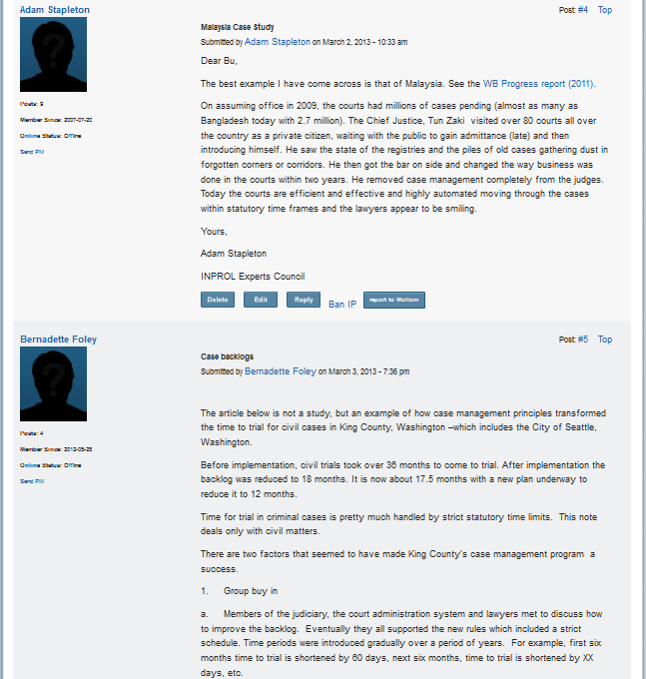
Accessing Community Expertise: Discussion Forums
Ask a Question
Community Feedback
Notes:
Encounter a problem in your work, have a theoretical question (i.e. police primacy)etc.
Can pose this question to INPROL’s entire member network
Post directly in one of our 3 forums: Rule of law, police and facilitated dialogue or email it to the inprol team
After review by a team member is posted on the website and an email will go out to all members alerting them to the question
Other members submit comments, resources and links in response
Can see here someone asked a very broad question looking for examples of studies of the causes of case backlogs, got about 10 answers with links to studies as well as commentary from people (including experts’ council) who’ve had experience in this area)
We welcome all kinds of questions from the very simple to the complex
Anything from “does anyone have a powerpoint on X? to POLICE PRIMACY
Also ask ppl to take research survey OTHER EXAMPLES

Slide 9
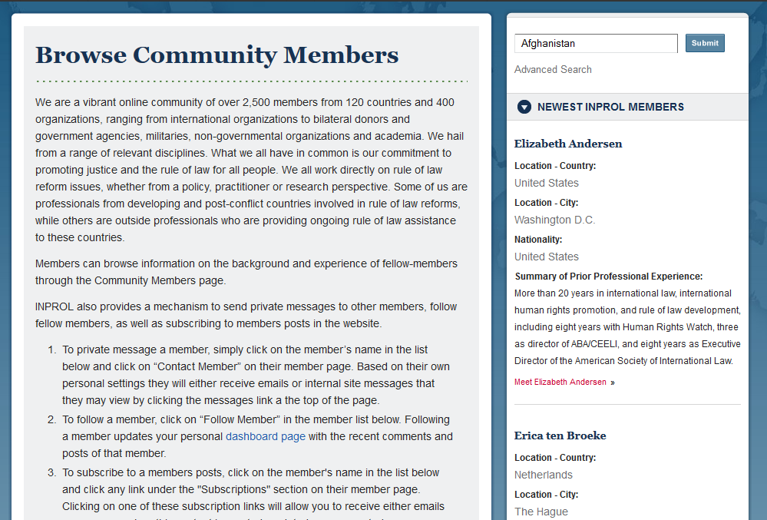
Accessing Community Expertise: Personal Connections
One-to-one connection with other members and experts
Search directory and message
Facilitated by INPROL staff
Notes:
In addition to posing a question to all INPROL members, you can seek out the help of other members and experts directly
Example: had someone looking for very specific case study information on criminal justice reforms in a small area of the world. INPROL team ID’ed a member who had done extensive work in that area, talked to him, then connected the two directly.
Can do this by
Browse or Search member directory by name, click on organizations, look for particular areas of expertise
Email INPROL staff

Slide 10
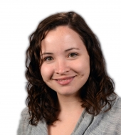
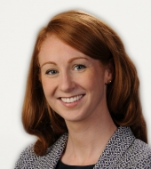
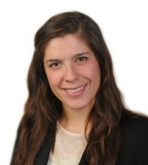
The INPROL Team
Facilitate and contribute to online discussions
Broker personal connections
Conduct research tailored to member needs
Notes:
This brings up one of the great and unique features of INPROL - that you are not left to navigate the network or makes these connections alone. The network is supported by a team of facilitators whose job it is to help you find the resources and people you need.
We: Facilitate online discussions For example:
You have a question and you either (1) don’t know if it’s right for INPROL or (2) aren’t quite sure how to frame it – email the facilitators and we can talk through it
You can’t find members with the expertise you need – we can help you locate the right person in the network
You have a question that for any number of reasons you can’t post publicly - talk to a facilitator and we can figure out a way to post it under our account, look into it internally etc.
Once question posted
contribute preliminary research so you get a quick response, reach out to specific members and experts with relevant knowledge- in short oversee to ensure you receive useful information
Not only guide discussions and connect members
There are sometimes questions that can’t be adequately answered by an existing resource or through member discussion
Large part of our work is to identify members questions where there simply isn’t a useful, accessible existing publication and do in depth research to answer this need
Results in 2 kinds of publications (talk about next)

Slide 11
Research Memoranda
Written in response to member questions
Recent topics addressed:
Interim justice and security arrangements
Building post-conflict investigative capacity
Notes:
Our help goes beyond guiding discussions, locating resources and connecting members
In some cases, members and partners questions can’t be adequately answered by pointing to an existing resource or a discussion on the online forums
For example UNDPKO working in Liberia - they and the government considering whether or not, as part of a package of criminal justice reforms to introduce plea bargaining into the legal system.
Asked a question in the forum looking for pros and cons, specifically in post-conflict countries and specifically looking at the effects on a developing RoL
Received several responses, but none that fully answered the question.
Worked with member who was a expert in this area, interviewed persons who were or had been involved in similar reforms and produced a document of about 30 pages that was then distributed to UN staff and Liberian government to help them as they deliberate. Also freely downloadable INPROL site so when anyone has a similar question - it’s there
We work closely with the member who asked the original question to make sure they are getting the resources they need
Point to emphasize this research is driven by and tailored to member needs

Slide 12
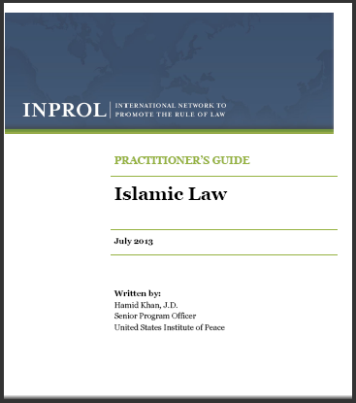
Practitioner Guides
Overview of key topics
Distill best practices and lessons learned:
“Introduction to Islamic Law”
“Common Law and Civil Law Traditions”
Notes:
Practitioner’s Guides are primers on a specific rule of law issue or area. Guides are written at the request of INL Afghanistan and focus on filling urgent gaps identified in the literature - areas where no useful resources are available. Guides provide a comprehensive overview of the topic, and distill best practices where relevant.
The most recent guide provides a concise introduction to Islamic Law.
Proven very usfeul to many of our partners
Currently being translated into ????
Both Research Memos and Practitioner’s Guides are freely downloadable from our site and we enourage you to print, share etc.

Slide 13
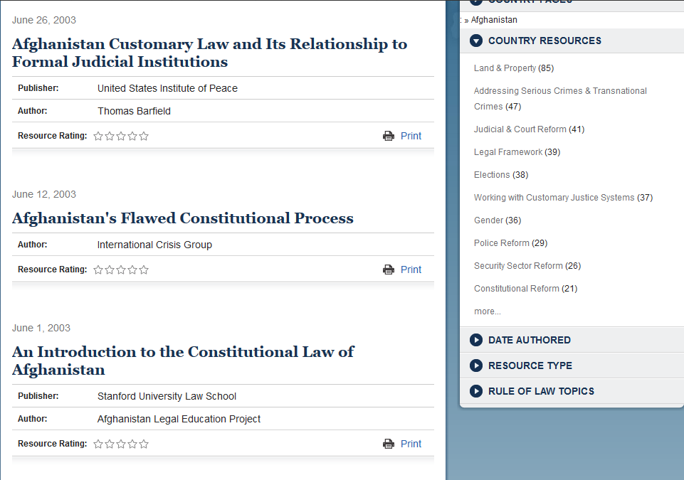
Digital Libraries
Rule of Law and Afghanistan Libraries
3,300+ curated resources
Accessible online
Organized by topic
Notes:
In addition to connecting you with people and documents we also make your job easier by collecting key documents and resources for rule of law practitioners in one place.
Collection of over 3000 in our digital library
Links to docs available online or in some cases with permission of authors/
screened for relevance and
vetted
updated weekly
While we generally don’t feature country specific documents, because of our focus on Afghanistan, we have a dedicated library of Afghanistan specific resources
See picture Stanford Law textbooks, which I know I have personally referred several people to
Not only a great way to streamline your research, but
also a great place to feature your own publications – can submit through the website (point to button in pic) or email them directly to the facilitators.
I.e. Stanford textbooks (also note have pointed people towards them in response to queries)
In addition to providing links to publicly available documents we can also serve as a space to house and share program related documents that you think could be useful to others
I.e. we are working with UNAMA’s Land and Property division to host all their releasable documents within the Afghanistan library
Can be anything you useful – powerpoints, concept notes, working papers etc. and can work with you to describe and credit it to your organization
Also welcome members to send links to documents not their own that they’ve found useful

Slide 14
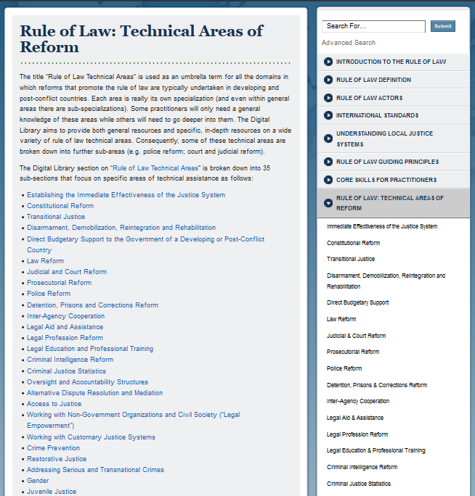
Rule of Law Topics
Primer on key rule of law topics
Everything from constitutional reform to non-state policing to
cultural awareness

Slide 15
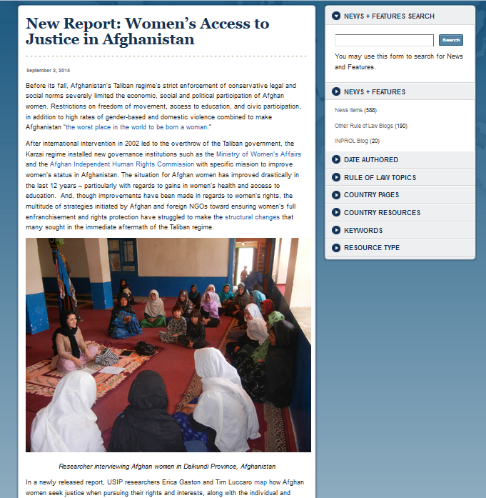
Publicizing your Work: News & Blogs
Spotlights the latest developments & innovative programs
Features members’ blog posts, updates and programs
Notes:
Site also hosts news items and a rule of law blog.
News items are updated daily and chosen to highlight important RoL related developments
Blogs - publish reposted and original pieces. INPROL staff authors many of them, and several related to Afghanistan. These blog posts (like that shown) can talk about a new report or article, recap an event or describe an interesting program. Also love to post content authored by members, including cross posting
Great way to publicize what you or your organization is doing.
Have an idea - we can work closely to develop it, or just send
Happy to feature events, new reports or just highlight your program
Encourage members to contact us about the blog through the website (post button) or by email
Also have a strong twitter and social media presence to further publicize your work

Slide 16
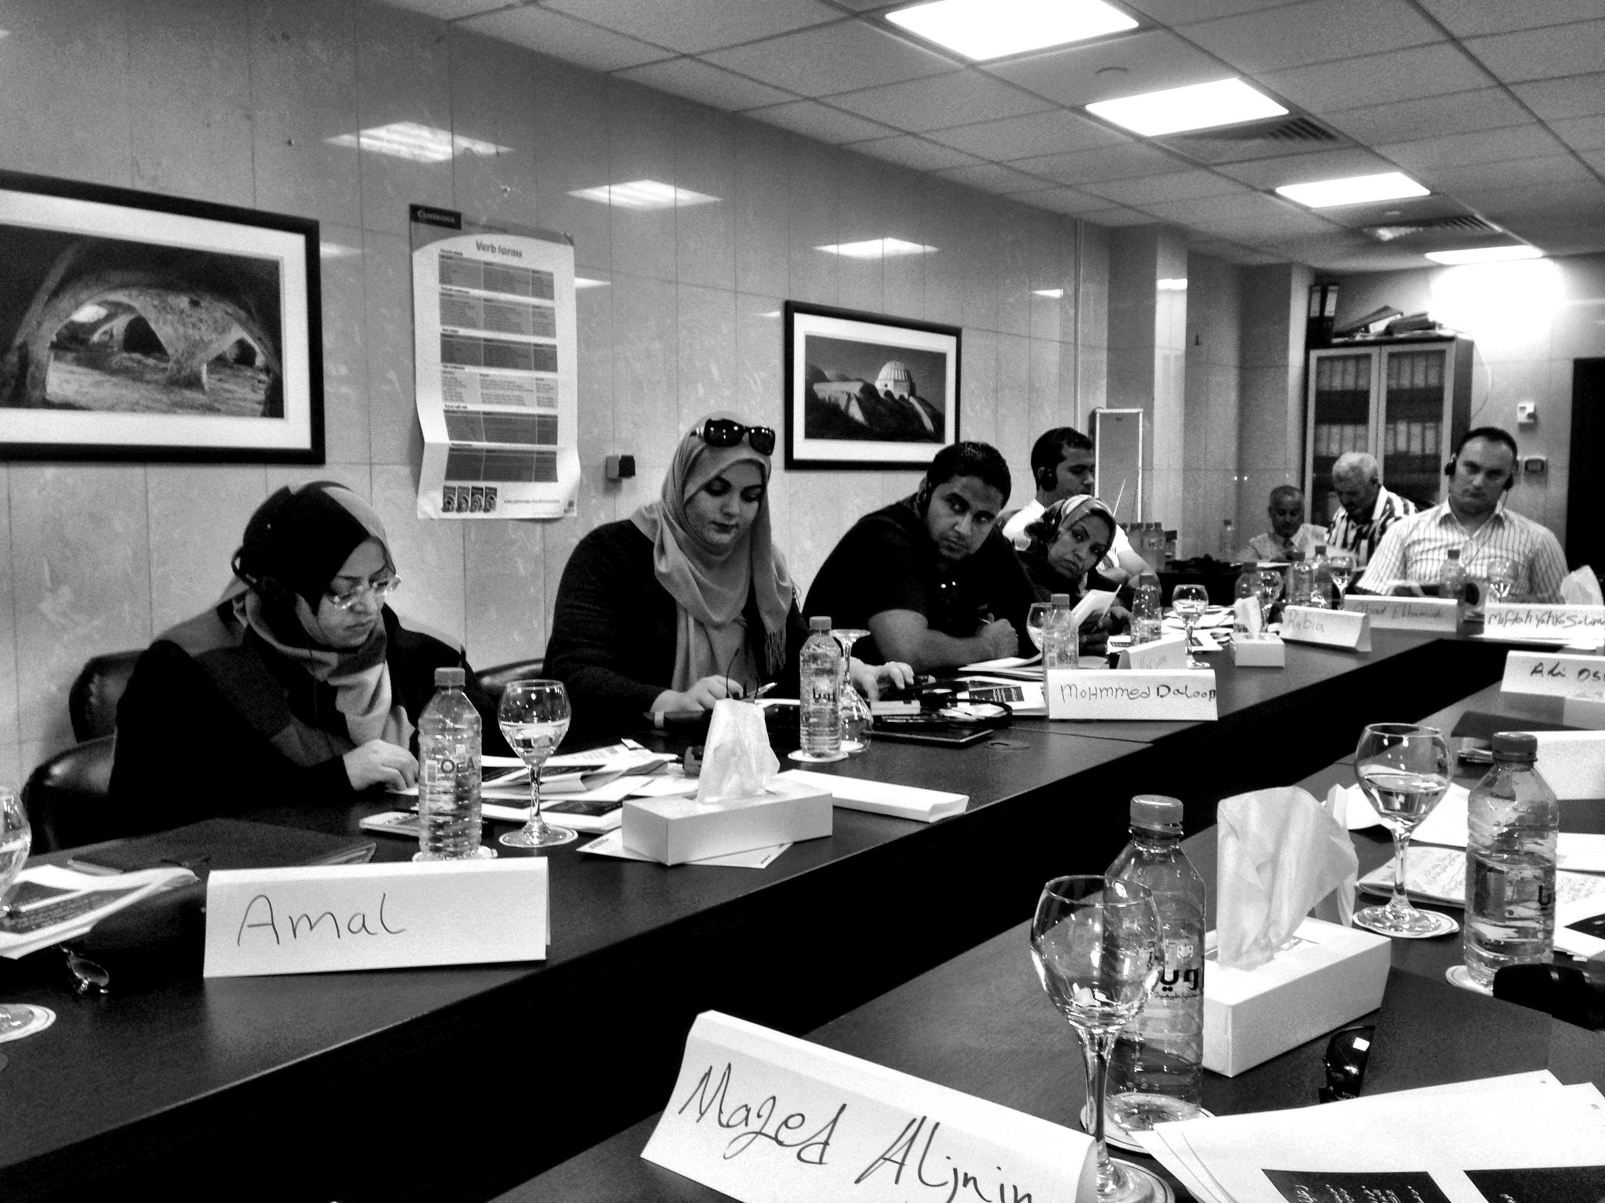
Events & Jobs
Calendar of rule of law events
Jobs submitted by members and organizations
Notes:
Along the same lines can use INPROL to publicize events and job opportunities
Targeted at an audience already interested and knowldegeable about this area
As with news etc. can submit directly through the website or by emailing

Slide 17
Become an INPROL member by visiting www.inprol.org
Connect with us on Twitter (@INPROL), Facebook, and LinkedIn
Contact the INPROL Team directly: inprol@inprol.org
Notes:
Encourage you all to become members
Both because we think INPROL offers tangible benefits to you, but because the more people we have the stronger our network becomes
Membership is completely free
Can sign up online
Or fill out form provided (easier)
Also provided an email address where can contact us directly with any questions about membership or otherwise

Slide 18
Let Us Meet Again
We welcome you all to our future conferences of OMICS Group International
Please Visit: www.omicsgroup.com
www.conferenceseries.com

