Slide 1
ROLE OF PERCUTANEOUS TIBIAL NERVE STIMULATION (PTNS) IN THE TREATMENT OF NEUROGENIC OVERACTIVE BLADDER SYNDROME
Perugia G., Corongiu E., Borgoni G., Polese M., Prontera P.P., Olivieri V., Liberti M.
Department of Gynaecological-Obstetric and Urologycal Sciences, ”Sapienza”, University of Rome, Italy.

Slide 2
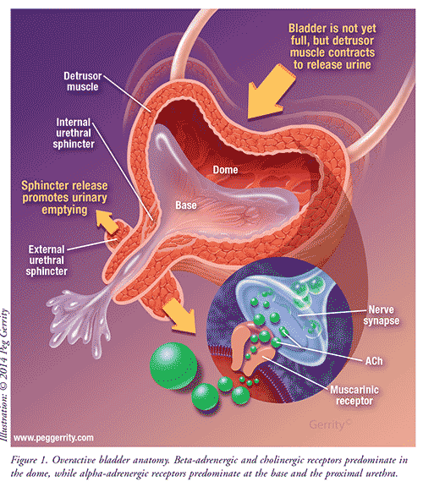
Overactive bladder syndrome (OAB) is characterized by a series of urinary symptoms such as incontinence, urgency, frequency, nocturia and it is differentiated in OAB due to an involuntary urodynamic detrusor contraction, and Neurogenic Detrusor Overactivity (NDO). Many neurologic pathologies can be responsible of NDO. The study is proposed to evaluate the results on symptoms and urodynamic findings of PTNS in patients with NDO.

Slide 3
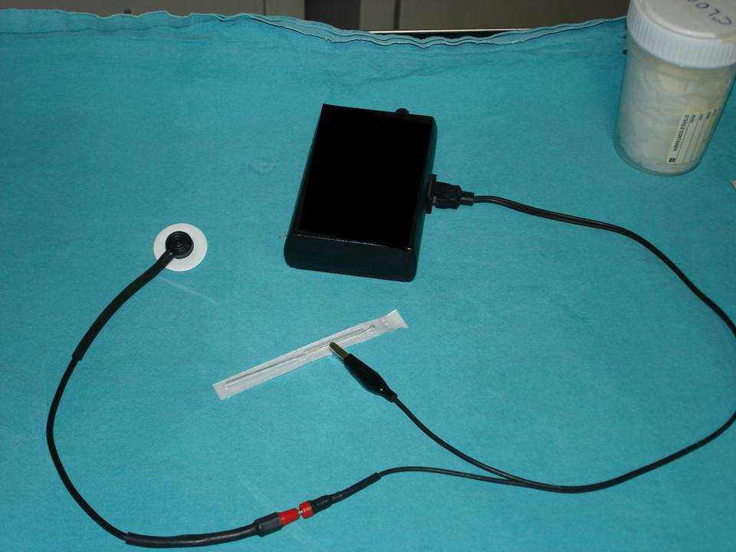
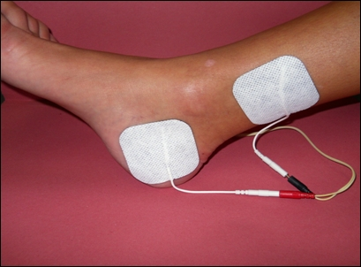
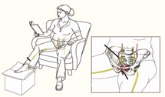
12 pts.,9 males and 3 females,age ranged from 25 and 76 years, with clinical and urodynamic diagnosis of NDO, underwent electrical tibial nerve stimulations , unilaterally, from the medial malleolus and posteriorly to the edge of the tibia, twice a week for a total of 6 weeks. Urodynamic parameters, OverActive Bladder Symptoms Score (OABSS) and voiding diary were evaluated in all pts. before treatment, after 6 elettrical stimulations and at the end of treatment.

Slide 4
RESULTS
PTNS was found to be effective on OAB symptoms in all pts. Mean 1st involuntary detrusor contraction ( IDC ) and mean maximum cistometric capacity ( MCC ) were significantly improved on standard cystometry. 8 pts. (66,6%) showed a complete disappearance of IDC and the other 4pts. (33,3%) showed an increased filling volume to IDC. No complications have been reported, and pts. compliance to treatment was very high.

Slide 5
RESULTS

Slide 6
CONCLUSIONS
PTNS is an effective and safe option to treat pts. with symptoms from NDO. Further studies are needed to assess the role of this technique, and to establish the length of treatment in order to maintain the results obtained.

