Slide 1
3rd Congress of Hepatitis and Liver Diseases October 10-12, 2016 Dubai, UAE
New Insights into the Roadmap of Pathogenesis of Liver Fibrosis
By
Dr. Eman Gamal El-Din El-Ahwany
Professor of Immunology
Immunology Department
Theodor Bilharz Research Institute

Slide 2
Pathogenesis of Liver Fibrosis

Slide 3
I- Established Concepts
II- Emerging Concepts
THE PATHOGENETIC ROADMAP OF LIVER FIBROSIS

Slide 4
I- Established insights (Role of HSCs in Liver Fibrogenesis)
1- Sinusoidal Events During Liver Fibrosis.
2- Regulatory Factors of HSC Activation in Liver Fibrogenesis.
3- Regulation of Gene Expression in HSCs During Liver Fibrosis.

Slide 5
1- Sinusoidal Events During Fibrosing Liver Injury

Slide 6
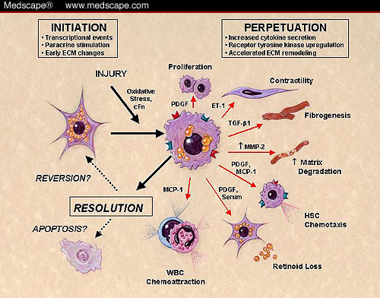
2-Regulatory Factors of HSCs Activation in Liver Fibrogenesis
Chemokines
↑MCP-1 (Chemotaxis).
Growth factors
↑ TGF-beta (ECM Synthesis).
↑ PDGF (Proliferation).
↑ VEGF (Pro-angiogenic).
Cytokines
↑ IL-1, IL-6 (Pro-inflammatory ).
↓ IL-10 (Anti-inflammatory).
↑ IL-4 & Il-13 (Pro-fibrogenic).
↑ Endothelin 1 (Contractility).
↑ Adipokines (Leptin) (Pro-fibrogenic ).
Membrane bound receptors
↑ Toll-like Receptor (Activation of HSCS).

Slide 7
3- Regulation of Gene Expression in HSCs During Liver Fibrosis
There has been tremendous progress in revealing the regulatory mechanisms that control gene expression and the epigenetic modification in HSCs during liver fibrosis.
The recent research has focused on transcriptional control pathways.
Recently, microRNAs (miRNAs) have been shown to play fundamentally important roles in regulation of gene expression in liver fibrosis.
MicroRNAs (miRNAs) are endogenous small non-coding RNAs that control gene expression by degrading target mRNA or suppressing their translation.

Slide 8
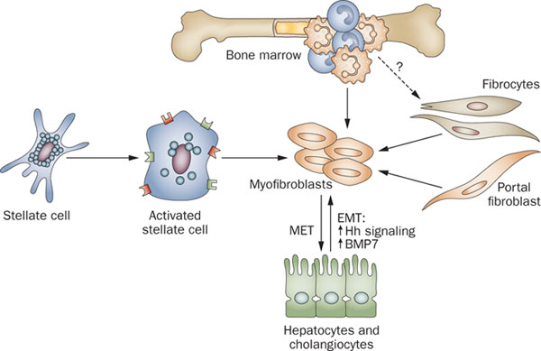
II- EMERGING CONCEPTS FOR THE MECHANISMS OF LIVER FIBROSIS
1- Bone-marrow Derived Fibrocytes.
2- Peripheral Blood Monocytes.
3- Hepatic Macrophages.
4- Portal Fibroblasts.
5- Epithelial Mesenchymal transition (EMT)

Slide 9
1-Bone Marrow Derived-Fibrocytes

Slide 10
2- Peripheral Blood Monocytes
Monocytes Are The Master Controller: Tissue damage generated by CLDs or injury stimulates the recruitment of monocytes from the blood stream.
Once recruited to the site of injury, these monocytes are stimulated to differentiate into either pro-fibrotic macrophages and fibrocytes or regulatory macrophages, depending upon the cytokines and growth factors found in conjunction with the damaged tissue.

Slide 11
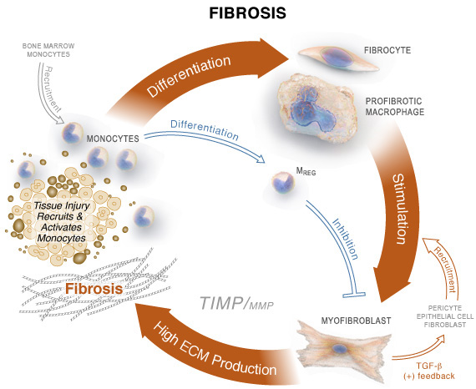

Slide 12
3- Hepatic Macrophages
The hepatic macrophages is a critical source of TGF-β and PFGF in liver fibrosis.
MQ & KCs secrete the potent profibrogenic cytokines IL-4 and IL-13.
MQ secrete IGF-1 stimulate the proliferation and surivial of myfibroblasts and prometes the collagen synthesis by these cells.
4- Portal Fibroblasts
The portal fibroblast were located within the Connective tissue of portal areas.
During liver injury, PFs express the highly specific fibroblast marker TE7.

Slide 13
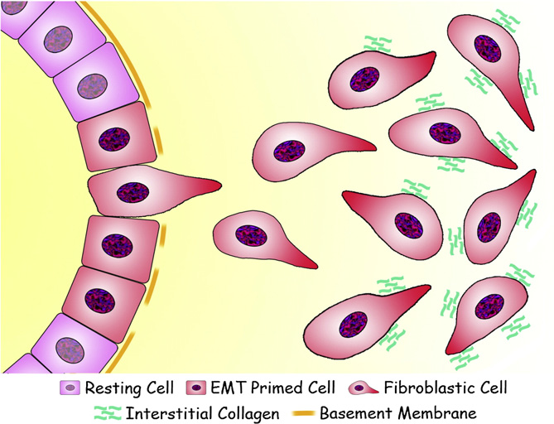
5- Epithelial–Mesenchymal Transition (EMT)
Down regulation of E-Cadehrins.
Up-regulation of MMPs.
Up-regulation and/or nuclear translocation of transcription factors underlying specific gene program.
Loss of cytokeratin and other epithelial markers.
Expression of alpha-SMA & FSP-1.
The chemokine Rho-GTPases mediated cytoskeletal reorganization to favor cell shape changes and activate motility.
The production of colagen type I,III & fibronectin.

Slide 14
EMT (Cont.)
The main molecular pathways involved in the induction of EMT, including Wnt/β-catenin and TGF-β/Smad pathways.
The transcription factor Snail controls epithelial–mesenchymal transitions by repressing E-cadherin expression.

Slide 15
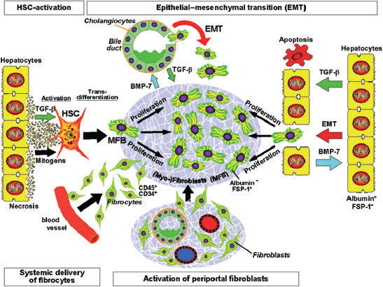
The Different Mechanisms of Fibrogenesis

Slide 16
OPTIONS FOR DIAGNOSIS AND THERAPY
A- Diagnosis:
TGF-β
BMP-7
TGF-β/BMP-7 Ratio
CTGF
G-CSF
FSP-1
Fibrocytes (CD45+, CD34+, CXCR4 & Collagen I).
miRNA (Overexpression of miR-27a and miR-27b).

Slide 17
OPTIONS FOR DIAGNOSIS AND THERAPY
B- Therapy:
TGF-β (Inhibition of TGF-β).
BMP-7 (BMP-7 peptide fragments antagonize TGF-β).
CTGF (Inhibition of CTGF).
Fibrocytes (Hormonal modulation).
G-CSF (accelerates healing of experimental liver damage and improves the survival rate).
Imatinib mesylate (PDGFR tyrosine kinase inhibtor).
Gene Therapy (Using siRNA & miRNA).

Slide 18
Conclusions
It is now evident that the heterogeneous pool of (myo-) fibroblasts originates from the EMT of cholangiocytes and most likely of hepatocytes, from the influx of bone marrow–derived fibrocytes into the damaged liver tissue and from differentiation of a subgroup of circulating monocytes to fibroblasts after homing in the damaged tissue.
Thus, the pathogenetic road map of fibrosis has not (yet?) changed, but newly discovered backstreets now establish a much more complex network of interacting pathways radiating to systemic responses.

Slide 19
Published Article
Serum Markers of Epithelial Mesenchymal Transition as Predictors of HCV-induced Liver Fibrosis,
Cirrhosis and Hepatocellular Carcinoma
Mona M Zoheiry1, Shaimaa AA Hasan1, Eman El-Ahwany1, Faten M Nagy1, Hoda Abu Taleb2, Mona Nosseir3, Mona Magdy3, Safa Meshaal5, Mohamed Darwish EL-Talkawy4, Inas Raafat5
1 Department of Immunology, Theodor Bilharz Research Institute, Giza, Egypt
2 Environmental Department, Theodor Bilharz Research Institute, Giza, Egypt
3 Department of Pathology, Theodor Bilharz Research Institute, Giza, Egypt
4 Department of Gastroenterology, Theodor Bilharz Research Institute, Egypt
5 Department of Clinical Pathology, Theodor Bilharz Research Institute, Egypt
Published in Electronic Physician, December 2015, Volume: 7, Issue: 8, Pages: 1626-1637

Slide 20
Abstract
Hepatitis C virus (HCV) is a major cause of chronic liver disease in Egypt, leading to hepatic fibrosis, liver cirrhosis (LC), and hepatocellular carcinoma (HCC). Liver fibrosis is characterized by excessive deposition of extracellular matrix (ECM). Newly-recognized pathogenic mechanisms point to the epithelial mesenchymal transition (EMT) of hepatocytes to matrix synthesizing (myo-) fibroblasts. Transforming growth factor-beta (TGF-β1), bone morphogenic protein (BMP)-7, and connective tissue growth factor (CTGF) are biomarkers reflecting the EMT process. YKL-40 is a glycoprotein member of ECM and plays a role in cancer cell proliferation. The purpose of this study was to determine the serum biomarkers of EMT and its impact on the fibrogenic process and tumorigenesis in HCV-genotype 4 patients.

Slide 21
Methods
In this case-control study that was conducted in 2013-2014, 97 HCV-infected patients were subjected to clinical examination, laboratory investigations, and liver biopsy
According to the histopathologic examination, they were classified to F0 (14 cases), F1 (17 cases), F2 (15 cases), F3 (18 cases), F4 (22 cases), and HCC (11cases)
Fifteen age- and gender-matched subjects were included as normal controls. Serum levels of TGF-β1,BMP-7, CTGF, YKL-40 were assessed, and the TGF-β1/BMP-7 ratios were calculated
The data were analyzed by plotting the receiver operating characteristic curve (ROC), Pearson product-moment correlation coefficient, and Spearman's rank correlation coefficient (Spearman's rho)

Slide 22
Results
Serum levels of TGF-β1, BMP-7, CTGF, and YKL-40 were significantly increased in all patient groups compared to controls (p < 0.001). LC exhibited the highest CTGF level and YKL-40 was highest in HCC
The TGF-β1/ BMP-7 ratios reflected the progression of EMT from CHC to LC, however, there was no significant difference between LC and HCC.

Slide 23
Table І: Demographic and laboratory data of all studied cases
Variables | Controls (n=15) | CHC without cirrhosis (n=64) | CHC with cirrhosis (n=22) | HCV-induced HCC (n=11)
Age | 45.0±7.5 | 47.4±9.3 | 51.3±5.9 | 48.9±7.2
Gender (M:F) | 3:2 | 3:1 | 6:5 | 7:4
Liver function tests (mean ±SEM)
AST (U/L) | 32.6±4.2 | 63.2±29.8 | 51.8±4.4 | 78.1±16.9
ALT (U/L) | 31.1±5.1 | 49.1±18.3 | 46.5±5.0 | 68.2±12.6
Alkaline phosphatase (U/L) | 189±60 | 331± 78 | 348±68 | 420±73
Albumin (g/dL) | 4.4±0.5 | 3.60±0.85 | 3.8±0.72 | 3.08±0.48
PC | 97.6±3.4 | 89.6±5.8 | 41.5±11.1 | 68.4±3.9
Alpha-fetoprotein (IU/mL) | 3.39±2.9 | 9.38±13.4 | 10.35±15.7 | 25.02±27.6
Data are expressed as mean± standard deviations (SEM) . CHC; chronic hepatitis C, HCC; hepatocellular carcinoma, HCV; hepatitis C virus. Normal range for ALT and AST is up to 40 IU/L. Normal range for alkaline phosphatase is up to 250 U/L. Normal range for albumin is 3.5-5 g/dl. Normal range for PT concentration is 80-100%. Normal range for alpha-fetoprotein is 0.1-9.6 IU/mL.

Slide 24
Table ІІ: Serum levels of TGF-β1, BMP7, TGF-β1/BMP7, CTGF and YKL-40 ratio in all studied groups
Group | n | TGF-β1 (pg/mL) | BMP-7 (pg/mL) | TGF-β1/BMP7 ratio | CTGF (ng/mL) | YKL-40 (pg/mL)
Control CHC LC HCC | 15 64 22 11 | 10.98±0.68 21.81±1.78ª 39.87± ^{a,b} 20.81±1.41^{a,c} | 8.35±0.45 18.63±1.43ª 22.33±2.79^{a,b} 11.73±0.79^{a,c,d} | 1.35±0.09 1.39±0.14 1.96±0.11^{a,b} 1.89±0.23^{b} | 22.97±4.70 63.67±1.79ª 77.08±4.02^{a,b} 69.46±10.03ª | 0.58±0.19 1.69±0.14ª 2.52±0.13^{a,b} 3.16±0.20^{a,b,e}
Data were expressed as mean ±SEM, ªp<0.001 significant increase than control, ^{b}p<0.001 significant increase than CHC, ^{c}p<0.01 significant decrease than LC, ^{d}p<0.01 significant decrease than CHC, ^{e}p<0.05 significant increase relative to LC.

Slide 25
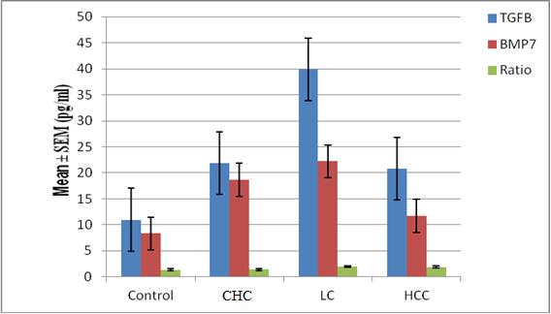
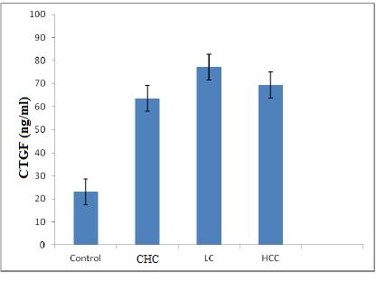
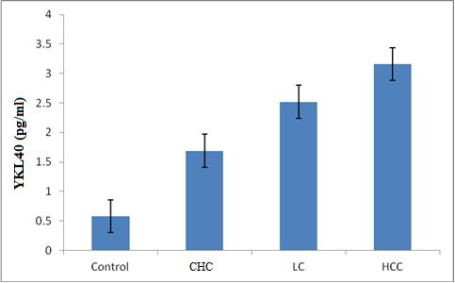
Figure 1: Serum concentration of TGF-β1, BMP7, their ratio, connective tissue growth factor and YKL40 in HCV infected patients and control serum samples.
CHC; chronic hepatitis C, LC; liver cirrhosis, HCC; hepatocellular carcinoma.
Data were expressed as mean ± SEM.

Slide 26
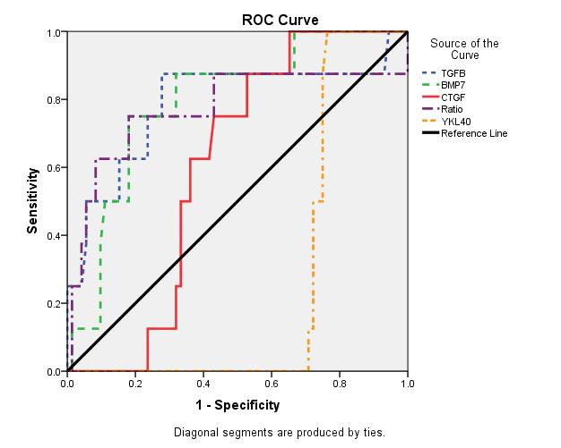
Figure 2: Receiver-operator characteristic (ROC) curves of serum biomarkers for prediction of significant fibrosis and cirrhosis . Data were analyzed considering patients with liver biopsy in the chronic hepatitis group. Among them TGF-β1 and BMP-7 were the most sensitive and specific.

Slide 27
To evaluate the usefulness of the studied serum biomarkers for predicting liver fibrosis and cirrhosis at stage F3 and F4 according to METAVIR scoring system, the area under the ROC curve was analyzed. The area under the curve (AUC) of TGF-β1 for identifying significant fibrosis (F3 and F4) was 0.716 (p ˂ 0.045), with a sensitivity 83.33% and specificity 75.0% at a cut off of 5.2. The AUC of BMP-7 was 0.733 (p ˂ 0.032). The sensitivity was 84.6%, and the specificity was 66.67% at a cut off 3.4.

Slide 28
Conclusions
Increased TGF-β1/BMP-7 ratio and CTGF levels reflect the rate of EMT and provide information about fibrogenic activity. Also, this ratio, in association with YKL-40, can be used to predict malignant transformation in HCV-genotype 4 Egyptian patients

Slide 29
Myofibroblast activation is accompanied by an changed miRNA expression pattern. MicroRNAs (miRNAs) are small, noncoding RNA molecules of 19–24 nucleotides in length. MiRNA are responsible in transcriptional and post-transcriptional regulation of gene expression.
Chronic liver disease
change miRNA patterns
progression of fibrosis by:
their potential to target the expression of ECM proteins
the synthesis of mediators of pro-fibrogenic pathways

Slide 30
What is microRNA?
Small RNA involved in expression regulation

Slide 31
In the liver, previous studies have shown that miRNAs play a fundamental role in HSCs proliferation, differentiation, apoptosis and migration and the aberrant miRNA expression is related to the development of liver fibrosis. Also, it was shown that certain miRNAs integrate pro-fibrogenic and pro-inflammatory signals in HSCs and control expression of various extracellular matrix genes during hepatic fibrogenesis.
MiRNAs are class of ~22 nucleotides noncoding RNAs that participate in the posttranscriptional regulation of many protein-coding mRNA molecules by specifically binding with 3-untranslated region (3-UTR) of target gene. MiRNA inhibits the target expression either by mRNA degradation or translational repression. The emerging role of miRNAs in innate and adaptive immunity strongly suggests an association with regulation of inflammatory diseases.

Slide 32
Circulating miRNA exist in at least two different protected conditions
Assotiated with RNA-binding proteins and lipoprotein complexes
Packaged into microparticles (exosomes,microvesicles, and apoptotic bodies)
This protection of miRNA provide stability and resistance to plasma RNase digestion.

Slide 33
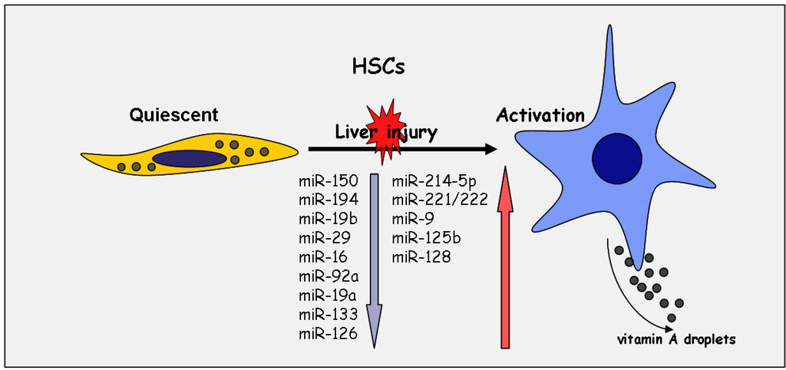

Slide 34
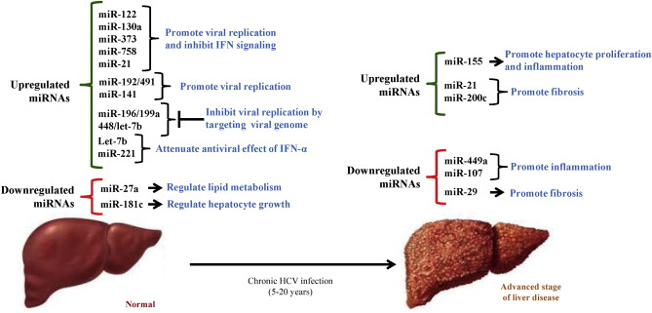

Slide 35
In recent years, enormous progress has been made in identifying microRNAs (miRNAs) as important regulators of gene expression and their association with or control of various liver diseases such as hepatitis, fibrosis and hepatocellular carcinoma (HCC)
This means miRNAs can be used for diagnosis, prognosis and treatment of these diseases

Slide 36
For example:
miR-122 is considered as the most abundant miRNA in normal liver, highly enriched in the liver parenchyma, accounting for more than 70% of the total miRNA population in hepatocytes.
These reduced miR-122 levels after fibrosis are suggested to be based on hepatocyte injury followed by miR-122 release into the blood stream.
miR-122 was shown to be involved in HCV replication by the interaction with HCV RNA genome, resulting in the high stability of the HCV RNA.
These data impose miR-122 as a first target of a novel therapeutic strategy to treat chronic HCV infection.
The members of the miR-29 family also function as anti-fibrotic miRNAs, first described in cardiac fibrosis by their inhibitory role on collagen I and III, elastin and fibrillin-1 expression.

Slide 37
Published Article
Circulating miRNAs as Predictor Markers for Activation of Hepatic Stellate Cells and Progression of HCV-Induced Liver Fibrosis
Eman El-Ahwany1, Faten Nagy1, Mona Zoheiry1, Mohamed Shemis2, Mona Nosseir3, Hoda Abu Taleb4, Maged
El Ghannam5, Rafaat Atta5, Suher Zada6
1 Immunology Department, Theodor Bilharz Research Institute, Giza, Egypt
2 Biochemistry Department, Theodor Bilharz Research Institute, Giza, Egypt
3 Pathology Department, Theodor Bilharz Research Institute, Giza, Egypt
4 Environmental Research Department, Theodor Bilharz Research Institute, Egypt
5 Gastroenterology Department, Theodor Bilharz Research Institute, Giza, Egypt
6 Biology Department, American University in Cairo, New Cairo, Egypt
Published in Electronic Physician, January 2016, Volume: 8, Issue: 1, Pages: 1804-1810

Slide 38
Abstract
Introduction: Liver fibrosis is the excessive accumulation of extracellular matrix that occurs by activation of hepatic stellate cells (HSCs), which has been identified as the major driver of liver fibrosis. Several studies confirmed that miRNAs have regulatory effects on the activation of HSCs by affecting the signaling pathways.
The aim of this study was to develop non-invasive diagnostic markers by measuring different circulating miRNAs in serum as predictor markers for early diagnosis of liver fibrosis and its progression.

Slide 39
Methodology
In this case-control study, we enrolled 66 subjects with chronic hepatitis C (CHC) with early stage of fibrosis and 65 subjects with CHC with late-stage fibrosis. Also, 40 subjects were included as normal controls.
The six main miRNAs, i.e., miR-138, miR-140, miR-143, miR-325, miR-328, and miR-349, were measured using the reverse transcription-polymerase chain reaction.

Slide 40
Results
In the cases of CHC both with early and late stage of fibrosis, the circulating levels of the six main miRNAs were significantly higher than the levels in the control group. ROC analysis indicated that the sensitivity and specificity of miR-138 were 89.3% and 71.43%, respectively, in the early stage of fibrosis. In the late stage, the sensitivity and specificity of miR-138 were 89.3 and 93.02%, respectively, whereas, for miR-143, they were 75% and 88.4%, respectively.

Slide 41
Table 1: Demographic and laboratory characterization of early and late fibrosis and control groups.
CHC with late fibrosis (n₌65) | CHC with early fibrosis (n₌66) | Control (n₌40) | Parameters
58.2 ± 9.6 | 49.3 ± 7.6 | 41.7 ± 13.6 | Age
40 / 25 | 39 / 27 | 23 / 17 | Male / female ratio
2.6 ± 0.2* | 3.7 ±0.6 | 4.1 ±0.9 | Albumin (g/dl)
3 ˃ | ˃ 1 – 3 | 1˂ | Bilirubin (mg/dl)
57.8 ± 15.3* | 69.1 ± 17.3* | 36.9 ± 5.2 | ALT (IU/L)
49.7 ± 11.1* | 52.8 ±13.9* | 29.7 ± 8.3 | AST (IU/L)
6˃ | 1.6 | 1 | Prothrombin time/ seconds
Data are expressed as mean ± SD.
* p< 0.01 significant versus Control Group. ALT: Alanine amino transferase, AST: Aspartate amino transferase.
Normal range for albumin is 3.5-5 g/dL, for ALT and AST is up to 40 UmL, for AFP is< or = 20 U/ml.

Slide 42
Table 2: Real time qPCR expression levels of miRNAs in serum of the different studied groups
Groups | Control | Early Fibrosis | Late Fibrosis
MicroRNAS
miR-138 | 50.3±1.15 | 101.90±0.8*** | 160.89±0.70***
miR-140 | 24.30±0.69 | 51.26±0.8** | 103.71±1.01***
miR-143 | 12.59±0.54 | 35.87±0.91* | 84.24±0.55***
miR-328 | 21.2±0.62 | 29.61±0.67* | 72.18±0.58**
miR-325 | 12.97±0.72 | 14.9±0.49* | 64.53±0.58**
miR-349 | 30.4±0.72 | 34.70±0.48* | 63.59±0.56**
.
Data shown are expressed as mean ± S.E.
***p<0.001, **p<0.01, *p<0.05 significant increase compared to normal control.

Slide 43
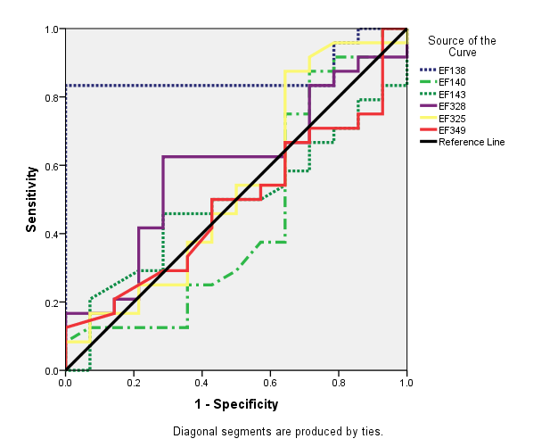
Figure 1: ROC curve analysis displaying the diagnostic power of the studied miRNAs in early stage of fibrosis.

Slide 44
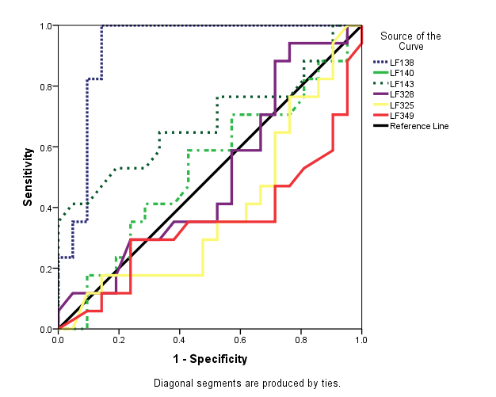
Figure 3: ROC curve analysis displaying diagnostic power of studied miRNAs in late stage of fibrosis.
Figure 2: ROC curve analysis displaying diagnostic power of studied miRNAs in late stage of fibrosis.

Slide 45
Conclusions
This study indicated that miRNAs might be considered potential diagnostic biomarkers for activation of HSCs and formation of fibrosis and offer insight into its progression.
We found that miR-138 was the more specific miRNA expressed in early and late fibrosis, followed by miR-143 in late fibrosis. However, the other miRNAs that were studied (miR-140, miR-235, miR-238, miR-349) showed increasing expression in late stage of fibrosis more than in the early stage.
Thus, it is recommended that further study be conducted at a larger scale.

Slide 46
Take Home Message
The circulating miRNAs could serve as novel non-invasive diagnostic and prognostic tools for the assessment of liver fibrosis.

Slide 47
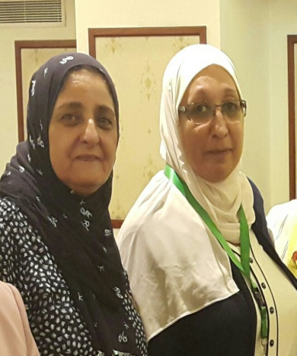
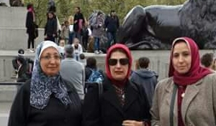
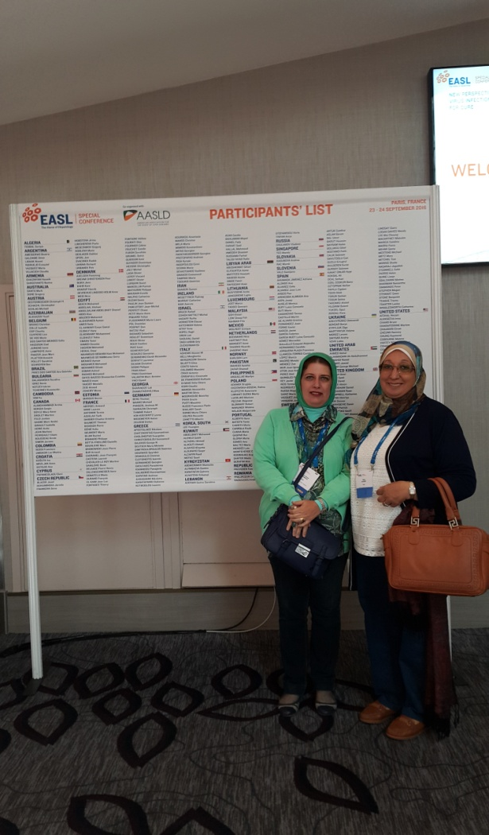
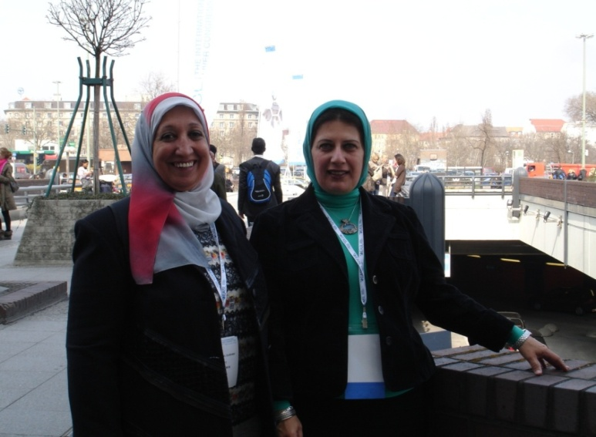
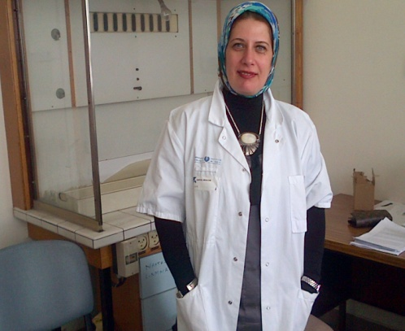
The Immunology Team (Immunology Department, Theodor Bilharz Research Institute)
Prof. Dr. Mona Zoheiry
Prof. Dr. Eman El-Ahwany
Prof. Dr. Faten Nagy
Dr. Hoda Abu Taleb
Dr. Marwa Hassan
Dr. Shaimaa Hassan

Slide 48
Recommendations
The new and emerging insights of the pathogenesis of liver fibrosis offer innovative diagnostic and therapeutic options.
It is likely that in a 5-year time frame more and more evidence will be provided for an effective translation of these insights in clinical practice.

Slide 49
Biography
All the diagrams are cited from Gressener et al., 2008, Hernandaz-Gea and Fiedman (2011) and Shrivastava et al., 2015.

