Slide 1
University of São Paulo at Ribeirão Preto College of Nursing. WHO Collaborating Centre for Nursing Research Development. Ribeirão Preto (SP), Brazil.
RENAIDST – Rede Nacional
NASAL COLONIZATION BY MICROORGANISMS IN NURSING PROFESSIONALS IN UNITS SPECIALIZING IN HIV/AIDS
Elucir Gir
Lílian Andreia Fleck Reinato
Fernanda Maria Vieira Pereira
Letícia Pimenta Lopes
Daiana Patrícia Marchetti Pio
Las Vegas, USA
2014

Slide 2
Introduction
Antimicrobial resistance is considered a public health problem worldwide. Two main factors have contributed to the sharp increase in this resistance: the misuse of antibiotics and spread of resistant microorganisms (PENDLETON; GORMAN; GILMORE, 2013)

Slide 3
Introduction
The main control measures for multi-resistant microorganisms consist of early identification of colonized or infected patients, identification of the area of isolation of patients with illustrative signs, and adherence to the contact precaution measures recommended by the Department of Hospital Infection Control (BRAZIL, 2007).

Slide 4
Introduction
Health professionals, especially nursing staff during direct contact with patients, objects, and environmental surfaces, constitute a class susceptible to colonization by resistant pathogens (SILVA, et al.,2012).
The hands of these professionals are considered the main vehicle of transmission of bacteria between patients (CDC, 2003; DREES et al, 2008).
Nursing professionals are susceptible to nasal colonization by microorganisms.

Slide 5
Objective
This study aimed to investigate the presence of microorganisms in the nostrils of nursing professionals in a Brazilian teaching hospital.

Slide 6
Methodology
Cross-sectional study conducted at two inpatient units specializing in HIV/AIDS. Nasal secretion samples were collected from nursing staff from January to February 2012.
After this the nasal secretions were collected using a Stuart swab.

Slide 7
Methodology
Samples were collected by researches, processed at the institution's microbiology laboratory and analyzed using the software SPSS version 19.0.
The ethical aspects were followed.

Slide 8
Results
Of the 73 professionals providing nursing services, nasal secretion samples were collected from 61 (83.6%). Six types of microorganisms were isolated in 20 (32.8%) positive cultures. It is important to note that Staphylococcus aureus represented 23.0%, four of which were Methicillin-resistant (MRSA).

Slide 9
Table - Distribution of the presences microorganisms in the nasal secretion samples of nursing professionals (n=61). Ribeirão Preto, SP, Brazil, 2012

Slide 10
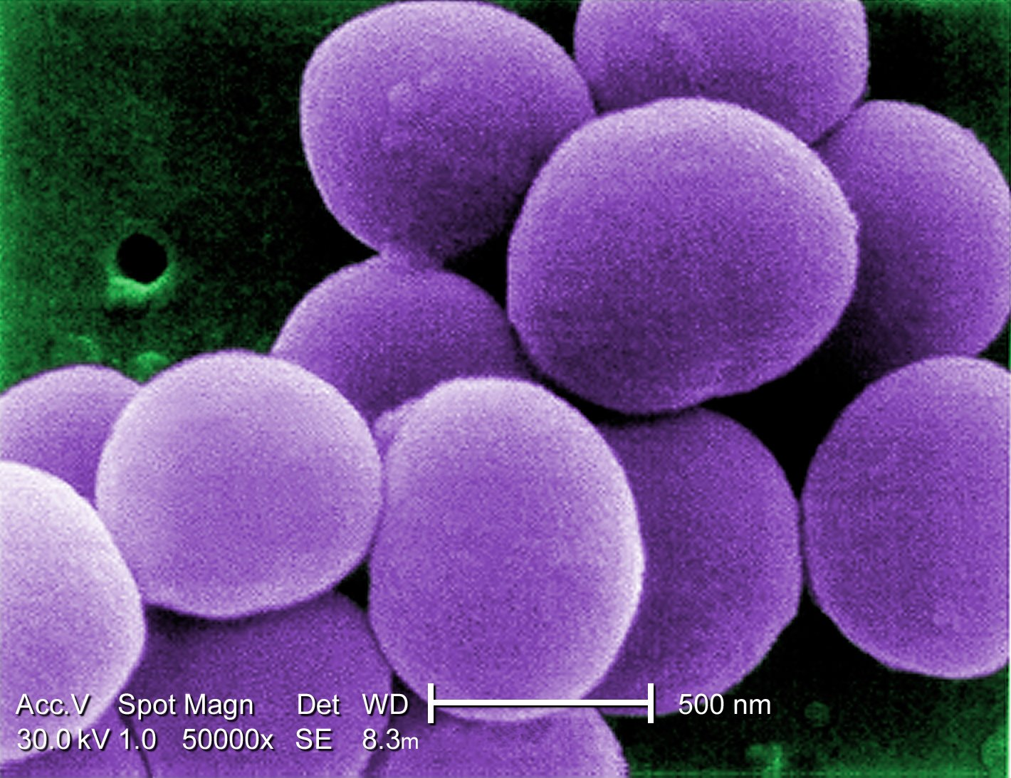
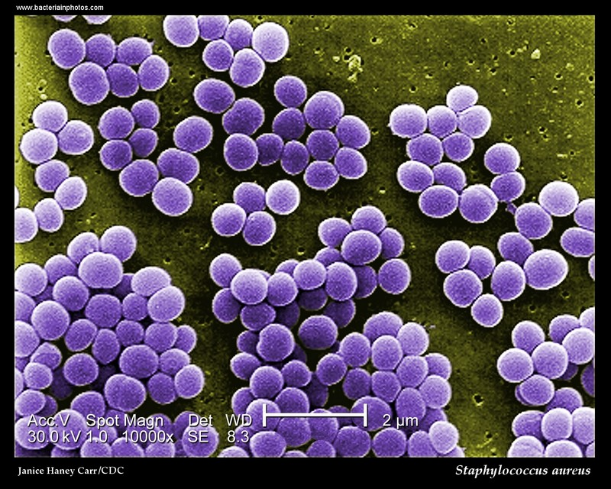
Conclusion
The category of nursing professionals with the largest representation in this study were female nursing assistants,75.4%.

Slide 11
Conclusion
Staphylococcus aureus was the microorganism most prevalent in the subjects of this study, representing 23.0% of those identified in the nasal site, being that 6.6% were MRSA.

Slide 12
Discussion
Long periods of hospitalization and prolonged and/or inadequate use of antimicrobials, together with the presence of invasive procedures, are factors that contribute to human colonization by microorganisms in hospitals (HIDRON, et al., 2005).

Slide 13
Discussion
Research conducted in a unit specializing in HIV/AIDS found that immunosuppression and prolonged use of antimicrobials associated with long hospitalization periods may facilitate colonization by multi-resistant bacteria in individuals with HIV/AIDS (REINATO, et al., 2013). Consequently, nursing professionals who provide direct assistance to these patients have a higher risk of contamination and colonization by resistant pathogens.

Slide 14
Conflicts of interest
The authors declare the absence of conflicts of interest concerning this article.
Acknowledgement
CNPq – Conselho Nacional de Desenvolvimento Científico e Tecnológico.

Slide 15
Contact Author
Elucir Gir. University of São Paulo. Nursing School of Ribeirão Preto. Department of General and Specialized Nursing. Av. Bandeirantes, 3900. Neighborhood: Monte Alegre. CEP: 14040-902, Ribeirão Preto, SP, Brazil

Slide 16
References
Silva ECBF, Samico TM, Cardoso RR, Rabelo MA, Bezerra Neto AM, Melo FL et al. Colonization by Staphylococcus aureus among the nursing staff of a teaching hospital in pernambuco. Rev. Esc. Enferm. USP. 2012 feb;46(1):132-7.
Centers for Disease Control and Prevention. Guidelines for environmental infection control in health-care facilities. Recommendations of CDC and the healthcare infection control practices advisory committee (HICPAC). MMWR. 2003 jun;52(10):1-42. Available from: http://www.cdc.gov/hicpac/pdf/guidelines/eic_in_hcf_03.pdf.
Drees M, Snydman DR, Schmid CH, Barefoot L, Hansjosten K, Vue PM et al. Prior environmental contamination increases the risk of acquisition of vancomycin-resistant Enterococci. Clin. Infect. Dis. 2008 mar;46(5):678-85.
Hidron AI, Kourbatova EV, Halvosa JS, Terrell BJ, Mcdougal LK, Tenover FC et al. Risk factors for colonization with methicillin-resistant Staphylococcus aureus (MRSA) in patients admitted to an urban hospital: emergence of community-associated MRSA nasal carriage. Clinical Infectious Diseases. 2005 jun;41(2):159-66.
Reinato LAF, Pio DPM, Lopes LP, Pereira FMV, Lopes AER, Gir E. Nasal colonization with Staphylococcus aureus in individuals with HIV/AIDS attended in a Brazilian Teaching Hospital. Rev. Latino-Am. Enfermagem. 2013 nov-dec;21(6):1235-9.
Brasil. Agência Nacional de Vigilância Sanitária. Investigação e controle de bactérias multirresistentes. Brasília, 2007. 21p.

