Slide 1
Human mercury exposure associated with artisanal gold miners in Sudan
International Conference on Pollution Control & Sustainable Environment
By
Eltayeb Tayrab, Manahil Azhary Abd Elrahim, Mohammed Elbagir, Mohamed Yassen, Ali Kodi

Slide 2
Background
Mercury (Hg) is a ubiquitous and highly toxic environmental pollutant (Chunying et al, 2005).
It is found in three forms with different toxicities: elemental, inorganic and organic (Orloff et al., 1997)
Mercury concentration in the blood is one of mercury exposure biomarkers.

Slide 3
Uses
One of the most common uses of mercury is for the extraction of gold from gold-containing ores (Kampalath & Jay 2015).

Slide 4
The risk
In artisanal small scale gold mining sites, the heating of the gold-mercury mixture with little or no personal protection, results in the evaporation of mercury and exposures through inhalation (WHO 1991).
The vapor emitted from metallic mercury is a potent neurotoxic agent (Sofya & Thomas, 2009); this vapor is a colorless and odorless substance (Gonul et al, 2014); approximately 80% of it is absorbed via the lungs (WHO, 1976).

Slide 5
Mills for powdering stones(Sudan)

Slide 6
Mercury in an open dish(washing)-Sudan

Slide 7
Hands and legs effects (Sudan)

Slide 8
Mercury measurement
Serum mercury was measured by direct mercury analyzer (DMA-80).

Slide 9
Partner institutions (Sudan)
Ministry of Minerals
Federal Ministry of Health
Khartoum State (environmental section)
Ministry of Petroleum (petroleum laboratory)

Slide 10
Heating of mercury in a pan

Slide 11
Why traditional gold mining?
Traditional gold mining merged strongly in Sudan in last 5 year after Southern Sudan referendum, and after loosing more than 70% of petroleum income.

Slide 12
The Objectives
To measure the blood mercury and lung function in gold miners at the River Nile State, Sudan.
The function included forced expiratory volume in the first second (FEV1), and forced vital capacity (FVC).

Slide 13
Study design
Descriptive, analytic, prospective study.

Slide 14
Study area
River Nile State (Abohamad) and the National Ribat University Hospital (Khartoum).
Faculty of Environmental Sciences and Disaster Management.
Faculty of Medical Laboratory Sciences.
Faculty of Medicine.
Abu Hamad google satellite map; this place is situated in Northern, Sudan, its geographical coordinates are 19° 32' 0" North, 33° 19' 0" East.

Slide 15
Study duration
December 2012 – January 2014.

Slide 16
Study population
Sudanese male miners working in the traditional mining sites in River Nile State, in Abohamad and surrounding area.
Aged 18-55 years.
Working in the field of traditional gold mining for not less than 6 months.

Slide 17
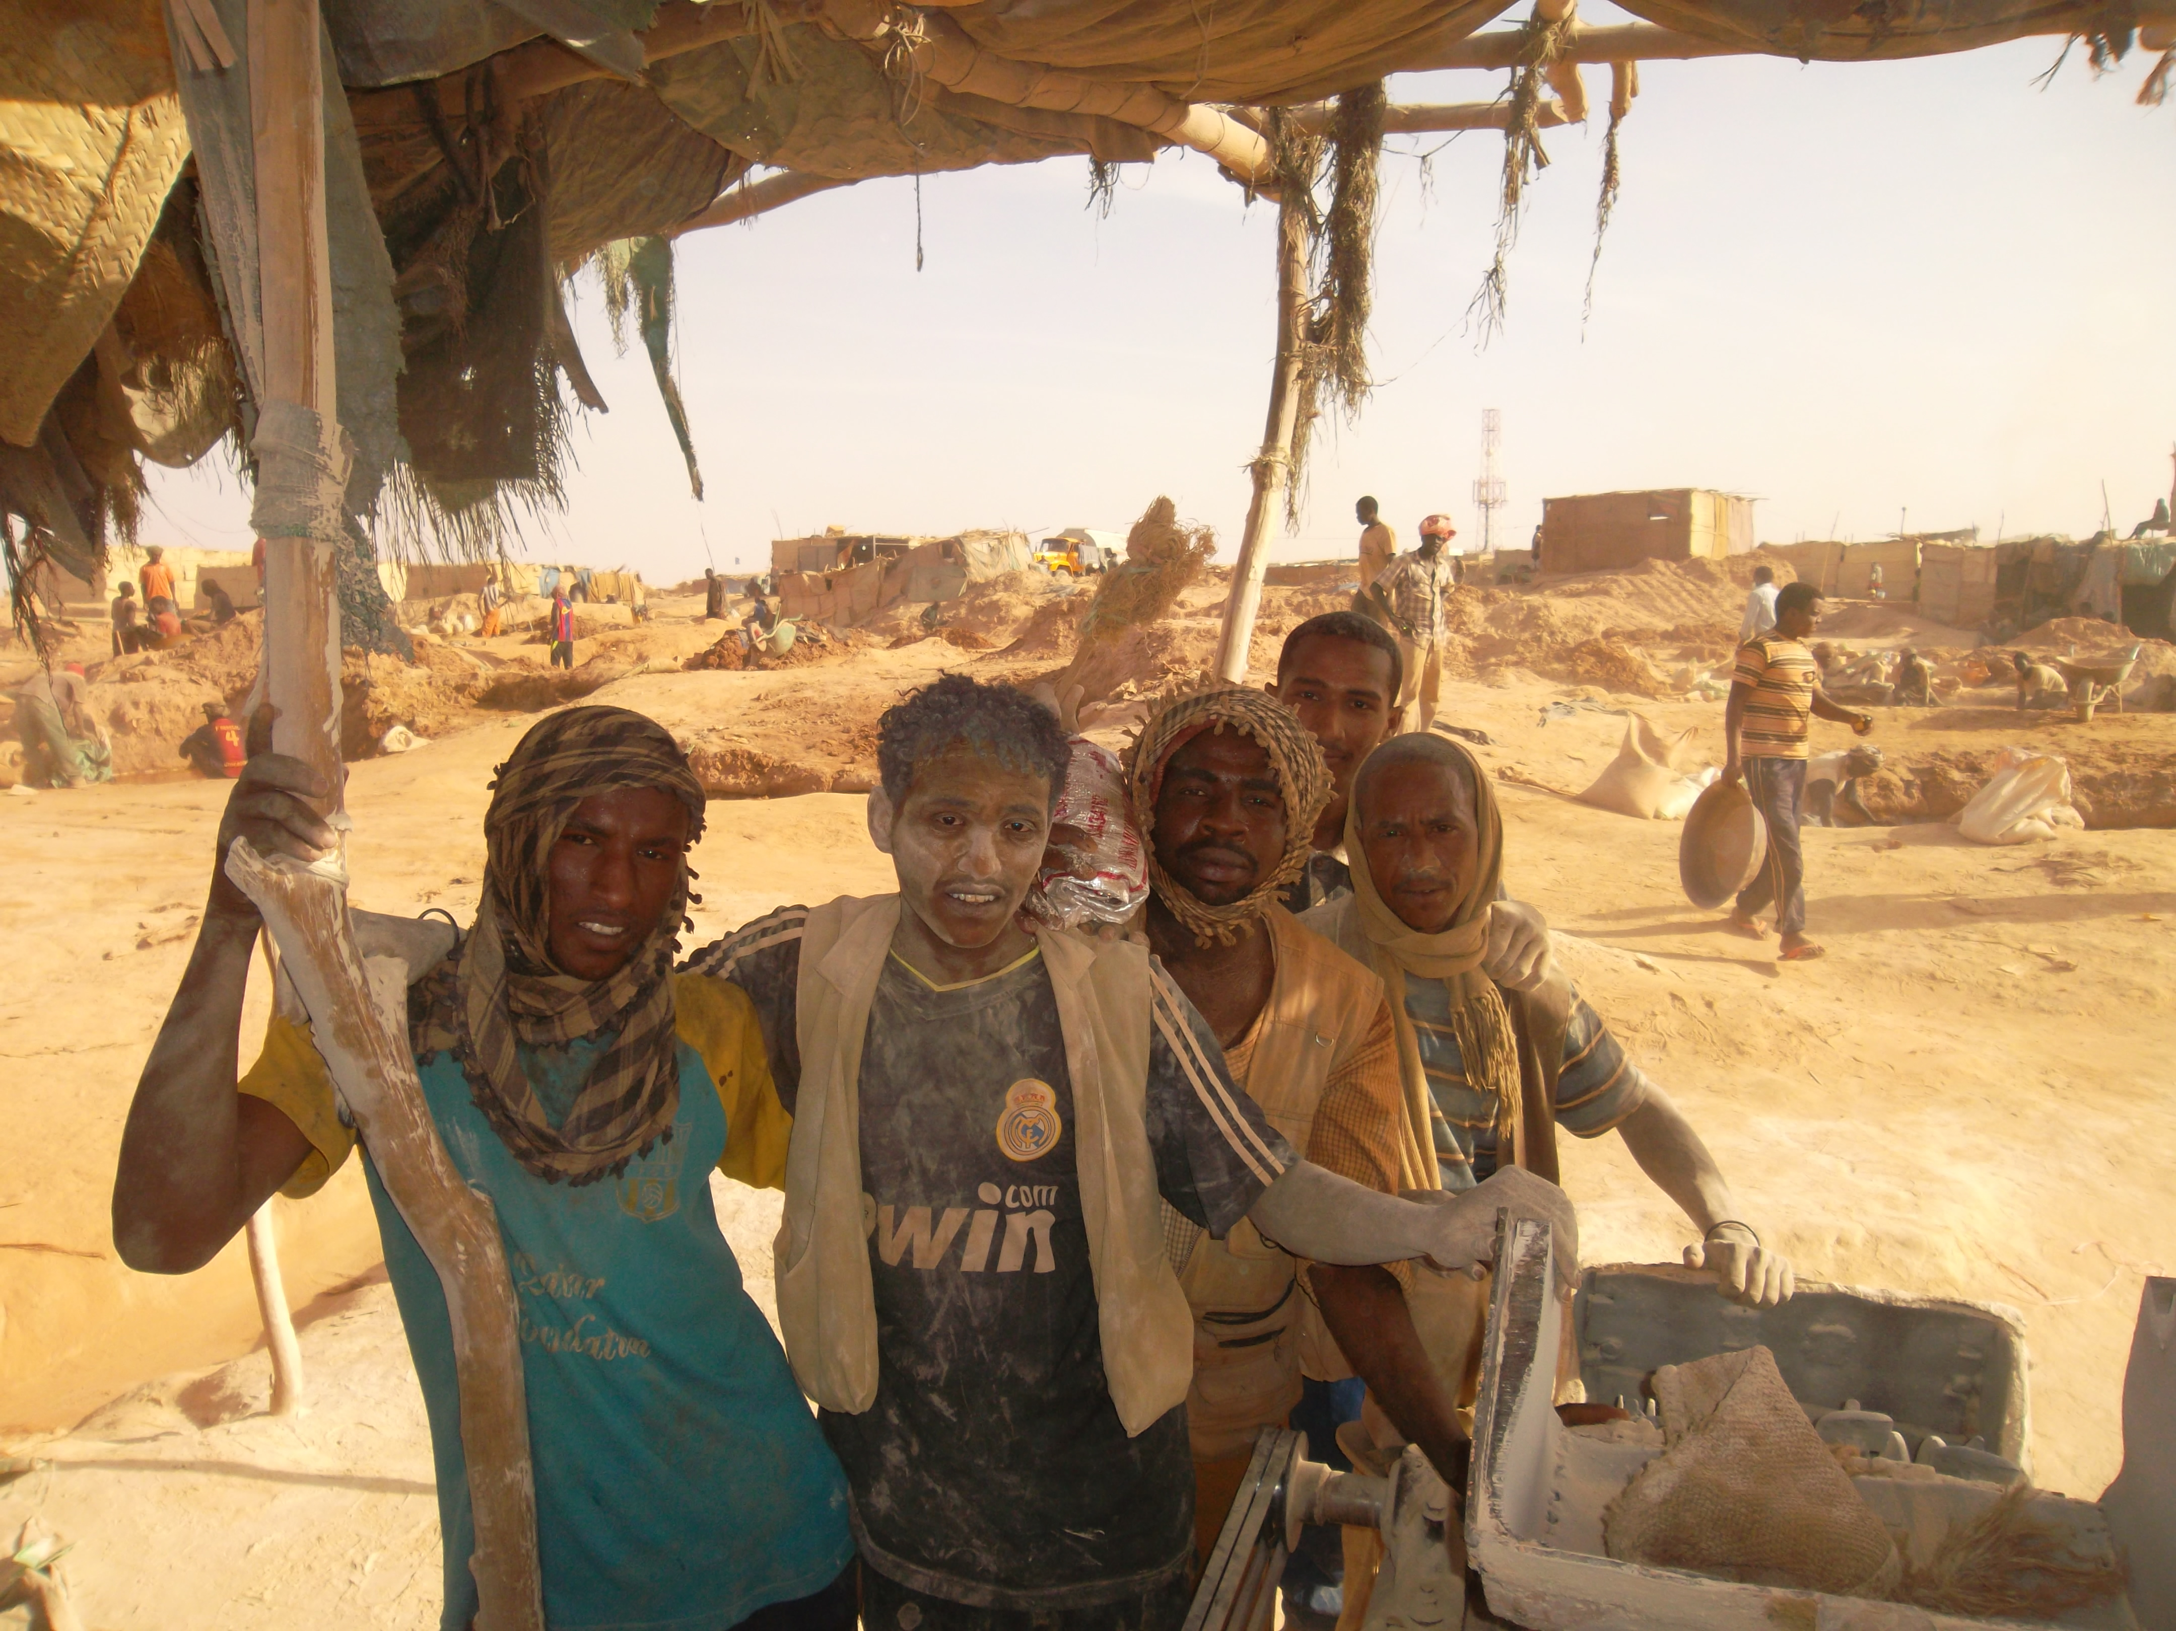

Slide 18
Sample size
83 traditional gold miners:
wells (39)
mills (26)
mercury washing (14)
mercury burning (5)
50 normal healthy controls, from Khartoum State not been in mining areas.

Slide 19
Data collection
10 ml venous blood in plain container (no anticoagulant), from both traditional gold miners and controls.

Slide 20
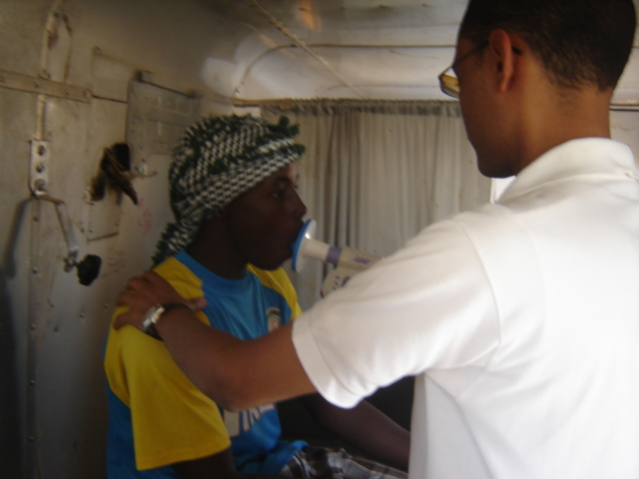
Manual spirometer

Slide 21
Ethical considerations
Ethical approval was obtained from ethical committee in National Ribat University; any patient gave approval consent.

Slide 22
Data analysis
SPSS version (20), and Microsoft Excel 2007

Slide 23
funding
The National Ribat University

Slide 24
Results
The study revealed that the serum mercury in the traditional gold miners was (24.9 ± 32.24mg/l) versus (1.40 ± 0.94mg/l) in the non-exposed control group; with P value (p= 0.000).

Slide 25
Results of lung function
Parameters | Traditional gold miners (n=83) (Mean ± Std) | Non exposed healthy controls (n= 50) (Mean ± Std) | P value
Age (years) | 30.46±10.01 | 28.1±5.39
Weight (kg) | 63.14±10.51 | 63.00±10.96
Height (cm) | 169±6.44 | 168.45±6.46
Mercury (Hg) (mg/l) | 24.9±32.24 Range (0.86–124mg/l) | 1.4±0.94 Range (0.29–3.6 mg/l) | 0.000

Slide 26
Results of lung function
Parameters | Traditional gold miners (n=83) (Mean ± Std) | Non exposed healthy controls (n= 50) (Mean ± Std)
Mean FEV1 (L) | 3.24±0.57 | 3.40±0.39
Mean FVC (L) | 3.7±0.69 | 3.86±0.60
FEVI/FVC ratio (%) | 86 | 89

Slide 27
Results: clinical symptoms
coughing 35(42.2%),
headache31(37.3%),
excessive sputum production 28(33.7%),
dizziness 27(32.5%),
chest pain 26(31.3%),
shortness of breath (SOB) 25(30.1%),
weight loss 22(26.5%),
wheezing 17(20.5%),
hemoptysis 6(7.2%),
burning micturition 31(37.3%)
constipation 17(20.5%) .

Slide 28
Discussion
Human absorption of liquid Hg0 is minimal, and acute toxicity does not occur easily, but the problem arises when liquid mercury is heated and bursts into the gaseous phase, which causes acute interstitial pneumonia when inhaled at a high concentration.

Slide 29
Discussion (continue…)
In the present study the traditional gold miners, work in a hot climate in a deserting area.
As seen in the field; Sudanese traditional gold miners do not take any safety measure when dealing with mercury, even gloves or masks.

Slide 30
Discussion (continue…)
They treat the mercury as if; non-toxic substance; especially in washing stage to extract gold from washed stoned powder, and when heating the gold-mercury mixture to evaporate mercury and remain gold in metallic pans.

Slide 31
Discussion (continue…)
The second source of exposure is that all the serious stages occur in the same area not exceeding few meters between stone milling, washing and modling.

Slide 32
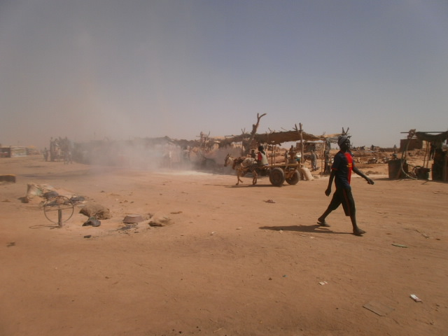

Slide 33
Discussion (continue…) …Risk..
This means that these miners and their families are exposed to dangerously high levels of mercury in the workplace. Similar finding was also reported earlier in Brazil by Castilhos et al (2015) , and in Iran by Babak et al (2013).

Slide 34
Discussion (continue…)
These gold miners complain from multi symptoms like persistent cough, headache, dizziness, chest pain, shortness of breath, wheezing and even hemoptysis.
These health effect may be associated with repeated exposure to mercury, which influence enzymes, cell membrane and neuron functioning as reported by (Hong et al; 2012).

Slide 35
Discussion (continue…)
most of the above clinical signs especially cough, headache, dizziness, muscle weakness were also reported in artisanal gold miners in Burkina Faso by Tomicic et al (2011), and Indonesia by Bose-O'Reilly et al (2010).

Slide 36
Conclusion
Serum mercury levels significantly increase in the traditional gold miners working in Abuhamed, River Nile State, Sudan; while forced expiratory volume in the first second (FEV1) and forced vital capacity (FVC) and forced expiratory volume decrease.

Slide 37
Conclusion
Occupational exposure to mercury is prevalent among traditional gold mining workers in Sudan.
Medical surveillance for all artisanal gold miners, including, quarterly and semiannual serum mercury assessment, and self-safety measures should be adopted.

Slide 38
Thanks

