Slide 1
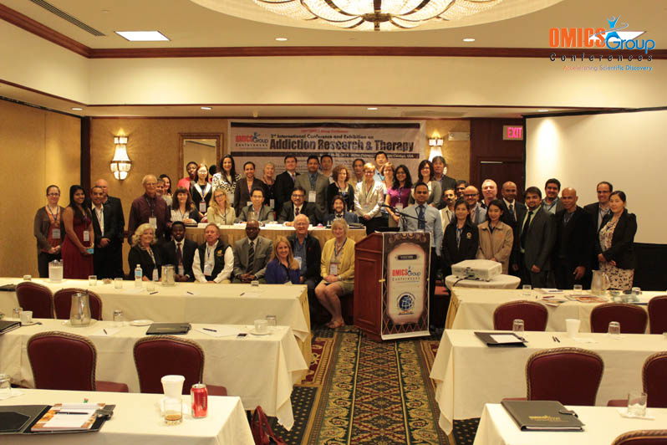
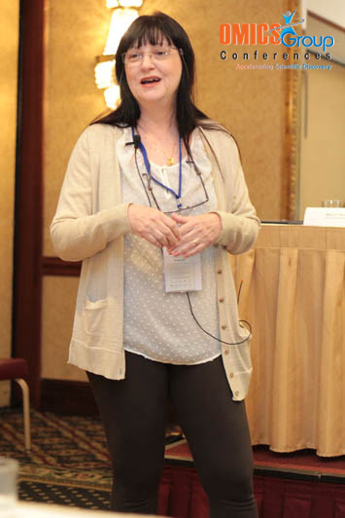
Addiction Therapy-2014 Chicago, USA August 4 - 6, 2014
Elizabeth Halpern

Slide 2
TRADITIONS & PUNISHMENTS
THE WHITE RUM OF THE SAILOR AND THE WHISKY OF THE COMMANDER
3rd International Conference and Ehxbition on Addiction Research & Therapy
August 4-6, 2014
Chicago, USA

Slide 3
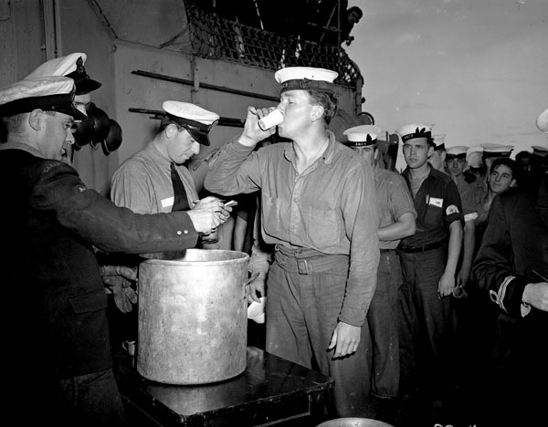

Slide 4
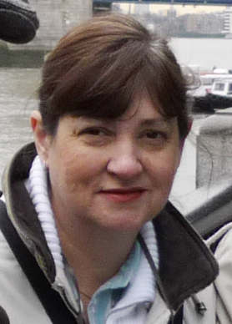
Dr. Elizabeth Halpern
PhD in Mental Health
FEDERAL UNIVERSITY of RIO DE JANEIRO (UFRJ)
PHYCHIATRY INSTITUTE (IPUB)
FRIGATE-COMMANDER of the BRAZILIAN NAVY
Chief of the DIVISION of MENTAL HEALTH
and of the CENTER for CHEMICAL DEPENDENCY for 5 years
Currently HEALTH DEPARTMENT CHIEF
of the NAVY CENTRAL HOSPITAL
Member of the research project Violences, Communication and Mental Health - Psychiatry Institute, Federal University of Rio de Janeiro, since 2010.

Slide 5
RESEARCH CONTEXT
Based on a research conducted for PhD in Mental Health;
First scientific study about the Navy tradition to drink alcohol in the workplace;
Center for Chemical Dependency (CEDEQ): founded in 1997, is a pioneer initiative of the Brazilian Navy, unparalled amongst the Brazilian Armed Forces;
It is a milestone that determined the official beginning of actions - from prevention to rehabilitation - directed to drug users.

Slide 6
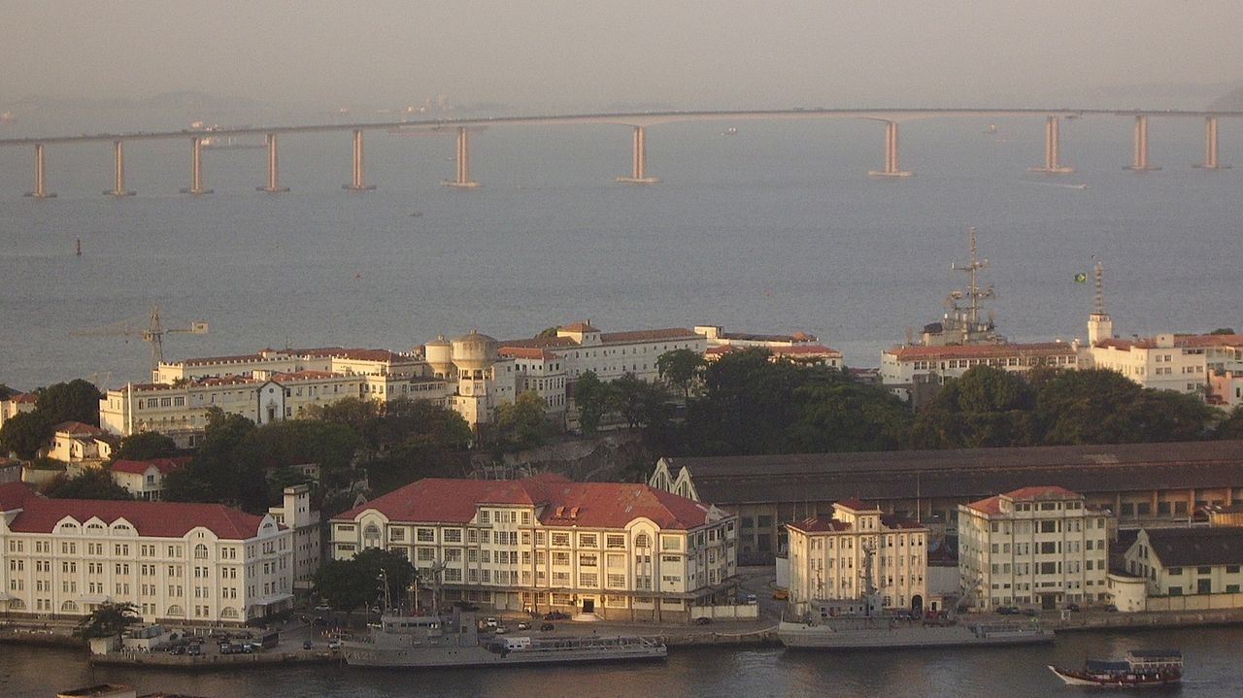
Navy Central Hospital

Slide 7
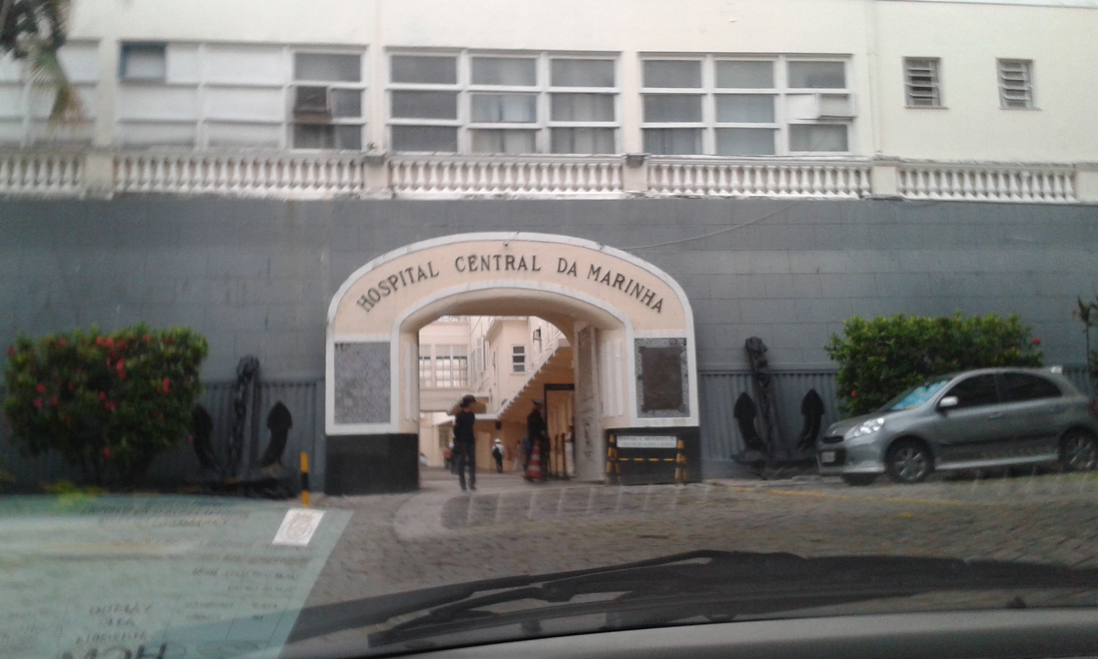
Navy Central Hospital

Slide 8
MAIN OBJECTIVE
Investigate the influence of the naval institution in the construction of alcohol dependency of CEDEQ’s pacients, particularly the aspects related to naval traditions in favor of beverage consumption in their daily labor, from a socio-cultural perspective.

Slide 9
ALCOHOLISM
Considered to be more than a medical condition, but a sociological phenomenon;
It is a multi-determined experience that can be examined from diverse angles;
The reasons for alcohol intake varies according to different cultures, societies, and historic circumstances.

Slide 10
FIELD OF STUDY: CEDEQ
Group treatment, two-hour therapeutic sessions, twice a week;
Treatment program consists of 5 steps: motivational group, phase I, II, III, and consolidation group;
Each stage involves compliance with specific goals;
Achievement of sobriety;
Behavioral techniques and on the 12 Steps and 12 Traditions of Alcoholics Anonymous.

Slide 11
TARGET POPULATION
CEDEQ is available to every military personnel from the age of 18: Enlisted Personnel (Praças) and Officers;
Officers: rarely seek for help, preffering private sessions;
Enlisted Personnel: the vast majority of the patients, and the numeric majority of the organization.
They rank lower in the military hierarchy and are at the base of the pyramid chain of command. In general, they are responsible for equipment operation and maintenence of the facilities of their military units.

Slide 12
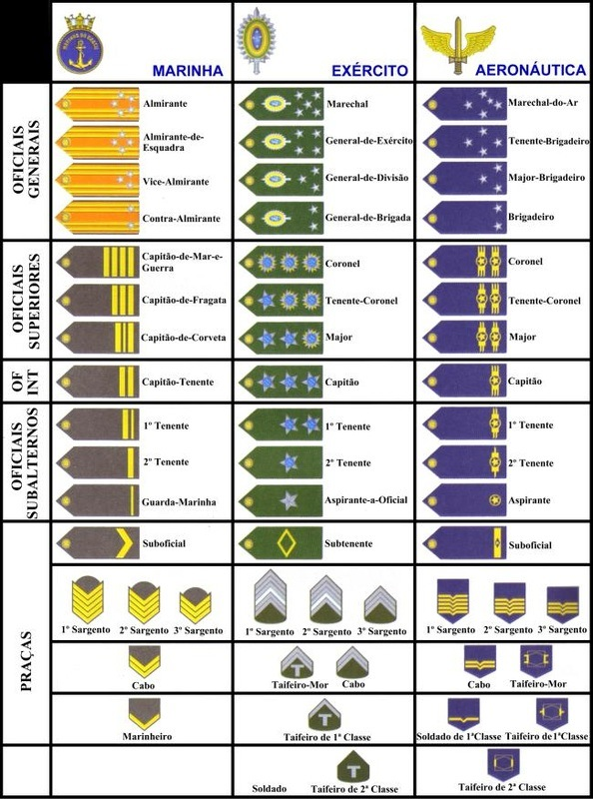
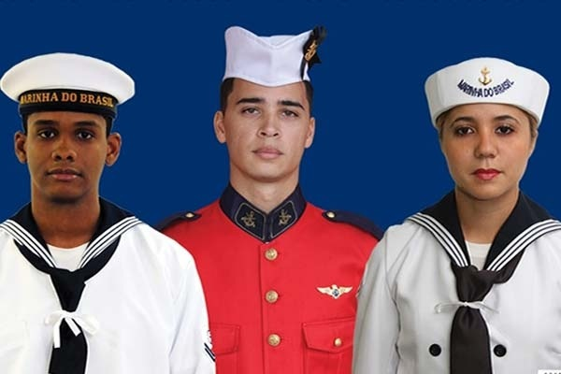
HIERARCHY

Slide 13
RESEARCH METHODS
ETHNOGRAPHY in the CEDEQ
2005-2009
PARTICIPANT OBSERVATION in TWO TREATMENT GROUPS
2010
OPEN-ENDED INTERVIEWS with 13 PATIENTS
Multiple Case Study: comparative and explanatory
HISTORY of WORK and LIFE of a PATIENT
SINGLE-CASE STUDY – SEVEN INTERVIEWS

Slide 14
THE SOCIO-ANTHROPOLOGICAL
METHOD
SAMPLING, DATA COLLECTION, ANALISYS and INTERPRETATION of DATA
Interactive movement (circular), non-sequential
(Tesch, 1990; Maxwell, 1996; Fossey et al, 2002)
The Realization of Feedback Loops
(Whitley; Crawford, 2005)
The steps flowed dinamically, rather than following a fixed script.
Analytical focus: the existence of an open and evolutionary character, as well as a constant dialectical movement of analysis and synthesis.

Slide 15
THE SOCIO-ANTHROPOLOGICAL
METHOD
SAMPLING, DATA COLLECTION, ANALISYS and INTERPRETATION of DATA
Constructivist perspective: active involvement of participants in the construction of meanings (Holstein, Gubrium, 1995; Whitley, Crawford, 2005; Groleau, Young, Kirmayer, 2006);
Interactionist perspective (Whyte, 1943/2005), individuals are the product of social interaction (Mead, 1982; Blumer, 1986);

Slide 16
RESULTS
Three constructs:
The alcoholic habitus;
The sailors’ duties;
The sailors’ sociabilities

Slide 17
THE ALCOHOLIC HABITUS
The alcoholic habitus is internalized since admission into the Brazilian Navy and it is strengthened throughout their careers;
Internalized patterns of behaviors, attitudes, and thoughts associated to ways of drinking, mainly collectively.
I go with my pals to “Broadway” [a place near the Navy District in Rio de Janeiro where they drink and have fun]. There, we “loosen up” and forget the issues on board.

Slide 18
SAILORS’ DUTIES
Work-related experiences peculiar to the Brazilian Navy working conditions that may contribute to alcohol addiction:
Those who work embarked know the cleaning system of the ship. This happens when we arrive at the port, you know? It is a heavy job, scrubbing and cleaning all day long! Then, the chiefs distribute “cachaça” to accomplish these tasks.

Slide 19
SAILORS’ SOCIABILITIES
Manners of consuming beverages, usually in group, associated with the execution of naval tasks:
On Fridays, lots of “caipirinhas” are served with the famous “feijoada” or “dobradinha” [a Brazilian dish made with tripe].

Slide 20
SAILORS’ SOCIABILITIES
Ritualized Opportunities to Drink on Board
It`s easy to drink on board, right? We have lots of events, parties in the barracks, celebrations. The guys drink a lot! It is tradition in the Navy: every day, with or without authorization, they drink anyway, because it is tradition in the Navy.

Slide 21
SAILORS’ SOCIABILITIES
Availability of drinks in the workplace
Each one takes his share of drinks in the maneuvers. In the intervals, everyone takes a sip. If you don’t, you can’t stand the heavy drills. The captain knows what’s going on, but pretends that he is not aware.

Slide 22
NAVY AMBIVALENCE
PROHIBITION vs. INCITEMENT
The Discipline Regulation of the Navy has got 84 disciplinary misdemeanors, liable to punishment, including inebriation on board;
In practice its use varies according to subjective interpretation, it depends on the circumstances and according to the judgment of each Command.
Sometimes they encourage drinking, especially to finish the tasks. Depending on the Command, they decide to arrest us. Nowadays, they refer the military to CEDEQ to avoid problems with the “law”.

Slide 23
NAVY AMBIVALENCE
PROHIBITION vs. INCITEMENT
Administrative and punitive procedures are applied without clear criteria, indicating differences in the manners of drinking among Enlisted Personnel and Officials.
The Navy is a lie, you have heard that, huh? [addressing the therapists]. The Commander drinks whiskey; Sailor drinks cachaça [white rum]. Early in the morning, the steward [responsible for serving food and drinks] arrives with whiskey of the Commander.

Slide 24
LABELLING
The Navy is divided into two groups: those who drink and those who are Believers. You cannot sit on the fence. The guy who doesn’t drink on board is dumb.

Slide 25
STIGMATIZATION
I used to drink a lot. From the moment I was caught, when I deserted, I was tagged as a drunker. I was forced to go to CEDEQ against my will. Everybody began to label me as an alcoholic.

Slide 26
LIMITATIONS OF STUDY
Since there are no systematic records concerning alcohol abuse in the administrative, operational, forensic and medical spheres, little is known;
The results cannot be generalized to other groups besides CEDEQ. They can serve as an explanatory model on a small scale (Elias & Scotson, 2000), which can be expanded to the military contingent of the Armed Forces.

Slide 27
RESEARCHER’S POSITION
As the chief of CEDEQ: a privileged position from which enabled to undertake the investigation, obtaining official access from within;
Her social position enabled the development an understanding of a sociological configuration after a long period of observation;
It is particularly hard to overcome the chain of command, denials, administrative requirements, and suspicions, chiefly when the subject is alcoholism.

Slide 28
RELEVANT ASPECTS
The realization of a single path, always unfinished, open to criticism, and to reinterpretations;
Leverage an interpretation of a culture, through a "native" researcher who went through a process of denativization;
The findings are never in their "pure" or "natural" state, they are affected by different viewpoints;
Finally, the cultural analysis of a survey is intrinsically incomplete and "essentially contestable", according to the social theorist, philosopher and British Major WB Gallie.

Slide 29
CONCLUSION
The referral of the military personnel to CEDEQ usually occurs when alcohol has already affected their lives, private and professional;
The professional approach seems to occur too late;
Considering that the Brazilian Navy has a crew of about 59,600 men, while a little over 50 people are treated in CEDEQ, a hidden demand must exist;
Finally, it is expected that this research encourages the assessment of the situation of alcohol drinking in the workplace to implement protective measures on behalf of the workers and the navy organization.

Slide 30
Articles Published
HALPERN, E. E.; FERREIRA, S. M. B.; SILVA FILHO, J. F. da. The effects of the labor situations in the construction of the alcoholism of the Brazilian’s Navy military patients. Cadernos de Psicologia Social do Trabalho, v. 11, n. 2, p. 273-286, dez. 2008.
HALPERN, E. E.; LEITE, L. C.; SILVA FILHO, J. F. da. Drinking on board: Learned tradition. Antropolítica: Revista Contemporânea de Antropologia e Ciência Política, v. 28, n. 1, p. 151-176, 1º sem. 2010a.
HALPERN, E. E.; LEITE, L. C. The dry law on board: Preventive challenges in Brazilian Navy. Arquivos Brasileiros de Psicologia, v. 62, n. 2, p. 103-114, 2010b.
__________. The construction of the alcoholic habitus and alcohol consumption in the workplace among military patients of Brazilian Navy. Cadernos de Saúde Coletiva, v. 19, n. 3, p. 356-365, jul. 2011a.
__________. Deciphering the meanings of navy ethylic behaviors of military patients. Boletim de Psicologia, v. 61, n. 135, p. 177-191, jul. 2011b.

Slide 31
Articles Published
__________. Representations on patient illness and cure at the chemical dependency center of the Central Navy Hospital. Ciência & Saúde Coletiva, v. 17, n. 4, p. 1079-1089, apr. 2012a.
__________. The “cooked crab” uniform and the “branquinha”: Life narratives of a military alcoholic patient. Cadernos de Psicologia Social do Trabalho, v. 15, n. 1, p. 65-80, 2012b.
_________. The connection between sailors’ duties and alcoholism. Revista Psicologia: Organizações e Trabalho, v. 13, n. 2, p. 111-126, maio-ago. 2013a.
_________. Oportunidades de beber a bordo: características do labor naval. Physis: Revista de Saúde Coletiva, v. 23, n. 4, p. 1277-1296, 2013b.
_________. Alcoholism in the working day: peculiarities of naval life. Revista Saúde e Sociedade, v. 23, n. 1, p. 131-145. 2014a.
_________. Examining the role of Brazilian Navy before alcohol intake in the workplace. Psychology, v. 5, n. 2, p. 104-108, 2014b.

Slide 32
Articles in Press
_________. Traditions and punishments: the white rum of the sailor and the whisky of the commander. Dilemas: Revista de Estudos de Conflito e Controle social, 2014c. In press.
________. Brazilian Navy: a trajectory of uniform(ization). Antíteses, 2014d. In press.
________. The "uniform" and the "glass": (un)necessary crossovers. Antropolítica: Revista Contemporânea de Antropologia e Ciência Política. 2014e. In press.

Slide 33
Meet the eminent gathering once again at Addiction Therapy-2015 Florida, USA August 3 - 5, 2015
Addiction Therapy – 2015 Website:
addictiontherapy.conferenceseries.com

