Slide 1
Advances in Internet of Things and Cyber Physical Systems and
its Adoption to Smart Ship
Professor Elizabeth Chang
The University of New South Wales
Australian Defence Force Academy
International conference on Wireless Communication and Network,
Sept 21-23, 2015 Baltimore, USA

Slide 2
Content
IoT and CPS – New Industrial Frontier
Top 5 Issues – IoT and CPS Adoption
IoT and CPS Solutions – Effort to date
Smart Adoption – The Success Evidence
Smart Ship – Top 10 Challenges
Smart Ship Solution – Embrace new Technology
Conclusion
Notes:
and Real time Analytics

Slide 3
1. IoT and CPS
- New Industrial Frontier
Notes:
and Real time Analytics

Slide 4
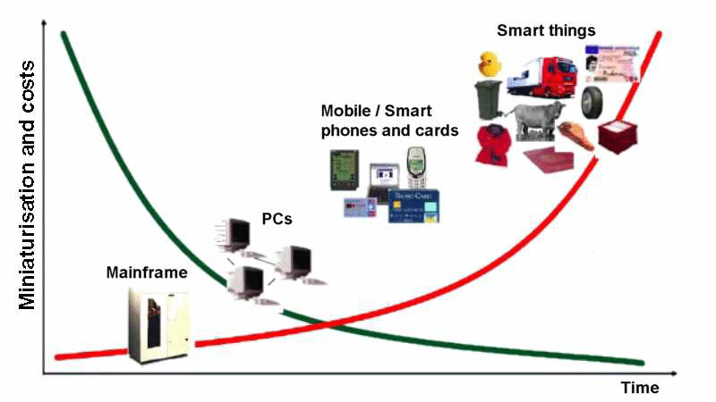
New Industrial Frontier
– IoT, WoT and CPS
Clouds
Internet of Things
Web of Things
Cyber Physical Systems
mobility, flexibility, safety
CPS
WoT IoT
Tech evolution
Toward wireless and mobile communica
Notes:
Adapted from from http://clasejosemanuel.blogspot.com/2011/05/cada-vez-mas-cerca-el-internet-de-las.html

Slide 5
IoT - Examples
The Internet of Things (IoT, also Cloud of Things or CoT) refers to the interconnection of uniquely identifiable embedded computing like devices within the existing Internet infrastructure. Example: Smart Grid
Networks of functional tightly coupled system
the Internet of Things is primarily focusing on using various technologies such as RFID, Zigbee, Bluetooth or 6LoWPAN.
Things, in the IoT, can refer to a wide variety of devices such as heart monitoring implants, biochip transponders on farm animals, automobiles with built-in sensors, or field operation devices.

Slide 6
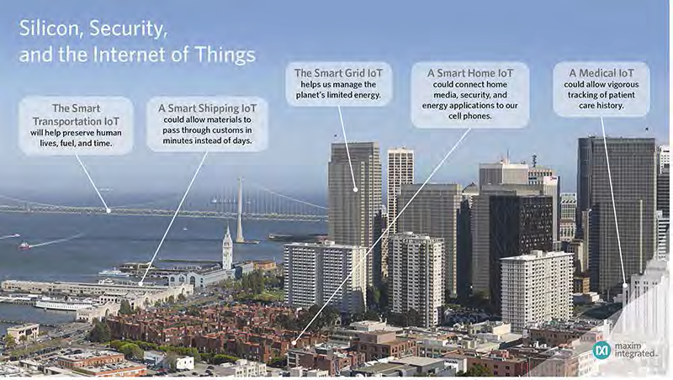
IoT - Tightly coupled system
Maxim Integrated 2014

Slide 7
WoT - Systems of systems
The Web of Things (or WoT) is a concept and plan to fully incorporate every-day physical objects into the World Wide Web.
The Web of Things is primarily an evolution of the Internet of Things.
On the other hand, just like what the Web is to the Internet, allow building an application layer for physical objects, or use 3rd party applications.
The use of embedded devices.

Slide 8
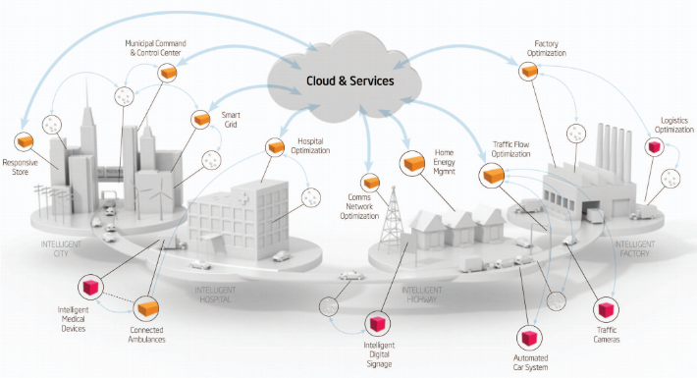
WoT - Examples

Slide 9
CPS - Globally connected systems of systems
A cyber-physical system (CPS) is a globally connected WoT.
Bring embedded systems to the Web. ie: aerospace, automotive, chemical processes, civil infrastructure, energy, healthcare, manufacturing, transportation, entertainment, and consumer appliances.
Adaptations: collision avoidance; precision (e.g., robotic surgery and nano-level manufacturing); operation in dangerous or inaccessible environments (e.g., search and rescue, firefighting, and deep-sea exploration); coordination (e.g., air traffic control, war fighting);
The US National Science Foundation (NSF) has identified cyber-physical systems as a key area of research. Starting in late 2006.
Notes:
Ongoing advances in science and engineering will improve the link between computational and physical elements, dramatically increasing the adaptability, autonomy, efficiency, functionality, reliability, safety, and usability of cyber-physical systems.

Slide 10
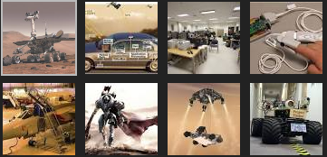
CPS - Examples
Ongoing advances in science and engineering will improve the link between computational and physical elements, dramatically increasing the adaptability, autonomy, efficiency, functionality, reliability, safety, and usability of cyber-physical systems.
Notes:
Ongoing advances in science and engineering will improve the link between computational and physical elements, dramatically increasing the adaptability, autonomy, efficiency, functionality, reliability, safety, and usability of cyber-physical systems.

Slide 11
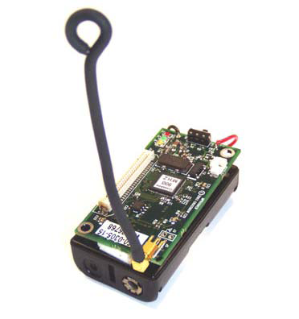

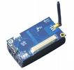
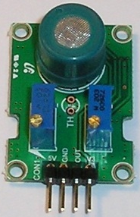
Underlying Technologies
– Wireless Communications
  Wireless Sensor Networks (WSN)
  Embedded devices, with tiny computers, sensors, actuators and network interfaces,
  Ability to deploy sensors with flexibility and mobility, on the Web
  Allows to retrieve data about objects and interact with them
  New global networks, enabling new applications and providing new opportunities for humanities and business

Slide 12
Smarter World
– Smart from here
Today, the world has 340 trillion trillion trillion unique IP addresses [Maxim Integrated 2014]
Each Person could have zillions of sensors with unique address [Maxim Integrated 2014]
60 billions RFID Tags embedded across entire ecosystems
many manufactured items, goods or assets today utilizing the Internet of Things are already Internet enabled, they have capability to talk to Internet, talk to each other, talk to service providers and talk to infrastructure and environment
Smart Things – are here to stay

Slide 13
2. IoT and CPS Adoption
- Top 5 Issues
Notes:
and Real time Analytics

Slide 14
IoT and CPS Adoption
Top 5 Issues
Security (Data, Asset, Resource, Humanity, Safety, Privacy)
QoS and Reliability (Service Guarantee, Trust)
Disaster and Outages (Risks, Losses, Consequences)
Cost and RoI (Capital expenses)
Big Data (Heterogeneous, Multi-sources, Large n Complex)

Slide 15
3. IoT and CPS Solutions
State of Art Progress
Notes:
and Real time Analytics

Slide 16
Embracing New Technology
Top 5 Issues
Security (Data, Asset, Resource, Humanity, Safety, Privacy)
QoS and Reliability (Service Guarantee, SLA, Trust)
Disaster and Outages (Risks, Losses, Consequences)
Cost and RoI (Capital expenses)
Big Data (Heterogeneous, Multi-sources, Large n Complex)
Top 5 R&D
Embedded System, both software and hardware ( ZigBee, Silicon, Blue tooth,.. )
Autonomous Computing, Industrial Agents, AI, ML, Onto-Auto ,…
Self-organization (frameworks, models, techniques, policies, processes,
Planning, Prediction and Forecast (Coalitions, Time of Usage Pricing..)
Predictive, Descriptive and Prescriptive Analytics, Conjoint DM, Data Lake, Dynamic Data Mart.

Slide 17
IoT Deployment – Security
Demand Build-in security, software and hardware
Silicon, ZigBee, ZigBee Pro, Blue Tooth
Silicon algorithms: AFS and elliptic curve cryptography, MAXQ1050, MAX32590 secure micro-controllers, bootloaders, life cycle protection of devices.
Security cameras, like ATM,
Supervised multitude of remote distributed sensors and control devices and health sensors
Detection on falsifying sensors data, underreporting consumption, resulting power shut down.
Algorithms: AES-128, secret keys, alarm standard, cryptography, stenography,
Risks, Trust, Cyber and ambient Security, Intrusion detection, Machine to Machine communication
Ambient Security
data mining, log mining, process mining
Notes:
Not about computer security, but Ambient security that include comput
In this chapter, we address the problem of data tampering to ensure that the data stored on the RFID tag is authentic. We specifically consider the issue of detecting data tampering on the RFID tags for applications such as data integrity management. To address this issue we present a novel fragile watermarking scheme which embeds a fragile watermark (or pattern) in the serial number partition of the RFID tag. This pattern is verified to identify if the data on the RFID tags is tampered or not. The novelty of this watermarking scheme lies in the fact that we have applied watermarking technology to RFID tags; in comparison most of the existing watermarking schemes are limited to images, audio or video applications. We term this scheme as TamDetect because it is a tamper detection solution. TamDetect is designed such that it can be easily plugged into existing RFID middleware applications. This proposal is one of the first works that integrates watermarking and RFID technologies and we have applied for a preliminary patent for this work.
This chapter provides detailed theoretical foundation for TamDetect solution. It also explains the algorithm design in detail by addressing all the requirements laid out in chapter 4. To validate the feasibility of the proposed scheme we simulated the TamDetect RFID system. This chapter also provides complete details on how the simulation was implemented to validate the proposed scheme. The chapter is then concluded by a discussion on simulation results.
We now outline the main requirements and design rationale for TamDetect, this represents the first two steps in the conceptual process discussed in chapter 4.
Theoretical Foundation for TamDetect
In this section we propose the theoretical foundation for TamDetect to address the issue of data tampering in RFID tags. This represents the third stage of the conceptual process described in section 4.5.3 where design decisions are analysed and an algorithm is presented. The proposed framework is shown in Figure 10.3, 10.4 and 10.5 and can be decomposed in four different stages:-
Watermark Generation
Selecting the Embedding Location
Watermark Embedding
Tamper Detection

Slide 18
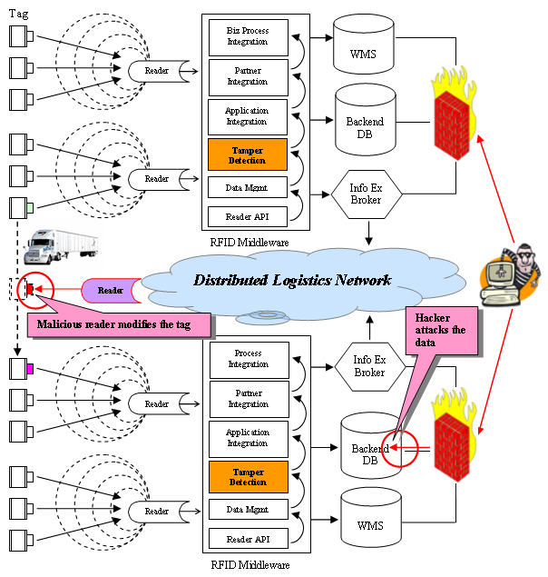
Our Work- Tamper Security
Security help identify and measure the network vulnerability, monitoring and control of malicious activities. It also detects the attacks, fraud, and intrusion etc. [Potdar, Chang etal 2005-2013]
Technology underpinning the above are:
Cyber Security
Network Security
Data and Database Security
RFID tamper detection
Barcode Watermarking
Information Security
Finger Print
Notes:
Not about computer security, but Ambient security that include comput
In this chapter, we address the problem of data tampering to ensure that the data stored on the RFID tag is authentic. We specifically consider the issue of detecting data tampering on the RFID tags for applications such as data integrity management. To address this issue we present a novel fragile watermarking scheme which embeds a fragile watermark (or pattern) in the serial number partition of the RFID tag. This pattern is verified to identify if the data on the RFID tags is tampered or not. The novelty of this watermarking scheme lies in the fact that we have applied watermarking technology to RFID tags; in comparison most of the existing watermarking schemes are limited to images, audio or video applications. We term this scheme as TamDetect because it is a tamper detection solution. TamDetect is designed such that it can be easily plugged into existing RFID middleware applications. This proposal is one of the first works that integrates watermarking and RFID technologies and we have applied for a preliminary patent for this work.
This chapter provides detailed theoretical foundation for TamDetect solution. It also explains the algorithm design in detail by addressing all the requirements laid out in chapter 4. To validate the feasibility of the proposed scheme we simulated the TamDetect RFID system. This chapter also provides complete details on how the simulation was implemented to validate the proposed scheme. The chapter is then concluded by a discussion on simulation results.
We now outline the main requirements and design rationale for TamDetect, this represents the first two steps in the conceptual process discussed in chapter 4.
Theoretical Foundation for TamDetect
In this section we propose the theoretical foundation for TamDetect to address the issue of data tampering in RFID tags. This represents the third stage of the conceptual process described in section 4.5.3 where design decisions are analysed and an algorithm is presented. The proposed framework is shown in Figure 10.3, 10.4 and 10.5 and can be decomposed in four different stages:-
Watermark Generation
Selecting the Embedding Location
Watermark Embedding
Tamper Detection

Slide 19
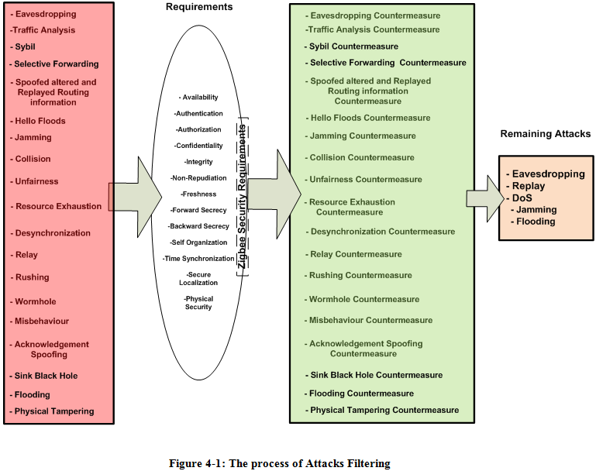
Our Work ZigBee Attack Experiment
Simulate operations to disrupt, deny, degrade or destroy communication data within nodes, hub and networks. [PhD theses and Publication available]
Security
Analytics
Attacks
Addressing
ZigBee Pro

Slide 20
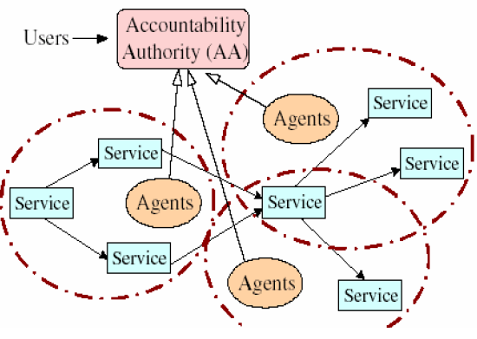
Research – Autonomy
Dynamic management Schemes
Situation awareness
Global self-organized network
Evolution theories
Regulation Mechanism
Random service detection
Service discovery and configuration

Slide 21


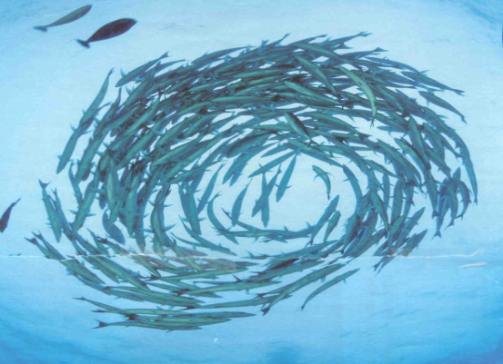
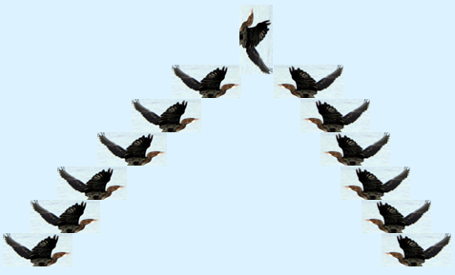
Research – Self-organization
Our work:
Architectures, Models, Temporary coalition
Multipath algorithms
NS2 simulations
Fault tolerance
Geo graphic protocols

Slide 22
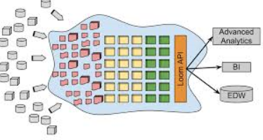
Research – Big Data, DataMart, Data Lakes
  Our Recent work:
  Dynamic DataMart scheme.
  Data Lake: Data dump, heterogeneous data repository, data integration from multiple sources, dump raw data in its native format until it is needed
Loom API | www.revelytix.com

Slide 23
4. Smart Adoption
Face the issues
Make our World Smarter
Notes:
and Real time Analytics

Slide 24
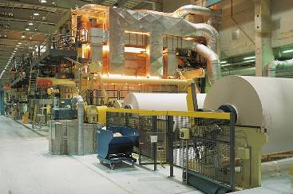
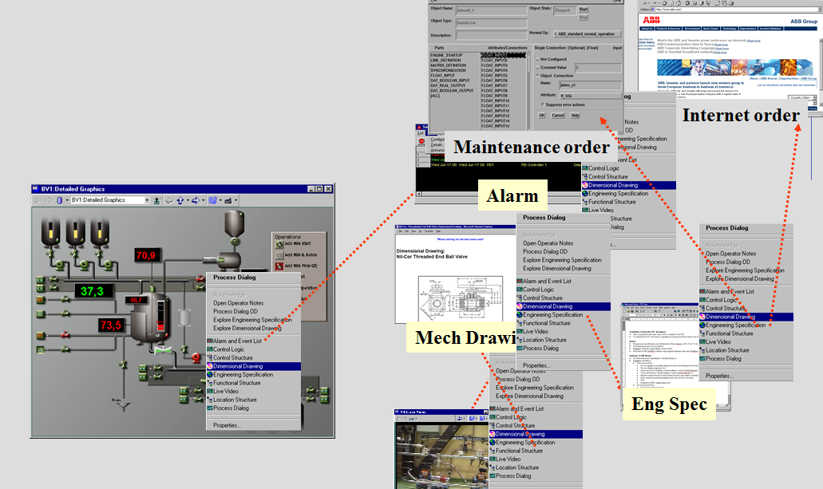
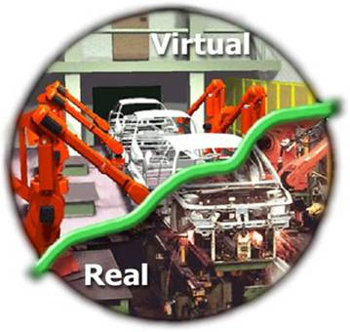
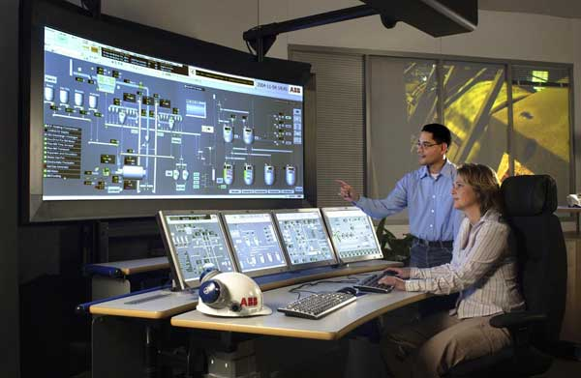
Manufacturing Adoption of IoT and CPS
The world effort since 1980s

Slide 25
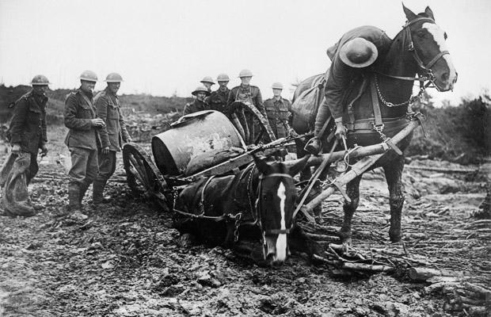

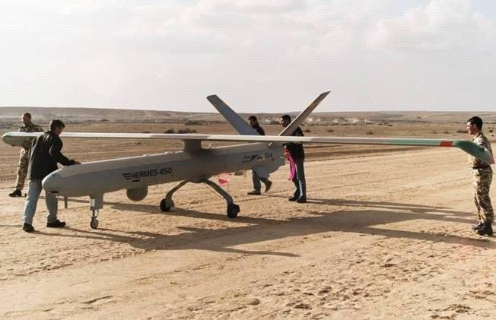
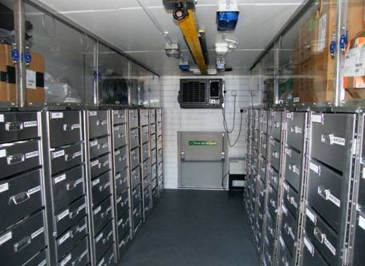
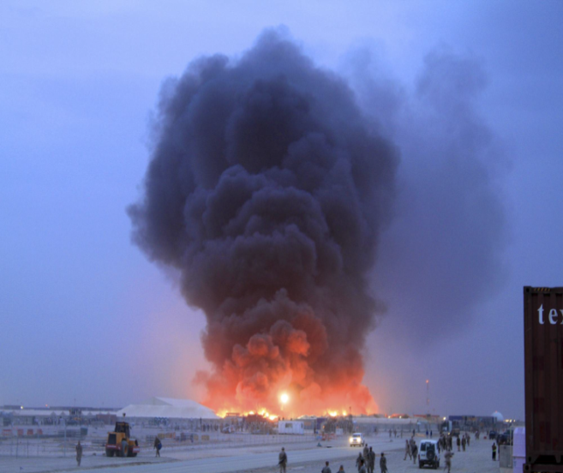
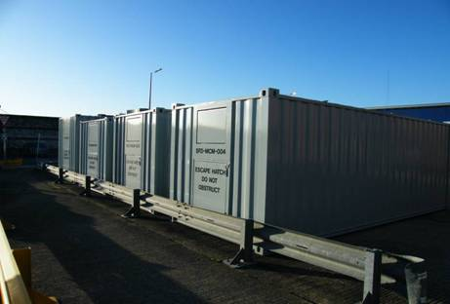
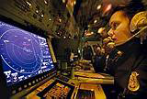
Defence Adoption of IoT and CPS since 1990s

Slide 26
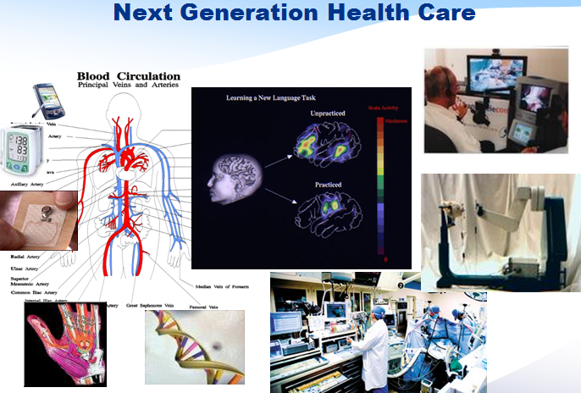
Medicare Adoption of IoT and CPS
The world effort Since 2000s
Robotic surgery and remote operation

Slide 27
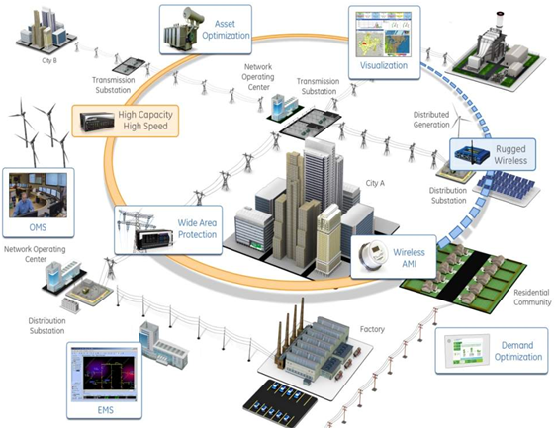
Smart City Adoption of IoT and CPS
The world since mid 2000s

Slide 28
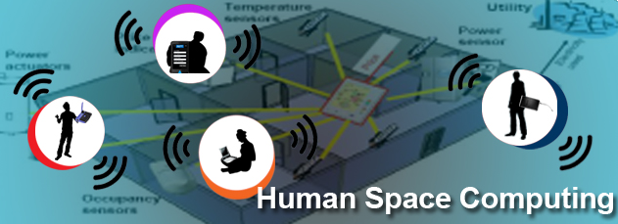
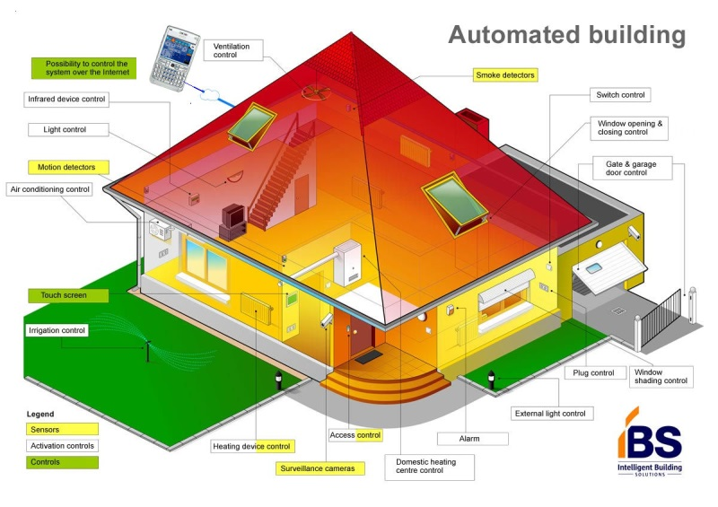

Smart Home Adoption of IoT and CPS
The world effort since early 2010s

Slide 29
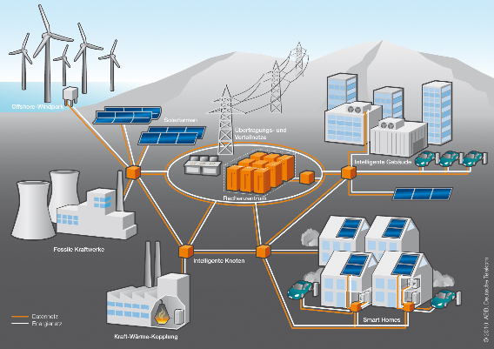
Smart Grid - Successful Adoption of IoT and CPS
The No.1 successful evidence and RoI

Slide 30
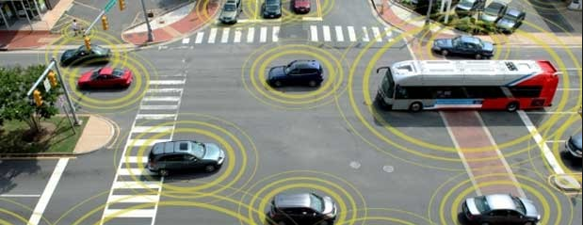
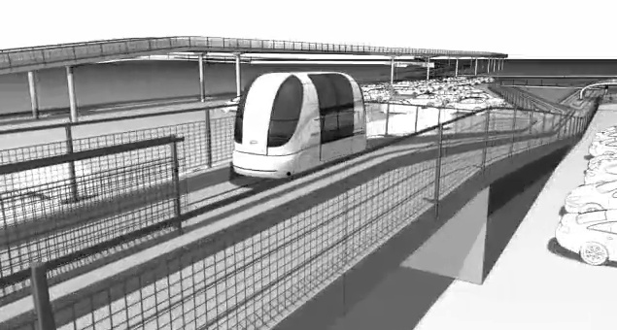
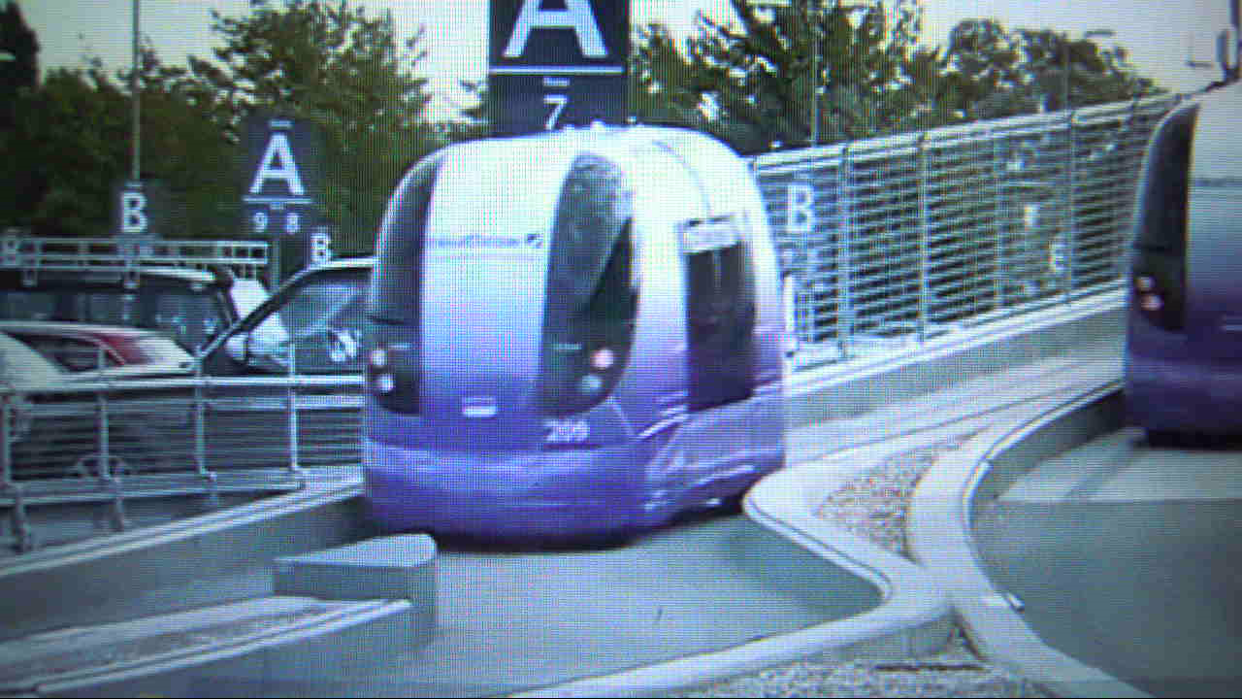
Smart Transportation
The No.2 successful evidence and RoI
http://connectedcarexpo.com/smart-transportation-innovation-coalition-stic/
London Airport2013

Slide 31
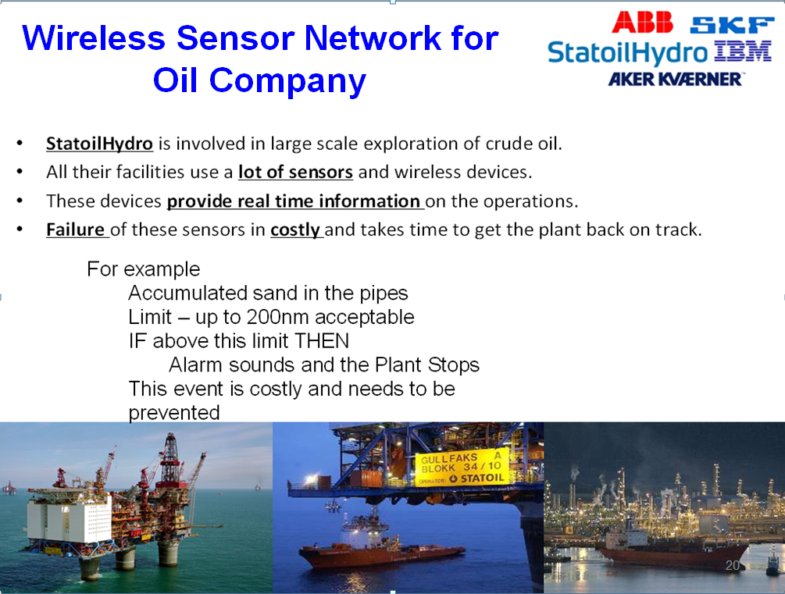
Our work 2008-2010 funded by StatoilHydro
Mining Industry Project with IoT and CPS

Slide 32

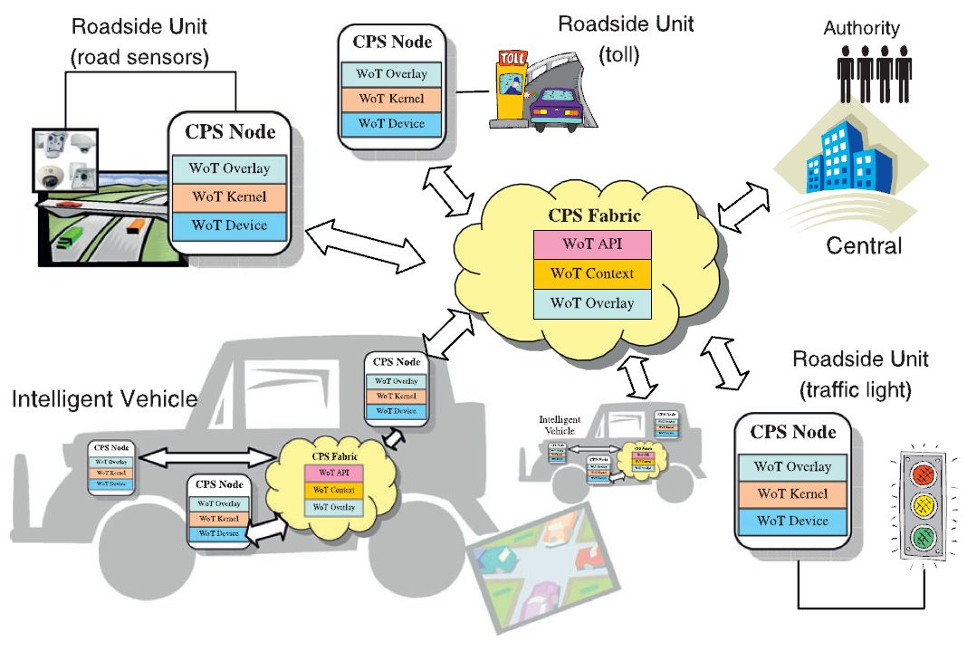
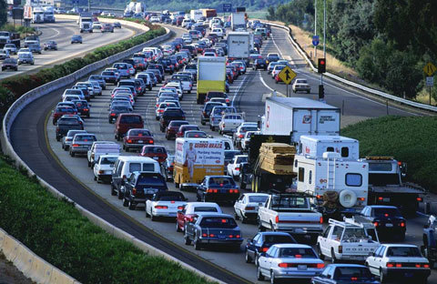
Our Work 2009-2012 Funded by ARC and Main Road WA
Traffic Control Project with IoT and CPS
Real Time Traffic Prediction using Wireless Sensor Networks & Real Time Data Mining
Aims:
Traffic flow Prediction in motorways and arterial roads
Traffic Congestion Forecasting and Management through Real-time data mining
Challenges:
Smart system to predict traffic on existing infrastructure
Traffic prediction models on arterial roads
Manage congestion in real-time
Outcome :
Traffic prediction and simulation System based on historical data and real time sampled data
Develop new prediction algorithms
Enable management congestion in real-time
Notes:
Traffic Engineering, Operations and management involve traffic engineering, so that vehicles move smoothly on the road or track. Older techniques include signs, signals, markings, and tolling.
Road and Traffic Management
The road traffic system consists of:
Road users (pedestrians, cyclists, riders, drivers)
Vehicles
Roadways
...working with this interaction is a fundamental part of what we do
Access to the road system is quite open
No licence requirements for pedestrians and cyclists
Large number of car, bus and truck drivers
When things go wrong, can result in serious injuries and fatalities
Even careful road users make mistakes
Vision zero and safe systems approach acknowledge this
How do we introduce something new?
Need confidence in success before deployment
Using the toolkit available to us
Engineering
Education
Enforcement
Encouragement
Evaluation and Continuous Improvement
Two examples of Managed Freeways elements for lane use management from Australia and UK

Slide 33
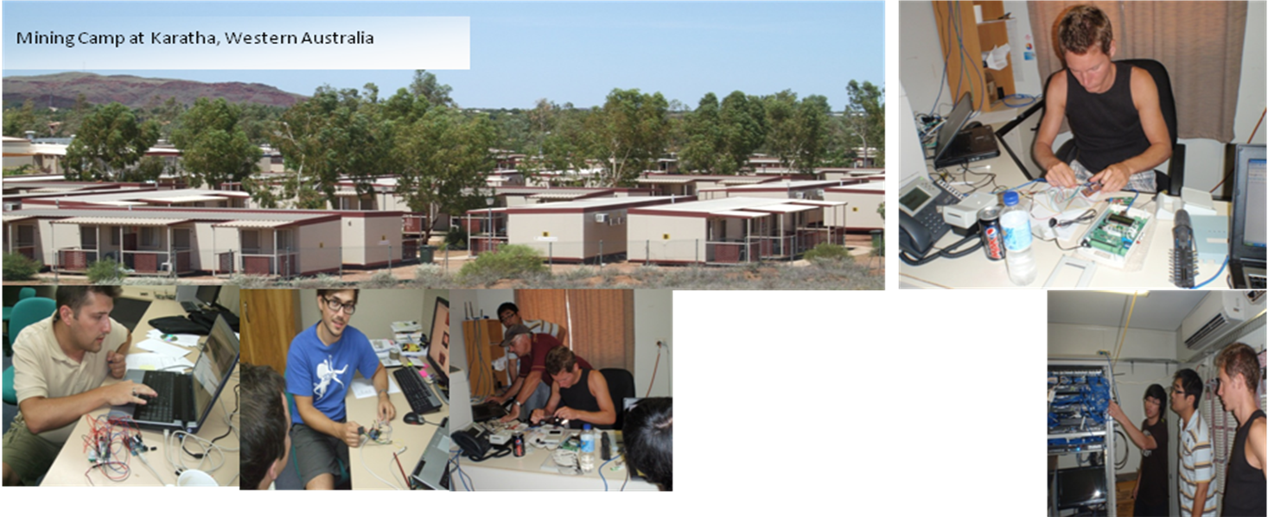
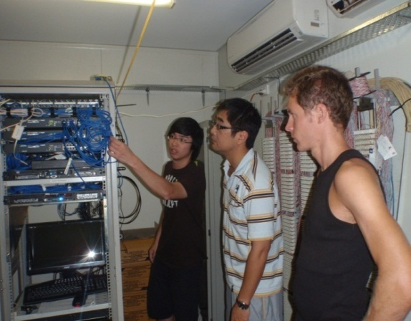
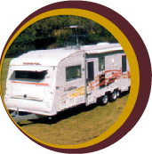
Our work 2010-2013 funded by ARC and Fleetwood
Smart Energy Usage with IoT and CPS
Smart Fleet Camp Project is funded by Fleetwood Int Corp and Australian Research Council. This project addresses the issues of high cost and high consumption of energy in mining Industries. we develop a world class unique wireless, infrared, sensor monitoring system. This system is going to save hundreds of thousand dollars per year from Industry and will help the world to cope with the energy shortages.
Notes:
Smart Camp Project is funded by Fleetwood Int Corp and Australian Research Council. This project addresses the issues of high cost and high consumption of energy in mining Industries. DEBII develops a world class unique wireless, infrared, sensor monitoring system. This system is going to save hundreds of thousand dollars per year from Industry and will help the world to cope with the energy shortages.

Slide 34
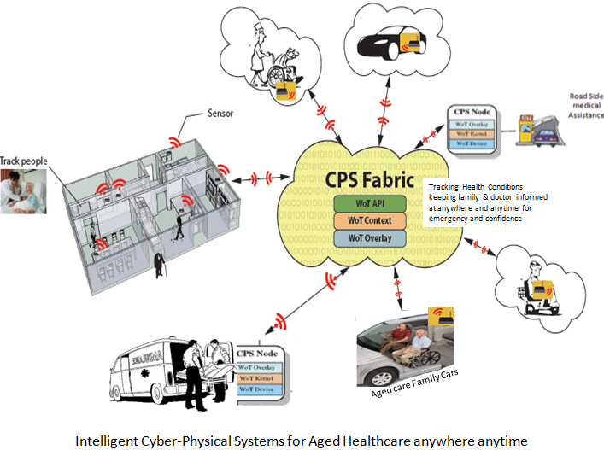
Our work 2011-2013
Health/Aged care with IoT and CPS

Slide 35
Our Work – IoT and CPS Architecture
New Architecture for Compositionality
    integrates heterogeneous components from physical and cyber world
Device visibility & invocation on the web
    abstractions that captures relationships between physical objects and CPS.
Engineering Software
  Abstraction and Semantics of Devices and events
  Composition of sensors/actuators and events
  Storage of ‘annotated’ data with clearly defined semantics
  Data exchange using platform independent & common format
  programming languages and abstraction models
Privacy, Trust, Security, Risk for QoS
  threat/hazard analysis, cyber-physical inter-dependence anatomy, investigation/prediction of gaming plots at different layers of CPS, privacy specification, light-weight security, confidence and trust maps, privacy properties, context-dependent trust models
Real Time Distributed Sensing, Computation and Control
    information collection and decision making in a distributed network environment with high latency and high uncertainty
Human Interfaces and Integration
    integration and adaptation between human scales and physical system scales
Information: From Data to Knowledge
    data fusion and data stream mining in real-time
Robustness, Adaptation, Reconfiguration
  adapt to faults through (self-) reconfiguration at both physical and cyber levels and fault recovery techniques
Modeling and Analysis: Heterogeneity, Scales, Views
  dealing with issues in large-scaled systems such as efficiency trade-offs between local and global, emergent behaviour of complex systems, etc.
Notes:
Architecture for Compositionality
integrates heterogeneous components from physical and cyber world
Real Time Distributed Sensing, Computation and Control
information collection and decision making in a distributed network environment with high latency and high uncertainty
micro-level network communication to prevent adverse effects at the macro-scale in distributed environment
control without centralized administration, measurement and incomplete information.
Physical Interfaces and Integration
abstract physical objects
mathematical representation of these models
abstractions that captures relationships between physical objects and CPS.
Human Interfaces and Integration
integration and adaptation between human scales and physical system scales
local contextual actions pertinent to users who are part of the system rather than just being the "users" of the system
theories on the boundary (e.g. hand-over or switch) between human control and (semi-) automatic control.
Information: From Data to Knowledge
algorithms for data fusion that deal with data cleansing, filtering, validation, etc.
data stream mining in real-time
storage and maintenance of different representations of the same data for efficient and effective (e.g. visualization) information retrieval and knowledge extraction.
Modeling and Analysis: Heterogeneity, Scales, Views
integration of temporal, eventual, and spatial data
characterize dimensions of physical objects such as time (e.g. to meet real-time deadline), location, energy, memory footprint, cost, uncertainty from sensor data, etc.
abstractions and models for cyber-physical control that can deal with - through compensation, feedback processing, verification, etc. – uncertainty
theories on "design for imperfection“ to ensure stability, reliability, and predictability of CPS
system evolution
dealing with issues in large-scaled systems such as efficiency trade-offs between local and global, emergent behaviour of complex systems, etc.
Privacy, Trust, Security, Risk for QoS
design principles for resilient CPS, threat/hazard analysis, cyber-physical inter-dependence anatomy, investigation/prediction of gaming plots at different layers of CPS
privacy specification that allow reasoning about and proof of privacy properties
information hiding for real-time streams
light-weight security solutions
confidence and trust maps, context-dependent trust models, and truth/falseness detection capabilities.
Robustness, Adaptation, Reconfiguration
robust system design that deals with and lives on unexpected uncertainties occurring in both cyber and physical worlds
adapt to faults through (self-) reconfiguration at both physical and cyber levels
fault recovery techniques
system evolvement through learning faults and dealing with uncertainties in the past scenarios and through run-time reconfiguration and hot deployment
Software
programming languages and abstraction models (of semantics and performance) that provide infrastructure to manage the massive complexity and scales of CPS
control theories that can reason about the behaviour of the hardware platform that runs the software and their inter-related feedback loop effects
computational models that establish an explicit connection between computational faults and control-theoretical error conditions and that includes time in their elementary semantics and the evaluation judgment (e.g. the correctness of an algorithm)
a framework that integrates various software techniques into a holistic solution for CPS
Design and Architecture Framework
Heterogeneous applications/systems operating at different time & space scales.
QoS composition of Cyber, Network and Physical components
Privacy, Security, Trust, Risks and Decisions
Real Time Information & Resources
Software Architectures
Web of Things
Internet of Things
new theories and engineering practices
model cyber and physical resources in a unified framework
integrated models addressing issues from both worlds
a novel architecture which allows the connection of sensors/actuators into the internet in a form suitable for standardized finding and invocation of sensors/actuators based on the Web of Things
direct connection of real-world objects with the internet in contrast to the earlier web which allows connection of virtual objects

Slide 36
Design of Reference Architecture
Capture both domain requirements and infrastructure requirements at a high level of abstraction
The two key architectural components are Node and Fabric
Node is a Web protocols-enabled computing unit that carries out data transformation
Three types of CPS Nodes - Actuator, Sensor and Controller
CPS Fabric facilitates communication amongst CPS Nodes, derive context and integrate with decision making modules and other related computational functions.

Slide 37
Architecture
“Web of Things Framework for Cyber-Physical Systems,” Concurrency and Computation: Practice and Experience, 23(9), 2011, pp. 905–923 ; With T.S. Dillon, H. Zhuge, C. Wu, J. Singh

Slide 38
Our CPS Architecture - based on WoT
QoS
“Web of Things Framework for Cyber-Physical Systems,” Concurrency and Computation: Practice and Experience, 23(9), 2011, pp. 905–923 ; With T.S. Dillon, H. Zhuge, C. Wu, J. Singh

Slide 39
Our CPS Node
Consist of Low-level run-time for communication, scheduling, and WoT resources management. Dynamically allocates network bandwidth, processing power and storage capacity for dealing with a large amount of data from the CPS device (sensor/actuator). Scheduler allocates computing resources to working threads (events) with different priorities to meet end-to-end QoS requirement. Provide load balancing., Detects and identifies newly connected physical devices and their associated resources. Provide these resource specifications to the WoT Overlay layer for manipulation by the cyber object.

Slide 40
Our CPS Fabric
Manage Service requirements at the application (cyber) level and network level. Uses an application-aware virtual network on top of the existing IP-network, Provides multi-routing, admission control, and on-network caching mechanism. Overlay Router component that uses multiple path delivery for time-critical RESTful messages. Delay Analyser component that uses admission control to ensure end-to-end delays meets the CPS QoS requirement. QoS Monitor component that obtains updated conditions of the underlying network using probes.

Slide 41
IoT and CPS Services
Performance guarantees.
Different priority to different applications, users, or data flows, or to guarantee a certain level of performance to a data flow.
Best Effort, Absolute QoS & Statistical QoS
QoS measurement:
  Additive metric - Latency
  Multiplicative metric – Reliability
  Concave metric - Bandwidth
Notes:
- Additive metric: sum of the individual QoS metric along a network path. end-to-end delay (latency), which is the sum of the transmission delays across each link and the processing delays of each router. Delay jitter and logarithm of probability
of successful transmission
- Multiplicative metric: product of the individual QoS metrics along a path. probability of successful transmission and reliability. Metrics of this type can be changed into an additive metric by taking their logarithms.
Concave metric: either the maximum or minimum QoS metric of all the individual QoS metric along a path. minimum available bandwidth.

Slide 42
5. Smart Ship
– Top 10 Issues
Our recent work funded by ADF 2014-2018
Notes:
and Real time Analytics

Slide 43
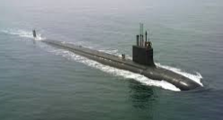
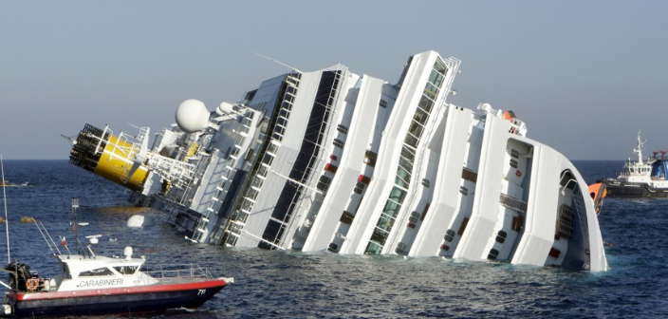
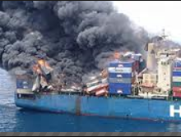
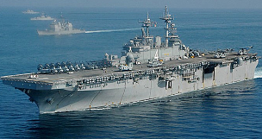
Ship and Types
Baselines
Small ship: 13,000 + items, Large Ship 45,000 items
Small warehouses or Floating warehouses
1 – 6 months journey Assets supply
People, Foods and Medical supply
Reliability, security and safety

Slide 44
Top 10 Issues for On-Board Ship
Security and Safety
Communication issues
On-Shore and Off-Shore Asset Visibility
Manual Data Entry System on-board ship
Engineering Reliability and Maintenance
Ship Tracking and Sustainment
Long Lead Time
Repairs n Overhaul
Poor Demand Planning
Un-balance Ship Inventory and Budget

Slide 45
Top 10 Issues for On-Board Ship
1. Security and Safety
  Human Assets
  Physical goods assets
  Defence services
  Piracy attacks
  Privacy
  Safety
  Financial responsibility

Slide 46
Top 10 Issues for On-Board Ship
2. Communication issues
  On and off communication
  Whether conditions
  Access to satellite
  Data exchange – normally 24 hrs delay (communication load, encryption, extraction, txt packet send/receive)

Slide 47
Top 10 Issues for On-Board Ship
3. On-Shore and Off-Shore Asset Visibility
  End-to-end Data visibility
  Data Misalignment
  Data Entry Error and Data Reject
  Track n Trace Spares,
  Track n Track “usuage” and “returns” (broken ones)
  Financial Accountability

Slide 48
Top 10 Issues for On-Board Ship
4. Manual Data Entry System on-board ship
  Manual based data entry
  No automation support
  Error-prone
  On-shore and off-shore data alignment
  On-shore and off-shore systems’ communication

Slide 49
Top 10 Issues for On-Board Ship
5. Engineering Reliability and Maintenance
  Keep pace with scheduled maintenance
  Outside manufacturing warrantee
  Varied engineering depreciation predictions
  Challenges in Engineering reliability modelling
  Approaches to Engineering replacement

Slide 50
Top 10 Issues for On-Board Ship
6. Ship Tracking and Sustainment
  Identify where about in emergency situation
  Submarine rescue
  Natural Disaster relief
  Substantial cost (financial and human resources)
  Substantial damages

Slide 51
Top 10 Issues for On-Board Ship
7. Long Lead Time
  Repair loop between 6 weeks to 6 months
  Lead time to “issue” (delivery the parts)
  Lead time to “Return” (return the broken parts)
  Repair pool estimation
  Balance between Schedule vs un-schedules maintenance

Slide 52
Top 10 Issues for On-Board Ship
8. JIT Repairs and Overhaul
  Engineering diagnostics
  Engineering Expert
  Data Expert
  Budget constraints
  Inventory forecast
  Inventory planning

Slide 53
Top 10 Issues for On-Board Ship
9. Poor Demand Planning
  Older Platforms
  Un-expected breakdown
  Difficult to forecast
  Multi factors and multi variables (Operator behaviours, Usage and usage rate, engineering reliability, maintenance, etc)

Slide 54
Top 10 Issues for On-Board Ship
10. Un-balance Inventory and Budget
  Cost of urgent repair
  Poor “safety Stock”
  (what you need, you do not have, what you don’t need, you have plenty)
  Cost–to-hold
  Optimisation of Inventory
  Optimisation of budget
  Buy vs repair decision
  Value for money

Slide 55
Top 10 Issues for On-Board Ship
Security and Safety
Communication issues
On-Shore and Off-Shore Asset Visibility
Manual Data Entry System on-board ship
Engineering Reliability and Maintenance
Ship Tracking and Sustainment
Long Lead Time
Repairs n Overhaul
Poor Demand Planning
Un-balance Ship Inventory and Budget
IoT
CPS
Data

Slide 56
5. Smart Ship Solution
– Embrace new Technology
Notes:
and Real time Analytics

Slide 57
Existing Work
Safety and efficiency of inland shipping [2013 http://ascelibrary.org/doi/pdf/10.1061/9780784413036.327]
Ericsson's Maritime ICT Cloud, connect vessels at sea with shore-based operations, [2015 http://www.landmobile.co.uk/news/ericssons-maritime-ict-cloud-enables-connected-ships
Route Exchange, connect Maritime cloud, services, stakeholders and geolocation of ships [2015 Application REX http://osdelivers.blackducksoftware.com/2015/02/11/industrial-internet-of-things-in-the-maritime-industry/
Signal K: connect all the previously disconnected Things on the boat into a Network of Things http://themarineinstallersrant.blogspot.com.au/2015/02/iot-and-your-boat.html

Slide 58
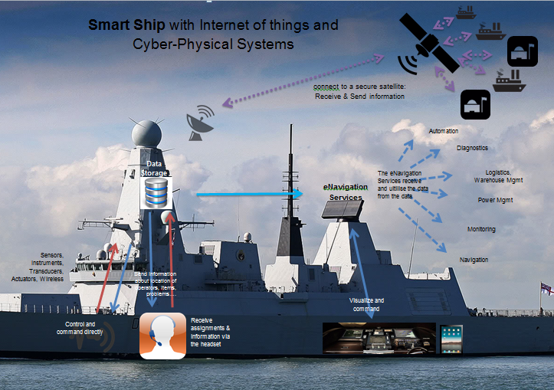
IoT for Smart Ship
Our solution (IoT, Voice, RFID, MobApp)
Tightly coupled and controlled system
Ship Top Issues
Security and Safety
Communication issues
On-Shore and Off-Shore Asset Visibility
Manual Data Entry System on-board ship
Engineering Reliability and Maintenance
Our proposed work
Voice headset, locations of each item…
share this information inside a single ship
use voice for managing the ship and sending information.
monitoring, navigation, asset movement
Location of operators , assets and via a sensor or the headset
Managers to assign orders

Slide 59
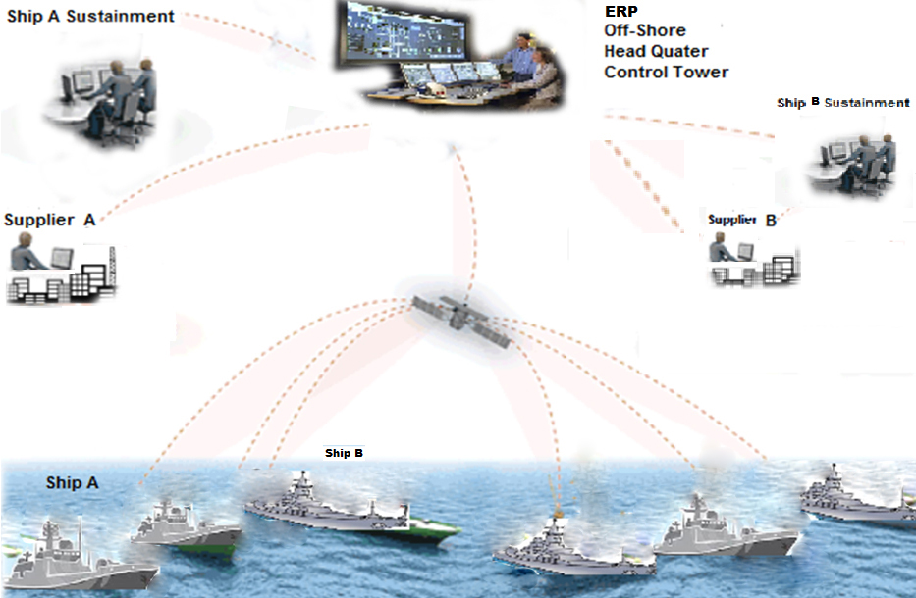
Smart Ship with CPS
Our solution (on-shore+ Off-shore, Sys Integration, E-to-E Visibility)
Globally connected Systems of Systems
Ship Top Issues
On-Shore and Off-Shore Asset Visibility
Engineering Reliability and Maintenance
Ship Tracking and Sustainment
Long Lead Time
Repairs n Overhaul
IoT
IoT
IoT
IoT
IoT
IoT

Slide 60
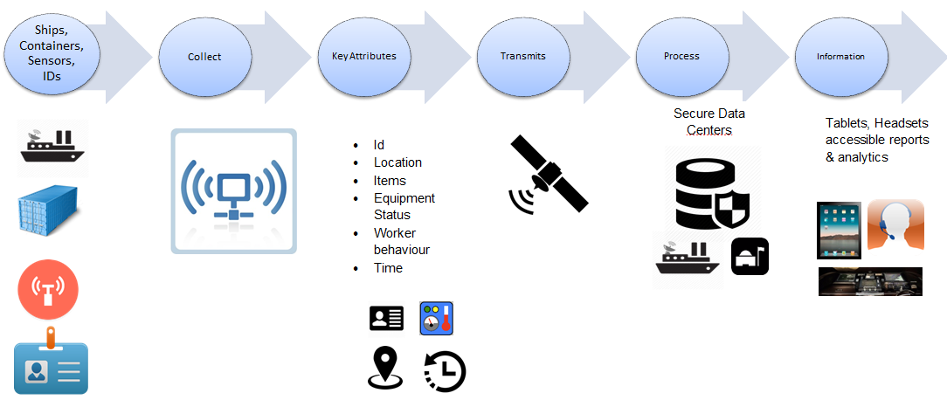
IoT for Smart Ship
Our Smart Ship Solution Process

Slide 61
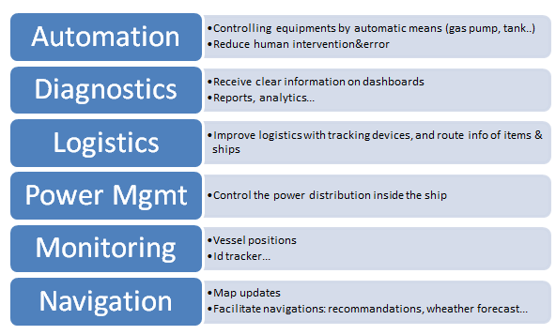
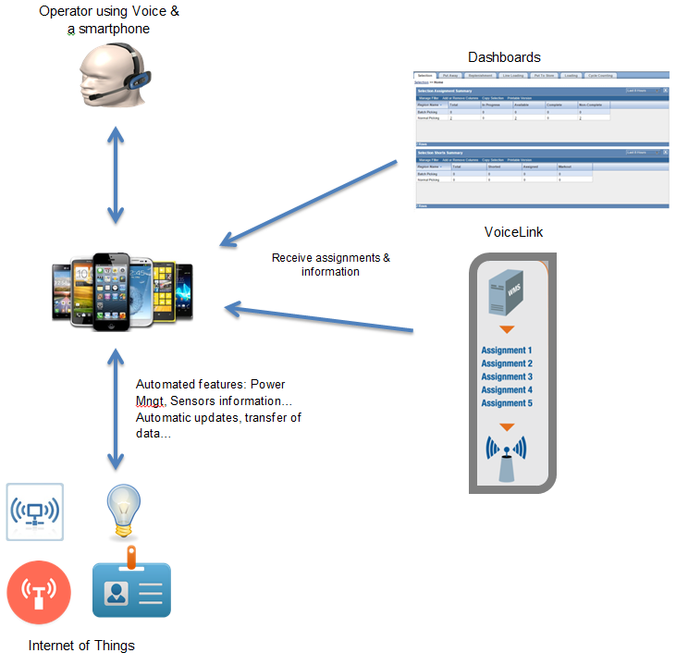
Software Integration for Smart Ship
Our Smart Ship Solution integration of RFID, Voice, Data, MobApp,+

Slide 62
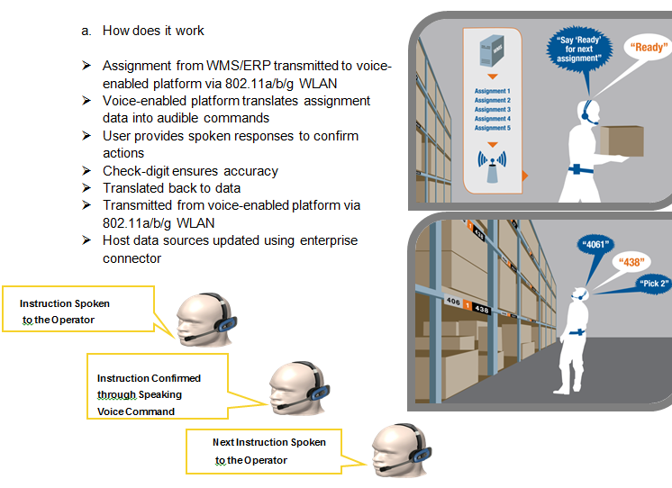
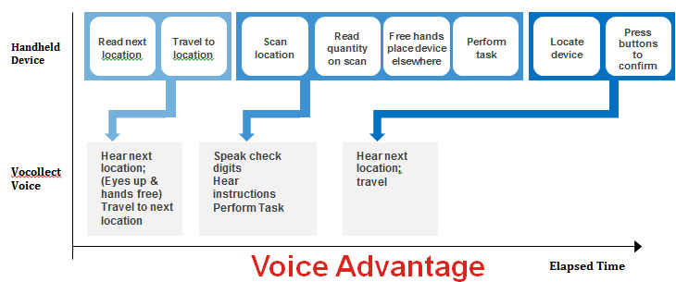
Voice + IoT, Enable Automation
Powered by Honeywell Voice link Technology
  Engineering Diagnostics (repair or overhaul)
  Breakdown scenario outline
  FastTrack of asset on the on-board ship
  Urgent demand description
  Accurate recording of asset usage rate
  Tracking “Return” of the assets

Slide 63
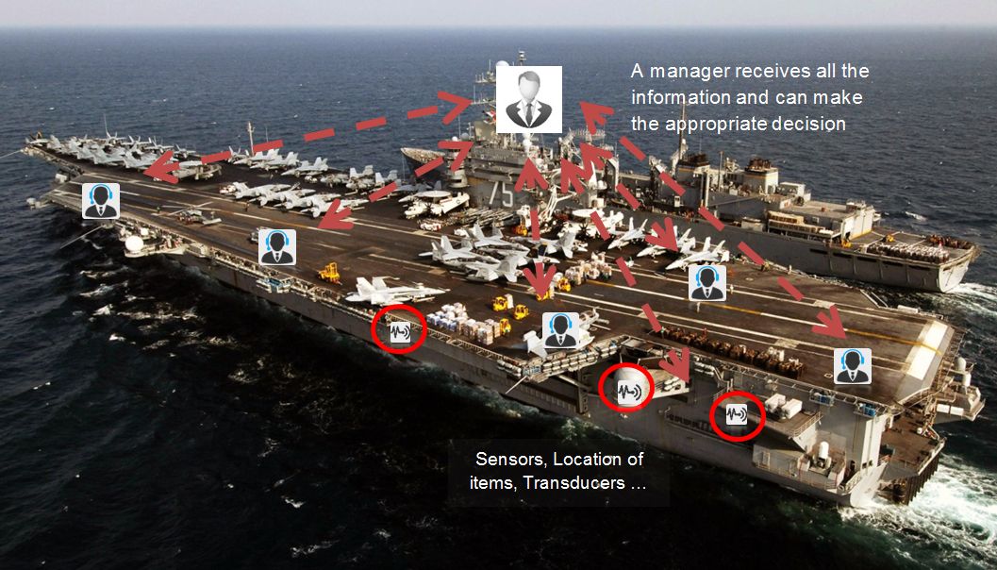
Smart Ship with IoT n CPS

Slide 64
Conjoint DM and In real time
The co-joint data and content mining on Big Data including the combined RFID and wireless sensors data on the goods and assets handling, warehousing and transportation, GPS, GPRS and position location system for transport vehicle and shipment tracking, Surveillance Systems for Operator Performance and situation awareness, provenance of Goods and Asset tracking.
The conjoint data and content mining are also needed for Inter- and intra-ship, on-shore and off-shore transactions; data monitoring,
Black-box (on ships vessels) communication and auto and semi-automated physical flow and information flow

Slide 65
Challenges on Conjoint DM
One of our biggest challenges in the conjoint data mining has been the assurance that the data quality, data are trusted and transmitted securely.
If the wrong decision is made based on the poor data set, it could result in major financial losses, high casualties and possible terrorist attack through the use of transport.

Slide 66
Our Approach on Conjoint DM
use structured data to disambiguate text segments and link them to records
use ontologies to disambiguate and annotate content segments to permit Data investigations
conjoint analysis of linked structured and content elements

Slide 67
Conjoint DM + Ship Ontology
We have developed ship ontology aimed at managing the Big data by defining the meaning of data through adding context that gives information on the data.
Our works include Ontologies, RDF annotations and contexts. We carry out mining and visualization of big data both relational data (ship warehouse data) and complex data includes tree structured data (Geo-data),
We work on XML based asset management (procedures and workflows), semi-unstructured textual data, voice data, image data (positions and locations), multimedia data (surveillance data), graphical data (Asset tracking data).

Slide 68
Real time Data Intelligence for Smart Ship
Ship Asset Ontology
Ship Class Common
Ship Type 1 Common
Ship Type 2
Common
Ship Type N
Common
Ship 1A
Ship 1B
Ship 1N
Ship 2A
Ship 2B
Ship 2N
Platform 1A1
Platform 1A2
Platform 1AN
System X1
System X2
System XN
Sub-System X1
Sub-System X2
Sub-System XN
Parts X1
Parts X2
Parts XN

Slide 69
Our Aim on Conjoint DM
cleansing and filtering the noisy unstructured data with respect to structured data;
text annotation to enrich the unstructured data semantically;
fuzzy matching and searching over structured data based on annotated values for deriving the correlation between data and content;
discovering the linkages between data and content;
representations of the conjoint information that is suitable for predictive analytics;
allowing new insights in the form of business intelligence and deep knowledge from the integrated data and content together.

Slide 70
Front-end Mobile App powered by Dynamic DataMart from Data Lake
  The Dynamic Data Mart Engine [39, 40] is a forward and backward loop that carries out 3M and 3R functions,.
  3M, namely:
  Data Mining: mining the application log, that mines the user’s behaviours/user’s decision makings and usage rates of each view and window widgets clicks, providing usage rates.
  Data Marshalling: for low usage rate views, we collect the data set, put them on probation period, to see whether we can reuse.
  Data Meshing: based on the data mining and data marshalling report, we create new views that potential will attract the usage.
  3R, namely:
  Recommendation: Following up 3M, we provide recommendation to the user, just like how Amazon.com gives it to people who have purchased a book by recommending them other similar books that other people have bought to the RI managers, that are likely to use the similar data set and making similar decision, but this decision making is now recorded and reused.
  Reconciliation: If the data is likely useful with high hit rate, but the view is not useful to finish a task, we reconcile all the window widgets and data set, provide new window workflows or widgets workflows.
  Representation: We then represent a new view to replace the old view to the user.
Citation: Chang etal “Dynamic Data Mart”, Keynote, IFIP World Computer Congress WCC 2015

Slide 71


Dynamic Data Mart
Chang, Rahayu, Diallo, Machizud “Dynamic DataMart” Keynote, WCC 2015, Korea
3M + 3R
Data
Recommendation
Reconciliation
Data Meshing
Data Mining
Drop/
Create
Views
Data Marshalling
Representation

Slide 72
Conclusion
Notes:
and Real time Analytics

Slide 73
Summary
IoT and CPS – New Industrial Frontier
Top 5 Issues – IoT and CPS Adoption
IoT and CPS Solutions – Ours and World Effort
Smart Adoption – The Success Evidence
Smart Ship – Top 10 Challenges
Smart Ship Solution – Embrace new Technology
Conclusion
Notes:
and Real time Analytics

Slide 74
Unleashing the Potential
Despite mounting political pressures and regulations, about security issues with IoT and CPS
IoT and CPS adoption, will be rolled out one by one,
Providing smarter world with great RoI
Preserve precious resources, human lives, fuel, human endeavour, and time
Demonstrate value for money

Slide 75
Acknowledgement
UNSW@ADFA Asset Management Graduates
CAPT Miko, CMDR M. O’Brian, MAJGEN M. Clifford
Inventory Reform Group CAS Group ADF and their financial sponsorship
Honeywell USA and Australia
Linfox Australia
Google image

Slide 76

Questions?
Contact: e.chang@adfa.edu.au
Work experience and PhD programs welcome at UNSW@ADFA

