Slide 1
From Chromosomal Instability to Metastasis: H19’s role in cancer progression and its clinical significance
Eli Raveh
Chemical Biology Dept.
Institute of Life Sciences
Notes:
At first I would like to thank the conference administration staff for their efforts & kind hospitality.
Well Our lab, headed by PROF. Avraham Hochberg , is mainly focused on H19 Biology in the context of cancer research.

Slide 2
H19 : a major gene in cancer, an excellent target for therapy
H19 & its key role in cancer:
H19 : a pivotal player throughout cancer progression
H19 : a cancer oriented mediator of stress response
H19 in the antithetic EMT and MET processes
BC819: a novel H19-based cancer therapy
Preclinical data and clinical studies
Notes:
In this lecture
we’ll introduce the h19 gene and elaborate its key role in all stages of cancer progression from initiation to metastasis
We’ll show how H19 mediates tumorigenesis as a stress response mechanism.
And how H19 contributes to contradictory cancer processes like EMT & MET.
This topic is also covered in a review article which has just been accepted for publication in molecular cancer.
Finally I’ll review our h19 based cancer therapy – especially bc819.
I’ll present some of the preclinical results ,
discuss our main clinical trials
and talk about our plans for future drug dev.

Slide 3
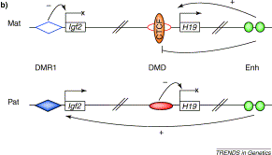
The H19 gene
Arney, 19(1),2003
Pre-mRNA
H19 mRNA 2.3Kb
miR675
Notes:
H19 , that resides on Human ch 11, is a paternally imprinted and matternally expressed gene, as opposed to its reciprocally imprinted neighbor gene IGF2,
H19 functions as a whole lncRNA , serving as a deocy for proteins and micro RNAs and as a scaffold for proteins, however it also exerts some of its functions through its microRNA 675(six seventy-five).

Slide 4
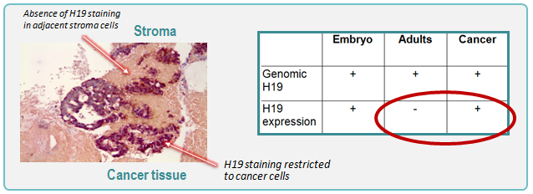
H19 unique expression pattern
H19 : The first oncofetal, non-coding mRNA discovered in humans
H19 is highly expressed in most human cancers, selectively expressed in cancer cells and plays a key role in many stages of cancer, from the primary tumor to its metastases
1
1
Source: Ariel I et al, Mol Pathol. 1997; Ariel I et al, Am. J. of Medical Genetics 2000.
Notes:
H19 is the first oncofetal (TITLE)….the term oncofetal describes h19’s unique expression pattern, since it’s expressed mainly in fetal tissue but its expression is shut down after birth and upregulated again only in cancer, in which it’s expressed in a multitude of cancers and in very high rates.
We will show here that H19 plays a key role througout cancer progression, from initiation to metastasis.

Slide 5
H19 is involved in tumorigenic response to various stress conditions
Notes:
We will start with showing several examples that enabled us to assume that H19 is responsible for tumorigenesis as a response mechanism to various stress conditions. and the first example is genome instability

Slide 6
H19 & genomic instability:
Alternative stress responses: cancer vs. poliploidy
H19
Critical mutations & epigenetic alterations in gatekeeper & caretaker genes
H19
H19
CANCER
H19 H19
polyploid
Aneuoploid
(attenuated track)
(Fast track)
P53 P53
H19
H19
CANCER
diploid
Induced genetic instability:
(UV irradiation, hypoxia,
chemotherapy, etc.)
diploid
diploid
Ploidy State: | Stable | Unstable
Polyploidy
Uncontrolled:
G1>S:
DNA damages acquired
(based on work by Dov Zipori’s group, Weizmann inst.)
Notes:
Chromosomal instability is considered as an initial protection against tumorigenesis . Polyploidy makes it difficult to cells to rapidly proliferate. However it is a state that lowers the activation energy towards further caner, (since it is) being a good starting point for further mutational events and cellular imbalance.
Studying liver and bone marrow models, Zipori and his colleagues have(?) shown that decline in p53 led to elevation in h19 level, an already described reuglatory connection reported by us and others. But they’ve also shown that P53 decline can lead either to ployploidy or to h19 upregulation. whILE polyploidy puts, at least temporarily, breaks on tumorigenesis, they found that the alternate H19 upregulation supports tumorigenic phenotype.
Therefore, this is one of the early stages in which h19 reacts to stress- in this case P53 DOWNREGULATION - by enhancing a tumorigenic phenotype instead of other stress management mechanisms- like polyploidy.

Slide 7
Overexpression of H19 enhances proliferation of bladder cancer cells in serum starvation
T24P CELLS
TA11 CELLS,
High H19
TA11 CELLS,
Control vector
Ayesh et al, 2002. Mol. Carcinog
Notes:
The results i’ve just shown align with several findings by our lab
For example, when comparing proliferation in response to serum starvation stress, we have seen that H19 overexpression enhances proliferation even under starvation.

Slide 8
Hypoxia: a major trigger of H19 expression
Genomic instability
Angiogenesis
EMT
Drug resistance
Cancer cell stemness
Tumor
Hypoxia
Norm
Hyp
Histone
Dose dependent upregulation of H19 in response to CoCl2- mimicked hypoxic conditions
Matouk et al, 2007. PLoS ONE
Notes:
Hypoxia , which is a common stress condition in many tumors is, perse, a trigger for many processes typical to cancer. not only genome instability that we have just described, but also stemness, angiogenesis to cope with hypoxia, multi-drug resistance and epithelial to mesenchymal transition.
We’ve found that H19 is upregulated upon hypoxia as seen in hepatocellular cancer cells,……
We also have shown that mimicry of hypoxia using cobalt chloride (that stabililizes hif1alpha ) upregultes h19.
We have also validated, what is not shown here, by rna silencing of hif1 alpha that this factor is essential for h19 upregulation in hypoxia.

Slide 9
Mutations in P53 enabled H19 induction upon hypoxia
Hepatocellular cancer
Lung cancer Breast cancer
Notes:
We have noticed that upregulation of h19 in response to hypoxia was detected mainly in p53 null or mutant cells in a screen of over than 25 cancer cell lines from several indications.
9

Slide 10
Nuclear monomeric P53 suppresses H19 up-regulation upon hypoxia
P53
Hypoxia
H358 cells
H19 expression
Control vector
Notes:
?
Indeed, expression of p53 , either WT or in its tetramerization-disabled form, is sufficient to prevent this hypoxic h19 upregulation. We therefore established the counterregulation between p53 and h19 in hypoxia.
ניתן לוותר במקרה שאין זמן

Slide 11
Microarray Data: H19 Modulates Gene Expression in Hypoxic Stress
H19 siRNA
Hypoxia
Gene expression profiling
Hep3b cells
control
Angiogenesis
Survival
H19
ANGIOGENIN
FGF18
B61
Id2
Angiotensinase C
AKT-1
EBAG-9
MITF
IER3
PRKCZ
BCL3
MDR
Apoptosis
MDR1
Sorcin
Cav2
MITF
TYMS
Thioredoxin
Caspase 3
GADD153
Matouk et al,2007. PLoS ONE
Notes:
Another interesting evidence for h19 mediated tumorigenesis stress response, arises from a differential transcription array we used to identify h19 knockdown effect in hypoxic liver cancer cells
We have shown that h19 regulates transcription pattern that supports many of the tumorigenic related processes which are elicited upon hypoxia. Processes like MDR angiogenesis survival and apoptosis inhibition.

Slide 12
H19 Overexpression Enhances Tumorigenesis and Angiogenesis of Bladder Cancer Cells
Matouk et al, PLoS ONE 2007
Notes:
12
We also confirmed these results in vivo with a mouse heterotopic model of bladder cancer
H19 overexpressing cells are pro-proliferative as seen in the upper panel and angiogenic as seen below.

Slide 13
H19 is a pivotal mediator of cancerous response to various stress conditions
Proliferation
Cancer cell stemness
Angiogenesis
H19
H19
H19
TP53/ Hypoxia/
Serum starvation
H19
H19
Drug resistance
EMT
Notes:
all together, and to summarize so far, we have shown that h19 confer on the stressed cell many tumorigenic properties.
We’ll now turn to one of the fatal characteristics of cancer, EMT.

Slide 14
H19 in EMT
Notes:
In the next section we will briefly review our recent published findings regarding h19 involvement in emt.

Slide 15
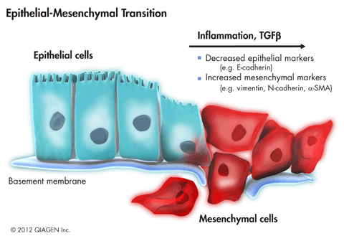
H19 involvement in metastasis
Notes:
In order to metastasize, epithelial cells in the primary tumor should disperse, lose their epithelial junctions and acquire motility and spreading properties. This epithelial to mesenchymal transition which is triggered by environmental cues, such as hypoxia, inflammation and extracellular ligands like TGFb and others, is accompanied with loss of epithelial markers and acquisition of mesenchymal markers.
Analysis of many tumors rebeal that H19 expression is seen both in the primary and the secondary site.
Also, H19 is often highly expressed in the invasive front of primary tumors.
Together with the hypoxia connection which also induces emt, it was reasonable to study h19 involvement in emt.

Slide 16
TGF-β Induces H19/miR-675 and Slug
Slug
TGFβ
Hep3b
TGFβ+
LY294002
H19
TGF -β - + +
Ly 294002 - - +
miR-675
TGF-β - + +
LY 294002 - - +
TGF-β - + +
Ly 294002 - - +
Notes:
We have shown that Tgfb, a known EMT inducer, Induces both h19 and its micro-RNA MIR 675. It also enhances the mesenchymal marker slug .
Specific Inhibiton of tgfb ablates the effects on both slug and h19 and its mir675.

Slide 17
Slug induction triggered by TGFβ is H19 dependent
H19 siRNA 1 and 2
TGFβ
Slug expression
Umuc3
Control
TGFβ - + + +
siRNA cont cont H19 (1) H19 (2)
Notes:
?
It seems that the coordinated induction of both H19 and the mesenchymal marker Slug is not circumstantial and that h19 controls slug expression, since H19 KD reduces TGFB DEPENDENT induction OF SLUG .
אולי מיותר

Slide 18
H19 dichotomy- H19 enables differentiation plasticity to support both EMT & MET
Notes:
We have shown that h19 is involved in emt ,However, in order to establish and colonize a secondary tumor site, cancer cells should go through a seemingly contrary process- MET, mesenchymal to epithelial transition. It appears that H19 plays a role also in MET!

Slide 19
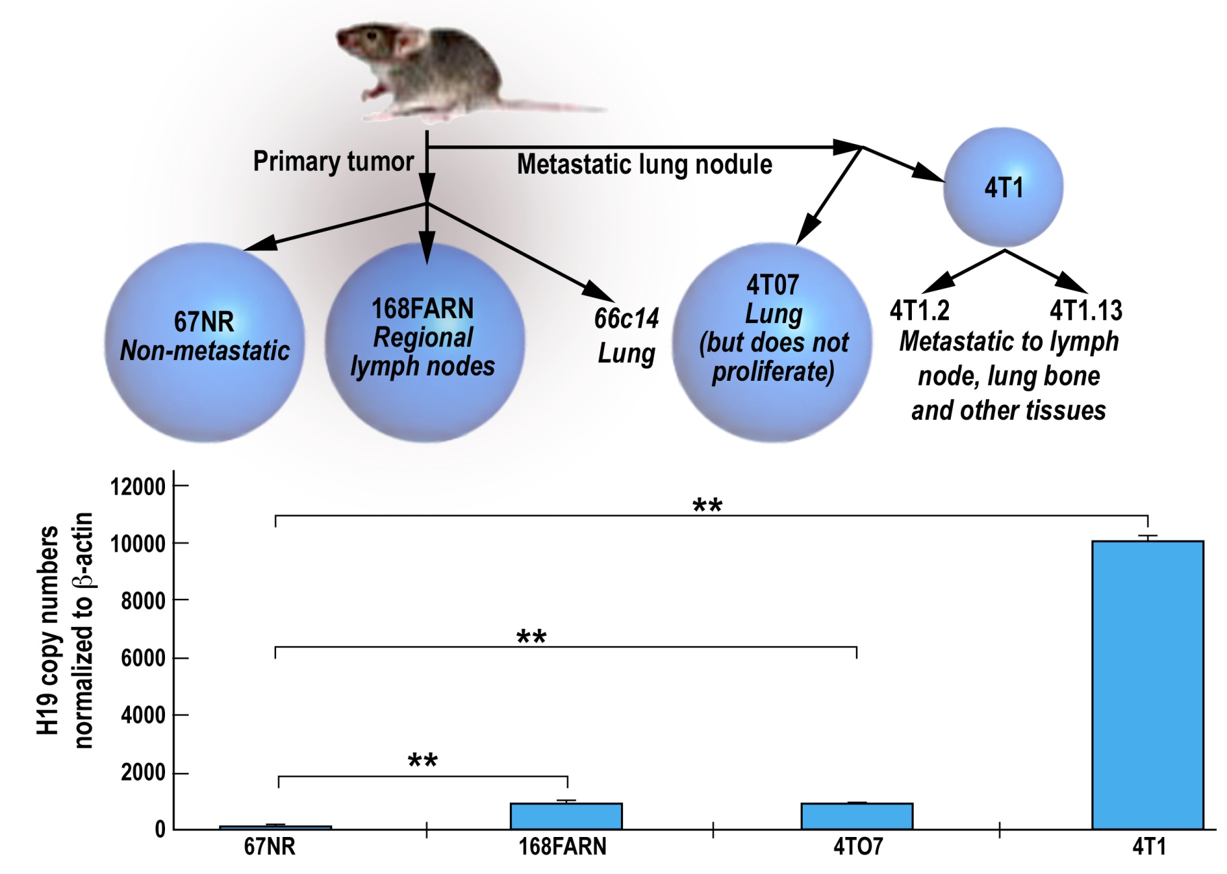
High abundance of H19 correlates metastatic potential
Notes:
One good model of metstasis to secondary site is the breast cancer cell lines model.
In this model different mammary gland cell lines from the same parent cell line differ by their metastatic potential
This model was previously used by Weinberg’s group to identify the metastatic marker Twist.
Intriguingly we have found that H19 expression level is positively correlated with the metastatic potential of the different cell line

Slide 20
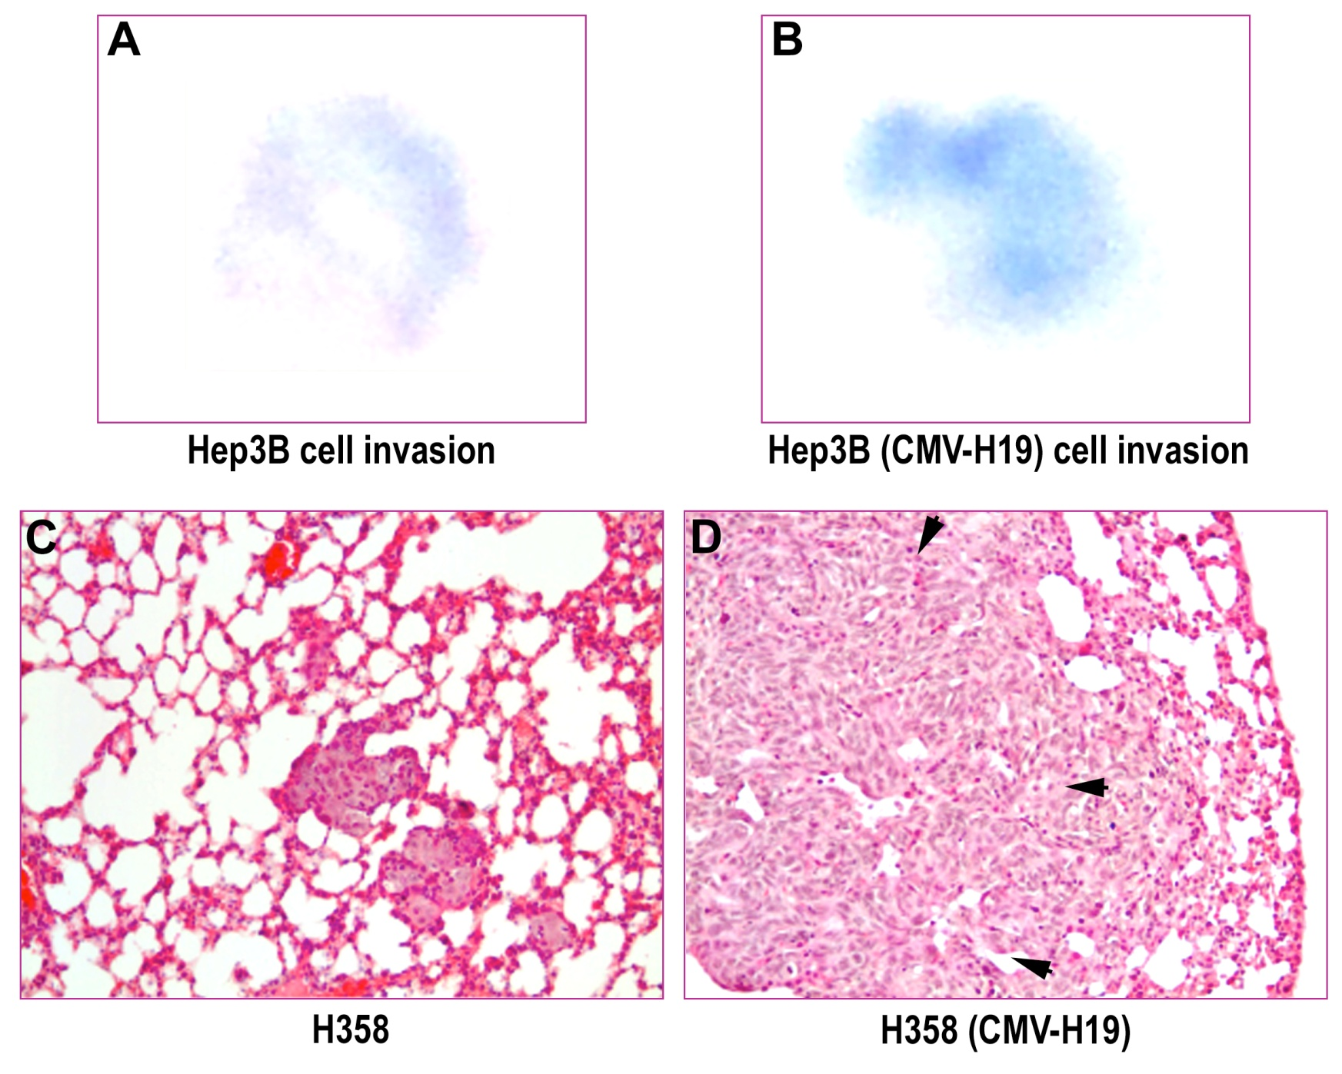
H19 enhanced lung colonization in vivo
D28
D1
D45
I.V.
injection
Mice sacrificed.
Lung examined
Visible lung metastasis
Notes:
ייתכן שניתן לוותר?
H19 also promotes secondary site formation. we used a lung metstasis model in vivo, injected cells to the vain tail and compared the number and size of the tumors formed in the lungs. cells that overexpressed h19 by stable transfection formed more tumors, also bigger in size on avarage. therefore, it can be concluded that h19 is involved in met as it is involved in emt.

Slide 21
H19 in metastasis
Removal of Micro-environment factors?
No let7? Alternative to Let7 H19’s miRNA copartners?
Micro-environment factors
EMT-MET
Tgf-β
Hypoxia
Chemotherapy
SHH
Yap1+TEAD
(PI3K/akt)
(P53 mutated)
HNF4α
Let7
miR134
miR200
H19
miR675
miR675
H19
EZH2
Histone acetylases
C-Myc
Hmga2
?
Rb
miR200
β−Catenin
Slug, Snail
TGFBI
(TGFβ
induced
protein)
Proliferation& colonization
E- cadherin
ZEB1/2
“MET”: Secondary site colonization
EMT: Primary site
Proliferation, differentiation
Stemness (de-differentiation), growth arrest
Notes:
So, how do we explain that h19 participates in two converse processes?
we believe that h19 acts differently in EMT and MET depending on cellular context and environmental cues, but serves the same purpose of tumorigenesis progression.
We noticed that H19 , according to literature can potentially control key plyers in both processes– EMT (slug & snail) & MET (by upregulating of miRNAs as mir200). Intriguingly, h19 can also sponge mir200 and inhibit its activity in EMT.
Since H19 is eventually a regulator of pivotal molecular circuit which is may underlie the balance between EMT & MET, it possibly mediates the switch between the two process, during cancer progression.

Slide 22
Outlines for H19 functions during tumor progression
Hypoxia/
Anoxia
Reduced p53
(epigenetics?)
low
H19
Genome instability
Hypersensitive cell populations
Apoptosis
↑ Oncogenes
↓ TSG
Selection against sensitive cancer cells: enhanced survival & error-prone DNA repair
Rb,p53
mutations
PRIMARY TUMOR
Proliferation and expansion
H19
Error-prone DNA repair
H19/mir675 expressing cells dominate
Epithelial phenotype suppression→ EMT
H19
Extracellular cues
Clonal selection for further acquired advantages and increased metastatic potential
H19
Aberrant
DNA repair with
caretakers mutations
+
increased proliferation rate
Extracellular cues
H19
H19 shifts to pro-colonization activities in secondary site due to removal of EMT environmental cues
POOR CLINICAL PROGNOSIS
High
Notes:
We won’t get into the details of this scheme that delineates h19 involvement in cancer progression. However the main concept here is that
h19 responds to various stress conditions by promoting and supporting proliferation & tumorigenesis along the various stages of cancer progression from tumor initiation to secondary tumor, and in the seemingly inverse EMT and MET processes,
During this process mutations in tumor suppressor genes like p53 and Rb are acquired and contribute to h19 upregulation that, in turn, confer on cancer cells an adaptive advantage.

Slide 23
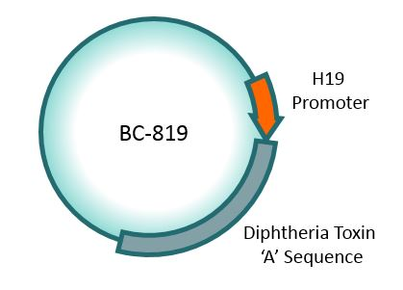
BC-819 :Simple, Direct, Efficient, and Safe
Notes:
As we have already mentioned h19 is AN oncofetal rna with a unique expression pattern restricted to cancerous tissues in adults.
As such, it’s an excellent target for cancer therapy.
To harness this unique expression pattern for therapy, our lab developed a therapeutic plasmid , bc819, that expresses the diphtheria toxin A chain under h19 promoter regulation
This plasmid is designed to specifically eliminate cancer cells as long as they express h19 .

Slide 24
BC-819 Acts Like a “Trojan Horse”
Tumor Cells
NORMAL CELL
CANCER CELL
H19 Transcription
Factors
BC-819 acts like a “Trojan Horse”, transfecting all cells in contact with the solution
BC-819 is instilled into bladder
NORMAL CELL
CANCER CELL
H19-specific transcription factors only initiate synthesis of Diphtheria Toxin A in cancer cells
NORMAL CELL
CANCER CELL
H19 Transcription
Factors
“Payload” dropped: DTA causes cell death in cancer cells only
“On Switch” is activated by H19 transcription factors
Notes:
As applied in bladder cancer, the plasmid instilled into the bladder, and enters all cells.
However, it’s switched-on only in cancer cells in which h19 promoter is natively active.
Active plasmid results in cancer-cell-death due to the diphteria toxin expression.

Slide 25
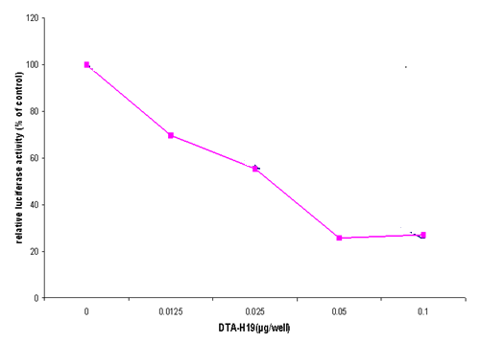
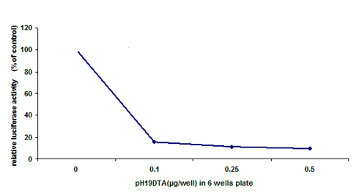
BC-819 In Vitro
BC-819 was tested in more than 100 carcinoma cell lines, among them:
Bladder
Colon
Glioblastoma
Ovarian
pancreatic
Hepatocellular
Lung
Breast
Melanoma
Squamous cell carcinoma
Kidney
Cervical
Gastric…
Human
Pancreatic
Carcinoma
Human Ovarian Cancer Ascites
Human Lung Cancer
Notes:
???
We have developed an in vitro method to evaluate plasmid activity in various cell lines by co-transfection with constitutive luciferase reporter used as a measure for cell viability.
In more than 100 cancer cell lines tested the plasmid is active and efficient, reducing the luciferase level to almost zero.

Slide 26
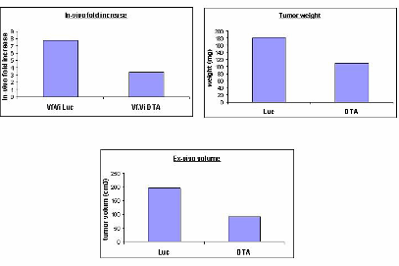
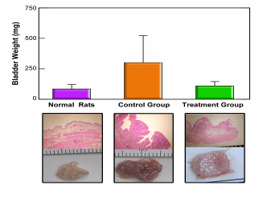
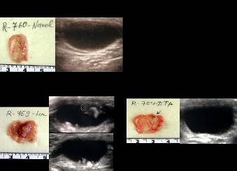
BC-819– In Vivo
Intra-vesical: Bladder cancer
Intra-arterial: Metastatic Liver cancer
Intra-peritoneal: Ovarian cancer
22
Notes:
Our lab has studied in preclinical orthotopic models administration of the plasmid via different routes and in many indications, such as
intravesical administration to the bladder,
intra-arterial injection in HCC
and intraperitoneal administration in ovarian cancer.
All have manifested profound tumor inhibition.

Slide 27
BC-819 in clinical trials
Notes:
We’ll now briefly review the clinical trials in which BC819 is applied.
Most of the trials were conducted by the biomedical company Biocancell, that Prof Hochberg is also its Founder and Chief Scientist.

Slide 28
BC-819 clinical trials
BC-819 has shown an excellent safety profile. In 130 patients treated with 1,796 doses, only 3 out of 56 SAEs reported were possibly drug related.
Completed 4 Phase I/IIa clinical studies showing good safety and tolerability in patients:
Bladder (standalone and combination with BCG - standard of care), Pancreatic and Ovarian Cancer
Positive results in two Phase IIb efficacy studies:
Bladder and Pancreatic cancer
Notes:
BC819 has an excellent safety profile. Out of almost 1800 (eighteen houndred) injections, only 3 were suspected to cause SAE related to the drug treatment.
4 phase 1/2b studies in bladder, pancreatic and ovarian cancer confirmed the safety and tolerabilty of the treatment,
And phase 2 studies in bladder and pancreas Have shown efficacy.

Slide 29
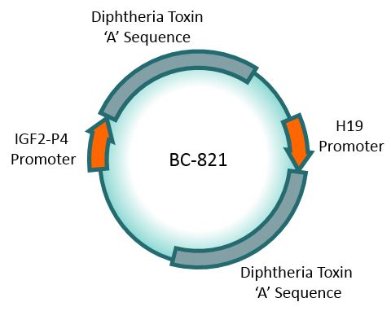
Future clinical trials (to start in 2016)
Bladder Cancer Ph3 trials :
BCG Failure - Randomized, open label, parallel-group study with BCG+BC-819 compared to BCG alone; SPA and fast track
BCG Unresponsive/Intolerant - Single arm, open-label study with BC-819 alone; Fast track
BC-821 Ph 1/2a trial to start in 2016
H19 and IGF2-P4 regulatory elements activate Diphtheria Toxin ‘A’ in cancerous cells
Developed for IV administration, appropriate for the treatment of most cancer types and their metastases
Notes:
We are currently focused on NMI bladder cancer treatment and are about to run two phase 3 studies during the next year,
the first to compare the combination of BC819 with STD of care, BCG,in patients with tumor recurrence after BCG treatment.
This study was granted a special assessment protocol status by the FDA,
The second study is to evaluate BC819 efficacy in patients which do not respond to BCG.
Both studies were granted a fast track by the FDA.
We also plan to start in the upcoming year safety studies with our new generation plamsid bc821
BC821 contains, in additioan to the h19-diphthria toxin A cassete, another DT expression cassette controlled by the igf2 p4 promoter, which is also cancer specific. This plasmid should cover the vast majority of cancers, and is designated for IV treatment of both primary tumors and their metastases.

Slide 30
In summary
We have shown that H19 is involved in each and every stage of cancer
We suggest that H19 mediates tumorigenesis as a unique response to stress
H19 plays a role in both EMT & MET to enable cancer progression
H19’s essential role in cancer , together with its cancer specific expression pattern, have been translated to Biocancell’s flagship product- BC819

Slide 31
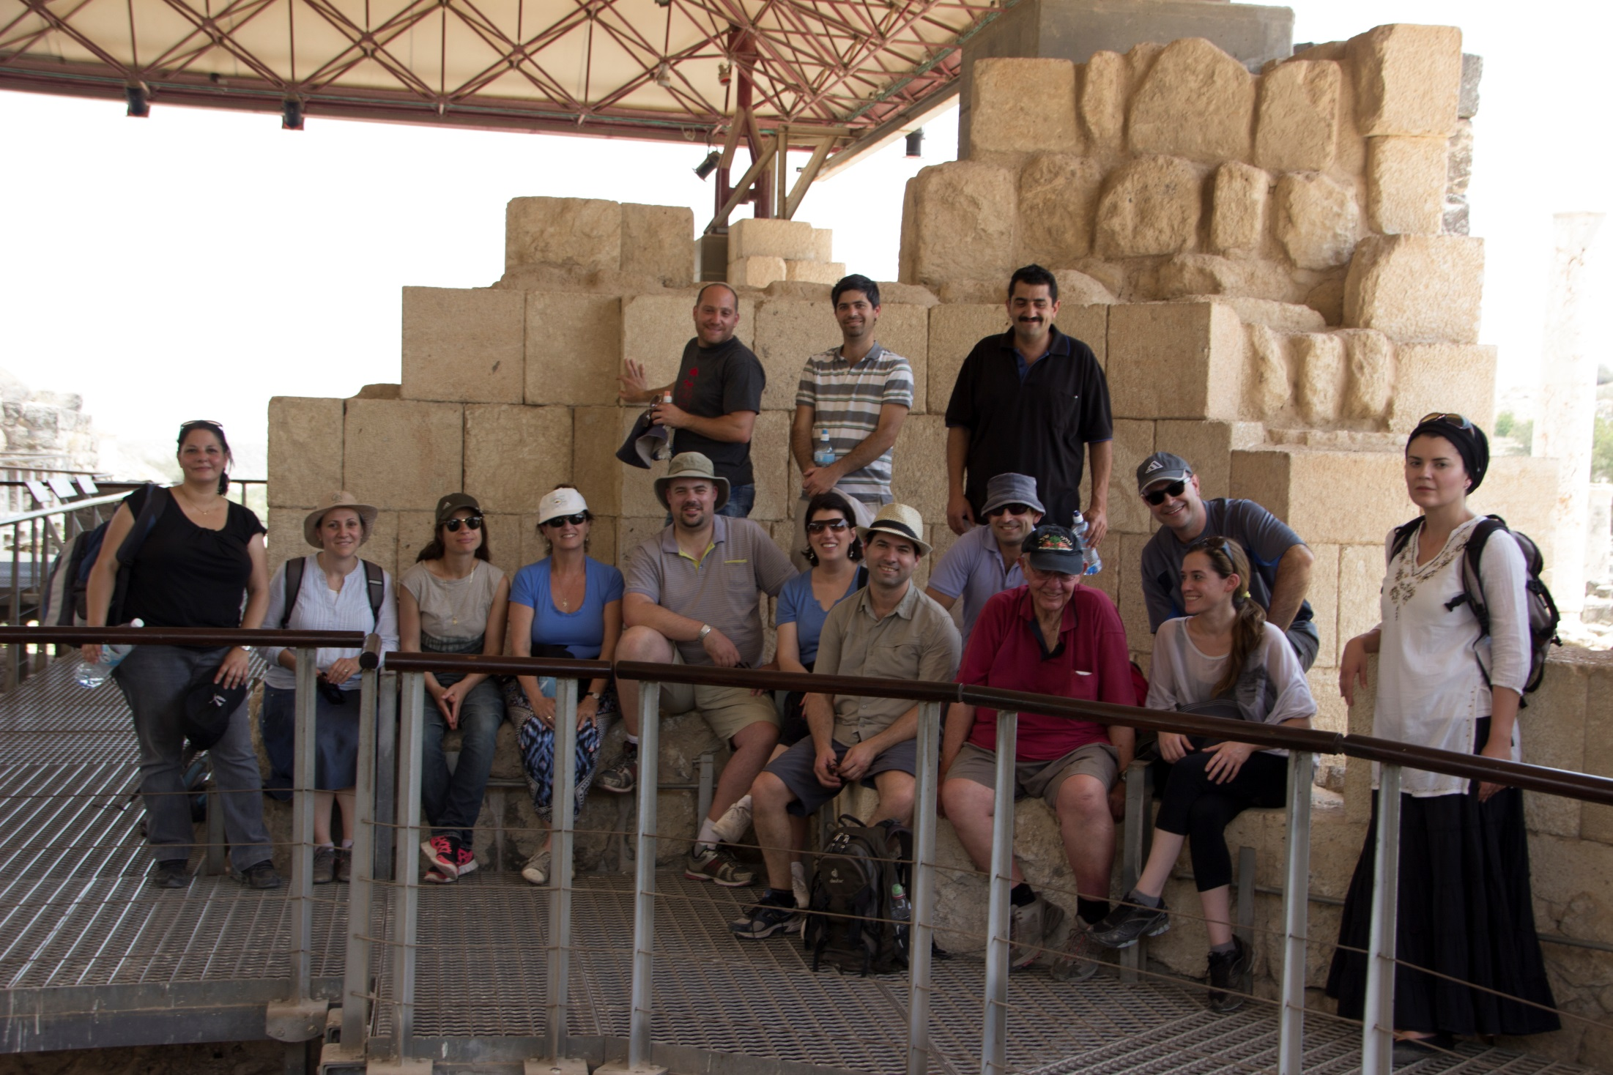
Dr. Imad Matouk
Prof. Avraham Hochberg
Thank you!
Notes:
Finally , I would like to emphasize the profound contribution of Prof Hochberg’s lab members and especially of the first author on most of our recent scientific papers, Dr Imad Matouk.
Thank you.

Slide 32
Validated/possible patterns through which H19 LncRNA can perform its function
Regulates IGF2 imprinting
H19 LncRNA
Cis
Trans
miR-675
Precursor .
Induces proliferation differentiation and
Limits placental
growth .
Induces EMT.
Endogenous sponge for let-7.
Modulates muscle differentiation ; Glucose metabolism, and
Induces EMT.
Chromatin modifier. e.g. Partner for MBD1, EZH2. Fine tunes imprinted status of genes in the cluster . Induces EMT.
Antisense Transcript for HOTS tumor suppressor protein.
Competes for stabilizing RNA binding proteins. e,g, IGFBP. Regulates IGF2 stability .

