Slide 1
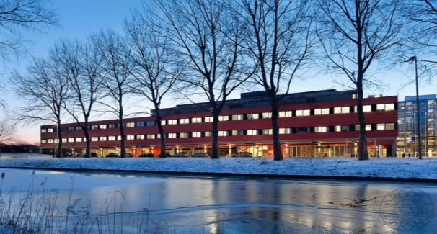
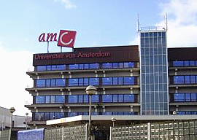
4thinternational conference on Nephrology & Therapeutics September 14-16, 2015 Baltimore, USA Renal dysfunction and metabolic syndrome: the chicken or the egg? Elena Rampanelli Academic Medical Center, University of Amsterdam, The Netherlands

Slide 2
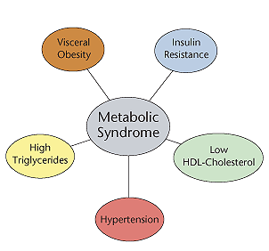
Metabolic syndrome
Type 2 Diabetes
Renal dysfunction
Tubular atrophy,
Interstitial fibrosis,
Glomerulosclerosis
Hearth disease
Stroke
Fatty Liver Disease
Notes:
2
Obesity and dyslipidemia can induce kidney injury independently of hypertension and diabetes.
Metabolic syndrome is a cluster of conditions — increased blood pressure, a high blood sugar level, excess body fat around the waist and abnormal cholesterol levels — that occur together, increasing your risk of heart disease, stroke and diabetes.

Slide 3
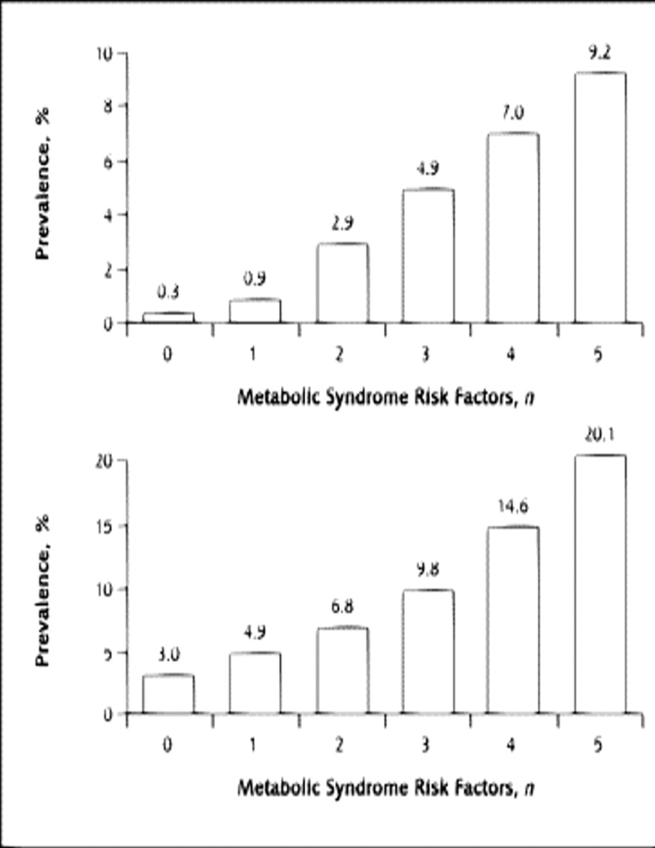
Metabolic syndrome & Renal dysfunction
In 1974, first description of an association between Metabolic Syndrome & Nephrotic proteinuria.
Serum lipid abnormalities (high TG, low HDL)
Associate with significantly increased risk of CKD,
Predict the development of renal dysfunction.
Increasing BMI associates with increased risk of developing ESRD.
Renal dysfunction appears long before hypertension/diabetes
in Metabolic syndrome.
Metabolic syndrome patients have
2.5-fold higher risk of developing CKD,
2-fold higher risk for microalbuminuria.
Prevalence of CKD
Chen et al. Ann Intern Med. 2004
N° Metabolic Syndrome components
Notes:
3
Obesity and dyslipidemia can induce kidney injury independently of hypertension and diabetes.
Metabolic syndrome is a cluster of conditions — increased blood pressure, a high blood sugar level, excess body fat around the waist and abnormal cholesterol levels — that occur together, increasing your risk of heart disease, stroke and diabetes.

Slide 4
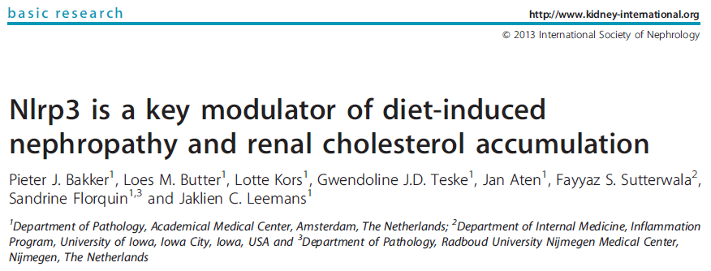
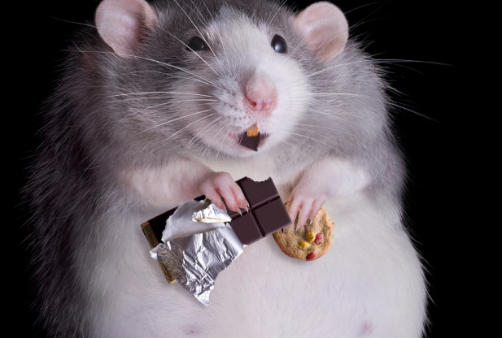
Murine model of diet-induced metabolic kidney injury
Mice: wild-type C57BL/6 and NLRP3 knock-out
Western-type diet
(energy derived from fat 43% vs. 11% in control; 0,15% extra cholesterol)
Weight gain
Insulin resistance
Dyslipidemia
Western-diet
Renal pathology
Renal steatosis
Cholesterol & phospholipid accumulation
Renal inflammation & fibrosis
Microalbuminuria
Notes:
4
43% energy from fat vs. 11% in control
0,15% extra cholesterol
Weight gain, insulin resistance, dyslipidemia
Renal steatosis,
Cholesterol & phospholipid accumulation in proximal tubules
Renal inflammation & fibrosis
Microalbuminuria & Increased sodium excretion
Ko mice
Less renal steatosis, less tubular cholesterol & phospholipids
Less renal inflammation & fibrosis
Less microalbuminuria

Slide 5
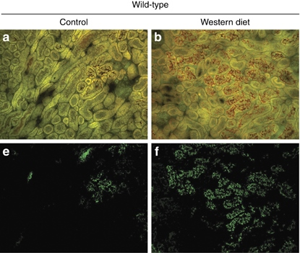
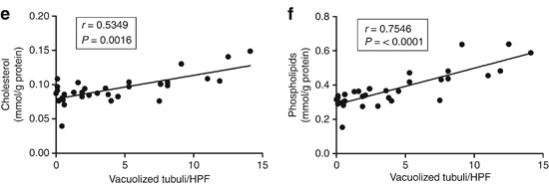
Kidneys in Murine model of Metabolic syndrome
Nile Red positive vacuoles
Phospholipid accumulation
Renal cholesterol and phospholipid levels in vacuolized tubuli.
Notes:
5
Obesity and dyslipidemia can induce kidney injury independently of hypertension and diabetes.
Metabolic syndrome is a cluster of conditions — increased blood pressure, a high blood sugar level, excess body fat around the waist and abnormal cholesterol levels — that occur together, increasing your risk of heart disease, stroke and diabetes.

Slide 6
Causes of renal dysfunction in Metabolic syndrome??
Glomerular hyperfiltration
Excess reabsorption
Physical compression
by adipose tissue
Hyperlipidemia
Renal lipotoxicity
Effects of LDL on tubular epithelial cells?
Cell viability
Intracellular Lipid accumulation
Tubular function
Inflammation
RAAS activation
Glomerular and tubulointerstitial
remodeling/injury

Slide 7
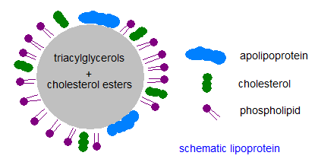
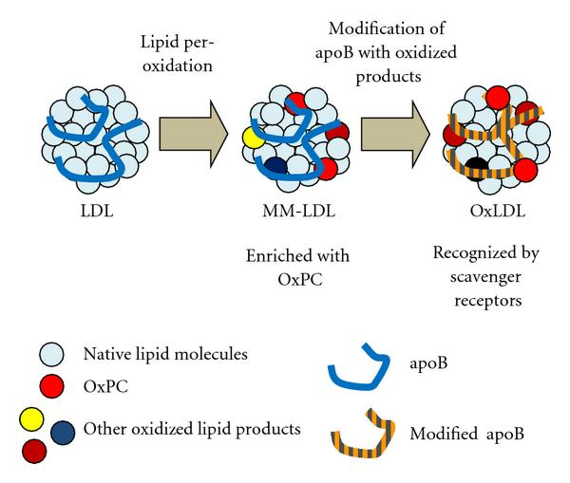
Experimental Approach
Lipoproteins from plasma of
human healthy donors.
Oxidation of LDL (oxLDL) with copper sulfate.
Tubular epithelial cells (TEC): HK2, immortoTEC, MDCK
LDL 5µg/ml LDL for 1/3/5 days
Control Lipoprotein-deficient serum (LPDS).

Slide 8
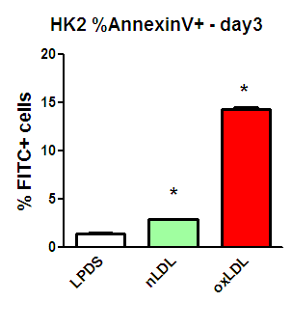
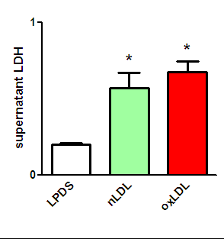
Harmful effects of LDL on TECs
Lactate Dehydrogenase (LDH)
Cytotoxicity Assay
Apoptosis
AnnexinV staining
% Annexin V+ cells
HK2 cells
Notes:
24h

Slide 9
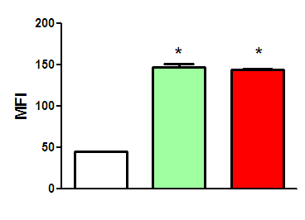
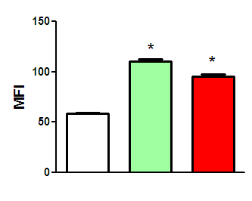
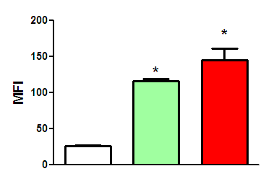
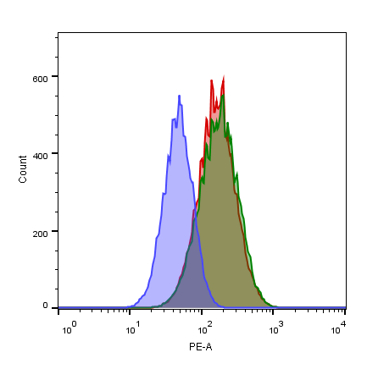
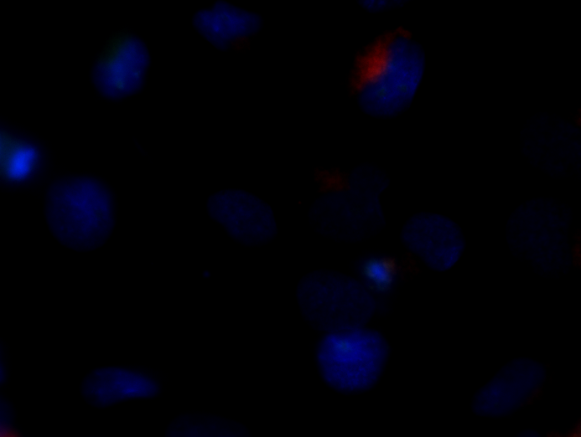
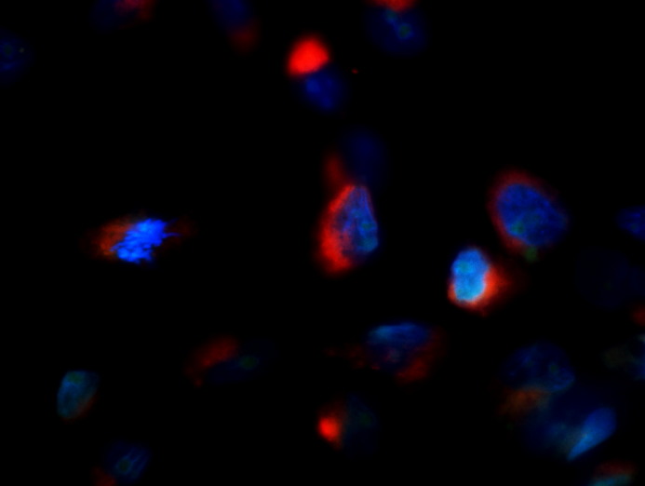
LDL-induced phospholipidosis formation in TECs
HK2
ImmortoTEC
MDCK
Phospholipidosis: lysosomal accumulation of phospholipids
LipidTOX Phospholipidosis Red Detection Kit
(Life Technologies).
HK2 3 days oxLDL
ctr nLDL
HK2 oxLDL
ctr nLDL
Ctr LPDS
nLDL
oxLDL
100x
HK2 ctr LDL
Notes:
DAY 3
HK2 23-11-14
TEC 5-5-14
MDCK

Slide 10
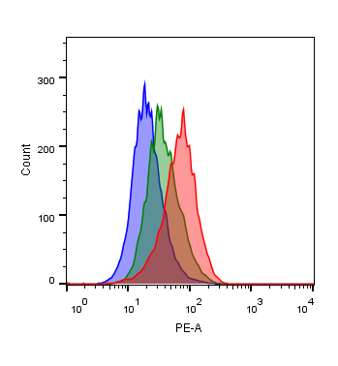
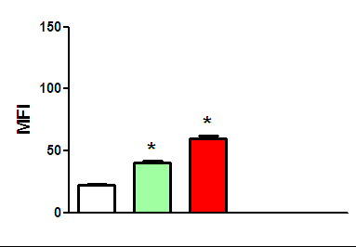
Enlargement of the lysosomal compartment upon LDL
HK2 cells – day 3
LysoTracker Red
labeling and tracking acidic organelles in live cells
3 days
LysoTracker Red MFI
Ctr LPDS
nLDL
oxLDL
ctr nLDL oxLDL
3 days
Notes:
11-5-14 Lp132
Lysotracker 50nM 1h 37C

Slide 11
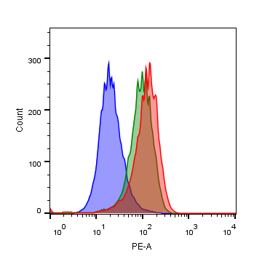
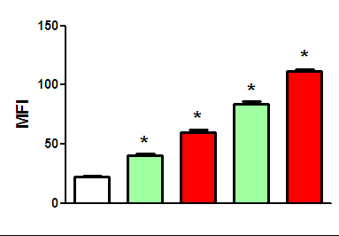
Enlargement of the lysosomal compartment upon LDL
HK2 cells – day 3/5
LysoTracker Red
labeling and tracking acidic organelles in live cells
5 days
LysoTracker Red MFI
ctr nLDL oxLDL
Ctr LPDS
nLDL
oxLDL
3 days
5 days
Ctr nLDL oxLDL
LAMP-2
β-actin
Notes:
11-5-14 Lp132
Lysotracker 50nM 1h 37C

Slide 12
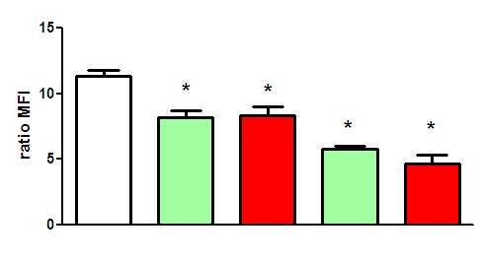
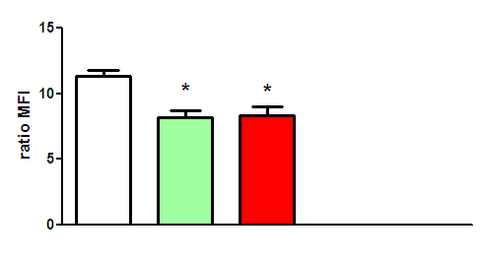
Impaired lysosomal acidification upon LDL
HK2 cells
LysoSensor Green: Low pH-dependent fluorescent dye
LysoTracker Red: Labeling acidic organelles
FC
Lysosensor MFI / Lysotracker MFI
Ctr LPDS
nLDL
oxLDL
3 days
Notes:
HK2 LYSOSENSOR + LYSOTRACKER
1/ 3/ 5 days Lp136/ Lp137 23-7-14
Lysotracker 50nM 1h 37C

Slide 13
Impaired lysosomal acidification upon LDL
HK2 cells
LysoSensor Green: Low pH-dependent fluorescent dye
LysoTracker Red: Labeling acidic organelles
FC
Lysosensor MFI / Lysotracker MFI
Ctr LPDS
nLDL
oxLDL
3 days
5 days
Notes:
HK2 LYSOSENSOR + LYSOTRACKER
1/ 3/ 5 days Lp136/ Lp137 23-7-14
Lysotracker 50nM 1h 37C

Slide 14
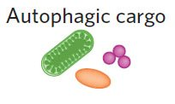
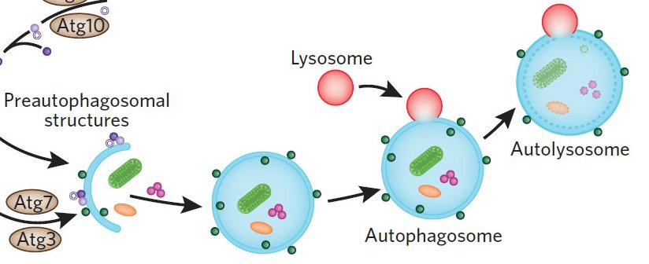
LDL-loading induces autophagy
WB
Ctr nLDL oxLDL
n/oxLDL
increase in LC3-II
decrease in LC3-I expression
LC3B I
LC3B II
β-actin
LC3B I
LC3B II
β-actin
ImmTEC
HK2
Notes:
Wb lc3b 30-12-15
11-5-14 Lp132 DAY 3 LAMP2 LC3B
Autophagy: intracellular degradation system
Unnecessary/ dysfunctional cytoplasmic components to lysosomes
LC3B II: recruited to autophagosomal membranes
increase in LC3-II + decrease in LC3-I expression as the hallmark of autophagy

Slide 15
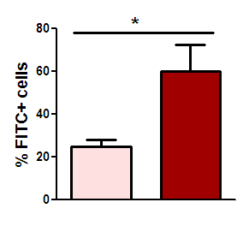
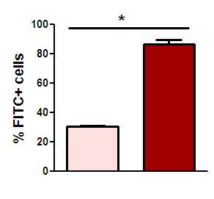
Autophagy as a protective mechanism
ATG5 knockdown (Short hairpin RNA)
Without autophagy More Apoptosis
% Apoptotic Annexin V+ cells upon oxLDL
-
-
3 days
+
+
ATG5
HK2
ImmortoTEC
Notes:
26-12-13 WB LAMP-2
11-5-14 Lp132 DAY 3 LAMP2 LC3B
Autophagy: intracellular degradation system
Unnecessary/ dysfunctional cytoplasmic components to lysosomes
LC3B II: recruited to autophagosomal membranes

Slide 16
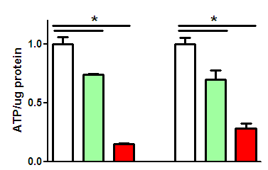
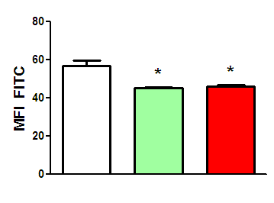
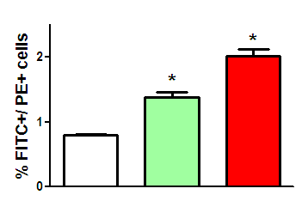
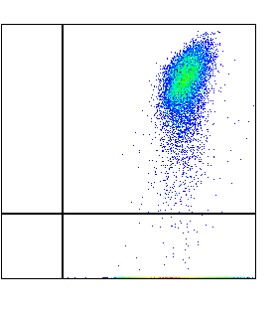
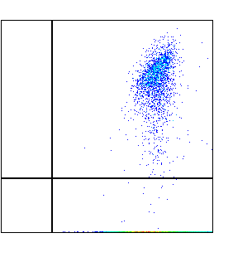
Impaired function after n/oxLDL treatment:
Less absorption
, ATP
, integral mitochondria
Glucose uptake
2-NBDG
Intracellular ATP
5 days
Ctr LPDS
nLDL
oxLDL
MDCK
MDCK HK2
Ctr LPDS
nLDL
Oxidative stress - ROS
Mitochondrial damage
5 days
Q2
58%
Q2
30%
Ctr LPDS
nLDL
oxLDL
PE
% Q3/ %Q2
Q3 42%
Q3 70%
FITC
HK2
Notes:
GLUCOSE MDCK 25-10-14
ATP MDCK HK2 22-11-14
MITOCH DAMAGE 29-10-14

Slide 17
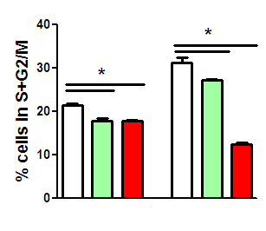
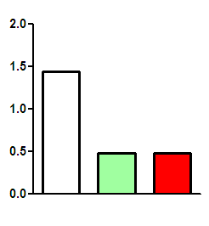
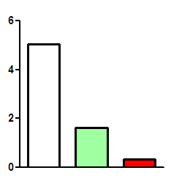
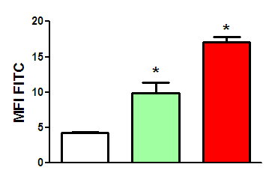
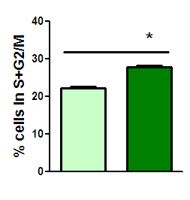
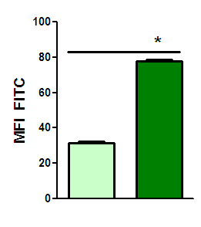
Impaired function after n/oxLDL treatment:
Improper response to EGF
Proliferation
Signaling activation
EGFR PI3K
5 days
Ctr LPDS
nLDL
oxLDL
Phospho/tot
HK2
-
EGF
+
+
EGF
+
Cholesterol-depletion
Methyl-β-cyclodextrin (MβC)
Cholesterol-rich microdomains
Cholera toxin subunit B- FITC
Proliferation surface EGFR
nLDL
MβC
-
-
+
+
Notes:
EGF 20ng/ml
MbC 10mM

Slide 18
Low-grade inflammation in Metabolic syndrome
renal steatosis
cholesterol & phospholipid accumulation
fibrosis
macrophage influx
microalbuminuria
NLRP3 deficiency protects against
NLRP3 mediates high fat diet-induced metabolic renal injury
Notes:
18

Slide 19
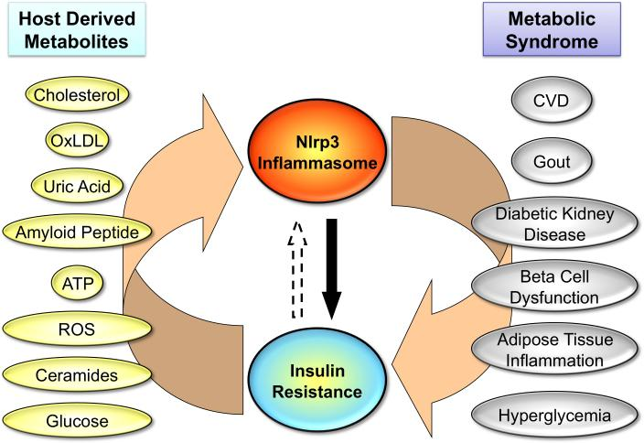
Low-grade grade metabolic inflammation:
NLRP3 inflammasome
Activated in CKD & diabetic nephropathy (DN)
Triggers onset of DN
Mediates diet-induced nephropathy & renal cholesterol accumulation
Mori et al., Nat. Med., 2011
Notes:
19

Slide 20
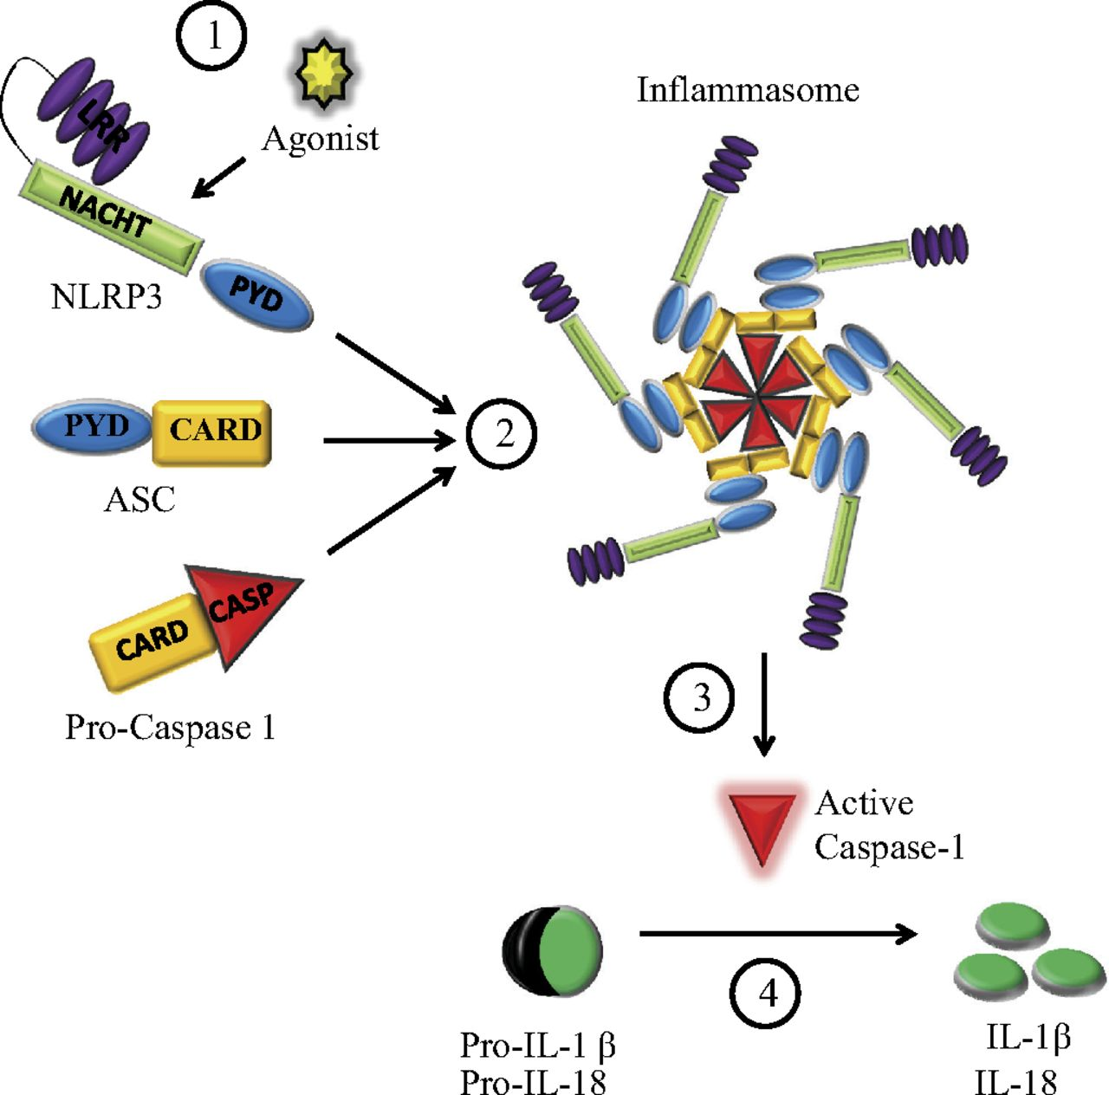
Low-grade grade metabolic inflammation:
NLRP3 inflammasome
NLRP3 Inflammasome
Cytoplasmic innate immune multiprotein complex
Nod-like receptor protein 3 NLRP3,
adaptor ASC,
pro-caspase-1
IL-1β and IL-18 maturation
dos Santos et al., Am. Journ. Physiol., 2012
Notes:
20
Two steps for maturation of IL-1β:
first signal leads to synthesis of pro-IL-1β and other components of the inflammasome, such as NLRP3 itself;
second signal results in the assembly of the NLRP3 inflammasome, caspase-1 activation and IL-1β secretion.

Slide 21
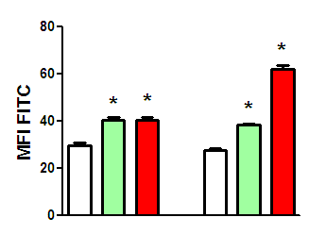
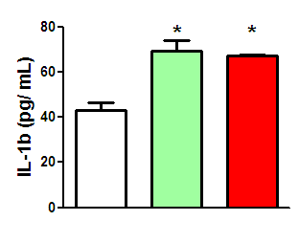
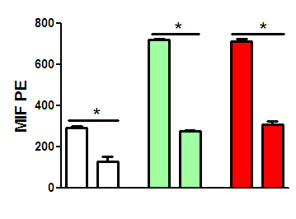
NLRP3 activation in metabolic overloading
IL-1β secretion
Caspase-1 activation
Silencing inflammasome components
Ctr LPDS
nLDL
oxLDL
Phospholipidosis
HK2
24h
1 day 3 days
shRNA ASC
3 days
Ctr
nLDL
oxLDL
ASC
+
-
+
-
+
-
Notes:
EGF 20ng/ml
MbC 10mM

Slide 22
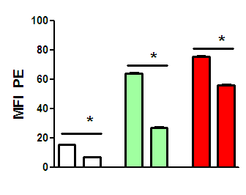
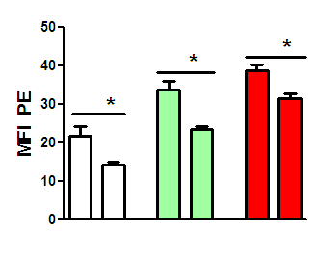
NLRP3 activation in metabolic overloading
IL-1β secretion
Caspase-1 activation
HK2
Silencing inflammasome components
Without NLRP3/ASC complex Less Phospholipidosis
Ctr LPDS
nLDL
oxLDL
Phospholipidosis
3 days
Ctr
nLDL
oxLDL
shRNA NLRP3
sgRNA NLRP3
24h
HK2 day 1 day 3
+
-
+
-
+
-
+
-
+
-
+
-
NLRP3
Notes:
EGF 20ng/ml
MbC 10mM

Slide 23
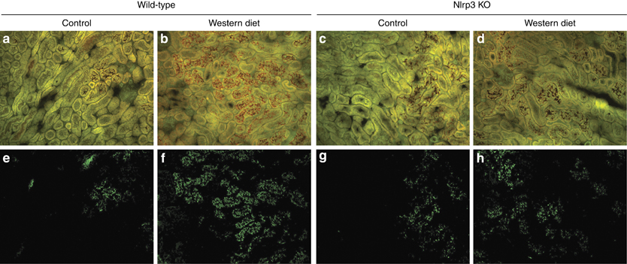
Absence of NLRP3 prevent excessive intracellular lipid deposition in proximal tubules
WT
NLRP3 KO
Nile Red staining

Slide 24
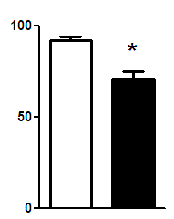
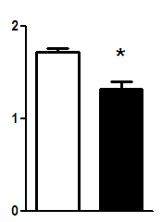
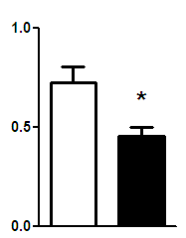
Absence of NLRP3 attenuates Western-diet-induced lipid accumulation in kidneys
WT
NLRP3 KO
Chol PG LPG BMP PC
PI SPA SPH LacCer Plasmalogens
p=0,057

Slide 25
PROPOSED MECHANISM
EGF
LDL
GFs
Cholesterol
Plasma membrane
LDL
Phospholipids
Cholesterol
Triacylglycerols
Apolipoprotein
Lysosome
Signaling
LDL
Mitochondria
V-ATPase
Apoptosis
LC3 II
ATP
Autophagy
Proliferation
Notes:
EGF 20ng/ml
MbC 10mM

Slide 26
PROPOSED MECHANISM
EGF
LDL
GFs
IL-1β
Cholesterol
Plasma membrane
LDL
Lysosome
LDL
Mitochondria
Apoptosis
LC3 II
ATP
Autophagy
NLRP3
Proliferation
Notes:
Autophagy prevent inflammasome activation
Can degradate IL1b

Slide 27
Department of Pathology, AMC, University of Amsterdam Jeroen Bakker Loes Butter Nike Claessen Peter Ochodnicky Sandrine Florquin Jaklien C. Leemans
Acknowledgement
Institute for Clinical Chemistry,
University Hospital of Regensburg, Germany Evelyn Orsó
Gerhard Liebisch
Gerd Schmitz
Vici

