Slide 1



3rd International Conference and Exhibition on Clinical & Cellular Immunology
Elena Gavrilova
Application of drugs based on release-active antibodies as immunotherapy agents
OOO “NPF “Materia Medica Holding”,
Moscow, Russia

Slide 2
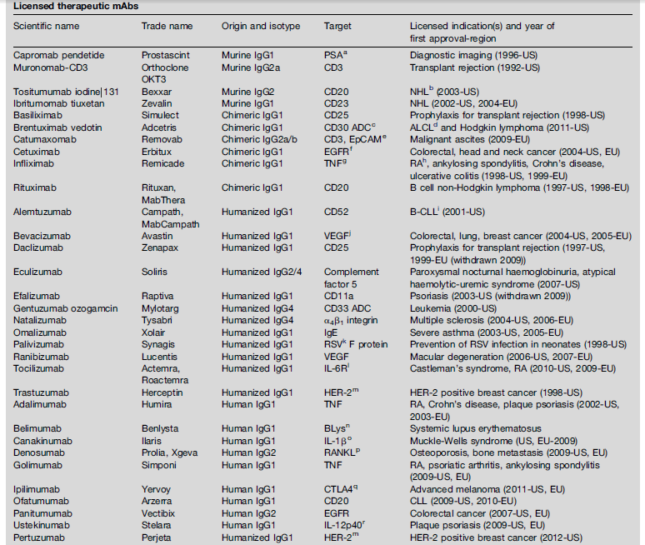
Monoclonal antibodies approved for therapeutic use
Buss NAPS et all// Current Opinion in Pharmacology, 2012

Slide 3
Limitations in mAbs-based therapies
Attributes
Description
Safety of biological material used
Potential cancer risk in case of EBV introduction
Generating stoichiometric amounts of heavy and light chains
Glycosylation profile
Production
Cost
Production cost is 300-500 million euros
Annual cost of therapy is US$100 000 per patient
Rapid elimination of mAbs
Non-linear PK and PD profile
Effect of demographic variables on mAbs PK
Tissue penetration properties
Pharmacokinetics
Route of administration
Intra-venous infusions
Safety
Immunogenicity
Side-effects
H. Samaranayake et al, Annals of Medicine, 2009
Notes:
3

Slide 4
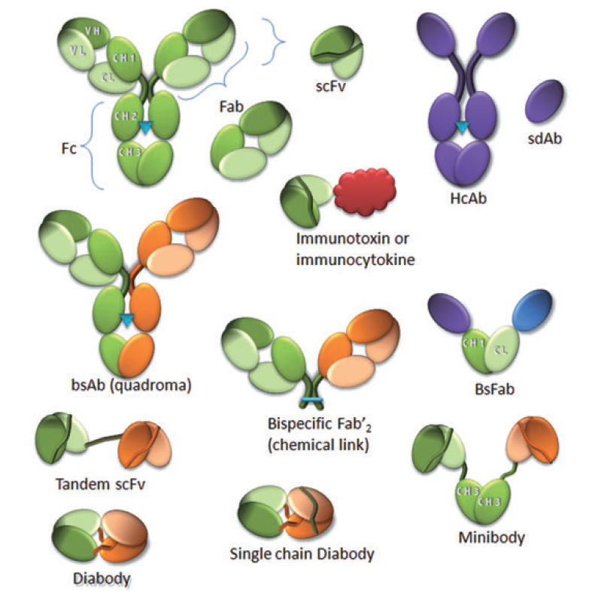
Antibodies engineering to safety and efficacy increase
Ab fragments with therapeutic potential
P. Chames et al, British Journal of Pharmacology, 2009
Notes:
4

Slide 5
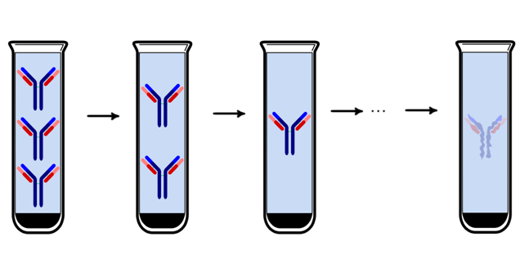
Release-active antibodies
Method: A combination of multiple rounds of consequent decrease in the substance’s initial concentration and physical treatment
Substance: Rabbit polyclonal antibodies to different targets
Level of Abs concentration reduction: 10²⁴
Antibody as initial substance
Modified activity
The technology was discovered d by Prof. Dr. Oleg Epstein (Epstein O.I., 1999, Epstein O.I. et al, Usp. Fiziol. Nauk, 2013).
Notes:
5

Slide 6
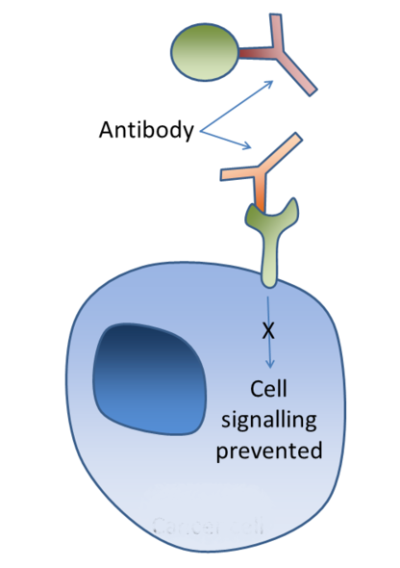

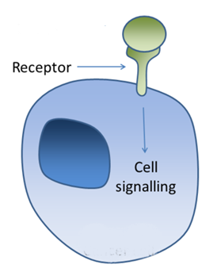
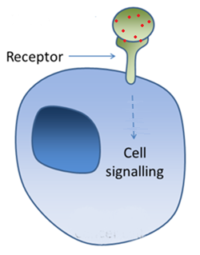
Ligand-receptor binding
How monoclonal antibodies work?
How release-active antibodies work?
mAbs neutralize
the targets
RA-Abs modify
the target
Regular process
RA-Abs
Modified target
Ligand
Receptor

Slide 7
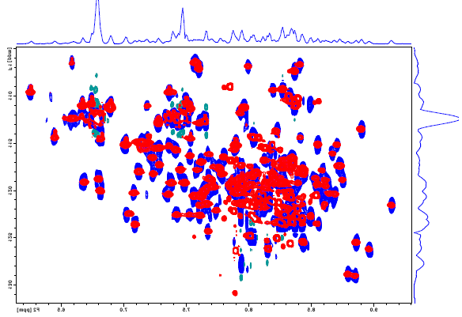
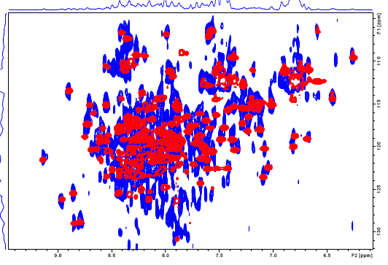
Study of influence RA of Ab to IFNγ on interferon-gamma by NMR
Preclinical site: Department of Structural Biology University of Pittsburgh School of Medicine (USA)
Design: ⁵N-¹H-HSQC spectra of IFN-γ in absence (colored in blue) and present of RA of Ab to IFN-γ or placebo (colored in red)
2D HSQC Spectrum of IFNg
IFNg + placebo
IFNg + RA of Ab to IFNg
IFNg
IFNg + vehicle
IFNγ + RA Abs to IFNg
Conclusion: Addition of concentrated RA of Abs to IFNγ causes specific chemical shift changes in two-dimensional ¹H,¹⁵N-HSQC spectra of ¹⁵N-labeled IFNg, located primarily at the IFNg dimer interface

Slide 8
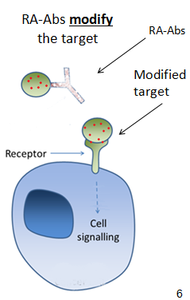
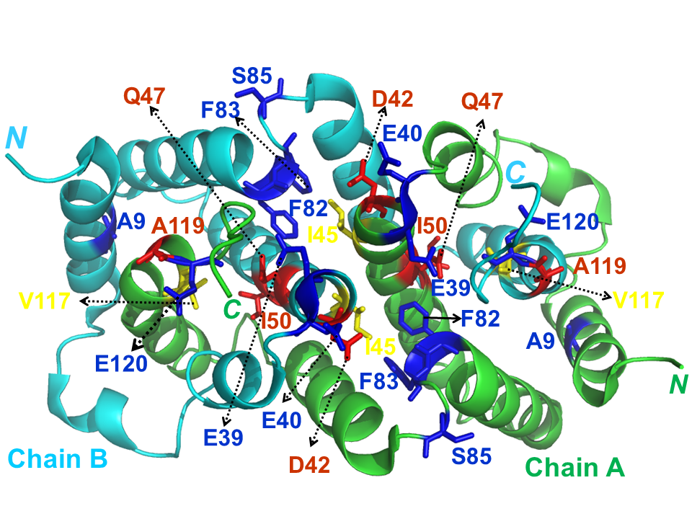
Study of influence RA of Ab to IFNγ on interferon-gamma
Site: Department of Structural Biology University of Pittsburgh School of Medicine (USA)
Main aa effected by RA Abs to IFNg
RA Abs to IFNg
IFNg
Receptor IFNg
Conclusion: The interferon-gamma sites which affected by Anaferon for children were founded
Notes:
8

Slide 9
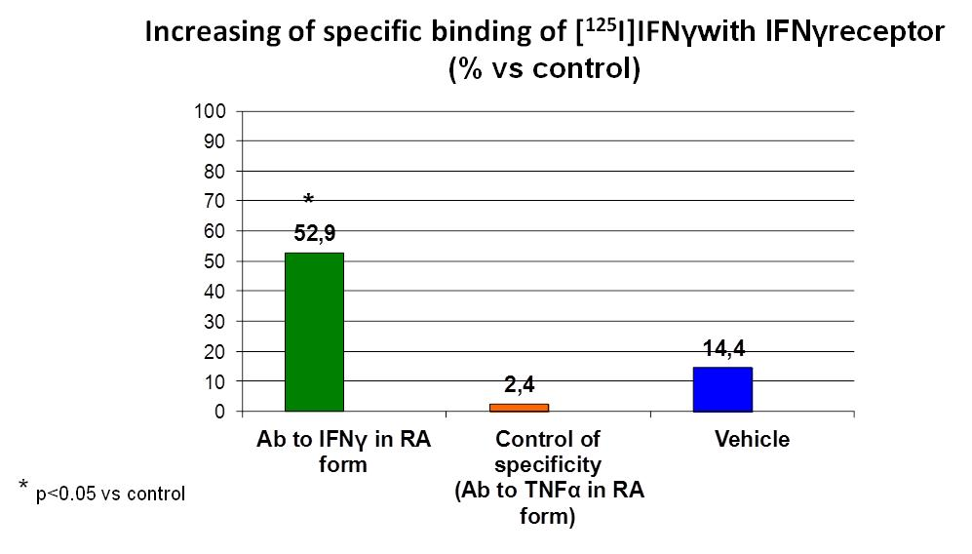
Study of influence RA of Ab to IFNγ on interferon-gamma
Agent: Ab to Interferon gamma in RA form
Site: Euroscreen (Belgium)
Assay: Radioligand binding assay
*p< 0.05 vs vehicle
Conclusion: RA Abs to IFN gamma significantly increase the specific binding of IFNg with IFNg receptor
Notes:
9

Slide 10
List of main Materia Medica drugs based
on RA antibodies
Notes:
10

Slide 11
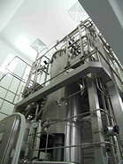
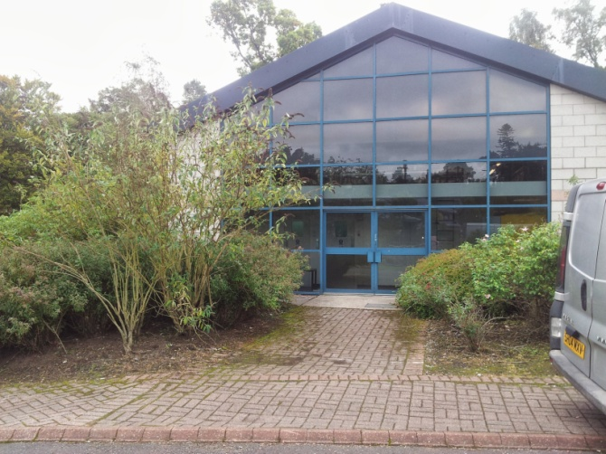
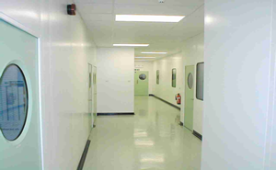
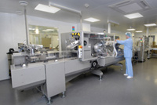
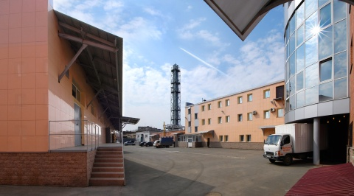
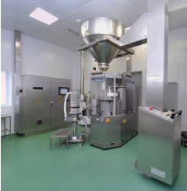
Manufacture
Antigen production:
Recombinant protein production
AB Biotechnology facility, UK
Immunization of SPF rabbits and
antiserum preparation
Affinity purified antibodies preparation:
Delipidization of antiserum
Viral inactivation stages
Affinity chromatography
Rabbit polyclonal affinity purified antibodies – Drug Substance
Materia Medica Holding facility, RF
Preparation of Drug Substance release-active dilutions
Preparation of Drug Product dosage form
Orodispersible tablets
Notes:
11

Slide 12
RA antibodies-based drugs preclinical studies
Toxicological studies
Pharmacological activity studies
Mechanism of action studies
Well planned and controlled
Performing in accordance with current requirement
Performed by world leading research institutions and CRO
Main European collaborators of Materia Medica
University Paris-Diderot, (France) Apcis SA (France) Pelvipharm (France) Syncrosome (France) CEREP SA (France) Porsolt & Partners Pharmacology (France) Urosphere S.A.S (France) Euroscreen S.A. (Belgium) U-CyTech biosciences (the Netherland) BioMedCode (Greece) MD Biosciences (Switzerland) Orthotopix Ltd (Finland) Pharmahungary 2000 Ltd (Hungary) Rheoscience A/S (Denmark)
University of Pitsburg (USA) Southern Research Institute (USA) Bhat Bio-tech India (P) Ltd (India) Monash University (Australia) PRECOS (UK) HD Biosciences Co.,Ltd (China) Novascreen Biosciences Corporation, (USA) Dabur Research Foundation, (India) London Imperial College, (UK) Ricerca Biosciences, LLC (USA) Zen-Bio Inc. (USA) University of Tromsø (Norway) Utah State University (USA)
12

Slide 13

RA antibodies-based drugs clinical studies
Clinical sites location:
Russian Federation
Commonwealth of Independent States
Asia
Number of clinical sites:
> 100, one-site and multi-central studies
Design of studies:
Double Blind Randomized Placebo Control or Comparative
Number of patients enrolled:
About 30 000
Notes:
13

Slide 14
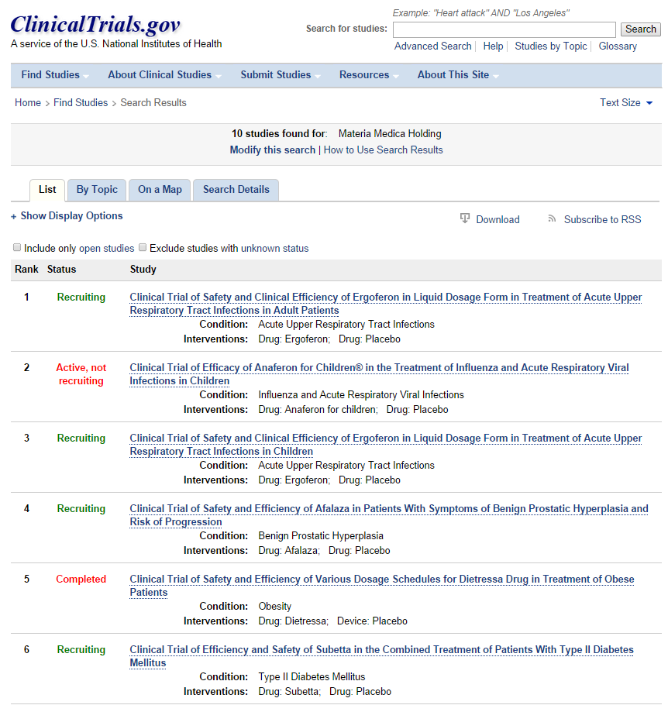
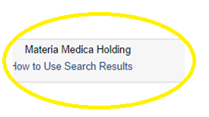
RA antibodies-based drugs clinical studies
14

Slide 15
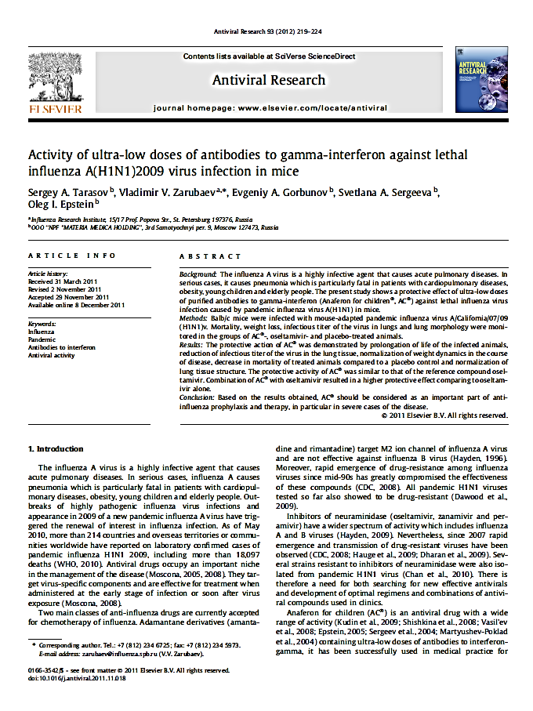
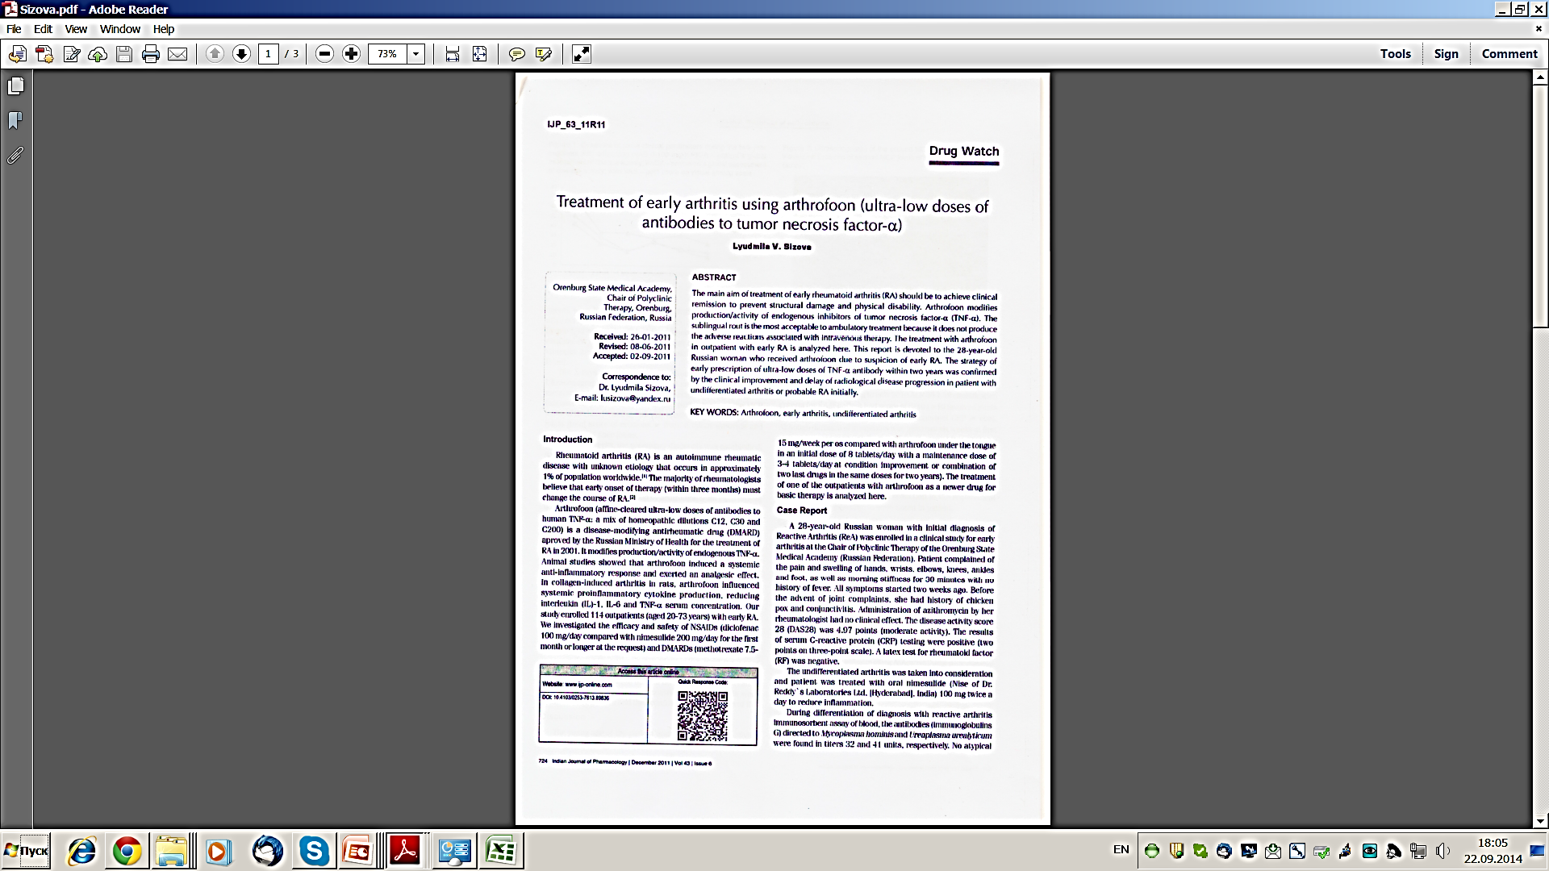
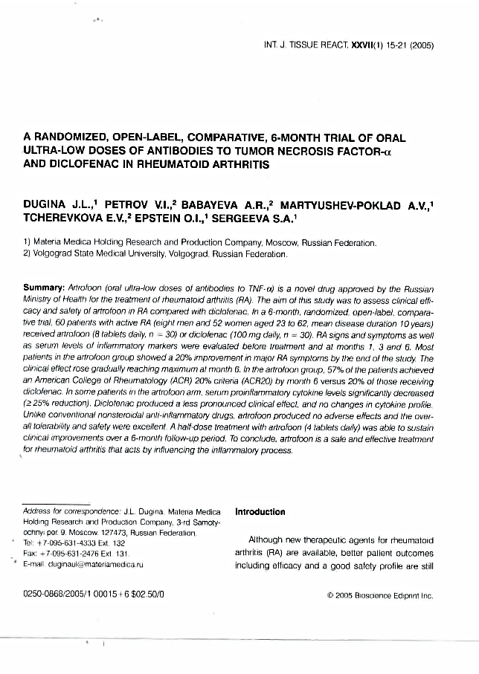
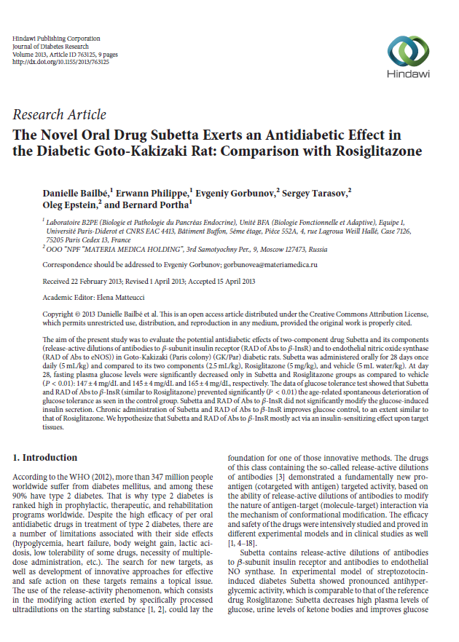
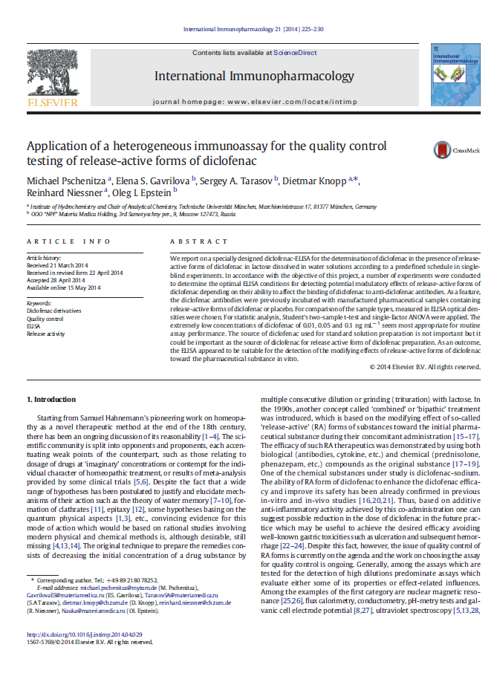
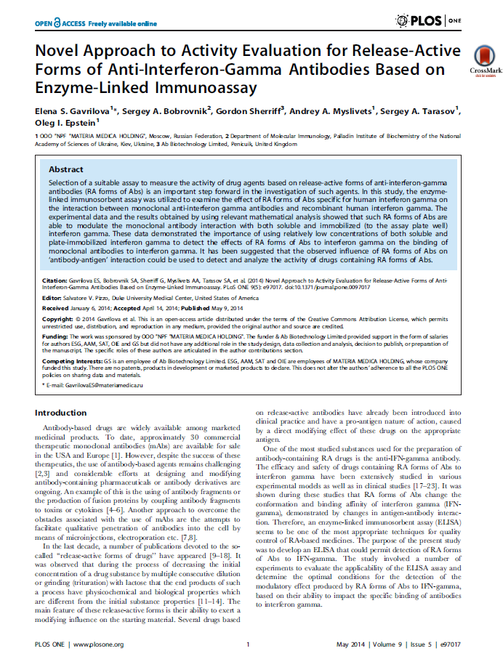
Publications

Slide 16
RA Abs to be discussed:
RA Abs to IFN-gamma (IFNg)
IFN-gamma is a cytokine with antiviral and antiparasitic activities, inhibiting the proliferation of a number of cells.
RA Abs to S-100 protein (S100)
S-100 protein is a Ca²⁺⁻binding neuropeptide which play an important role in appearance of depression, anxiety etc.
RA Abs to endothelial NO synthase (eNOS)
Endothelial NO synthase is an enzyme catalyzing the production of nitric oxide. This enzyme is one of the responsible for appearance of sexual motivation.

Slide 17
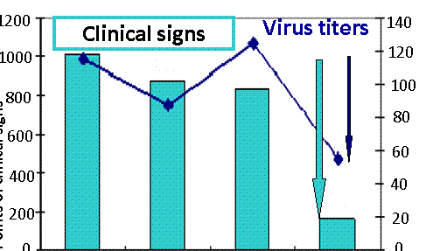
Efficacy of RA of Abs to interferon-gamma (IFNg):
Antiviral activity against DNA-viral infections
Preclinical site: Research institute for epidemiology and microbiology (Russia)
Model: genital herpes ( herpes simplex virus strain type 2) in guinea pigs
Points of clinical signs
Lg of virus titers
Control acyclovir RA Abs to IFNg RA Abs to IFNg
(treatment) (treatment and prophylaxis)
Conclusion: There were decreases of the virus titer and points of a clinical signs in RA Abs to IFNg group in comparison with control and reference standard group
Epstein O.I., Vestnik MAN RS, 2008
Notes:
Efficacy of anaferon agains DNA viruses was shown in models of lethal and non lethal herpes viral infection in mice and guinea pigs. Anaferon was comparable with acyclovir
17

Slide 18
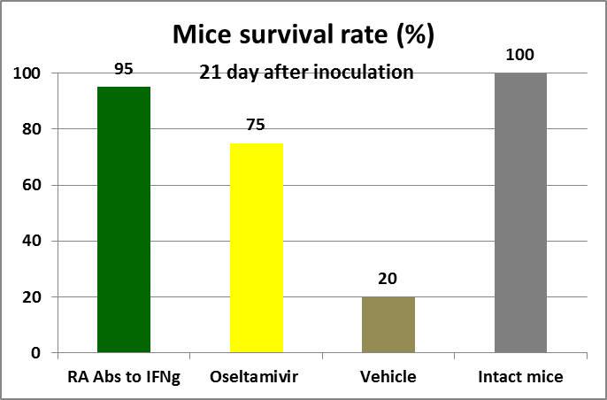
Efficacy of RA Abs to IFNg:
antiviral activity against RNA-viral infections
Preclinical site: APcis S.A. (France)
Virus: influenza A/Equine/2/Miami/1/63 (H3N8)
***
***
*** p<0.001 vs control
Conclusion: Survival rate in RA Abs to IFNg group was comparable to Oseltamivir group
Submitted for publication
Notes:
In the next few slides I’ll present some examples of efficacy of our drugs.
Viral infections. In vitro and in vivo preclinical studies conducted in France showed high antiviral activity of ultralow doses of antibodies to interferon gamma against different RNA viruses, including retroviruses and pandemic influenza H1N1. Efficacy was not less then tamiflu and azidothimidine showed.
18

Slide 19
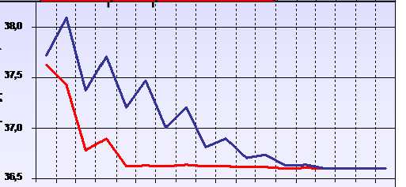
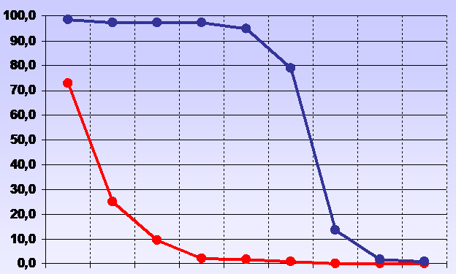
Clinical studies of RA Abs to IFNg
Antiviral activity against DNA-viral infection
Site: Tomsk Institute of pharmacology (Russia)
Design: Randomized double blind placebo-controlled in 236 patients (1-18 y.o.) with chickenpox
T, ⁰C
The duration of fever
Percent of patients with itch
1 2 3 4 5 6 7 8 9, d
1 2 3 4 5 6 7 8 9,d
Ra Abs to IFNg
Placebo
Conclusion: Administration of Ra Abs to IFNg reduced the duration of fever at 2.7 days, the time of appearance of new lesions - 3.3 days, itch - 4.2 days.
Kudin M.V. et al, CHILDREN INFECTIONS, 2007
Notes:
19

Slide 20
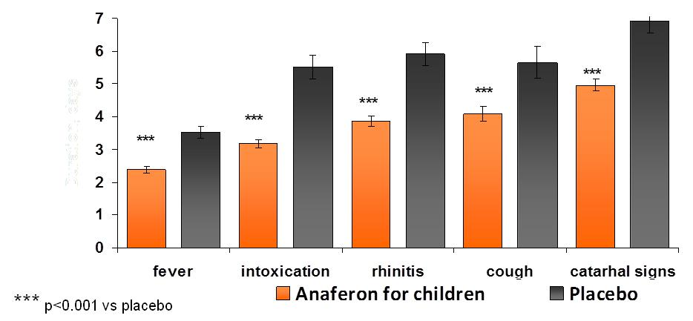
Clinical studies of RA Abs to IFNg
Antiviral activity against RNA-viral infections
Target: Interferon gamma
Agent: Ab to Interferon gamma in RA form
Site: Influenza institute (Russia); Russian State Medical University (Russia)
Design: Randomized double blind placebo-controlled in 255 patients (0.5 – 14 y.o.) with upper respiratory viral infections
Duration of major clinical signs (days)
RA Abs to IFNg
Conclusion: Administration of RA Abs to IFNg significantly reduced the duration of clinical signs in comparison with placebo
Notes:
20

Slide 21
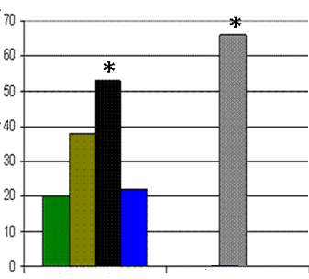
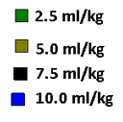
Efficacy of RA Abs to S-100 protein:
anxiolytic activity
Agent: Ab to S100 protein in RA form
Preclinical site: Porsolt & Partners Pharmacology (France)
Model: Vogel conflict test
Number of shocks (% vs vehicle)
* p<0.05 vs vehicle
RA Abs to S100 protein
Clobazam
(64 mg/kg)
Conclusion: There are significant increase in a numbers of shocks in RA Abs to S-100 group in comparison with vehicle
Castagne V., et al //JPP, 2008
Notes:
21

Slide 22
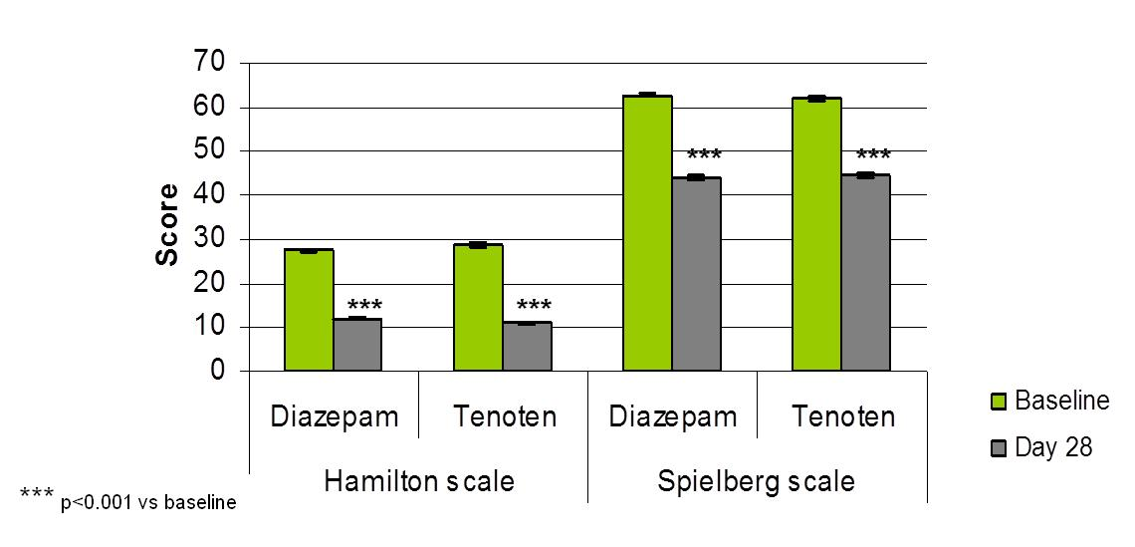
Clinical studies of RA Abs to S-100 protein:
anxiolytic activity
Target: S100 protein
Agent: Ab to S100 protein in RA form
Sites: Four Russian clinical sites
Design: Randomized clinical study in 247 patients (18 – 65 y.o.) with anxiety disorders in comparison with diazepam
Clinical signs assessed by scales
RA Abs to S-100
RA Abs to S-100
Conclusion: Anxiolytic activity of RA Abs to S-100 is close to one of Diazepam
Martyushev-Poklad A, et al //The Practitioner 2006
Notes:
22

Slide 23
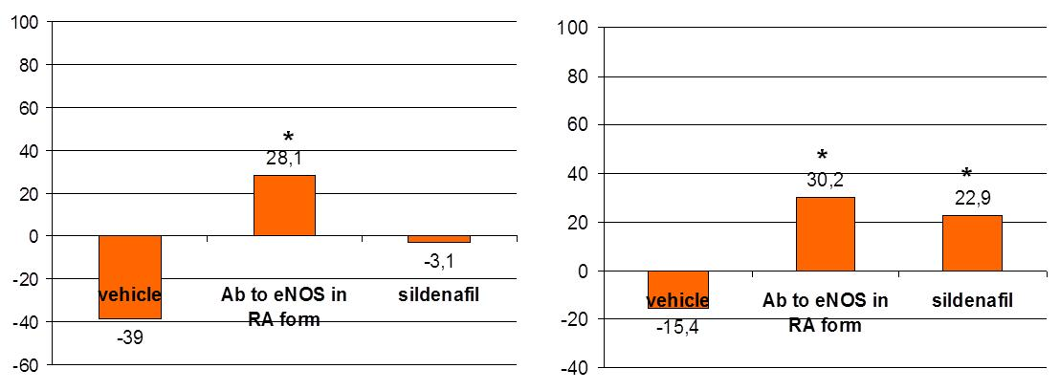
Efficacy of RA Abs to endothelial NO-synthase (eNOS):
sexual activity
Agent: Ab to eNOS in RA form
Preclinical Site: University of Tromsoe (Norway)
Model: assessment of sexual activity of Fischer 344 rats
Change in preference score on day 28 of treatment (% vs baseline)
Change in intromission ration on day 28 of treatment (% vs baseline)
* p<0.05 vs vehicle
Conclusion: Sexual activity of rats increased after receiving of RA Abs to eNOS in comparison with sildenafil and vehicle group
Chu X and Agmo A,// Pharmacol Biochem Be, 2008
Notes:
23

Slide 24
Clinical studies of RA Abs to eNOS:
patients with erectile disfunction
Agent: Ab to eNOS in RA form
Sites: Four Russian clinical sites
Design: Randomized double blind placebo-controlled clinical trial in 169 patients (18 – 70 y.o.) with erectile disfunction
Patients (%) with erectile dysfunction responded to 12 weeks therapy
IIEF – International Index
of Erectile Function (EF)
***
RA Abs to eNOS
***
% of specific binding of radioligand ([3H] pentazocine) with sigma-1 receptor
***
*** p<0.001 vs placebo
Conclusion: There is an significant activity of RA Abs to eNOS in comparison to placebo
Tarasov S.A. et al //Signatura, 2007
Notes:
24

Slide 25
Toxicological studies
Experimental sites:
Research Institute of Pharmacology (Tomsk, Russia),
Volgograd State Medical University (Volgograd, Russia)
Studies:
  Single-dose (acute)toxicity study
  General toxicity study
  Cumulation studies
  Study of mutagenic properties
  Study of allergenic properties
  Study of reproductive toxicity
  Study of postnatal development
Experimental animals:
mice,
rabbits,
guinea pigs,
rats (including sexually immature and infant)
oral
intraperitoneal
subcutaneous
Route of
administration:
  No toxic effects of RA Abs have been revealed exerts positive effect on lactating females (general condition, body weight gain) and postnatal development (facilitates cognition process and memory trace reproduction )
Conclusion:
25

Slide 26
Drugs safety assessment in clinic studies
Sources of data
Safety assessment of the drugs during the clinical studies:
1. The assessment in the course of every planned visit via questioning of patients
2. the assessment of vital functions:
3.the assessment of main laboratory rangers:
  clinical blood analysis
  clinical urine analysis
  biochemical markers
Data from regulatory bodies of countries where the drugs have been registered (15 countries) on adverse events associated with the drug use
Spontaneous reports on adverse events
Reports in international press on adverse events associated with the drug use
Conclusion
  The available data indicates no adverse events associated with the drug use

Slide 27
Main advantages of RA Ab as therapeutic agents
High safety: has been used for 14 years and in ~100 mln patients
High efficacy: demonstrated in clinical studies conducted
(the same or even better than that of the reference drugs)
Oral use
Possibility to combine with other medicinal drugs
Low price
Platform to rapidly screen and develop new drugs
Key Advantages
Medical Benefits
  Long-term use possible
  Use in pediatric practice
  Use in patients with concomitant diseases
  Use for disease prophylaxis
Future prospects
Platform to rapidly screen and develop new drugs
Possibility of testing a plenty of different targets

Slide 28
Thank you for your attention!
Elena Gavrilova
In case of any questions please contact me at:
GavrilovaES@materiamedica.ru

