Slide 1

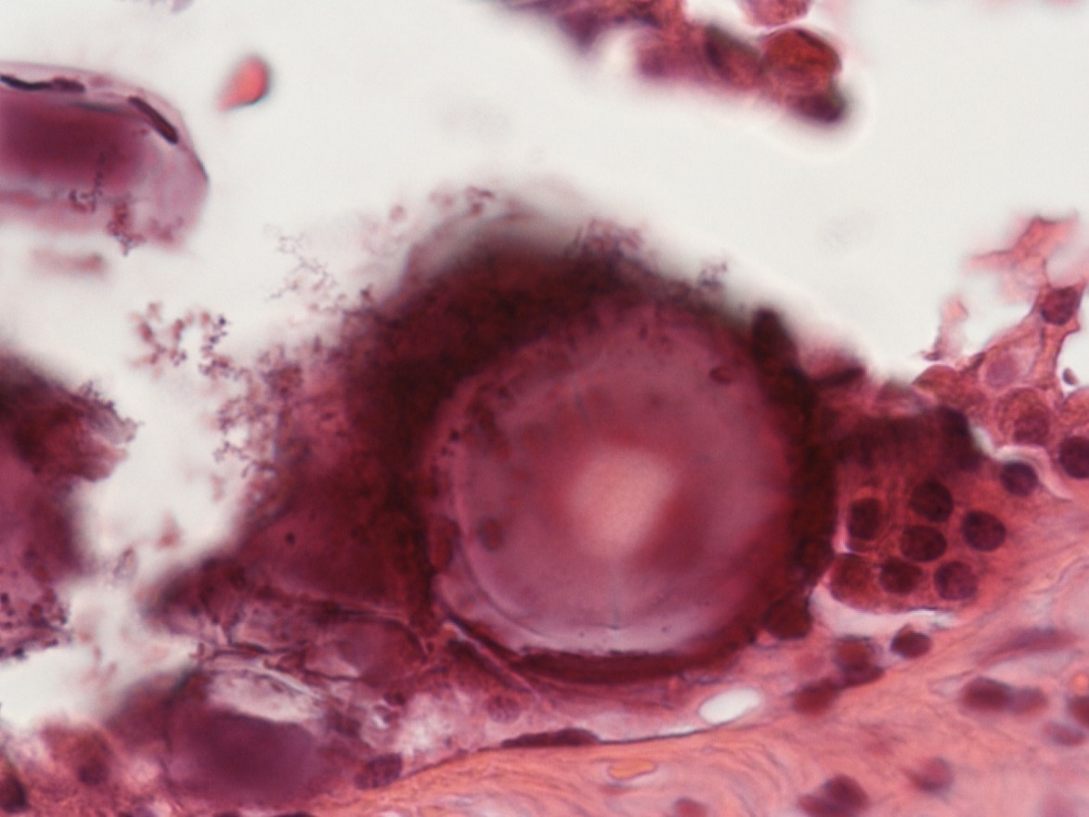
Microcalcification as an active phenomenon mediated by epithelial cells with mesenchymal characteristics
Elena Bonanno and Manuel Scimeca
University of Rome Tor Vergata, Italy

Slide 2

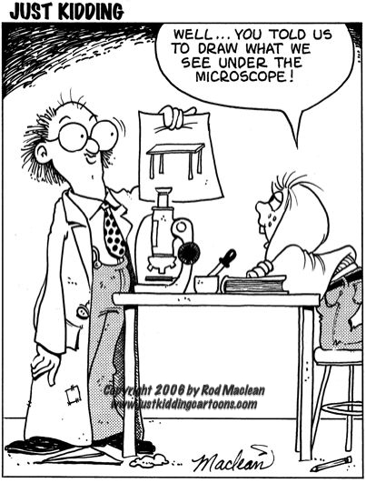
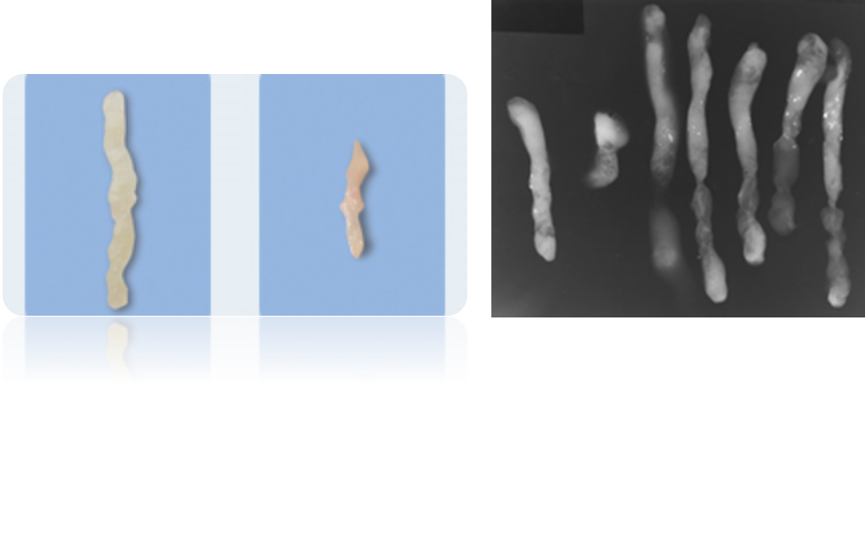


Slide 3
EDX (energy-dispersive analysis) detects one element at a time.
The number of X-rays for a specific element generated by the electron beam is linearly related to the number of atoms of that element in the analyzed volume.
In addition to characteristic X-rays, the beam electrons generate background or continuum X-rays. These continuum X-rays are generated when the incident electrons are decelerated in the electromagnetic field of the nucleus of atoms in the specimen. The continuum X-rays do not carry information about the elemental composition of the sample.
Mineral forms
Elemental composition

Slide 4
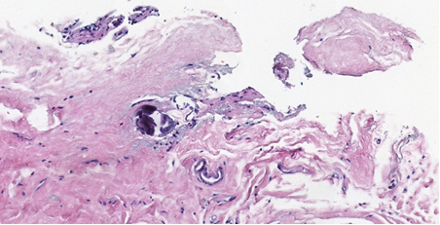
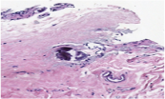
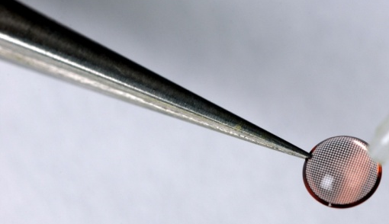
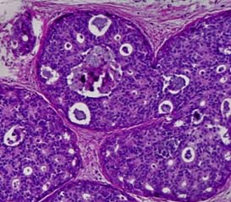
MORPHOLOGICAL STUDY
H&E
86 breast diagnostic biopsies :
60 vacuum-assisted needle biopsies
6 surgical biopsies on radiologically
suspicious breast microcalcifications
20 samples of breast diagnostic biopsies without microcalcifications.
Study protocol approved by the “Policlinico Tor Vergata” independent ethical
committee (# 94.13)
ULTRASTRUCTURAL STUDY
&
MICROANALYSIS

Slide 5
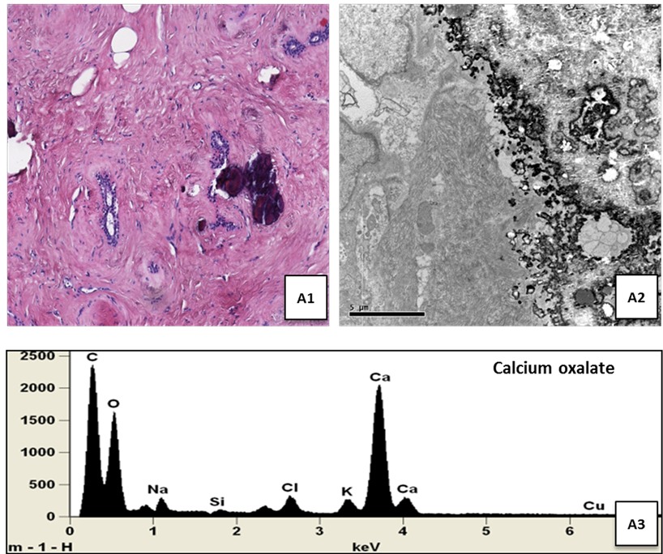
Distribution of CO calcifications in Breast lesions
Elemental composition of calcification in breast pathology.
A1) calcifications in fibroadenomas.
A2) Electron micrograph by TEM of the microcalcification
A3) EDX : calcium oxalate (CO)

Slide 6
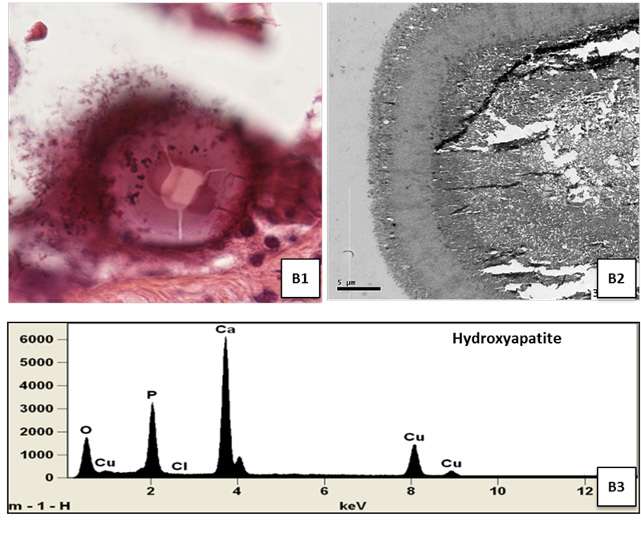
Distribution of HA calcifications in Breast lesions
Elemental composition of calcification in breast pathology.
B1) microcalcifications in “in situ” carcinoma
B2) Electron micrograph by TEM of the microcalcification
B2) EDX:hydroxyapatite

Slide 7
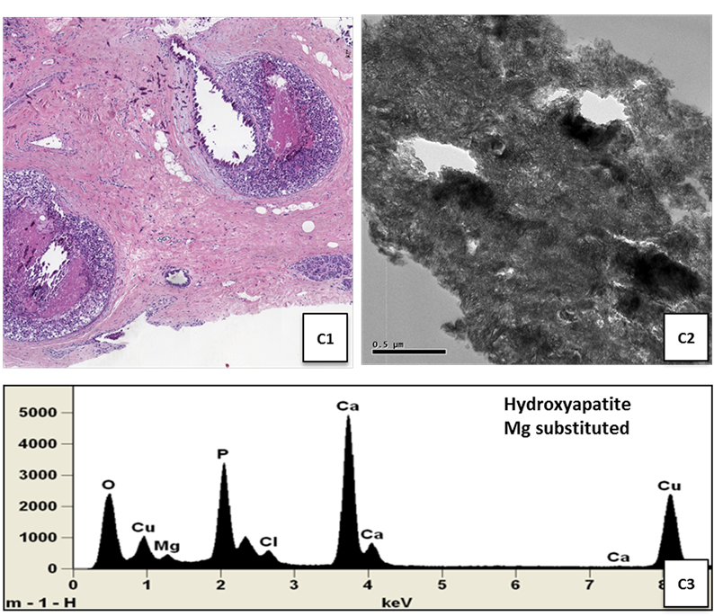
Distribution of Mg-HAp calcifications in Breast lesions
Elemental composition of calcification in breast pathology.
C1) microcalcifications in a comedocarcinoma
C2) Electron micrograph by TEM of the microcalcification
C2) EDX: hydroxyapatite Mg substituted.

Slide 8

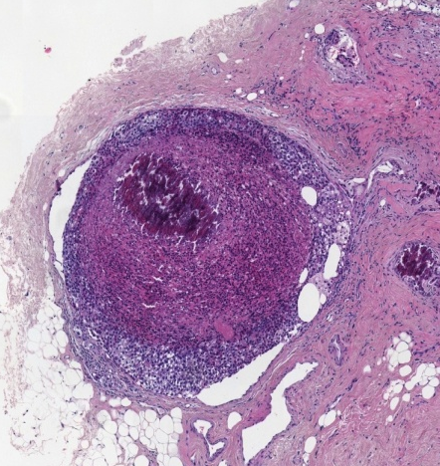
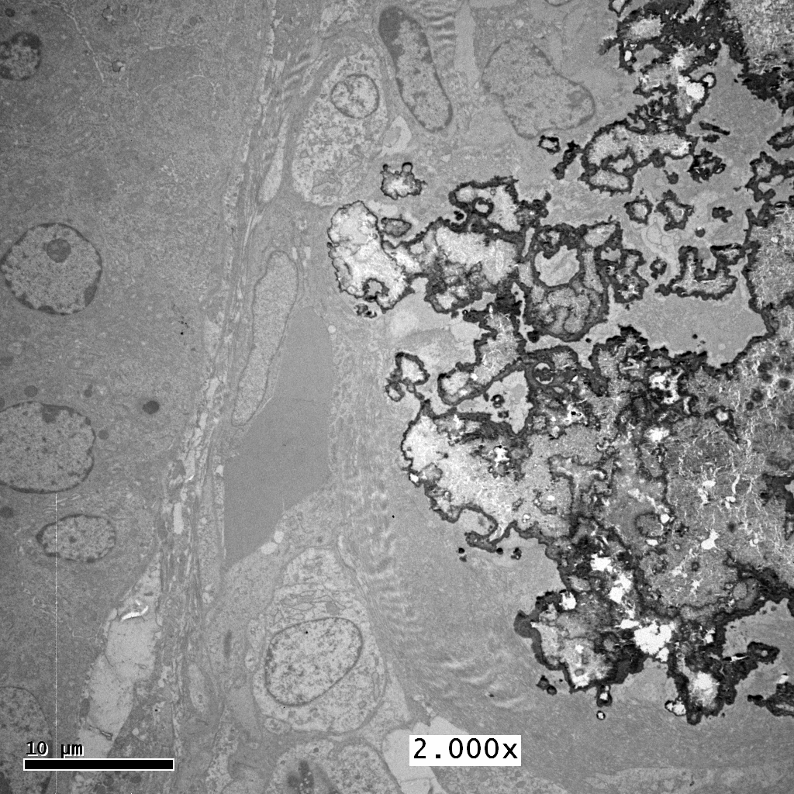
Hydroxyapatite Mg substituted

Slide 9


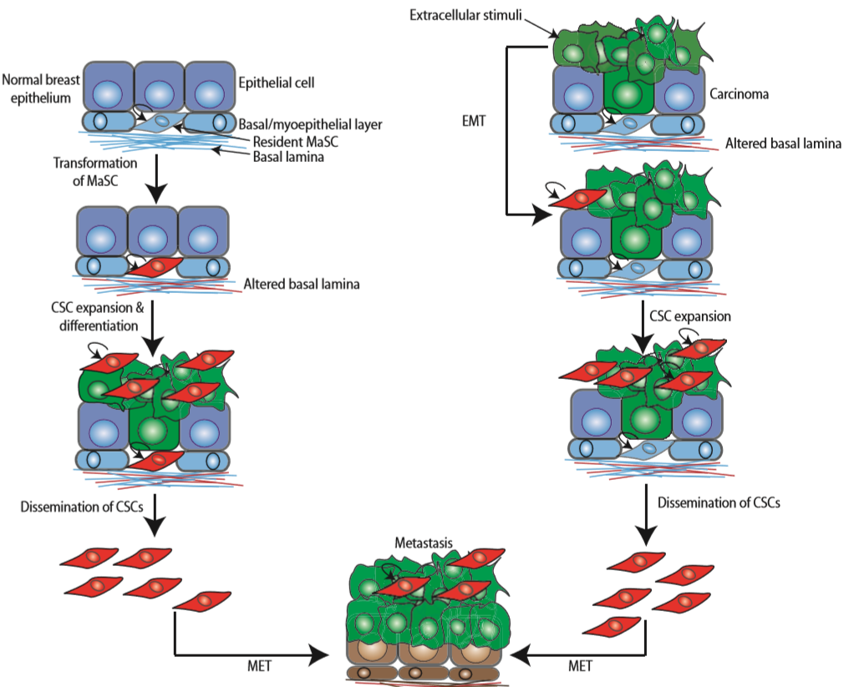
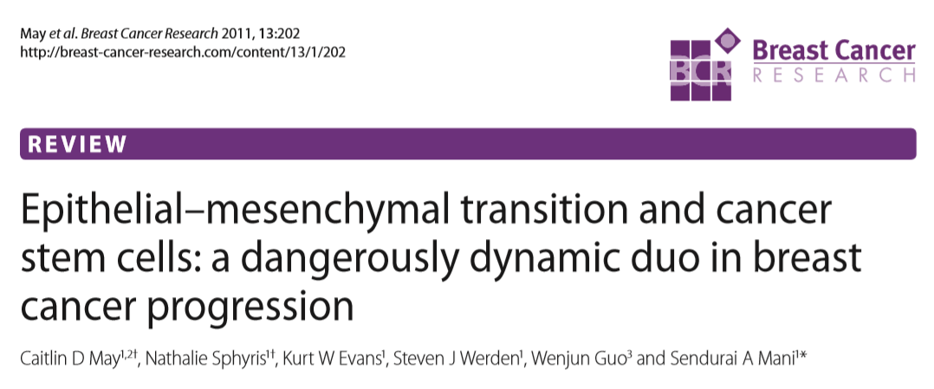
Osteoblast like cell




β2-microglobulin and others

HA



 Vimentin
 N-cadherin
 β-catenin
 BMP-2
Osteocalcin
 Osteopontin




EPITHELIAL TO MESENCHYMAL TRANSITION




 BMP-2












Mesenchymal like cell
EMT can drive breast cells
to an osteoblast phenotype?

Slide 10
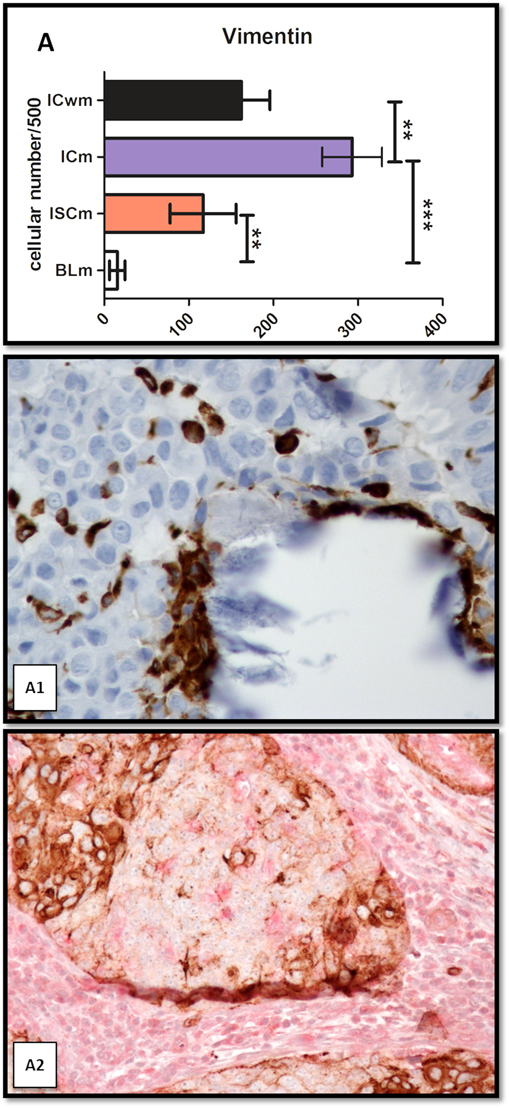
EMT
Breast cancer microcalcifications, mesenchymal phenotype and mineralizations.
A1) Vimentin-positive cells in a ductal in situ comedocarcinoma in proximity of calcium deposits.
A2) Double staining for pan-cytokeratin (brown stain) and vimentin (red cytoplasmic stain).
The co-localization of both markers highlight the EMT just as it is occurring.

Slide 11
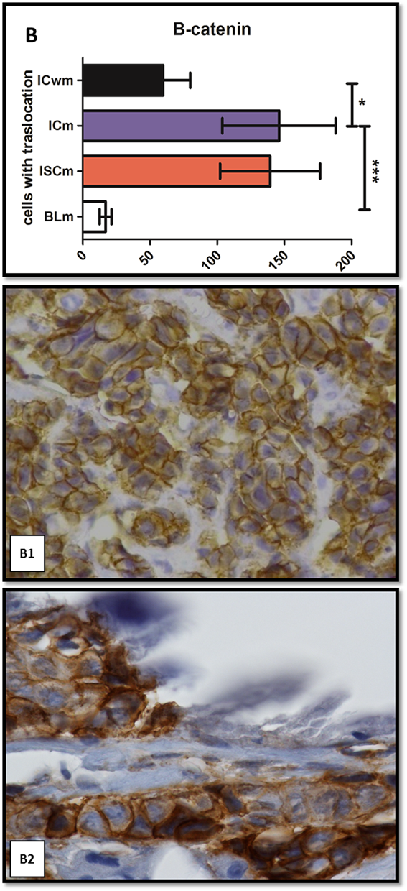
EMT
β-catenin is localized to cell membranes in normal epithelial cells and noninvasive tumor cells, it is located either in the cytoplasm (something that is reflective of dissociation from E-cadherin) or in the nucleus (something that is reflective of its role as a transcriptional activator) in cells that undergo EMT.
Breast cancer microcalcifications, mesenchymal phenotype and mineralizations.
β-Catenin translocation of the signal in the cytoplasm/nucleus of cells
ICwm showed a prevalent β-catenin membrane stain (B1).
Signal close to a microcalcification in the Icm (B2).

Slide 12
β2-M was reported as a growth factor and signaling molecule in cancer cells. It is also known to be able to trigger the EMT phenomenon as well as being capable of activating stromal cells, such as osteoblasts and osteoclast
Breast cancer microcalcifications, mesenchymal phenotype and mineralizations.
β 2-M near a microcalcification in ISCm.

Slide 13
OPN plays an important role in the mineralization process since it regulates both HA production and its inhibition depending on its phosphorylation state
Breast cancer microcalcifications, mesenchymal phenotype and mineralizations.
OPN expressions in BLm. E2) OPN is primarily expressed in cells surrounding calcium deposits.
BMP-2 and OPN signal allowed us to assume that mineralization observed in breast is similar to that which occurs in bone.

Slide 14
BMP2 is a member of the transforming growth factor superfamily and able to induce mineralization in osteoblasts cultures
Breast cancer microcalcifications, mesenchymal phenotype and mineralizations.
OPN is primarily expressed in cells surrounding calcium deposits.
BMP-2 and OPN signal allowed us to assume that mineralization observed in breast is similar to that which occurs in bone.

Slide 15
Osteoblast like-cell identification by TEM analysis.
Breast cancer cells with mesenchymal characteristics.

Slide 16
Osteoblast like-cell identification by TEM analysis.
Electron micrograph show ultrastructural details of a cell exhibiting osteoblast-like morphology with a large cytoplasm and a huge rough reticulum.

Slide 17
Osteoblast like-cell identification by TEM analsysis.
Electron micrograph of cells surrounding microcalcification in malignant lesions. Ultrastructural details of cells obtained by immunogold reaction for vimentin. Numerous gold particles indicated the presence of vimentin filaments inside the cytoplasm of this cell (circle).

Slide 18
Osteoblast like-cell identification by TEM analsysis.
Cell near a microcalcification containing a HA-matrix vesicle. The enlargement in (H) capture a matrix vesicle just as it initiated the exocytosis of Mg-HA (EDX spectrum in (I) and (J)).

Slide 19
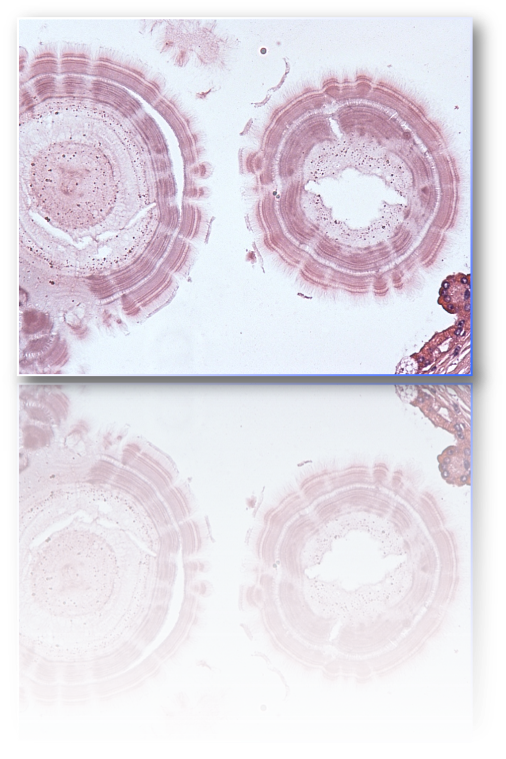
SUMMING UP
Microcalcifications, now considered an early diagnostic marker of breast cancer, revisited as a result of a complex biological process like the EMT, could become a prognostic marker.
The introduction of the EMT markers i.e. vimentin and the elemental analysis of breast lesion with microcalcifications may add further data to complete the clinical setting of diagnosis, prognosis and therapy of breast cancer patients.
The identification of new forms of calcification in breast lesions opens innovative perspectives in the field of breast cancer prevention.
The presence of HA in a benign breast lesion could represent a higher risk to develop a breast cancer?

Slide 20

CHIARA ANTONACCI
SIMONE BISCHETTI
ELENA GIANNINI
MATTEO CHIMENTI
FILIPPO BORRI
SARA CASELLA
SIMONE FACCHETTI
ANDREA SAGGINI

