Slide 1
About OMICS Group
OMICS Group International is an amalgamation of Open Access publications and worldwide international science conferences and events. Established in the year 2007 with the sole aim of making the information on Sciences and technology ‘Open Access’, OMICS Group publishes 400 online open access scholarly journals in all aspects of Science, Engineering, Management and Technology journals. OMICS Group has been instrumental in taking the knowledge on Science & technology to the doorsteps of ordinary men and women. Research Scholars, Students, Libraries, Educational Institutions, Research centers and the industry are main stakeholders that benefitted greatly from this knowledge dissemination. OMICS Group also organizes 300 International conferences annually across the globe, where knowledge transfer takes place through debates, round table discussions, poster presentations, workshops, symposia and exhibitions.

Slide 2
About OMICS Group Conferences
OMICS Group International is a pioneer and leading science event organizer, which publishes around 400 open access journals and conducts over 300 Medical, Clinical, Engineering, Life Sciences, Pharma scientific conferences all over the globe annually with the support of more than 1000 scientific associations and 30,000 editorial board members and 3.5 million followers to its credit.
OMICS Group has organized 500 conferences, workshops and national symposiums across the major cities including San Francisco, Las Vegas, San Antonio, Omaha, Orlando, Raleigh, Santa Clara, Chicago, Philadelphia, Baltimore, United Kingdom, Valencia, Dubai, Beijing, Hyderabad, Bengaluru and Mumbai.

Slide 3
The Particle Universe
Edwin Zong

Slide 4
My bucket list
What is the explosion/big bang made of?
What is the “bomb” made of?
What is the dark matter made of?
Is it possible for matter/energy to stay in one physical state forever? If not, how does it manifest itself in our universe?

Slide 5
The mechanical talk

Slide 6
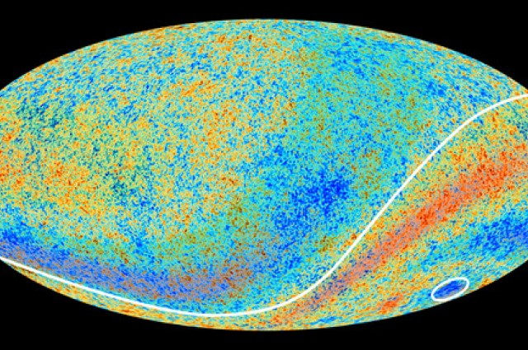
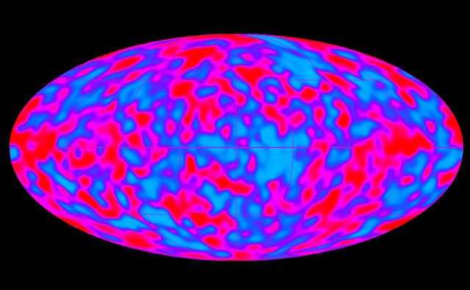
Neutrino is the Immediate product of Gamma Ray Photon!
Neutrino “annihilate” Neutrino→ Gamma ray!
Photon hit Proton → pion/charged particle → Muon/Neutrino
Neutral pions → Gamma ray!
# 1 unbinding raw material is PHOTON!
# 1 coupled/structured raw material is Neutrino! IceCube : Neutrino Cosmos v.s Gamma ray telescopes

Slide 7
The photon
Photons are electromagnetic/radiation power
Photons are carriers
The carrier (e.g. the dirt power this toddler holds) is not a void

Slide 8
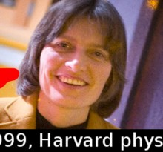
Photon can be slowed Down!
1999, Lene Hau, a Harvard University physicist led a team to conduct an experiment at the Rowland Institute for Science
They decreased a light beam speed “20 million-fold down” from 186,282 miles a second to a 38 miles an hour.
"In this odd state of matter, light takes on a more human dimension; you can almost touch it" says Hau. Can Neutrinos be slowed down?

Slide 9
The photon Bonding
The photon bonding/coupling has recently been accomplished in an inorganic lab
A remarkable discovery called The Rydberg blockade by coaxing photons into bonding together to form “molecules” – a state of matter by a group led by Harvard Professor of Physics Mikhail Lukin and MIT Professor of Physics Vladan Vuletic.

Slide 10
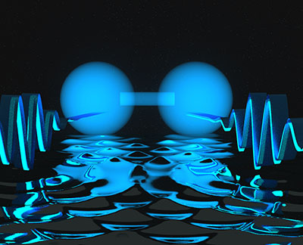
The photon Bonding
When a light photon is not paired, it possesses pure kinetic energy/radiation power with little gravitational effect (e.g. a solar ray!)
If it is paired e.g. photon bonding or photosynthesis, it possesses positional energy/gravitation (e.g. the solar ray captured inside an apple).

Slide 11
3 Bonding Possibilities
The Neutral or “Even Bonding" of photons
The ¯ or ⁺ charged = Polarized or “Non-Evenly Bonding" of photons, which is heavier or massive on one end than the other end!
The left-handed man is not “Anti-Human” compared to the Right-handed man!

Slide 12
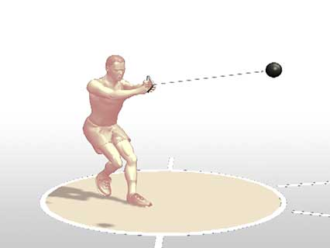
The mass
The physical body (non-void) which is related to the force required to accelerate it
It is related to its “inertia”, and it is essential to Newton's laws of motion.

Slide 13
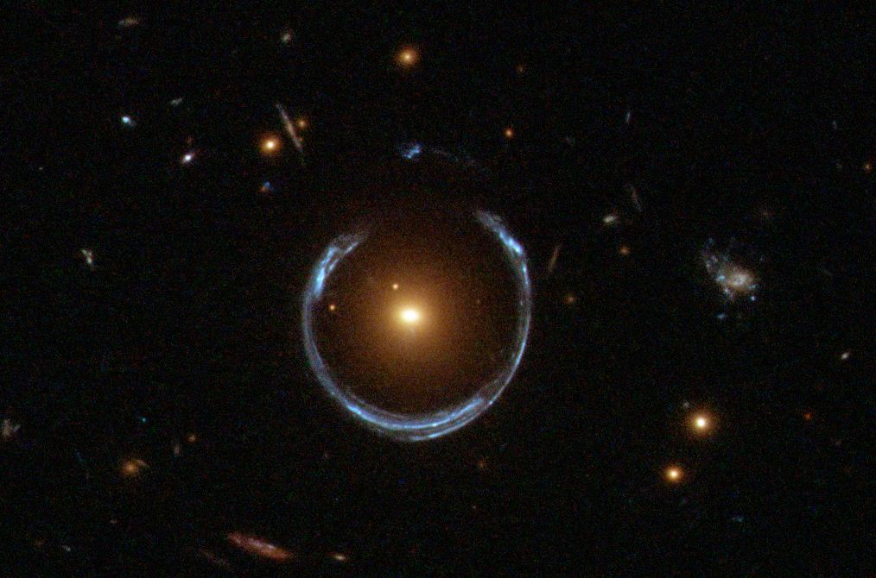
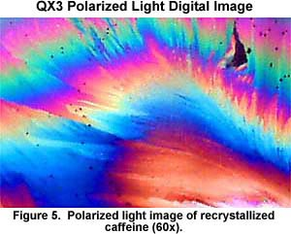
The light
Light Polarization
Gravity Lensing Effects
Light is Mass

Slide 14
The photon is Mass!

Slide 15
The mass of a photon
An upper limit has been inferred through satellite measurements of planetary magnetic fields: The Charge Composition Explorer spacecraft indicates an upper limit of 6 × 10¯¹⁶ eV with high certainty. The improved new limit is 7 × 10¯¹⁷ eV by Roderic Lakes in a laboratory experiment
The Compton wavelength of a “particle” is equivalent to the wavelength of a photon whose energy is the same as the “rest”-mass energy of the “particle”. The m is the photon mass! C is the speed of light! h: Planck's constant

Slide 16
The physical existence of a Photon
The energy carrier has a physical existence that can be inferred by a nuclear force: At distances less than 0.7 fm (fm, or 1.0 ×10¯¹⁵metres) , the nuclear force becomes repulsive. This repulsive component is caused by the physical size of photons!

Slide 17
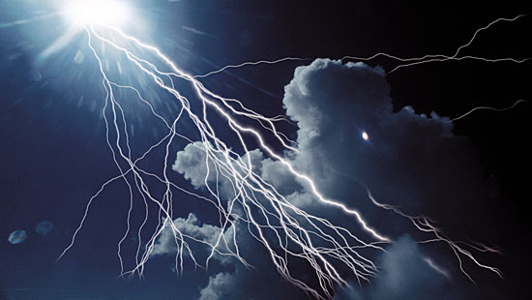
The Unification of Mass and Force!
The photon is the force/son of the majesty
The photon is the carrier/father
The photon is the majesty/holy spirit
Does it sound familiar?

Slide 18
The “rest” mass
No particle can be in the state of “rest”
The mass of different state is original and an “absolute” with Newtonian “certainty”.
The insertion of “rest mass” fundamentally “shaketivitize” the Newtonian physics and lands many bright minds in a world of “uncertainty”.
To assign a number value e.g. zero to a fabricated concept of “rest mass” further confuses people

Slide 19
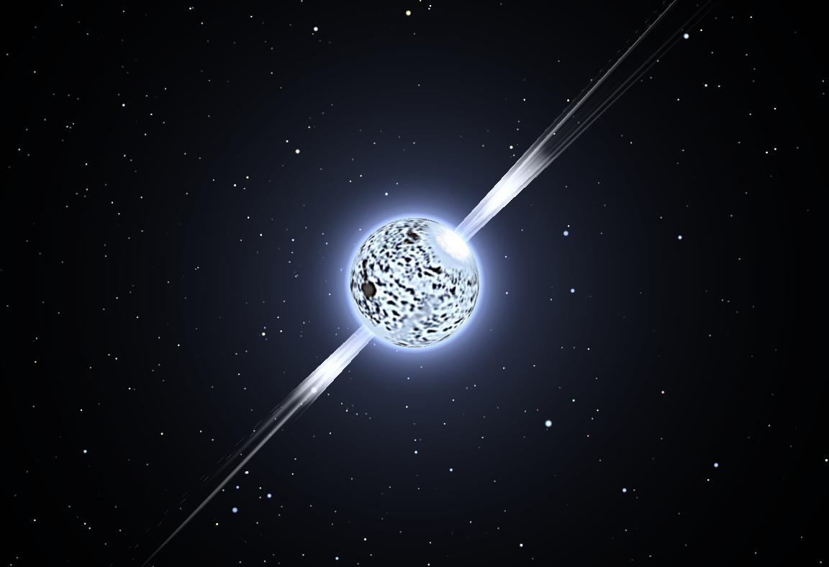
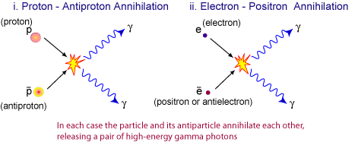
“Annihilation” → Photons
Neutron Star→β decay → neutrinos + e¯ or e⁺→γ photons+ X-ray activities

Slide 20
“Antimatter/Antiparticles”
The Particles (α! & β) and “anti” particles (α & β)→ Gamma rays! Neutrinos etc.
The reverse of “Said Annihilation” → Turn lights into us!

Slide 21
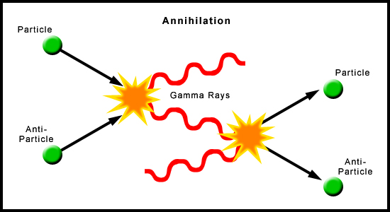
“ Beyond a reasonable doubt”
Photon→ Neutrino, α & β particles → nucleus

Slide 22
The frozen space
The neutrino background is still present today, with about 56 electron neutrinos, 56 electron “anti”-neutrinos, 56 “muon” neutrinos per cubic centimeter, for a total of 337 neutrinos per cubic centimeter in the Universe. (45%)
The photons of the CMBR are slightly more numerous with 411 photons/cc. (55%)
*Astro.ucla.edu/ Edward L wright/neutrinos

Slide 23
Neutrino
β¯ decay ¹⁴C₆⁺ →¹⁴ N₇⁺ + e¯ + νₑ(¯?)
β⁺ decay ²³Mg₁₂⁺→ ²³Na₁₁⁺ + e⁺+νₑ
Inverse β decay νe(¯?) + p → n + e¯

Slide 24
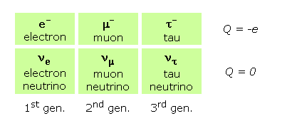
The dark matter is Neutrino!
e¯ + e⁺ → γ + γ. The electron (e¯) and a positron (e⁺) are the decay products from neutron thru double beta decay
The neutrinos are the #1 structured masses in cosmos!
The “dark matter” is estimated to constitute 84.5% of the total matter in the universe

Slide 25
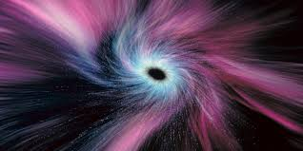
The infrastructure of Black Hole
A black hole is very cold - below 2.7 kelvin
The “Cold” temperature freezes lights and mass that enter black hole!
The black hole “chilling” with plasma

Slide 26
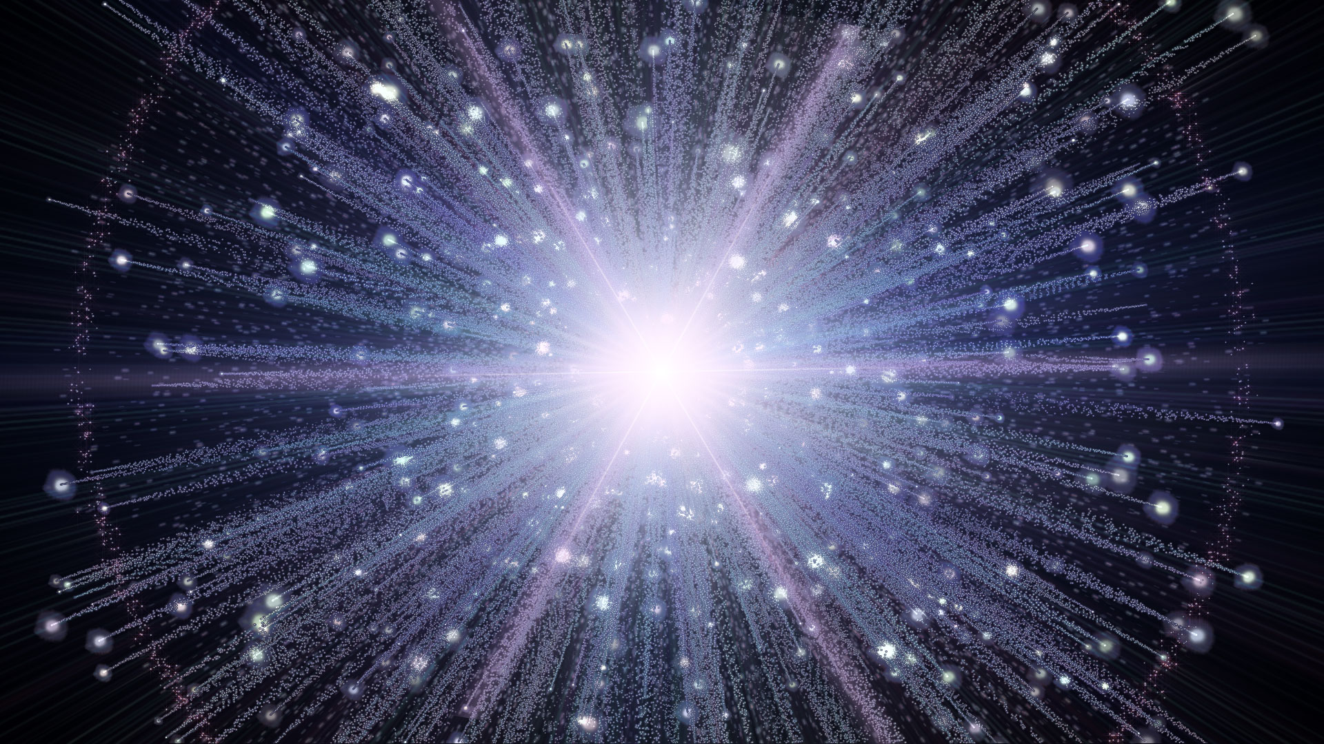
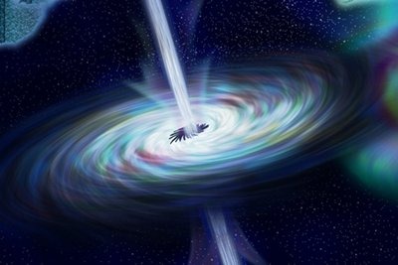
The myth buster
The γ ray burst is e¯ + e⁺ → γ ray! (predominantly)
The big bang is νₑ¯ + νₑ → γ ray! (predominantly)

Slide 27
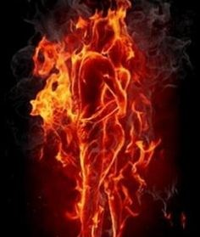
The “Hot” hole vs “cold” hole
Without electric magnetic power, everything collapse into a black hole – extraordinary cold!
The Galactic nucleus or black hole is just a “cold” hole!!
With electric magnetic power, everything inflates e.g. nucleus
The strong and weak nuclear force are “Captured” electric magnetic power – directly from a big bang and supernova! Our atom nucleus is just a “hot” hole!!
2 basic forces – Electric magnetic power and Gravity!

Slide 28
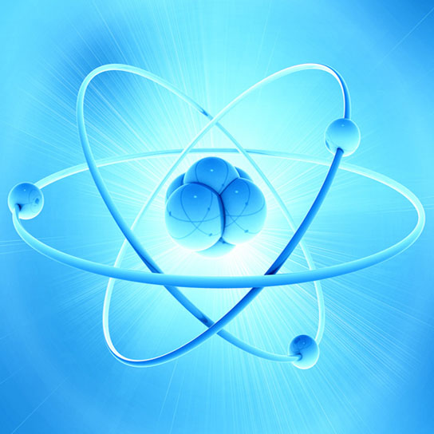
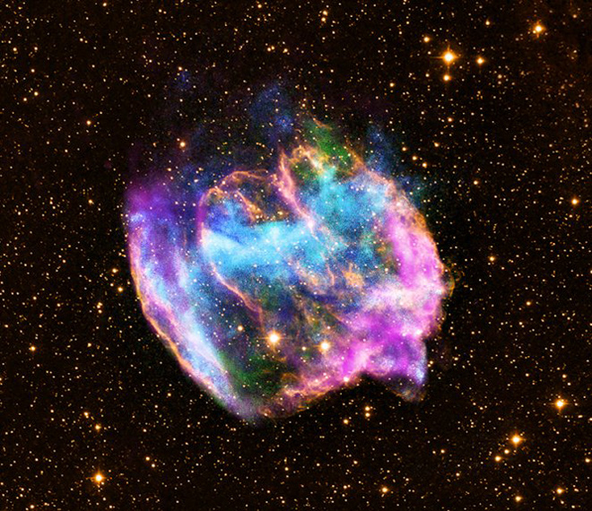
The atom nucleus vs Galactic nucleus
The atom nucleus is a “hot” hole! The dark matter inside our hot nucleus is super active, demanding extraordinary bonding power/nuclear force that is captured directly from a big bang or supernova!
The black hole is a “cold” hole! The big bang ray is “frozen” in the cold deep space which makes emulsion possible: congregate photons – Galactic nucleus/gravity generating!

Slide 29
2-Particle Mode
The neutrinos are similar to the electron, with 1 difference: neutrinos do not carry electric charge - “evenly bonding” photons!
The ¯ or ⁺ charged = Polarized or “Non-Evenly Bonding" of photons, which is heavier or massive on one end than the other end!
"2" particle table which are photon and Neutrino!
The reverse of “Said Annihilation” : Gamma rays! Neutrinos →The Particles (α! & β) and “anti” particles (α & β) or Electron/Proton/Neutron

Slide 30
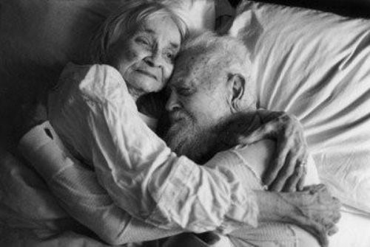
“Single” or “Taken”
Light is “decouple or single” photon : ready for mingle as single! e.g. light polarization etc.
The neutrino is “coupled/bundled or taken” photons : not available e.g. Weakly Interacting Massive Particle or wimp

Slide 31
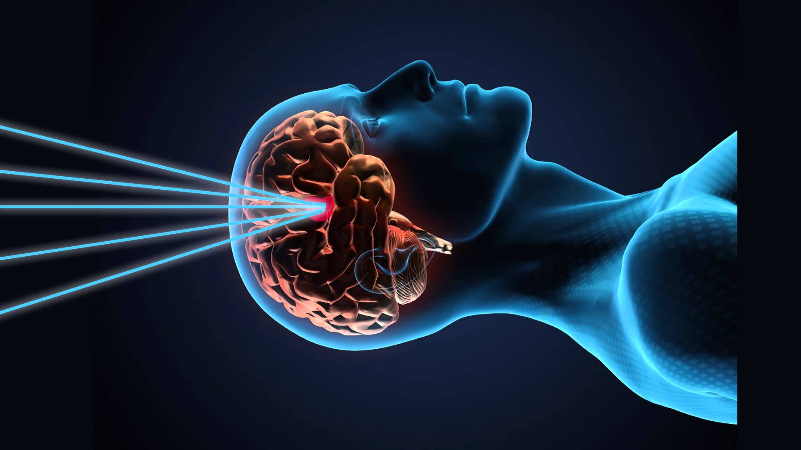
Photon and Neutrino
Photon Engineering – Communication/ optical computing, Artificial big bang ray
Neutrino Engineering – Surgery or surgical alike operations/Turn target of interest into dark matter

Slide 32
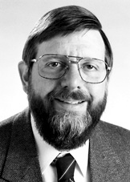
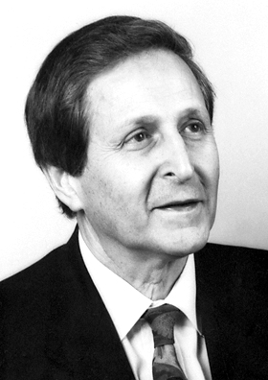
Controlled Collapse of chilling light effects
Laser cooling refers to a number of techniques in which atomic and molecular samples are cooled down to near absolute zero through the interaction with one or more laser fields* The Nobel Prize in Physics 1997
Once the interactions are increased beyond a defined value, the condensates collapse and rapidly lose 25-40% in atom number*

Slide 33
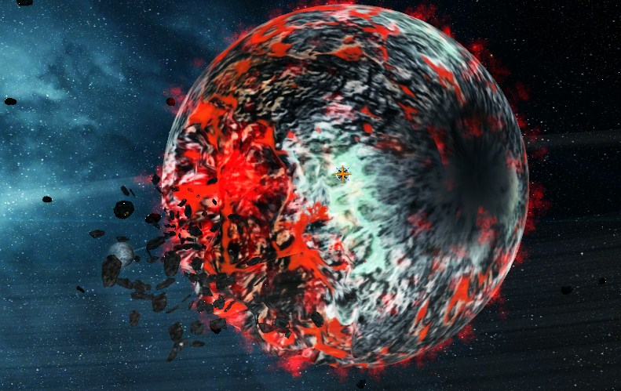
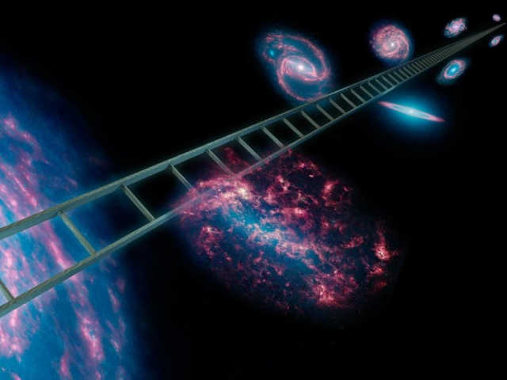
Laser Neutrino Annihilation Synergistic Applicator©℗
Bloodless Surgery & Non-chemical antibiotics
The most persuasive tool for peace talk
Local Cosmos Reconstructive Engineering

Slide 34
The Gravity → The matter loves to “crunch” together!

Slide 35
The Gravity
There are 2 basic forces: the gravity & the electromagnetic power/radiation
The gravity is “crunching/orbiting” power
The single orbiting power unifies matter & particles, because particles possess orbiting power/gravity when they are coupled (e.g. a photon!)
The gravity leads to the big “crunch” → dark matter!
The big “crunch” → The bang→ The Kinetic energy!

Slide 36
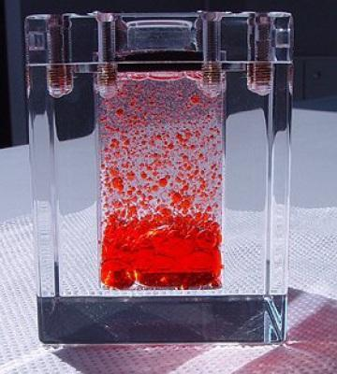
Emulsion-A form of Gravity
The “crunch” is preferable based on similarity
Emulsion occurs ubiquitously!

Slide 37
The Universe Inflation and Focal “Collapse”/Focal “Crunch”
The initial universe’s inflation is powered by a big bang’s photons
The secondary inflation of galaxies is fueled by their star’s photons.
The focal collapse is due to the fact that their stars run out of fuel, which subsequently ages galaxies to their dwarf stage/senior citizen, which are mostly made of dark matter along with fewer stars.

Slide 38
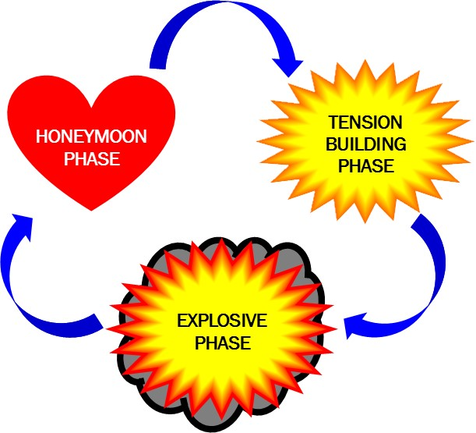
The Universe Inflation & focal Crunch
The big bang & star’s radiation → inflation
The loss of radiation → The big “crunch” of matter/the pre-big bang dark matter
The Destiny of kinetic energy → The positional energy
The Destiny of positional energy → the kinetic energy
The Destiny of a single photon → The paired/bundled photons
The Destiny of a paired/bundled photons → the single photon

Slide 39
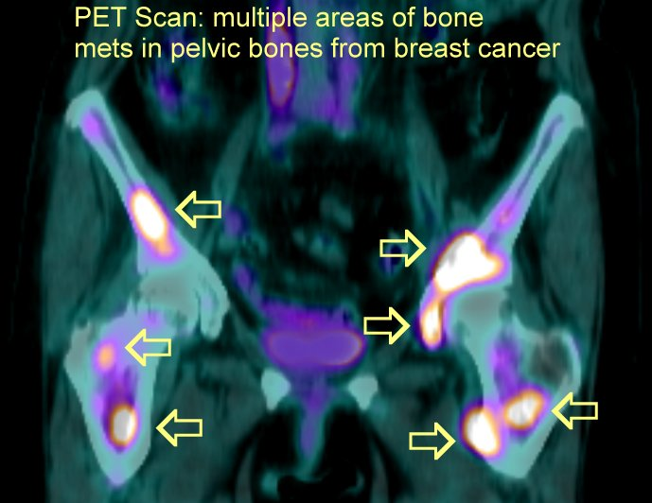
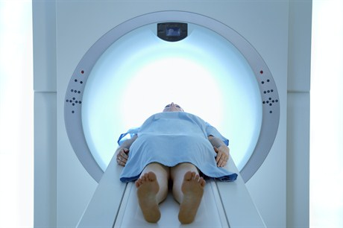
Pet-Scan
The PET scan detects pairs of gamma ray photons emitted indirectly by a positron-emitting radionuclide (tracer), which is introduced into the body such as FDG
e¯ + e⁺ → γ + γ

Slide 40
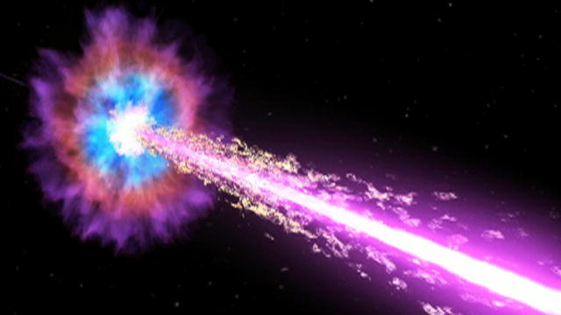
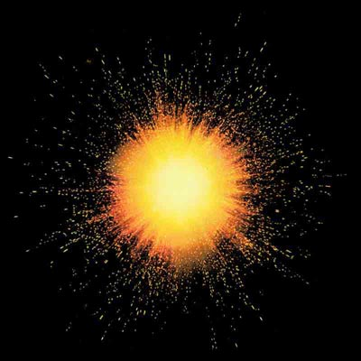
γ – ray
e¯ + e⁺ → γ + γ. The electron (e¯) and a positron (e⁺) are the ionized clouds surrounded black hole. This is the recipe for gammy ray burst!
The interchange of proton and neutron will release electron and neutrino.
νₑ¯ + νₑ → γ ray! (predominantly)
That is a recipe for a big bang!

Slide 41
The big bang is γ – ray!

Slide 42
The mother of our big bang-the big “crunch” of matters/dark matters! - The Zion of our galaxies (Zolaxy)

Slide 43
The “dark matter”
27% “dark matter”, 68% “dark” energy and 5% normal matter source* NASA
Neutrinos (They are Mass!) – dark matter/black hole
Cosmic Rays/photons (They are Mass!)

Slide 44
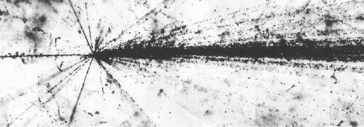
The “dark energy”
The Emulsion power in Space!
The energy associated with “dark matter”

Slide 45
E=MC²
The universe is an enclosed system where nothing exists outside.
Given the open space within, the little “loss or gain” of mass/energy in space happens continuously which is “absolute” with Newtonian “Certainty” !
The changing of mass/energy will lead to the changing of velocity (Colorful or WOW effects)
The velocity or “time-scaled” process is the result from such said mass/energy’s changing; it is not the other way around!
How and where we look at “time-scaled” process is “irreverestic” to the “loss or gain” of mass/energy
The space is just a void

Slide 46
The fountain of certainty
The loss/gain of mass/energy in a void/space is ABSOLUTE! e.g. in our universe.
The velocity or “time-scaled” process is the result from such said mass/energy’s changing; it is not the other way around!
The artificial time is irrelevant to mass/energy changing.
No particle can exist in the state of “rest”.
The mass in different state is “absolute” with Newtonian “certainty”.
The insertion of “rest mass” fundamentally “shaketivitize” the Newtonian physics and lands many bright minds in a fantasy world of “uncertainty”.
To assign a number value e.g. zero to a fabricated concept of “rest mass” further drowns everyone who is near to it.

Slide 47
The Mass/Energy Evolution
E bigbang= E kinetic energy + E positional energy
The Destiny of kinetic energy → positional energy; the Destiny of positional energy → kinetic energy.
The Destiny of a single photon → "marry" another photon; the Destiny of "married" photons → separated from its partner.
The big bang’s Photons (emulsion/bonding)→ neutrino & electron → protons & neutrons/primordial nucleons formation
The “initial” /or unstable nucleus’s decay → dark matter/neutrino →β decay →electric activities/x-rays and λ ray bursts

Slide 48
You
The radiation/photon → dark matter/neutrino →visible matter/inorganic matter →organic matter → you → collapse →pre big bang dark mass/neutrino →big bang→→→you again!

Slide 49
The mechanism of our universe is ridiculously simple!
As John Wheeler once said, "Some principle uniquely right and uniquely simple must, when one knows it, be also so obvious that it is clear that the universe is built, and must be built, in such and such a way and that it could not possibly be otherwise.”

Slide 50
Our beautiful universe!- r4b.us

