Slide 1
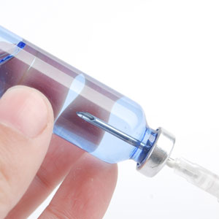
About OMICS Group
OMICS Group is an amalgamation of Open Access Publications and worldwide international science conferences and events. Established in the year 2007 with the sole aim of making the information on Sciences and technology ‘Open Access’, OMICS Group publishes 700+ online open access scholarly journals in all aspects of Science, Engineering, Management and Technology journals. OMICS Group has been instrumental in taking the knowledge on Science & technology to the doorsteps of ordinary men and women. Research Scholars, Students, Libraries, Educational Institutions, Research centers and the industry are main stakeholders that benefitted greatly from this knowledge dissemination. OMICS Group also organizes 1000+ International conferences annually across the globe, where knowledge transfer takes place through debates, round table discussions, poster presentations, workshops, symposia and exhibitions.

Slide 2

OMICS International Conferences
OMICS International is a pioneer and leading science event organizer, which publishes around 700+ open access journals and conducts over 500 Medical, Clinical, Engineering, Life Sciences, Pharma scientific conferences all over the globe annually with the support of more than 1000 scientific associations and 30,000 editorial board members and 3.5 million followers to its credit.
OMICS Group has organized 1000+ conferences, workshops and national symposiums across the major cities including San Francisco, Las Vegas, San Antonio, Omaha, Orlando, Raleigh, Santa Clara, Chicago, Philadelphia, Baltimore, United Kingdom, Valencia, Dubai, Beijing, Hyderabad, Bengaluru and Mumbai.

Slide 3

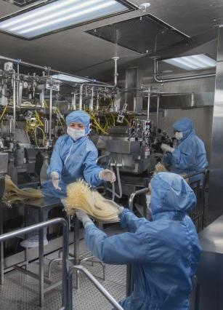
Global Implementation of System-Based Microbial Control For Parenteral Manufacture
Ed Tidswell

Slide 4
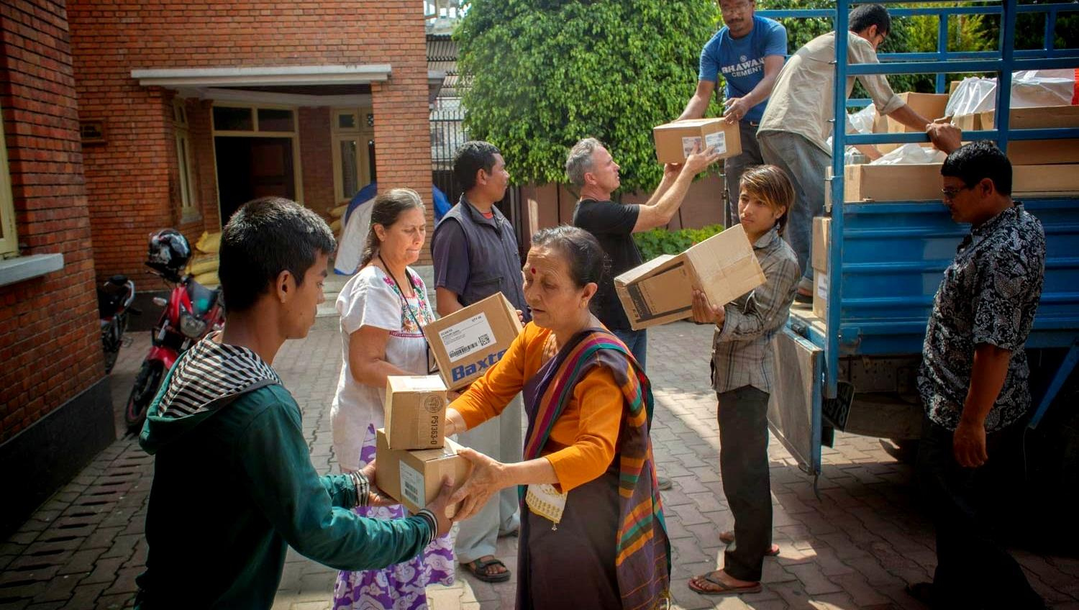
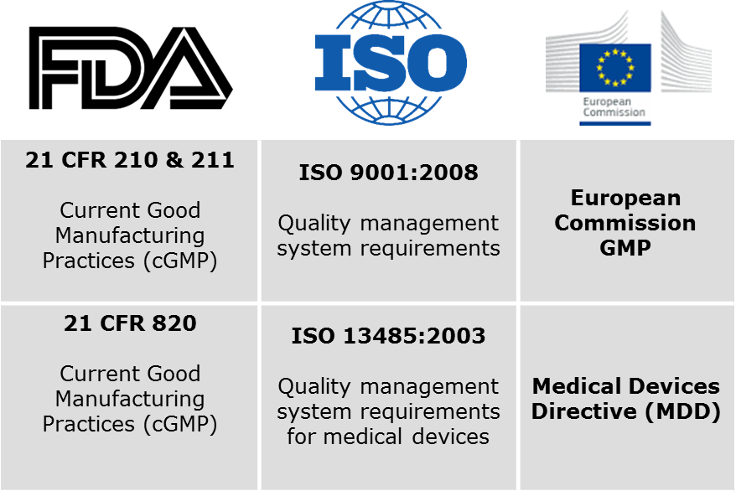
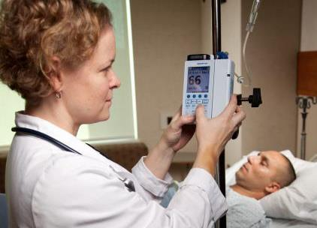
Drug & Device Manufacturing –
Local & Global Challenges
Supply
Regulations
Process & portfolio diversity
Supply chain
Base costs
Linking lab to market
Global
Regional
Complexity & diversity
Personalized care
Therapies
Technologies
Notes:
Supply -Significant amount of cost base comes from supply chain - linking laboratory to market place, home, hospital, clinic
Regulations – global and local, all seemingly different
Diverse products – personalized with care pushed in to the community, new therapies, new technologies of manufacture

Slide 5
Drug & Device Manufacturing –
Needs & Necessities
Supply
Regulations
Process & portfolio diversity
Flexible production
Increased agility
Minimal downtown
Self-detection, self-correction
Effective QS integration
Flexible
Commensurate compliance
Improved knowledge
Flexible processes
Systems
Notes:
Flexible production
Production demands fluctuate and unforeseen challenges occur at a higher frequency than before, delivering products in a 100% reliable manner requires a high level of agility. Most existing facilities are not built for that so upgrading facilities to become more flexible requires engineering projects, and they have to be executed with minimal downtime during running production.
Integrated quality
It is becoming more and more difficult to live up to the various quality regulations in different markets – and many of the regulations are also becoming more complex. So, ensuring a consistent level of compliance requires effective integration of quality systems throughout the entire organisation – also across different sites. Part of that exercise is to identify the right level of compliance and not over-do it. And that’s easier said than done for most pharma companies.
Entering new domains
Pharma has seen a lot of new products and technologies emerge over the past decade. It is necessary to adopt both new drugs and technologies. This has impact on equipment, on processes and on the manufacturing facility as a whole. Successfully determining and implementing the new solutions of course requires in-depth knowledge of the solutions – and that is in short supply for the majority of pharma companies that have not worked with the respective drug categories or technologies previously.
cture

Slide 6
Regulations –
Complexity & Diversity
EU Annex 1 & PIC/s Annex 1 Manufacture of Sterile Medical Products | ISO 14644 Cleanrooms and Associated Controlled Environments | FDA 21 CFR 211 |  | FDA Guidance for Industry Guide to Sterile Drug Products Produced by Aseptic Processing
Adjacent rooms of different grades should have a pressure differential of 10 – 15 Pa (guidance values) (Item 53) | The pressure…should lie typically in the range of 5 Pa to 20 Pa (Section A.5.3) | Aseptic processing, which includes as appropriate: (iii) An air supply filtered through high-efficiency particulate air filters under positive pressure, regardless of whether flow is laminar or non laminar |  | For example, a positive pressure differential of at least 10-15 Pa should be maintained between adjacent rooms of differing classification (with doors closed)
Identical intent - Adjacent rooms of different grades should have a positive pressure differential
10-15 Pa | 5–20 Pa |  | None | 10–15 Pa

Slide 7
Regulations –
Complexity & Diversity
Annex 1 Guidance
Grade A: The local zone for high risk operations, e.g. filling zone, stopper bowls, open ampoules and vials, making aseptic connections. Normally such conditions are provided by a laminar air flow work station. Laminar air flow systems should provide a homogeneous air speed in a range of 0.36 – 0.54 m/s (guidance value) at the working position in open clean room applications. The maintenance of laminarity should be demonstrated and validated
Intent
Assure that air flow (first air) over and around high risk aseptic operations protects the product by preventing ingress and sweeping away contamination by proven (validated) mechanics and mechanism of HEPA filtered air

Slide 8
Regulations –
● Effective QS integration ● Flexibility ● Commensurate compliance
Global &
Regional
Global Quality Requirement establishes intent
Should guidance values be outlined globally?
Yes
No
Local
Systems-based microbial control

Slide 9


What is System-Based Microbial Control?
System – A group of interdependent items that interact regularly to perform a task
System-Based Microbial Control
The systematic and logic driven management process for the control of microbial hazards and risks during the drug and device manufacturing life-cycle; assuring the provision of products meeting specifications
System-based microbial control is a self-detecting, self-correcting system
Systems thinking is not one thing, not a new SOP but a set of habits or practices
A framework that is based on the recognition that the component parts of a system are best understood as in relationships with each other rather than in isolation
Logic – The principles and reasoning permitting sound decision

Slide 10
Why System-Based Microbial Control?
Self-Detecting Self-Correcting Systems
Sustained continuous improvement, preventative corrections and improved process control require systems that self-detect and self-correct
Improved Process Control
Improved process control increases product performance, efficiency and economy, reduces scrap and product recalls
Increased Flexibility & Compliance
Patient safety is based upon sound reasoning (logic) for decision. Without documented logic decision becomes arbitrary and compliance driven by strict adherence to rules, reducing flexibility, patient safety and increasing costs
Enhances & Grows Competency
Focuses on facts, data and underpinning science and engineering. Fosters evaluation of data and controls from all elements and parts of quality assurance cohesively geared to patient safety

Slide 11

Microbial Monitoring & Control – Jenga Towers That Support Product Quality
Built from add on specific requirements or instructions
No documented or easily explained logic to the selection of controls and monitoring
Costly through excessive or poorly targeted testing and controls and monitoring
Difficult to change through inability to predict, detect and correct
Uncertain control of product quality assurance
Does not permit flexible self-determined patient safety compliance
WL/observation commitments
Ad hoc initiatives
Legacy

Slide 12
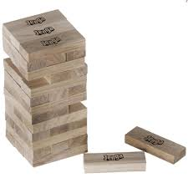
System-Based Microbial Control
Systematic construction of controls
Designed on easily understandable and documented logic of controls and monitoring
Efficient through value-adding testing and controls
Easier to change through increased predictability, self-detection and self-correction
Certain control of product quality assurance
Permits flexible self-determined patient safety compliance

Slide 13
Microbial Monitoring & Control – Typical Environmental Control
Specifications
Investigations
Process Map
Risk
Assessments
Data
Qualification
Assessment
Quality Plan
Monitoring

Slide 14
System-Based Microbial Control – Environmental Control
Triggers (detection) – Data, trends and observations trigger specific actions
Actions (correction) – Specific review and decision tree evaluations of risk assessments, qualifications, control plan
Risk Assessments
pFMEA (process stream)
Traffic flow
Touch point
Quantitative
Real Time Risk Assessments
Real time in situ risk assessment
Control Scheme documents the controls and monitoring and logic
Quality Plan documents the schedule of improvements and logic for the schedule

Slide 15
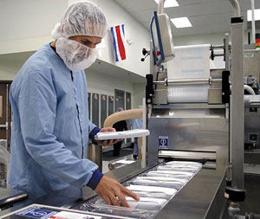
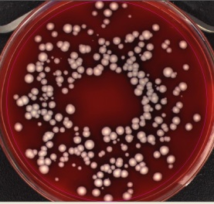
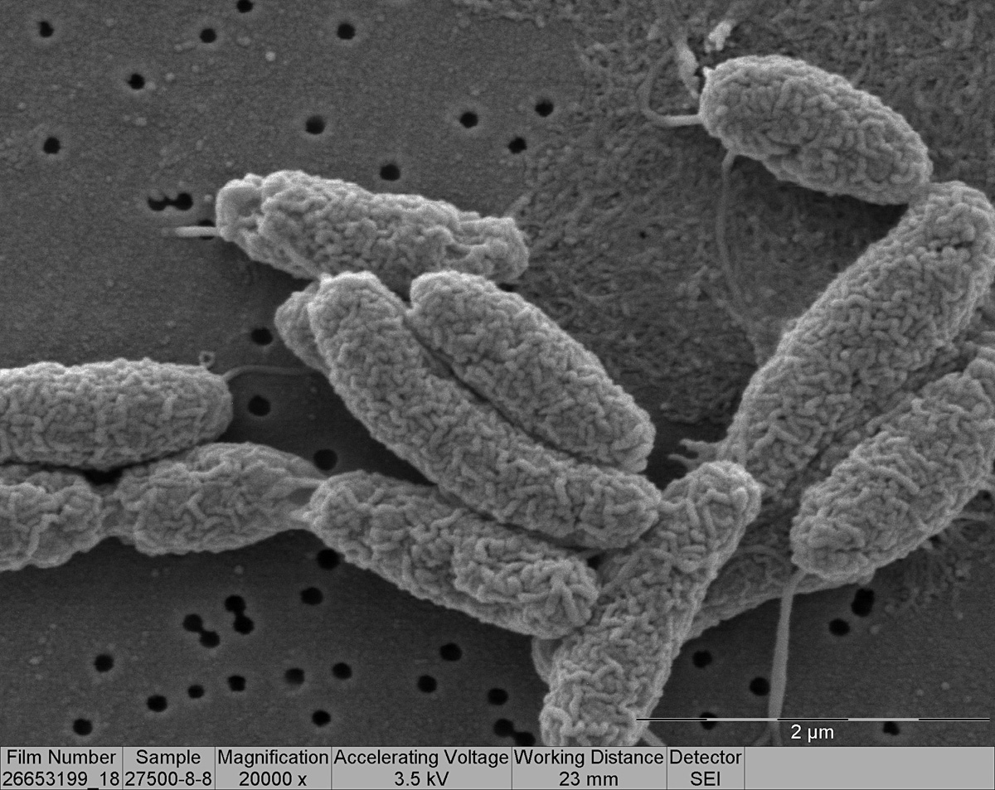

System-Based Environmental Microbial Control –
Key Points Risk Assessments
pFMEA
Microbial Ingress –assessment of probability and severity of microbial ingress in to the process
Microbial Proliferation – assessment of probability and severity of microorganisms replicating at that point in the process
Microbial Retention – assessment of probability and severity of microorganisms remaining, staying, adhering to that part of the process
Pyrogens – applying the above same failure modes

Slide 16
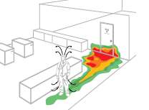
System-Based Environmental Microbial Control –
Key Points Risk Assessments
Traffic Flow & Touch Points
Personnel
Product
Waste
Components
External to Area - Consider traffic flow outside the immediate areas where common touch points can occur from items that never enter the cleanroom or environment under evaluation

Slide 17
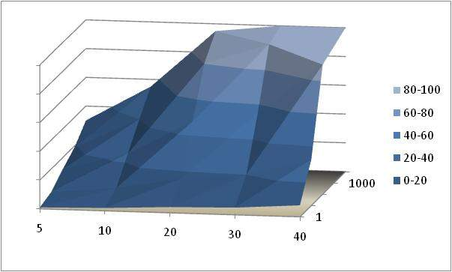
System-Based Environmental Microbial Control –
Key Points Risk Assessments
Quantitative Risk Assessments
Probability of Ingress
Air-borne ingress – for open process steps or open containers air borne ingress can be quantified
Mechanics of air flow – air flows and contamination rates are quantifiable as likely units contaminated with at least 1 cfu
QbD – quantitative assessment of contamination risk maps design space in a surface response model permitting QbD principles to be applied
Time of
Exposure
Magnitude of Challenge (cfu)

Slide 18
System-Based Environmental Microbial Control –
Key Points Risk Assessments
Real Time Risk Assessments
Manufacturing
Behavior, operationally focused tool
Structured, objective assessment of cleanroom microbiological risks
Regularly executed during shifts (in real-time)
Performed and overseen by Microbiologists
Identified risks are mitigated as far as possible at time of discovery (real-time)
Risks are reported to Manufacturing, Quality, Engineering management
Focus alters with improved performance - evergreen
Mean of continuous improvement on cGMP
Microbiologist
Engineers

Slide 19

System-Based Environmental Microbial Control –
Key Points Triggers
Triggers
  Set to avoid ‘nuisance or noise’ responses
  Consider rolling time, certain SPC rules
  Recovery rates and hit rates
  Define risk profile or minimum species profile and ‘index microorganisms’ to respond to
  Inspection, audit observations
  Control fails (e.g. growth promotion)

Slide 20
System-Based Environmental Microbial Control –
Key Points Example Triggers
Main Categories of Microorganism
Recovered From Cleanrooms*
Aseptic Manufacturing Cleanroom Recovery Rates**
Microorganism | Grade B | Grade C | Grade D
Gram positive cocci | 81% | 63% | 41%
Gram positive non-sporing rods | 3% | 14% | 12%
Gram positive sporing rods | 13% | 10% | 19%
Gram negative rods | 2% | 12% | 20%
Fungi, yeasts, mold | 1% | 1% | 8%
Room Classification | Active Viable Air (%) | Passive Viable Air (%) | Surface Sample (%) | Glove or Garment (%)
Isolator/Closed RABS (ISO 5 or better) | < 0.1 | < 0.1 | < 0.1 | < 0.1
Grade B | < 1 | < 1 | < 1 | < 1
Grade C | < 5 | < 5 | < 5 | < 5
Grade D | < 10 | < 10 | < 10 | < 10
*Derived from Sandal, T. (2011). A Review of Cleanroom Microflora: Types, Trends, and Patterns.,
PDA J. Pharm. Sci and Tech., 65, 392-403.
** USP <1116>

Slide 21

System-Based Environmental Microbial Control –
Key Points Actions
Action
  Risk assessment review – root cause or failure mode included? Add if missing…
  If root cause or failure mode included was it risk assessed appropriately? Re-assess with improved knowledge…
  If risk assessment was appropriate were the controls adequate? Adjust, amend, add as necessary and include on Quality Plan
  Review control plan – were the cohesive controls and monitoring program appropriate. Adjust, change as necessary Control Plan
  Review qualifications (environmental monitoring performance qualification). Adjust, add as necessary and include on Quality Plan
  Action instill continued improvement in know-how, competency, knowledge and keeps the system ‘evergreen’

Slide 22

System-Based Environmental Microbial Control –
Key Points Control Plan
Control Plan
Describes holistic microbiological controls, and monitoring
Rationale for cohesive set of controls and monitoring
Single source document for risk-based microbial controls
States the logic, science and engineering reasons
Permits a holistic view of cohesive controls
Can be used to change sampling and controls
A swift and easy means for non-facility personnel to evaluate the ‘health’ of the facility
  Reviewed upon triggers and therefore assists continued improvement in know-how, competency, knowledge and keeps the system ‘evergreen’

Slide 23
System-Based Environmental Microbial Control –
Key Points Quality Plan
Quality Plan
Describes environmental control improvements
Cohesive holistic plan and schedule of actions and improvements
States the logic and rationale for the sequence and schedule
Includes ‘bridging’ actions
Maintained ‘evergreen’ to sustain a genuinely continuum of systematic and cohesive improvements
Regularly reviewed and approved by Quality and manufacturing

Slide 24
Global Implementation
71 ‘entities’
4 regions
26 Countries
Terminally sterilized
Aseptic
Compounding
LVPs
SVPs
Devices
Varying competency
Not in current QMS
Significant paradigm change

Slide 25
Global Implementation - Strategy
Design process
Pilot at multiple entities and use to grow SMEs
Asses impact at 80-100% entities
Embed in QMS
Global requirements & multiple tools
Prioritize implementation outside QMS process
Communication at multiple venues – top down, bottom up
Regional SME deploy
Align regional and entity SMEs through personal objectives
Flexible deployment pattern

Slide 26
Global Implementation - Strategy
Design process
Pilot at multiple entities and use to grow SMEs
Asses impact at 80-100% entities
Embed in QMS
Global requirements & multiple tools
Prioritize implementation outside QMS process
Communication at multiple venues – top down, bottom up
Regional SME deploy
Align regional and entity SMEs through personal objectives
Flexible deployment pattern

Slide 27
Global Implementation - Assistance
Supporting Documentation – additional information, reinforcing learning
Compile feedback on draft quality system documents and use as learning tool
FAQ – collect during pilot impact assessments
Program of presentations
Encourage facility-facility partnering, interaction within a community
Develop champions from early adopters, pilot facilities to lead
Provide best practices, lessons learned and supporting literature
Single location for resources and community

Slide 28
Global Implementation - Learning
Wide variety in competency
Over communicate
Use multiple means of assisting
Ideal implementation sequence rare
Quality Plan first if not all elements in place
Control plan forces conversations on logic
Control plan forces clarity on state of control
Generally positive feedback from MOHs

Slide 29
System-Based Environmental Microbial Control –
Summary
Challenges
Supply/shortage. Regulations and standards complex. New processes, new technologies, new products
Needs
Agility, flexibility, speed. Commensurate compliance, global integration. Systems thinking with improved know-how
Systems-based Microbial Control
Structured way of operating
Genuine science and engineering foundation for patient safety
Instill continuous improvement and improved competency
Documents genuine current state and provides clear logic of road map for the future state – because we all have legacy and aspire to improve

Slide 30


Thank You!

Slide 31
Let us meet again..
We welcome you all to our future conferences of OMICS International
2nd International Conference and Expo
on
Parenterals and Injectables
On
October 24-26, 2016 at Istanbul, Turkey
http://parenterals-injectables.pharmaceuticalconferences.com/

