Slide 1
About OMICS Group
OMICS Group International is an amalgamation of Open Access publications and worldwide international science conferences and events. Established in the year 2007 with the sole aim of making the information on Sciences and technology ‘Open Access’, OMICS Group publishes 400 online open access scholarly journals in all aspects of Science, Engineering, Management and Technology journals. OMICS Group has been instrumental in taking the knowledge on Science & technology to the doorsteps of ordinary men and women. Research Scholars, Students, Libraries, Educational Institutions, Research centers and the industry are main stakeholders that benefitted greatly from this knowledge dissemination. OMICS Group also organizes 300 International conferences annually across the globe, where knowledge transfer takes place through debates, round table discussions, poster presentations, workshops, symposia and exhibitions.

Slide 2
About OMICS Group Conferences
OMICS Group International is a pioneer and leading science event organizer, which publishes around 400 open access journals and conducts over 300 Medical, Clinical, Engineering, Life Sciences, Phrama scientific conferences all over the globe annually with the support of more than 1000 scientific associations and 30,000 editorial board members and 3.5 million followers to its credit.
OMICS Group has organized 500 conferences, workshops and national symposiums across the major cities including San Francisco, Las Vegas, San Antonio, Omaha, Orlando, Raleigh, Santa Clara, Chicago, Philadelphia, Baltimore, United Kingdom, Valencia, Dubai, Beijing, Hyderabad, Bengaluru and Mumbai.

Slide 3
INFLUENCE OF NANODISPERSIONS ON CORROSION BEHAVIOUR OF ALUMINUM METAL MATRIX NANOCOMPOSITES FABRICATED USING POWDER METALLURGY ROUTE
E.Y. El-Kady¹, T. S. Mahmoud¹, M. Abdel-Aziz², T.A. Khalil¹
¹Mechanical Engineering Department, Shoubra Faculty of Mechanical Engineering, Benha University.
²Central Metallurgical Research and Development Institute (CMRDI)- Helwan –Cairo.

Slide 4
Introduction
Particulate reinforced metal matrix composites (MMCs) combine two or more materials that have different corrosion potentials and corrosion characteristics.
Reinforcement ceramic particles, such as SiC or Al₂O₃ particles, may interact electrochemically, chemically, or physically with the matrix leading to accelerated corrosion.

Slide 5
Introduction
In addition, galvanic interactions between the ceramic particles and matrix can also accelerate corrosion.
Preferential corrosion along a particle matrix interface can lead to rapid penetration along the large interfacial areas in composites.

Slide 6
Introduction
Corrosion resistance is one of the candidate properties that it is believed to be enhanced by the addition of ceramic nanoparticulates to metal matrix such as aluminum and its alloys.

Slide 7
Aim of the Investigation
The aim of the present investigation is to study the electrochemical corrosion behavior of both Al/SiC and Al/Al₂O₃ nanocomposites in 3.5 wt.-% NaCl solution.
The nanocomposites were fabricated using the conventional powder metallurgy route.
The effect of the nanoparticulates type, size and volume fraction on the electrochemical corrosion characteristics was extensively studied.

Slide 8
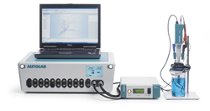
Experimental Work

Slide 9
Materials
Commercially pure Al powder having minimum purity of 99.7% was used as a matrix.
The Al powders have size range of 10–100 μm.
Both nano-SiC and nano-Al₂O₃ particulates were used as reinforcing particles.
The SiC and Al₂O₃ particulates have two different average sizes, typically, 200 nm (from 100 nm to 300 nm) and 60 nm (from 20 nm to 100 nm).
Several Al-based MMNCs containing 1, 3 and 5 vol.-% of the nano- SiC and Al₂O₃ particulates were prepared using powder metallurgy route.

Slide 10
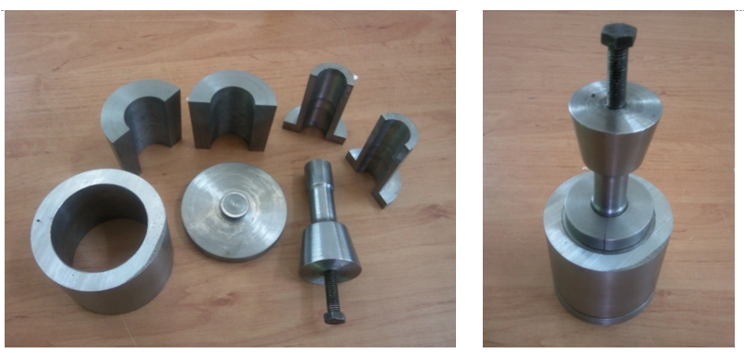
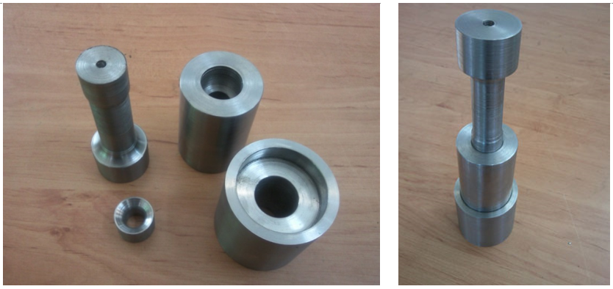
Fabrication of MMNCs
The fabrication method includes the following steps: (1) mixing, (2) cold compaction, (3) sintering and finally (4) hot extrusion.
Photographs shows the compaction die arrangement.
Photographs show the extrusion die arrangement.

Slide 11
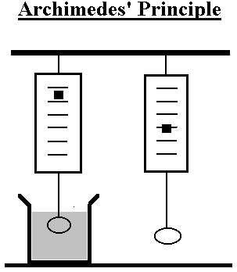
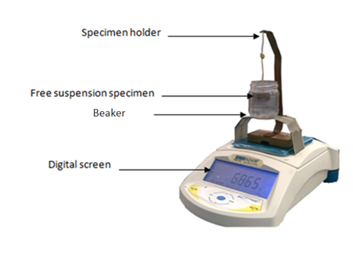
The Porosity of MMNCs
The bulk porosity of the fabricated Al/SiC and Al/Al₂O₃ MMNCs was measured using the water displacement (Archimedean density) approach.

Slide 12
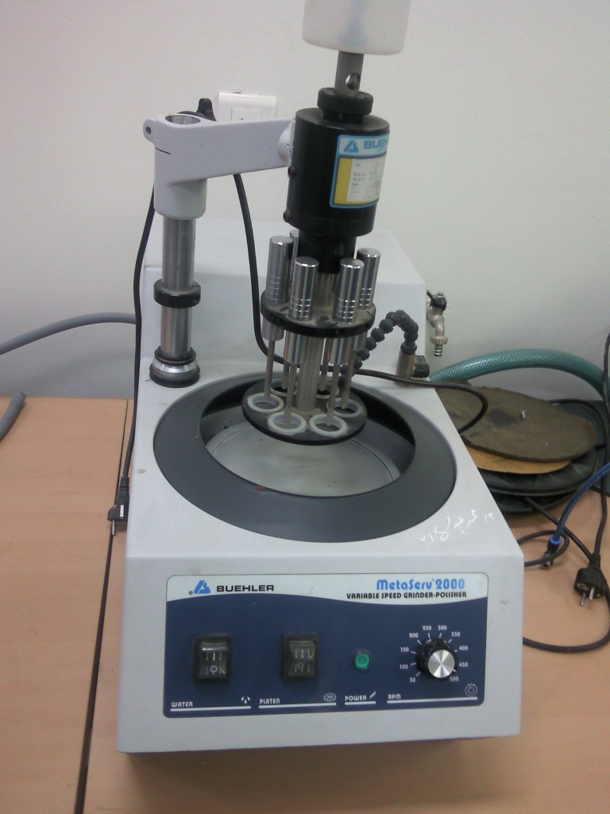
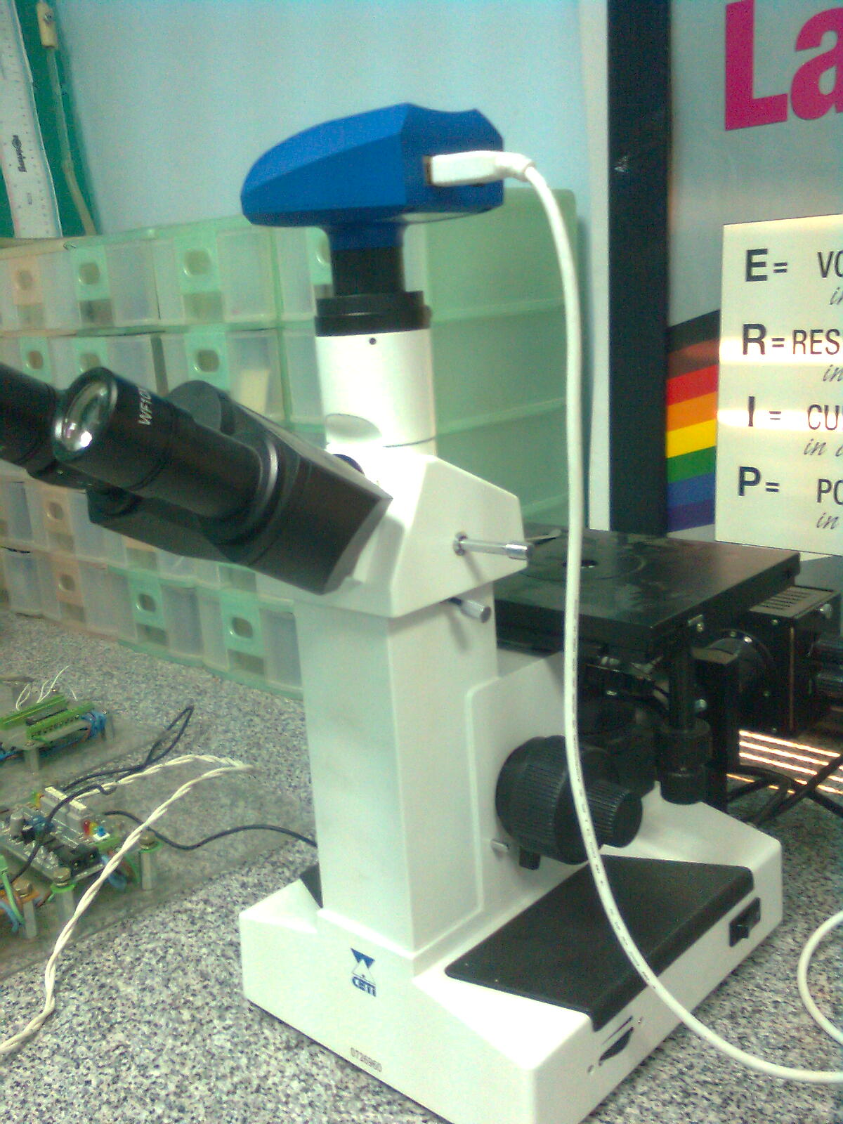
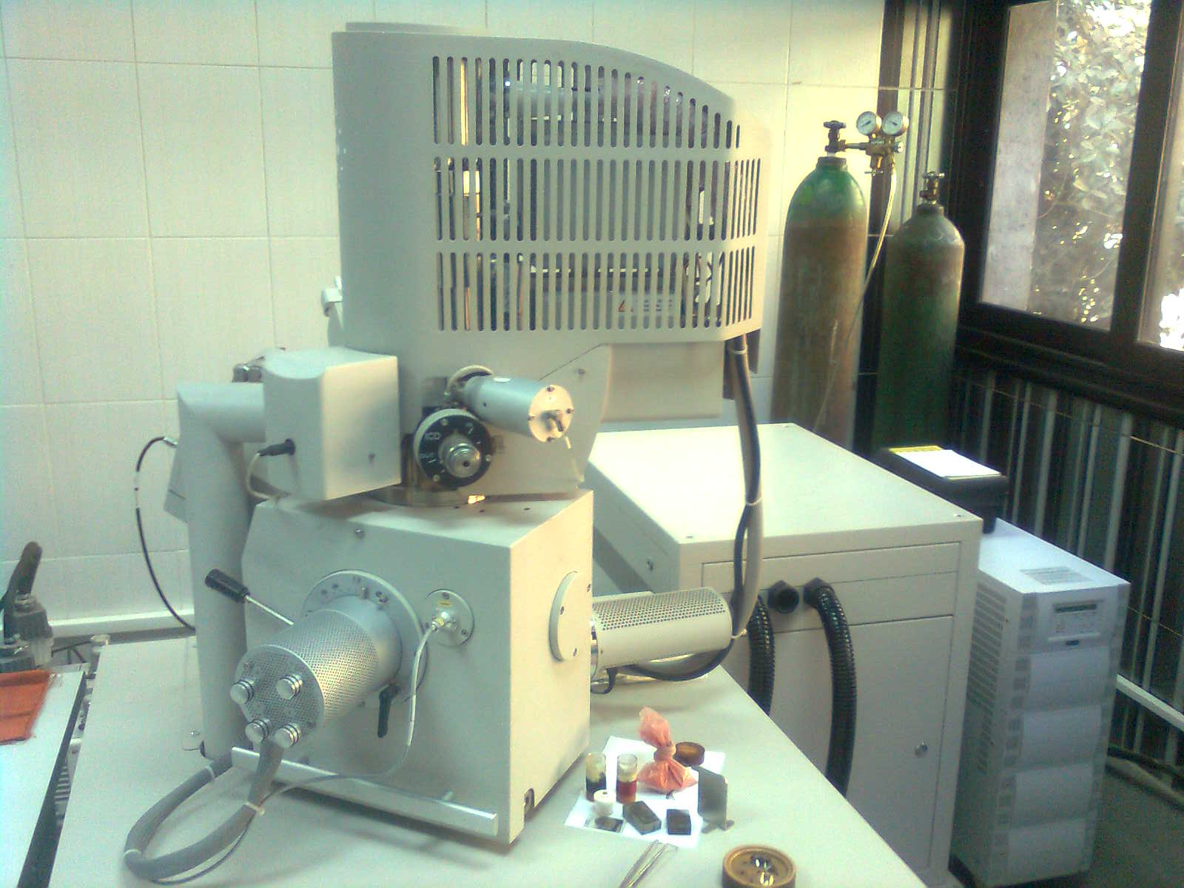
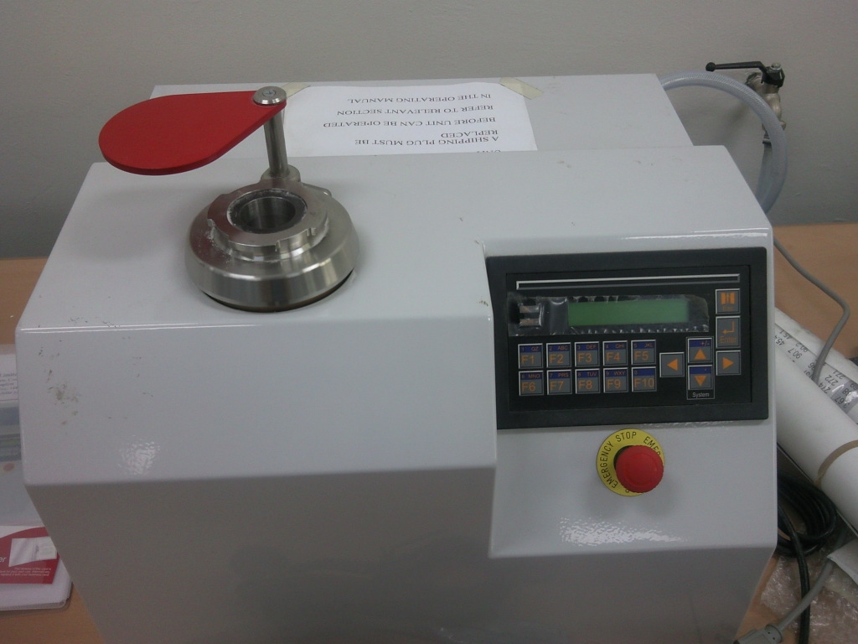
The Microstructure of MMNCs
The microstructure of the aluminum MMNCs was examined using both optical microscope (OM) and Scanning Electron Microscope (FESEM).

Slide 13
Corrosion Tests
Linear polarization tests were performed on the investigated the nanocomposites.
Anode polarisation curves using a measurement system consisting of the AutoLab PGSTAT128N potentiostat including differential electrometer amplifier were constructed.
The PGSTAT128N equipped with FRA2 module and NOVA software for impedance measurements.

Slide 14
Corrosion Tests
The nanocomposite materials featured the examined electrode that were ground and polished with the method used in the practical metallographic techniques.
The inspected surfaces of the specimens were washed with acetone immediately before the examinations.
Specimens prepared in this way were tested in the 3.5 wt.-% water NaCl solution.
The surface area of the examined specimens was about 1 cm².
The tests were carried out at room temperature.

Slide 15
Corrosion Tests
The electrochemical tests were carried out in the two-electrode corrosion cell has a volume of 400 ml.
The platinum electrode was the auxiliary one, and the reference electrode was the saturated calomel electrode.
Potential change rate was 30 mV/min.
The corrosion current (I_{corr}) in mA, corrosion potential (E_{corr}) in mV, polarization resistance (R_{p}) in kΩ and corrosion rate (CR) in (mm/year) were calculated from the electrochemical tests.

Slide 16
Results & Discussion

Slide 17
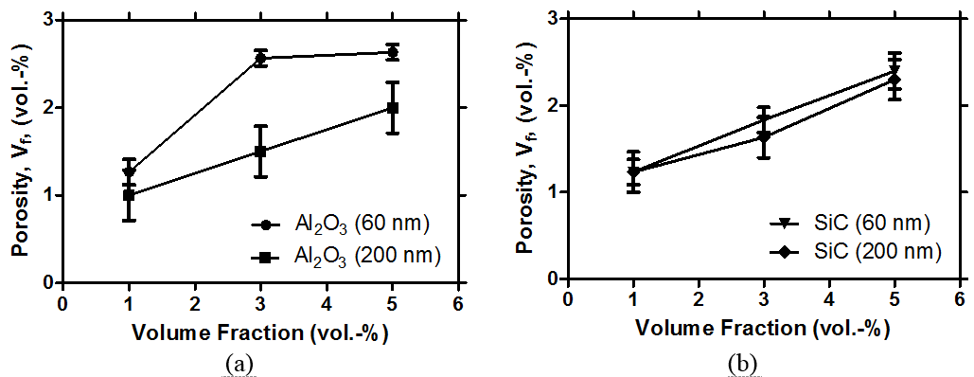
Porosity of Nanocomposites
Variation of the bulk porosity of the MMNCs after extrusion with the volume fraction of the (a) Al₂O₃ and (b) SiC nano-particulates having different sizes

Slide 18
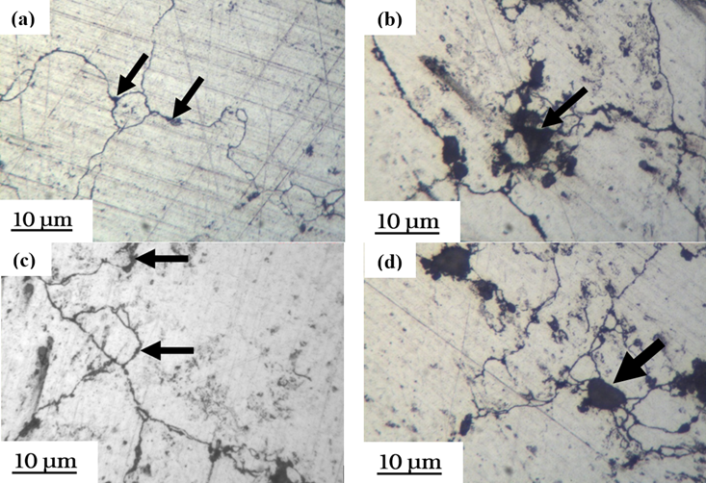
Microstructure of Nanocomposites
Optical micrographs of (a) Al/1 vol.-%Al₂O₃, (b) Al/5 vol.-%Al₂O₃, (c) Al/1 vol.-%SiC and (d) Al/5 vol.-%SiC nanocomposites. Both SiC and Al₂O₃ have average size of 60 nm.

Slide 19
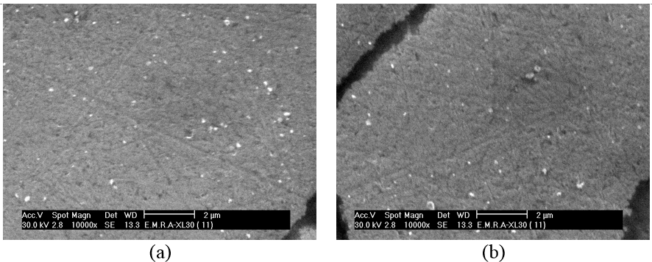
Microstructure of Nanocomposites
SEM micrographs of (a) Al/3 vol.-%Al₂O₃ (60 nm) and (b) Al/3 vol.-%SiC (200 nm) nanocomposites.

Slide 20
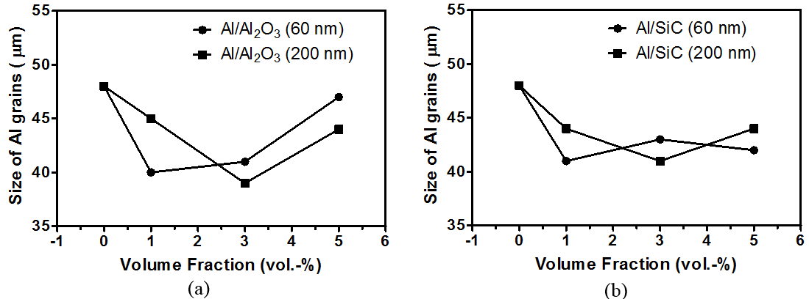
Microstructure of Nanocomposites
Variation of the average size of Al grains with the volume fraction of (a) Al₂O₃ (b) SiC nanoparticulates having different sizes.

Slide 21
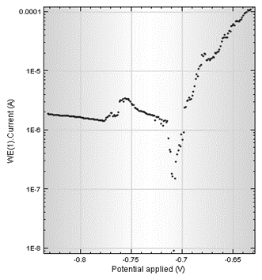
CORROSION BEHAVIOUR OF Al Matrix
The results revealed that the I_{corr}, E_{corr}, R_{p} and CR of the pure Al matrix were about 0.0036 mA, -700 mV, 4.66 kΩ and 0.0397 mm/yr, respectively.

Slide 22
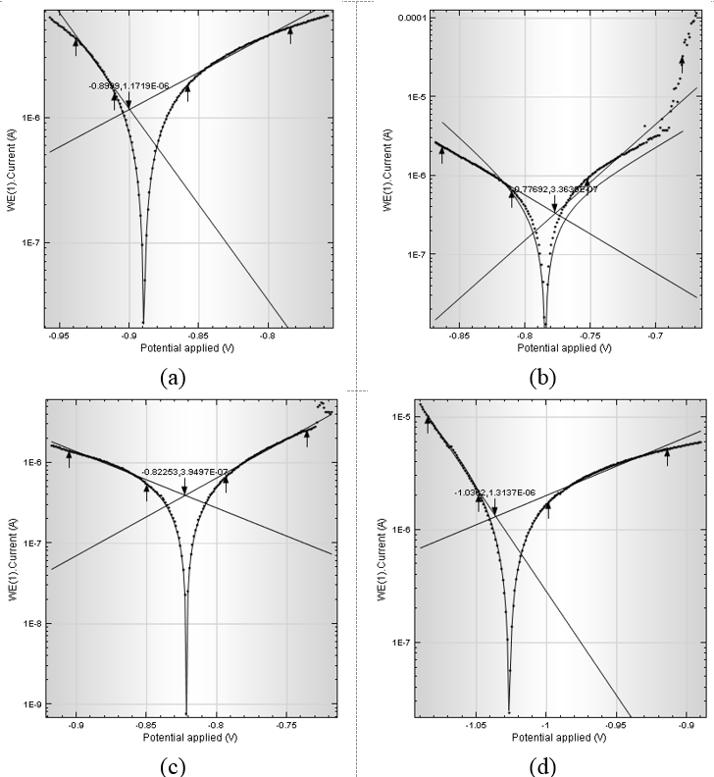
CORROSION BEHAVIOUR OF Al/Al₂O₃ NANOCOMPOSITES
Polarization curves for Al/Al₂O₃ nanocomposite samples in 3.5 wt.% NaCl solution; (a) 1 vol.% (60 nm), (b) 5 vol.% (60 nm), (c) 1 vol.% (200 nm), (d) 5 vol.% (200 nm).

Slide 23
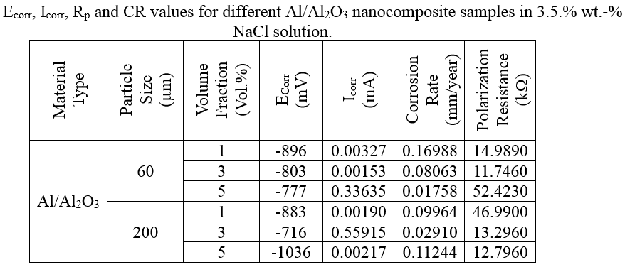
CORROSION BEHAVIOUR OF Al/Al₂O₃ NANOCOMPOSITES

Slide 24
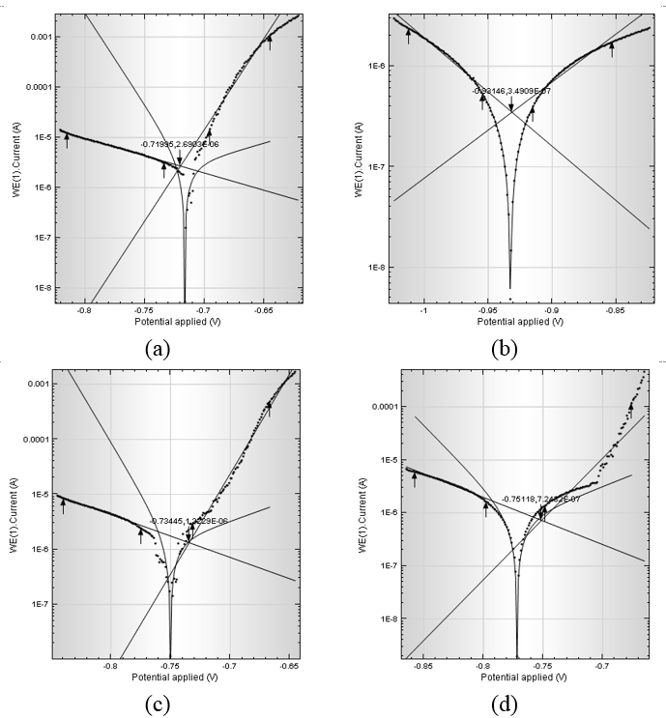
CORROSION BEHAVIOUR OF Al/SiC NANOCOMPOSITES
Polarization curves for Al/SiC nanocomposite samples in 3.5 wt.% NaCl solution; (a) 1 vol.% (60 nm), (b) 5 vol.% (60 nm), (c) 1 vol.% (200 nm), (d) 5 vol.% (200 nm).

Slide 25
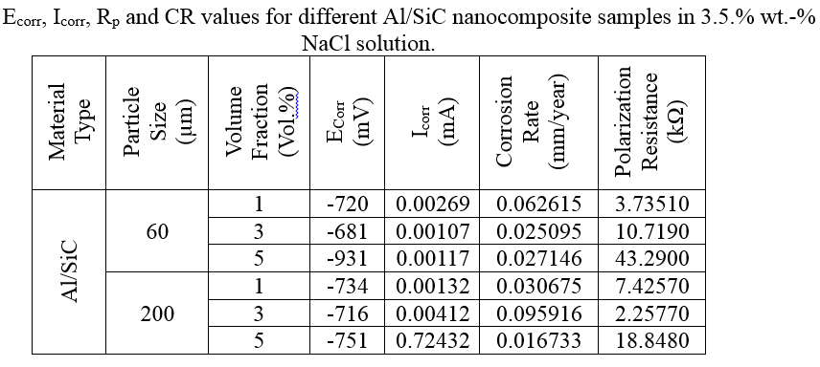
CORROSION BEHAVIOUR OF Al/SiC NANOCOMPOSITES

Slide 26
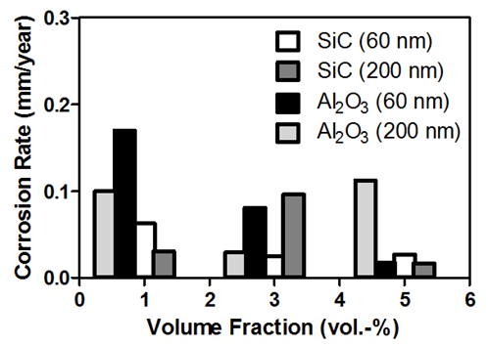
Comparison between the corrosion rates of the Al/SiC and Al/Al₂O₃ nanocomposites
Comparison between the corrosion rates of the Al/SiC and Al/Al₂O₃ nanocomposites at different sizes and volume fractions of the nanoparticulates.

Slide 27
Conclusions

Slide 28
Conclusions
Based on the results presented, the following conclusions can be draw:
Dispersion of both Al₂O₃ and SiC nanoparticulates in pure Al matrix using powder metallurgy route can assist in improving the corrosion resistance of Al. However, the correct choice of the volume fraction and the size of the nanoparticulates as well as the processing parameters plays an important role in determining the corrosion behavior of the nanocomposites.
Generally, the Al/SiC nanocomposites exhibited lower corrosion rates in 3.5 wt.-% NaCl solution than the Al/Al₂O₃ nanocomposites. The Al/5 vol.-% SiC (200 nm) nanocomposites exhibited the lowest corrosion resistance among all the investigated materials even the pure Al matrix.

Slide 29
Conclusions (Cont.)
The corrosion rates of the 60 nm Al/SiC and Al₂O₃ nanocomposites in 3.5 wt.-% NaCl solution was reduced with increasing of the volume fraction of the nanoparticulates.
The Al/SiC nanocomposites exhibited better corrosion resistance in 3.5 wt.% NaCl solution than the Al Al₂O₃ nanocomposites.

Slide 30
Thank You

Slide 31
Let Us Meet Again
We welcome you all to our future conferences of OMICS Group International
Please Visit: http://materialsscience.conferenceseries.com/
Contact us at
materialsscience.conference@omicsgroup.us
materialsscience@omicsgroup.com

