Slide 1
Gene expression profiles of the immuno-transcriptome in IAD and RAO affected horses
Dipartimento di biomedicina comparata e alimentazione
Equine Patavium Hospital
Dr. Elisa Padoan

Slide 2
INTRODUCTION
IAD (Inflammatory Airways Disease) Acute flogosis
Neutrophilic infiltrate
Mast cells infiltrate
6-8 years old
RAO (Recurrent Airways Obstruction) Chronic flogosis
Neutrophilic infiltrate
12-15 years old

Slide 3
IMPORTANCE IN EQUINE VETERINARY PRACTICE…
Poor knowledge about pathogenesis
Limited pharmacological success
Extending time to go back to sport activities in IAD-horses
Poor life quality in RAO patients
Huge economic losses

Slide 4
AIM OF THE STUDY
IMMUNO-RELATED GENE EXPRESSION IN THE BRONCHO-ALVEOLAR LAVAGE FLUID IN
IAD RAO
HORSES

Slide 5
FIRST RESEARCH 13 Horses
7 Controls
6 RAO (T0 e T1)
any pharmacological treatment
Real time RT-PCR 10 immuno-related genes
SECOND RESEARCH 54 Horses
8 Controls
20 IAD
26 RAO
DNA-Microarray
Real time RT-PCR analysis of inflammatory mediators expression in RAO-affected horses
Gene expression profiles of the immuno-related genes in respiratory system of IAD and RAO affected horses

Slide 6
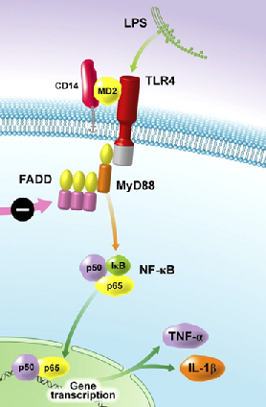
RAO vs Controls Real Time RT-PCR
First research
Results
IL1β, IL6, IL8, IL13, IL17, INFγ, TGF1 β, NF-κB, TLR4, TNFα
“REAL TIME RT-PCR ANALYSIS OF INFLAMMATORY MEDIATORS EXPRESSION IN recurrent airway obstruction-AFFECTED HORSES” E. Padoan, S. Ferraresso, S.Pegolo, M. Castagnaro, C. Barnini, L. Bargelloni (Vet Immun. Immunopath. Submitted)
GENE | IL1β | IL8 | TGF1β | NFKB | TLR4 | TNFα | INFγ
Fold-change | 11,9 | 16,5 | 2,8 | 4,0 | 27,9 | 2,9 | 2,3
P-value | <0,05 | <0,01 | <0,01 | <0,01 | <0,01 | <0,01 | <0,05

Slide 7
Sampling
Second research
CLINICAL EVALUTATIONS
CLINICAL EXAMINATION AND ENDOSCOPY
BRONCHO-ALVEOLAR
LAVAGE
CITOLOGYCAL EVALUTATION
BACTERIOLOGICAL EXAMINATION
GENES EXPRESSION ANALYSIS
“Endoscopic scoring of mucus quantity and quality: observer and horse variance and relationship to inflammation, mucus viscoelasticity and volume» V. Gerber, Equine vet. J. (2004) 36 (7) 576-582

Slide 8
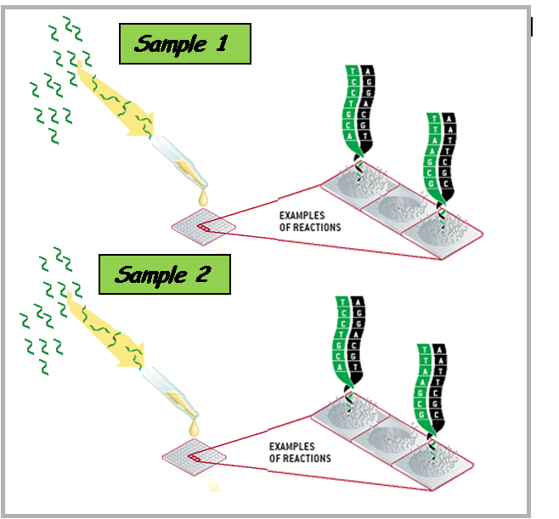
Second research
Experimental Design
DNA-MICROARRAY
It allows to measure the expression level of thousands of genes simultaneously
The samples of different categories are all labeled with the same fluorophore (Cy-3)
The expression level of each gene is measured from the fluorescence emitted by the corresponding probe

Slide 9
Second research
Experimental Design
TRANSCRIPT SELECTION AND ARRAY DESIGN
BIBLIOGRAPHY RESEARCH
IMMUNO-RELATED GENE LIST IMMPORT
IMMUNO/MUCOSAL CHIP GEO
LISTS COMBINING
11.297 IMMUNO-RELATED GENES
7238 EQUINE TRANSCRIPTS
MICROARRAY 8 x 15k
8 samples
15000 probes

Slide 10
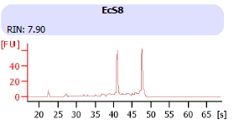
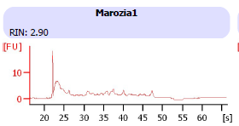
RNA Integrity Number
Second research
Experimental Design
7 Controls
10 IAD
8 RAO
RNA intact
RNA degraded

Slide 11
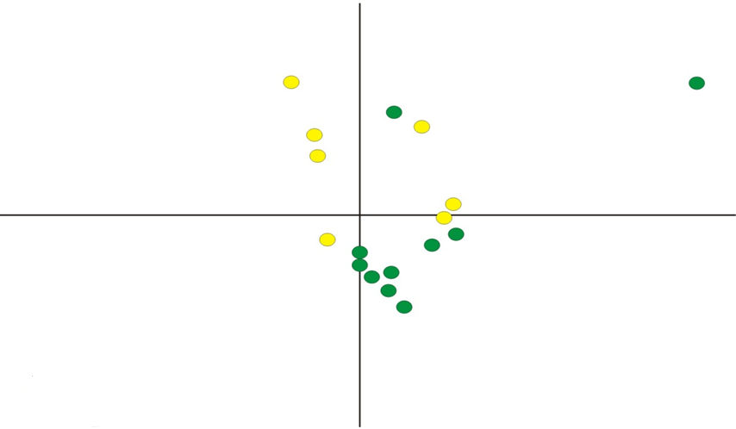
Principal Component Analysis
Second research
Results
Controls VS IAD
X AXIS 40% VARIANCE
Y AXIS 21% VARIANCE
IAD
Controls

Slide 12
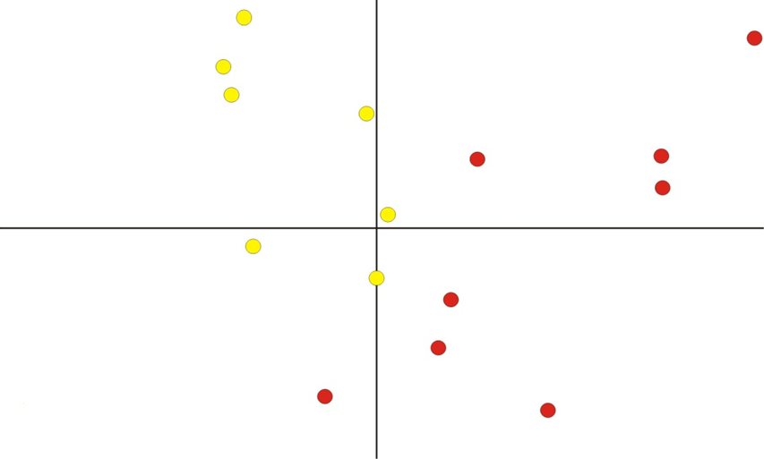
Principal Component Analysis
Second Research
Results
Controls VS RAO
X AXIS 55% VARIANCE
Y AXIS 11 % VARIANCE
RAO
Controls

Slide 13
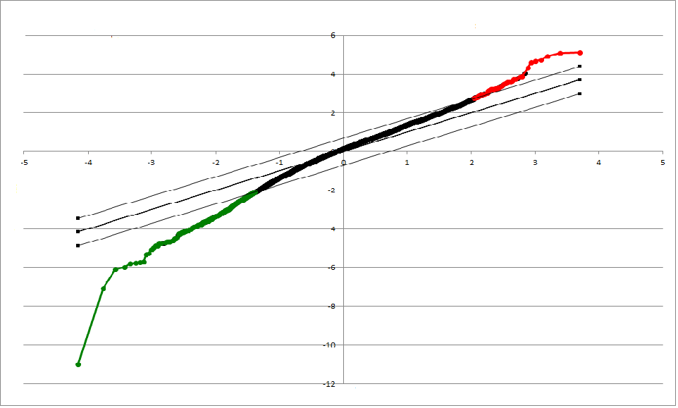
IAD Significance Analysis Microarray
Second research
Results
379 Transcripts (6,3 %)
55 Over-regulated (0,9%)
324 Down-regulated (5,4%)

Slide 14
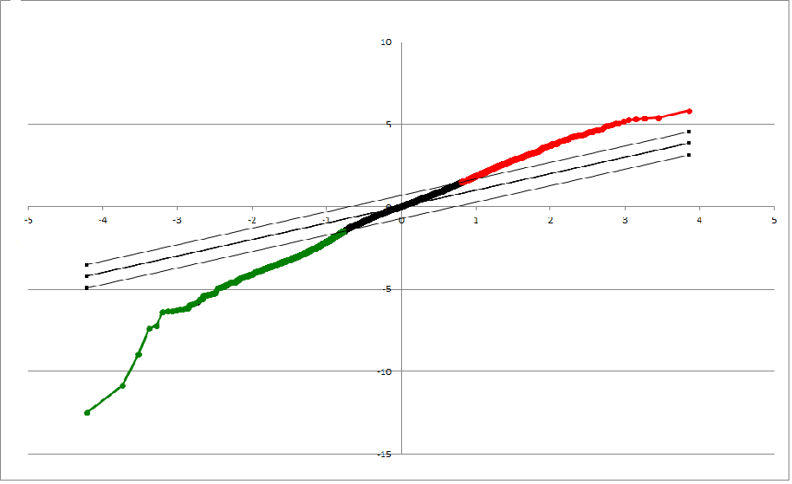
RAO Significance Analysis Microarray
Second research
Results
1763 Transcripts (29,2%)
903 Over-regulated (14,9%)
860 Down-regulated (14,3%)

Slide 15
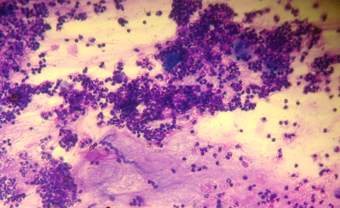
IAD UP-REGULATED
Second research
Discussion
KATA2A K(lysine) acetyltransferase 2A LENG8 LRC member 8 SYNJ1 Synaptojanin1 TSNEN15 tRNA splicing endonuclease 15 homolog TRIM23 Tripartite motif containing 23 NAT10 N-acetyltransferase 10 PRPF39 Pre-mRNA processing factor 39 homolog | Cellular metabolism
IL10RA Interleukin 10 receptor, alpha | Regulation

Slide 16
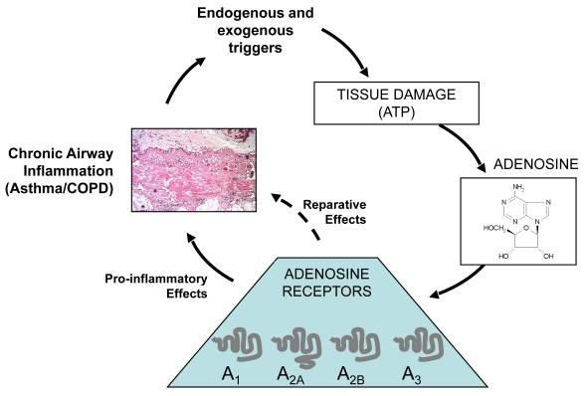
Second research
Discussion
RAO UP-REGULATED
CCL17 Chemokine, C-C motif ligand 17 ARHGAP27 Rho GTPase Activating Protein 27 ARHGAP15 ARHGAP26 ARHGAP9 ARHGAP25 ARHGAP40 ADORA2A Adenosine A2A Receptor TLR4 Toll Like Receptor 4
TGFβ1 Transforming Growth Factor Beta 1 MMP9 Matrix Metallopeptidase 9
Flogosis
PIK3CG Phosphoinositide-3-Kinase Catalytic
Gamma Polypeptide
Bronchoconstriction

Slide 17
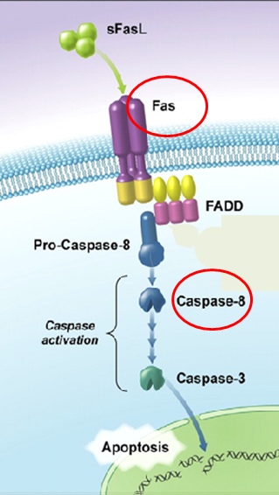
RAO UP-REGULATED
TFPT TCF3 (E2A) fusion partner FOXP3 forkhead box P3 FAS TNF Receptor Superfamily, Member 6 (FC 2,03) MAPK8 Mitogen-Activated Protein Kinase 3 CASP 8 Caspase 8, Apoptosis-Related Cysteine Peptidase
Apoptosis
“Apoptosis and Epithelial Injury in the Lungs”T. R. Martin, N. Hagimoto, M.Nakamura, G. Matute-Bello, PROCEEDINGS OF THE AMERICAN THORACIC SOCIETY, VOL 2 2005

Slide 18
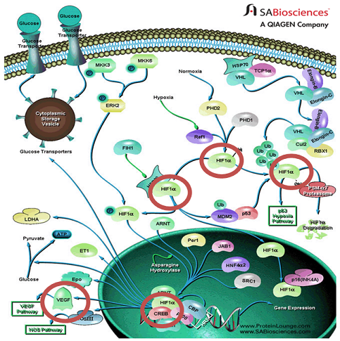
RAO UP-REGULATED
MMP1 Matrix metallopeptidase 1 MBP Myelin basic protein HIF1AN Hypoxia Inducible factor 1, alpha subunit inhibitor VEGF Vascular endothelial growth factor CREBBP CREB Binding protein | Hypoxia

Slide 19
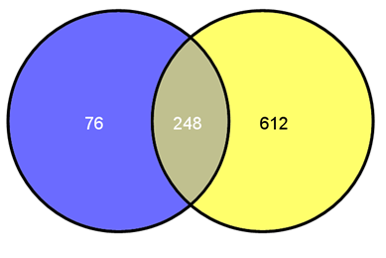
Results
Second research
DOWN-REGULATED IAD & RAO
IAD
RAO

Slide 20
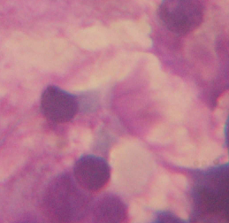
DOWN-REGULATED IAD & RAO
RSPH9 Radial Spoke Head 9 IFT57 Intraflagellar Transport 57, 74, 27, 871, 88, 20, 52, 122, 140, 80, 172 NEK3 Never in Mitosis Gene Related Kinase 3, 4, 11
Muco-ciliary Clearance Reduction
SERPINA 1 Serpin Peptidase Inhibitor, Clade A | Extracellular Matrix Remodelling
IGHG4 Immunoglobulin Heavy Constant Gamma 4 IGLC1 Immunoglobulin Lambda Constant 1 | Antibodies Release Reduction

Slide 21
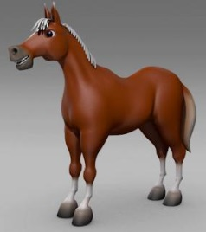
Comparative Analysis
Differentially expressed RAO genes
IRAK3 interleukin-1 receptor-associated kinase 3 (FC 3,09)
Pathway bronchitis, bronchiectasia, enphysema, asthma, COPD

Slide 22
SUMMARIZING…
DNA MICROARRAY
PATHOGENESIS

Slide 23
SUMMARIZING…
Reduced muco-ciliary clearance vs mucus hypersecretion (IAD and RAO)
Extracellular matrix remodelling/
Bronchoconstriction (IAD and RAO)
Hypoxia markers (RAO)

Slide 24
…PROSPECTIVES
PROTEIC EXPRESSION
DNA MICROARRAY
CLINICAL SIGNS
ANIMAL MODEL
PIK3CG
CCR7
ADORA2A
IL2

Slide 25
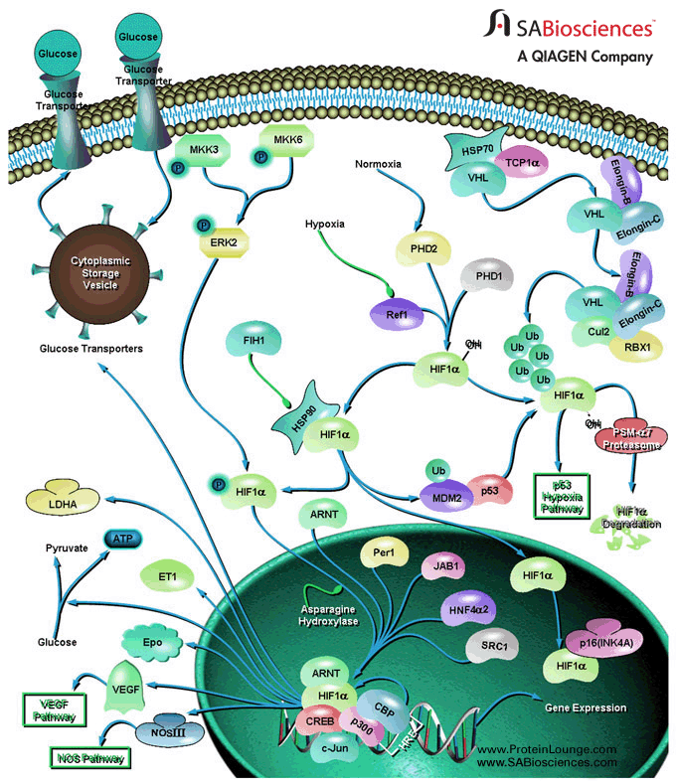
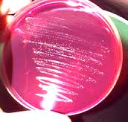
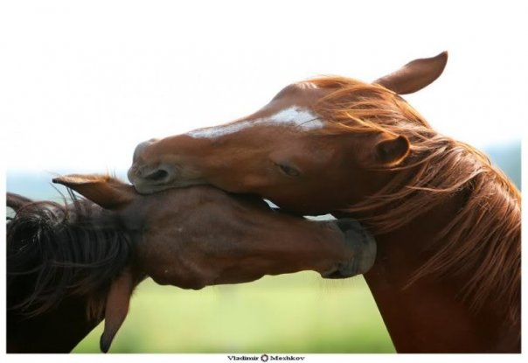
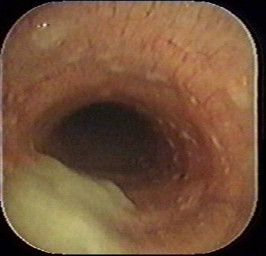
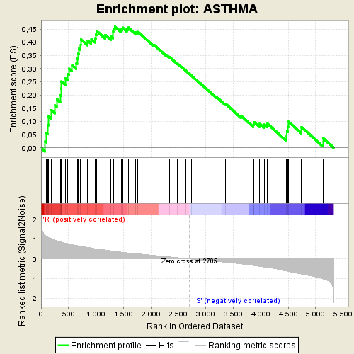
THANK YOU
TO MY DAD

