Slide 1
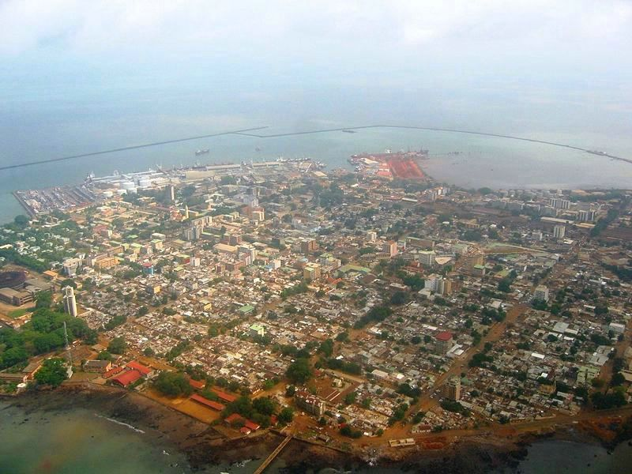
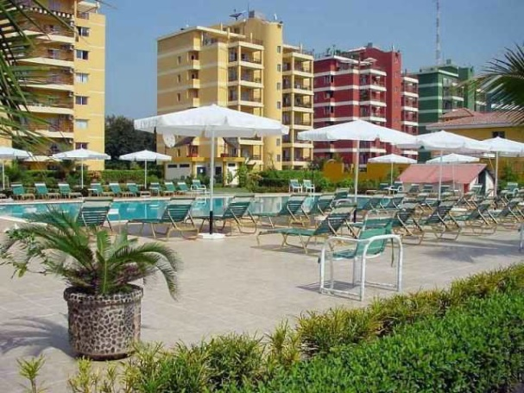
Why persistence of Ebola community deaths in Conakry, Guinea? Conakry, January 1st – February 12th 2015
Dominique Jeannel^{1,2}, Laurel Delayo-Zomahoun¹, Emmanuel Heleze¹, Mariame Bah-Kante³, Cyrille G. Diffo¹, André K. Missombo⁴, Gaston Tshapenda⁴, Geneviève Dennetiere, Lazare Kouassi¹, Karamoko Keita⁵, Abdouramane Marega⁵,
Boubacar Diallo¹, William Perea¹.
¹ WHO, Geneva – ² French Institute for Public Health Surveillance, France – ³ Guinea Presidence Desk – ⁴ CDC, Atlanta, USA - ⁵Health Direction of Conakry City, Guinea

Slide 2
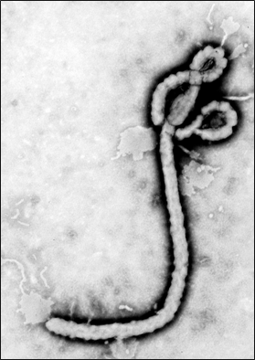
Ebola fever – Ebola virus
Identified in 1976
Filoviridae,
Marbourgvirus
Ebolavirus– 5 viruses
Ebola (Zaire)
Soudan
Bundibugyo
Tai Forest (Ivory Coast)
Reston (animals only)

Slide 4
Ebola virus disease – key facts
The incubation period 2 to 21 days.
Humans are not infectious until they develop symptoms.
First symptoms are the sudden onset of fever fatigue, muscle pain, headache and sore throat.
followed by
vomiting, diarrhoea, rash,
symptoms of impaired kidney and liver function,
in some cases, both internal and external bleeding (e.g. oozing from the gums, blood in the stools).
Laboratory findings include low white blood cell and platelet counts and elevated liver enzymes.

Slide 5
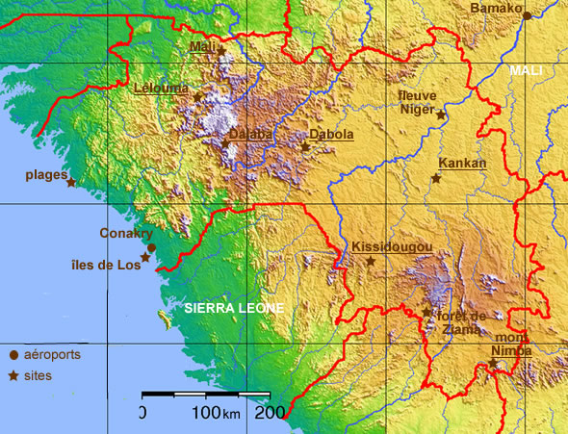
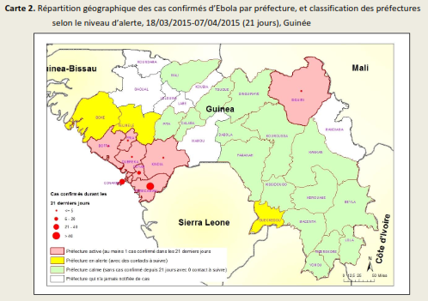
Ebola worse outbreak Guinea Liberia Sierra Leone 27 741 cases 11 284 deaths

Slide 6
Context – early February 2015, Conakry, Guinea
Although the weekly number of Ebola cases decreased markedly since December 2014 and all Ebola riposte activities were deployed :
the number of Ebola community deaths (ECD) showed no decrease
Conduct safe and dignified burials met with frequent difficulties
reticence/hostility to Ebola control activities were regularly reported
A study was then conducted on ECD in Conakry in order to get a better understanding of their circonstances

Slide 7
Objective
Provide accurate information on ECD since 1st January 2015 regarding :
history of contamination and disease,
seeking for health care
social reaction
Conakry city
and its 5 communes

Slide 8
Methods
Trends analysis during the last 3 months (1st november 2014-10 february 2015) for:
Reported ECD in Conakry (national database)
Ebola reported cases and Ebola deaths in clinics (national database)
Statistics of calls to the Ebola free hotline in Conakry (N°115)
For all ECD between 1st January and 12 February 2015, a descriptive analysis was conducted from investigation reports (27 ECD) with collection of the following information
Death classification, type of burial
Transmission chain
Area of residence, place of contamination, place where symptoms started
Patient journey in the community
Patient journey in seeking for health care
Social reaction to control activities

Slide 9
Trends in confirmed Ebola cases and deaths in Conakry, Guinea week 46 2014 – week 7 2015

Slide 10
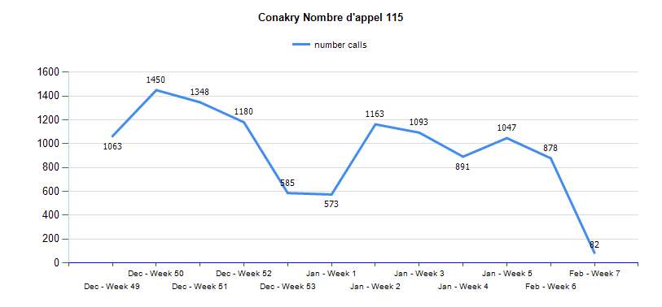
Number of calls to the free Ebola hotline (N°115)
Week 50 2014 to week 6 2015

Slide 11
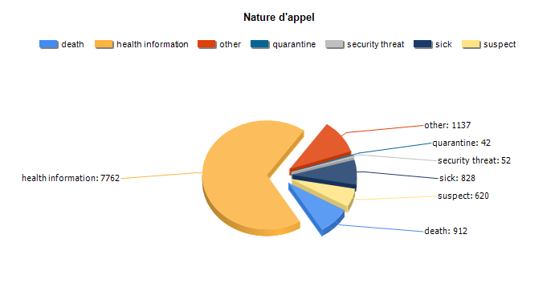
Reasons for calling the free Ebola hotline (N°115)
Week 50 2014 to week 6 2015

Slide 12
Classification of ECD, type of burial
78% of ECD were biogically confirmed
Safe and dignified
59% were reported in Matoto, the largest commune of Conakry city
For 74% of ECD, safe and dignified burial was conducted

Slide 13
Was the deceased previously known as a contact or suspect case?
89% of the deceased were
not identified as contacts
11% were contacts with no
follow-up
(No followed-up contact)

Slide 14
Seeking health care
For 16 cases (59,3%) seeking medical care was reported
2 deaths occured in a medical clinic (1 private clinic, 1 Donka national hospital)
Type of medical structure | Number | %
Private clinic | 12 | 44%
Public medical center | 2 | 7%
Hospital | 3 | 11%

Slide 15
Disease duration and reported symptoms
Fever 84%
Asthenia 90%
Diarrhea/vomiting 50%
6 cases of bleeding
2 cases of fœtal death/abortion

Slide 16
Patients journey
At least 48% attended unsafe funerals
At least 59% had contact with an
Identified Ebola suspect
(mostly identified a posteriori)

Slide 17
Transmission chain
Identified | Number | %
a posteriori | 11 | 40
a priori | 3 | 11
imprecise | 5 | 19
unknown | 7 | 26

Slide 18
Social reaction
Hostility
3 physical assaults
1 threat with a weapon
2 death threats

Slide 19
Refusals of control activities
For the 27 ACD situations, were reported:
5 refusals of safe and dignified burials and 4 refusals of biological sampling (oral swab)
7 refusals of environmental spraying with bleach
8 refusals of epidemiological investigation
12 refusals of contact follow-up
1 suspect case could not be removed from the family and transfered to an Ebola clinic

Slide 20
Conclusions (1)
ECD in Conakry early 2015 originated mainly from contamination while helping an Ebola patient or during funeral attendance in places of active transmission in low Guinea
Most of Ebola community deaths in Conakry concerned individuals not identified as contacts
For three quaters, biological sampling could performed and safe and dignified burial conducted
When the information was available, most of the deceased has sought medical care at least once, mosly in private clinics
2 patients deceased in a medical clinic/hospital
6 cases presented with bleeding
Problem of triage in medical facilities, private as well as public

Slide 21
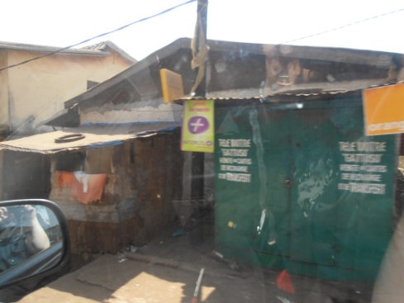
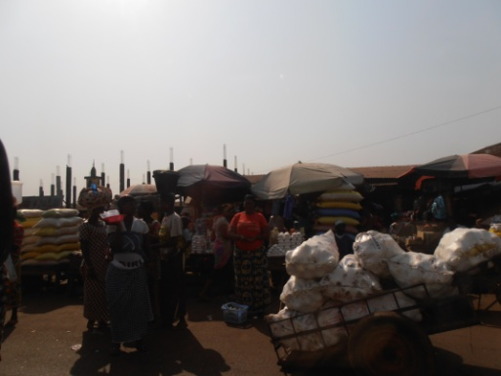
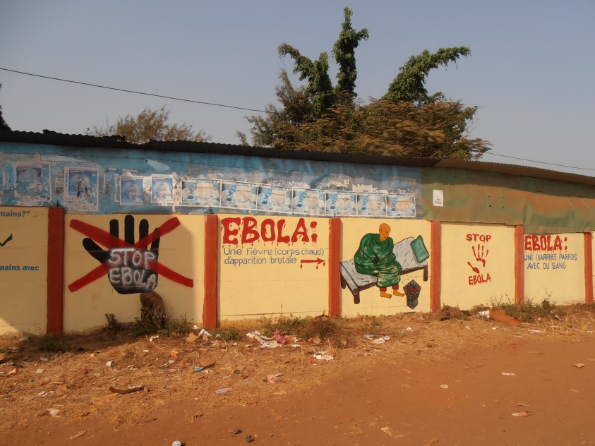
Conclusion (2)
Transmission chain: identified a postériori for the majority of Conakry ECD
For the majority of ECD:
Residence in Conakry
Ebola symptoms started in Conakry
At least one third got contaminated in Conakry and 40 % elsewhere (area with Ebola active transmission in low Guinea)
The origin of the contamination chain was mostly outside Conakry

Slide 22
Conclusion
In more than half of the ECD situations, cooperation of the family was obtained
But open hostility (family and/or neighbours) occured one out of four ECD situations
The majority of hostile reactions or reluctances were reported in Matoto commune
Principal consequences of social difficulties
Refusals of environmental spraying
Refusals of epidemiologic investigations
Refusals of contact follow-up

Slide 23
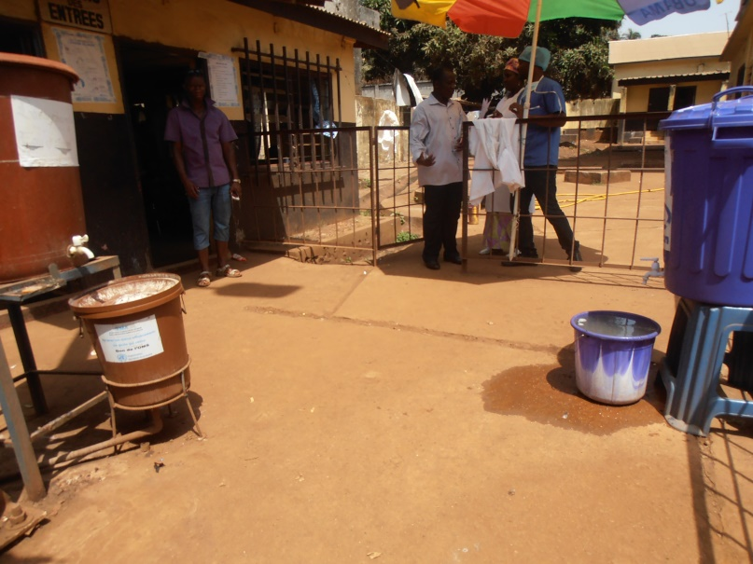
Impact of the study on the improvemnt of Ebola strategy in Guinea
The study brought useful information to:
Implement active surveillance
Implement more efficient triage methods in all clinics and hospitals as well as prevention of infection for health workers
The cas definition was modified in march, to improve its sensitivity and help physicians to identified suspect cases and call for intervention of field epidemiologists for case classification

Slide 24
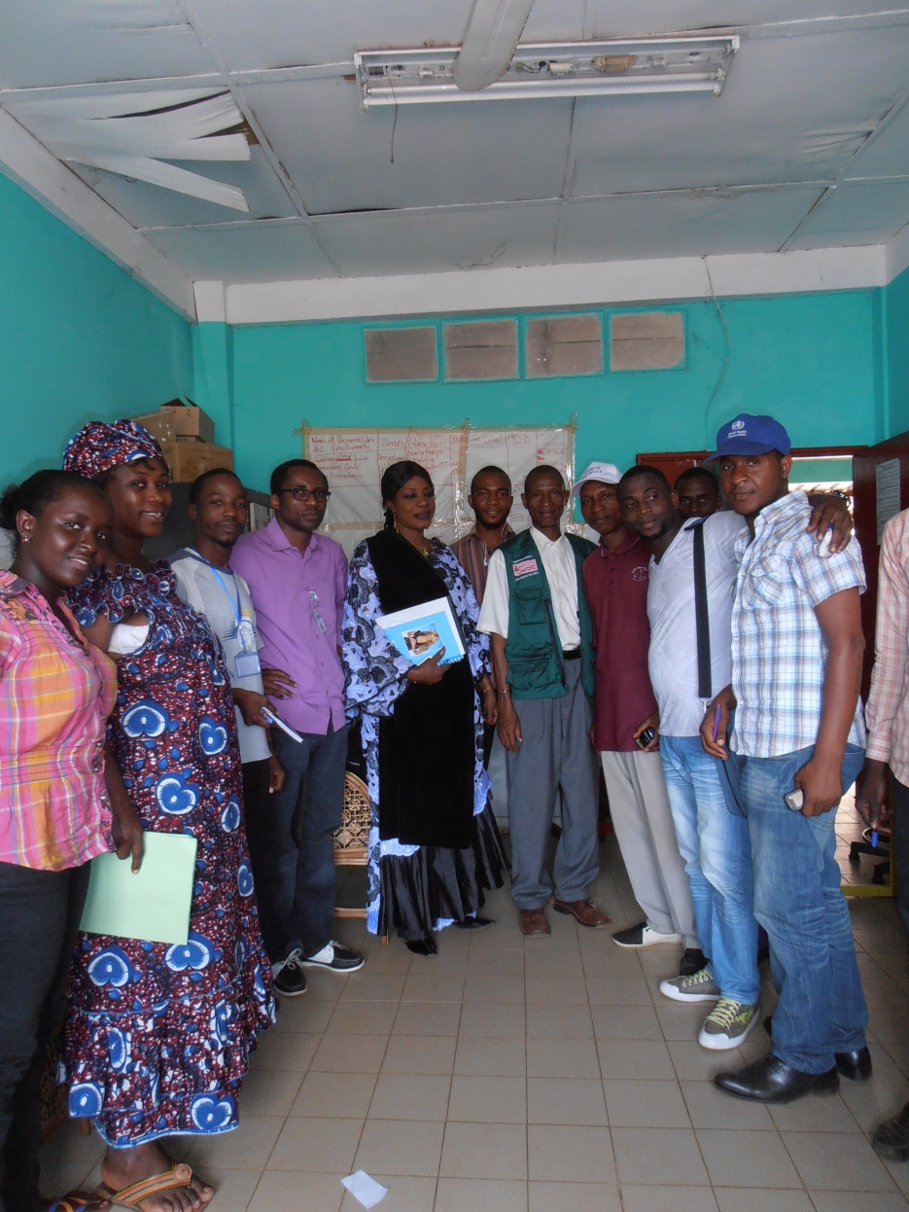
Many thanks to
All the field epidemiologic teams in Conakry that have been working very hard to investigate cases and ECD, collect epidemiological data, supervize contact follow-up, and provide information and confort to the population
All the wonderfull colleagues involved in the fight against Ebola epidemics
Matoto team, Conakry

