Slide 1
About OMICS Group
OMICS Group International is an amalgamation of Open Access publications and worldwide international science conferences and events. Established in the year 2007 with the sole aim of making the information on Sciences and technology ‘Open Access’, OMICS Group publishes 400 online open access scholarly journals in all aspects of Science, Engineering, Management and Technology journals. OMICS Group has been instrumental in taking the knowledge on Science & technology to the doorsteps of ordinary men and women. Research Scholars, Students, Libraries, Educational Institutions, Research centers and the industry are main stakeholders that benefitted greatly from this knowledge dissemination. OMICS Group also organizes 300 International conferences annually across the globe, where knowledge transfer takes place through debates, round table discussions, poster presentations, workshops, symposia and exhibitions.

Slide 2
About OMICS Group Conferences
OMICS Group International is a pioneer and leading science event organizer, which publishes around 400 open access journals and conducts over 300 Medical, Clinical, Engineering, Life Sciences, Phrama scientific conferences all over the globe annually with the support of more than 1000 scientific associations and 30,000 editorial board members and 3.5 million followers to its credit.
OMICS Group has organized 500 conferences, workshops and national symposiums across the major cities including San Francisco, Las Vegas, San Antonio, Omaha, Orlando, Raleigh, Santa Clara, Chicago, Philadelphia, Baltimore, United Kingdom, Valencia, Dubai, Beijing, Hyderabad, Bengaluru and Mumbai.

Slide 3
FORENSIC RESEARCH AND TECHNOLOGY CONFERENCE
SAN ANTONIO (USA): 6 – OCTOBER 2014
A New Multidisciplinary Approach to Learn Lessons From Disasters (Forensic Investigations of Disasters (FORIN)): Researching Causes in Disasters
Djillali BENOUAR
USTHB, Algeria ,
Periperi U Partner
IRDR Science Committee Member
dbenouar@gmail.com

Slide 4
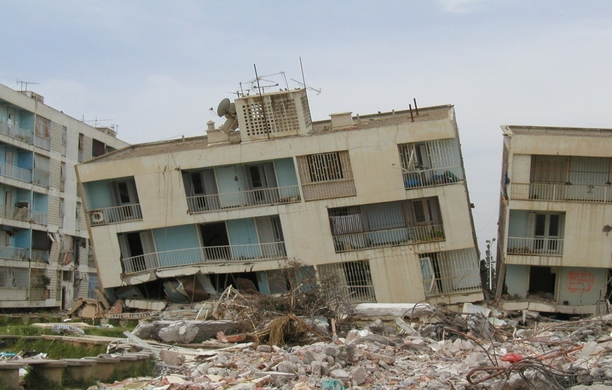
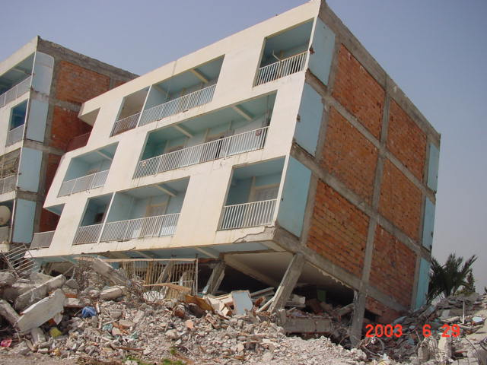
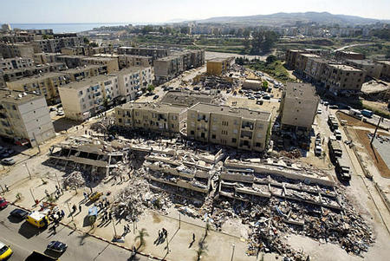
Generally, responsibility for disaster losses is widely spread over institutions and over space and time

Slide 5
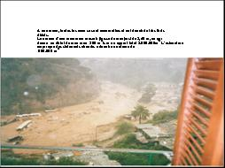
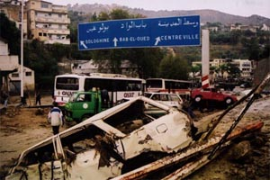
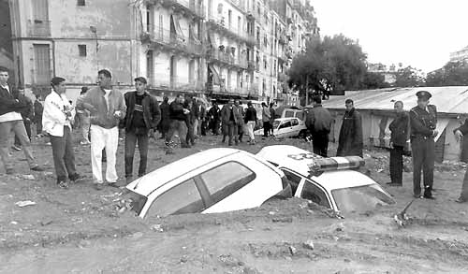

Slide 6
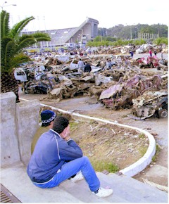

Slide 7
THE CAUSES OF DISASTERS ARE DRIVEN BY COMPLEX ENGINEERING SOCIO-ECONOMIC, SOCIO-CULTUREL, AND VARIOUS GEOPHYSICAL AND HYDROMETEOROLOGICAL FACTORS.
SUCH INTERACTING FACTORS, OCCURING ACROSS A RANGE OF TEMPORAL AND SPATIAL SCALES, COMBINED IN SEVERAL WAYS TO CONFIGURE DISASTERS RISKS.
USING SOME SELECTED DISASTERS IN ALGERIA, THE DYNAMICS OF SUCH RISKS AND THEIR CONFIGURATIONS WILL BE EXPLORED USING A NEW APPROACH AND METHODOLOGY, NAMELY FORENSIC INVESTIGATIONS OF DISASTERS (FORIN STUDIES) DEVELOPED BY IRDR PROGRAMME.

Slide 8
INTRODUCTION
Our knowledge of the causes of disasters and how to eﬀectively manage disaster risks has grown considerably in recent years, but to judge by results it remains seriously inadequate. Moreover, the considerable amounts of information that are available are not being adequately deployed, nor eﬀectively used and implemented..

Slide 9
INTRODUCTION (cONT)
A more demanding and penetrating approach to understanding the actual causes of a disaster would potentially go a long way in supporting future evidence-based decision-making, as well as increasing accountability for responsible policy-making in disaster risk reduction

Slide 10
The current research deFicit
The question is why, when so much more is known about the science of natural events, including extremes, and when technological capacity is so much stronger, are large-scale and even small- and medium-scale disasters apparently becoming more frequent and the losses continuing to increase at a rapid rate.

Slide 11
There has been over the last 60 years a substantial expansion of knowledge about the potential magnitude and frequency of many natural events and the places in which they are more likely to occur.
Often the increase in losses is attributed to increases in human population and material wealth, and their expansion into more hazardous locations.
This is certainly part of the explanation.

Slide 12
It is also true that scientiﬁc knowledge and modern technology are not uniformly distributed and that many developing countries have a lower capacity to utilize or introduce the science and technology that is theoretically available due to institutional or social capacity constraints or, perhaps more importantly, cultural and resource scarcity reasons.

Slide 13
But the fact that major disasters continue to occur in developed countries suggests that there must be more to the explanation than access to science and technology, and choice of location, and resource scarcity.
THIS POINTS TO A DEFICIT AND A DEFICIENCY IN THE PREPONDERANCE OF EXISTING RESEARCH ON DISASTERS.

Slide 14
After a major disaster event it often happens that an enquiry is made or new research undertaken into the causes and consequences. When such investigations are conducted (and there have been many), they typically focus heavily on either the geophysical or atmospheric processes or the technological and structural aspects of the damage.

Slide 15
Emergency preparedness and the disaster relief and rehabilitation response are also often examined.
Sometimes an enquiry may extend to the eﬀectiveness of existing policy and make recommendations for future policy improvements.
These eﬀorts rarely seem to probe very deeply into the more underlying and sometimes longer-term causes of the disaster.

Slide 16
Nor are the enquiries necessarily carried out at arm’s length from those most intimately involved and responsible. This is understandable to the extent that those consumed in disaster response and on the spot have the most knowledge of just what occurred, but not necessarily why or how.
One consequence appears to be that enquiries tend to leave many questions unanswered or even not asked. Is it also the case, as some would argue, that in the aftermath of a disaster when many are suﬀering materially and physically and from post-traumatic stress disorder that there may be reluctance to risk creating more distress by probing too deeply into the causes.

Slide 17
The need to restore conﬁdence and build an optimistic vision of the future frequently seems to trump probing investigations of causes.
IN CONSEQUENCE, THE STATED OBJECTIVE OF “BUILDING BACK BETTER” MAY REMAIN UNREALIZED.

Slide 18
Why forensic investigations?
Such studies will search for additional, wider and more fundamental explanations for the on-going rise in disaster losses. These might extend from gaps in scientiﬁc knowledge in some instances to the ineﬀective application of available knowledge. Commonly identiﬁed in previous investigations are poor building standards, planning and design of infrastructure and human settlements.
Less frequently addressed are questions concerning how and why decisions were made and management options chosen.
This applies not only to major policy choices but to the many everyday incremental decisions and social and cultural practices, beliefs and perceptions that shape the resilience and vulnerability of communities.

Slide 19
FORENSIC APPROACH IS PERHAPS SIMILAR TO SOLVING A PICTURE OF A DISASTER PUZZLE.
THE OBJECTIVE IS TO DIG MORE DEEPLY INTO THE CAUSES OF DISASTERS IN AN INTEGRATED, COMPREHENSIVE, TRANSPARENT, AND INVESTIGATIVE OR FORENSIC STYLE.
TO ESTABLISH A SOUND BASIS FOR ANALYSIS, FORIN RELIES UPON THE ACTUAL EVIDENCE FOUND AND APPLIES ACCEPTED SCIENTIFIC METHODOLOGIES AND PRINCIPLES TO INTERPRET THE DISASTER IN ALL ITS PROCESS.
OFTEN, THE ANALYSIS REQUIRES THE SIMULTANEOUS APPLICATION OF SEVERAL SCIENTIFIC DISCIPLINES SIMIULTANEOUSLY.

Slide 20
FOUR HYPOTHESES ARE FORMULATED AS:
NEW AND MORE PROBING RESEARCH AND UNDERSTANDING OF THE REASONS FOR INCREASE IN PUBLIC VULNERABILITY AND WIDER EXPOSURE WOULD ENABLE AND STIMULATE IMPROVED DRR.
This is contingent upon greater accountability, visibility and transparency of risk reduction processes being employed (the risk reduction hypothesis).

Slide 21
2. NEW AND MORE INTEGRATED AND PARTICIPATORY RESEARCH REQUIRED TO YIELD MORE USEFUL AND EFFECTIVE RESULTS (the integration hypothesis).
Much of the previous research into disasters has been conducted in fragmentary fashion by natural scientists, social and economic experts, engineers, public health specialists, emergency planners, humanitarian relief organizations and many others, acting in their own relative professional isolation.
Reviews of the causes of disasters are carried out either from a sectoral perspective or from the perspective of a speciﬁc component of the cause of impact, i.e., the inadequacy of early warning systems.

Slide 22
3. RESPONSIBILITY FOR CONTINUED INCREASE OF VULNERABILITY AND EXPOSURE IS LOCALLY SPECIFIC AND DIFFUSE OVER INDIVIDUALS, ORGANIZATIONS AND OVER TIME.
This diﬀuse responsibility is not something planned or methodically organized but has simply evolved or grown up in this way.
It is now postulated that more precise identiﬁcation and structuring of responsibilities, especially if these esponsibilities can be made visible and transparent, could contribute signiﬁcantly to disaster risk reduction (the responsibility hypothesis).

Slide 23
There are many actors and decision makers who have a hand in the creation and/or the prevention of the growth of vulnerability and exposure.
These range across many governmental and civil society organizations and institutions and are spread from household and local levels to the national, regional, international, and global. FORIN investigations therefore involve a focus on responsibilities and accountability, in the expectation that their more precise recognition would lead to improvements in disaster risk reduction.

Slide 24
4. THE KNOWLEDGE THAT EXISTS ABOUT DISASTER RISK REDUCTION HAS NOT BEEN COMMUNICATED EFFECTIVELY.
THIS IS BECAUSE THE INTENDED RECIPIENTS ARE UNAWARE OF THE INSIGHTS OR ALTERNATIVELY ARE RESISTANT TO THE KNOWLEDGE AND INFORMATION AND MAY FEEL THREATENED BY IT (THE COMMUNICATION HYPOTHESIS).

Slide 25
To tell experts, managers, and decision-makers that they are failing in their task (to reduce disaster risk) is not likely to be welcome news, and some resistance or denial is to be expected.
The communication hypothesis suggests that new and better ways of communicating scientiﬁc understanding about disaster risk reduction are required if the practice of DRR is to become more eﬀective. It is also more than a matter of communication.

Slide 26
THIS APPROACH WILL CERTAINLY ENABLE RECOMMENDATIONS TO BE DEVELOPED THAT WILL FACILITATE INSIGHTFUL DECISION ON MEASURES TO REDUCTION THE IMPACTS OF DISASTERS.

Slide 27
The objectives of FORIN Investigations
- To experiment with multi-disciplinary and multi-stakeholder inputs
- To encourage participation by decision makers as they develop public policy
- To guide policy across and involving all key disciplines
- To guide public and private investments that reduces risk

Slide 28
MY QUESTION TO ALL OF US
HOW TO CONVINCE THE POLITICIANS AND DECISION MAKERS TO ACCEPT THAT AFTER EACH DISASTER A FORENSIC INVESTIGATION BE CONDUCTED?

Slide 29
THANK YOU VERY MUCH FOR YOUR ATTENTION

Slide 30
Let Us Meet Again
We welcome you all to our future conferences of OMICS Group International
Please Visit:
www.omicsgroup.com
www.conferenceseries.com

