Slide 1
INFLUENCE OF MELATONIN ON ARSENIC MEDIATED PANCREATIC DAMAGE IN SWISS ALBINO MICE
DIMPLE DAMORE
Bhavan’s Sheth R.A.College of Science, Gujarat University, Ahmedabad, Gujarat, India

Slide 2
INTRODUCTION
Arsenic - 20th most abundant element
Arsenic toxicity - global health problem affecting millions of people
Arsenic Contamination in the world – US, Mexico, Chile, Bolivia, Argentina, Hungary, Romania, India, Bangladesh, Thailand, Vietnam, Taiwan, China Nepal
Asia - Bangladesh, Taiwan and India (West Bengal)

Slide 3
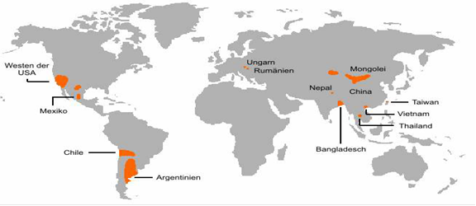
ARSENIC CONTAMINATION IN THE WORLD

Slide 4
CONTAMINATION
Natural geological sources
Mining
Industrial processes
Commercial products
Pesticides, Herbicides, Fungicides
Food - Seafood & Fish

Slide 5
Absorption - predominantly from ingestion from the small intestine, though minimal absorption occurs from skin contact and inhalation
Absorbed arsenic accumulates in the liver, pancreas, kidney, heart, and lungs and deposited in the keratin rich tissues: nails, hair, and skin.

Slide 6
EFFECTS
Gastrointestinal Renal
Dermal Haematological
Developmental Musculoskeletal
Reproductive Endocrine
Respiratory Neurological
Cardiovascular Hepatic

Slide 7
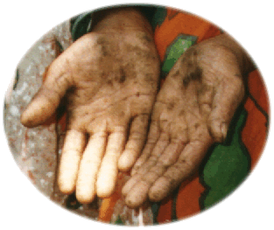
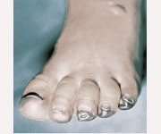
HALLMARK SIGNS OF ARSENIC TOXICITY skin lesions on palm , blackfoot disease

Slide 8
ARSENIC TOXICITY
Formation of ROS/RNS,
Alter sulfhydryl homeostasis
Lipid peroxidation
Conformational changes to biomolecules
DNA damage
Depletion of glutathione
Carcinogenicity of Lung, Skin, Kidney,
Liver, Bladder, GI tract

Slide 9
Antioxidants used to combact Arsenic toxicity
Vitamins A, C, D & E
Calcium Supplementation
Protein Supplementation
Combination of Vitamins and Calcium
Selenium
Antioxidants like SOD, GSH, Catalase
Amino acids ( Methionine, Cystine & Cysteine
Plant Extracts ( Curcumin & Kalmegh-Andrographis paniculata)
Antioxidant Used in this study - Melatonin

Slide 10
MELATONIN (5-methoxy-N-acetyl tryptamine)

Slide 11
MELATONIN (MLT)
Regulation of retinal function, Circadian rhythm, Reproduction
Oncostatic effects
Anti inflammatory functions
Immune system stimulations
Powerful antioxidant

Slide 12
MELATONIN (MLT)
Direct free radical scavenger
Detoxifies ROS/RNS
Stimulation of antioxidant enzymes
Augmenting the efficiency of other antioxidants
Increasing the efficiency of mitochondrial oxidative phosphorylation and reduces electron leakage there by lowers free radical generation

Slide 13
OBJECTIVES : IN VIVO STUDIES
To study the effect of arsenic trioxide (As₂O₃) on biochemical parameters, serum indices & histological analysis of Pancreas
To investigate the ameliorative effect of melatonin (MLT) on arsenic induced pancreatitis

Slide 14
EXPERIMENTAL PROTOCOL
Animals : Adult Swiss Female Mice.
(Mus musculus) (30-35g)
Experimental Groups :
Control
As₂O₃ treated (LD – 0.5mg/kg bw )
As₂O₃ treated (HD – 1.0mg/kg bw)
Melatonin (MLT) alone
As₂O₃ (HD) + MLT
Mode of administration :
As₂O₃ (po) and MLT (ip)
Duration of Treatment : 30 days

Slide 15
PARAMETERS STUDIED
Gravimetric :
Body weight & organ weight
Biochemical :
Protein (Lowry et al., 1951)
Total –SH ( Sedlak & Lindsay., 1968 )
Blood Glucose (Nelson & Somogyi., 1945)
Serum Amylase (Schwiara., 1972)
Serum Lipase (Moss & Henderson., 1999)
Arsenic Retention Estimation
STATISTICAL ANALYSIS

Slide 16
General Mechanism of Arsenic Induced Toxicity
As - High affinity for –SH groups –Protein degradation
↓ Carbohydrate metabolism ↓ Enzymes
- ROS/Radicals/H₂O ₂ - ↓ Antioxidant system – ↑ LPO
Oxidative Stress – Protein degradation
- Accumulation in mitochondria - ↓ Carbohydrate
metabolism ↓ Enzymes – Metabolic Insult -
Pancreatitis

Slide 17
GRAVIMETRIC

Slide 18
PROTEIN & TOTAL -SH

Slide 19
SERUM AMYLASE BLOOD GLUCOSE

Slide 20
SERUM LIPASE

Slide 21
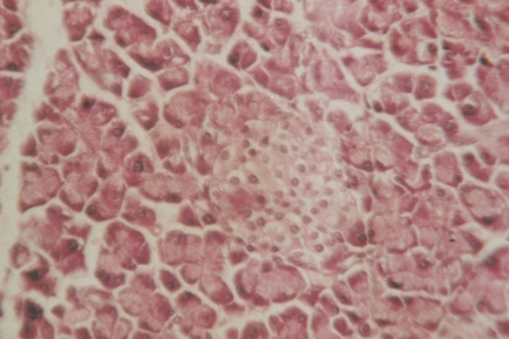
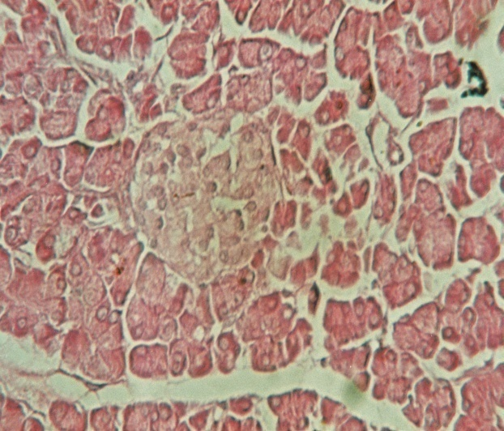
HISTOPATHOLOGICAL ANALYSIS
CONTROL
Normal architecture of Pancreas
Normal Islet size & cell population
Normal acinar tissue
Normal capillary number in Islet
ARSENIC TREATED
(Pathological changes )
Shrunken islets with vacuolization
Reduction in Islet cell number
Damaged acinar tissue
Increased capillary number & diameter

Slide 22
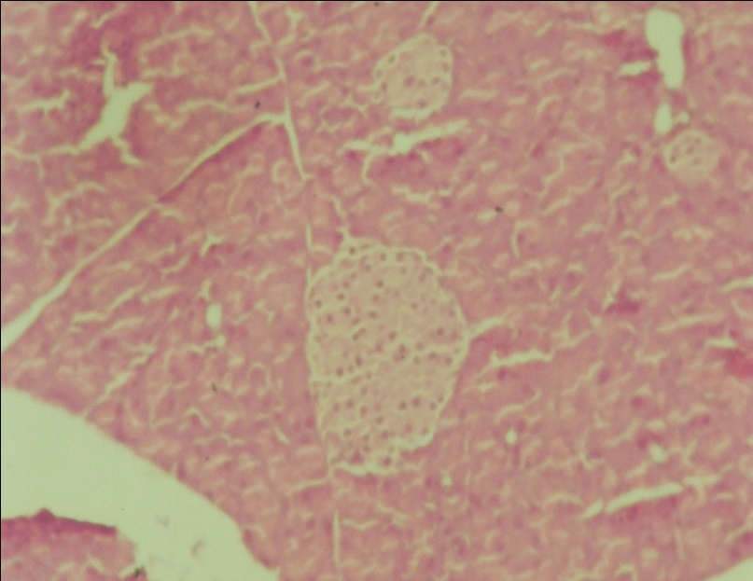
T.S of pancreas of MLT+ As₂O₃ treated mouse showing revival in the morphology and population of cells

Slide 23
CONCLUSION
Arsenic trioxide treatment
- Reduction in body and organ weights
- Declined levels of protein and total sulfhydryl
groups
- Elevated levels of serum amylase, serum lipase
& blood glucose
- Arsenic retention
Histological analysis
- Destruction of the exocrine and endocrine tissue

Slide 24
Administration of melatonin (MLT)
Reversed the above toxic effects and improved the arsenic induced altered function in pancreas

Slide 25
PROBABLE MECHANISM BY WHICH MELATONIN
PROTECTS AGAINST ARSENIC TOXICITY
MELATONIN (MLT)
quenches
superoxide radical
Suppresses NO
formation
Attenuates
Accumulation of H₂O₂
Prevents ROS
formation
Protective effects in activities of antioxidant system
Oxidative
Stress

Slide 26
Thank you

