Slide 1



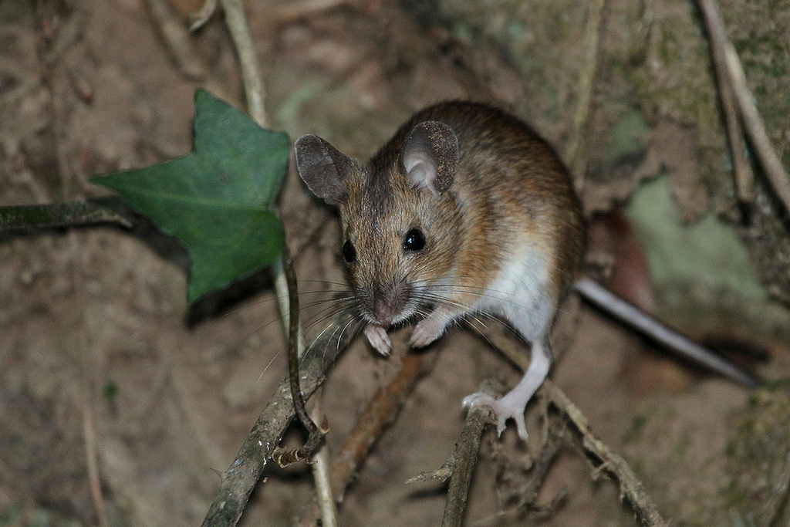
Complex ungulate and predator effects on
foraging behaviour and acorn dispersal
by Algerian mice: an experimental approach
Diego Gallego García Mario Díaz Esteban

Slide 2
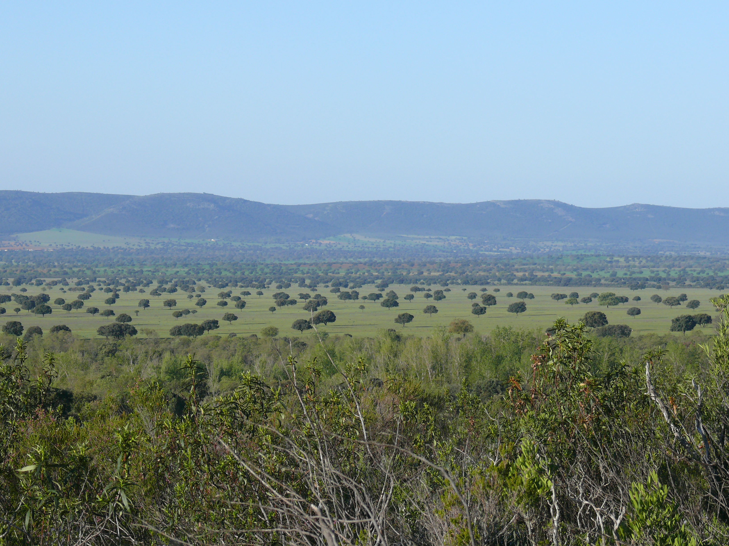
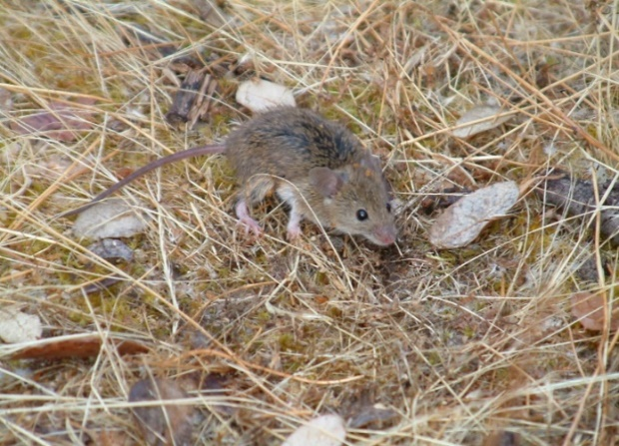
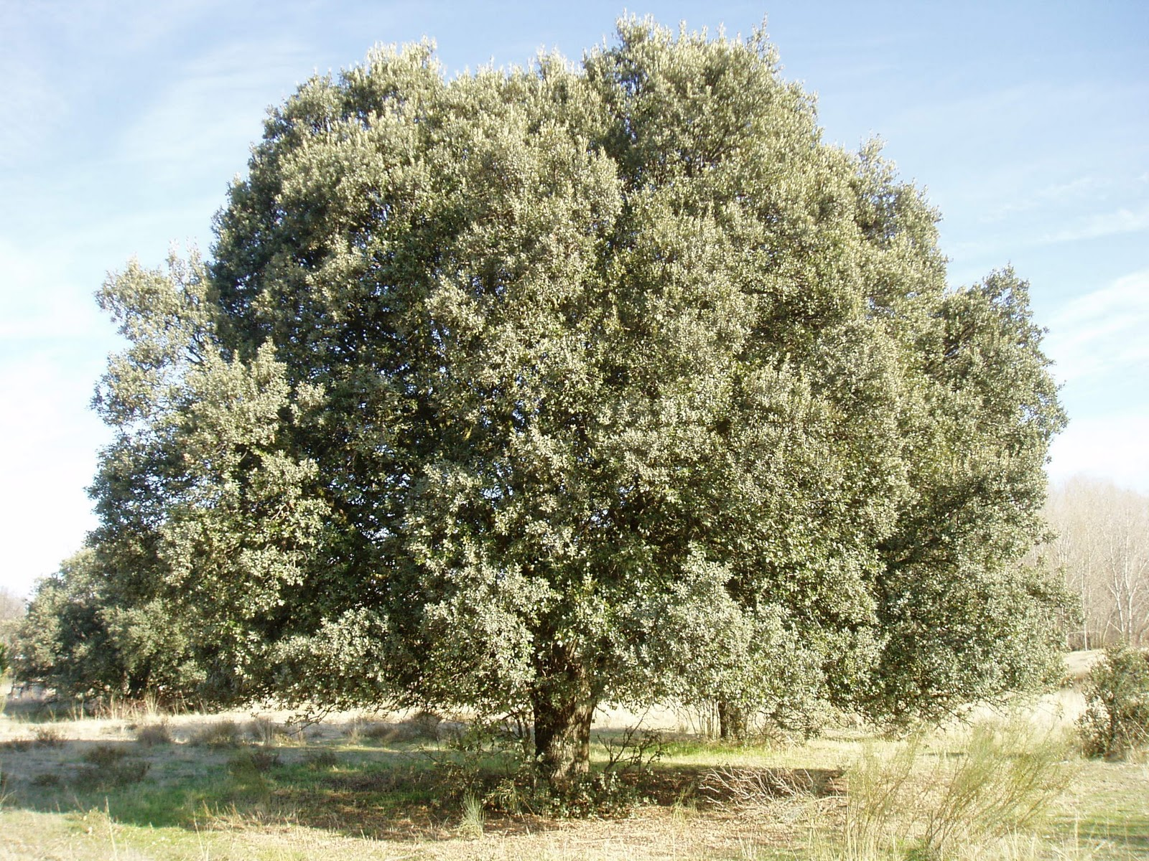
Introduction
Dehesas are human-managed oak woodlands (Quercus) of SW Spain
Scattered distribution of trees on a grassland matrix
Natural regeneration failure
Regeneration of Mediterranean woodlands depends on seed dispersal by scatter-hoarding animals
Seed dispersal is a conditional mutualism
Campos P, Huntsinger L, Oviedo JL, Díaz M, Starrs P, Standiford RB & Montero G. 2013. Mediterranean Oak Woodland Working Landscapes: Dehesas of Spain and Ranchlands of California. New York (NY): Springer.
Díaz M, Campos P & Pulido FJ. 1997. The Spanish dehesas: a diversity in land-use and wildlife. In: Pain D & Pienkowski M, editors. Farming and birds in Europe: The Common Agricultural Policy and its implications for bird conservation. London (UK): Academic Press. p. 178-209.
Pulido FJ & Díaz M. 2005. Regeneration of a Mediterranean oak: a whole-cycle approach. Ecoscience. 12:92-102.
Vander Wall SB. 1990. Food hoarding in animals. University of Chicago Press.

Slide 3
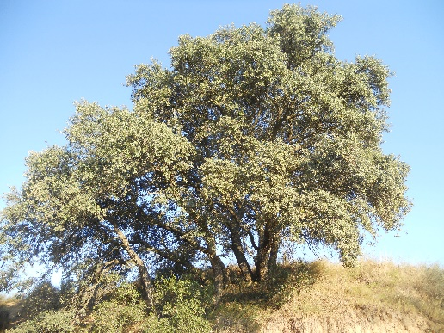
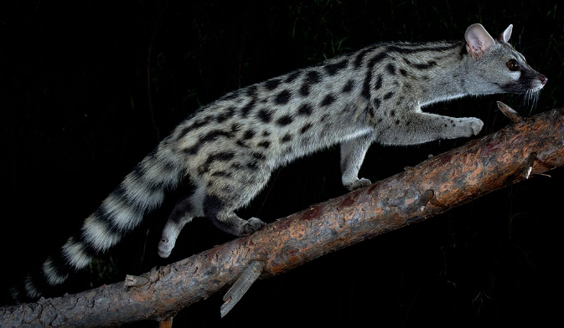
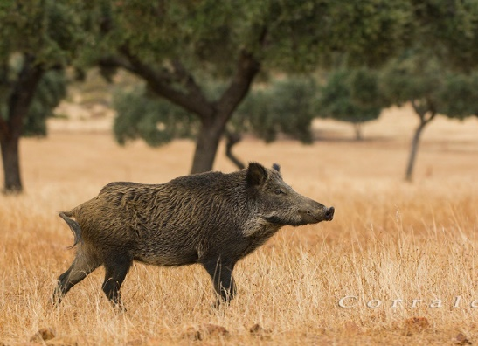
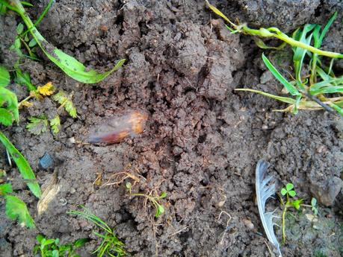
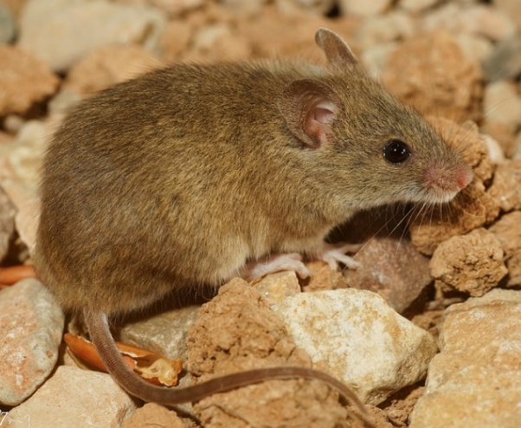
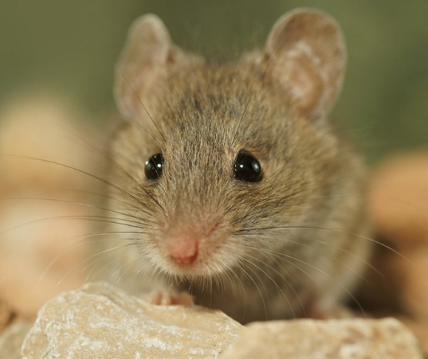
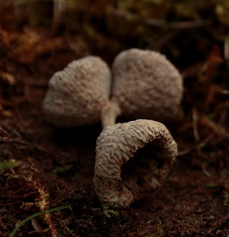
Introduction
Keesing F. 1998. Impacts of ungulates on the demography and diversity of small mammals in central Kenya. Oecologia. 116:381-389.
Caro TM. 2005. Antipredator defenses in birds and mammals. Chicago: Chicago University Press.
Puerta‐Piñero C, María Gómez J & Schupp EW. 2010. Spatial patterns of acorn dispersal by rodents: do acorn crop size and ungulate presence matter? Oikos 119:179-187
Torre I, Díaz M, Martínez-Padilla J, Bonal R, Viñuela J & Fargallo JA. 2007. Cattle grazing, raptor abundance and small mammal communities in Mediterranean grasslands. Basic Appl Ecol. 8:565-575.
Interspecific competitors
Decreased habitat quality (trampling, rooting)
Predators
Indirect effects:
    Ungulates decrease habitat quality → higher perceived predation risk → more acorns dispersed
    Ungulates decrease rodent abundance → relaxed competition for food → fewer acorns dispersed
Direct effects → competition for food
    More time foraging
    More time devoted to acorn handling
    More acorns dispersed
REGENERATION ACHIEVED!
Decreased rodent abundance
Indirect cues (habitat structure, moonlight)
Direct cues (scents, tracks)
Predation risk→ ecology of fear:
  Less time foraging
  More time devoted to vigilance
  Less time devoted to acorn handling
  More acorns dispersed
COMPLEX INTERACTION
Cache
pilferage risk
Predation risk
Intraspecific competitors
REGENERATION FAILURE
Steele MA, Contreras TA, Hadj-Chikh LZ, Agosta SJ, Smallwood PD, Tomlinson CN. 2014. Do scatterhoarders trade off increased predation risks for lower rates of cache pilferage? Behav Ecol. 25:1-10.

Slide 4
Introduction
Predictions
PREDATION RISK AND UNGULATE PRESENCE WILL MODIFY MICE FORAGING AND ACORN DISPERSAL BEHAVIOUR
THE AIM OF THE STUDY IS TO ASSESS THE EFFECTS OF UNGULATE PRESENCE AND PREDATION RISK ON THE FORAGING BEHAVIOUR AND ACORN DISPERSAL OF ALGERIAN MICE
UNGULATE PRESENCE WILL MODULATE THE EFFECTS OF PREDATION RISK

Slide 5
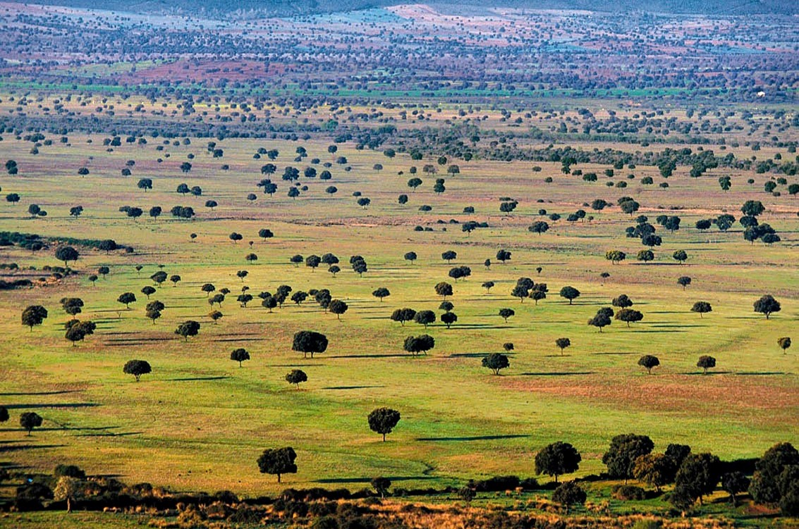
Materials & Methods

Slide 6
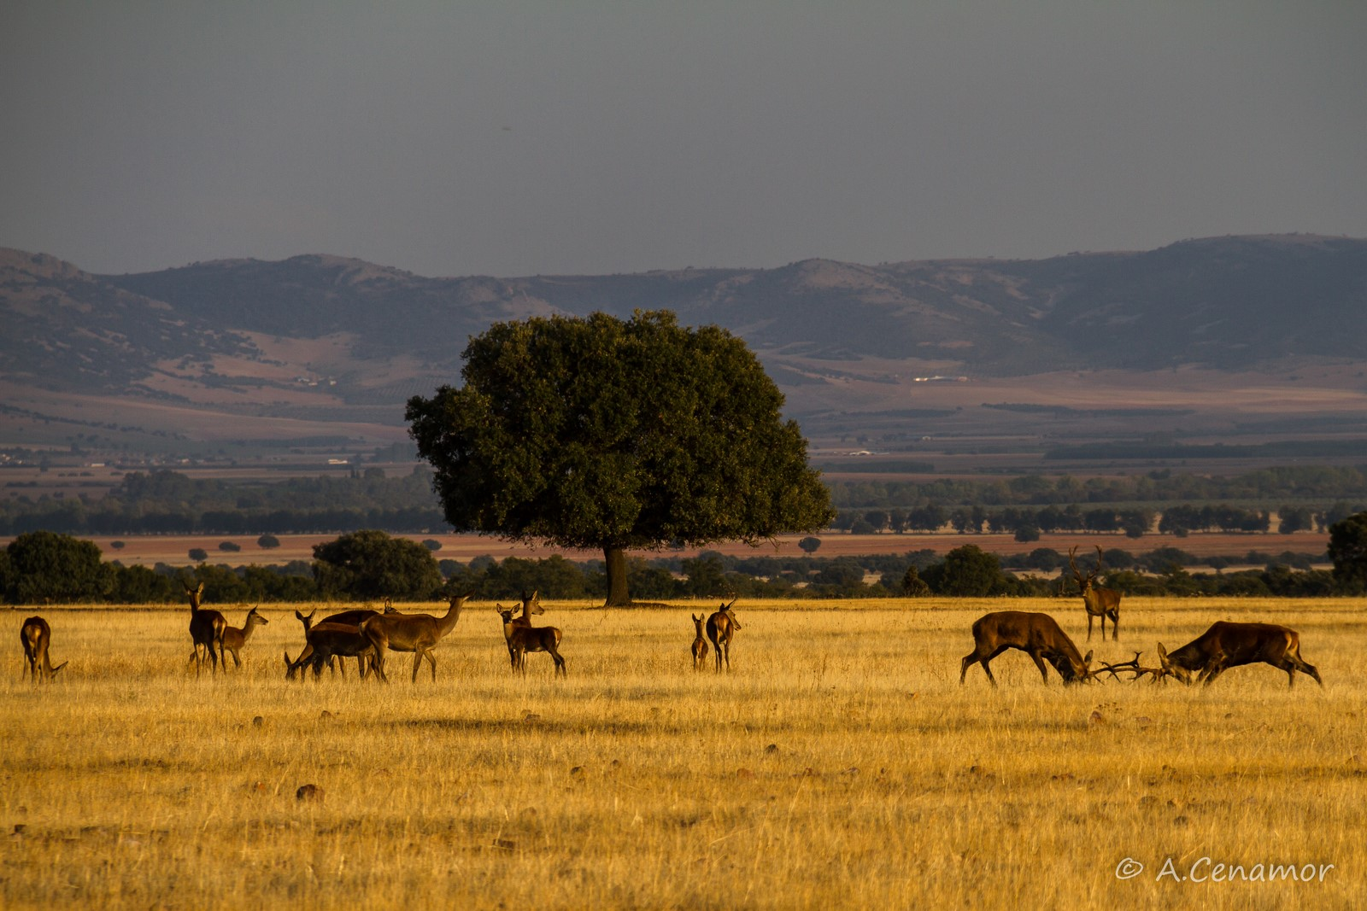
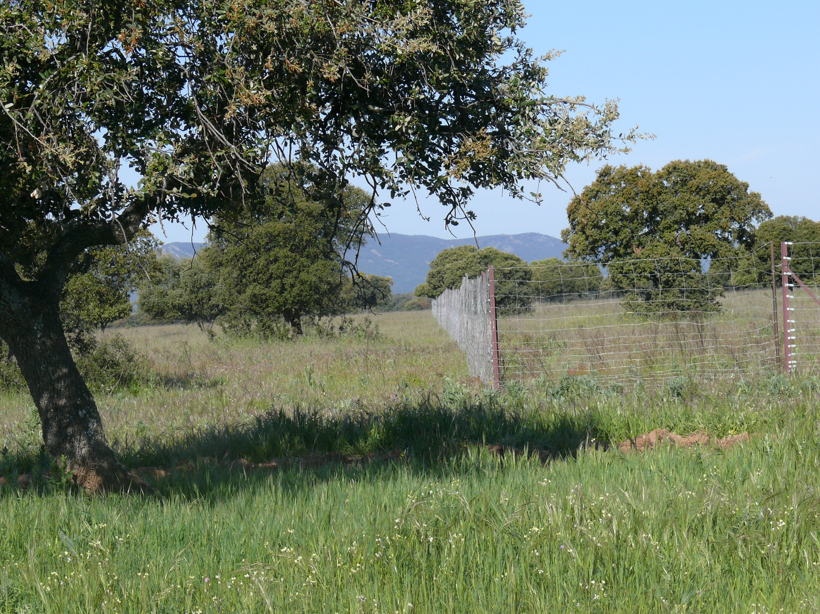
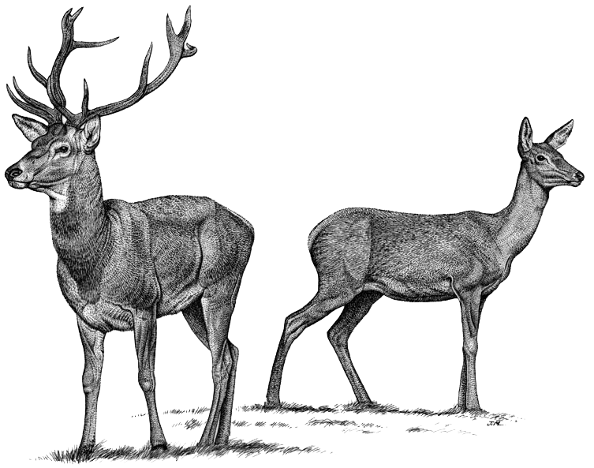
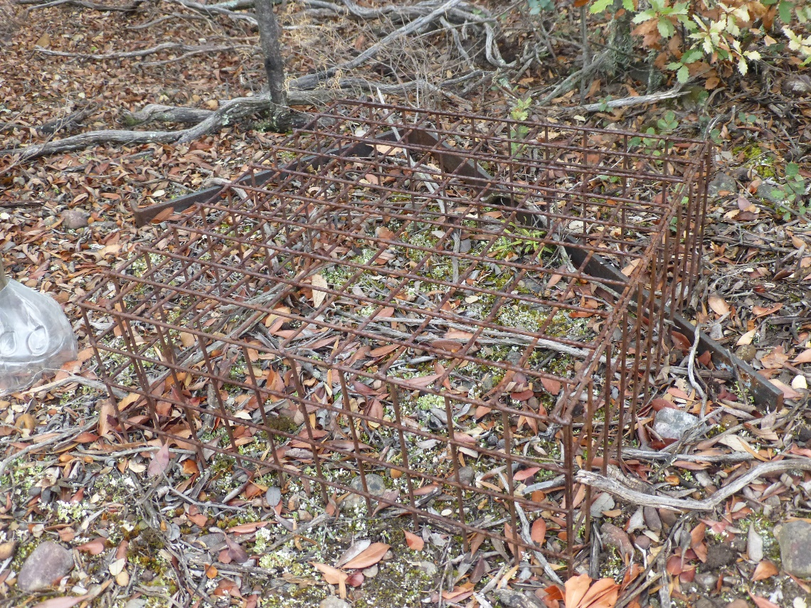
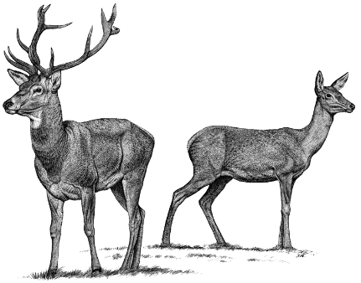
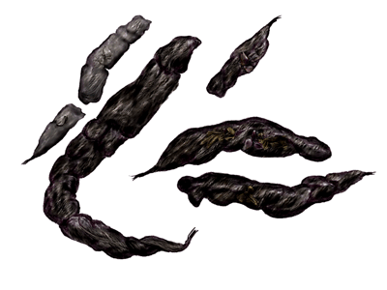
Materials & Methods
Simulation of genet presence
Control

Slide 7
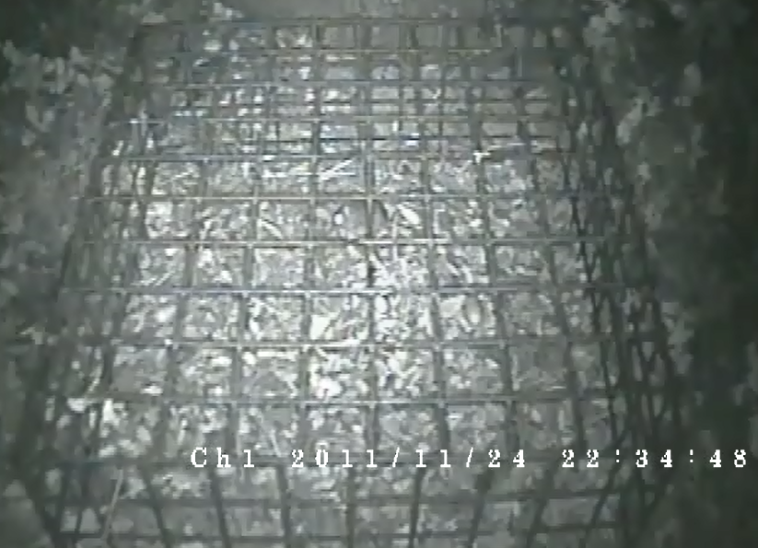
Materials & Methods
Identification of individuals:
  Dominant (larger)
  Relatives (smaller, tolerated)
  Sneakers (non-tolerated)
Analyses of behavioural responses to experimental treatments focused on dominant individuals
Time that conspecifics (relatives or sneakers) spent in the cage was added as a continuous covariate

Slide 8
Materials & Methods
Mixed linear models
(We worked with the means obtained for each tree)
Duration of foraging events
Proportion of time devoted to:
    Vigilance (“freezing”)
    Acorn handling (“handling”)
RESPONSE VARIABLES
    Acorn dispersal rate → Number of acorns dispersed from the cage/number of events
FIXED EFFECTS → Exclosure + Scent Treatment + Interaction (exclosure x scent treatment)
RANDOM FACTORS → Site

Slide 9
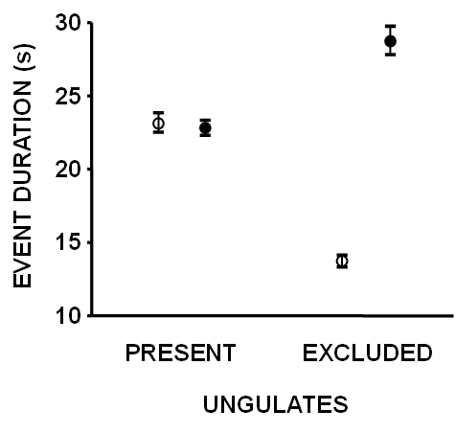


Results & Discussion
EVENT DURATION
Control
Scent treatment (genet)
Effect | d.f. | F | p
Site | 1 | 0.54 | 0.463
Exclosure | 1 | 25.70 | 0.000
Scent | 1 | 173.62 | 0.000
Excl. x Scent | 1 | 189.21 | 0.000
Error | 956
Longer events with ungulates
Longer events as a response to scent treatment
Interaction:
  With ungulates: no significant effects of scent treatment
  Without ungulates: longer events as a response to scent treatment

Slide 10
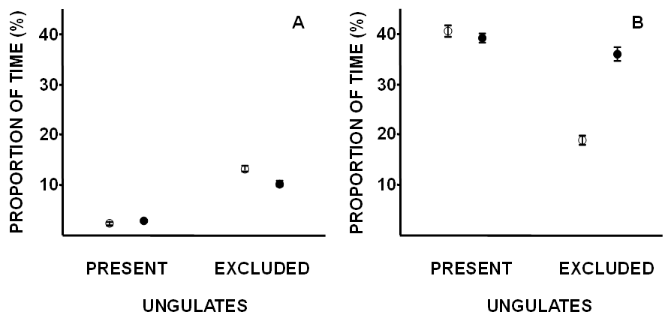
Results & Discussion
VIGILANCE TIME (%)
Control
Scent treatment (genet)
Effect | d.f. | F | p
Site | 1 | 97.09 | 0.000
Exclosure | 1 | 394.66 | 0.000
Scent | 1 | 2.58 | 0.109
Excl. x Scent | 1 | 12.07 | 0.001
Error | 956
More time spent vigilant without ungulates
No significant effects of scent treatment overall
Interaction:
  With ungulates: no significant effects of scent treatment
  Without ungulates: reduction in vigilance time as a response to scent treatment

Slide 11
Results & Discussion
ACORN HANDLING TIME (%)
Control
Scent treatment (genet)
Effect | d.f. | F | p
Site | 1 | 8.23 | 0.004
Exclosure | 1 | 121.73 | 0.000
Scent | 1 | 57.34 | 0.000
Excl. x Scent | 1 | 77.96 | 0.000
Error | 956
More time spent handling acorns with ungulates
Scent treatment increased acorn handling time
Interaction:
  With ungulates: no significant effects of scent treatment
  Without ungulates: scent treatment increased acorn handling time

Slide 12
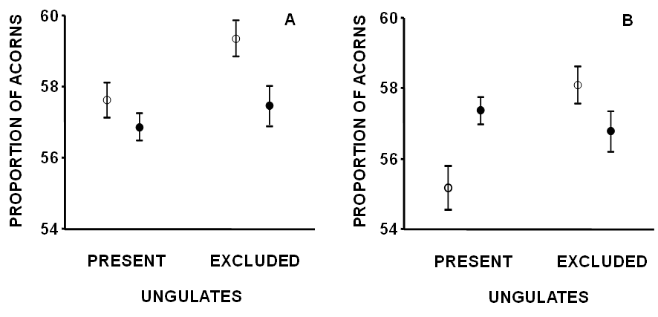
Results & Discussion
ACORN DISPERSAL RATE(%)
Control
Scent treatment (genet)
Effect | d.f. | F | p
Site | 1 | 9.27 | 0.002
Exclosure | 1 | 5.41 | 0.020
Scent | 1 | 7.71 | 0.006
Excl. x Scent | 1 | 1.39 | 0.238
Error | 956
Higher acorn mobilization without ungulates
Lower acorn dispersal in response to scent treatment
Non-significant effects of the interaction

Slide 13
Results & Discussion
When we added covariates related to vegetation structure to our analysis…
Resprout cover and resprout height:
  Increased event duration
  Decreased vigilance time
  Increased acorn handling time
  Decreased the number of acorns dispersed
Reduction in perceived predation risk
However, the effects of fixed factors on mice foraging behaviour and acorn dispersal did not change
The effects of ungulate exclosures on mice foraging behaviour and acorn dispersal WERE NOT MEDIATED by the exclosure effects on vegetation structure

Slide 14
Results & Discussion
When we added covariates related to the activity of sneakers to our analysis…
The time that sneakers spent inside the cages:
  Increased event duration
  Decreased vigilance time
  Increased acorn handling time
  Increased the number of acorns dispersed
Increase in cache pilferage risk
Once more, the effects of fixed factors on mice foraging behaviour did not change
But the effects of fixed factors on acorn dispersal changed
The effects of ungulate exclosures on mice foraging behaviour WERE NOT MEDIATED by the exclosure effects on the activity of sneakers
The effects of ungulate exclosures on acorn dispersal WERE MEDIATED by the exclosure effects on the activity of sneakers
Why did sneakers have an effect on acorn dispersal, but did not have the pertinent effect on mice foraging behaviour?

Slide 15
Results & Discussion
When we added covariates related to the activity of relatives to our analysis…
The time that relatives spent inside the cages:
  Increased event duration
  Decreased vigilance time
  Increased acorn handling time
  Decreased the number of acorns dispersed
Reduction in perceived predation risk
Dilution effect on predation risk
Reduction of individual vigilance
Elgar MA. 1989. Predator vigilance and group size in mammals and birds: a critical review of the empirical evidence. Biological Review 64:13-33.
Once more, the effects of fixed factors on mice foraging behaviour did not change
But the effects of fixed factors on acorn dispersal changed
The effects of ungulate exclosures on mice foraging behaviour WERE NOT MEDIATED by the exclosure effects on the activity of relatives
The effects of ungulate exclosures on acorn dispersal WERE MEDIATED by the exclosure effects on the activity of relatives

Slide 16
Results & Discussion
Control
Scent treatment (genet)
When controlling for the effects of the activity of relatives, outside exclosures scent treatment produced the expected response on acorn dispersal
Why did relatives have an effect on acorn dispersal, but did not have the pertinent effect on mice foraging behaviour?
+ COVARIATE

Slide 17
Conclusions
Experimental exclosure of ungulates and the addition of predator odor in field conditions proved that rodents are responsive to the presence and activity of these distantly-related animal groups
We obtained complex (and unexpected) results regarding the effects of experimental manipulations on mice foraging activity and acorn dispersal:
  Scent treatment produced less distressed behaviours inside exclosures, while outside them it produced no significant effects → less acorns were dispersed when predator presence was simulated
Besides, in the case of foraging behaviour variables (event length, vigilance time and acorn handling time) these effects were not explained by indirect effects of the ungulate exclosures on vegetation structure and intraspecific relations (relatives and sneakers).
However, mice acorn dispersal was mediated by exclosure effects on conspecific activity → foraging decisions are modulated by the presence of conspecifics
The interaction between the effects of ungulates and predators produced complex outcomes on factors influencing mice foraging behaviour. Such outcomes can be mediated by indirect effects of ungulates on vegetation structure and conspecific activity
These complex, cascading effects could ultimately determine oak tree regeneration and long-term sustainability of dehesas if not taken properly into account

Slide 18

THANKS FOR YOUR
ATTENTION!!
“La mayor encina fue bellota chiquitina”
AMAIA
AITA, AMA PAULA
PABLO
TOMÁS

