Slide 1
Nasal administration of antigens using maltodextrin nanoparticles:
a mechanistic study
Pr Didier BETBEDER
INSERM U995, university Lille, France
5th Asia Pacific Global Summit and Expo on
Vaccines & Vaccination
July 27-29, 2015 Brisbane, Queensland, Australia

Slide 2
Nanoparticles for vaccine delivery
- Purified antigens are poorly immunogenic
- They require adjuvants to improve their immunogenicity
Nanoparticles might be used as antigen delivery systems therefore acting as adjuvants
EA4483 / U995
UMR1282

Slide 3
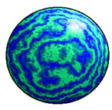
Fabrication
Cationic starch hydrogels
High pressure homogeneisation
Ultrafiltration (<40 kDa)
Size
Zeta potential
Labeling FITC
Cationic polysaccharidic NP
Anionic phospholipid core

Slide 4
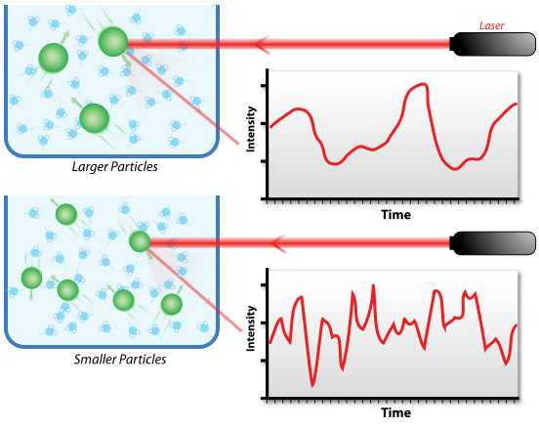
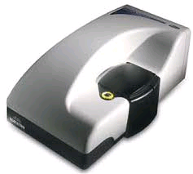
Nanoparticles
EA4483 / U995
UMR1282

Slide 5
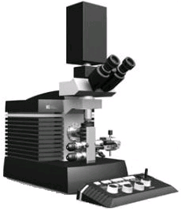
Nanoparticles
Scale Bar : 100nm
Transmission electronic microscopy of nanoparticles.
Micrographs were taken with a LVEM5-TEM (Delong Instrument, Brno, Czech Republic).
EA4483 / U995
UMR1282

Slide 6
Nasal administration

Slide 7
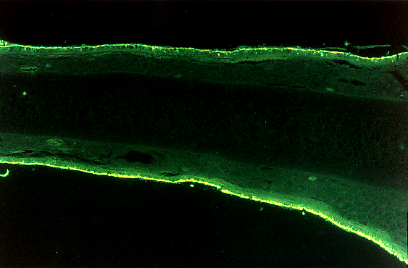
Intra-nasal
2 hrs after i.n administration: rats
S: Septum; SL: Subepithelial Layer ; E : Nasal Epithelium

Slide 8
Nasal administration of NP
autoradiograms were obtained after sagital cryosection
2 hrs

Slide 9
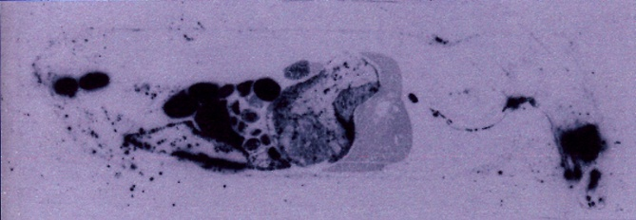
Nasal administration of NP
autoradiograms were obtained after sagital cryosection
2 hrs
12 hrs
3 days later all the radio-activity was found in the feces
GIT elimination

Slide 10
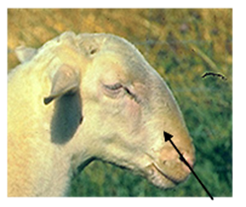
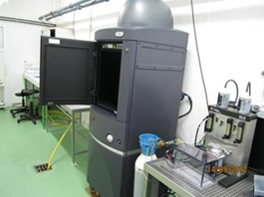
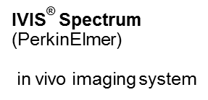
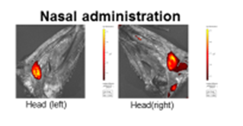
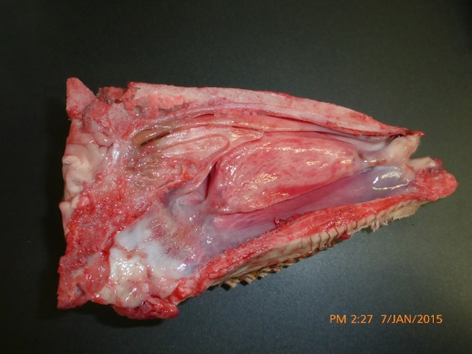
24h after nasal administration
Voie nasale D :
NP are still in the nose!!!

Slide 11
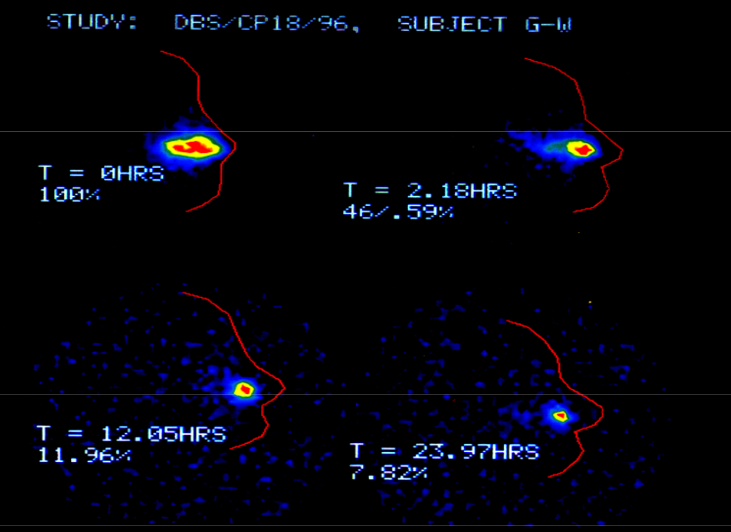
Human Volunteers
scintigraphic analysis

Slide 12
Long residence time!!!!
Mechanisms?

Slide 13
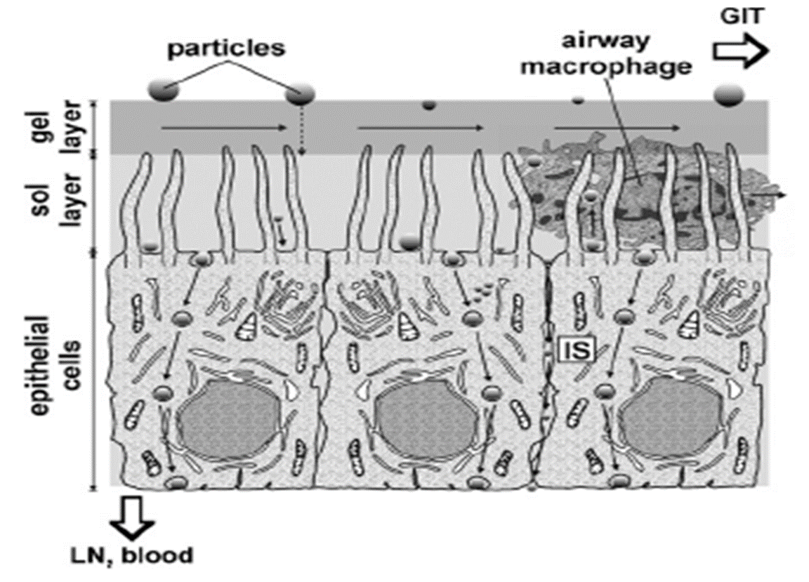
In vitro studies

Slide 14
Airway epithelial cells
Betbeder et al , Nanotechnology (2010)
EA4483 / U995
UMR1282

Slide 15
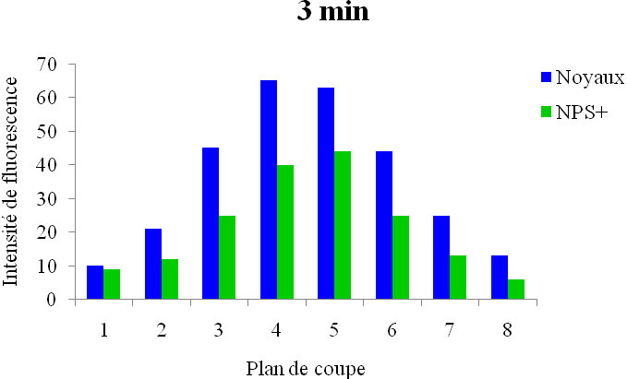
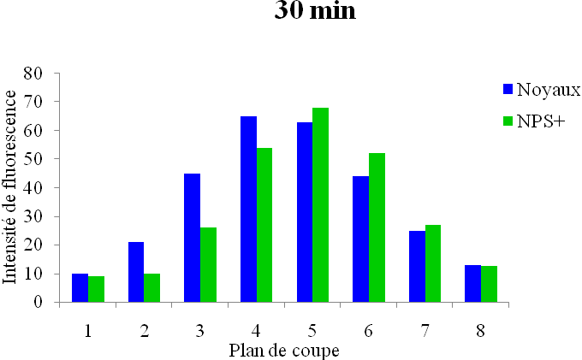
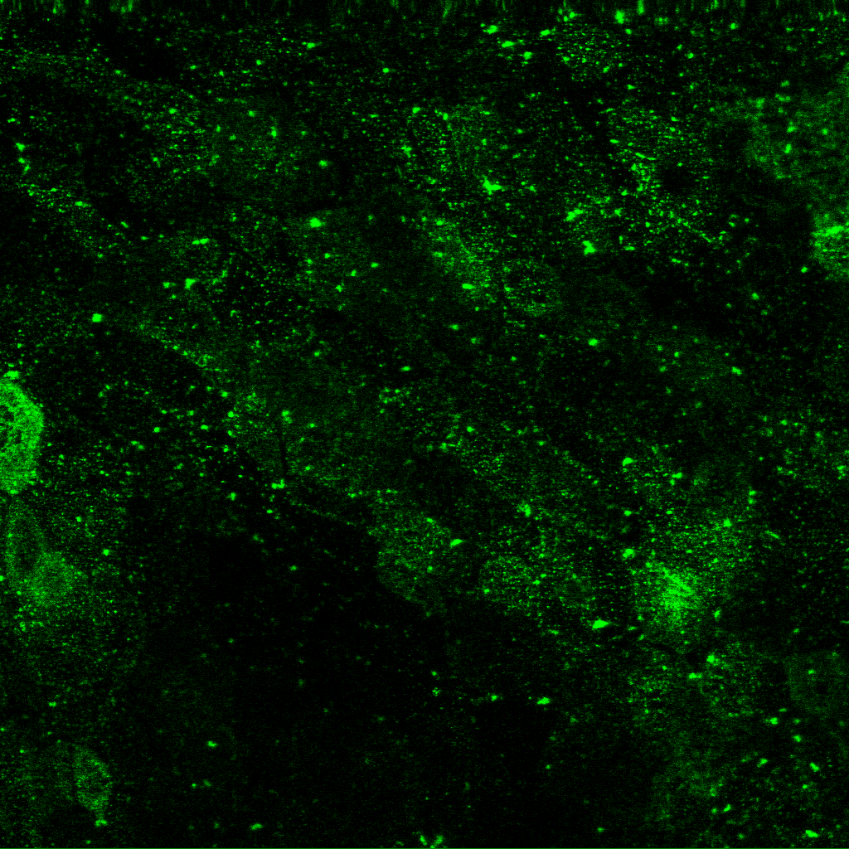
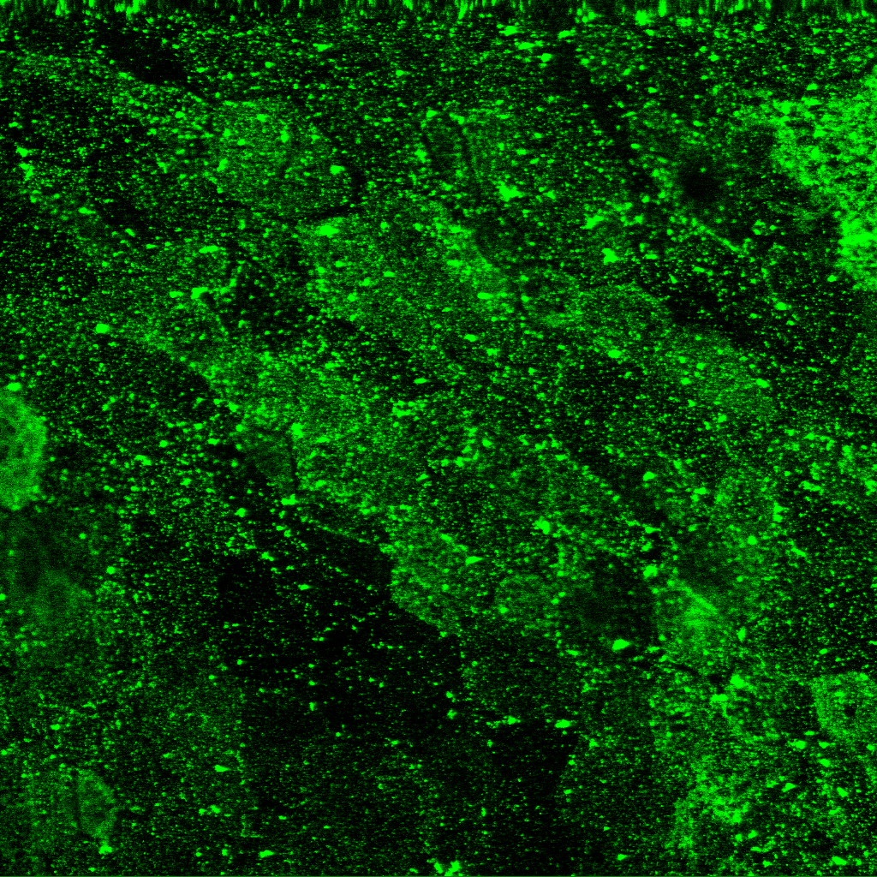
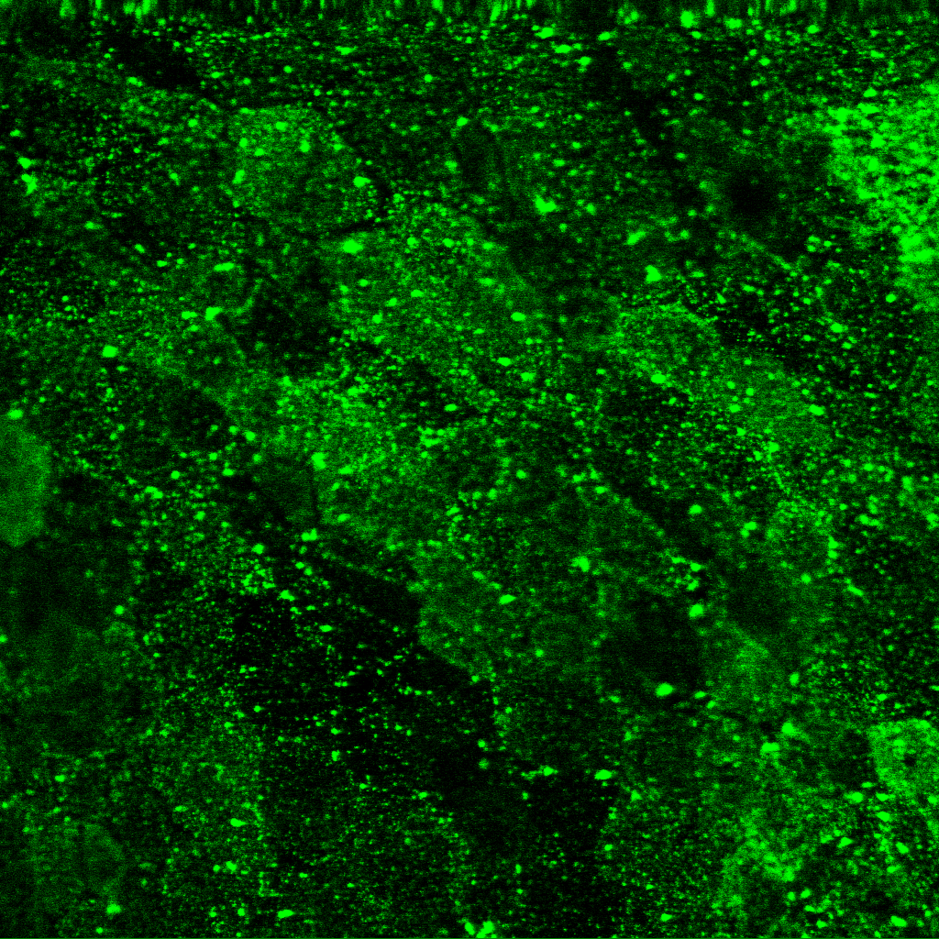
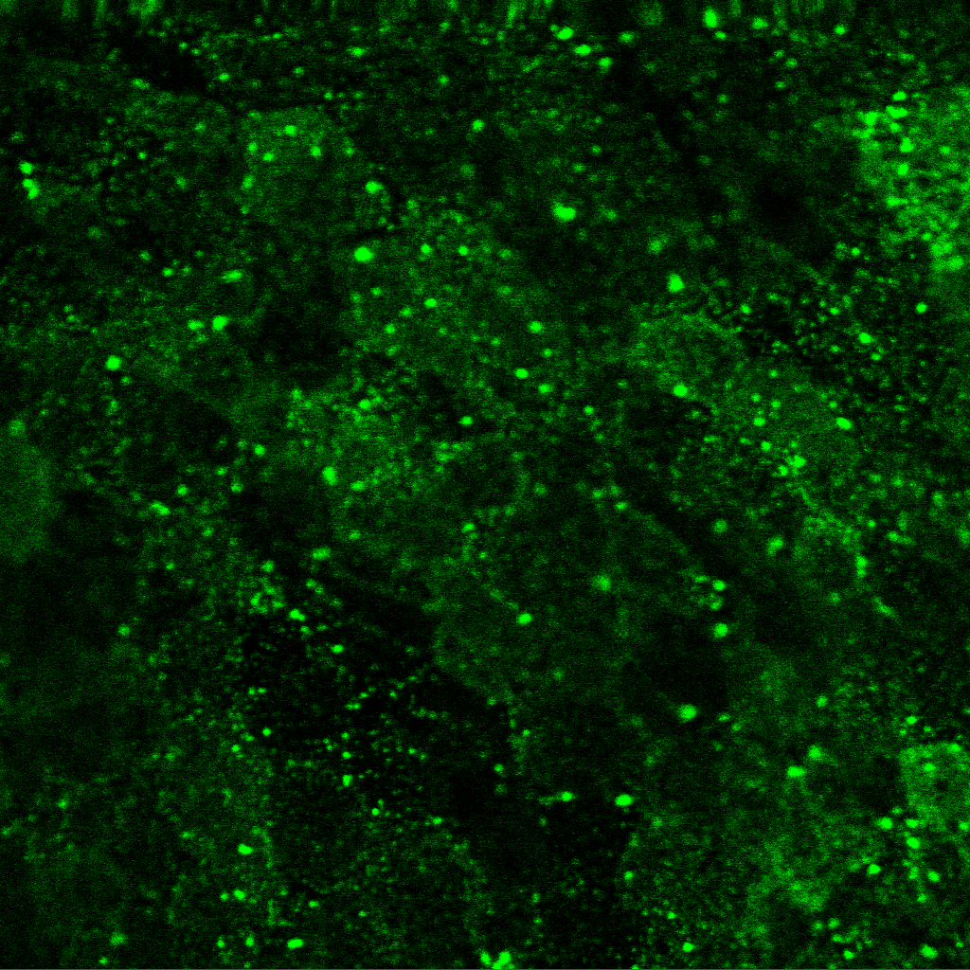
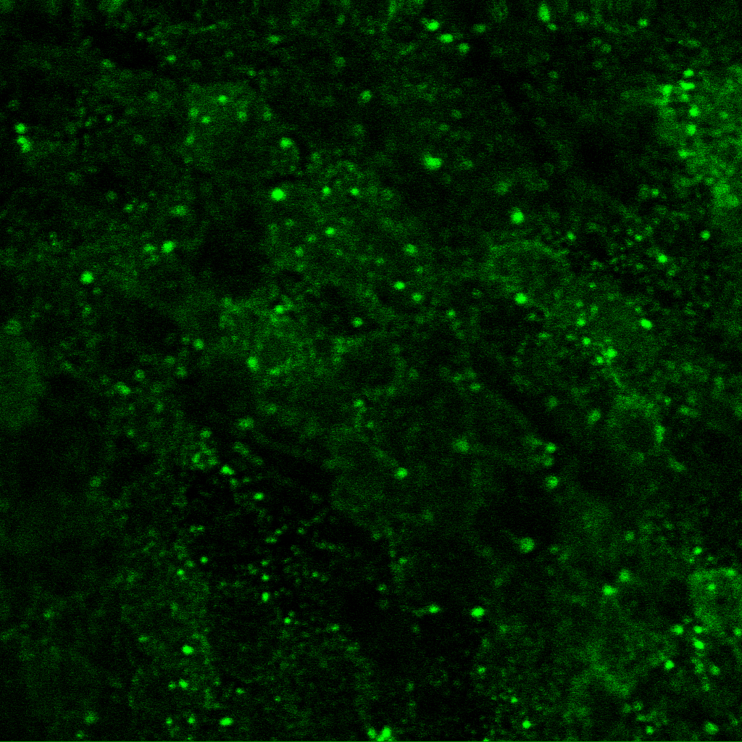
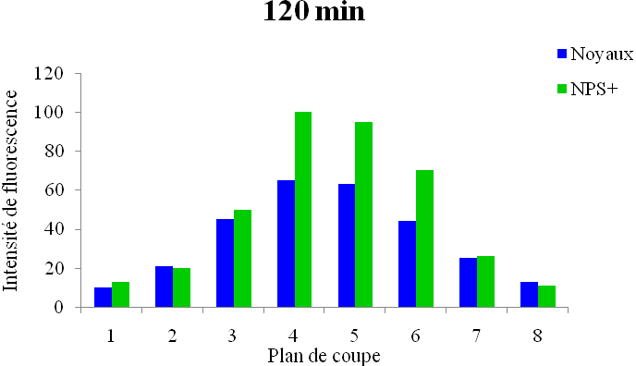
Nanoparticles repartition in cells
Apical
Basolatéral
1
8
After only 3 mn NP
are in the center of the cells

Slide 16
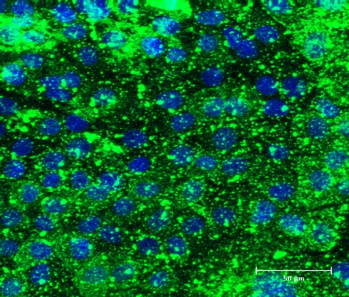
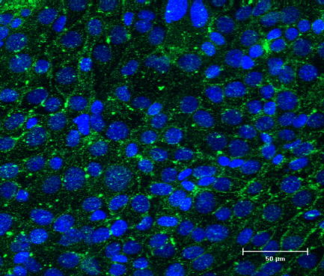
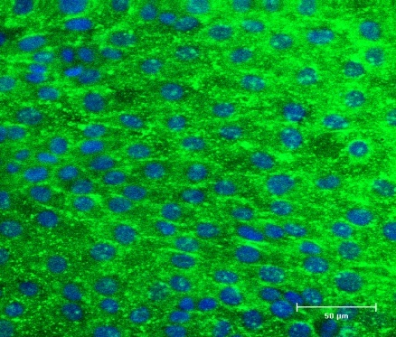
Endocytosis pathway
Control
Chlorpromazine
Filipine
NP enter epithelial cells via the clathrin pathway

Slide 17
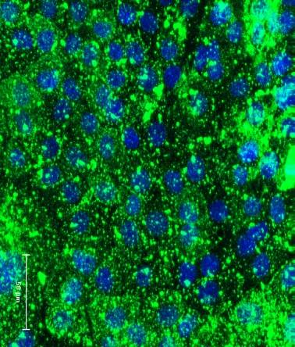
Characterization of the efflux
After 30 mn incubation with the NPs the uppernatant of the cells containing non-endocytosed NPs are washed every 30 mn for 2 hours with or without filipin
Control t 0 min
2 hrs washing
Filipin
+ 2 hrs washing

Slide 18
Toxicity?

Slide 19
In vivo
Very well tolerated,
no inflammation even at large doses
In vitro
- Non cytotoxic
- No ROS induction
- Non genotoxic
Mehri et al., Int. J. of Pharm. 423 (2012) 37–44

Slide 20
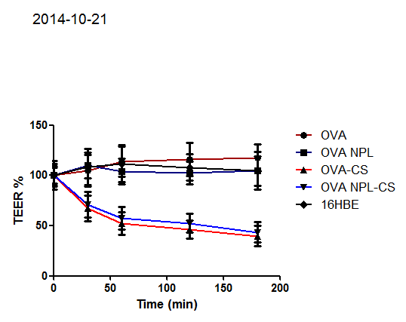
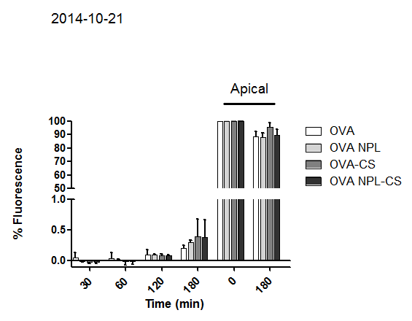
Evaluation of NP and protein paracellular and
transcytosis through airways
Basolateral
chamber
In vitro permeability studies
Apical
chamber
TEER
Epithelial barrier

Slide 21
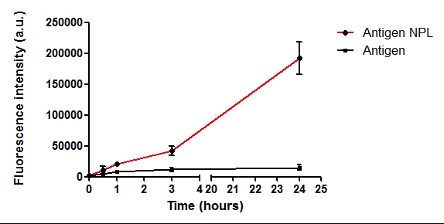
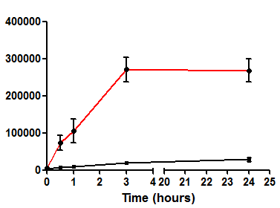
Antigen uptake par airway cells
Airway epithelial cells (16HBE14o)
THP1-derived macrophages
NPL improved antigen uptake
12 fold in airway epithelial cells
9 fold in macrophages

Slide 22
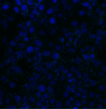
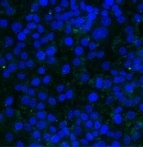
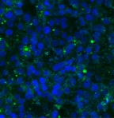
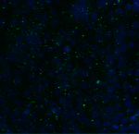
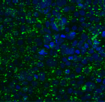
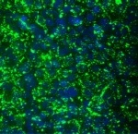
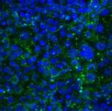
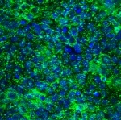
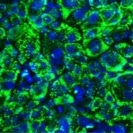
Delivery of ovalbumin in cells
3 min
30 min
120 min
OVA
NP 1/OVA
DGNP/OVA
NP increase Ovalbumin delivery in airway epithelial cells
Dombu et al, Biomaterials 2012, 33, 9117
Betbeder et Lefebvre, EP Patent, 2011
Betbeder et al, WO Patent , 2012

Slide 23
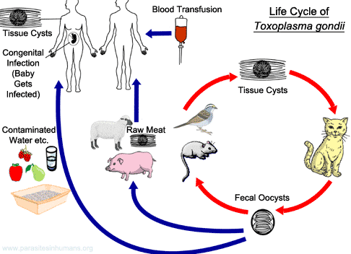
Intracellular parasite
30 % human population infected: muscle, brain and eyes
Live attenuated vaccine in sheeps withdrawn in Europe

Slide 24
Vaccine Formulation
Toxoplasma gondii antigens
Nanoparticles
Nanoparticle Formulation
Antigens
Total Extract from parasite lysate
TE (2000 proteins….)

Slide 25
Vaccine Formulation
Nanoparticles
Formulation
TE
 | size (nm) | zeta potential (mV)
NP | 71.26 +/-31.53 | +38.3
TE | 482.4 +/-198.5 | -33.5
NP/TE (3/1 w:w) | 88.40 +/-43.54 | +37.4
TE is totally loaded in NP !!!!
Pailllard et al; Pharm Res, 2010 Betbeder et al; Biomaterials, 2012
Betbeder et al; Biomaterials, 2013 Dimier-Poisson et al, Biomaterials, 2015

Slide 26
Association of TE antigens
From ratio (1/1, w/w) all the antigens are
totally loaded in the NP!!!
Stable for at least 3 months at 40°C in solution…
Native PAGE
Native PAGE analysis of nanoparticle-protein interactions.
Dimier-Poisson et al , Biomaterials, 2015

Slide 27
Ag delivery in epithelial cells

Slide 28
Delivery of TE antigens
In Vitro FITC-labeling of Total Antigen Extract
15 min
60 min
Confocal analysis of the delivery of proteins into epithelial cells by nanoparticles.

Slide 29
In vivo evaluation of vaccine
TE is associated with Nanoparticles
TE is delivered into mucosa cells by Nanoparticles
Are nanoparticles/TE formulations able to trigger an immune response after nasal administration protective against toxoplasma gondii challenge ?

Slide 30
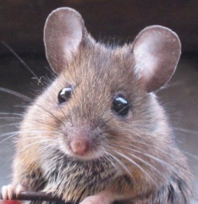
Immunisation and challenge
10 mice per group:
- control PBS
-control DGNP Nanoparticles : 30µg
-Total extract : free antigens (TE): 10µg
-Vaccine formulation TE/DGNP (10µg/30µg)
-Total extract : free antigens (TE): 10µg + Cholera toxin (CT)
Mice CBA/J (H-2^{k})
D0 D15 D30
D60
post-infection monitoring
D105
Nasal route Immunisation
Lethal
Challenge with toxoplasma gondii

Slide 31
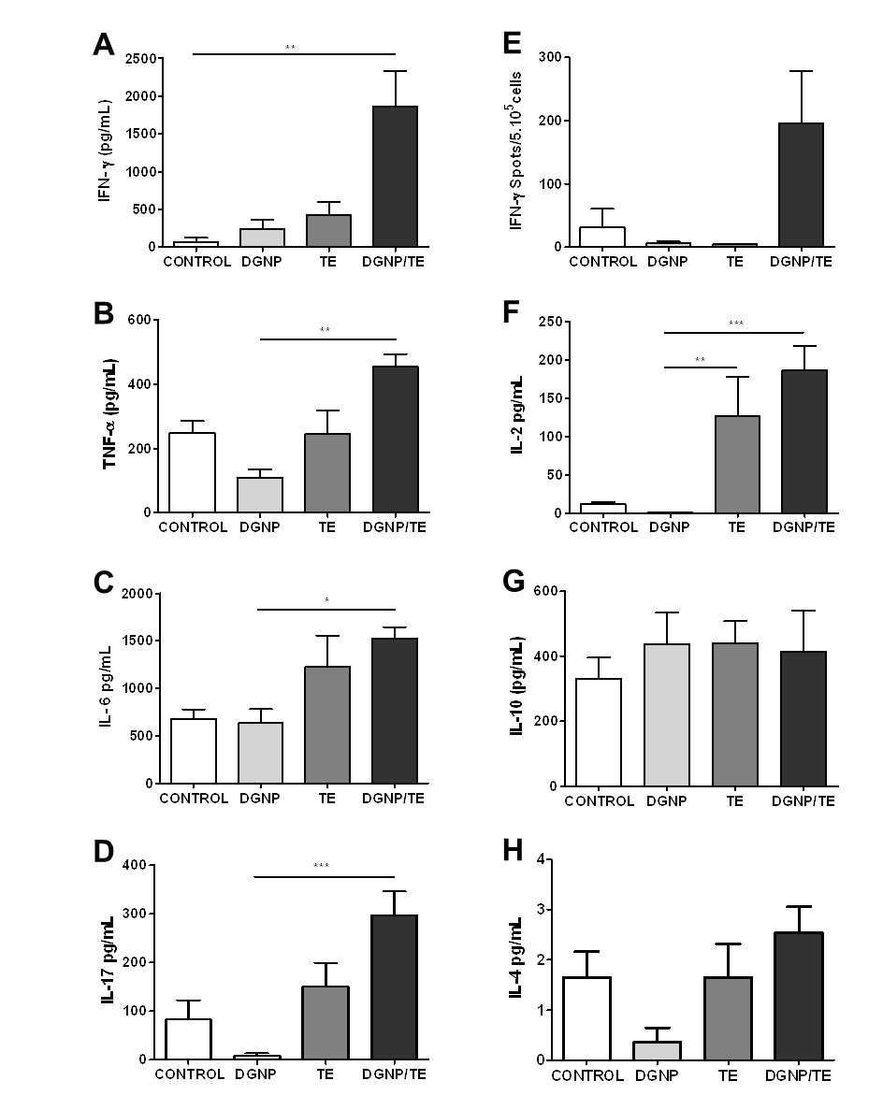
In vivo cellular response
Th1
Splenocytes
Cellular response after vaccination with TE, DGNP, or DGNP/TE. CBA/J mice were immunized three times at 2-week intervals by the nasal route. Splenocytes from vaccinated mice were recovered 1 month after the third immunization and cultured with 10 μg/ml TE. Cell-free supernatants were harvested and assayed for cytokines. Splenocytes from six mice in each group were tested individually. Controls were untreated mice.

Slide 32
In vivo cellular response
Th2
Splenocytes
Cellular response after vaccination with TE, DGNP, or DGNP/TE. CBA/J mice were immunized three times at 2-week intervals by the nasal route. Splenocytes from vaccinated mice were recovered 1 month after the third immunization and cultured with 10 μg/ml TE. Cell-free supernatants were harvested and assayed for cytokines. Splenocytes from six mice in each group were tested individually. Controls were untreated mice.

Slide 33
In vivo cellular response
Th17
Splenocytes
Cellular response after vaccination with TE, DGNP, or DGNP/TE. CBA/J mice were immunized three times at 2-week intervals by the nasal route. Splenocytes from vaccinated mice were recovered 1 month after the third immunization and cultured with 10 μg/ml TE. Cell-free supernatants were harvested and assayed for cytokines. Splenocytes from six mice in each group were tested individually. Controls were untreated mice.

Slide 34
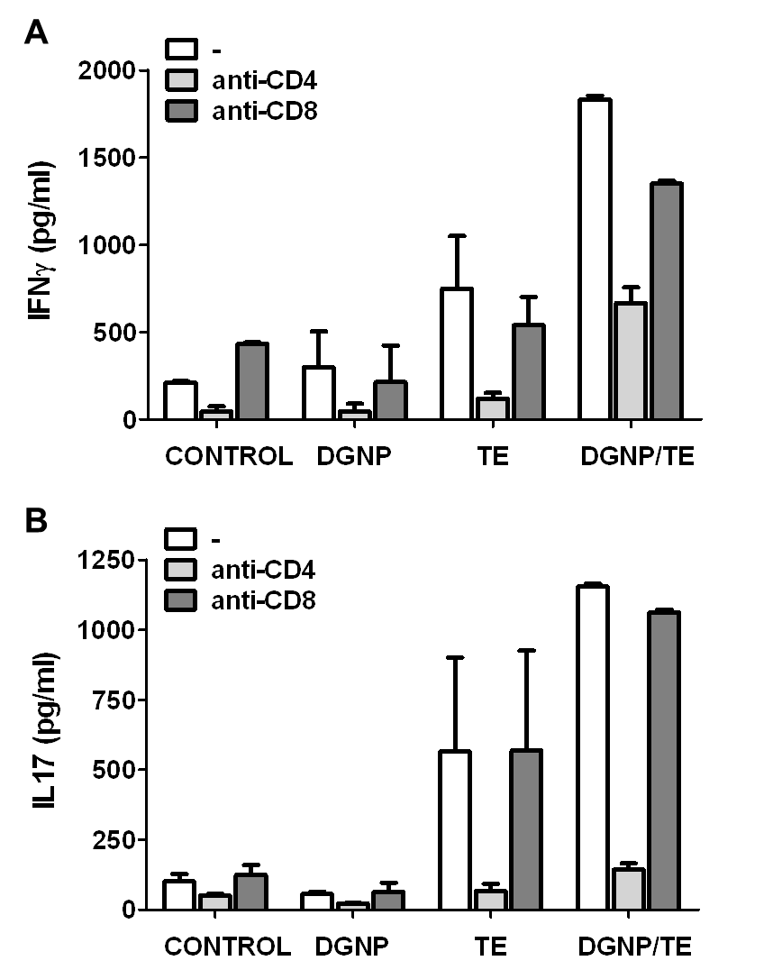
In vivo cellular response
Splenocytes
Cellular response after vaccination with DGNP, TE or DGNP/TE. The CBA/J mice were immunized three times at 2-week intervals by the nasal route. Splenocytes from vaccinated mice were recovered 1 month after the third immunization and cultured with 10 μg/ml TE. IFN-γ (A) and IL-17 (B) were measured in the absence or the presence of 20 μg/ml of anti-CD4 or anti-CD8 mAb. Controls were untreated mice.

Slide 35
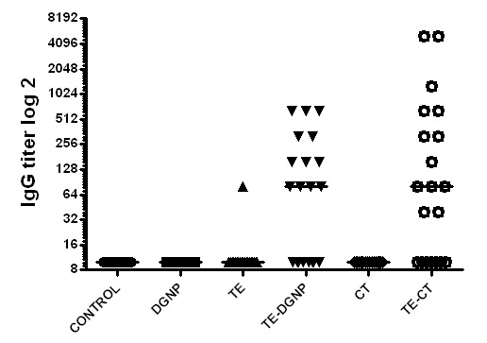
Seric IgG
*
*

Slide 36
Toxoplasma gondii challenge
Survival rate (%)
*
Only mice vaccinated with NP were protected
*

Slide 37
In vivo protection
(non lethal challenge)
Brain cyst load of CBA/J mice immunized and orally infected with 30 cysts of 76K T. gondii strain. Brain cyst load was evaluated 1 month after challenge.

Slide 38
Vaccination of sheeps against toxoplasmosis

Slide 39
T gondii challenge
- 11 sheeps per group
- i.n administration of NPL/TE
- D0 and D20
- challenge with TE
Humoral response
Cellular response (PBMC and spleen)
Protection against challenge (brain oocyst evaluation)

Slide 40
Humoral Response : IgG
control
NP/TE

Slide 41
Blood samplings 6weeks after 2nd imminusation
Immune Response study :
Cellular :
IFN-γ quantification
Lympho-proliferation

Slide 42
Cellular immune response in spleen
Control
NP/ET
control
NP/TE
High IFN-γ activation
Specific splenocyte proliferation

Slide 43
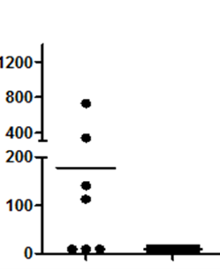
Protection against infection!!!!
Brain cyst load
-
No cyst on nasal route vaccinated sheeps
Nasal administration protects against oral challenge with T.gondii
1st time that a vaccine protects against T.gondii infection!!!!

Slide 44
NP vaccine after nasal administration:
NP are quickly endocytosed and exocytosed
- Long mucosal residence time (mice, sheeps, humans) and are totally eliminated via GIT
- Non toxic
Formulation with antigens
100% antigen loading!!!!! 2000 different proteins.. Highly stable
Strong antigen delivery in mucosa
Nasal administration of vaccine induces
cellular immune response in the spleen
TH1 and TH17
Full protection against intestinal infection of T. gondii toxoplasmosis in mice and sheeps
These results highlight the interest of using such technology for mucosal vaccines and we are looking for collaborations for Tcell vaccine (virus, bacteria, parasites infections)

Slide 45
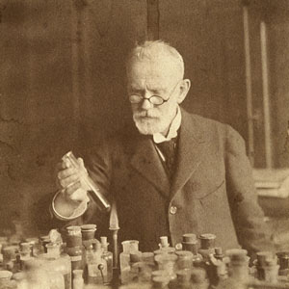
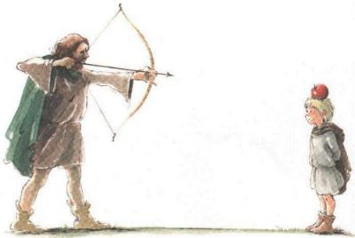
Paul Ehrlich (1854 -1915) was a German scientist. Known for his work in hematology and immunology, is considered the father of the therapeutic targeting (magic bullet).
He is with Elie Metchnikoff joint winner of the Nobel Prize in Physiology or Medicine 1908
Notes:
45

Slide 46
Acknowledgements
EA4483 / INSERM U995
UMR1282
Pr Didier Betbeder
Dr Rodolphe Carpentier
Fatima Dahmani
Beatrice Bernocchi
Pr Isabelle Dimier-Poisson
Céline Ducournau
Thi Thanh Loi N’Guyen
didier.betbeder@univ-lille2.fr
Dr Nathalie Jouy
Emeline Machez
Meryem Tardivel

