Slide 1


CONTEXT SPECIFIC ROLE OF DEUBIQUITYLASE ENZYME, USP9X, IN HEAD AND NECK CANCER
Devathri Nanayakkara
Eskitis Institute for Drug Discovery
Griffith University

Slide 2
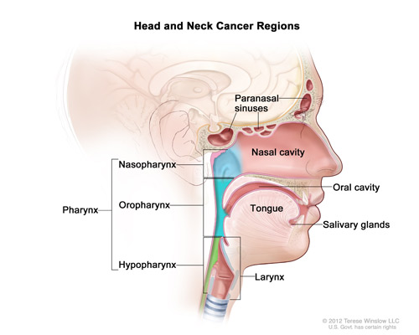
Head and neck cancer

Slide 3
Head and neck cancer
Sixth most common cancer

Slide 4
Head and neck cancer
Sixth most common cancer
Five year survival rate after diagnosis, 50%

Slide 5
Head and neck cancer
Sixth most common cancer
Five year survival rate after diagnosis, 50%
Early tumors - asymptomatic
Drug resistance

Slide 6
Head and neck cancer
Sixth most common cancer
Five year survival rate after diagnosis, 50%
Early tumors - asymptomatic
Drug resistance
    “Need to study the underlying molecular pathways unveiling potential detection markers and drug targets”

Slide 7
In a recent study,
Characterized the somatic mutation landscape of OSCC-GB

Slide 8
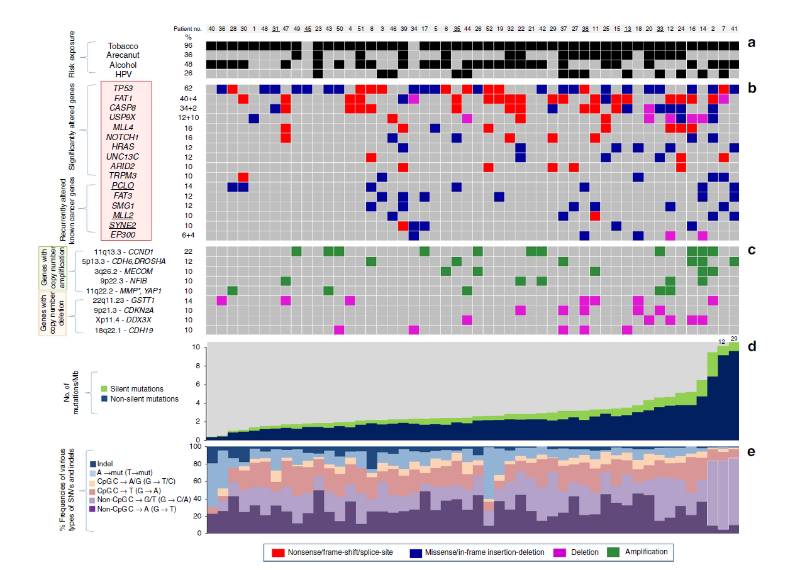

Slide 9
- Found Five new genes associated with OSCC-GB

Slide 10
Among them was USP9X
22% harboured copy number loss and truncating mutations
Role as tumor suppressor

Slide 11
USP9X
Deubiquitylating enzyme
  Family of cysteine and metalloproteases

Slide 12
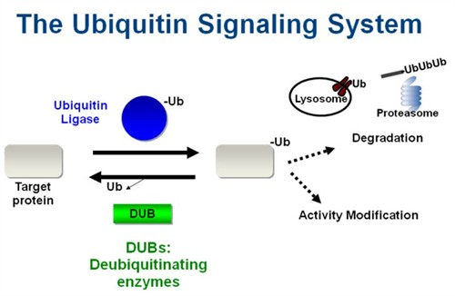
USP9X
Deubiquitylating enzyme
  Family of cysteine and metalloproteases
http://legacy.butler.edu/biology/faculty-staff/research-interests/jkowalski/research-in-the-kowalski-lab/

Slide 13
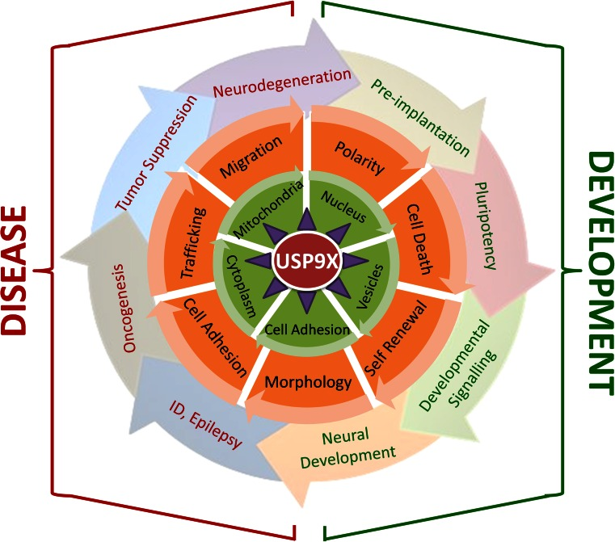
Murtaza et al, 2015

Slide 14
USP9X in cancer

Slide 15

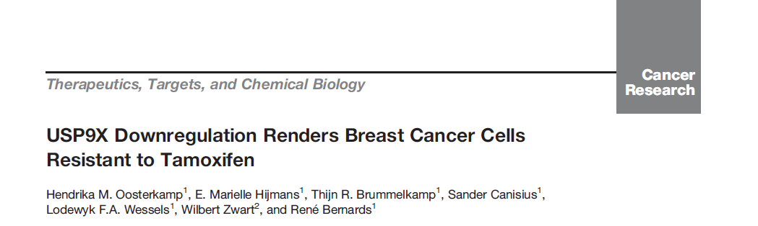
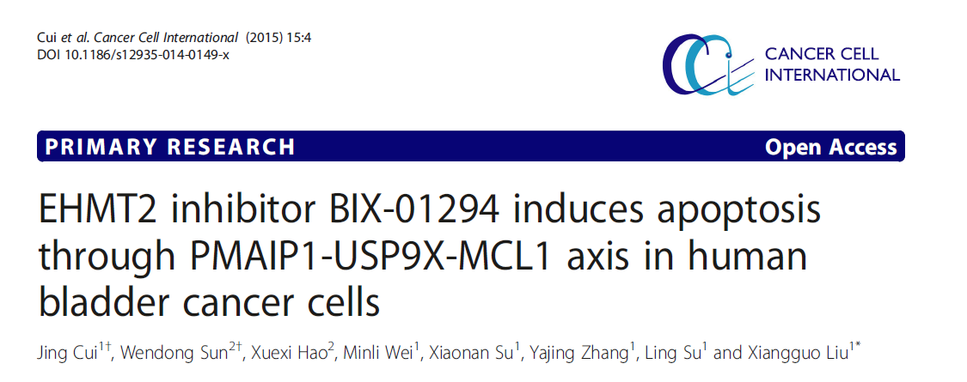
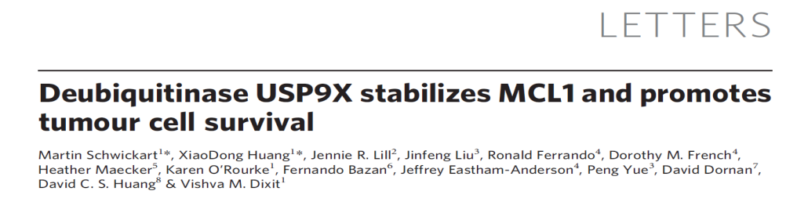
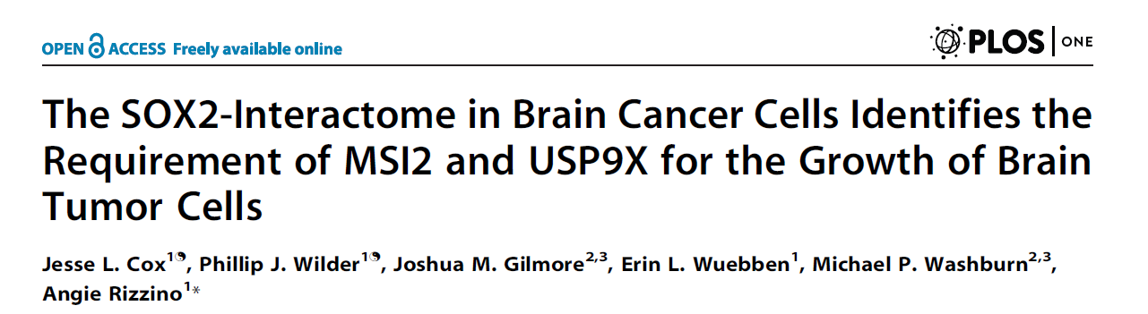
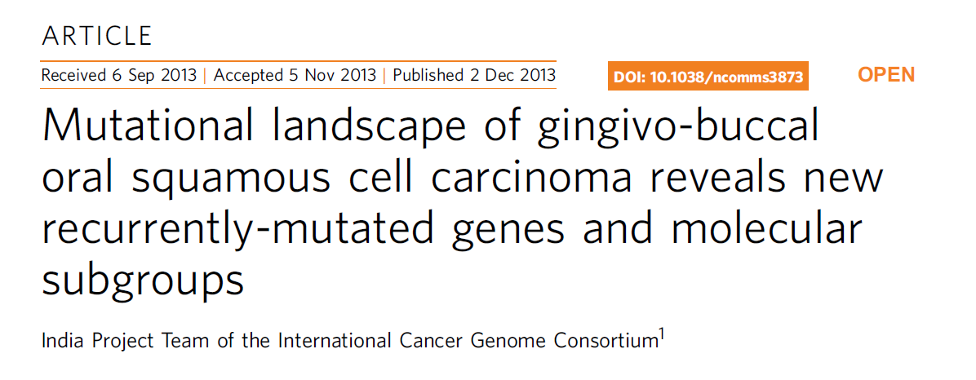
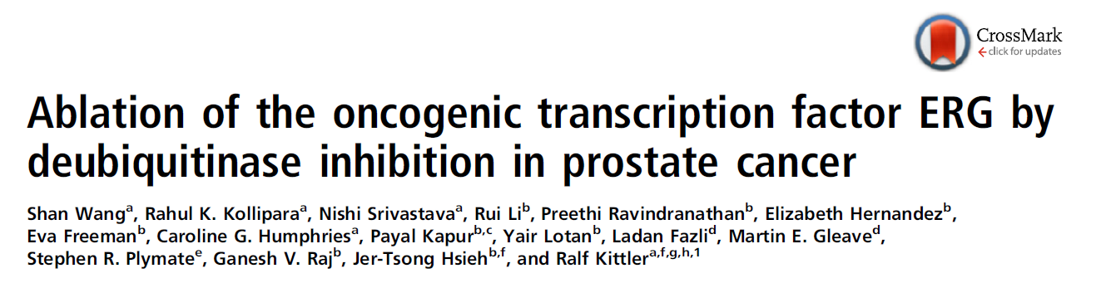
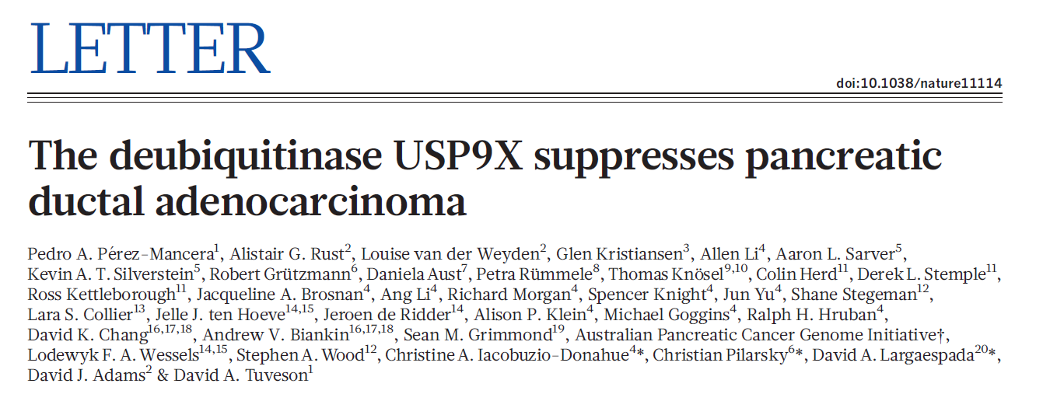
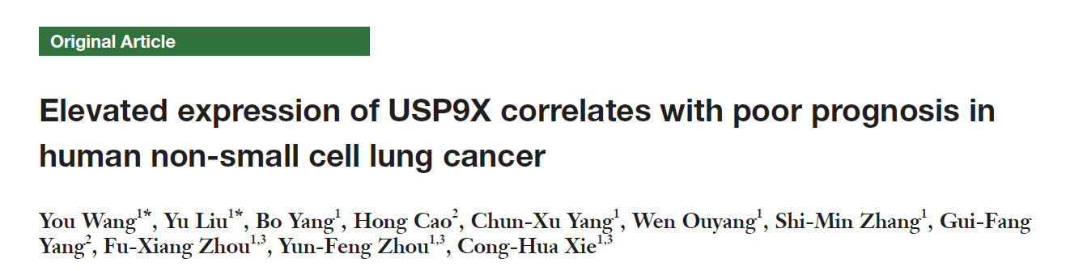
USP9X in cancer

Slide 16
USP9X in cancer
Colorectal cancer
Breast cancer
Bladder cancer
Lymphoma
Brain cancer
Oral cancer
Prostate cancer
Pancreatic cancer
Lung cancer

Slide 17
In this study,
Aims :
To evaluate the role of USP9X in an in vitro system
To elucidate the molecular mechanisms USP9X is involved in

Slide 18
How?
In vitro cell lines
  SCC15, CAL27, FaDu and Detroit 562

Slide 19
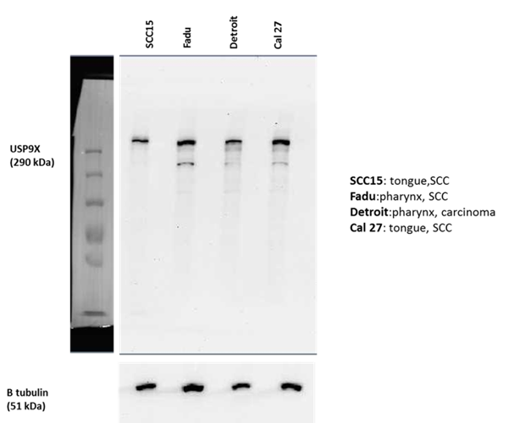
Immunoblotting to probe for USP9X expression
Detroit 562
SCC15
FaDu
CAL27
USP9X
290 kDa
β tubulin
51 kDa
All 4 cell lines express USP9X

Slide 20
Knockdown approach
  siRNA

Slide 21
Immunoblotting to probe for USP9X protein levels 72 h after siRNA treatment
SCC15 CAL27 FaDu Detroit 562
siRNA
NT USP9X NT USP9X NT USP9X NT USP9X
USP9X
290 kDa
Β tubulin
51 kDa
USP9X is efficiently knocked down in all four cell lines

Slide 22
Effect on cell aspects
  Cell proliferation
    CyQUANT Assay

Slide 23
CyQUANT Analysis of cell proliferation following siRNA treatment to knockdown USP9X
SCC15
CAL27
*
*
time
time
FaDu
Detroit 562
*
*
*
*
*
*
time
time
* P value < 0.05
In absence of USP9X, a decrease in cell numbers was observed

Slide 24
Decrease in cell numbers,
  Apoptosis?

Slide 25
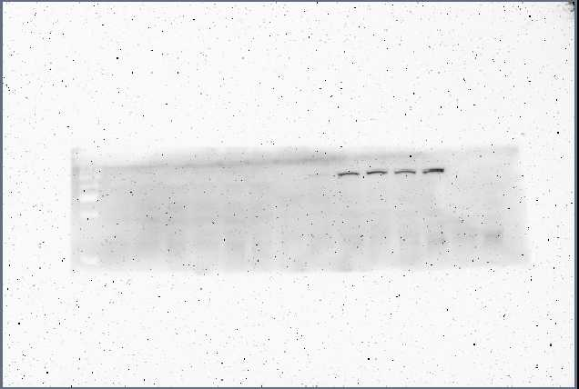

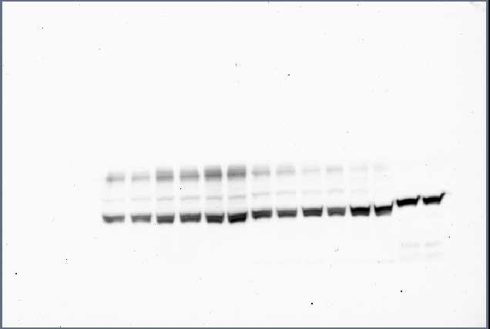
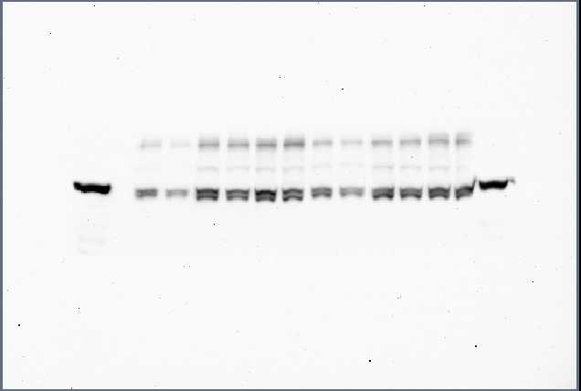
Immunoblotting for cleaved PARP-1
SCC15
CAL27
FaDu
Detroit 562
time
48h 96h 144h 48h 96h 144h 48h 96h 144h 48h 96h 144h
siRNA
NT USP9X NT USP9X NT USP9X NT USP9X NT USP9X NT USP9X NT USP9X NT USP9X NT USP9X NT USP9X NT USP9X NT USP9X
Cleaved
PARP-1
89 kDa
β tubulin
51 kDa
No elevation in apoptosis detected upon depletion of USP9X

Slide 26
Decrease in cell numbers in absence of USP9X prompts a role of a

Slide 27
Decrease in cell numbers in absence of USP9X prompts a role of a “tumor promoter”

Slide 28
Decrease in cell numbers in absence of USP9X prompts a role of a “tumor promoter”
Contradicts predicted oncosupressive role
Context specific

Slide 29
Decrease in cell numbers in absence of USP9X prompts a role of a “tumor promoter”
Contradicts predicted oncosupressive role
Context specific
      Pancreatic cancer

Slide 30
Decrease in cell numbers in absence of USP9X prompts a role of a “tumor promoter”
Contradicts predicted oncosupressive role
Context specific
      Pancreatic cancer

Slide 31
Decrease in cell numbers in absence of USP9X prompts a role of a “tumor promoter”
Contradicts predicted oncosupressive role
Context specific
      Pancreatic cancer
Tumor suppressor

Slide 32
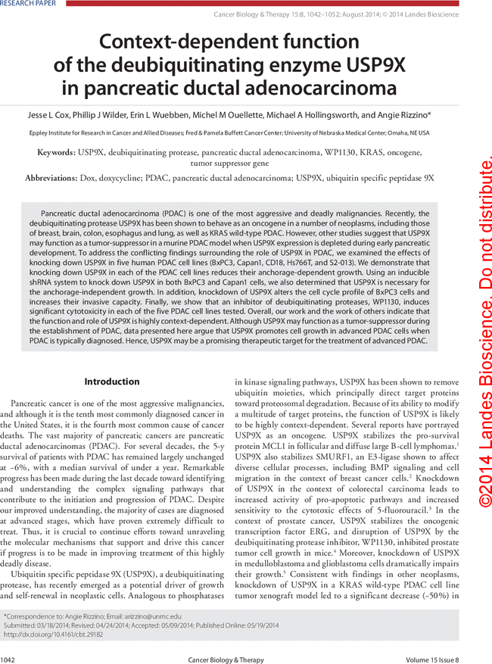
Decrease in cell numbers in absence of USP9X prompts a role of a “tumor promoter”
Contradicts predicted oncosupressive role
Context specific
      Pancreatic cancer
Tumor suppressor

Slide 33
Decrease in cell numbers in absence of USP9X prompts a role of a “tumor promoter”
Contradicts predicted oncosupressive role
Context specific
      Pancreatic cancer
Tumor suppressor
Tumor promotor

Slide 34
To further confirm,
Overexpression of USP9X

Slide 35
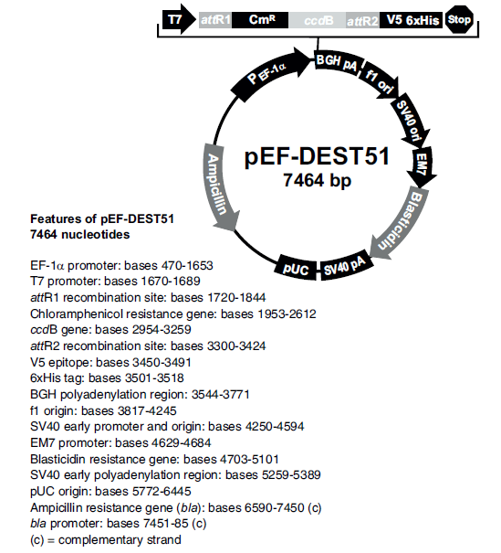
To further confirm,
Overexpression of USP9X
Usp9x cDNA

Slide 36
To further confirm,
Overexpression of USP9X
Usp9x cDNA
To establish stable cell lines,
Linearized the plasmid
Lipofectamine 2000
After 3 days: antibiotic selection
(12 days)

Slide 37
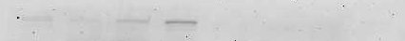
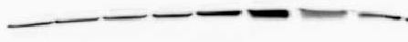
Immunoblotting to detect ectopic expression of USP9X
pDEST51 USP9X
pDEST51
Detroit 562
Detroit 562
SCC15
CAL27
FaDu
scc15
CAL27
FaDu
V5
β tubulin
USP9X is ectopically expressed in all four cell lines

Slide 38
CyQUANT Analysis of cell proliferation following ectopic expression of USP9X
SCC15
CAL27
*
*
*
*
*
*
*
FaDu
Detroit 562
*
*
*
*
*
*
* P value < 0.05
Ectopic USP9X protein expression increased cell proliferation

Slide 39
Cell numbers are directly proportional to level of USP9X protein

Slide 40
Cell numbers are directly proportional to level of USP9X protein
has an oncogenic role

Slide 41
Molecular mechanism regulated by USP9X

Slide 42
Molecular mechanism regulated by USP9X
Murtaza et al, 2015

Slide 43
Molecular mechanism regulated by USP9X
  mTOR
  Wnt
  Notch
Regulates cell proliferation
Known USP9X substrates

Slide 44
Molecular mechanism regulated by USP9X?
  mTOR
  Wnt
  Notch
CyclinD1, c-MYC, HES1

Slide 45
Molecular mechanism regulated by USP9X?
  mTOR
  Wnt
  Notch
Quantitate the RNA levels by qPCR
CyclinD1, c-MYC, HES1

Slide 46
RNA extraction
cDNA
qPCR

Slide 47
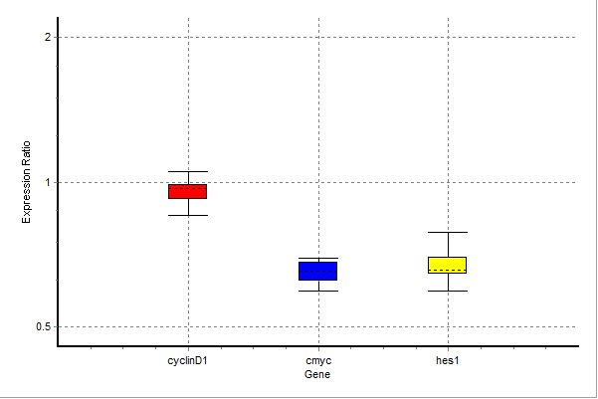
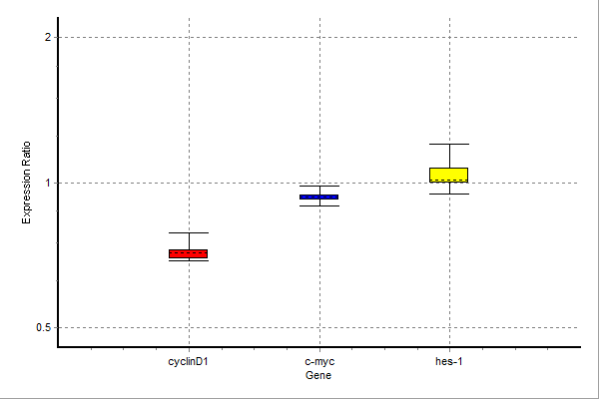
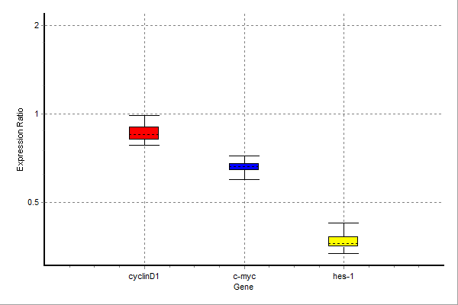
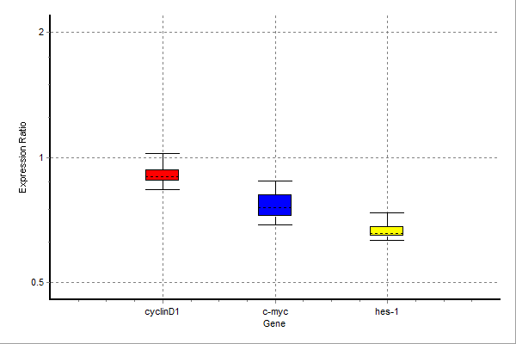
Fold change of target genes 144 h after knockdown of USP9X
SCC15
CAL27
FaDu
Detroit 562

Slide 48
Fold change of target genes 144 h after knockdown of USP9X
SCC15
CAL27
FaDu
Detroit 562

Slide 49
Fold change of target genes 144 h after knockdown of USP9X
SCC15
CAL27
FaDu
Detroit 562

Slide 50
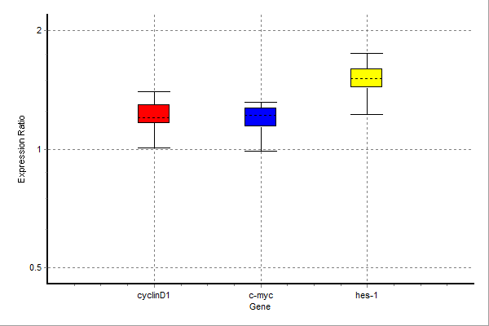
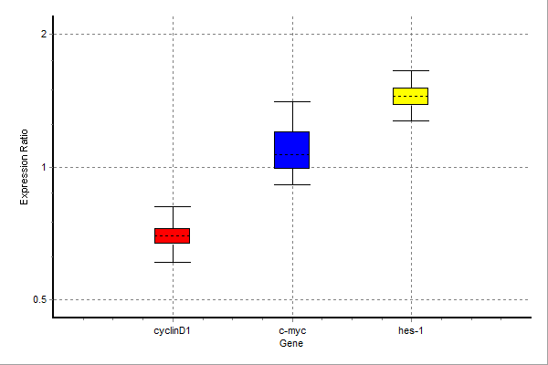
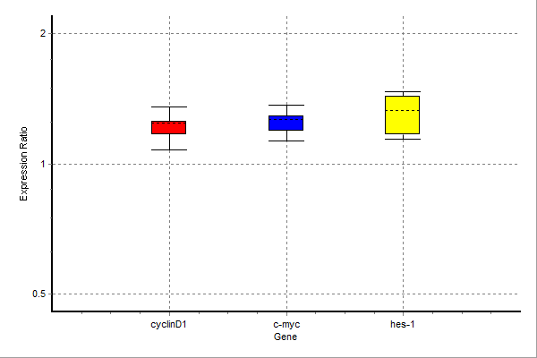
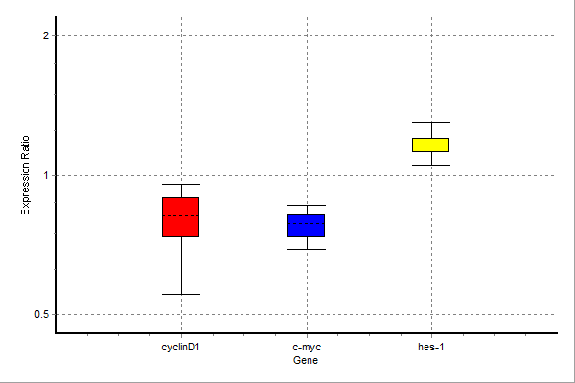
Fold change of target genes 144 h after ectopic expression of USP9X
SCC15
CAL27
FaDu
Detroit 562

Slide 51
Consistently HES1 expression correlated with cell proliferation measured by CyQUANT assay
USP9X seems to positively regulate notch pathway

Slide 52
Consistently HES1 expression correlated with cell proliferation measured by CyQUANT assay
USP9X seems to positively regulate notch pathway
Hypothesis: USP9X regulates proliferation of head and neck cancer cells through notch pathway

Slide 53
Conclusions
USP9X depletion caused a decrease in cell proliferation
Ectopic expression of USP9X led to increase in cell proliferation
USP9X positively regulates Notch pathway

Slide 54

ACKNOWLEDGEMENT
Stephen
George
Nicholas Saunders
Wood lab members
Funding: Griffith University

Slide 55
THANK YOU!

