Slide 1

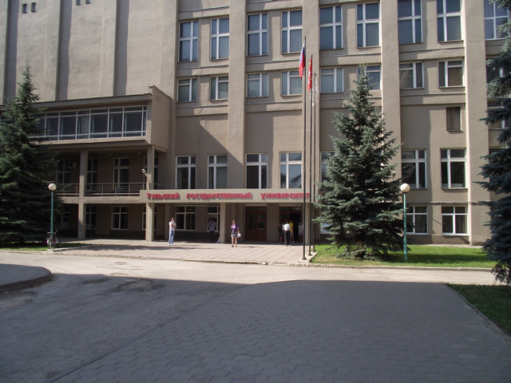
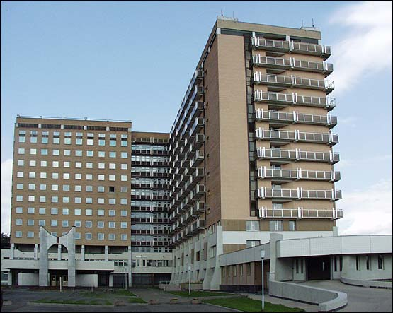
CELL THERAPY PATIENTS WITH CARDIOMYOPATHY
Las-Vegas, 2014

Slide 2
Cardiomyopathies – diseases of the myocardium with structural and functional abnormalities.
Dilated cardyomyopathy
Hypertrophic cardyomyopathy
Restrictive cardyomyopathy
Arrhythmogenic right ventricular cardyomyopathy /dysplasia

Slide 3
AHA classification for cardiomyopathies
Genetic
Mixed
Acquired
Primary cardiomyopathies
Infiltrative
Storage
Toxicity
Endomyocardial
Inflammatory
Endocrine
Cardiofacial
Neuromuscular
Nutritional
Autoimmune
Consequence of cancer therapy
Secondary cardiomyopathies

Slide 4
Actuality
*Population morbidity caused by:
Essential hypertension 191,8 – 100000
Intracranial hemorrhage 26,8 – 100000
Cardiomyopathy 24,3 – 100000
*http://old.rosminzdrav.ru

Slide 5
Aim: To evaluate the efficacy of systemic allograft multipotent mesenchymal stromal cells (MMSC) of the bone marrow for the treatment of dilated cardiomyopathy (DCM) of viral origin

Slide 6
Patients
 | Main group (cell therapy) | Control group (no cell)
Number | 32 | 30
Age | 40,8 ± 5,2 | 41,3 ± 4,7
Men Women | 20 12 | 16 14
EF | 25,3 ± 3,2 | 24,3 ± 4,8

Slide 7
Informed consent was obtained for all patients before participation in the study, and the study protocol was approved by the Ethics Committee.

Slide 8
Study Design
echocardigraphy
biochemical blood tests(inc. CEA, AFP, PSA, CA19-9, CA125, CA15-3),
6-minute walk test,
questionnaires SF-36, EQ-5D
Control point: before injection; 14 days and 1,3,6,12,24 months after the initial injection

Slide 9
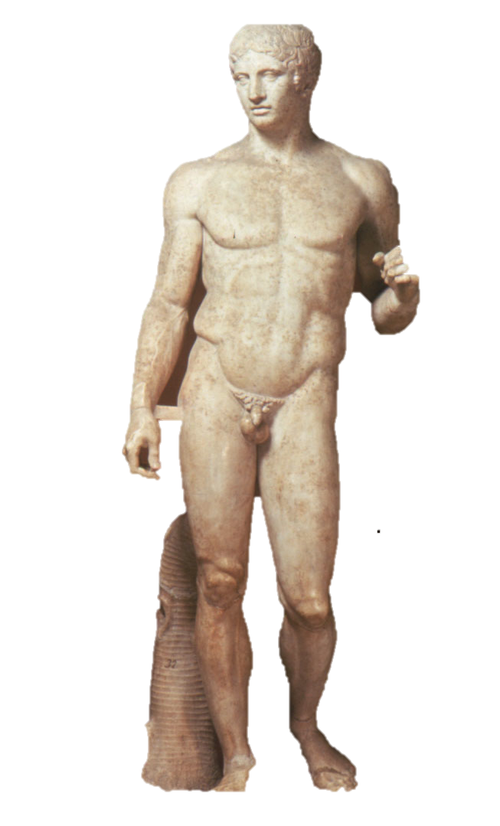
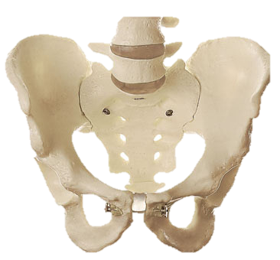
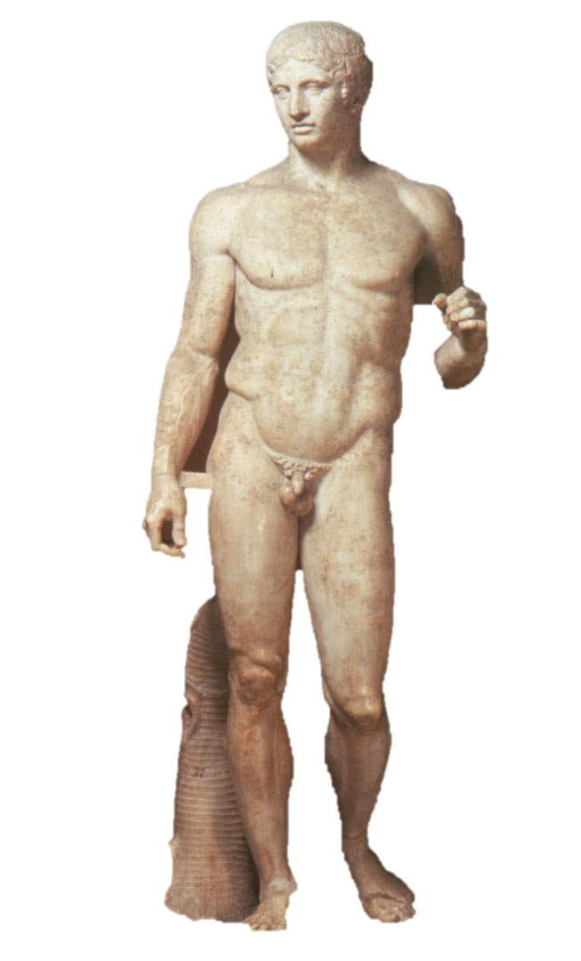
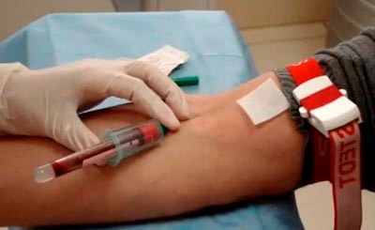
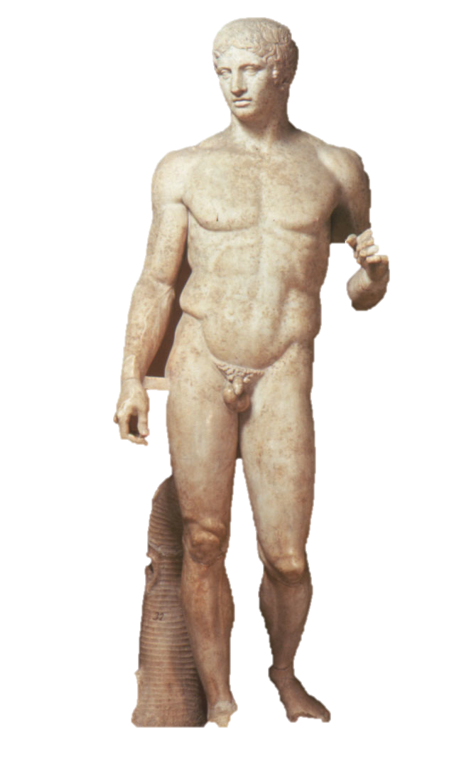
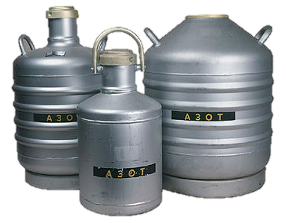
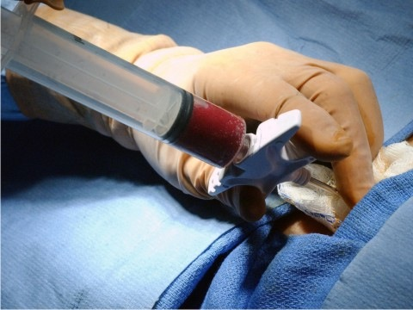
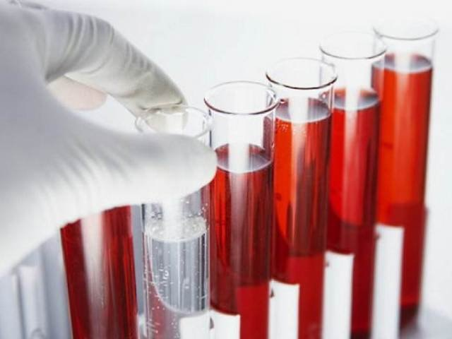

Slide 10
Control of Cells
Viruses | Herpes symp. I,II,VI Cytomegalovirus, Epstein-Barr, HBV, HCV, HIV-1, HIV-2
Fungi | Candida Albicans,
Bacteria | Lactobacillus spp., Mycoplasma spp., Staphylococcus aureus., Steptococcus spp., Bacteroides caccae, Bacteroides distasonis, merdae, Bacteroides eggerthii, stercoris, uniformis, Bacteroides fragilis group, Bacteroides fragilis BFT-toxin, Mobiluncus curtissi, Prevotella spp(bivia, disiens, melaninogenicus) SyphilisTPHA(Treponema pallidum pallidum)

Slide 11
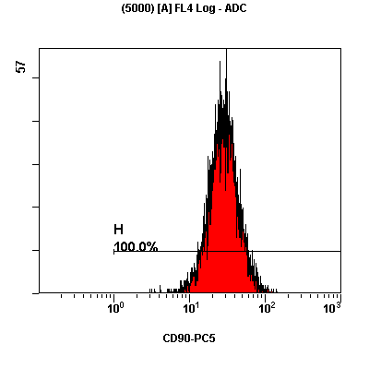
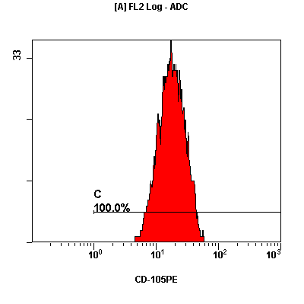
Criteria for Selection
-Safety cells
-High viability(97%)
-Expression of markers MMSC
(CD34-,90+,105+, etc.)

Slide 12
Method of injection cells
- intravenous route
The injection was carried out in the hospital from 3-5 days after pharmacological correction of the general condition.
All patients completed the course of MMSC injections.
The repeat injection was carried out at 30 ± 2.6 days.
The total number of cell injected was 207 ± 5.8 million cells.

Slide 13
RESULTS:
Procedural characteristics:
–No procedure-related complications during injections cells material
–3 patients(10%) had mild fever(37,2 – 37,3^{O}C)
–No allergic reactions
–No cancer
–No myocardial infarction

Slide 14
Echocardigraphy (Ejection Fraction,%)
 | Before injection | 14 day after | 1 month | 3 month | 6 month | 12 month | 24 month
Main group | 27.9 ± 1.9 | 28.1 ± 1.6 | 30.3 ± 1.3 | 34.2 ± 0.7 | 34.8 ± 1.5 | 33.2 ± 2.9 | 28.8 ± 1.7
Control group | 28.2 ± 1.7 | 28.1 ± 1.1 | 27.6 ± 1.6 | 27.2 ± 0.7 | 28.5 ± 2.3 | 27.9 ± 1.9 | 27.2 ± 1.5
Main group – with cells Control group – no cells

Slide 15
6-minute walk test

Slide 16
Questionnaire
Health-related quality-of-life instruments

Slide 17
SF-36
PH – physical health MH – mental health

Slide 18
EQ-5D

Slide 19
Hospitalizations

Slide 20
Mortality

Slide 21
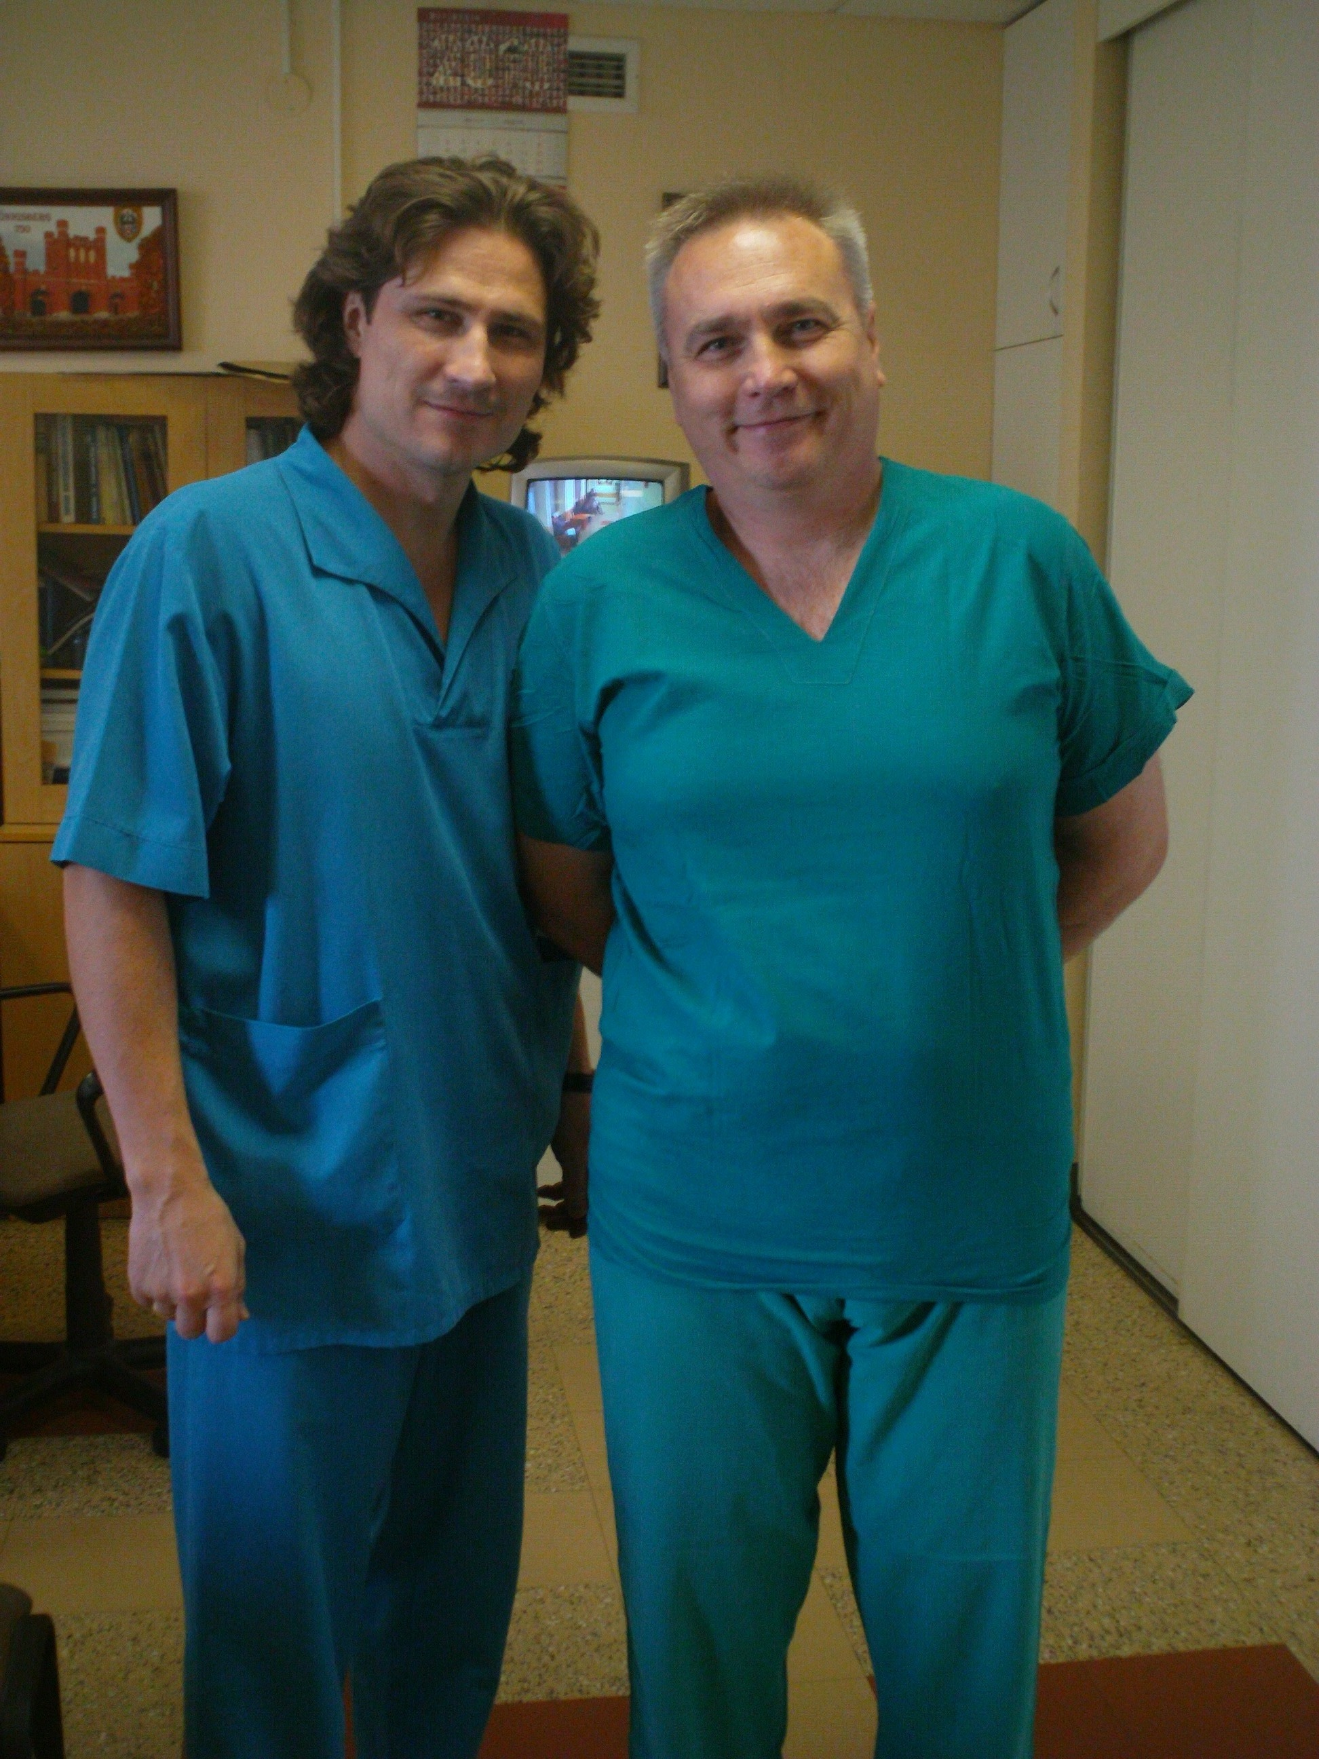
Take home message:
Injection of allogenic MMSC in patients with DCM after viral myocardial damage is safety and efficacy

Slide 22
Professor, MD Lishchuk Alexander Professor,MD Kornienko Andrey
(Federal State “3rd Central Military Hospital named after A.A. Vishnevsky”, Ministry of Defence of the Russian Federation)
Professor, MD, Khadartsev Alexander
(Federal State Budgetary Educational Establishment of Higher Professional Education “TULA STATE UNIVERSITY, Medical Institute”)
Professor, ScD, Saburina Irina
Professor, ScD, Kolokoltsova Tamara
(Institute of General Pathology and Pathophysiology, Russian Academy of Medical Science)

Slide 23
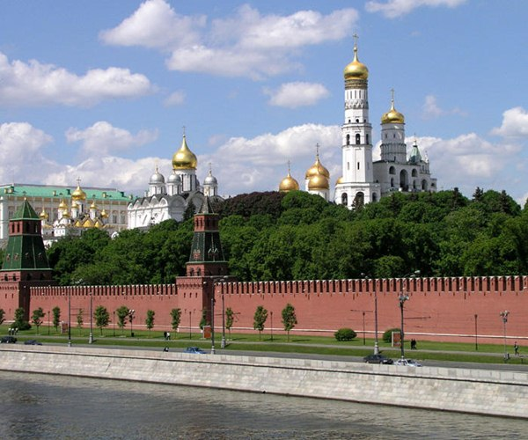
Thank you
for attention

