Slide 1
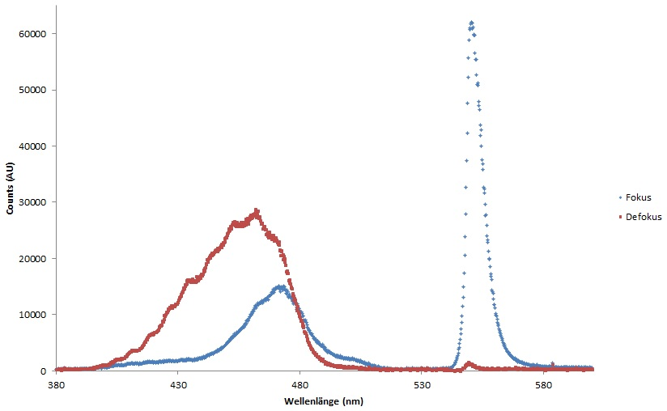
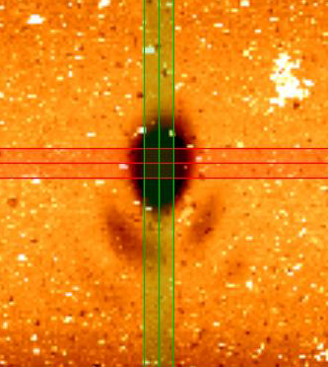
Principles and applications of optical switching assisted imaging
and structuring schemes
David Köhne, Claudia Geisler, Peter Simon & Alexander Egner
Laser-Laboratory Göttingen
Hans-Adolf-Krebs Weg 1
37077 Göttingen - Germany
david.koehne@llg-ev.de

Slide 2
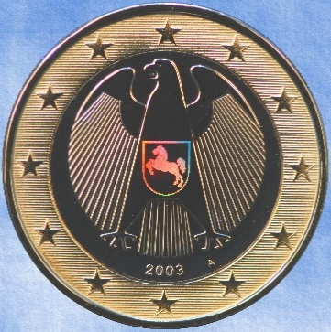
holographic design elements
self-cleaning surfaces
Application areas of nanostructures
diffractive security features
cell growth engineering
field amplification
Notes:
Numerous Technology fields statt industrie

Slide 3
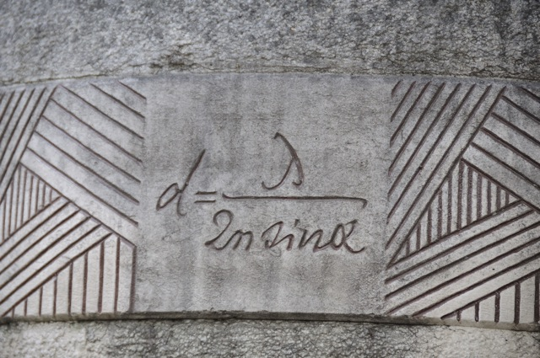
Abbe's formula on a memorial stone in Jena
Alternative approach?
IR
processing quality
UV
Notes:
Cost and complexity increase dramatical, NA limited 1-2

Slide 4
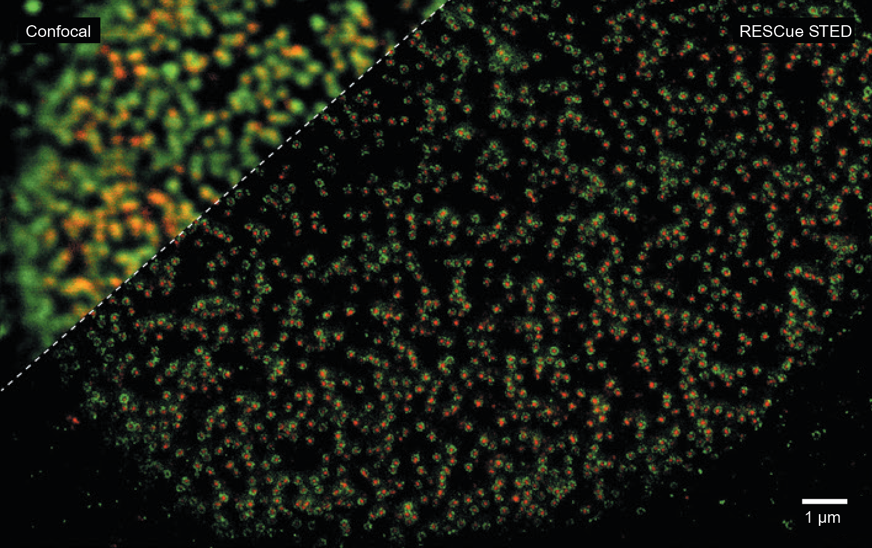
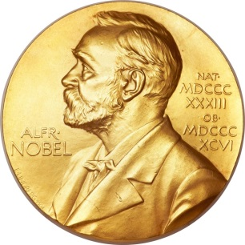
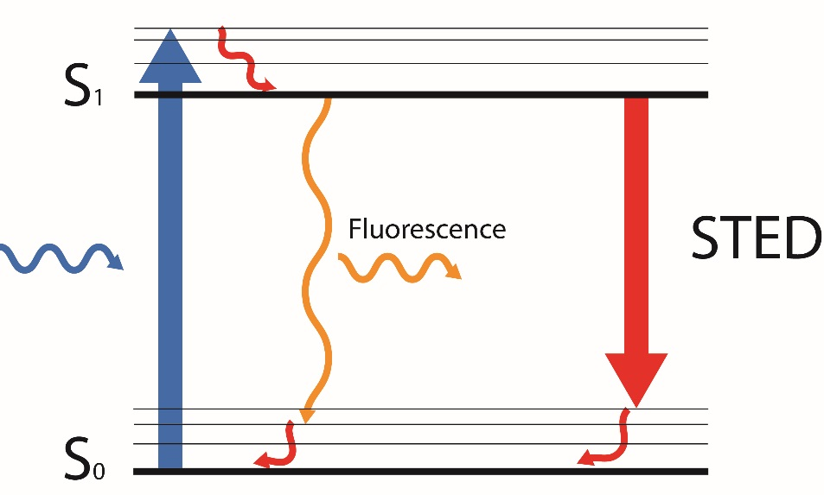
Abberior Instruments, Nature Vol. 526
STimulated Emission Depletion microscopy:
Super-resolution microscopy
Visible wavelength regime
Depopulation of excited state
Nobel prize (Hell, Moerner & Betzig 2014)
Exc.
Depletion
donut
Exc.
+
Notes:
Es gibt eine methode unter dem beugungslimit im sichtbaren bereich. Fluorescent marker. (Saturation from the sted beam)

Slide 5
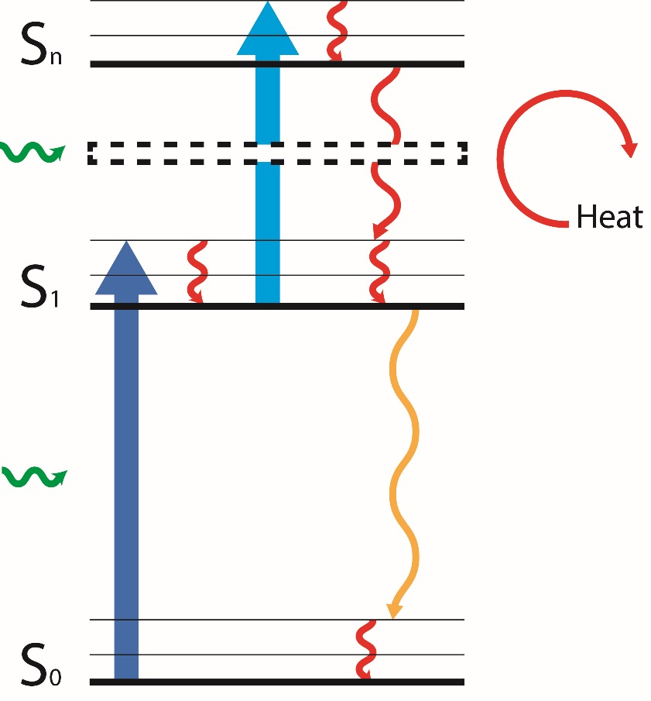
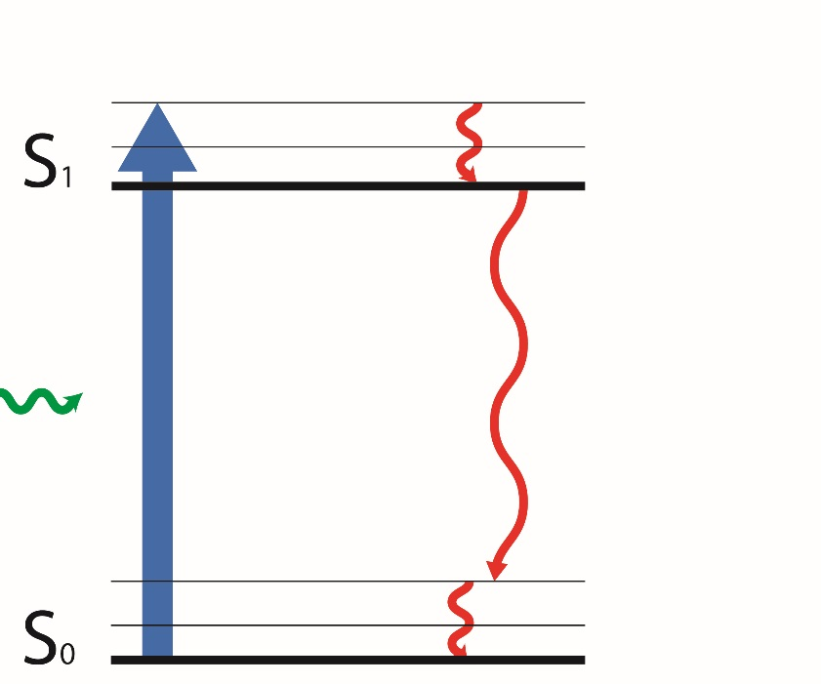
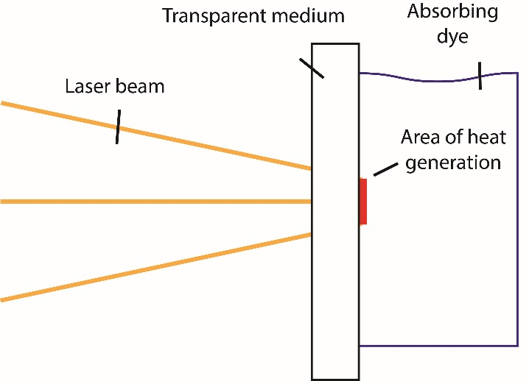
Laser Induced Backside Wet Etching:
Fluorophores deposit energy
Able to structure fused silica, sapphire etc.
Excimer laser (UV)
Notes:
Adapt sted to libwe. It also uses dye molecules. UV nicht erwähnen. Fluorophores work in the ESA way, not the method.

Slide 6
STED
Control shape
LIBWE
Deposit heat

Slide 7
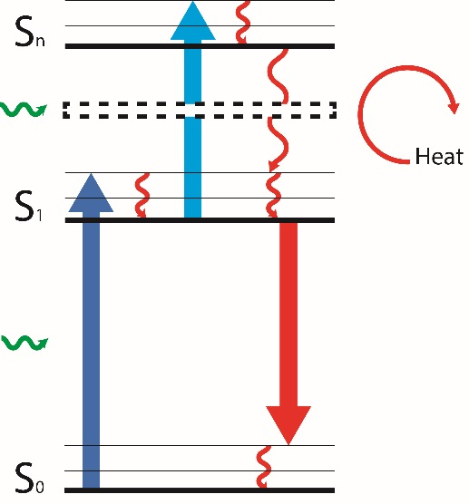
Required dye properties:
Excited State Absorption (ESA) in the visible range
Soluble at high dye concentrations
High fluorescence quantum efficiency
➔ Laser dye
Our choice: Rhodamine 6G
Excited state absorption: λ = 440 nm
Soluble in ethanol up to c = 0.16 mol/l, in methanol up to c = 0.66 mol/l
Fluorescence quantum yield: 96 %
Ground state absorption maximum: λ = 530 nm

Slide 8
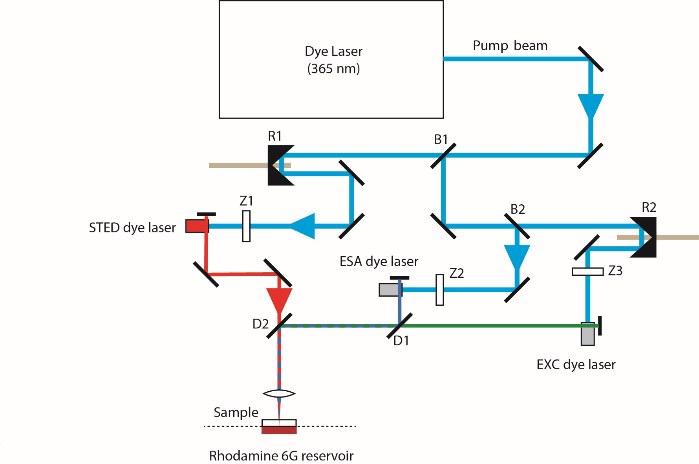
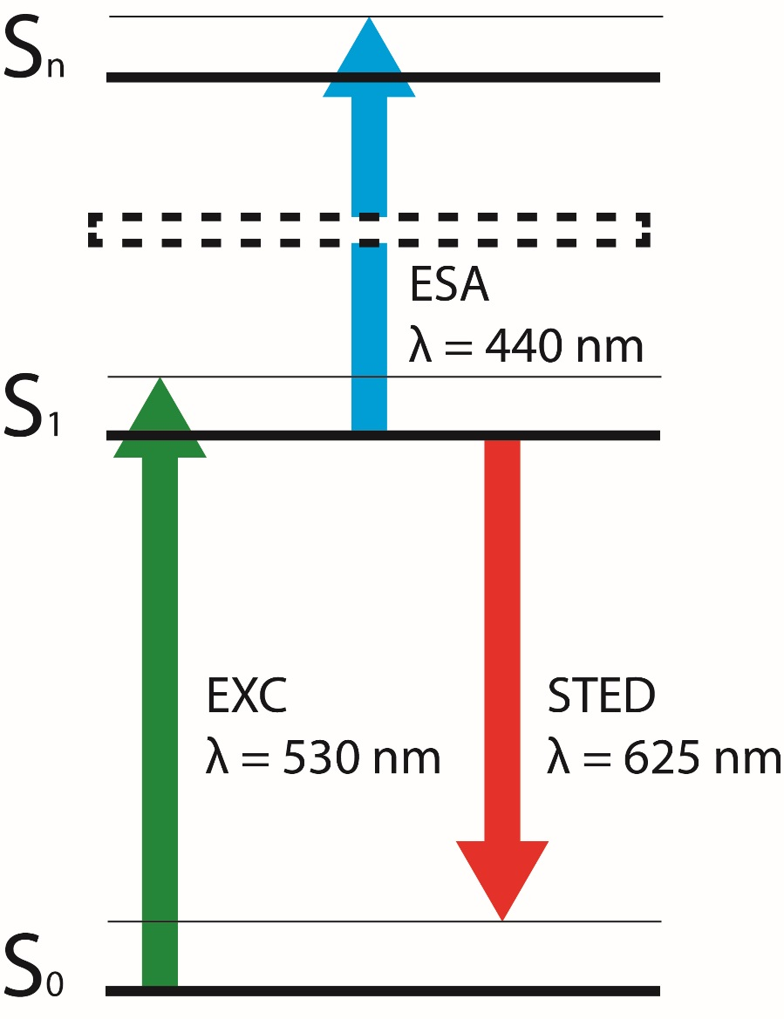
Laser parameters:
ESA laser beam: 440 nm, 50 ps, >1000 mJ/cm²
EXCitation laser beam: 530 nm, 50 ps, > 1000 mJ/cm²
STED laser beam: 625 nm, 50 ps, >1000 mJ/cm²
All laser beams synchronized
Repetition rate: 4 Hz

Slide 9
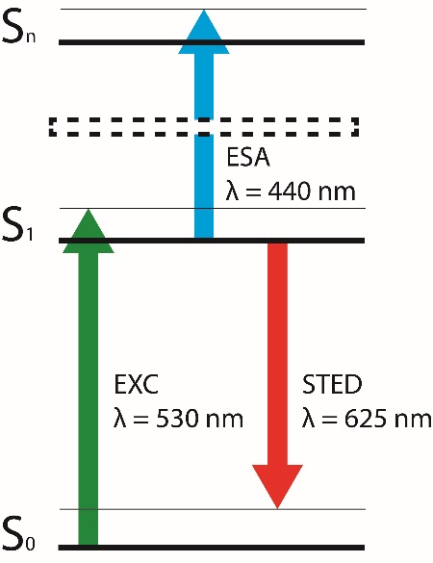
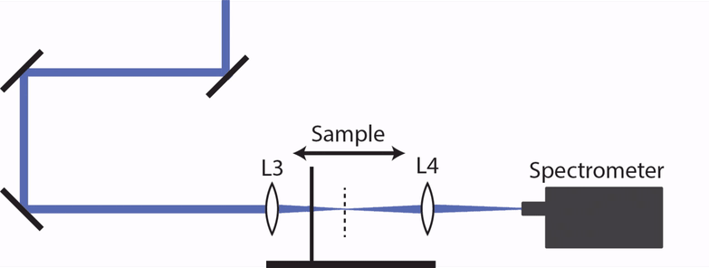
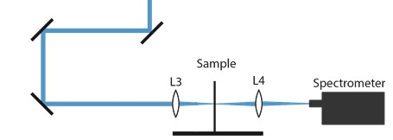
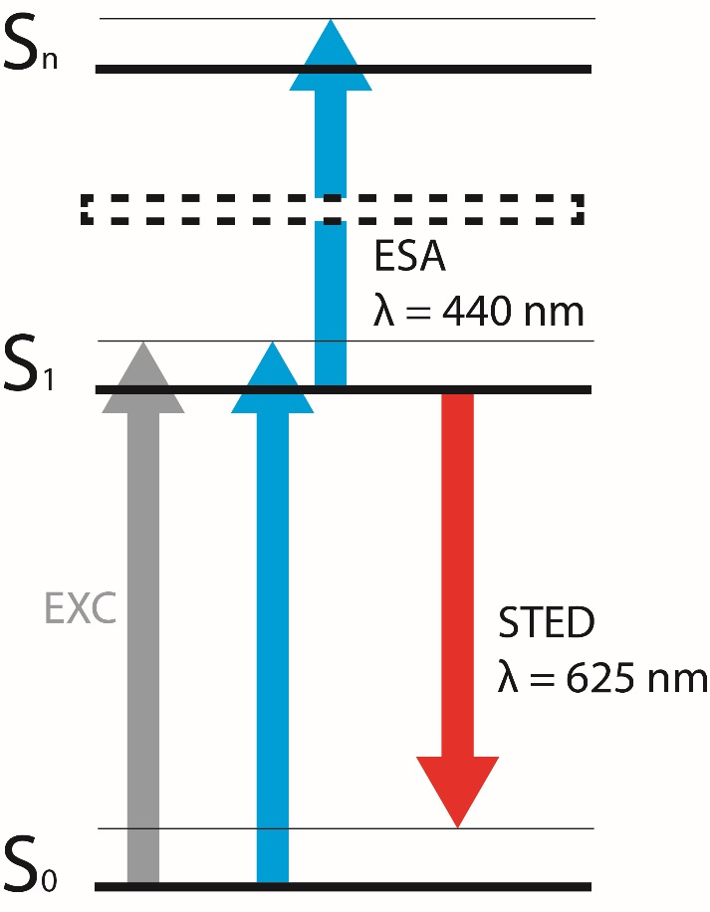
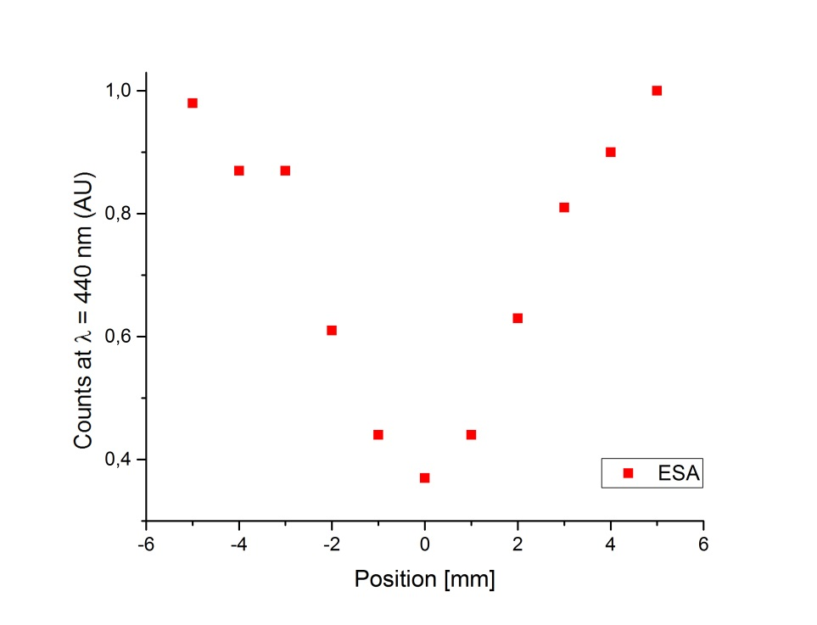
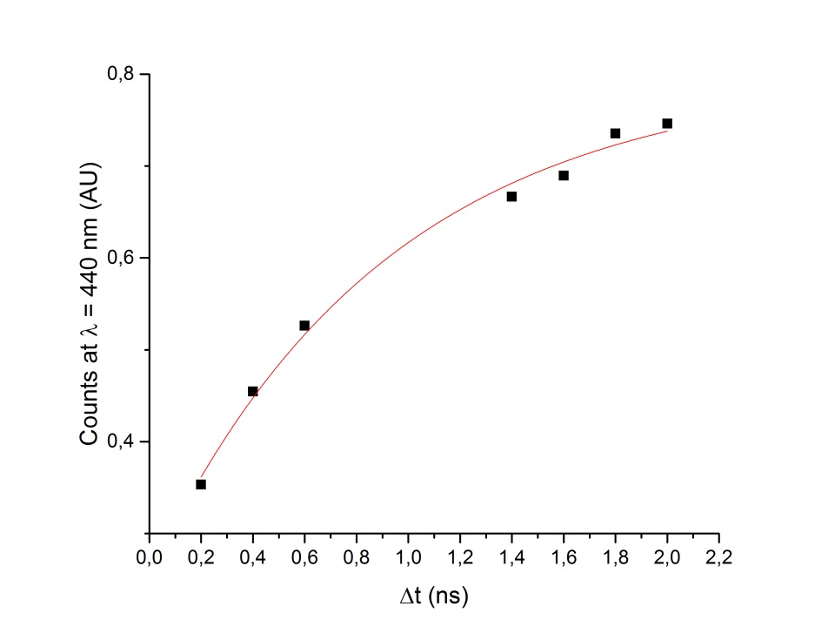
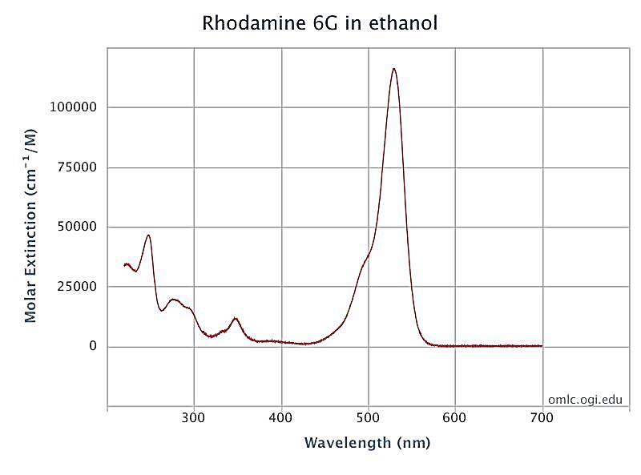
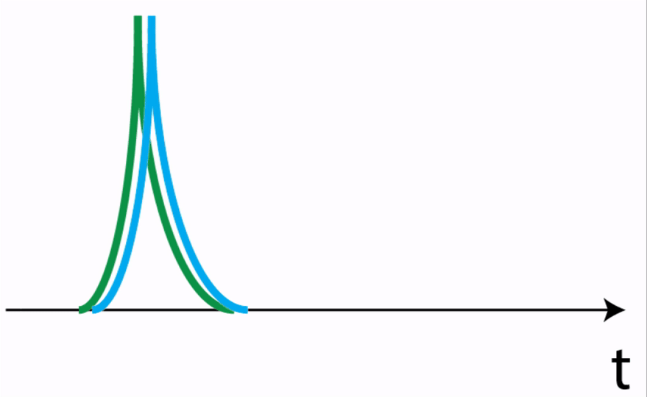

Slide 10
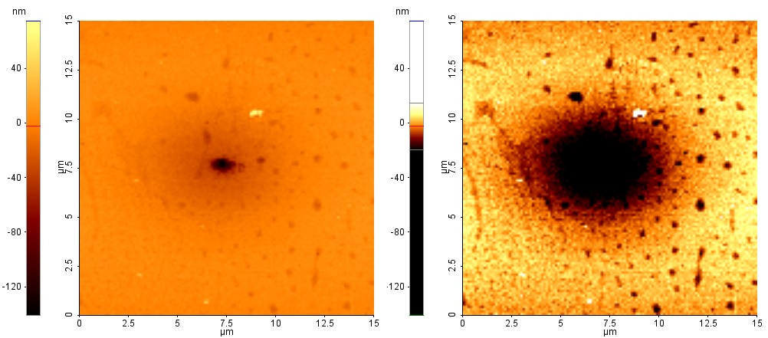
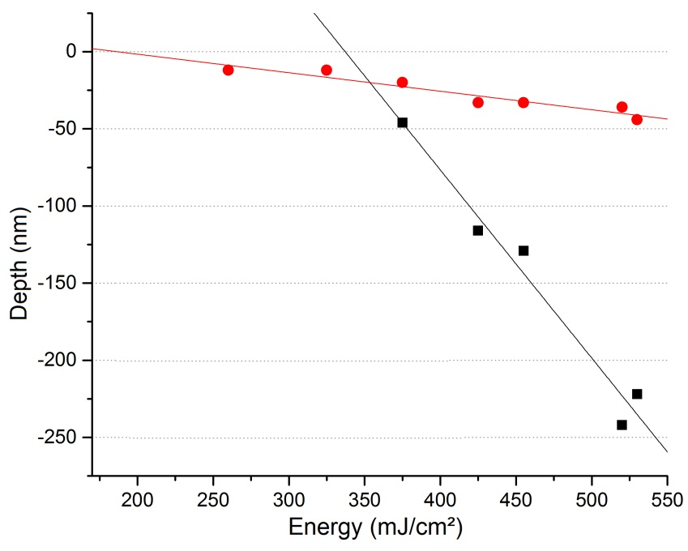
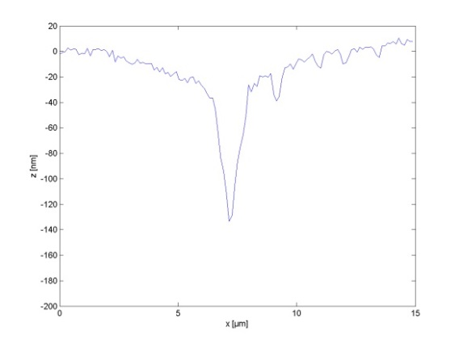
Sample: PMMA
1000 pulses
AFM Image

Slide 11
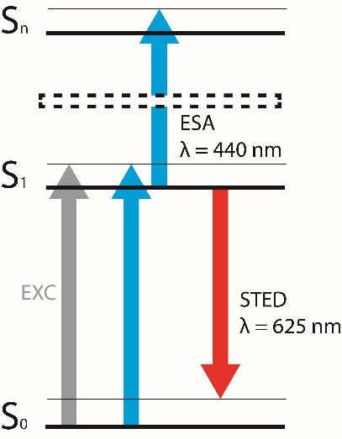
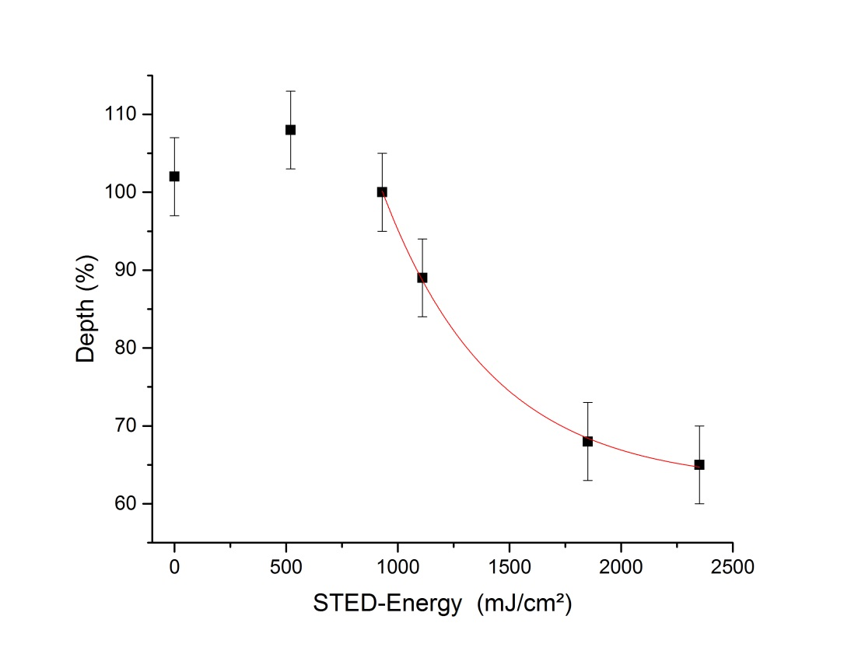
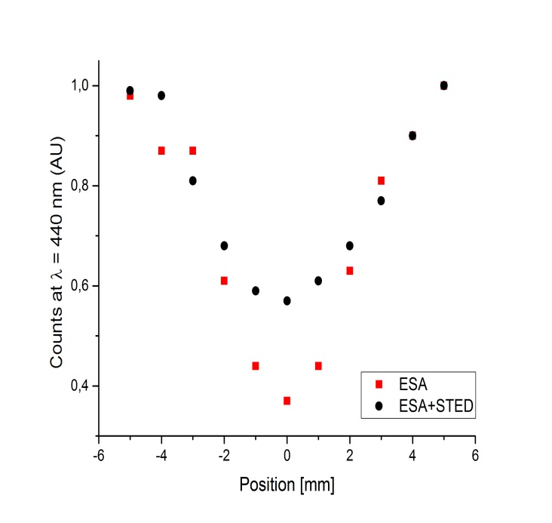
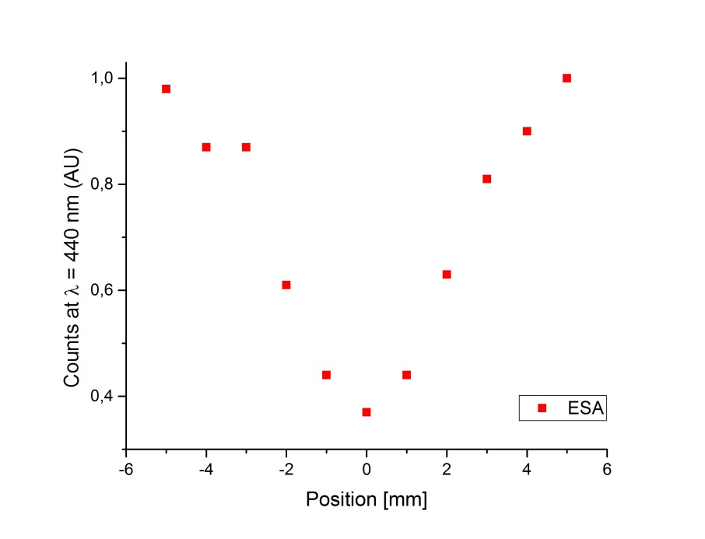
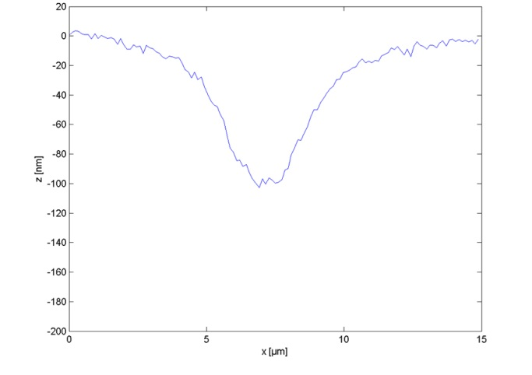
Superimpose STED and ESA laser beam

Slide 12
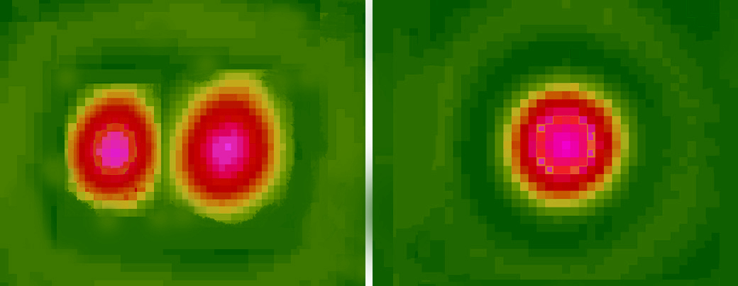
Add phase plate to STED laser beam
Notes:
Fokusverteilung ggf noch im fokus

Slide 13
ESA
STED
+
+

Slide 14
Summary
Proof of principle
STED laser beam reduces structure size
Interesting effect for higher ESA energies
Outlook
Work with higher Numerical Aperture
Optimize laser parameters (repetition rate, pulse width)
Better fluorophores
Other substrate material

Slide 15
Laser-Laboratory Göttingen
Dr. Alexander Egner
Dr. Peter Simon
Dr. Claudia Geisler
Haugen Mittelstädt
Dr. Francesco Rocca
Jennifer Krüger
Oskar Laitenberger
René Siegmund
Contact:
David Köhne
david.koehne@llg-ev.de

Slide 16
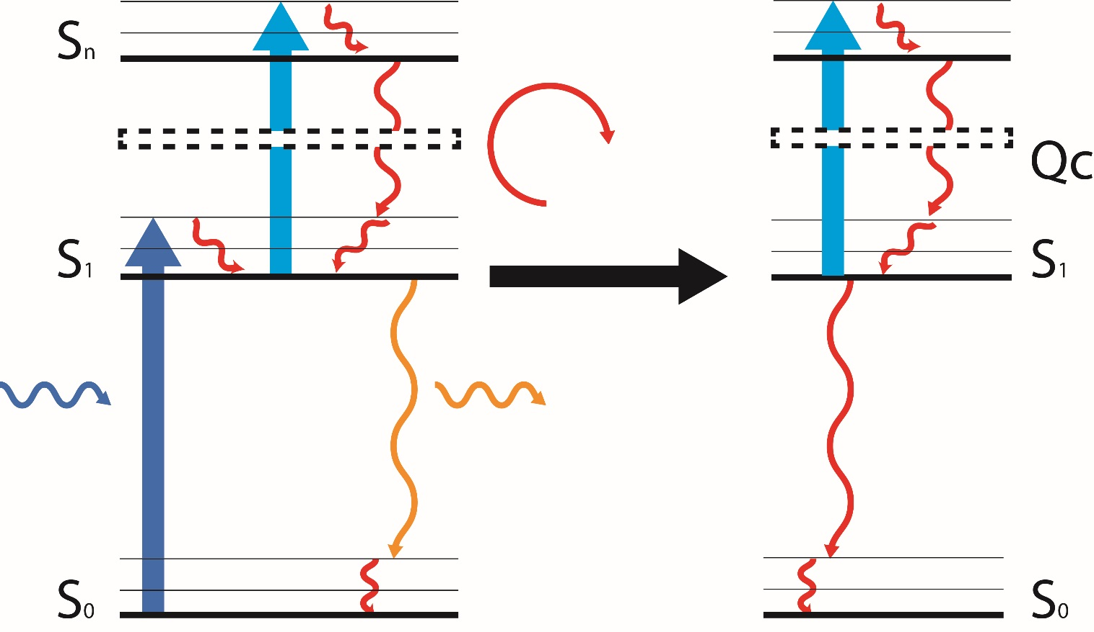
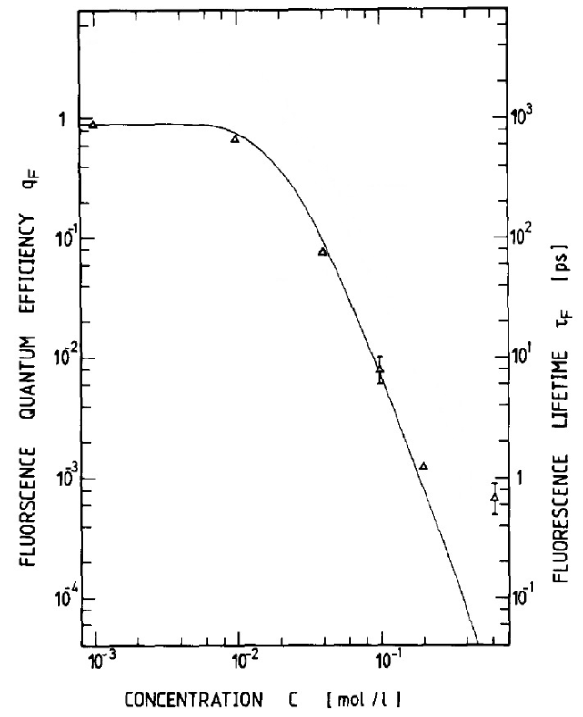
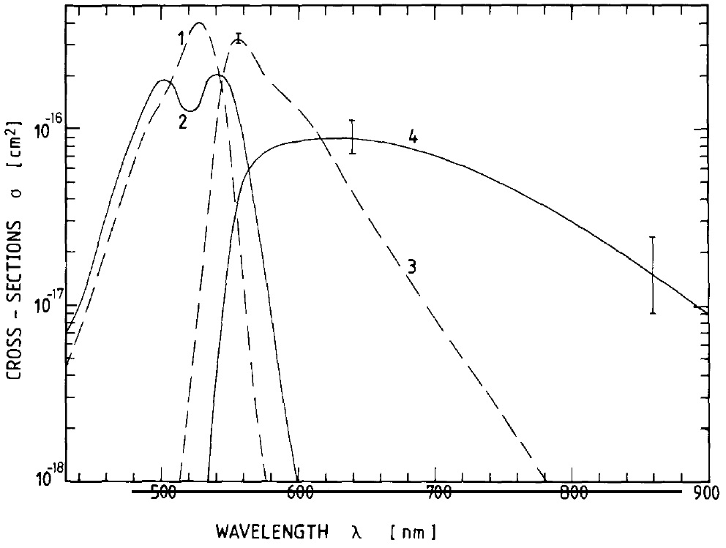
Rhodamine 6G
Soluble in Ethanol till c = 0,16 mol/l, in Methanol till c = 0,66 mol/l
Ground Absorption Maximum λ = 530 nm
Excited State Absorption λ = 440 nm
Well known behavior at high concentrations
Rhodamine 6G
Soluble in Ethanol till c = 0,16 mol/l, in Methanol till c = 0,66 mol/l
Ground Absorption Maximum λ = 530 nm
Excited State Absorption λ = 440 nm
Well known behavior at high concentrations
Rhodamine 6G
Soluble in Ethanol till c = 0,16 mol/l, in Methanol till c = 0,66 mol/l
Ground Absorption Maximum λ = 530 nm
Excited State Absorption λ = 440 nm
Well known behavior at high concentrations

Slide 17
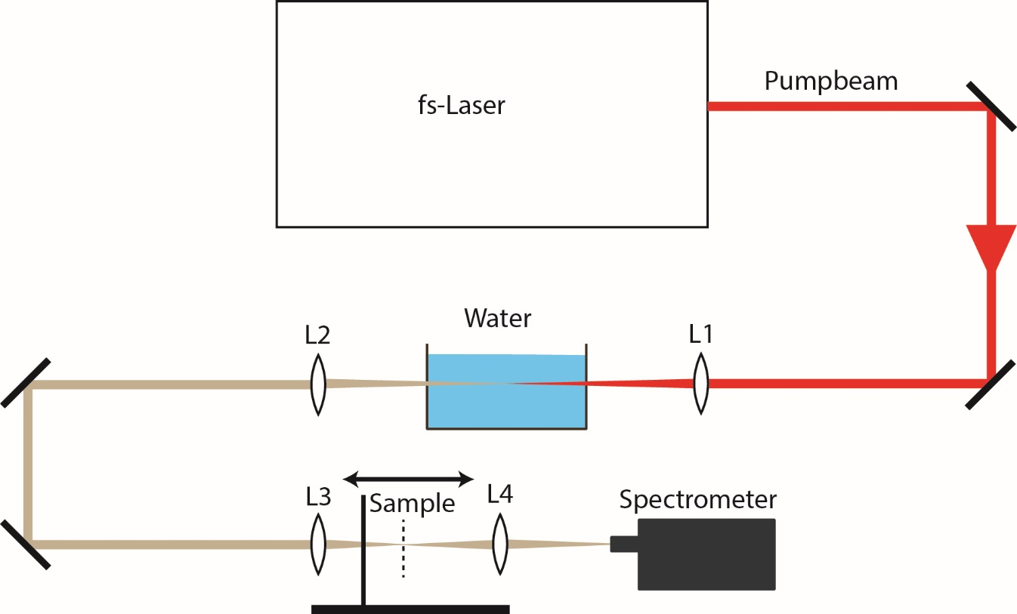
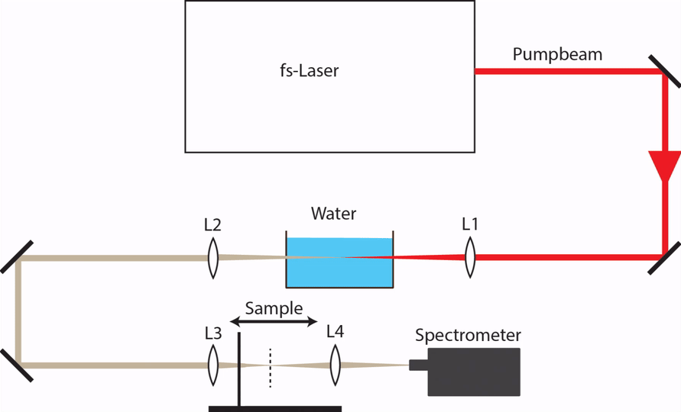
Dye Parameters:
Excited State Absorption (ESA) in the visible range
High-concentrated soluble
High Fluorescence quantum efficiency
Acridine Rot, Atto 647n, Atto 532, Merocyanine 540, Rhodamin 700, Rhodamin B and Rhodamin 6G
Dye Parameters:
Excited State Absorption (ESA) in the visible range
High-concentrated soluble
High Fluorescence quantum efficiency
Acridine Rot, Atto 647n, Atto 532, Merocyanine 540, Rhodamin 700, Rhodamin B and Rhodamin 6G
Rhodamin 6G

Slide 18
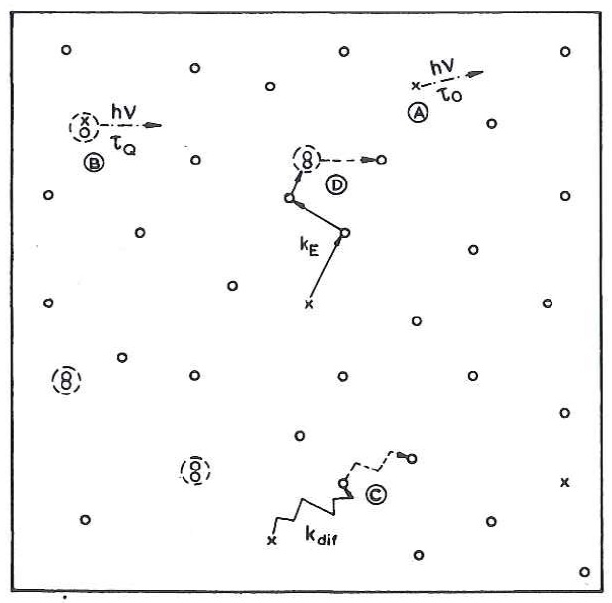
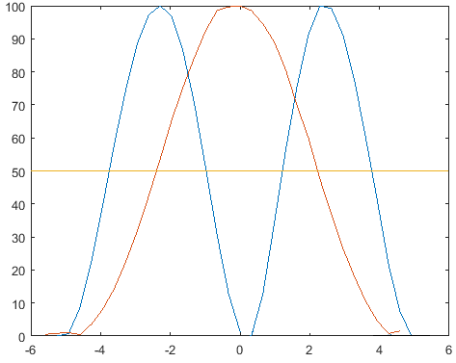

Slide 19
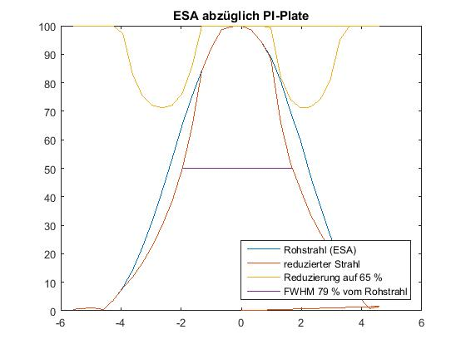

Slide 20
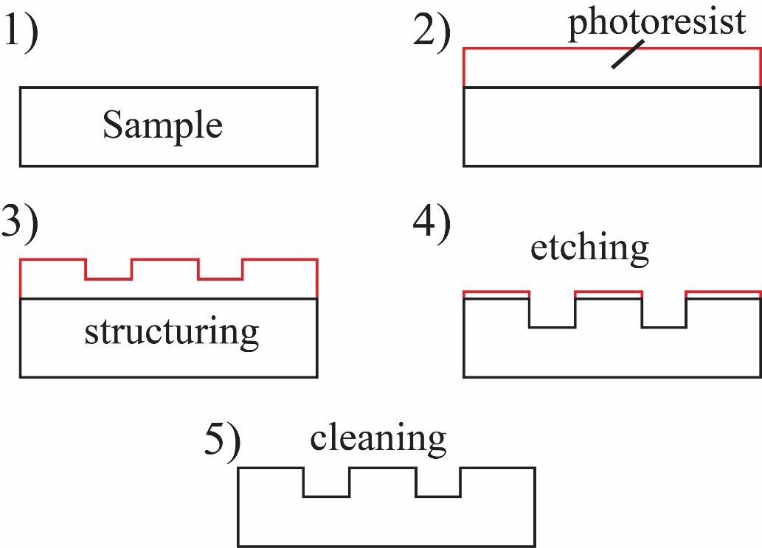
Standard methods:

