Slide 1
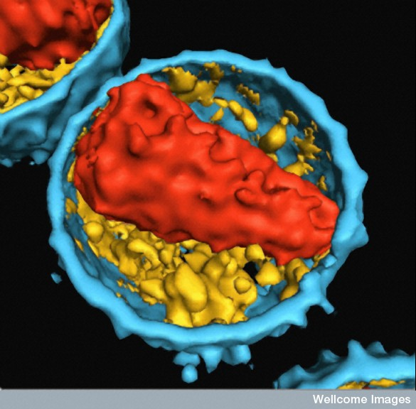
Inhibiting HIV-1 reverse transcription by target the reverse transcription complex
David Harrich
Molecular Virology Laboratory
Department of Molecular and Cell Biology
Programme in Infectious Diseases
International Conference on
Retroviruses & Novel Drugs
June 09, 2015

Slide 2
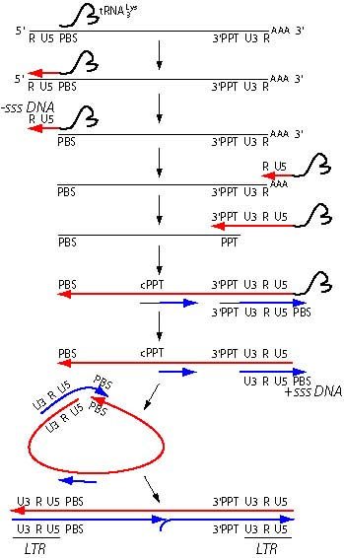
Reverse Transcription:
+single strand RNA to double strand DNA
Early:
Intermediate
Late:

Slide 3
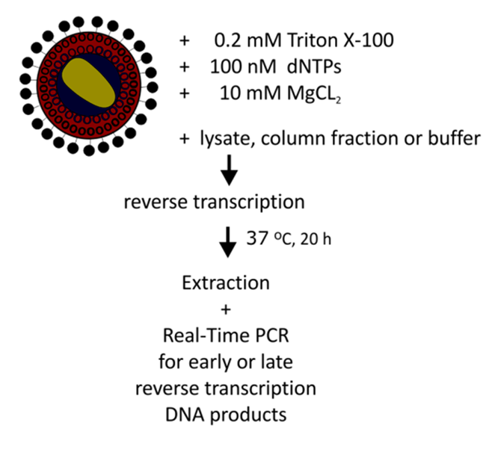
Background: Cellular factors stimulate reverse transcription in vitro
Endogenous Reverse Transcription (ERT) is inefficient (late DNA/early DNA products) compared to reverse transcription in cells. (Hooker et al. 2003) (Warrilow et al JVI 2008)
ERT efficiency can be stimulated by cell lysates. (Narayan et al., PNAS 2004) (Warrilow et al., JVI 2008)
Late DNA:Early DNA

Slide 4
Background 2: Eukaryotic translation elongation factors stimulates reverse transcription in vitro
eEF1A and other EF1 subunits were identified in cell lysate fractions that simulate reverse transcription late DNA synthesis in vitro.
The immunodepletion of eEF1A and eEF1G from lysate fractions resulted in decreased efficiency of endogenous reverse transcription reactions.
Warren et al PNAS 2012

Slide 5
Background 3: eEF1A and eEF1G associate with the reverse transcription complex subunits
RT and IN associated with eEF1A or eEF1G by co-IP.
eEF1A/1G co-purified with RTC isolated by isopycnography
siRNA downregulated eEF1A/1G in cells decreased post-infection levels of RTC, suggesting that one or both are important for RTC stability
Warren et al PNAS 2012

Slide 6
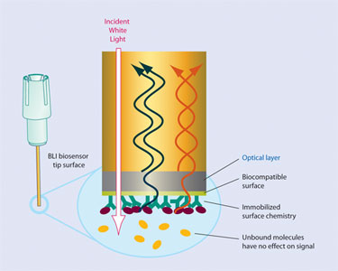
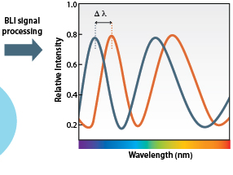
Does eEF1A or 1G directly interact with the RTC subunits RT or IN?
Biolayer Interferometry (BLI)

Slide 7
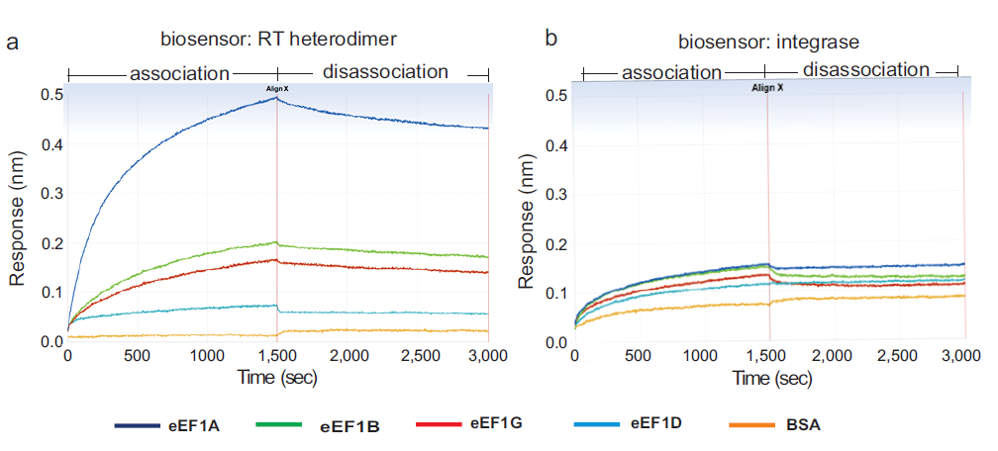
The EF1 subunit eEF1A binds RT not IN in vitro using BLI
RT
IN
RT courtesy Stuart LeGrice; IN courtesy of Duane Grandgenett
Preliminary data

Slide 8
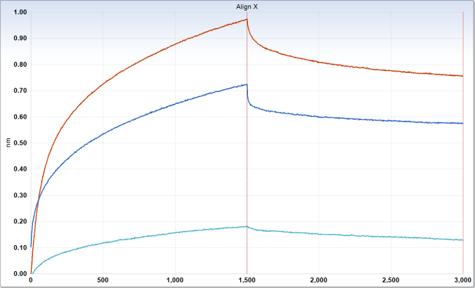
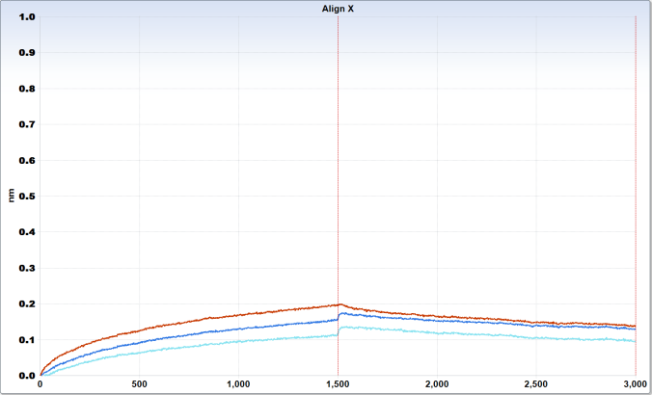
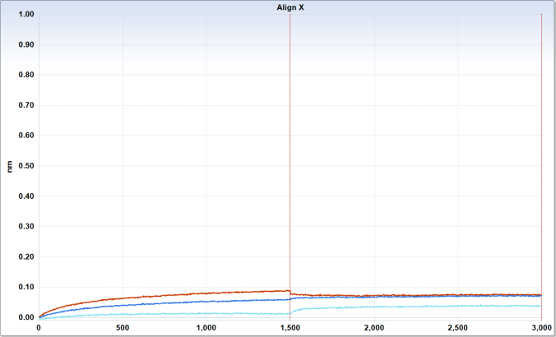
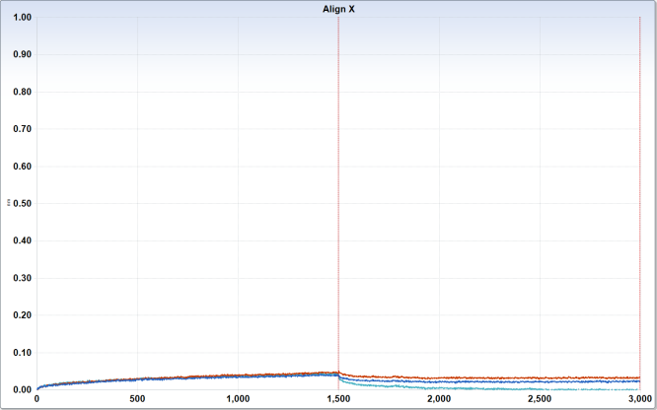
Reciprocal experiments using EF1 subunit probes and soluble RT
a
b
Association
Dissociation
Association
Dissociation
eEF1A
eEF1β
Kd ~3-4 nM
Time (seconds)
Time (seconds)
c
Association
Dissociation
d
eEF1D
Association
Dissociation
eEF1G
Time (seconds)
Time (seconds)
RT concentrations:
90nM
30nM
10nM
Sensorgram of association and dissociation of eEF1A1, eEF1B, eEF1D and eEF1G with HIV RT. Biotinylated (a) eEF1A1, (b) eEF1B, (c) eEF1D and (d) eEF1G were immobilized on biosensors. The association and dissociation with various concentrations of HIV RTp66/p51 were measured respectively on the OctetRed system. Data are representative of three independent experiments
Preliminary data

Slide 9
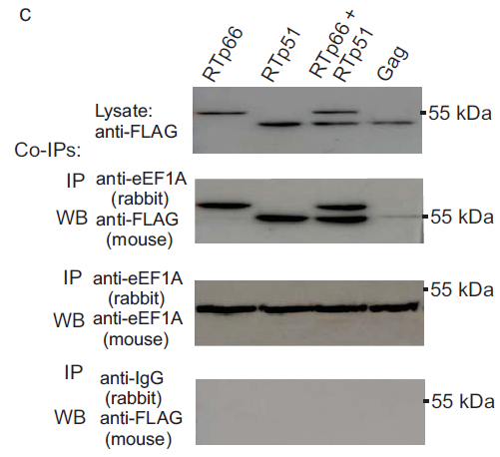
Co-IP assays indicate interaction between RT and eEF1A
IP: eEF1A WB: RT
Preliminary data

Slide 10
Co-IP assays indicate interaction between RT and eEF1A
IP: eEF1A WB: RT
IP: RT WB:eEF1A
Lysate
Anti-RT IP product
55 kDa
WB Anti-eEF1A
WB Anti-eIF3A
170 kDa
55 kDa
WB Anti-HIV RT
Preliminary data

Slide 11
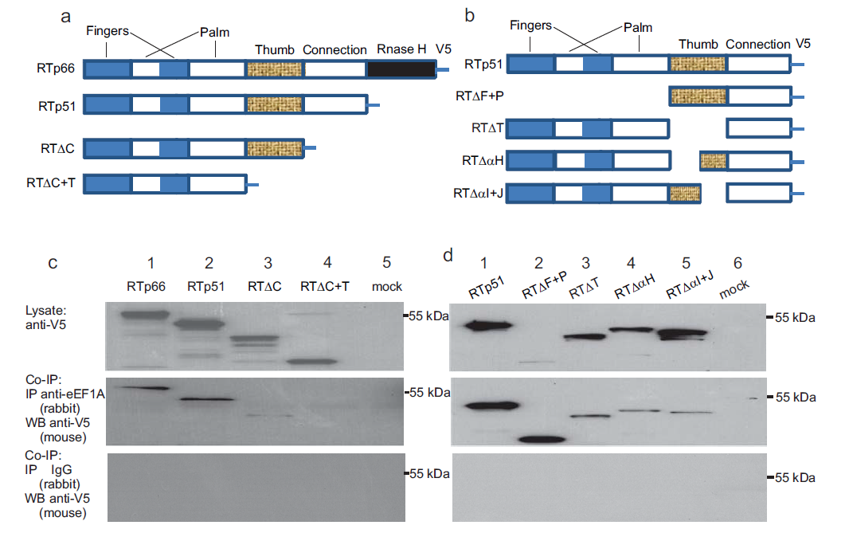
The RT thumb and connection domain are important for interaction with eEF1A
Preliminary data

Slide 12
The RT thumb and connection domain are important for interaction with eEF1A
Preliminary data

Slide 13
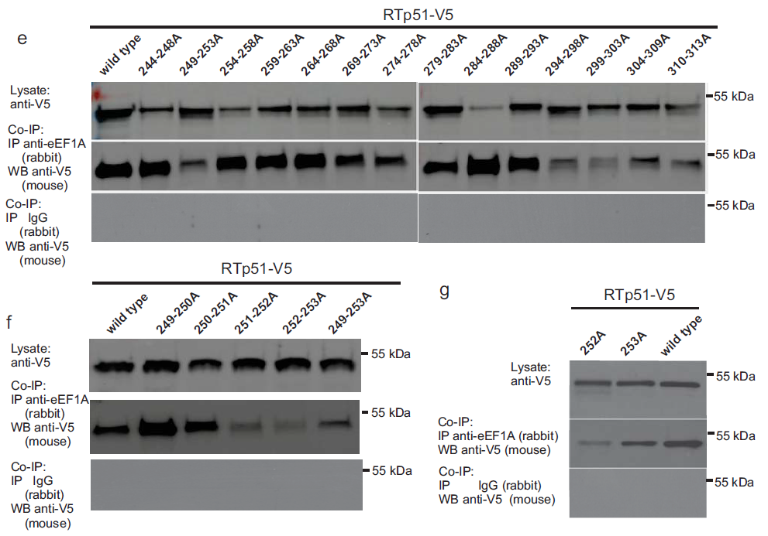
Alanine scanning mutagenesis of the RT thumb domain:
multiple binding sites?
5x Ala
2x Ala
single Ala
Preliminary data

Slide 14
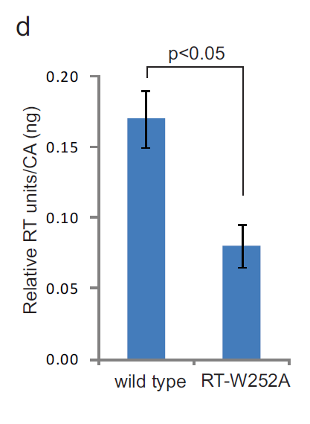
Does W252A affect RT activity / reverse transcription?
Standard homopolymer substrate RT assay.
Reverse Transcription in Jurkat cells; 4 hours post-infection
Table 2: Analysis of reverse transcription by wild type or RT-W252A mutant virus in Jurkat cells
 |  | WT^{1,3} | W252A^{2,3} | p value⁴ | WT + NVP^{5,3}
Infection using equivalent amount of CA⁷ | early DNA copy number | 15,212 ± 3,226 | 11,350 ± 3,110 | ≥ 0.05 | 8,393 ±3,785
 | late DNA copy number | 3,244 ± 696 | 1,332 ± 216 | < 0.05 | 1,912 ± 598
 | late/early DNA % | 21.3 ± 0.2 | 11.7 ± 0.6 |  | 22.7 ± .06
The decrease in RTn efficiency is consistent with previous studies that indicated eEF1A is important for late DNA synthesis. Warren et al. 2012 PNAS
Preliminary data

Slide 15
Does W252A affect RT activity / reverse transcription?
Standard homopolymer substrate RT assay.
Reverse Transcription in Jurkat cells; 4 hours post-infection
Table 2: Analysis of reverse transcription by wild type or RT-W252A mutant virus in Jurkat cells
 |  | WT^{1,3} | W252A^{2,3} | p value⁴ | WT + NVP^{5,3}
Infection using equivalent amount of CA⁷ | early DNA copy number | 15,212 ± 3,226 | 11,350 ± 3,110 | ≥ 0.05 | 8,393 ±3,785
 | late DNA copy number | 3,244 ± 696 | 1,332 ± 216 | < 0.05 | 1,912 ± 598
 | Late/early DNA % | 21.3 ± 0.2 | 11.7 ± 0.6 |  | 22.7 ± .06
The decrease in RTn efficiency is consistent with previous studies that indicated eEF1A is important for late DNA synthesis. Warren et al. 2012 PNAS
Preliminary data

Slide 16
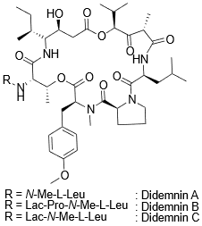
Didemnin B binds to eEF1A and inhibits its role in translation
Didemnins are cyclic depsipeptide compounds isolated from a tunicate (sea-squirt).
Didemnin B is the one that possesses the most potent biological activities.
It is a strong antiviral agent against both DNA and RNA viruses such as herpes simplex virus type 1.
Dideminin B irreversibly binds eEF1A and therefore inhibits translation blocking interaction with the eF1B complex.

Slide 17
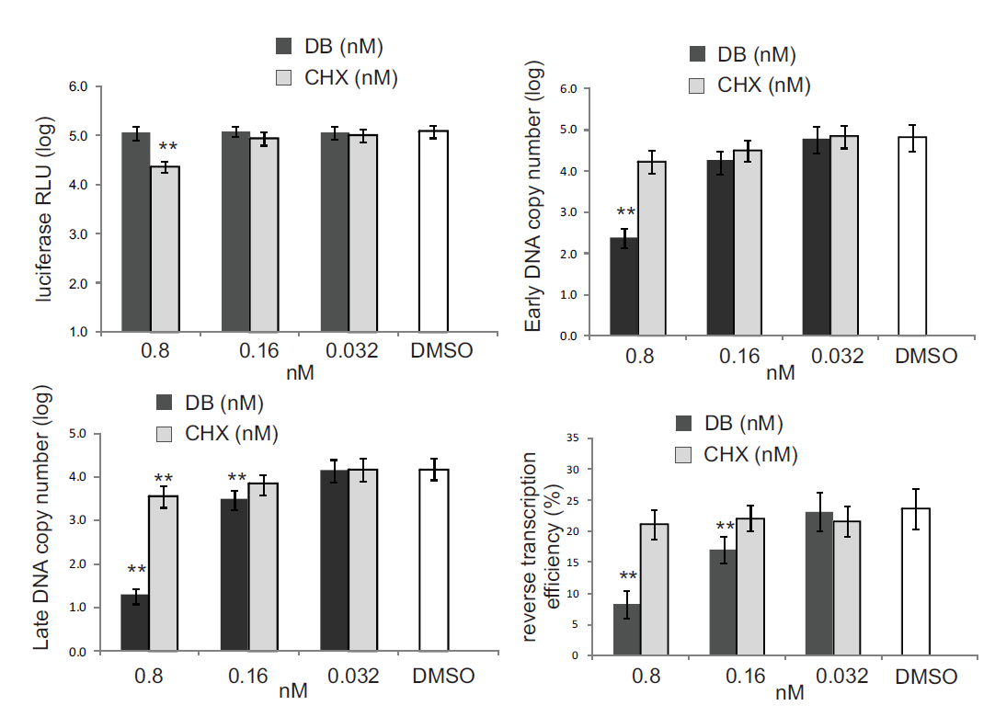
The eEF1A inhibitor, didemnin B (DB) inhibits HIV-1 reverse transcription.
No translational inhibition at 0.8 nM DB
HEK293T cells treated with DB or CHX for 2 h
Attach HIV-1 at 20°C for 2h
Infection at 37°C 4 h
Collect cell lysate for analysis of HIV-1 DNA
>200-fold inhibition
>500-fold inhibition
Preliminary data

Slide 18
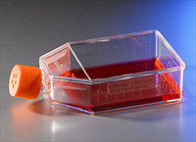
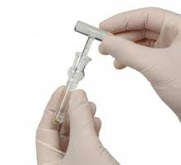
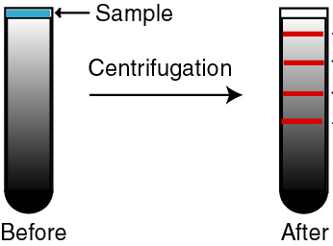
Do eEF1A1 and eEF1G associate with the
reverse transcription complex in cells?
HEK-293T cells
+/- didemnin B
Infected with HIV-1 pseudotyped with
V-VSG envelope for 4 h. Heat-inactivated virus were used as a negative control.
Cells are lysed using a
dounce homogenizer
Fractions:
12
1
Fractions are assayed for:
HIV-1 DNA by qPCR
ELISA for CA
Equilibrium density gradient centrifugation using a 20 – 70 % continuous sucrose gradient

Slide 19
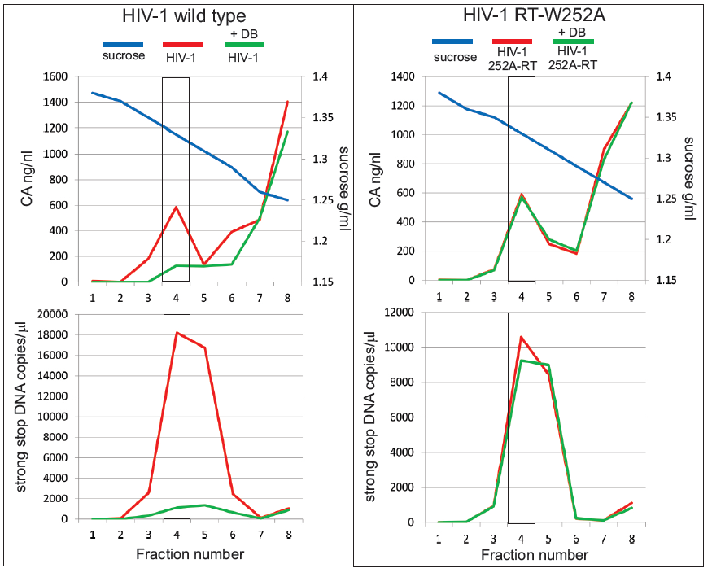
Analysis of RTCs +/- DB by isopycnography; 20-70% sucrose gradients
Preliminary data

Slide 20
Analysis of RTCs +/- DB by isopycnography; 20-70% sucrose gradients
Preliminary data

Slide 21
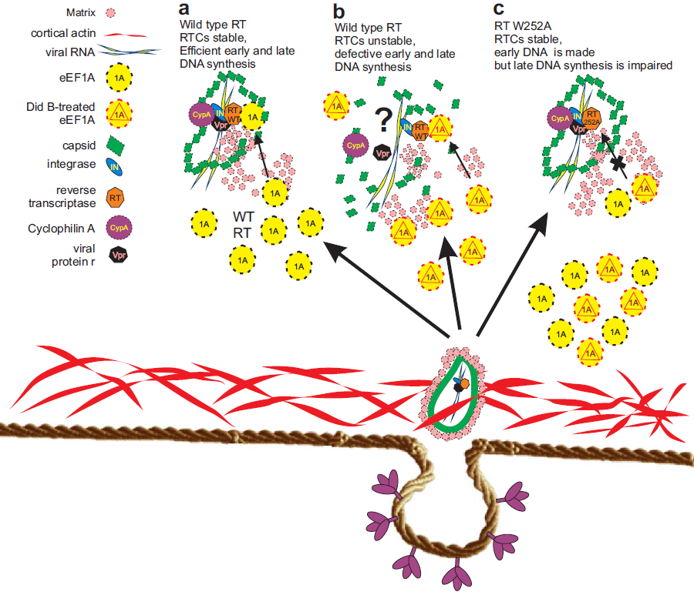
Proposed model: DB-treated eEF1A leads to altered uncoating/RTN

Slide 22
A Tat with a mutated basic domain inhibits reverse transcription
Basic
DYKDDDDK
FLAG
Basic domain which binds to the TAR sequence is mutated.
“Nullbasic”

Slide 23
Future Virology 8:757 2013
NB= Nullbasic (Tat mutant)
Inhibits RT, Tat and Rev

Slide 24
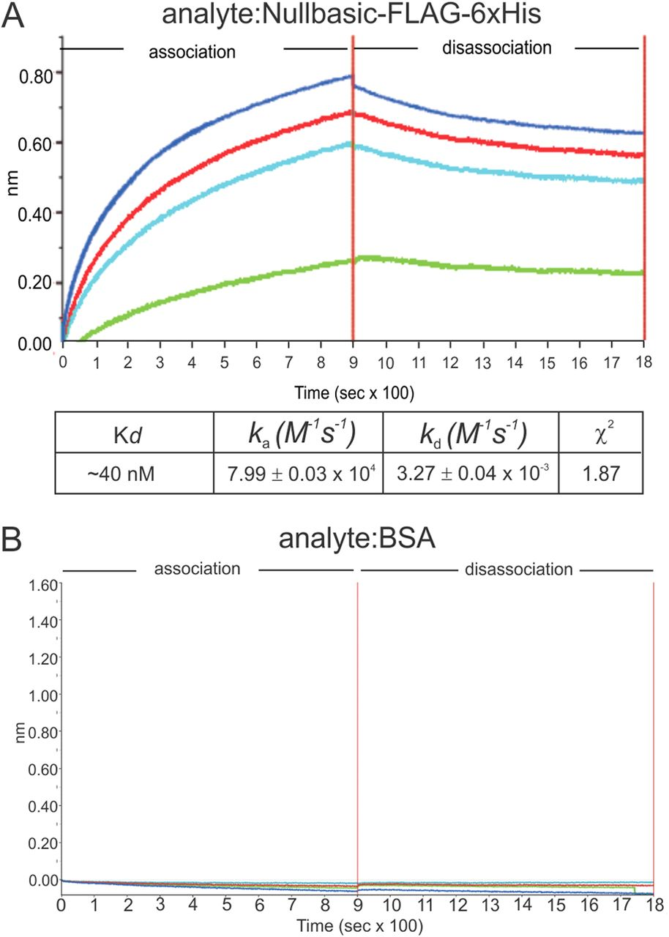
BLI sensograms of binding events between Nullbasic and RT
Min-Hsuan Lin et al. J. Virol. 2015;89:4827-4836
Notes:
BLI sensograms of binding events between Nullbasic and RT. The Octet Red96 system was used to measure binding events between Nullbasic and RT. (A and B) BLI sensograms. Biotinylated RT p51/66 was bound to a streptavidin biosensor and applied to solutions containing 10 nM (green), 30 nM (light blue), 90 nM (red), or 270 nM (dark blue) of Nullbasic-FLAG-V5-6×His (A) or (B) BSA. The BLI experiment was repeated at three times with similar results. The results of a representative sensogram are shown.

Slide 25
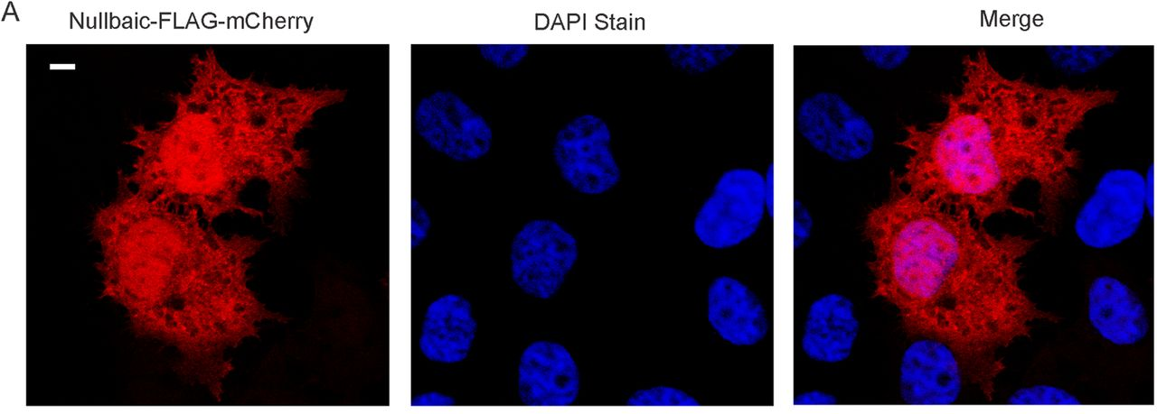
Nullbasic is located throughout the cell
Min-Hsuan Lin et al. J. Virol. 2015;89:4827-4836
Notes:
Nullbasic is present in HIV-1 virions. (A) HEK293T cells were transfected with a Nullbasic-FLAG-mCherry expression plasmid. After 24 h, the cells were stained with DAPI. The cells were visualized by fluorescent confocal microscopy, and the white bar in the left panel indicates 10 μm. (B) Isolation of HIV-1 by velocity gradient centrifugation and detection of Nullbasic. HIV-1 was produced by cotransfection of a proviral plasmid with a Nullbasic-FLAG expression plasmid (right panel) or an empty expression plasmid (left panel). The virus was pelleted through 20% sucrose cushion, collected in 1× PBS, placed on the top of a linear 6 to 18% iodixanol gradient, and centrifuged for 1.5 h at 250,000 × g. Fractions were collected from the top and were assayed for CAp24 by ELISA and Nullbasic-FLAG by Western blot analysis with an anti-FLAG antibody. The experiment was repeated three times with similar results. The results of a representative experiment are shown.

Slide 26
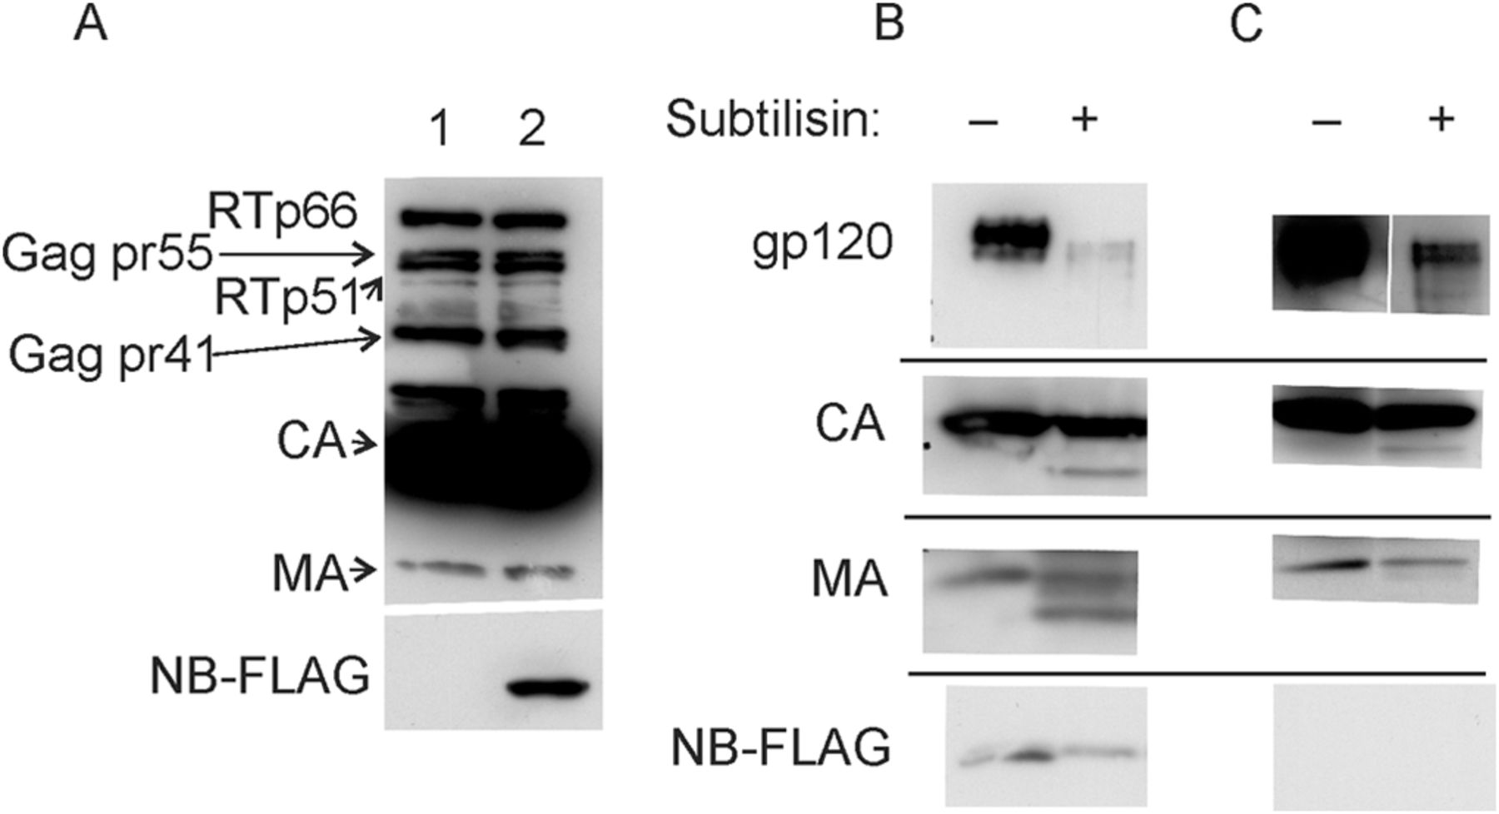
Subtilisin digestion of HIV-1 indicates Nullbasic is packaged in virions
Min-Hsuan Lin et al. J. Virol. 2015;89:4827-4836
Notes:
Subtilisin digestion of HIV-1 indicates Nullbasic is packaged in virions. HIV-1 virus stocks described used for velocity gradient analysis were pelleted through a 20% sucrose cushion. Samples of each concentrated virus were incubated with or without 1× subtilisin digestion buffer and analyzed by Western blot analysis. (A) Concentrated HIV-1 produced in the absence (lane 1) or presence (lane 2) of Nullbasic underwent Western blot analysis with an anti-HIV antibody (top panel) or the M2 anti-FLAG antibody (bottom panel). (B) Western blot analysis of Nullbasic-treated HIV-1 with antibodies specific for gp120 (top panel), CA (second panel), MA (third panel), and FLAG (that detects Nullbasic) in the presence or absence of subtilisin as indicated. (C) A Western blot as described for panel B but using HIV-1 made by cells not coexpressing Nullbasic. The experiment was repeated twice with similar results, and the results of a representative experiment are shown.

Slide 27
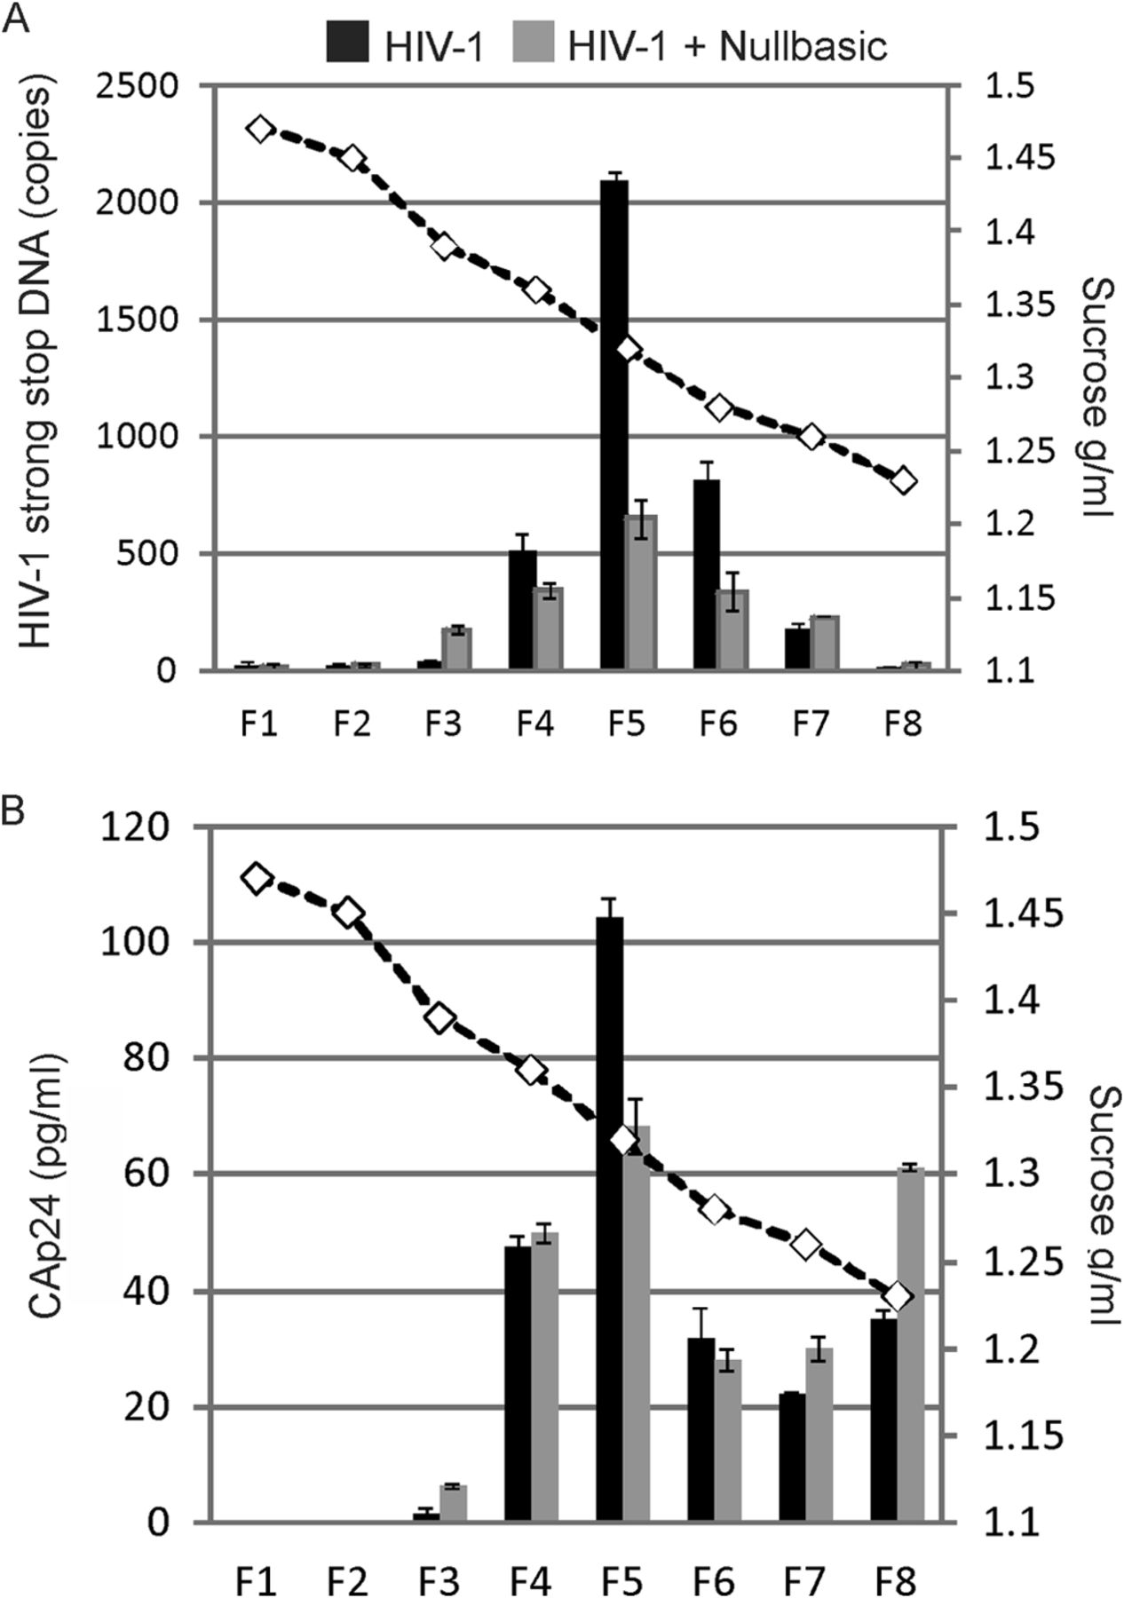
Inhibition of RTC DNA synthesis by Nullbasic
Min-Hsuan Lin et al. J. Virol. 2015;89:4827-4836
Notes:
Inhibition of RTC DNA synthesis by Nullbasic. HIV-1 was produced by cotransfection of a proviral plasmid with a Nullbasic-FLAG expression plasmid (■) or an empty expression plasmid (■) as described in Materials and Methods. HEK293T cells were infected with VSV-G-pseudotyped HIV-1. Cell lysates were prepared 4 h postinfection and layered on top of a 20 to 70% linear sucrose gradient. After centrifugation, fractions were collected from the bottom and the density of each fraction was measured (dashed line). A sample from each fraction was assayed for HIV-1 −sssDNA by qPCR (top graph) and for CAp24 by ELISA (bottom graph). The experiment was repeated twice with similar results, and the results of a representative experiment are shown.

Slide 28
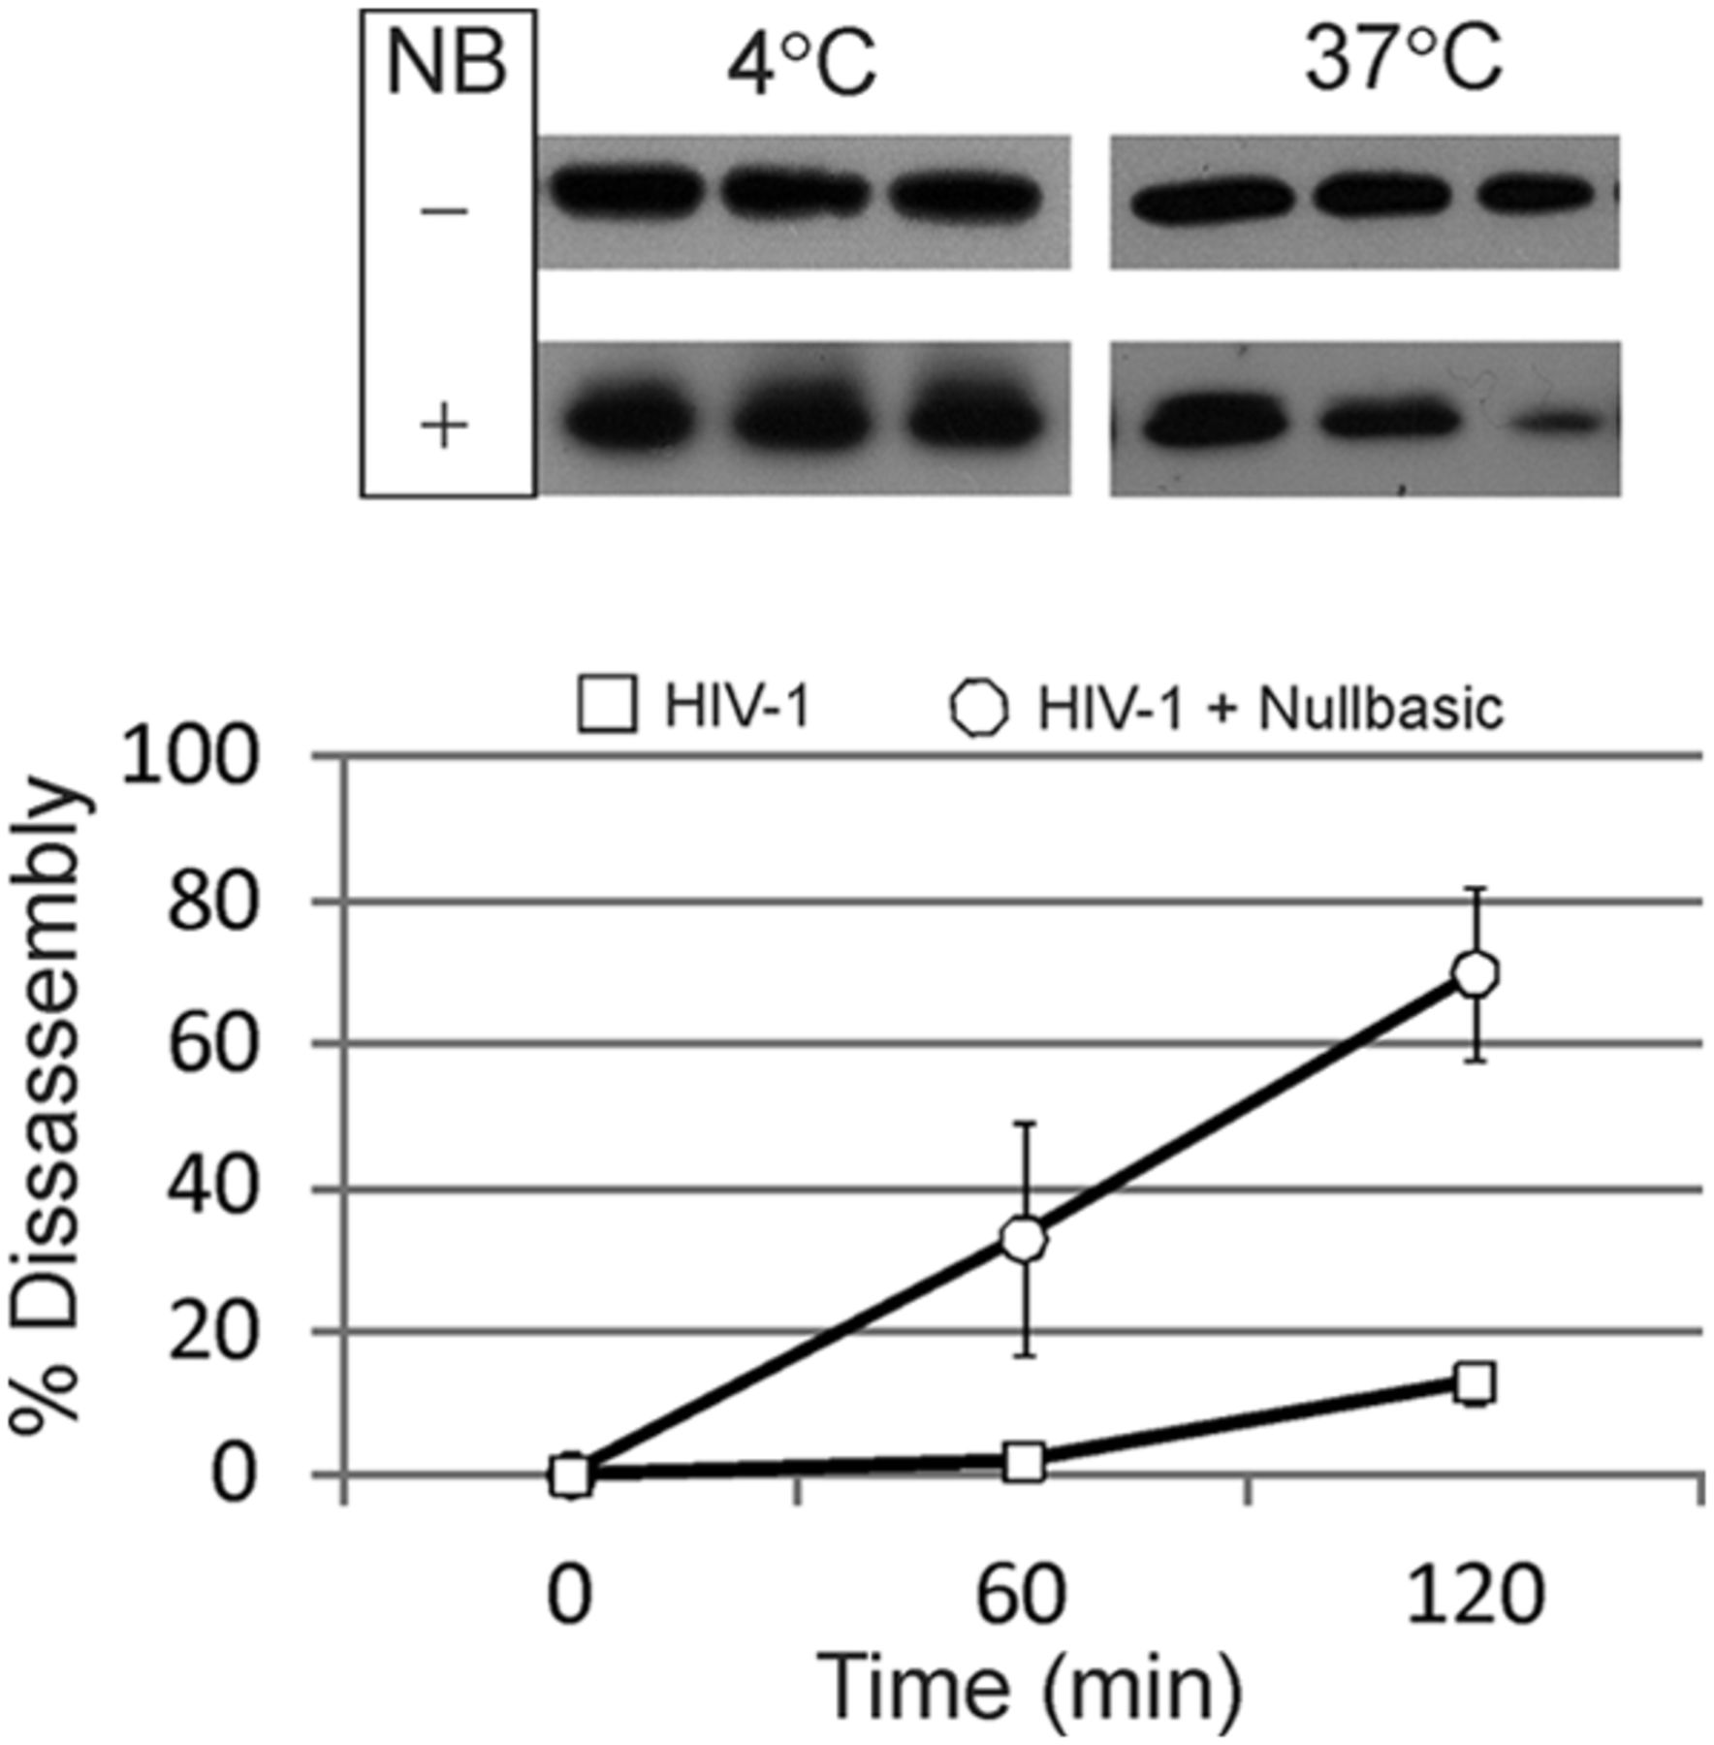
Nullbasic incorporation in HIV-1 leads to increased core disassembly kinetics in vitro.
Isolate intact cores from virions
Incubate cores at 4°C or 37°C
Centrifuge sample
Measure pelleted and soluble CA
Min-Hsuan Lin et al. J. Virol. 2015;89:4827-4836
Notes:
Nullbasic incorporation in HIV-1 leads to increased core disassembly kinetics in vitro. Purified cores from HIV-1 or HIV-1 containing Nullbasic were incubated at 4 or 37°C for 0, 60, or 120 min. (A) Western blot analysis of treated cores. The treated samples underwent ultracentrifugation, and the protein sediment was solubilized in an SDS–2% PAGE loading dye and analyzed by Western blotting with a monoclonal anti-CA antibody and a secondary antibody conjugated to HRP. The blots were developed using chemiluminescence. (B) Disassembly kinetics of viral cores in vitro at 37°C. Quantification of the protein bands from all experiments was calculated using digital images and ImageJ software. The percent disassembly was calculated by comparing values at 60 and 120 min to those at time zero. The results show mean values and standard errors of the mean. The experiment was repeated three times, and the results of a representative result are shown.

Slide 29
Summary
As eEF1A is abundant and binds RT strongly,
we propose that it is a predominant cellular RT binding protein.
The RT thumb and connection domain contain the eEF1A binding site(s).
Didemnin B (DB) is an eEF1A binding compound that potently inhibits reverse transcription.
DB treatment greatly affected the levels of RTC in infected cells. However W252A RTC are not affected.
This suggests that DB binding RT leads inappropriate uncoating and decreased reverse transcription.
A mutant Tat protein, Nullbasic, binds to RT in virions causing instability of the viral core and defective reverse transcription.
Conclusion:
The RTC can be destabilized by 1) small molecules that bind eEF1A1 and 2) by Nullbasic that binds RT, both events resulting in defective reverse transcription.

Slide 30
Molecular Virology Group
Dongsheng Li
Ting Wei
Daniel Rawle
Hongping Jin
Lina Rustanti
Past Members
Ann Apolloni
Haran Sivakumaran
Vincent Cutillas David Warrilow
Kylie Warren
Rui Wang
Fangyun Jin
Moshin Kahn
Min-Hsuan Lin
Kirsten Spann
University of Edinburgh
Cathy Abbott
Dinesh Soares
Thank You !
Special thanks to:
Stuart LeGrice
Duane Grandgenett
Johnson Mak
Funding: NHMRC, ARC

