Slide 1
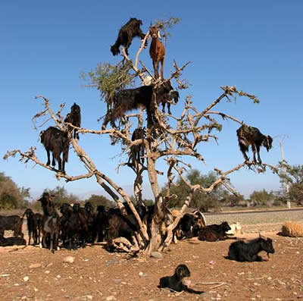
VOLUNTARY INTAKE AND PALATABILITY INDICES OF PEDI GOATS FED TANNINIFEROUS ACACIA KARROO LEAF MEAL BY CAFETERIA METHOD
Brown D*, Ng’ambi J W and Norris D
(University of Limpopo, south africa)

Slide 2
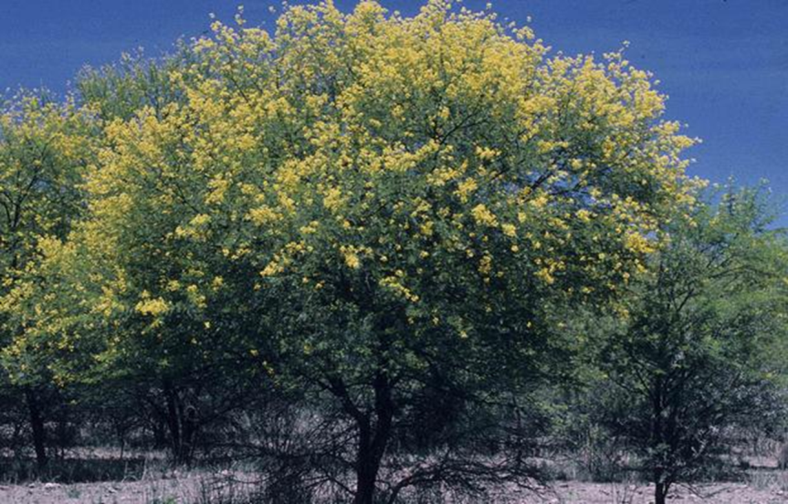
Acacia karroo tree

Slide 3
Outline
1. Background
2. Objective
3. Methodology
4. Results and discussion
5. Conclusion and recommendation

Slide 4
Background
Goats play multiple roles in the support of the poor in the communal areas of S.A
However, their productivity is hindered by shortage of good quality feed (dry season)
Browse trees legumes and shrubs have potential as alternate sources of feed for domestic livestock in communal rangeland ( Solomon et al., 2007a)
Acacia karroo (AK) is an important leguminous tree in communal rangelands and can provide enough nutrients for goats (Aganga et al., 2000)
However, AK contains ANFs such as condensed tannins (Ngambu et al., 2012)

Slide 5
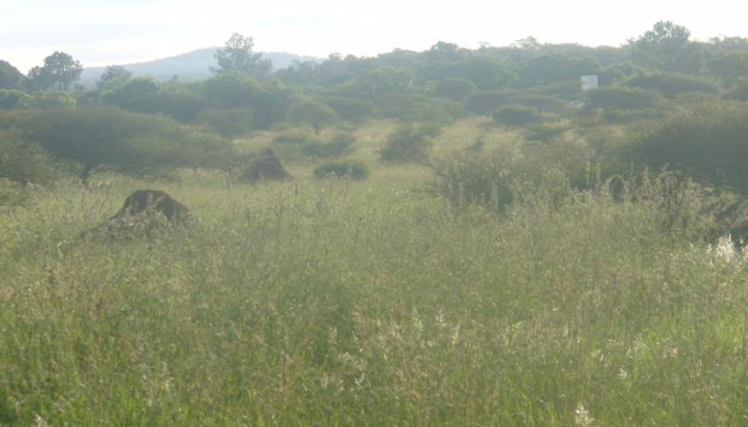
AK – National Weed List
– Encroacher of the natural rangeland

Slide 6
CTs may lower feed intake (FI) by reducing palatability (Reed, 1995)
Reduction in FI and palatability is associated with the astringency in the mouth of the animal (drying /puckering sensation)
“Palatability” is the stimulation to eat aroused by the feed (physical/chemical) ((Baumont, 1996)
DMI is also influenced by palatability (Tamir and Asefa, 2009)
Information on DMI and palatability of tannin-rich diet is equivocal.

Slide 7
The objective of this study was to determine the effects of dietary level of Acacia karroo leaf meal on voluntary feed intake, palatability and preference rankings of Pedi goats

Slide 8
METHODOLOGY
The study was conducted at the University of Limpopo experimental farm
5 goats were housed individually with 5 feeding trough each, in a cafeteria feeding approach described by Larbi et al. (1993)
Each goat had free access to the diet of their choice and position of trough was randomized each day to avoid “habit reflex”
The experiment lasted for 23days , consisting of a 15-day adaptation period and 8 days of data collection

Slide 9
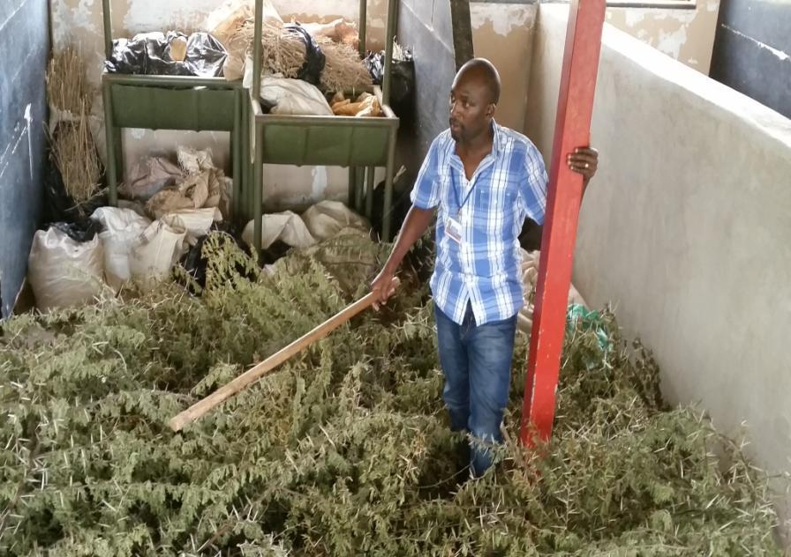

Slide 10
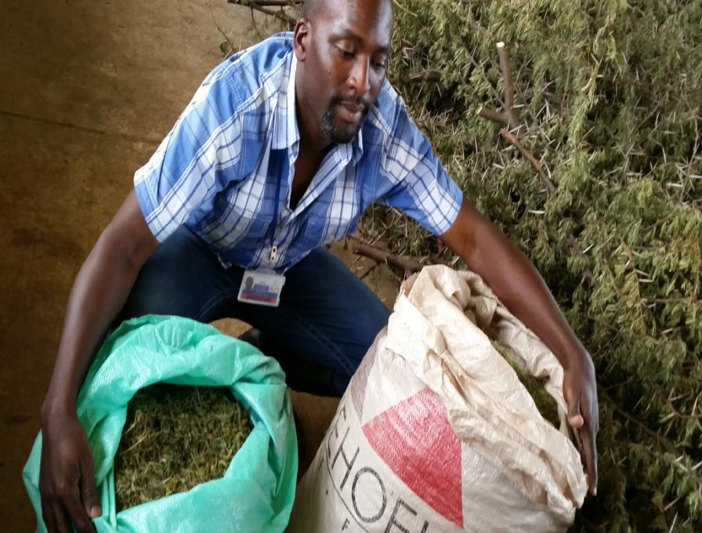

Slide 11
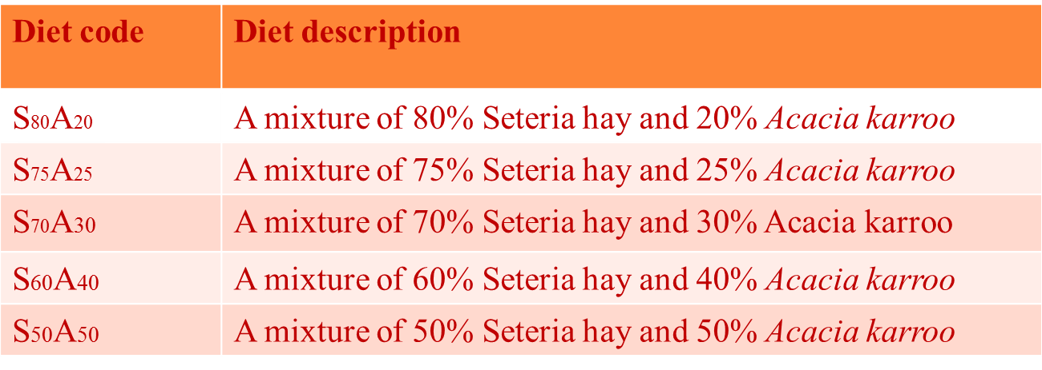
EXPERIMENTAL DIETS

Slide 12
DM, OM, CP and Ash (AOAC,2005)
Fibre components (Van Soest et al., 1994)
Total phenolic contents (Folin-Ciocalteus method and expressed as tannic acid equivalent-Makkar et al., 1993)
CTs content (Butanol-HCl method and expressed as leucocyanidin equivalent- Porter et al., 1993)
Mineral elements were analyzed by AOAC method using the Atomic Absorption Spectrophotometer

Slide 13
MEASUREMENT AND STATISTICAL ANALYSIS
A daily RPI was calculated for each diet by dividing the amount consumed by that of the highest value, and multiplying the result by 100 (Larbi et al., 1993)
These daily RPI values obtained for each diet were subjected to ANOVA (SAS, 2008) with feeds as treatments and individual animals as replicates in a CRD.
The diets were ranked based on these calculations with the highest consumption value being the most preferred and vice versa

Slide 14
Results and discussion
Nutritive value of dietary mixtures of Seteria verticillata grass hay and Acacia karroo leaves
Nutrient | S₈₀A₂₀ | S₇₅A₂₅ | S₇₀A₃₀ | S₆₀A₄₀ | S₅₀A₅₀ | SEM
DM | 95.24^{c} | 95.86^{b} | 94.05e | 95.21^{d} | 97.01ª | 0.000
OM | 91.52e | 91.56^{d} | 91.60^{c} | 91.67^{b} | 91.75ª | 0.000
CP | 8.90e | 9.16^{d} | 9.34^{c} | 9.84^{b} | 10.37ª | 0.13
Ash | 8.47 | 8.43 | 8.39 | 8.32 | 8.24 | 0.11
Fat | 1.12e | 1.20^{d} | 1.28^{c} | 1.45^{b} | 1.61ª | 0.04
ADF | 47.03ª | 46.12^{b} | 45.21^{c} | 43.39^{d} | 41.57e | 0.67
NDF | 69.90ª | 67.91^{b} | 65.91^{c} | 61.93^{b} | 57.94e | 0.42
CT | 0.41e | 0.51^{d} | 0.61^{c} | 0.82^{b} | 1.02ª | 0.017
TP | 0.39e | 0.49^{d} | 0.58^{c} | 0.78^{b} | 0.98ª | 0.003

Slide 15
Relative Palatability Index (RPI) rankings and average daily intake (g/kg W^{0.75}) of experimental diets by Pedi goats using cafeteria method
Diet | DMI (g/kg W^{0.75}) | RPI (%) | Preference ranking
S₈₀A₂₀ | 14.59^{c} | 23.65^{c} | 5
S₇₅A₂₅ | 20.00^{bc} | 31.97^{c} | 4
S₇₀A₃₀ | 30.14^{b} | 53.07^{b} | 3
S₆₀A₄₀ | 44.16ª | 81.83ª | 2
S₅₀A₅₀ | 52.38ª | 96.91ª | 1
SEM | 4.413 | 5.725

Slide 16
Prediction of dry matter intake (DMI) and relative palatability index (RPI) of Pedi goats offered mixtures of Seteria verticillata grass hay and Acacia karroo leaf meal
Factor | Y-variable | Formulae | r² | P
DMI (g/goat/day) | RPI | Y =1.702x + 2.601 | 0.71 | <0.0001
OM (%) | RPI | Y = 1.821x + 2.601 | 0.71 | <0.0001
CP (%) | RPI | Y = 8.913x + 9.983 | 0.72 | <0.0001
NDF (%) | RPI | Y = 2.463x – 1.135 | 0.71 | <0.0001
ADF (%) | RPI | Y = 3.021x + 0.412 | 0.71 | <0.0001
CT | RPI | Y =34.047x + 28.643 | 0.61 | <0.0001
TP | RPI | Y = 34.353x + 30.266 | 0.58 | <0.0001

Slide 17
IMPLICATION
High voluntary DMI of Diets S₆₀A₄₀ and S₅₀A₅₀ suggests that tannin-rich diets do not always depress intake
Reduced palatability in tannin-rich plants may be related to the type than the amount of tannins present in browse species
Nutrient content could be a definitive predictor of intake and palatability of forage-rich diets
Palatability studies could be used in designing supplemental feeding programs for ruminants in the tropics

Slide 18
THANK YOU!

