Slide 1
About OMICS Group
OMICS Group International is an amalgamation of Open Access publications and worldwide international science conferences and events. Established in the year 2007 with the sole aim of making the information on Sciences and technology ‘Open Access’, OMICS Group publishes 400 online open access scholarly journals in all aspects of Science, Engineering, Management and Technology journals. OMICS Group has been instrumental in taking the knowledge on Science & technology to the doorsteps of ordinary men and women. Research Scholars, Students, Libraries, Educational Institutions, Research centers and the industry are main stakeholders that benefitted greatly from this knowledge dissemination. OMICS Group also organizes 300 International conferences annually across the globe, where knowledge transfer takes place through debates, round table discussions, poster presentations, workshops, symposia and exhibitions.

Slide 2
About OMICS Group Conferences
OMICS Group International is a pioneer and leading science event organizer, which publishes around 400 open access journals and conducts over 300 Medical, Clinical, Engineering, Life Sciences, Pharma scientific conferences all over the globe annually with the support of more than 1000 scientific associations and 30,000 editorial board members and 3.5 million followers to its credit.
OMICS Group has organized 500 conferences, workshops and national symposiums across the major cities including San Francisco, Las Vegas, San Antonio, Omaha, Orlando, Raleigh, Santa Clara, Chicago, Philadelphia, Baltimore, United Kingdom, Valencia, Dubai, Beijing, Hyderabad, Bengaluru and Mumbai.

Slide 3
The Editor as Auteur
The Modern Primacy of Editors and Preditors
Dan Smith, Mt. San Antonio College, Walnut, California

Slide 4
Auteur Theory of Film
Because the Director is involved in all three phases of production, the Director can be considered the Author (Auteur) of the film
Notes:
Originated in France in the 1950’s, accepted as one of the key characteristics of theatrical film art.
But Television is different, and increasingly influences the film world for both technological and business reasons. 3 Phases: Pre-Production, Principal Photography and Post-Production

Slide 5
Nonlinear filmmaking
“Nonlinear filmmaking” (Lucas) involves writing and shooting after principal photography, as a result of needs made apparent in the editing work.
Scenes are cut during Production, and VFX are built while live-action scenes are being shot.

Slide 6
Editing functions now occur during all phases of production, not just Post Production
Editing Timelines are built during preproduction, often in the form of Previz, or Pre-Visualization
Notes:
Previz occurs during Preproduction. Comparable to a Storyboard

Slide 7
Previz
Previz is used to assemble an editing timeline in Pre-Production.
As Principal Photography and Visual Effects are completed they are put into the timeline.
Notes:
For large-budget epics change becomes difficult, because VFX are worked on in parallel with production.
Spiderman example: Toby Maguire couldn’t move through the set during a scene, because the budgeted-and-bid VFX would have to be redone if his blocking were changed.

Slide 8
Many filmmakers then insert principal photography footage into the timeline after each take, and decide upon subsequent takes based upon the resulting edit.
Notes:
Example: David Fincher on Zodiac.

Slide 9
Cable miniseries increasingly function like motion pictures, with Previz to minimize expenditures, and a unique editing rhythm to give the show a distinctive “feel”
Notes:
Game of Thrones example: all scenes budgeted from Previz, which led to choice of locations OR
True Detective example: single 500+-page script broken down into smaller pieces. True Detective: Rough cuts were made on set, and second unit shoots were done to secure the shots needed for the edit.
Temp music was added. After Director Cary Fukunaga supervised the initial cuts, Showrunner Nic Pizzolatto then became involved in supervising the final edits. Only then was the temp music replaced by T-Bone Burnet’s score

Slide 10
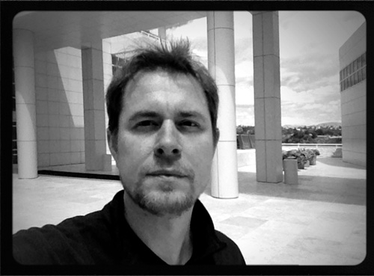
“’True Detective’ was a
show about storytelling
and narrative itself as much as
anything else, so playing with the timelines, points of view and flow of information was elemental to the story. Most of the shifts in time were ‘baked in’ to the screenplays but there were many occasions where we created new segues or omitted scripted ones as we explored and ‘rewrote’ in the cutting room.”-Alex Hall, Editor

Slide 11
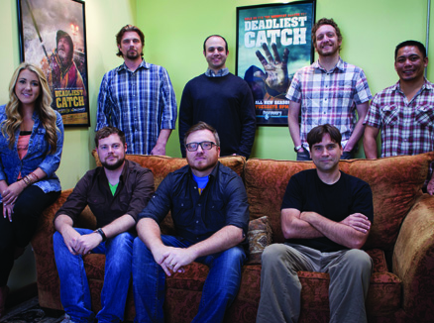
Reality Shows
Reality Shows are
shot, then the script is
assembled by the Story Editor while the show is edited. The Story Editor functions as a Post Production Supervisor in many cases.
Notes:
Conflict is emphasized by selective editing. Contestants who get along find their footage left out.
Deadliest Catch edits 17 episodes from 26,000 hours of footage, so the story structure for each episode must be found in the editing process by Supervising Editor Josh Earl. He uses notes from the Shooter/Producers on each boat.

Slide 12

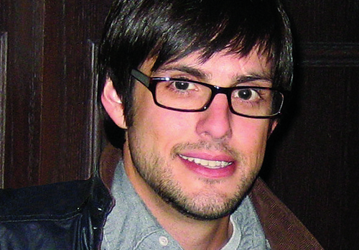
Sitcoms and 1-Hour dramas
Most still function in the traditional manner at broadcast and cable networks, with variations, such as “Brooklyn Nine-Nine”
Notes:
Usually directors work on a Director’s cut for 4 days, and turn it over to the Showrunner. Showrunners are often Writer/Producers.
Brooklyn Nine-Nine and The Office examples: Shows are overwritten by as much as 40 pages, and improvised “fun run” takes. The editors then cut the episodes to fit the broadcast time slot, modifying act structure and content. Then a second (longer edit) is made for the online version.

Slide 13
News
News segments are re-used throughout a longer news cycle; clips are re-used each time there’s a further development in the story.
Research is often done by combing social media for not only news but the clips used in the story. Thus editors acquire the footage, not paid shooters.
Notes:
Strangely, interns and Video News Releases become key providers of footage under this model.

Slide 14
Web Production
Web Production clip shows assembled by editors are common; tagging of links from other clips are done using editing crew on social media

Slide 15
Advertising
Advertising images are composited, with the editor creating the final product
Notes:
The storyboard has been the starting point for ads since the beginning, so Previz is simply a modern version of standard practice since the 1950’s.

Slide 16
Program Length
Program times can now vary, rather than being tied to a single length. The Editor is concerned with effectiveness of the presentation, not a predetermined time.

Slide 17
The Rise of the Preditor
Preditors are Producer/Editors. They are responsible for their shows, and control the creative content. This addresses the lower budgets that resulted from smaller audiences for all shows. Examples abound in Reality Shows, but they are also prominent in online series.

Slide 18
The Modern Editor
Editing (picture)
Sound
Music
Graphics
Animation
VFX
Composition
Deliverables
Skills for Editors now include all software needed to post a production:
Notes:
While this bevy of skills means more training is needed for editors than ever before, it also means that they can edit an entire show themselves. This one-person approach saves money and allows flexibility.
It also allows for editing in shifts. Rather than incurring overtime costs, editors leave after 8 hours and turn over the job to the evening or overnight editor.

Slide 19
The Future is Now
Make a 3D space with multiple cameras, and create your shots after shooting is done.
The proximity of the shots as well as the angles can be chosen in the edit bay. Thus, not only the director but the editor can shoot the picture.
Notes:
Software integration, such as James Cameron’s Fusion system, allows upwards of 100 cameras to be used in creating a 3D space in the computer.

Slide 20
Questions?
Dan Smith
dsmith@mtsac.edu

