Slide 1
BREAST CANCER IN YOUNG AGE (≤40 YEARS): THE UNIVERSITY OF TENNESSEE MEDICAL CENTER AT KNOXVILLE 10 YEAR EXPERIENCE
Snyder D, Heidel RE, Panella T, Bell J, Orucevic A
University of Tennessee Medical Center – Knoxville
Departments of Pathology, Surgery, and Medicine
The Graduate School of Medicine
The Department of Pathology

Slide 2
BACKGROUND
Breast cancer is most common invasive cancer in women worldwide
Second leading cause of death from cancer among women
Approx. 11,000 cases/year in US younger than 40¹
5-7% of all breast cancer cases are < age 40²
Breast cancer in ≤40y/o associated with more aggressive behavior and higher mortality than in older age.^{1,3}
¹Lee H, Han W. 2014, J Breast Cancer, 17(4): 301-307.
²Reyna C, Lee M. 2014, J Multidiscip Healthc, 7: 419-429.
³Pilewskie M, King T. 2014, J Surg Oncol, 110:8-14.

Slide 3
POOR PROGNOSTIC FACTORS
“Unfavorable” ER/PR/HER2 phenotype⁴
Triple negative (ER-/PR-/HER2-)
HER2+ (traditionally considered “unfavorable”, but new reports show benefit of Herceptin on overall survival)⁴
Young age (≤40) at time of diagnosis^{2,5,6}
More advanced stages
Higher grade tumors
More lymphovascular invasion
More often “unfavorable” phenotype
Non-Caucasian race²
²Reyna C, Lee M. 2014, J Multidiscip Healthc, 7: 419-429.
⁴Ross, JS., et al. 2009. The Oncologist, 14(4): 320-368.
⁵Slamon, D., et al. 2011. N Engl J Med, 365(14): 1273-1283.
⁶Collins, L., et al. 2012. Breast Cancer Res Treat, 131: 1061-1066.

Slide 4
OBJECTIVE
Young (≤40) Caucasian female patients from our institution
10 year period (1/1/1998-7/1/2008), last follow-up date 8/1/2013
Evaluated prognostic value on overall survival of:
Pathologic tumor characteristics
ER/PR/HER2 subtypes
TNM Stage
Analyzed type of therapy received

Slide 5
METHODS
Complete data was available for 80 ≤40 y/o Caucasian females with breast cancer
Divided into five ER/PR/HER2 groups based on 2011 St. Gallen International Consensus Panel classification system⁷
Luminal A like group (ER+ and/or PR+, HER2-, low Ki67)
Luminal B/HER2- like group (ER+ and/or PR+, HER2-, high Ki67)
Luminal B/HER2+ like group (ER+ and/or PR+, HER2+)
Non-luminal HER2+ like group (ER-, PR-, HER2+)
Triple negative like group (ER-, PR-, HER2-)
⁷Goldhirsch A, et al. 2011. Ann Oncol, 22(8):1736-1747.

Slide 6
80 ≤40 y/o BC patients
41% (33/80) ER+/PR+/HER2-
31% (25/80) ER+/PR+/HER2+ or ER-/PR-/HER2+
28% (22/80) ER-/PR-/HER2-
“Favorable” subtype
“Unfavorable” subtypes
Distribution of patients into ER/PR/HER2 subtypes

Slide 7
METHODS (cont.)
Frequency statistics, Kaplan-Meier and multivariate Cox regression curves measured impact on overall survival by
Pathologic tumor characteristics
Effect of ER/PR/HER2 subtype
TNM stage

Slide 8
RESULTS
Majority presented with grade 3 invasive BC (67%) and TNM stage II (50%)
ER+/PR+/HER2- ("favorable") | 33/80 (41%)
ER+/PR+/HER2+ or ER-/PR-/HER2+ ("unfavorable") | 25/80 (31%)
ER-/PR-/HER2- ("unfavorable") | 22/80 (28%)
Mastectomy (modified radical or total) | 54/80 (67.9%)
Breast conserving surgery | 23/80 (29%)
Post-surgery radiation | 37/80 (46.1%)
Post-surgery adjuvant chemotherapy | 66/80 (82%)
ER+ patients receiving hormonal therapy | 37/49 (76.5%)
Patients with negative lymph nodes | 38/80 (47.5%)
Average number of retrieved lymph nodes | 12.3
Notes:
Mastectomy on young; More rad than conserving; Only er+ 75% received – interesting in theory all should

Slide 9
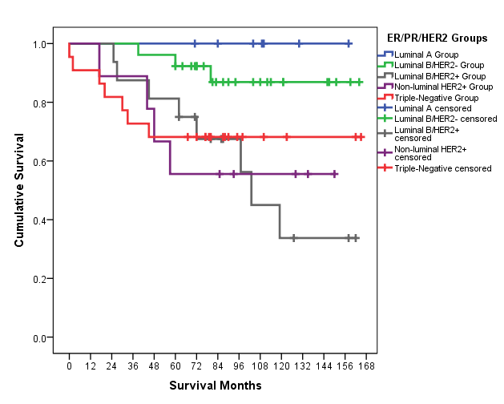
RESULTS (cont.)
Kaplan Meier curve.
Patients with ER+/PR+/HER2- subtype had significantly better OS than ER-/PR-/HER2- or ER+/PR+/HER2+ (p=.035) in univariate analysis

Slide 10
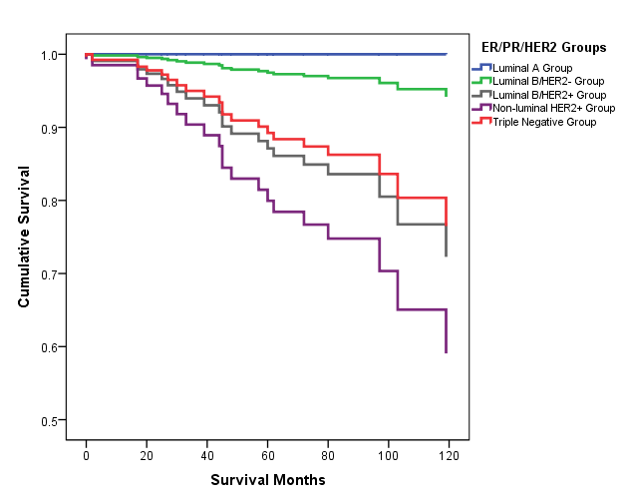
RESULTS (cont.)
Cox Regression curve.
When ER/PR/HER2 subtype was controlled for TNM stage and grade in multivariate analysis, only TNM stage was a significant predictor of OS (p<.001)

Slide 11
Summary of results
Majority of our young patients presented with high grade and Stage II breast carcinomas
Treatments:
Surgery: 67.9% of patients underwent mastectomy
Postsurgical treatments:
46.1% received radiation therapy
82% received chemotherapy
76.5% ER+ received hormonal therapy
Patients with ER+/PR+/HER2- (“favorable”) subtype had significantly better OS than ER-/PR-/HER2- (triple negative) or ER+/PR+/HER2+ (triple positive)
When ER/PR/HER2 subtype was controlled for TNM stage and grade in multivariate analysis, only TNM stage was a significant predictor of OS

Slide 12
DISCUSSION
We showed for the first time in this sub-cohort (≤40 y/o) of our Caucasian female breast carcinoma patients that “unfavorable” triple negative ER/PR/HER2 subtype and traditionally considered unfavorable HER2+ subtype were significant predictor of worse overall survival in univariate analysis.
Notes:
Small size, race, classification breakdown

Slide 13
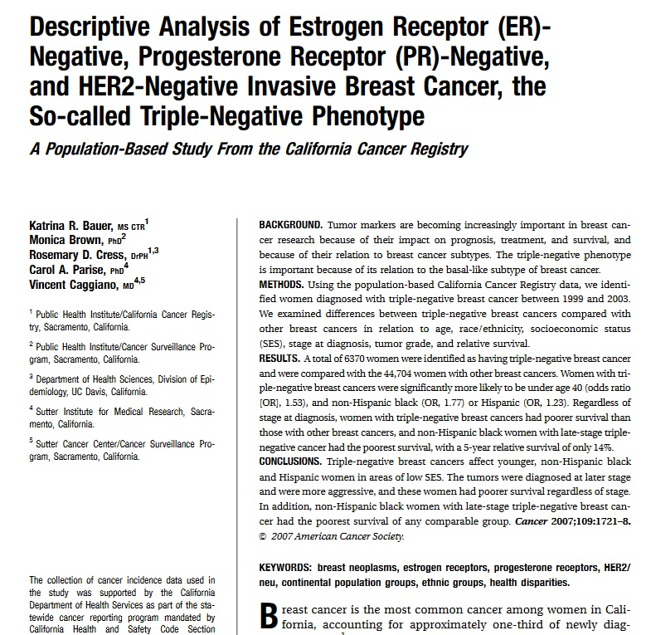
DISCUSSION
Other researchers:
“Triple-negative breast cancers…were more aggressive”
“these women had poorer survival regardless of stage”
“Triple-negative breast cancers (most commonly) affect younger, non-Hispanic and Hispanic women in areas of low SES.”
⁶ Bauer K., et al. Cancer. 2007;109:1721-1728.
Notes:
Small size, race, classification breakdown

Slide 14
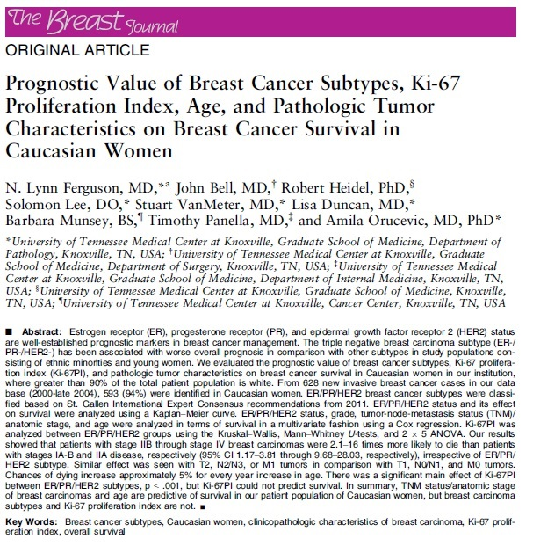
DISCUSSION
However, in multivariate analysis (controlling for TNM stage and grade), ER/PR/HER2 subtype was not significant predictor of OS, but TNM stage was significant predictor of OS.
These results are in concordance with our previously published data on the effects of ER/PR/HER2 on OS⁸
⁸Ferguson, NL., et al. Breast J. 2013; 19(1)22-30.
Notes:
Small size, race, classification breakdown

Slide 15
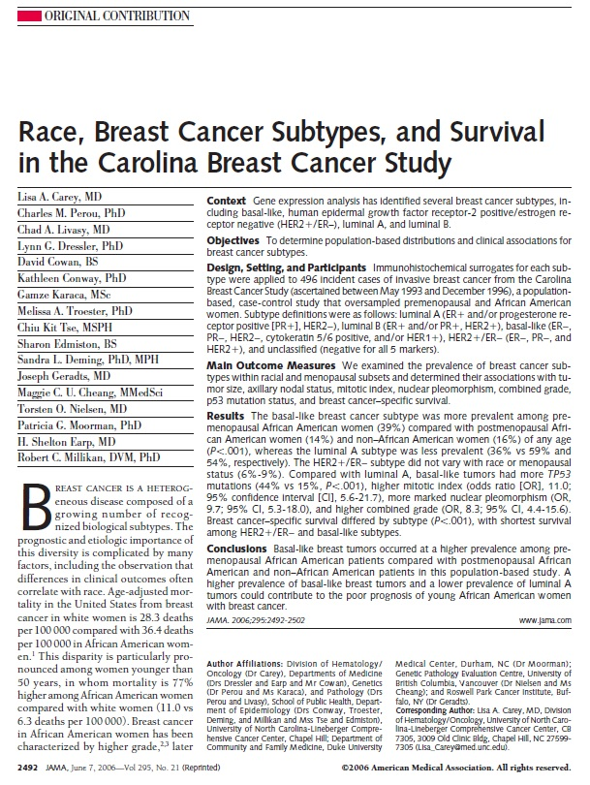
DISCUSSION
Possible causes for the differences in our findings compared to other researchers:
Population differences – we only studied young Caucasian females, while other studies included all ethnicities
Carolina Breast Cancer Study:
Triple-negative BC more common in pre-menopausal African Americans compared to non-African Americans
(39% vs 16%)
⁹ Carey L., et al. JAMA 2006, 295:2492
Notes:
Small size, race, classification breakdown

Slide 16
DISCUSSION
Other possible causes:
Differences in time period of studies – significant improvements in therapies over the last two decades
Type of classification system used (St. Gallen vs others)
Sample size
Notes:
Small size, race, classification breakdown

Slide 17
CONCLUSIONS
TNM staging for breast cancer is a relevant prognostic marker in ≤40 y/o Caucasian females with breast carcinoma.
ER/PR/HER2 status is probably relevant for prognosis, but is likely influenced by other variables.
Further studies on a larger scale such as NCDB and SEER database analysis are warranted that will systematically analyze impact of race, and different ER/PR/HER2 classification systems on overall survival in this particular age group.
These analyses should be performed in the same time period as our study was performed.
Notes:
So ER/PR/HER2 while it may be relevant for prognosis in certain populations, is not as relevant in Caucasians.

Slide 18
THANK YOU!

Slide 19
References
1. Lee, H., and Han, W. “Unique Features of Young Age Breast Cancer and Its Management.” J Breast Cancer. 2014; 17(4):301-307.
2. Reyna C, Lee M. “Breast cancer in young women: special considerations in multidisciplinary care.” J Multidiscip Healthc. 2014; 7: 419-429.
3. Pilewskie M, King T. “Age and Molecular Subtypes: Impact on Surgical Decisions.” J Surg Oncol. 2014; 110:8-14.
4. Ross, JS., et al. “The HER-2 receptor and breast cancer: ten years of targeted anti-HER2 therapy and personalized medicine.” The Oncologist. 2009; 14(4): 320-368.
5. Slamon, D., et al. “Adjuvant Trastuzumab in HER2-Positive Breast Cancer.” N Engl J Med. 2011; 365(14): 1273-1283.
6. Bauer K., et al. “Descriptive analysis of estrogen receptor (ER)-negative, progesterone receptor (PR)-negative, and HER2-negative invasive breast cancer, the so-called triple-negative phenotype. Cancer. 2007;109:1721-1728.
7. Goldhirsch A., et al. “Strategies for Subtypes-Dealing with the Diversity of Breast Cancer: Highlights of the St Gallen International Expert Consensus on the Primary Therapy of Early Breast Cancer 2011.” Ann Oncol. 2011; 22(8):1736- 1747.
8. Ferguson, NL., et al. “Prognostic value of breast cancer subtypes, Ki-67 proliferation index, age, and pathologic tumor characteristics on breast cancer survival in Caucasian women.” Breast J. 2013; 19(1)22-30.
9. Carey LA., et al. “Race, breast cancer subtypes, and survival in the Carolina Breast Cancer Study.” JAMA. 2006, 295:2492

