Slide 1
Design, Synthesis, Docking and 2D QSAR studies of novel 3,5-diaryl Pyrazole Derivatives and their evaluation as Antioxidants and as Immunomodulators, inhibitors of TNF-α, IL-2, IL-6
Dr Dalia Soliman
Assoc. Proff. Of Pharmaceutical Chem.
Egyptain Russian University/AlAzhar University
Cairo, Egypt

Slide 2
Introduction
Orally active small molecules that modify the pro-inflammatory cytokine release associated with many auto-immune disorders such as rheumatoid arthritis (RA) have generated considerable interest in the pharmaceutical industry. They offer a cost-effective and convenient alternative to biologics such as Enbrel, Remicade, Humira and Kineret
These agents are expensive, parenterally administered. They are also under review for increased risk of cancer, infection, multiple sclerosis, and for the potential to induce neutralizing antibodies over the long term

Slide 3
Tumor necrosis factor-α (TNF-α), one of the major pro-inflammatory cytokines, has been proven to be a potential target for these agents. TNF-α has been called a sentinel cytokine or “the body's fire alarm”
The overexpression of TNF-α has been implicated in a number of serious inflammatory disorders such as rheumatoid arthritis, multiple sclerosis, inflammatory bowel disease, graft-versus-host disease, and adult respiratory distress syndrome.
TNF-α is a strong inducer of other pro-inflammatory cytokines such as interleukins IL-1, IL-6 and IL-8

Slide 4
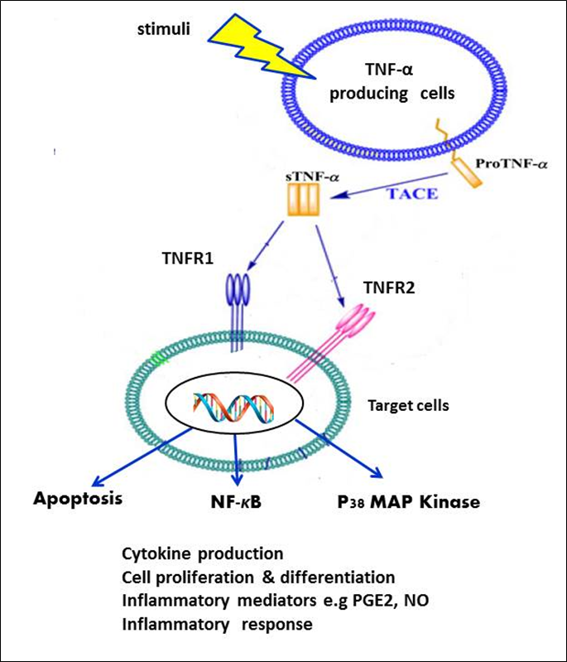
Figure (1): Receptor binding and biological actions of TNF-α (Chem Biol Drug Des 2010)

Slide 5
IL-6 is a potent pro-inflammatory agent that plays a crucial role in the pathogenesis of systemic inflammatory disease. Targeting this pathway in rheumatoid arthritis (RA) seems an attractive route as IL-6 is important for both joint destruction and systemic manifestations.
It promotes inflammatory events through the expansion and activation of T cells and the differentiation of B cells.
IL-6 blockade is a major advancement in the treatment of RA as it targets a unique molecule.

Slide 6
IL-2 proved to play a pivotal role in regulating immune response, its suppression has been widely used to prevent allograft rejection in organ transplantion.
IL-2 inducible T-cell kinase (ITK) has been found to play an important role in T-cell activation and proliferation, where it is primarily expressed.
Therefore, ITK represents a novel potential target for anti-inflammatory therapy in a variety of indications such as psoriasis and allergic asthma.

Slide 7
P38-α also known as cytokine-suppressive anti-inflammatory drug binding protein (CSBP), is a member of the mitogen activated protein (MAP) kinase family that is involved in stress and inflammatory response signal transduction pathways.
It is critical for the production and activity of multiple pro-inflammatory cytokines, including TNF-α, IL-1, IL-6, and IL-8, in cells such as macrophages, monocytes, synovial cells, and endothelial cells.

Slide 8
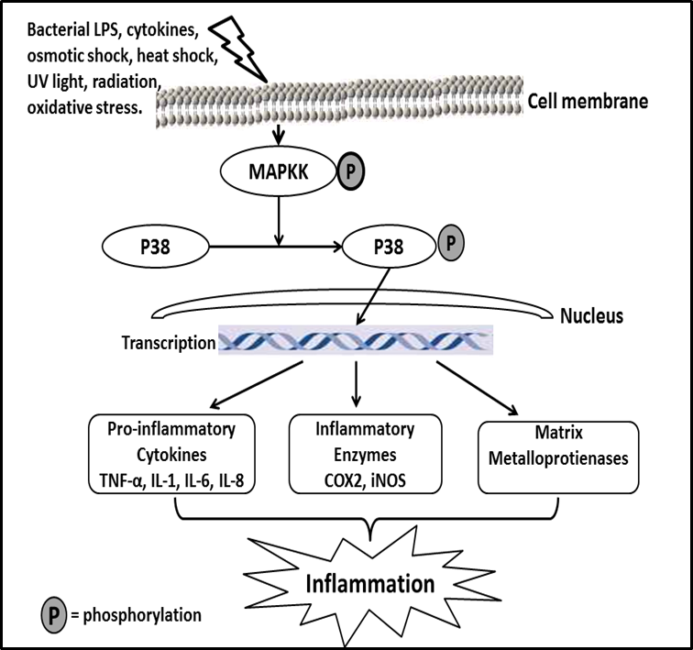
Figure (2): P38 MAPK regulation of inflammation (Pharmacol Ther 1999)

Slide 9
Therefore, inhibition of these targets has become a major focus of current drug discovery and development in treatment of severe inflammatory disorders.

Slide 10
Examples of pyrazole based scaffolds as immunomodulators

Slide 11
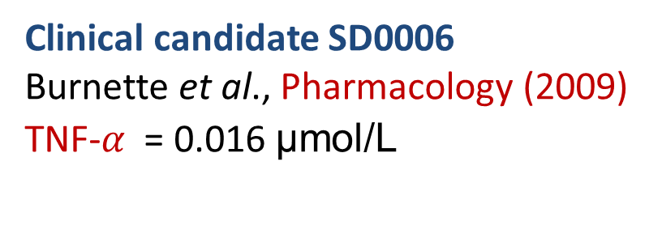
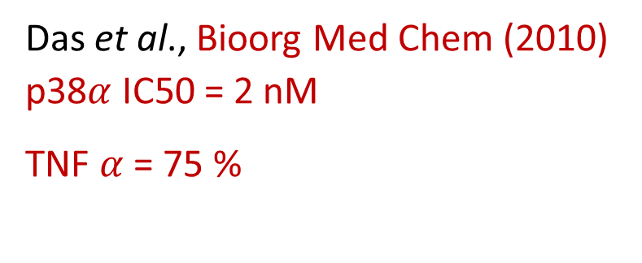
Clinical candidate SD0006
Burnette et al., Pharmacology (2009)
TNF-$α$= 0.016 μmol/L
Das et al., Bioorg Med Chem (2010)
p38$α$ IC50 = 2 nM
TNF $α$= 75 %

Slide 12
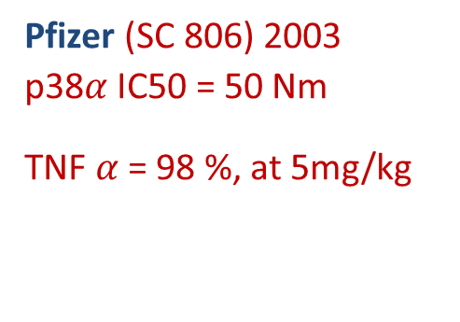
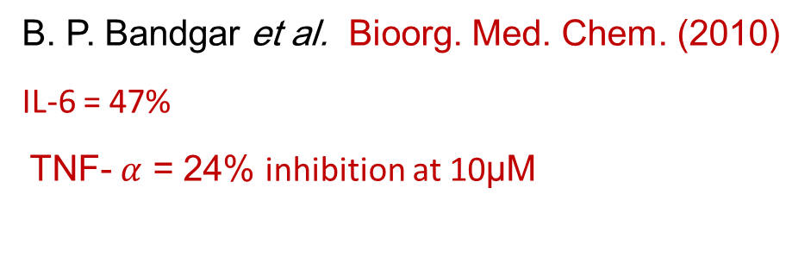
Pfizer (SC 806) 2003
p38$α$ IC50 = 50 Nm
TNF $α$= 98 %, at 5mg/kg
B. P. Bandgar et al. Bioorg. Med. Chem. (2010)
IL-6 = 47%
TNF- $α$ = 24% inhibition at 10μM

Slide 13
IL-2
BTP-3 = 314 nM
BTP-1= 417 nM
Wu Chen et al., Cellular Immunology (2002)

Slide 14
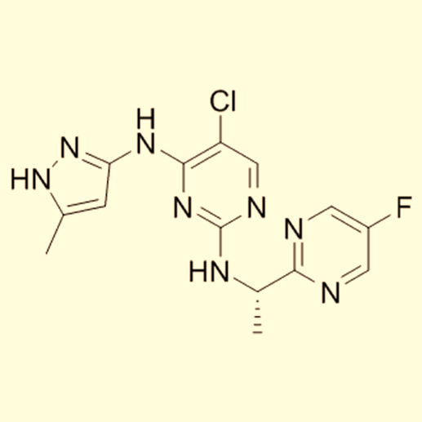
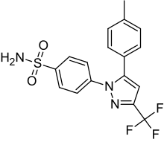
IL-6
Celecoxib
Liu Y et al., Cancer Prev Res (Phil 2011) Wang et al., Oncol Rep (2014)
Scuto et al., Leukemia (2011)

Slide 15
Aim of The Work

Slide 16
Fig (3): Some representative examples of pyrazole-based cytokine inhibitors and the novel
compounds

Slide 17
Synthesis

Slide 20
Biological Evaluation

Slide 21
In vivo TNF-α, IL-2, IL-6 Assay In Rat (Acute LPS Model)
The novel compounds were evaluated for their ability to inhibit LPS-induced production of TNF-α, IL-2 and IL-6 in rat at 30 mg/kg p.o.
Enzyme-linked immunosorbent assay kit, life science inc. (E90133Ra), (E90073Ra), (E90079Ra).
Dexamethasone was used as a reference drug.

Slide 22
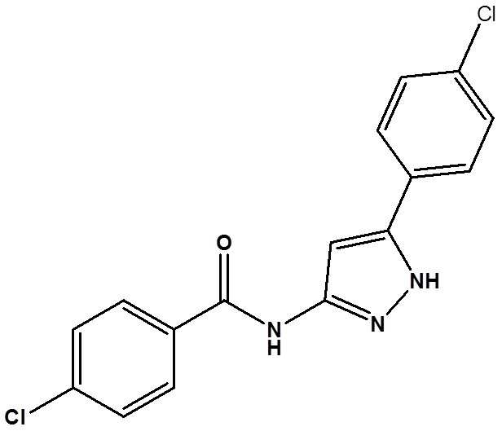
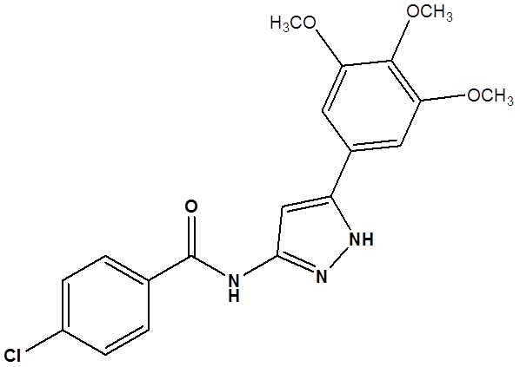
TNF-α
6a = 47%
6i = 50%
Dexamethasone = 63%
6f = 48%

Slide 23


IL-2
6f = 58 %.
6i = 60 %
6g = 62 %
Dexamethasone = 66%

Slide 24
IL-6
6f = 42 %
6i = 45 %
Dexamethasone = 57 %

Slide 25
Antioxidant Activities

Slide 26
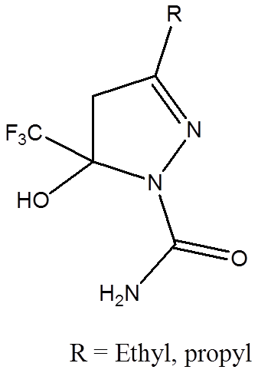
Increased generation of reactive oxygen species (ROS) has been observed in degenerative diseases. It has been reported that the pyrazole core possesses radical-scavenging ability and even its modulation in inflammatory response was sometimes related to its considerable antioxidant activity.
Tarun et al., International journal of Research in Pharmacy and Science (2012)

Slide 27
Moreover, it has been reported that certain antioxidants reduce LPS-induced inflammation and fever.
Glutathione peroxidase is an important enzyme in cellular antioxidant defense systems, detoxifying peroxides and hydroperoxides.
If GPX activity is decreased, more hydrogen peroxide is present, which leads to direct tissue damage and activation of nuclear factor-κB–related inflammatory pathways.

Slide 28
Superoxide Dismutase (SOD) is one of the most important antioxidative enzymes.
It catalyzes the dismutation of the superoxide (O₂⁻) radical into either ordinary molecular oxygen (O₂) or hydrogen peroxide (H₂O₂).

Slide 29
Antioxidant Activities
Glutathione Peroxidase Cellular activity Assay Kit was used to measure GPX.
LPS reduced it by 52%
Dexamethasone 51 %
All the tested compounds reduced GPX by 45-47 %.
Superoxide Dismutase Activity Assay KIT
LPS reduced it by 64%
Dexamethasone 62 %
All the tested compounds reduced SOD in the range 57-52 %
Finally, Compound 6i reduced the enzyme by 57%.

Slide 30
2D QSAR Studies

Slide 31
Development of QSAR Models
QSAR analyses for inhibitory activities of the synthesized pyrazole derivatives against TNF-α, IL-2 and IL-6 were performed in order to determine the crucial factors governing this activity. The analysis was run by means of the DS 2.5 software (Discovery Studio 2.5, Accelrys, Co., Ltd., San Diego, CA, USA).
Training set was prepared from the synthesized compounds with their measured pIC50s
“Calculate Molecular Properties” module was used for calculating different molecular properties for the training set compounds

Slide 32
Genetic function approximation (GFA) was utilized to search for the best possible QSAR regression equation capable of correlating the variations in the biological activities of the training compounds with variations in the generated descriptors
multiple linear regression modeling (MLR)
QSAR model was validated employing leave one-out cross-validation, r2 (squared correlation coefficient value) and r2 prediction (predictive squared correlation coefficient value), residuals between the predicted and experimental activity of the test set and training set

Slide 33
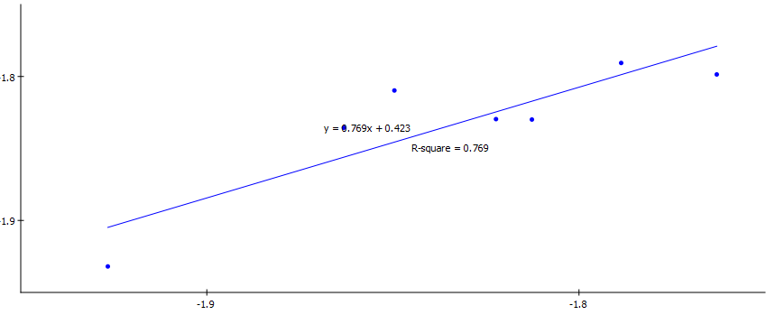
TNF-α
Predicted pIC50
Experimental pIC50
Fig (4) Predicted versus experimental PIC50 of the tested compounds against TNF-α according to equation 1 r² = 0.769, r² (prediction) = 0.654, Least square error = 0.000572
Equation (1) representing the best performing QSAR model for the activity
against TNF-α:
-logIC50 = - 1.42953 – 0.16598 SC_3_C – 0.0033134 Jurs_WNSA_2.

Slide 34
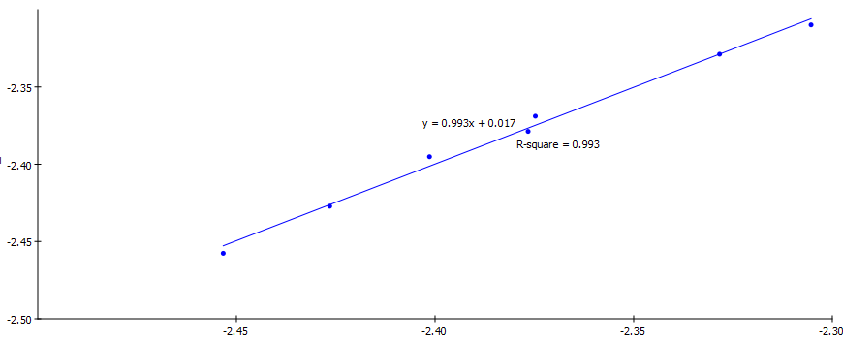
IL-2
Predicted pIC50
Experimental pIC50
Fig (5): Predicted versus experimental pIC50 of the tested compounds against IL-2 according
to equation 2 r² = 0.993, r² (prediction) = 0.892, Least square error = 0.0054
Equation (2) = -2.2525 + 0.00049194 PMI_Y − 0.0039522 Molecular_Volume

Slide 35
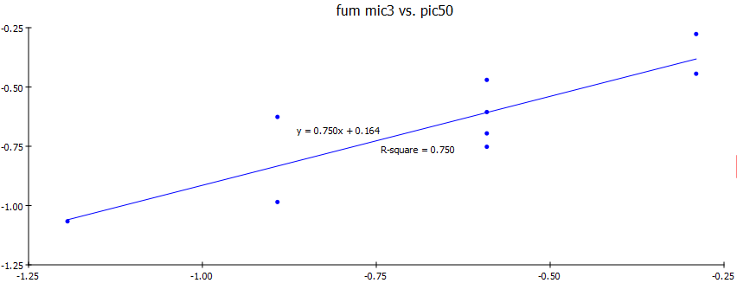
IL-6
Predicted pIC50
Experimental pIC50
Fig (6) Predicted versus experimental pIC50 of the tested compounds against IL-6 according
to equation 3 r² = 0.750, r² (prediction) = 60, Least square error = 0.019
Equation (3) = -2.0117 − 0.36899 Kappa_3_AM + 0.00066893 PMI_Y

Slide 36
Docking Studies

Slide 37
IL-2

Slide 38
Schematic representation of important interactions between SB 203580 and ITK.
Fig (7). The structure and binding mode into the active site of ITK

Slide 39
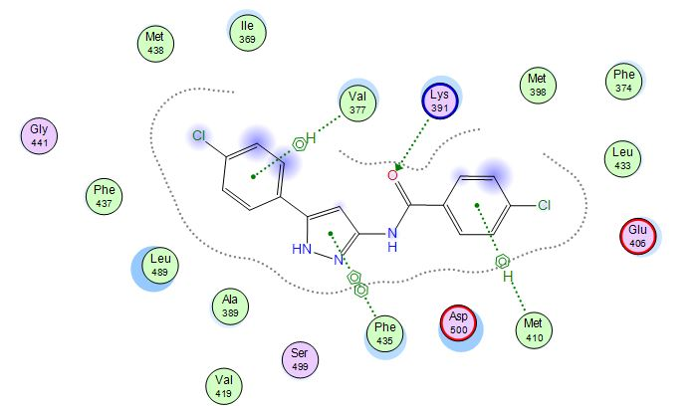
Fig (8) : Binding interactions of 6i into the active site of ITK (PDB ID: 1SM2).The important
amino acid residues are shown together with their respective number.
S =-11.721, E-Conf = -6.627 Kcal/mol, RMSD = 1.014

Slide 40
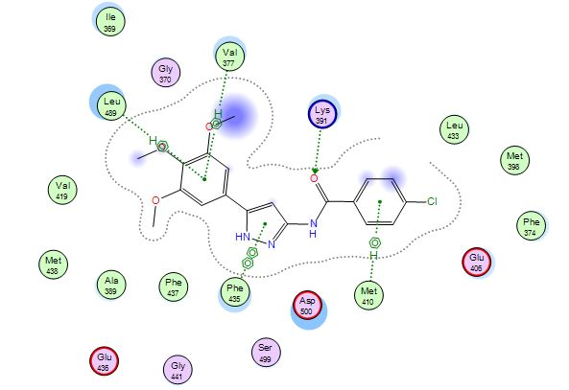
Fig (9). Binding mode of 6f into the active site of ITK (PDB ID: 1SM2). The important amino acid residues are shown together with their respective number.
S = -13.221, E-Conf = -3.626 Kcal/mol, RMSD = 1.26

Slide 41
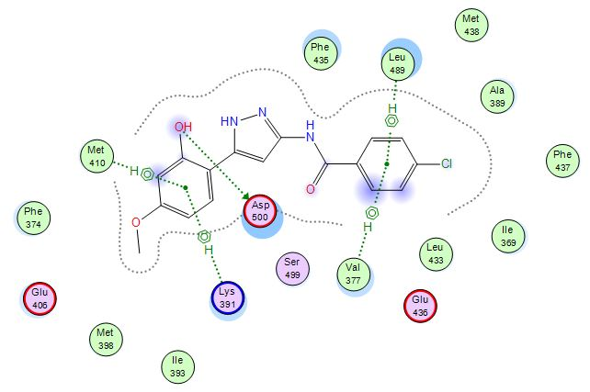
Fig (10): Binding mode of 6f into the active site of ITK (PDB ID: 1SM2). The important amino acid residues are shown together with their respective number.
S = -12.991, E-Conf = -5.442 Kcal/mol, RMSD = 1.454

Slide 42
TNF-α

Slide 43
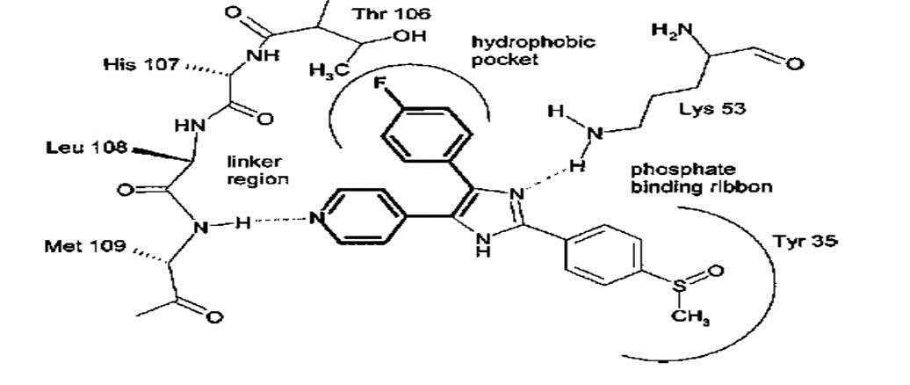
Schematic representation of important interactions between SB 203580 and p38α.
Thr 106
Hydrophobic
pocket
linker
region
Met 109
Phosphate binding ribbon
Med Res Rev. 2006, 26, 1-62.

Slide 44
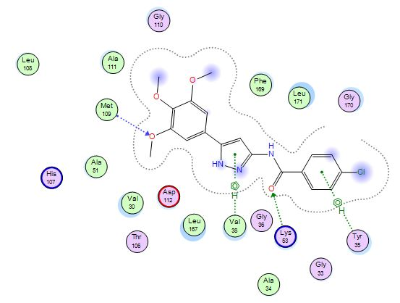
Fig (11): Binding interactions of 6f into the active site of p38α (PDB ID: 1GM2). The important amino acid residues are shown together with their respective number.
S = -13.59, E-Conf = -4.842 Kcal/mol, RMSD = 0.843
-

Slide 45
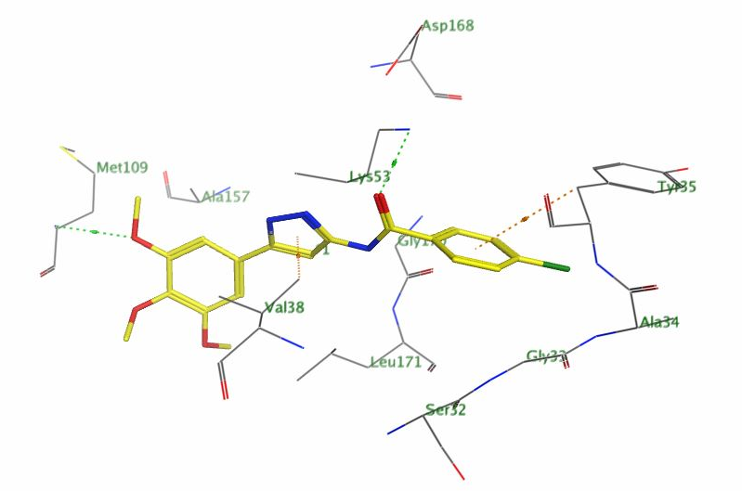
Fig (12): 3D representation of binding interactions of 6f within the active site of p38α (PDB ID: 1GM2). The important amino acid residues are shown together with their respective number.

Slide 46
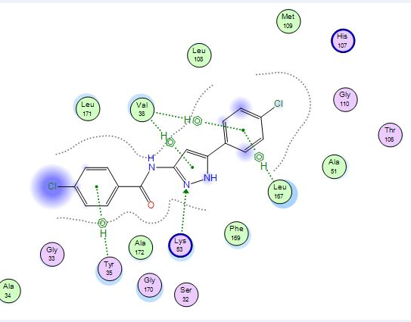
Fig (13): Binding interactions of 6i into the active site of p38α (PDB ID: 1GM2). The important amino acid residues are shown together with their respective number.
S = -11.650, E-Conf = -3.842 Kcal/mol, RMSD = 2.23
-

Slide 47
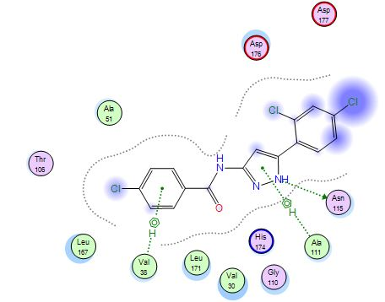
Fig (14): Binding interactions of 6j into the active site of p38α (PDB ID: 1GM2). The important amino acid residues are shown together with their respective number.
S = -11.897, E-Conf = 1.032, Kcal/mol, RMSD = 1.762
-

Slide 48
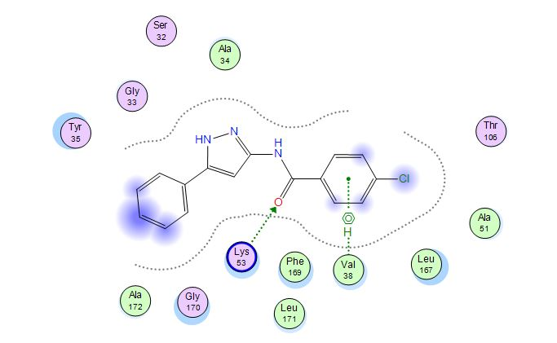
Fig (15): Binding interactions of 6a into the active site of p38α (PDB ID: 1GM2). The important amino acid residues are shown together with their respective number.
S = -13.11, E-Conf = 1.184, Kcal/mol, RMSD = 1.184
-

Slide 49
Conclusions
In an attempt to generate 3,5-diaryl pyrazoles as
immunomodularors through inhibition of multiple
pro-inflammatory cytokines such as TNF-α, IL-2, and IL-6 novel
derivatives were synthesized and evaluated against these
cytokines.
Compounds 6i and 6f demonstrated significant inhibitory
activities against the three cytokines compared to
the reference dexamethasone.
A 2D QSAR model was generated for each of these activities
where the models were characterized by high correlation
coefficient values and good predictive ability.
The biological results were in agreement with docking
scores and binding interactions into the active sites of the
enzymes.
.

Slide 50
Synthesis: Al-Azhar University, Pharmaceutical Chemistry Department.
Biological evaluation: Biochemistry lab at Animal Reproduction Institue.
In Silico studies: were performed on MOE.10 and DS 2.5 softwares.

Slide 51
Thank you

