Slide 1

Clinical Outcome of Reconstruction With Tissue Expanders for Patients With Breast Cancer and Mastectomy
Mitsui Memorial Hospital
Department of Breast and Endocine surgery
Daisuke Ota

Slide 2
No financial support for this study was provided.
The authors report no conflicts of interest.

Slide 3

The incidence of breast cancer is increasing in Japan.
Improved prognosis is expected due to advances in screening and adjuvant therapy.
Esthetics
QOL
Prognosis
Curability
Improvement in postoperative QOL is a very important issue for breast cancer patients.

Slide 4
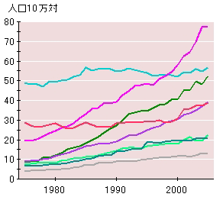



Do reconstructions with tissue expanders (TEs) and permanent implants (PIs) affect the prognosis or local recurrence rate?
Overall Survival(%)
100
80
60
40
20
0
0
10
20
30
40
50
60
70
80
90
100
110
120
Months
Did the infection rate increase?

Slide 5
Patients & Methods-1
Of patients who had undergone mastectomies for primary unilateral breast cancer in our hospital between 2000 and 2009, 197 patients who had immediate reconstruction with TEs (TE group) and 540 patients who had mastectomy (MT group) were included.
An antibiotic was administered pre-operatively based on guidelines for patients undergoing any surgical procedure.
A J-VAC® drain was inserted into the regional axilla. When the drainage was < 50 mL/day, the drainage tube was removed.

Slide 6

Infection
Infection !!
Erythema, high fever, pain, or tenderness
Types of TEs
Koken Co., Ltd.
2000~2006
Allergan, Inc.
2006~present

Slide 7
Patient characteristics
TE(197)
MT(540)
Number of patients
197
540
Median age (years)
46(27-79)
58(39-88)
p<0.0001
Axillary lymph node
SLN or No treatment
Dissection
*94 (47.7%)
103 (52.3%)
**153 (28.3%)
387 (71.7%)
p<0.0001
Median
follow-up period
93.0 months
93.5 months
p=0.8066
DM and/or HD
Yes
No
3 (1.5%)
194 (98.5%)
25 (4.6%)
515 (95.4%)
p=0.0509
*No treatment = 6 cases
**No treatment = 3 cases

Slide 8
TE(197)
MT(540)
Chemotherapy
Yes
No
86 (43.7%)
111 (56.3%)
227 (42.0%)
313 (58.0%)
p=0.6942
Endocrine therapy
Yes
No
131 (66.5%)
66 (33.5%)
344 (63.7%)
196 (36.3%)
p=0.4832
PMRT
Yes
No
3 (1.5%)
194 (98.5%)
26 (4.8%)
514 (95.2%)
p=0.0419
Local & distant metastases
Yes
No
32 (16.2%)
165 (83.8%)
114 (21.1%)
426 (78.9%)
p=0.1423
Distant metastasis
Yes
No
29 (14.7%)
128 (85.3%)
104 (19.3%)
436 (80.7%)
p=0.1562

Slide 9
Clinicopathologic Findings
TE(197)
MT(540)
T factor
Tis-T3
T4
192 (97.5%)
5 (2.5%)
500 (92.6%)
40 (7.4%)
p=0.0146
Hormone receptor
Positive
Negative
Unknown
160 (81.2%)
30 (15.2%)
7 (3.6%)
400 (74.1%)
140 (25.9%)
0
Histologic type
DCIS
IC
31 (15.7%)
166 (84.3%)
39 (7.2%)
501 (92.8%)
p=0.0005
Axillary involvement
Positive
Negative
73 (37.1%)
124 (62.9%)
240 (44.4%)
300 (55.6%)
p=0.0725

Slide 10
Local Recurrence
TE
MT
All patients
Yes
No
8 (4.1%)
189 (95.9%)
22 (4.1%)
518 (95.9%)
p=0.9936
IC
Yes
No
8 (4.8%)
158 (95.2%)
22 (4.4%)
479 (95.6%)
p=0.8176
The LR rate in the TE group was not different from the MT group amongst all patients or patients with IC.

Slide 11
Local Recurrence
TE
MT
Axillary LN-negative
Yes
No
1 (0.8%)
123 (99.2%)
1 (0.3%)
299 (99.7%)
p=0.5178
Axillary LN-positive
Yes
No
7 (9.6%)
66 (90.4%)
21 (8.8%)
219 (91.2%)
p=0.8259
The LR rate in the TE group was not different from the MT group amongst the patients with or without LN metastases.

Slide 12
Univariate and Multivariate analyses of LR
Univariate analysis
Multivariate analysis
Odds ratio
p value
Odds ratio
p value
Age < 40 years 5.02 0.0003 3.94 0.0033
T3 or T4 3.61 0.0033 1.96 0.1403
Axillary involvement 20.73 <0.0001 15.19 <0.0001
Lymphatic invasion 5.28 0.0001 1.22 0.7187
HR negative 1.43 0.5142
Reconstruction with TE 1.00 0.9936
Reconstruction with TE did not affect the LR rate.

Slide 13
Relapse-free Survival
All patients
IC
TE n=197
TE n=166
MT n=540
MT n=501
Probability
Probability
100
100
80
80
RFS at 10 years
TE: 80.8%
MT: 74.7%
RFS at 10 years
TE: 73.1%
MT: 78.8%
60
60
40
40
20
p=0.2818
20
p=0.4402
Months
Months
0
0
0
20
40
60
80
100
120
0
20
40
60
80
100
120
RFS in the TE group was not different from the MT group amongst all patients or patients with IC.

Slide 14
Relapse-free Survival
HR-negative
HR-positive
TE n=30
TE n=160
MT n=140
MT n=400
Probability
Probability
100
100
80
80
RFS at 10 years
TE: 66.7 %
Bt: 71.5 %
RFS at 10 years
TE: 82.3 %
Bt: 75.6 %
60
60
40
40
20
p=0.3978
Months
20
p=0.2787
Months
0
0
0
20
40
60
80
100
120
0
20
40
60
80
100
120
RFS in the TE group was not different from the MT group amongst the patients who were HR-negative or –positive.

Slide 15
Relapse-free Survival
Node-negative
Node-positive
TE n=124
TE n=73
MT n=300
MT n=240
Probability
Probability
100
100
80
80
RFS at 10 years
TE: 89.6%
MT: 88.9%
RFS at 10 years
TE: 65.7%
MT: 57.1%
60
60
40
40
20
p=0.6830
Months
20
p=0.4478
Months
0
0
0
20
40
60
80
100
120
0
20
40
60
80
100
120
RFS in the TE group was not different from the MT group amongst the patients with or without LN metastases.

Slide 16
Overall Survival
IC
All patients
TE n=197
TE n=166
MT n=540
MT n=501
Probability
Probability
100
100
80
80
OS at 10 years
TE: 84.2%
MT: 81.9%
OS at 10 years
TE: 82.8%
MT: 80.9%
60
60
40
40
20
p=0.3068
20
p=0.3470
Months
Months
0
0
0
20
40
60
80
100
120
0
20
40
60
80
100
120
OS in the TE group was not different from the MT group amongst all patients or IC patients.

Slide 17
Overall Survival
HR-negative
HR-positive
TE n=30
TE n=160
MT n=140
MT n=400
Probability
Probability
100
100
80
80
OS at 10 years
TE: 67.3%
MT: 72.7%
OS at 10 years
TE: 86.6%
MT: 85.2%
60
60
40
40
20
p=0.4737
Months
20
p=0.3613
Months
0
0
0
20
40
60
80
100
120
0
20
40
60
80
100
120
OS in the TE group was not different from the MT group amongst the patients who were HR-negative or -positive.

Slide 18
Overall Survival
Node-negative
Node-positive
TE n=124
TE n=73
MT n=300
MT n=240
Probability
Probability
100
100
80
OS at 10 years
TE: 93.8%
MT: 93.6%
80
OS at 10 years
TE: 69.9%
MT: 67.8%
60
60
40
40
20
p=0.6436
months
20
p=0.6420
months
0
0
0
20
40
60
80
100
120
0
20
40
60
80
100
120
OS in the TE group was not different from the MT group amongst the patients with or without LN metastasis.

Slide 19
Univariate and Multivariate Analyses of RFS
Univariate analysis
Multivariate analysis
Risk ratio
p value
Risk ratio
p value
Age ＜40 years 2.26 0.0005 1.87 0.0064
T3 or T4 3.50 <0.0001 2.28 <0.0001
Axillary involvement 5.97 <0.0001 5.76 <0.0001
HR-negative 1.63 0.0046 2.58 <0.0001
Reconstruction
with TE
1.35 0.1251
Reconstruction with TE did not affect prognosis.

Slide 20
Incidence of Infection
Infection
TE
MT
p value
Yes
26 (13.2%)
22 (4.1%)
No
171 (86.8%)
518 (95.9%)
p<0.0001
The incidence of infection was 13.2% and 4.1% in the TE and MT groups, respectively. The incidence of infection in the TE group was significantly higher than in the MT group (p< 0.0001).

Slide 21
Univariate and Multivariate Analyses of Infection
Univariate analysis
Multivariate analysis
Odds ratio
p value
Odds ratio
p value
Axillary clearance 1.99 0.0455 2.61 0.0081
BMI ≥ 25 kg/m2 3.56 <0.0001 4.98 <0.0001
Chemotherapy 1.65 0.0921
Reconstruction
with TE
3.58 <0.0001 5.90 <0.0001
Multivariate analysis of infection indicated that axillary clearance, BMI ≥25 kg/m2 and reconstruction with TE were independent risk factors for infection.

Slide 22
Summary-1
Compared with the MT group, immediate reconstruction with TEs did not reduce the RFS and OS. Univariate analysis of LR and RFS revealed that reconstruction with TEs was not a risk factor.
The incidence of infection in the TE group was significantly higher than in the MT group (P < .0001).
Multivariate analysis indicated that axillary clearance, a BMI ≥25 kg/m2, and reconstruction with TEs were independent risk factors for infection.

Slide 23
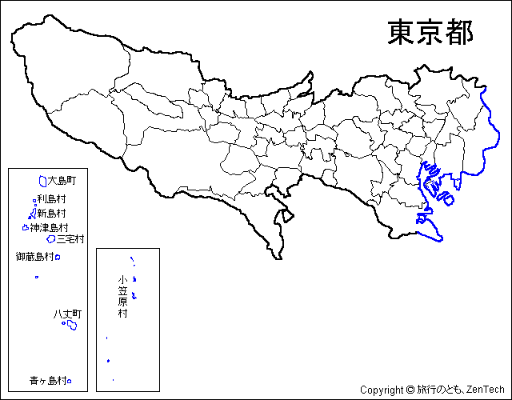
Map of Tokyo

Slide 24

Map of Tokyo
Mitsui Memorial Hospital
Chiyoda-ku
Shinagawa -ku
Breast Surgery Clinic

Slide 25
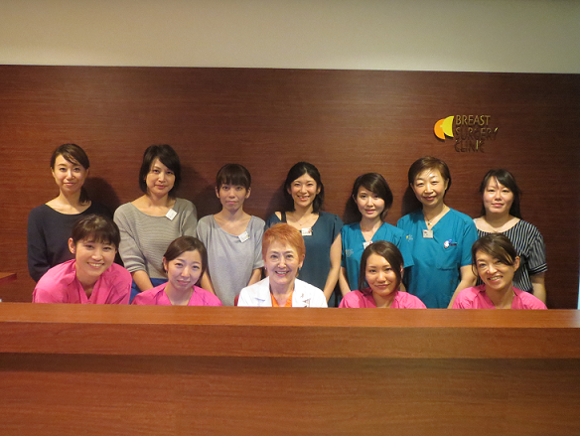
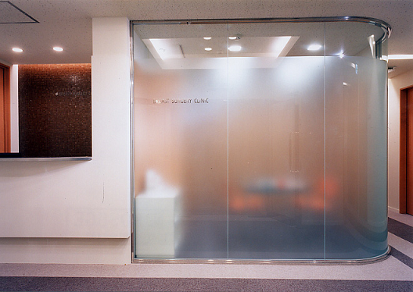
Breast Surgery Clinic
Dr. Yoshiko Iwahira

Slide 26


Identification of complications in mastectomy with immediate
reconstruction using TEs and PIs

Slide 27


What complications of reconstruction developed, such as removal of TEs or PIs?
What were the causes for the complications?
Yes ! We evaluated the complications.

Slide 28
Patients & Methods
A retrospective review was performed involving 233 patients (239 reconstructions) undergoing post-mastectomy breast reconstruction between 1997 and 2009.

Slide 29
Patient characteristics
Number of patients 233
Reconstructions 239
Simultaneous bilateral
reconstructions 3% (6/233 patients)
Median age 46 years (range, 27-79 years)
Axillary lymph node resection
Yes 55% (131/239 reconstructions)
No 45% (108/239 reconstructions)
BMI
≥25 (kg/m2) 9% (20/233 patients)
<25 (kg/m2) 91% (213/233 patients)
Chemotherapy
Yes 42% (97/233 patients)
No 58% (136/233 patients)
Radiotherapy
Yes 1% (3/239 reconstructions)
No 99% (237/239 reconstructions)

Slide 30
Patient characteristics
Invasive cancer
Yes 84% (201/239 reconstructions)
No 16% (38/239 reconstructions)
T factor
T4 3% (8/239 reconstructions)
T0-3 97% (231/239 reconstructions)
Nodal involvement
Yes 34% (81/239 reconstructions)
No 66% (158/239 reconstructions)
Hormone-responsive
Yes 81% (195/239 reconstructions)
No 14% (33/239 reconstructions)
Unknown 5% (5/239 reconstructions)
Diabetes mellitus 1% (2/233 patients)
Recurrence
Local recurrence 3% (7/239 reconstructions)
Local and distant metastases 14% (32/233 patients)

Slide 31
239 reconstructions with TEs
Removal of TEs or PIs
15.5%(37/239)
Re-reconstruction
7.6%(18/239)
TE infections 16.7% (3/18)
PI infections 11.1% (2/18)
TE deflation 16.7% (3/18)
PI deflation 11.1% (2/18)
Mismatched PI 22.2% (4/18)
Wound complication 16.7% (3/18)
Dislocated TE 5.5% (1/18)
Failed Reconstruction
7.9%(19/239)
TE infections 57.8% (11/19)
PI infections 15.8% (3/19)
TE deflation 15.8% (3/19)
Local recurrence 5.3% (1/19)
Severe post-operative
pain 5.3% (1/19)
Completion of Reconstruction
92.1 %(220/239)

Slide 32
Correlation between TE Infections
and
Failed Reconstruction
TE Infections
Yes
No
p value
Completion of reconstruction
13 (54%)
207 (96%)
Failed reconstruction
11 (46%)
8 (4%)
p<0.0001
The reconstruction completion rate among patients without TE infections was significantly higher than in patients with TE infections.

Slide 33
Risk Factors for TE Infections
TE
with infection
TE
without infection
p value
Lymph node metastasis
Yes (n=81)
No (n=158)
12 (50%)
12 (50%)
69 (32%)
146 (68%)
p=0.0788
Lymph node resection
Yes (n=131)
No (n=108)
16 (67%)
8 (33%)
115 (54%)
100 (46%)
p=0.2186
Chemotherapy
Yes (n=94)
No (n=141)
9 (45%)
11 (55%)
85 (40%)
130 (60%)
p=0.6332
BMI
≧25 kg/m2 (n=20)
＜25 kg/m2 (n=219)
6 (25%)
18 (75%)
14 (7%)
201 (93%)
p=0.0019
Seroma aspiration
Yes (n=40)
No (n=199)
16 (67%)
8 (33%)
24 (11%)
191 (89%)
p<0.0001

Slide 34
Multivariate Analysis for TE Infections
Multivariate analysis
Factors
OR
95% CI
p value
BMI ≥25 kg/m2
3.47 0.93-12.13 0.0625
Seroma aspiration
28.75 5.71-40.03 <0.0001
Seroma aspiration was a significant independent risk factor for TE infection.

Slide 35
Summary-2
15.5% of the reconstructions (37 reconstructions) required removal of TEs or PIs.
7.9% of the patients (19 patients) declined re-reconstruction. The most frequent reason was infection of TEs.
The reconstruction completion rate among patients without TE infections was significantly higher than in patients with TE infections.
Seroma aspiration was a significant independent predictive factor for TE infections.

Slide 36
Conclusion
Immediate reconstruction with TEs did not affect local recurrence or prognosis.
To improve the reconstruction completion rate, it is important to prevent TE infections, and inhibition of seroma formation is needed.

Slide 37
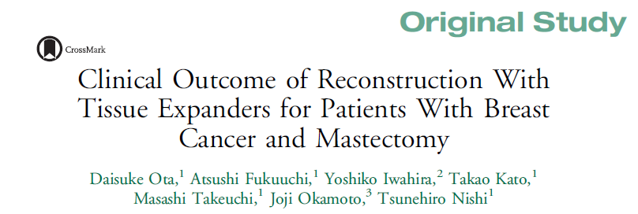
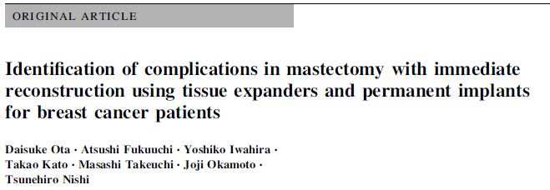


Slide 38
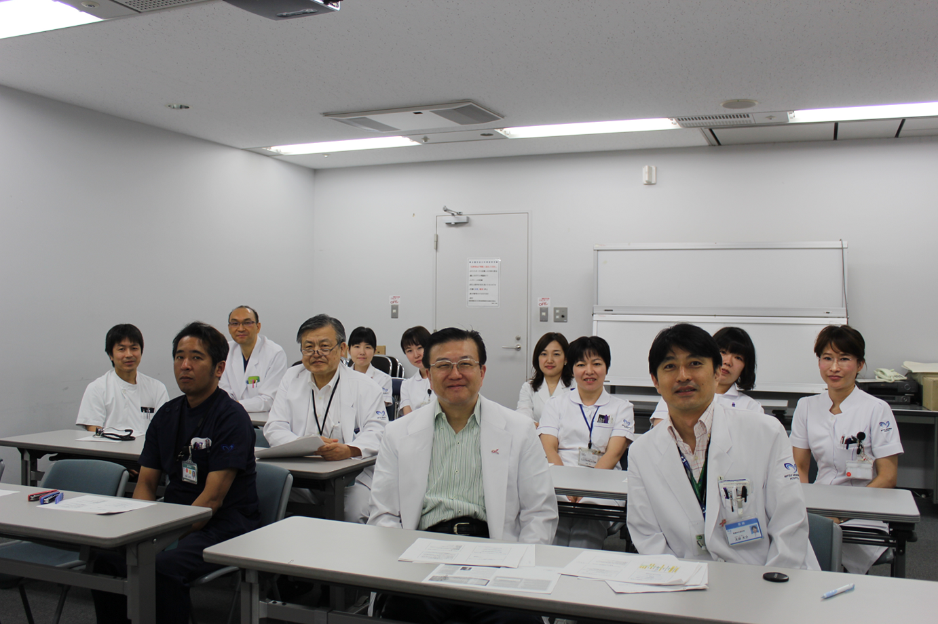
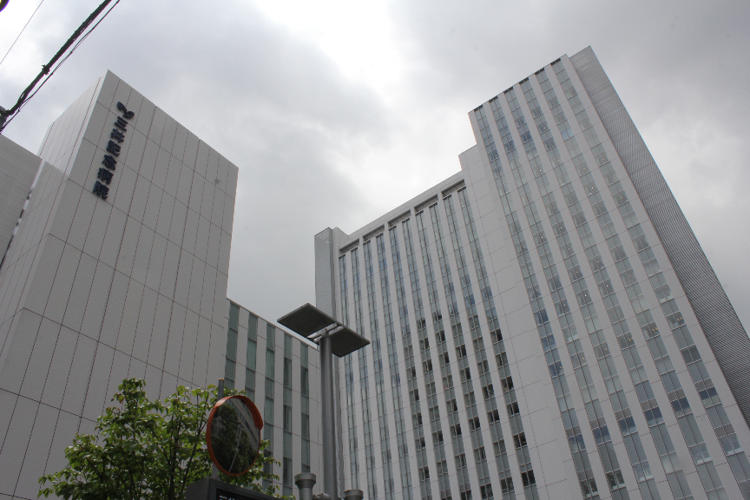
Mitsui Memorial Hospital
We are the Breast Cancer Team !!
Mitsui Memorial Hospital

