Slide 1

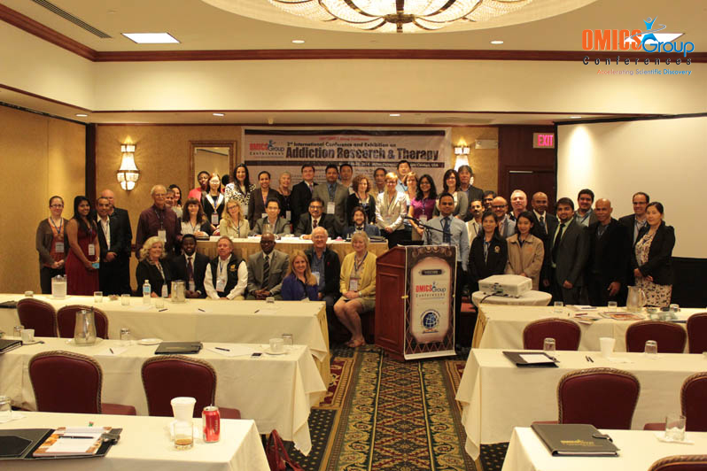
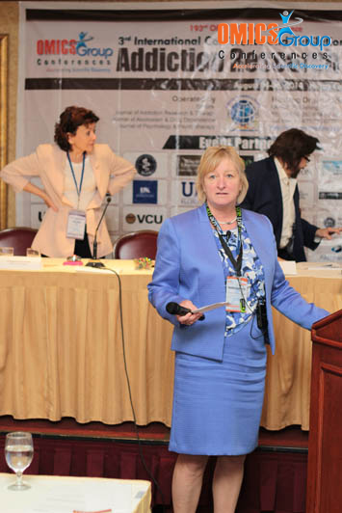
Addiction Therapy-2014
Chicago, USA
August 4 - 6, 2014
Cynthia Stuhlmiller

Slide 2



Harm Reduction, New Recovery and Addiction Therapy
Cynthia Stuhlmiller, Professor of Rural Nursing
University of New England, Armidale, New South Wales, Australia

Slide 3


Slide 4
Presentation Outline
Background of my interest
Historical overview
Current divergent philosophies, goals and approaches
“New Recovery”
Where are we going debate—audience participation

Slide 5
Background of my interest
Medical detox units for GM
USA methadone madness
Drug courts
Tri morbidities—separation of treatments
Easier to get heroin than bactirm/septa
The UNE/Coledale Student-led Clinic
  Unlimited unsupervised success story (like the Serengeti)
  Incidences (kids injecting on site, threats, disposing)
  Needles brought in by kids, bins, neglect
  Liability (risk to whom)?
  How do we define success?
  Is this good enough?

Slide 6
Historical overview
Time immemorial
1960’s-70’s
1976—Dutch experience decriminalisation
  1976 Opium Act revision—distinguish drugs of harm
  1977 Drug normalisation policy
  1984 needle exchange
1986 Switzerland injecting room
1988 Tacoma needle exchange
England, Europe, USA, Australia (since 1985)
2001 Australia shooting gallery
HIV, Hep C—1$ saves 4$
2013 Illegal Magazine in Denmark profits to procurement

Slide 7
Divergent philosophies
Abstinence
Gabriel Nahas, James Royce
Harm reduction/minimisation
Alan Marlett
Genetically ingrained brain can only heal itself
Habitual disposition has modified whole person
Cruel to society
Prohibition works
If legal—more addicts, child abuse, mugging, robbery
renormalisation
Modify risky behaviour
Meet person on own terms
Do not reject but engage
Inhumane (treat only if ab)
Prohibition increases use
Moderation & normalisation
  Needle syringe
  Injecting rooms
  Methadone
  Loosen drug laws
Is this a valid distinction?

Slide 8
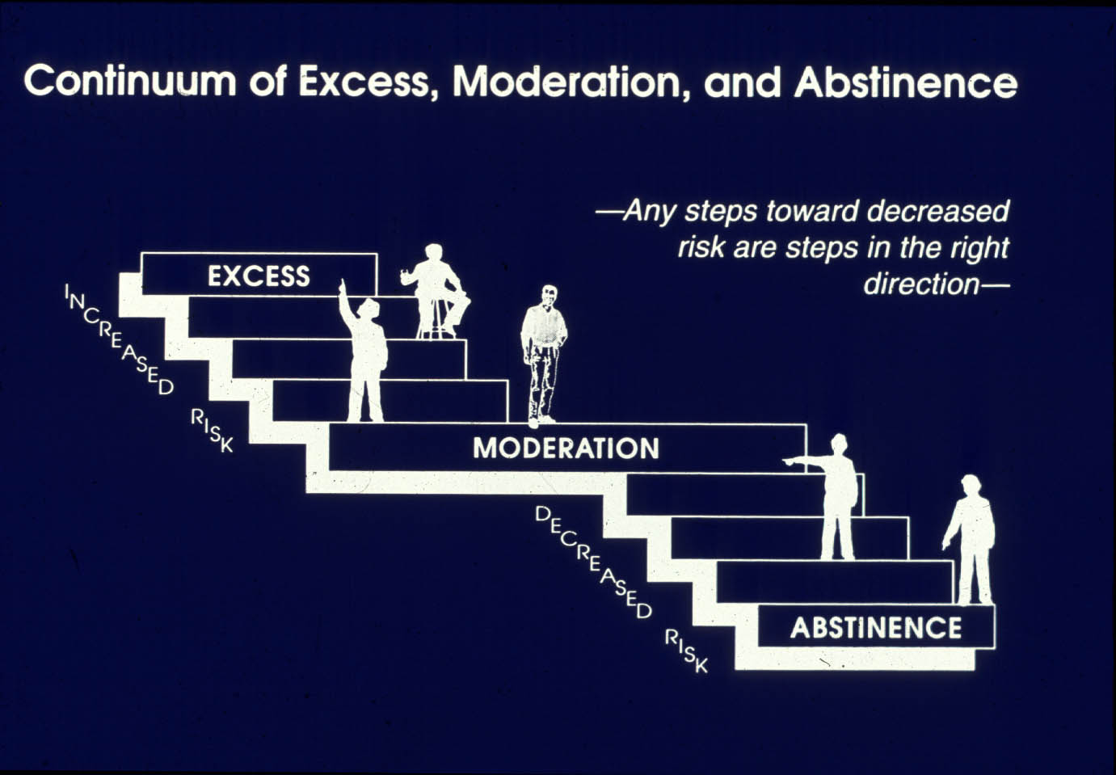

Slide 9
Users blog http://www.memoirsofanaddictedbrain.com/connect/hello-
  Harm reduction for whom?
  Person or society?
  Show of respect
  Give tools not drug
  Give treatment not tools
  Why teach injecting vs keeping away from needles?
  Methadone is just legal addiction
  Harm reduction is a band aid
  Harm reduction would prevent overdose
  Harm reduction is path to abstinence
  Harm reduction condones and enables
  Is harm reduction treatment?
  Damaged brains cannot make good decisions

Slide 10
Rationale for harm reduction
“Most problematic users are conflicted and ambivalent about stopping or unclear about what they need to do. Effective treatments must engage them where they are in their ambivalence. This means accepting them in treatment before they are ready to commit to stopping. Then we can establish respectful, empathic, supportive, collaborative therapeutic relationships that enable comprehensive assessment and clarification of realistic goals and personalized plans for working toward positive change that suit each person. All positive change goals that are steps in the right direction are then seen as successes on the path toward one’s ideal outcome. This “harm reduction” approach extends the reach of treatment to the entire spectrum of problematic drug users rather than restricting treatment only to those people who are ready, willing and able to embrace abstinence at the beginning of the process. This shift in the focus of treatment makes treatment more attractive and appealing to a large number of people who are not “motivated for abstinence-only treatments.”
BUT WHERE IS THE ENGAGEMENT? WHAT ARE THE OUTCOMES?

Slide 11
Australia since 1985
Public health approach
Reduce supply of harmful substances
Reduce demand for their use
Reduce health-related harm of use

Slide 12
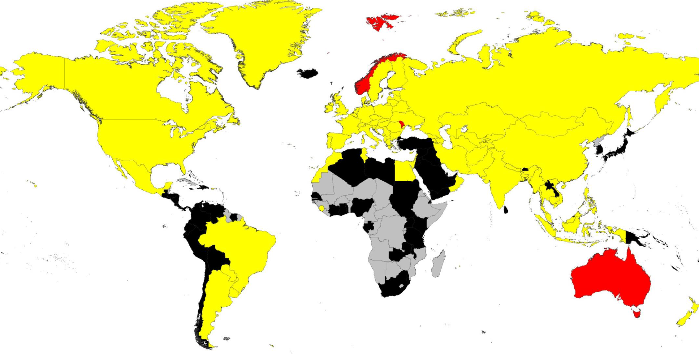
NS distribution/per IDU/ per year

Slide 13
Measure of Success
The effectiveness of these programs has been evaluated in Australia. The evaluation found that approximately 32,000 new HIV infections and 97,000 new Hepatitis C infections had been prevented during the decade 2000-2009 as a direct result of the Needle and Syringe Programs. In addition, the programs resulted in health care cost savings of over four dollars for every one dollar spent.
National Centre for Education and Training on Addiction (Australia)

Slide 14
Where’s the evidence?
Does the $1-$4 hold up still?
Freely available syringes reduce HIV
Insufficient evidence for hep C
  Palmateer N, Kimber J, Hickman M, Hutchinson S, Rhodes T, Goldberg D (May 2010). "Evidence for the effectiveness of sterile injecting equipment provision in preventing hepatitis C and human immunodeficiency virus transmission among injecting drug users: a review of reviews". Addiction 105 (5): 844–59.
What are the treatment outcomes from NS programs?

Slide 15
“New Recovery” http://www.anex.org.au/wp-content/uploads/Australian-Drug-Policy-harm-reduction-and-new-recovery-April-2012.pdf
Recovery concept—US, UK, AU
More holistic approach needed that includes housing, work, education, child welfare, meaningful activity, health services etc.
Controversy by AU harm min folks—we do not have the resources

Slide 16
What say you?

Slide 17

Meet the eminent gathering once again at
Addiction Therapy-2015
Florida, USA
August 3 - 5, 2015
Addiction Therapy – 2015 Website:
addictiontherapy.conferenceseries.com

