Slide 1
Photothermal Desorption of Buckypapers for VOC Sampling and Analysis
Claudiu T. Lungu¹, Jonghwa Oh¹, Evan L. Floyd²
¹University of Alabama at Birmingham
²University of Oklahoma

Slide 2
Outline
Introduction
Innovation
Methods
Results & Conclusions
Future work & Discussions

Slide 3
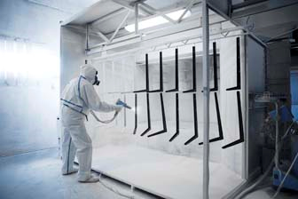
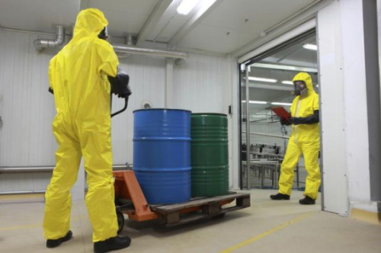
Introduction
Volatile Organic Compounds (VOCs)
Global atmospheric emission- 1300 TgC/yr
Health concern in many industries using solvents (e.g., painting, spraying, coating, etc.)
Exposure assessment for gases/vapors
Conventional sorbent-based sampling
Laboratory analysis
Notes:
Annually, global atmospheric VOC emission is estimated as more than a thousand T grams of carbon and industries contribute to a considerable amount of VOC emission. Especially, in industries dealing with solvents, VOCs are a health concern for workers and for the exposure assessment of gases or vapors in general, sorbent-based sampling followed by laboratory analysis has been a conventional method.

Slide 4
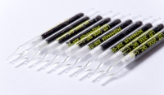
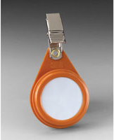
VOC Sampling and Analysis
Sampling
Sorbent- activated charcoal/carbon
High specific surface area (> 1000 m²/g)
Affordable (e.g., $ 0.42/g SKC Anasorb CSC)
Analysis
Chemical desorption
Time-consuming (≥ 30 min)
Toxic solvents (e.g., CS₂ or MeCl)
Only 0.1 % analyzed in gas chromatography (GC)
Thermal desorption
Directly in GC system; traditionally one shot analysis
Expensive thermal extraction unit
System integrity check (e.g., leak checks)
SKC Sorbent Tube
3M Passive Sampler
Notes:
More specifically, for sampling VOCs, activated charcoal or carbon is commonly used as a sorbent due to their high surface area and affordability. For analysis, VOCs adsorbed on the sorbents are desorbed usually through chemical or thermal desorption along with gas chromatography. In case of chemical desorption, sample preparation is time consuming and a toxic solvent such as carbon disulfide is used, and following analysis has limited sensitivity. On the other hand, thermal desorption takes no time for sample preparation and analysis has higher sensitivity. However desorption unit with GC is expensive and due to complicated plumbing system, reliability check such as leak tests is required whenever used.

Slide 5
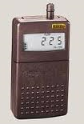
VOC Sampling and Analysis
Sampling methods
Active sampling
Pump- inconvenient
Sorbent tube
Tubing
Passive sampling
Passive badge containing sorbent
No pump- wearer acceptance
Limited sensitivity by diffusion
Notes:
Depending on the sampling method, it can be categorized into active sampling and passive sampling (for VOCs). Active sampling has a sampling train of a pump to pull contaminated air, a sorbent tube, and tubing to connect a pump and a sorbent tube. A pump is not desirable for workers due to it’s inconvenient size and weight which also sometimes limits the movement of the workers. On the other hand, passive sampling requires only a sorbent which is inserted in a badge as seen. So it has great wearer acceptance but its sensitivity is limited when it comes to analysis. Since the sampling rate is driven only by diffusion, it sometimes does not collect enough mass to be detected with analytical equipment such as GC and it is worse when short-term sampling is performed in very low exposure situation.

Slide 6
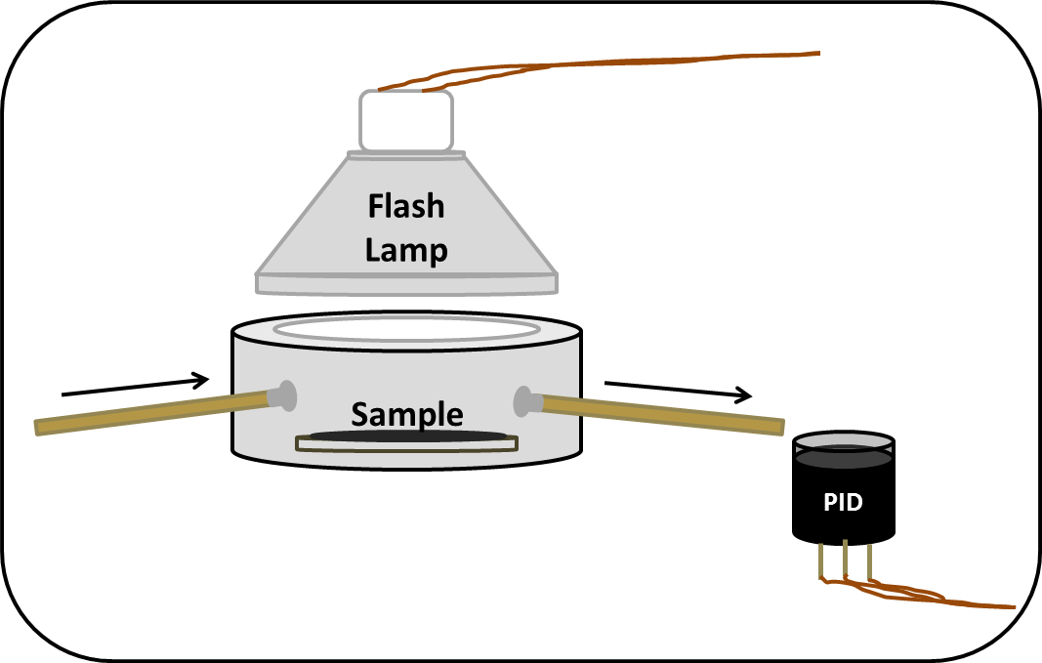
Innovation: Novel Pre-Analysis Technique
Photo-thermal Desorption (PTD)
A pulse of light, thermally desorbing analyte
An alternative to current VOC analysis
Elimination of sampling preparation/analysis time and cost
No toxic-solvents used
Repeated analysis, desorbing a portion of analyte at once
Enhanced sensitivity
- E. Floyd, K. Sapag, J. Oh, C. Lungu, Ann. Occup. Hyg. (2014)
PTD System
Notes:
So, in order to bridge and overcome those issues, our group developed a new pre-analysis technique, called photothermal desorption in which a pulse of light thermally desorbs analyte which is quantified with a photoionization detector or PID. Photothermal desorption can be an alternative for the current VOC analysis since it eliminates such time consuming, expensive laboratory sample preparation and analysis, no toxic solvents are involved, repeated analysis is possible, and it has greater sensitivity compared to chemical desorption.

Slide 7
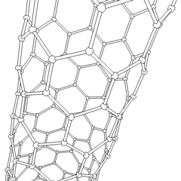
Sorbent for PTD: Carbon Nanotubes (CNTs)
Superior electrical, optical, and thermal conductivity
A wide variety of applications (e.g., mechanical, structural, thermal, electrical, biomedical, etc.)
Large surface area (300 – 1,000 m²/g)
Can be higher by further fabrication process
Single-walled Carbon Nanotubes (SWNTs)
Considered as a prime material for gas sorption
Higher in electrical/thermal conductivity (3000 W/m·K)¹
¹Thermal conductivity of gold- 300 W/m·K
SWNT
Notes:
For PTD, we needed to develop an efficient sorbent and we have examined carbon nanotubes because they have large surface area which can be even increased through further fabrication process. Especially, single-walled carbon nanotubes or SWNTs are well known for their excellent thermal conductivity which is an important characteristic to work with PTD.

Slide 8
Carbon Nanotubes (CNTs)
Synthesis methods of CNTs/SWNTs
Chemical Vapor Deposition (CVD)
Arc Discharge (AD)
High-pressure Carbon Monoxide (HiPco)
Laser Ablation (LA)
Buckypaper
A self-supporting form made of CNTs
3M Passive Sampler
Notes:
Depending on the synthesis methods, CNTs can be largely categorized into chemical vapor deposition, arc discharge, high-pressure carbon monoxide, and laser ablation. Since different synthesis and pretreatment can contribute to the broad range of their characteristics/properties such as tube size, surface area, mechanical properties, etc., we’ve examined three different types of SWNTs for our studies, including CVD, AD, and HiPco. We’ve fabricated them into a buckypaper which is a self-supporting form of CNTs in order to make them easy to be handled as a substrate for use in passive samplers.

Slide 9
Methods
Fabrication of BP
Adsorption Efficiencies
Heat Treatment
Photothermal Desorption
Notes:
Once BPs were fabricated, adsorption efficiencies were examined and further heat treatment was performed to improve their adsorption properties. Lastly, photothermal desorption was tested.

Slide 10
Fabrication of BP
Three types of SWNTs
Chemical Vapor Deposition (CVD)
Arc Discharge (AD)
High-pressure Carbon Monoxide (HiPco)
Vacuum filtration method
Suspension with solvents (i.e., acetone or methanol)
Filtration under vacuum
Additional cleaning/rinsing only for AD SWNTs¹
¹ Suspended in 1 % surfactants of sodium cholate and sodium dodecyl sulfate in water when purchased
Notes:
Vacuum filtration method was employed to fabricate them into a BP. Different fabrication methods using acetone and methanol were examined and cleaning or rinsing process was added to the fabrication process of arc discharge SWNTs since they were suspended in surfactants when purchased them.

Slide 11
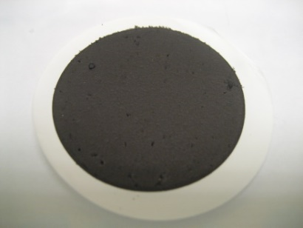
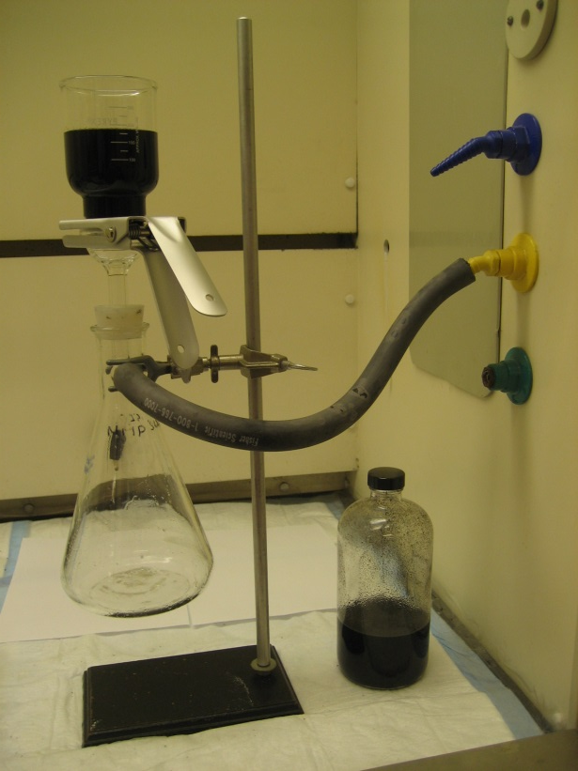
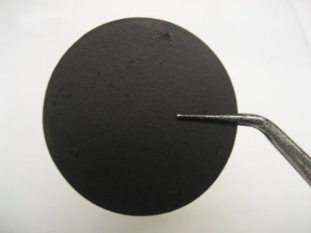
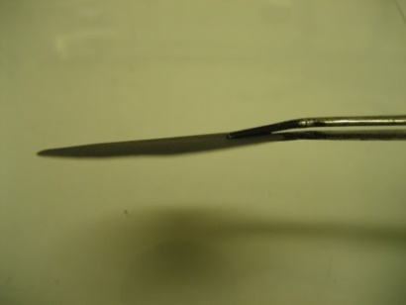
Vacuum Filtration Process
SWNTs suspended
in solvent
Membrane filter
Vacuum
Notes:
This picture shows the fabrication of buckypaper through vacuum filtration method. Once the suspension is filtered through, SWNT cake deposited onto a membrane filter is delaminated to make it buckypaper as shown here.

Slide 12
Types of BPs
CVD Felt
No self-supporting form obtained
AD BP
Acetone suspension & DI water/acetone cleaning
HiPco BP
Methanol suspension & no cleaning
Notes:
We were unable to obtain CVD BP through the vacuum filtration process and only a felt form in which CNTs were supported by a filter membrane was fabricated. We successfully tested PTD with the CVD felt but the related data is not shown here. Only data on AD and HiPco BPs will be discussed here.

Slide 13
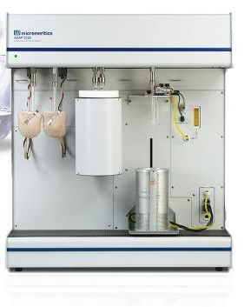
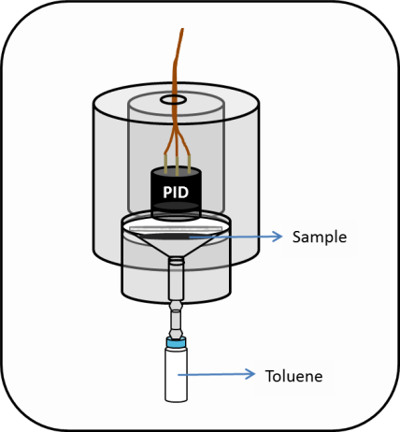
Adsorption Efficiencies
Surface area & pore size
ASAP 2020 Physisorption Analyzer
Degassing at 300 C for 1 hr prior to analysis
N₂ adsorption at 77 K (-196 ˚C)
Adsorption isotherm (capacity)
Diffusive Adsorption Isotherm Chamber (DAIC)
VOC TRAQ PID (Photoionization Detector)
Toluene as a representative VOC at 30 ˚C
Physisoprtion Analyzer
DAIC System
Notes:
After the BPs were fabricated, adsorption efficiencies were examined in terms of surface area and adsorption isotherm. Physisorption analyzer was used to determine the surface area as well as pore size using N2 at 77 K. And, adsorption isotherm was performed with our lab-designed system, called diffusive Adsorption Isotherm Chamber to determine adsorption capacity. Toluene was used as a representative VOC and temperature was kept at 30 C.

Slide 14
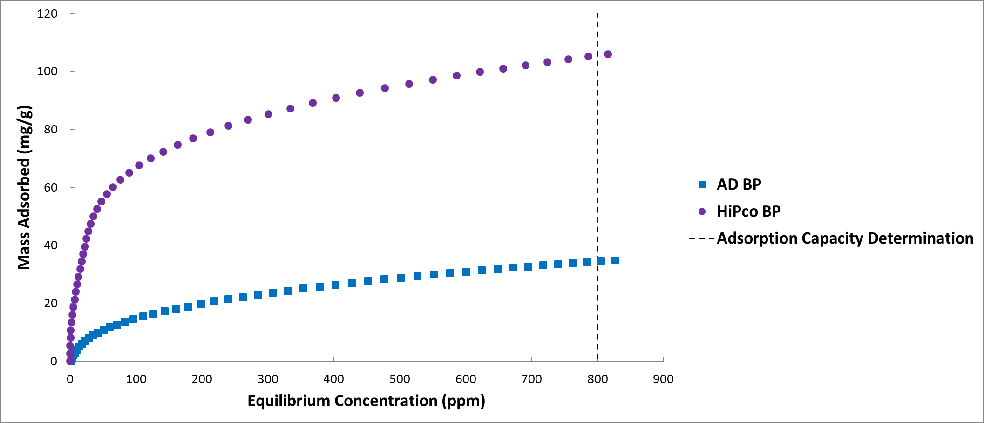
Adsorption Isotherms
Toluene adsorption capacity at 800 ppm
Notes:
This graph shows isotherm curves obtained through the DAIC system. Adsorption capacity was determined at 800 ppm and HiPco BP had the higher adsorption capacity than AD BP.

Slide 15
Results: Adsorption Efficiencies
Surface area (SA), mean pore diameter (d) & toluene adsorption capacity¹
¹ n=3 for SA & d, n=1 for adsorption capacity
² Cleaning/rinsing repeated with 250 mL DI water & 50 mL solvent
³ SA determined by Brunauer, Emmett, and Teller (BET) theory
- J. Oh, E. Floyd, T. Watson, C. Lungu, Anal. Methods. (2016)
 | AD BP² | HiPco BP
BET SA³ (m²/g) | 322 ± 38 | 649 ± 3
d (nm) | 9.7 ± 0.5 | 7.7 ± 0.3
Adsorption Capacity (mg/g) | 34 | 106
Notes:
This table shows the results of adsorption efficiencies. HiPco BP exhibited the higher specific surface area- about six fifty square meter with the smallest mean pore diameter and the greatest toluene adsorption capacity over 100 mg/g. AD BP showed a half of the HiPco SA with a little bit larger pore size and a third of the HiPco capacity. Additionally we observed that an extended high temperature degassing improved the adsorption properties of AD BPs, suggesting that the cleaning process did not completely remove surfactant residues.

Slide 16
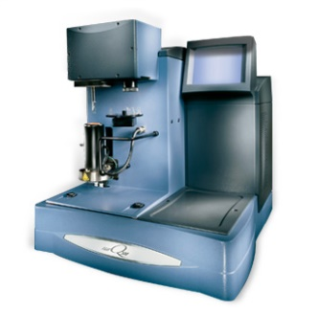
Heat Treatment
Thermogravimetric Analysis (TGA)
10 ˚C/min in air, up to 800 ˚C
Heat treatment (HT) Conditions
AD BP: 300 – 350 ˚C for 60 – 120 min
HiPco BP: 250 – 350 ˚C for 30 min
Surface area
ASAP 202 Physisorption Analyzer
N₂ adsorption at 77 K (-196 ˚C)
Changes in weight and physical integrity (i.e., appearance and surface)
TGA
Notes:
So, heat treatment was performed mainly to remove surfactants in AD BP but also HiPco BP was examined to improve adsorption properties by removing any impurities during synthesis and fabrication process. Three different heat treatment conditions per each type of BP were designed based on thermogravimetric analysis data and, after heat treatment, SA was measured and changes in weight and physical integrity were recorded.

Slide 17
Selection of HT Condition
AD BP- 300 ˚C for 90 min
BET SA- 970 ± 18 m²/g
3 times increase (SA before HT- 322 m²/g)
HiPco BP- 300 ˚C for 30 min
BET SA- 933 ± 54 m²/g
40 % increase (SA before HT- 649 m²/g)
- J. Oh, E. Floyd, M. Parit, V. Davis, C. Lungu, Journal of Nanomaterials (2016)
Notes:
Considering those parameters, a condition at 300 C for 90 min and 300 C for 30 min were determined to be the most appropriate for AD BP and HiPco BP, respectively. In fact, the surface area of AD BP increased almost three times compared to before heat treatment (322 m2/g) while HiPco BP increased a little bit (40 %) as expected.

Slide 18
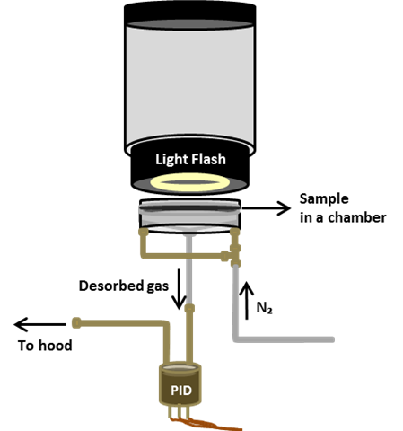
Phototherm Desorption (PTD)
Desorption efficiencies
Flow: 15 mL/min N₂
Source: xenon flash lamp
Loading: 864 µg toluene vaporized
Light E: 1.84 – 7.37 J
One pulse administered
Quantification: integration of peak area of PID data
Desorption Unit
Notes:
With those BP sorbents, desorption efficiencies were examined with our lab-designed desorption unit. BPs were preloaded with vaporized toluene (1 ul) and irradiated with light energies from 1.8 to 7.4 J. Desorption was determined by integrating the peak area obtained from PID data signal.

Slide 19
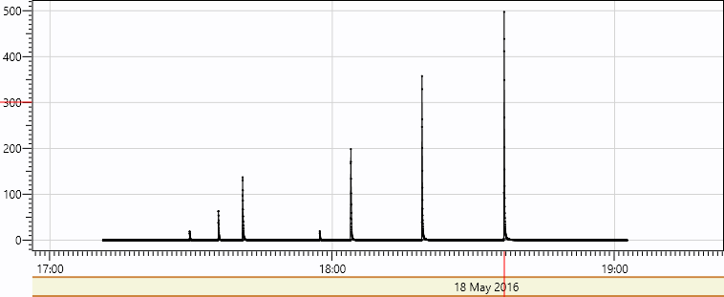
PID Data
HiPco BP
AD BP
Notes:
This graph is an example of our PID data collected with AD and HiPco BPs at different energy levels.

Slide 20
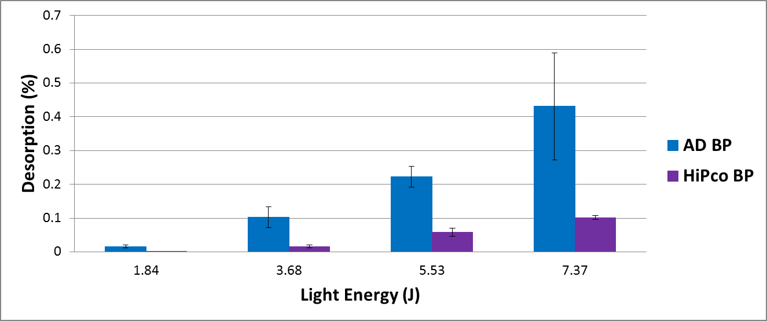
Results: PTD
t-test, p-values <.0081, .0106, .0007 & .0256 at 1.84 3.68, 5.53 & 7.37 J
Notes:
As a result, AD BPs showed higher desorption at all energy levels examined compared with HiPco BPs. (Desorption for the AD BPs ranged from 0.016 to 0.431 % while for HiPco BPs were from 0.001 to 0.102 %.) Difference in desorption between AD and HiPco BPs was statistically significant at all energy levels.

Slide 21
Conclusions
Toluene adsorption capacity proportional to surface area for all tested BPs
HiPco BP was more adsorptive before HT but AD BP improved to the similar degree of adsorption properties to HiPco BP after HT
AD BP showed higher desorption at all energy levels; potential use for efficient VOC sampling and analysis with PTD

Slide 22
Future work & discussions
Further examinations with more precise, elaborated PTD set-up
PTD with other VOCs
e.g., polar compounds- through functionalization
Prediction of proportional desorption by applied energy after enough data collected
Commercialization of PTD technique
BP sorbent, light source & a detector or an analyzer (e.g., PID or portable GC)
Development of alternative sorbents to BPs
Biomass derived carbonaceous materials through HTC (Hydrothermal Carbonization) process

Slide 23
Acknowledgements
National Institute for Occupational Safety and Health (NIOSH) R21 (#5R21OH010373)

Slide 24
Thanks

