Slide 1


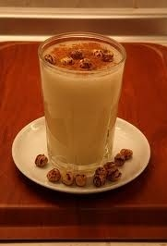
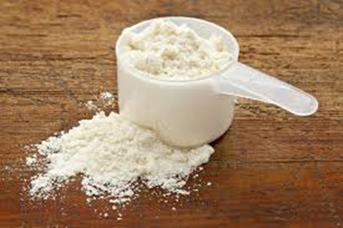

PRODUCTION OF OAT BOZA POWDER ENRICHED WITH WHEY POWDER
Çiğdem Konak GÖKTEPE, Nihat AKIN
University of Selcuk, Faculty of Agriculture, Department of Food Engineering, Konya TURKEY

Slide 2



Introduction
Boza is a traditional Turkish fermented cereal-based beverage which made by various cereals (barley, oat, millet, maize, wheat or rice). Only ones or mixture of this cereals are used for prepared boza. Water is added to semolina and flour of this cereals and cooked with stirred. After that, sugar and inoculum which is generally used previous boza batch are added this cereal slurry and fermented with yeasts and lactic acid bacteria.

Slide 3
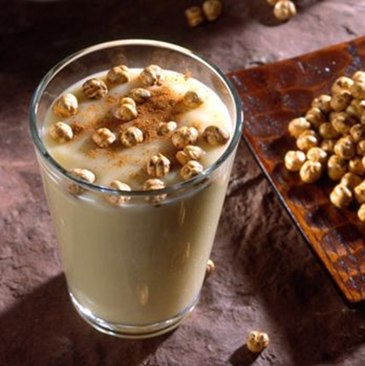
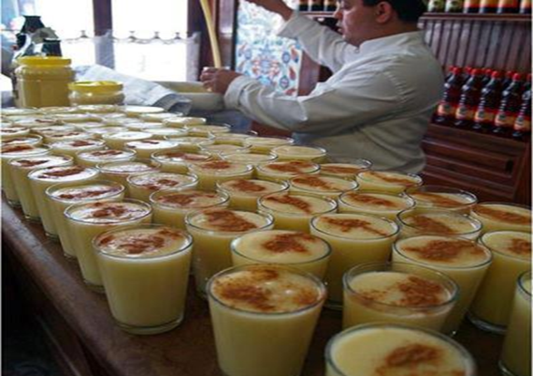

Fermentation improves organoleptic qualities of the product. Most of the spoilage and pathogenic microorganisms are inhibited by a combination of pH reduction, a lowering of oxidation-reduction potential, competition for essential nutrients and the production of inhibitory compounds (Hancioğlu and Karapınar, 1997).
Boza has thick consistency, pale yellow color and characteristic acidic-alcoholic odor (Anon., 1992). It is a favorite drink in Turkey, on particularly cold winter night and is consumed with cinnamon and roasted chickpeas ( Başaran, 1999).

Slide 4
In this research oatmeal was used in boza powder production. Oat which is more substantial than the other cereals in term of protein quality, lipid amount, mineral composition and vitamin B₁ is used widely on human diet (Köse, 1996).
Further, boza was enriched with demineralized (70 %) whey powder in different ratio of 0, 2.5, 5.0 and 7.5 %. After fermentation, boza samples were dried with spray drier. Because boza become undrinkable form in short time by the reason of continuation ethyl alcohol and lactic acid fermentations. Producing companies may preserve boza at refrigirator condition (+4 ◦C) for short time and therefore boza may be consumed in two days after produced (Kentel, 2001).
The aim of this study was to improve nutritional value and to prolong the shelf life of boza by addition whey powder and spray drying respectively.

Slide 5
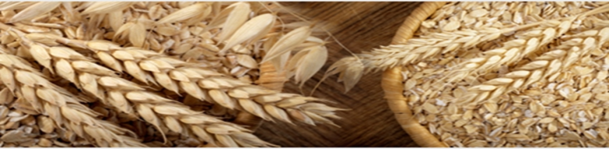
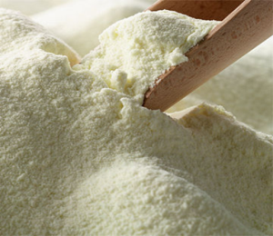
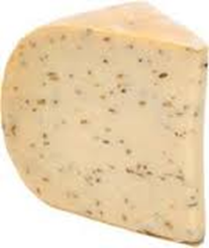

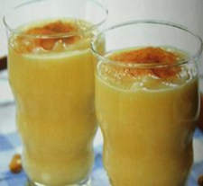
2. Materials and Methods
2.1. Materials
To prepare oat boza,
oatmeal,
demineralized (70 %) whey powder,
sugar and
a previous boza batch were used.
Previous boza that was used as a starter culture for boza fermantation was bought from local markets, Akman Boza, in Ankara. Oatmeal and sugar were obtained from local markets in Konya. Demineralized (70 %) whey powder supplied from Enka Dairy Market, in Konya.

Slide 6
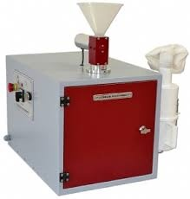
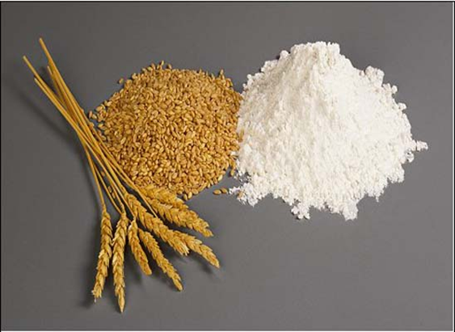
2.2. Methods
2.2.1. Oat Boza Production
Oat boza samples were prepared according to Hayta et al. (2001) with minor modification. As mentioned previously, oat was used as raw materials in boza production. Oats was cleaned from foreign materials and oat groats were ground in an hammer mill equipped with 1 mm opening screen (Falling Number-3100 Laboratuvary Mill, Perten Instruments AB, Huddinge, Sweden) to obtain oatmeal.

Slide 7
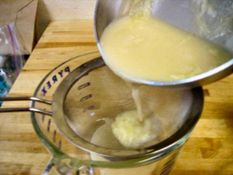
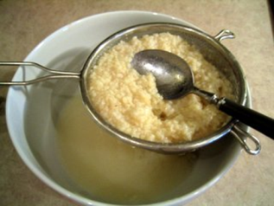
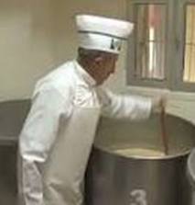

Oatmeal was fortified with demineralized (70 %) whey powder at different ratio (0, 2.5, 5.0, 7.5 %).
The mixture was boiled in five times water (w/v) for 1 h under continuous stirring.
The mixture was allowed to cool overnight and diluted with water at levels of 10%.
Sugar (2 % w/v) addition
Mixture was inoculated with previous boza batch (2%) which was bought from the market
Inoculated mixture was incubated at 30 °C for nearly 6 h until pH of samples were about 4.0-4.20 .
After at the end of the fermentation 15% granulated sugar (saccharose) was added. Coolig below 15 °C ready to service

Slide 8
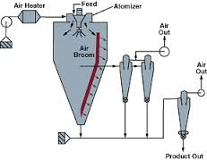
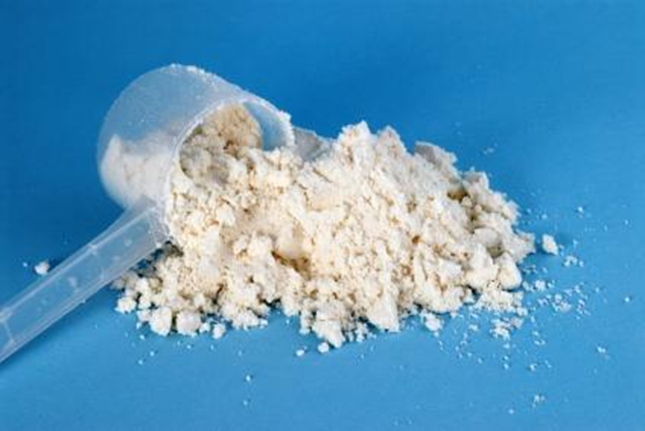
2.2.2. Oat Boza Powder Production
After fermentation, oat boza samples were dried with spray drier. In practice, fermentation is retarded by cold storage to extend the shelf-life of boza.
Oat boza powder was produced by using spray-dryer (Niro Atomizer 7827 type pilot dryer unit). The size and morphology of the spray-dried particles are controlled by the air temperature. Using for the oat boza powders produced, inlet air temperature was 180 ◦C in drying tower and the outlet temperature was 90-92 ◦C. The powder temperature was determined about 60-65 ◦C. Oat boza powders were kept in polyethylene bags at room temperature until used.
Oat boza powder was supplied and they were analyzed as chemical and physical.

Slide 9
2.2.3. Analytic Methods
The AACC methods were used for determination of
moisture (method 44-19),
crude ash (method 08-03),
protein (AACC 46-12) contents of oat boza (AACC ,1990).
The pH values of the samples were deter­mined by using a digital type pH meter (WTW pH315 i/set) according to TS 9778 (Anon. ,1992).
The total titratable acidity of samples was calculated as lactic acid as described by Kentel (2001).
Color measurement was examined using a Minolta Chroma Meter CR-400 (Minolta, Osaka, Japan). The L, a and b were determined according to the CIE Lab color space system, where L corresponds to light/dark chromaticity (changing from 0 % dark to 100 % light), a to green/red chromaticity (changing from 60 % green to 60 % red) and b to blue/yellow chromaticity (changing from 60 % blue to 60 % yellow). The instrument was calibrated with a white reference tile (L=97.10, a=-4.88, b=7.04) before the measurements (Francis ,1998).

Slide 10
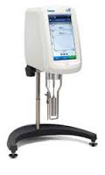


Viscosity was measured at 4 °C using a Brookfield viscometer (Lab line, Model No 4535, Lab Line Instruments, Inc., Melrose Park, IL., U.K.) equipped with a spindle 7 at 20 rpm.
Sensory properties were determined oat boza and oat boza powder samples. Oat boza powder samples were prepared for sensory evaluation. For this purpose, 25 grams boza powder was completed 100.0 ml with distilled water and stirred. Seven panelists who knew boza were asked to score the oat boza samples in terms of overall acceptability using 5 point hedonic scala with 1-2 dislike, 3 acceptable, 4-5 like extramely.
Statistical analysis was performed with the JMP (SAS Institute Inc., Cary, NC, USA) version 5.0. One-way analysis of variance (ANOVA) was performed to determine differences oat boza samples. Statistically significant differences (p ≤0.05) between means were determined by Student’s t test.

Slide 11


2.2.4. Microbiological Method
After the fermentation, 10 g of boza was taken under aseptic conditions, and transferred in 90 ml 0.1% peptone water. From the appropriate ten-fold dilutions, pour plate counts were made out using the following media and incubation conditions:
Man, Rogosa and Sharpe (MRS, Merck) Agar overlaid with the same medium for lactic acid bacteria, 30°C 24-48 h incubation under anaerobic condition ;
Potato dextrose agar (PDA, Merck) plates for yeasts, 30°C 72 h incubation;
Plate Count agar (PCA,Merck) for total mesophilic aerobic bacteria, 30°C 48 h incubation.
The standard pour plate method was employed to determine the counts of microorganisms. After incubation, plates with 3–300 colonies were counted, and the results expressed as colony forming unit/gram (cfu⁄g)(Gürgün and Halkman 1988).
Notes:
Suitable media and incubation condition

Slide 12
3. Result and Discussion
3.1. Analytical results of oatmeal and whey powder
Chemical and physical composition of oatmeal and whey powder are given Table 1. These results are in agreement with that reported by Kirk and Sawyer (1999) and Yalcuk (2012).
Table 1. Some chemical and physical properties of whole grain oat flour and whey powder
 | The wholegrain oatmeal | Whey Powder
Crude ash (%)* | 1.6381 | 5.7732
Moisture (%) | 8.30 | 3.50
Protein content(%)* | 15.07 | 8.58
Colour values
L | 90.88 | 100.05
a | 1.65 | -3.20
b | 7.64 | 13.23
* in dry basis ** Protein = N x 6.25

Slide 13
3.2. pH values of oat boza samples
As shown in Table 2, pH values of oat boza samples were measured at before and after fermentation process. Statistical analysis of the data showed no significant differences (p>0.05) in the pH values of oat boza samples.
When the supplementation levels of whey powder increased, pH values of oat boza samples for after and before fermentation were decreased due to its sitimulating lactic acid bacteria and yeast fermentation and whey’s composition. Similar results had been reported by Mauriello et al., (2001).
Table 2. pH values of boza samples made with different ratio of whey powder *
 | pH value before fermentation | pH value after fermentation
0 % WP ** | 6.17ª | 4.01ª
2.5 % WP ** | 5.85^{b} | 4.30ª
5.0 % WP ** | 5.86^{b} | 4.23ª
7.5 % WP ** | 5.89^{b} | 4.17ª
*Student’t multiple range test. Means with same letter within column are not significantly different (p< 0.05). Variables were determined by the one- way ANOVA model.
** WP: Whey powder

Slide 14
3.3. Total titratable acidity values of oat boza and boza powders
The data belongs to total titratable acidity contents is shown in Table 3. The acidity contents of oat boza samples were ranged between 0.66 and 0.73% after fermentation. Statistically, acidity values of oat boza samples with 2.5, 5.0 and 7.5 % whey powder addition were not significiantly different values (Table 3 see). But significant decreasing was observed the control sample that is prepared without whey powder addition due to high lactose content of whey powder. This could be explained that lactose is sitimulating microbial activity (Penesar et al. 2007).
According to the Turkish Boza Standard (TS 9778), titratable acidity by means of lactic acid should be 0.2–0.5% in sweet boza and 0.5–1.0% in sour boza. In reference to our results, these samples were called sour boza.
Table 3. Total titratable acidity values of boza samples made with different ratio of whey powder *
Samples | Total titratable acidity (lactic acid %) after fermentation
0 % WP ** | 0.66^{b}
2.5 % WP ** | 0.68^{ab}
5.0 % WP ** | 0.72ª
7.5 % WP ** | 0.73ª
*Student’t multiple range test. Means with same letter within column are not significantly different (p< 0.05). Variables were determined by the one- way ANOVA model.
** WP: Whey powder

Slide 15
Figure1 The total acidity contents of oat boza and reconstituted boza samples made with different rates of whey powder( WP: Whey powder)
As seen in Figure1, total titratable acidty contents of reconstituted oat boza samples are ranged between 0.36 and 0.54 %. Total titratable acidity values were decreased depends on applied spray drying process to oat boza powders compared with fresh oat boza samples.

Slide 16
3.4. Total solid content of oat boza and boza powders
The effect of whey powder addition on total solid content of boza samples are shown in Table 4. The total solid content of boza samples were ranging between 26.60 and 31.40 %. The highest value of solid content was found in oat boza sample contain 7.5 % whey powder. This could be explained that raise of dry matter was due to the differences of moisture rate between whey powder and oatmeal which were used raw material for the production of boza. During the research we didn’t consider this differences, we noticed that it the end of the study.
According to the Turkish Boza Standard (TS 9778), total dry matter and total sugar (as saccharose) content should be minimum 20 and 10%, respectively.
Table 4. Total dry content of boza and boza powder samples made with different rates of whey
powder *
 | Total solid content of boza (g/100g) | Total solid content of boza powder (g/100g)
0 % WP ** | 27.07^{b} | 2.20^{b}
2.5 % WP ** | 26.60^{b} | 2.19^{b}
5.0 % WP ** | 29.00^{ab} | 3.19ª
7.5 % WP ** | 31.40ª | 3.140ª
*Student’t multiple range test. Means with same letter within column are not significantly different (p< 0.05). Variables were determined by the one- way ANOVA model.
** WP: Whey powder

Slide 17
3.5. Protein content of oat boza samples
Protein content of oat boza samples are given in Figure 2. The protein content of boza samples were ranging between 6.16 and 15.96 %. When the supplementation levels of whey powder increased, protein content of oat boza samples were increased. The highest value of protein content was found in oat boza sample contain 7.5 % whey powder (Fig 2 see) because whey is a source of whey protein (McIntosh et al. 1998).
Figure 2. The protein contents of oat boza made with different rates of whey powder ( WP: Whey powder)
* in dry basis ** Protein = N x 6.25

Slide 18
3.6. Crude ash content of oat boza samples
As seen in Figure 3, the crude ash contents of oat boza samples are ranged between 1.0037 and 2.0201 %. The crude ash content of whey powder was detected 5.77% ( see Table 1). A similar result by Yalcuk (2012) is reported. The highest ash content was observed the oat boza samples 7.5 % whey powder addition due to high mineral content of whey powder (Fig 3 see). Statistical analysis of the data showed significant differences (p<0.01) in the crude ash contents of oat boza samples.
Figure 3 The crude ash contents of oat boza samples made with different rates whey powder ( WP: Whey powder)

Slide 19
3.7.Color values of oat boza and boza powders
Color values of oat boza samples are shown in Table 5. Statistical analysis of the data showed no significant differences (p>0.05) in the color values of oat boza samples after fermentation.
Table 5. Color values of oat boza made with different rates whey powder after fermentation*
 |  | Color
 | L* | a* | b*
0 % WP ** | 67.61ª | 1.06ª | 12.97ª
2.5 % WP ** | 67.63ª | 1.03ª | 13.04ª
5.0 % WP ** | 67.64ª | 1.02ª | 13.06ª
7.5 % WP ** | 67.64ª | 1.01ª | 13.06ª
*Student’t multiple range test. Means with same letter within column are not significantly different (p< 0.05). Variables were determined by the one- way ANOVA model.
** WP: Whey powder

Slide 20
Color L, a, and b values were compaired fresh boza samples and boza powder samples that was observed lightness (L value) was increased boza powder but redness (a value) and yellowness (b value) decreased that could be releated to drying proses.
Figure4 .The color values of oat boza and reconstituted boza samples made with different rates of whey powder ( WP: Whey powder)

Slide 21

3.8. Viscosity values
Figure 5. The viscosity value of oat boza made with different rates whey powder ( WP: Whey powder)
As seen in Figure 5, the viscosity values of oat boza samples decreased after fermentation. Samples which were added with whey powder had lower viscosity values due to the high solubilty of lactose compared to the control samples. As the amount of the used whey powder increased, the viscosity values rose up, too. This rise was associated with whey protein amount which increased with using whey powder.

Slide 22
3.9. Microbiological analysis
The microbial quantifications were seen in Table6. Total mesophilic aerobic bacteria, lactic acid bacteria and yeast counts changes between 4.5 and 22.5 x 10⁸; 2.2 and 9.1x 10⁸; 3.5 and 16.2x 10⁸ cfu/g respectively.
Table 6.Quantification of total mesophilic aerobic bacteria, lactic acid bacteria and yeast population in boza samples*
Microorganism counts | Samples
 | 0 % WP** | 2.5 % WP** | 5.0 % WP ** | 7.5 % WP**
Total mesophilic aerobic bacteria (CFU g⁻¹ ) | 4.5^{c}x10⁸ | 4.55^{c} x10⁸ | 14.1^{b} x10⁸ | 22.5ª x10⁸
Lactic acid bacteria (CFU g⁻¹ ) | 2.2^{d} x10⁸ | 5.25^{c} x10⁸ | 6.2^{b} x10⁸ | 9.15ª x10⁸
Yeast (CFU g⁻¹ ) | 3.5^{d} x10⁸ | 4.6^{c} x10⁸ | 7.25^{b} x10⁸ | 16.25ª x10⁸
*Student’t multiple range test. Means with same letter within column are not significantly different (p< 0.05). Variables were determined by the one- way ANOVA model.
** WP: Whey powder

Slide 23
Figure 6. The microorganism counts of oat boza made with different rates whey powder ( WP: Whey powder)
When the supplementation levels of whey powder increased, microbial population of oat boza samples were increased due to lactose in whey sitimulating lactic acid bacteria and yeasts growing. So that oat boza samples with 7.5% whey powder addition had the highest microbial counts ( Fig 6 see).
Associations of lactic acid bacteria and yeast were found to be responsible for boza fermentation, which agrees with the results found in the literature about boza (Yazıcıoğlu, 1985; Birer, 1987; Zorba et al., 2003; Todorov, 2010 ).

Slide 24
The sensory assessment of oat boza samples produced at the end of the 6 h fermentation is shown in Figure 7. The sensory properties of oat boza were compared with control sample which prepared without whey powder adding. Boza prepared with 2.5 % whey powder addition was the most liked one. More than 2.5 % whey powder addition caused source salty taste due to the high mineral content of whey powder.
3.10. Sensory properties of oat boza
Figure 7. The sensory properties of oat boza made with different rates of whey powder (WP: Whey powder)

Slide 25
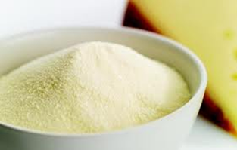
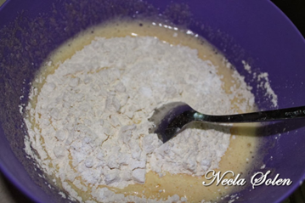
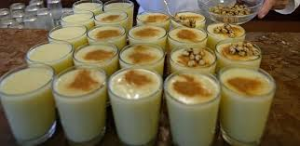

Further, boza powder which obtained spray dryer were prepared for sensory evaluation. For this purpose, 25 grams boza powder was completed 100.0 ml with distilled water and stirred. Seven panelists who knew boza tasted them and decelerated same score with fresh boza samples.

Slide 26

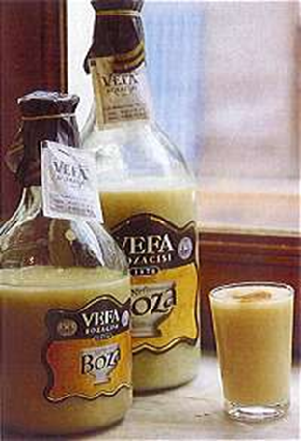


4. Conclusions
The results of this research showed that whey powder can be used an ingredient for producing oat boza. Researchers have tried to fortify yoghurt and other fermented beverages with whey protein. However, they found some modifications in the taste of the final product because it has a high concentration of minerals (Reyna, 1977; Shahani and Mathur, 1978; Vitti and Vale, 1987). So that we used 70% demineralized whey powder to product boza samples.

Slide 27

Whey addition increased total ash, protein and acidity contents significantly. Whey is a source of biological and functional valuable proteins. Lactose content of whey developed fermentation activity.
The result of the overall acceptability test showed that oat boza powder prepared with 2.5 % whey powder took the most liking score from the panelists. 5.0 and 7.5 % whey powder levels were tolarable in sensory evaluation.
It was observed that spray-dried oat boza could be preserved without losing their own characteristic tastes and odours. The result indicated that spray-dried oat boza is easier to storage, handling and transport.

Slide 28


