Slide 1
IL-2 as the adjuvant in FMD vaccine
Chunxia su，ph.D.
Ningxia Medical University
Yinchuan，China

Slide 2
Overview of FMD
Foot-and-mouth disease (FMD) is a severe, highly contagious and economically devastating viral disease worldwide.
Notes:
Which affects Cows，sheep，and other cloven-hoofed animals，which not ONLY reduce animal’s commercial value by decreasing animals’weitght and milk output,but is also the most important animal disease limiting commerce of animals and animal product. that is why it is very significant to prevent,control and even eradicate FMD.

Slide 3
Overview of FMD vaccine
Inactivated antigen vaccines have been available since the early 1900s.
Notes:
The traditional vaccine played an very important role in preventing, controlling FMD.

Slide 4
Overview of FMD vaccine
Shortcomings of traditional vaccines for FMD：
First, there are so many different strains of the FMD virus;
Second, traditional vaccines involve live FMD virus;
Third, traditional vaccines can not differentiate infected from vaccinated animals.
Notes:
First, that you must have a very well-matched vaccine to have any effect.Second, so the mode of production exist a risk to reveal live FMDV to environment
Besides, there are other important shortcomings of current inactive vaccines, including short shelf life, the need for adequate cold chain of formulated vaccines, and difficulties of certain serotypes and and subtypes to grow well in the cell culture for vaccine production

Slide 5
Overview of FMD vaccine
The need for better foot-and-mouth disease (FMD) vaccines is not new.
subunit vaccine
live vector vaccine
Nucleic acid vaccines
Novel attenuated vaccine
Synthetic peptide vaccine
Notes:
In order to address these problems, new vaccines are necessary and urgent to develop into satisfied candidates of classical vaccines. A number of strategies were disigned to develop novel FMD vaccines.VP1,which is one of FMDV capsid proteins was considered most important to construct subunit vaccine.Adenovirus and poxvirus are widely utilized to efficiently express heterologous genes.

Slide 6
Overview of FMD vaccine
Humoral immune response was considered to be an important defence mechanism in FMD infection.
In recent past, there has been an increasing evidence of the importance of T cell mediated immunity in FMD.
Notes:
But， aurally current vaccine can not induce enough T cell response against FMD.

Slide 7
Overview of FMD vaccine
In recent years, special attention has been paid to cytokines as FMD vaccine adjuvants.
IFNα,β,γ;IL-2,IL-6,IL-9,IL-18,IL-15,TNFα,IL-1β
Notes:
So，in order to enhancing immune response，especially，T cell immune response，definitely，adjuvant was considered necessary to be used to improve immune response of vaccine。 Sofar，there are so many cytokine were studied for enhancing immune response of FMD vaccine

Slide 8
IL-2 is a very popular adjuvant
IL-2 is one of the most widely used adjuvants for vaccination to stimulate the proliferation and activation of various immune effector cells such as T cells, NK cells, B cells, and macrophages.
Notes:
IL-2 not ONLY has the capacity to induce the proliferation and differentiation of T cells as well as B cells and NK, but also inducing secretion of other cytokines such as IFN-γ, IL-4 and TNF. And It also promotes the induction of Ab secretion.

Slide 9
IL-2 is a very popular adjuvant
IL-2 enhanced the immunogenicity of the FMD DNA vaccine candidate.
H.-T. Wong et al. Vaccine,2002

Slide 10
IL-2 is a very popular adjuvant
IL-2 was able to enhance the specific immune response against FMD virus type O, A22 and Asia 1.
S. Yadav et al. Vaccine,2005
Notes:
as evident by significantly higher ELISA antibody titres (P < 0.05) in serum obtained from mice receiving IL-2 along with vaccine as compared to mice immunized with vaccine alone. Similarly, the same group of mice showed significantly higher lymphoproliferative responses in SMNC against mitogen PHA and FMD virus types O, A22 and Asia 1 on all DPVs as compared to the group inoculated with vaccine alone

Slide 11
IL-2 is a very popular adjuvant
IL-2 is important in many types of T effector cell differentiation.
Notes:
Back to the discovery of IL-2,which was considered as a T-cell growth factor, and now research work show that IL-2 promotes naive CD4+ T cell differentiation into T helper-1 (Th1) and T helper-2 (Th2) cells while inhibiting T helper-17 (Th17) and T follicular helper (Tfh) cell differentiation.

Slide 12
T follicular helper cells (Tfh), a new specialized subset of CD4+ helper T cells，providing help to B cells.

Slide 13
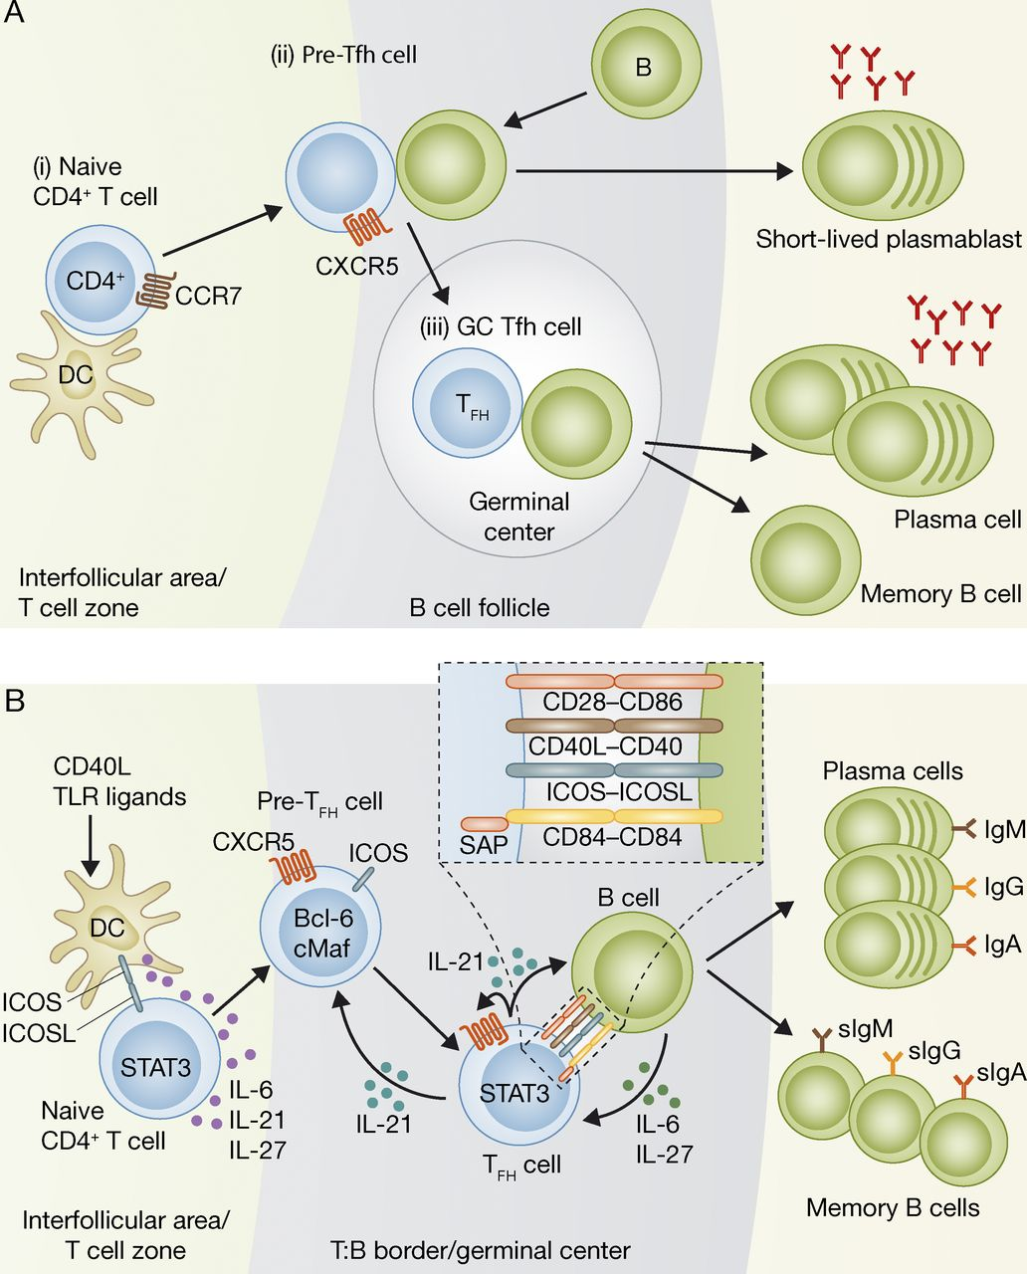
© 2012 Ma et al.
Ma C S et al. J Exp Med 2012;209:1241-1253
Notes:
(i) DCs provide signals that up-regulate CXCR5 and down-regulate CCR7 on CD4⁺ T cells allowing them to migrate to B cell follicles. (ii) At the T cell–B cell border, pre–Tfh cells interact with activated B cells presenting cognate Ag. Helping B cells differentiation into short-lived plasmablasts or their migration into follicles to form GCs. (iii) Within GC, Tfh cells continue to provide help to the B cells, supporting the GC reaction cells somatic hypermutation, class switch recombination, ,and facilitating the generation of long-lived plasma cells and memory B，this help directs the magnitude and quality of the antibody response.

Slide 14
Su C,et al. PLoS One ，2013

Slide 15
PNA+
Su C,et al. PLoS One ，2013

Slide 16
rAd5VP1 induced the secretion of IL-21 and the expression of Bcl-6 mRNA.
Su C,et al. PLoS One ，2013

Slide 17
Can IL-2 as an adjuvant for FMD vaccine candidate promote the generation of T follicular helper cells？

Slide 26
PNA+

Slide 27
summary
IL-2 as an adjuvant for an adenovirus-vectored FMD vaccine candidate through the generation of Th1, Th2 as well as T follicular helper cells.

Slide 28
acknowledgement
Xiangguo Duan，Ph.D.
Guanxian Xu，Ph.D.
Jie Zheng，graduate student
Feng Wang，graduate student

Slide 29
Thanks for your patient！

Slide 30
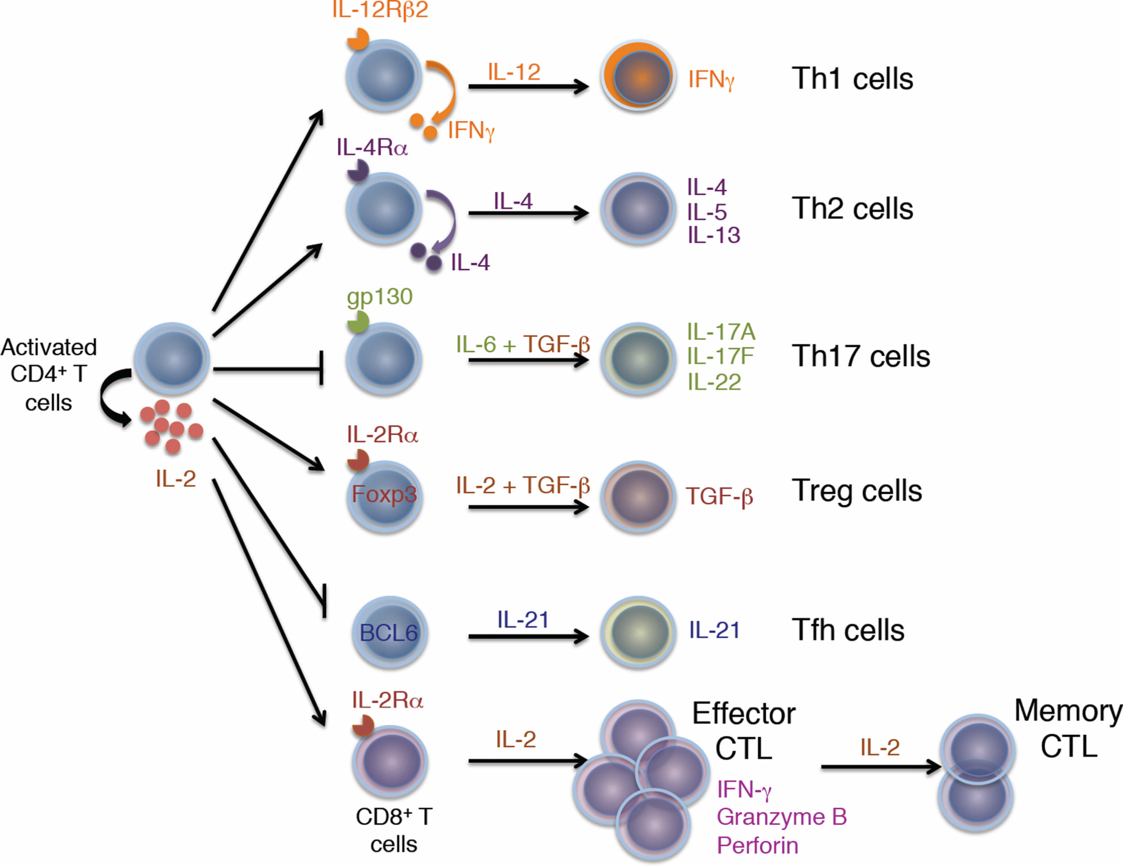
Liao et al, Immunity,2013
Notes:
Interleukin‑2 (IL‑2) signals act via signal transducer and activator of transcription 5 (STAT5) and influence the differentiation of T helper (TH) cell subsets (including TH1, TH2 and TH17 cells) as well as the homeostasis of regulatory T (TReg) cells. Contact with IL‑2 promotes TH1 cell generation by increasing the levels of the IL‑12 receptor β2 subunit (IL‑12Rβ2) and of T‑bet, and this results in enhanced interferon‑γ ?(IFNγ) production. For TH2 cells, IL‑2 signals induce the upregulation of IL‑4Rα ?by these cells and enhance the production of typical TH2‑type cytokines, notably IL‑4, IL‑5 and IL‑13. The generation of TH17 cells depends on IL‑6 and transforming growth factor‑β ?signals. Unlike the formation of TH1 and TH2 cells, TH17 cell differentiation is inhibited by IL‑2 signals. Indeed, IL‑2‑mediated activation of STAT5 limits the responsiveness of these cells to IL‑6 by downregulating the expression of IL‑6Rβ; STAT5 also competes with STAT3 for binding to the Il17 gene locus. TReg cells depend on IL‑2 signals for their generation and homeostasis. Moreover, contact with IL‑2 maintains high levels of CD25 and forkhead box P3 (FOXP3) expression by TReg cells and enhances their suppressive capacity. γc

Slide 31
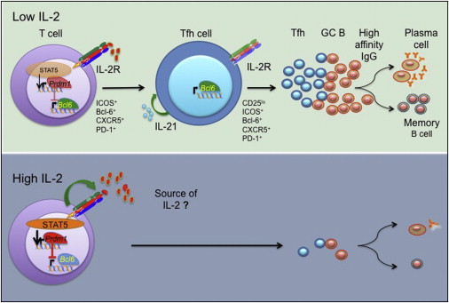
Thomas R. Malek, Wasif N. Khan. Immunity 2012
Notes:
These data indicate that strong IL-2 signals drive both CD4+ and CD8+ T cells to become terminally differentiated effector T cells that are destined for rapid death following the clearance of the pathogen concerned. Conversely,low level IL-2 signals allow responding CD4+T cells to differentiate into Tfh cells of central memory T cells, and CD8+ T cells to survive as long-lived memory T cells.

Slide 32
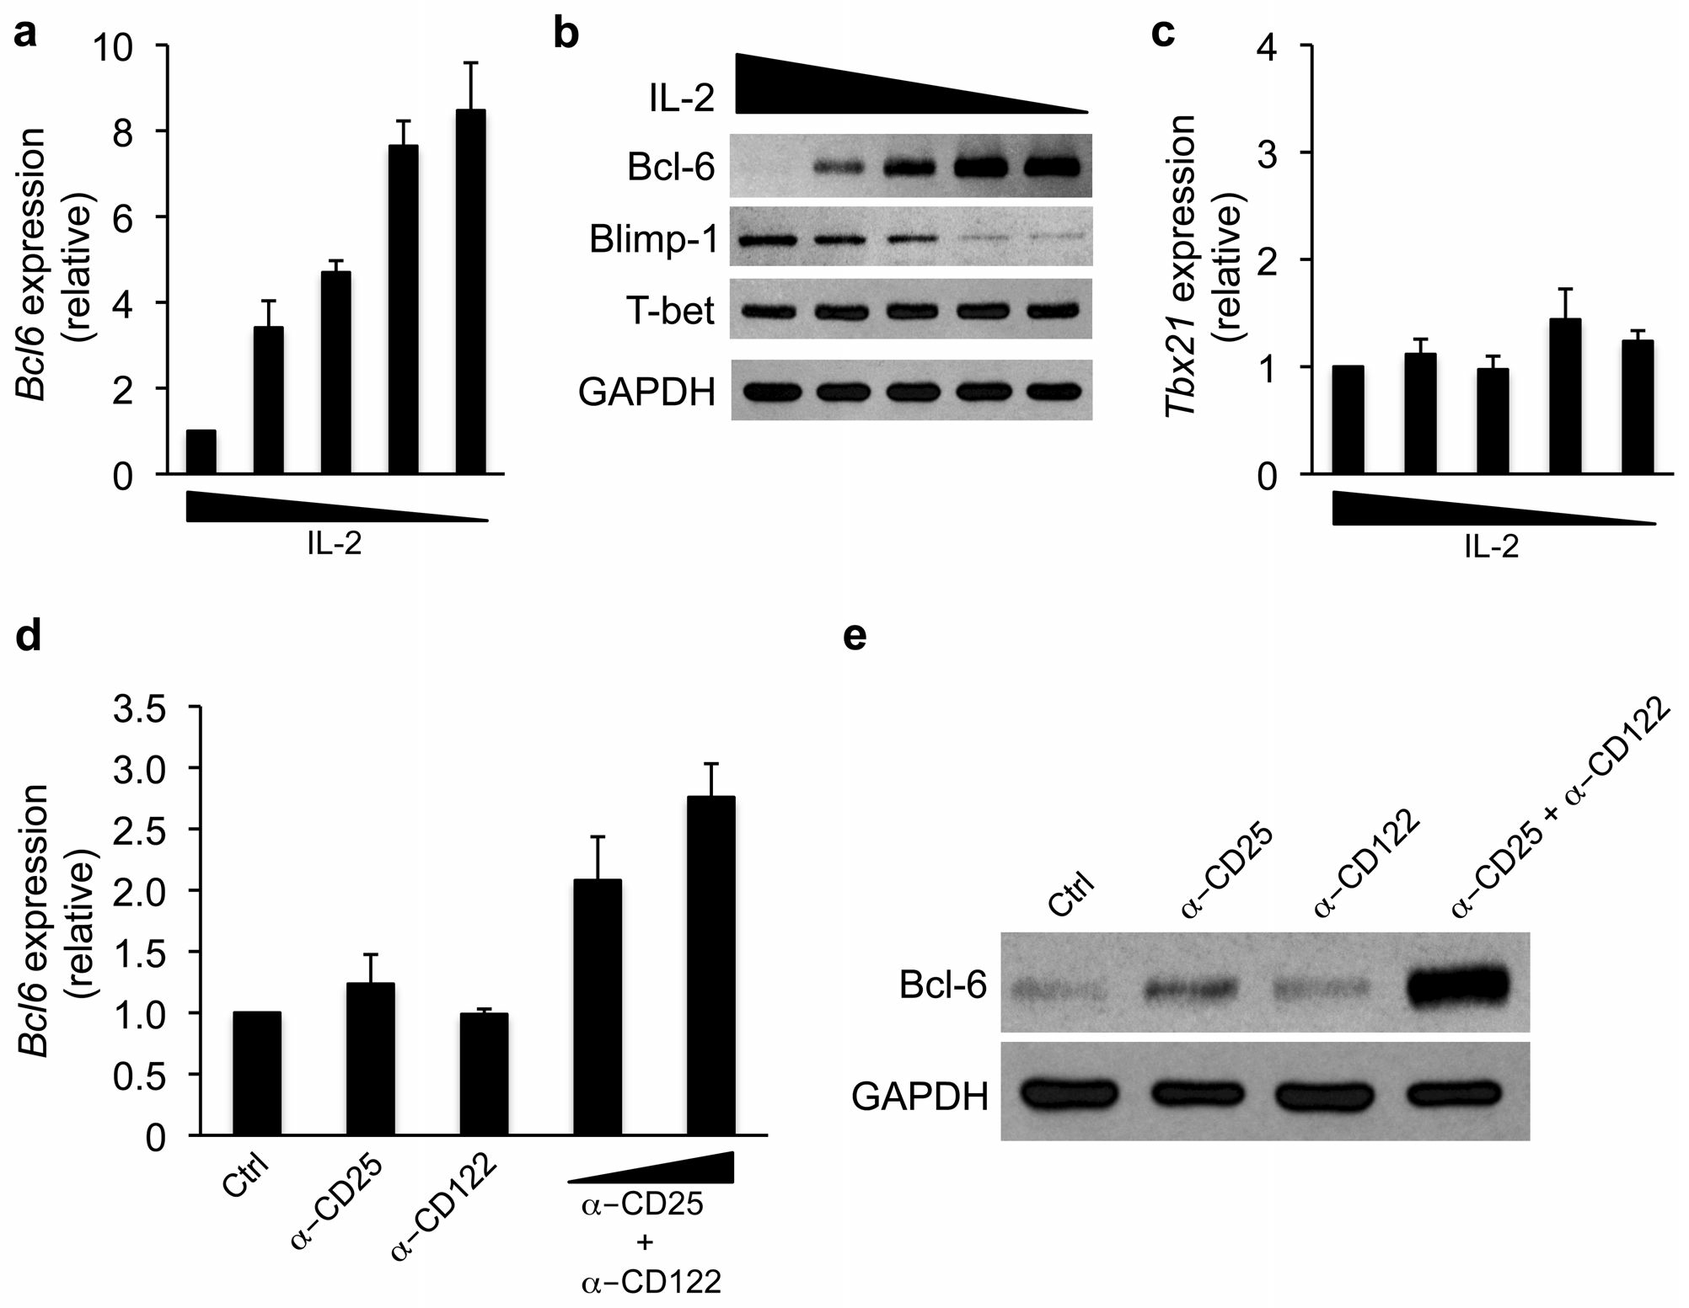
Oestreich et al. Nat Immunol，2013
Notes:
These data indicate that strong IL-2 signals drive both CD4+ and CD8+ T cells to become terminally differentiated effector T cells that are destined for rapid death following the clearance of the pathogen concerned. Conversely,low level IL-2 signals allow responding CD4+T cells to differentiate into Tfh cells of central memory T cells, and CD8+ T cells to survive as long-lived memory T cells.

