Slide 1
The Association Among Maternal Nonresponsive Feeding Practices and Child's Eating Behaviors and Child Weight Status in Children Aged 1 to 6 Years
Department of Child Health care
Nanjing Maternal and Child Health Hospital
Chunmei Shi, Min Zhang, Meiling Tong
2016.8.29

Slide 2
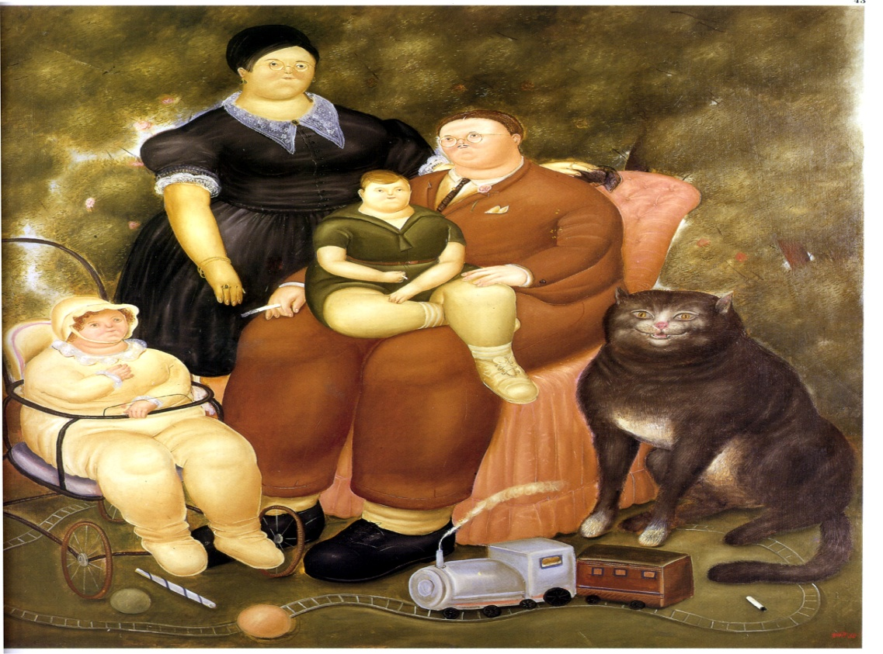
Responsive parenting
Interactive behaviors between caregivers and children
Sensitive to child’s cues
Prompt
Appropriate
World Health Organization. Infant and young child feeding: Model Chapter for textbooks for medical students and allied health profession[M]. Geneva: World Health Organization, 2009: 16, 20.

Slide 3
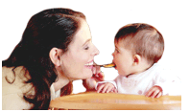
Parental Responsivity - applied to feeding
Sensitive to child’s cues
Respond to child’s cues:
Prompt
Appropriate
Development/age
Culture
Situation
Responsive Feeding
Black & Aboud, J Nutr, 2010

Slide 4
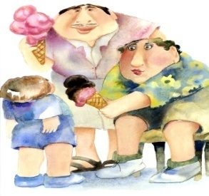
Nonresponsive parenting
Giving children whatever they want.
Letting children be in charge of what they want, whenever they want it.

Slide 5
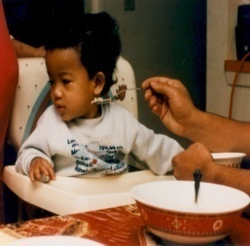
WHAT IS NON-RESPONSIVE FEEDING?
Excessive parental control
Forceful – Eat! Eat!
Underweight children remain underweight
Restrictive – No dessert for you!
Overweight children remain overweight
Fisher & Birch, AJCN, 1999
Notes:
5

Slide 6
WHAT IS NON-RESPONSIVE FEEDING?
Lack of parental control
Indulgence
Eat whatever you want
Risk of overweight / obesity
Uninvolved
Eats meals alone
Risk of underweight
Notes:
6

Slide 7
Responsive Feeding Questionnaire (RFQ)
3 closed-ended items ("yes" means there exists nonresponsive feeding practices):
1) Restriction: You only give child to eat what you like or what you think is good food;
2) Pressuring: If child refuses to eat, you will force or trick him/her to continue to eat a certain amount of food;
3) Uninvolved or neglectful: No or little active physical help during mealtimes.

Slide 8
Child Eating Behavior Questionnaire (CEBQ)
10 closed-ended items:
child prefers high-calorie food? ;
child rarely eats vegetables / fruits food?;
child prefers snacks, thus affecting the regular meal;
child refuse to accept new foods;
child often refuses to open mouth or push away food?;

Slide 9
Child Eating Behavior Questionnaire (CEBQ)
10 closed-ended items continue:
6) child always has food in her mouth;
7) child eats very slow;
8) when eating, child is easily distracted;
9) the place where child eats is not fixed, he/she would stop participating and start walking around;
10) feeding child is often a struggle.

Slide 10
Basic information of the investigated subjects
Characteristics |  | Age group (months of age) |  |  |  |  |  |  | Total
 |  | 12 | 13-18 | 19-24 | 25-36 | 37-48 | 49-60 | 61-72
Child gender (%) | Boy | 158(52.5) | 230(55.4) | 192(54.2) | 441(54.2) | 186(53.0) | 69(58.0) | 40(58.0) | 1316(54.3)
 | Girl | 143(47.5) | 185(44.6) | 162(45.8) | 373(45.8) | 165(47.0) | 50(42.0) | 29(42.0) | 1107(45.7)
Maternal educational level | High School | 64(21.3) | 30(7.2) | 49(13.8) | 141(17.3) | 74(21.1) | 35(29.4) | 11(15.9) | 404(16.7)
 | Undergraduate | 152(50.5) | 295(71.1) | 241(68.1) | 516(63.4) | 219(62.4) | 59(49.6) | 43(62.9) | 1525(62.9)
 | Graduate | 85(28.2) | 90(21.7) | 64(18.1) | 157(19.3) | 58(16.5) | 25(21.0) | 15(20.4) | 494(20.4)
Child’s BMI percentile^{[19]} | < P₁₅ | 16(5.3) | 22(5.3) | 17(4.8) | 109(13.4) | 41(11.7) | 19(16.0) | 15(21.7) | 239(9.9)
 | P₁₅-P₈₅ | 191(63.5) | 282(68.0) | 246(69.5) | 549(67.4) | 246(70.1) | 81(68.1) | 45(65.2) | 1640(67.7)
 | P₈₅-P₉₅ | 67(22.3) | 80(19.7) | 70(19.8) | 97(11.9) | 39(11.1) | 11(9.2) | 4(5.8) | 374(15.2)
 | > P₉₅ | 27(9.0) | 31(7.5) | 21(5.9) | 59(7.2) | 25(7.1) | 8(6.7) | 5(7.2) | 176(7.3)
Total |  | 301 | 415 | 354 | 814 | 351 | 119 | 69 | 2423

Slide 11
Eating behavior problems detected in different age groups of children

Slide 12
The detection rates of maternal nonresponsive feeding in children aged 1 to 6 years

Slide 13
Correlations between maternal nonresponsive feeding practices and child’s eating behaviors
 | OR for weight status of children (95% CI)
 | Preferring high-calorie foods | Rarely eating vegetable /fruits | Preferring junk food | Refusing new foods | Refusing to eat | Keeping food in mouth | Meal time >30min | Meal inattention | Meals at non-permanent locations | Feeding struggle
Restriction | 1.52 (1.24, 1.86) | 2.09 (1.69, 2.59) | 1.86 (1.49, 2.32) | 1.77 (1.43, 2.18) | 1.76 (1.42, 2.16) | 1.37 (1.11, 1.70) | 1.25 (1.03, 1.52) | 1.41 (1.13, 1.74) | 1.72 (1.41, 2.08) | 1.66 (1.36, 2.04)
Pressure | 1.70 (1.39, 2.08) | 1.73 (1.38, 2.16) | 1.80 (1.43, 2.27) | 1.59 (1.28, 1.97) | 2.88 (2.31, 3.60) | 2.98 (2.38, 3.73) | 3.18 (2.64, 3.82) | 3.58 (2.98, 4.30) | 2.73 (2.30, 3.256) | 4.71 (3.84, 5.77)
Uninvolved | 1.42 (1.16, 1.74) | 2.12 (1.71, 2.63) | 2.25 (1.81,2.80) | 1.62 (1.31, 2.00) | 2.65 (2.16, 3,24) | 2.15 (1.75, 2.65) | 2.31 (1.91, 2.79) | 2.09 (1.68,2.61 ) | 2.10 (1.73, 2.55) | 3.35 (2.75,4.08)

Slide 14
Association of child’s eating behaviors and maternal nonresponsive feeding practices with Child’s BMI
 | BMI (χ2) months of age
 | 12 | 13-18 | 19-24 | 25-36 | 37-48 | 49-60 | 61-72
Gender | 0.15 | 12.96** | 1.30 | 0.33 | 5.78 | 4.01 | 7.71
Maternal education level | 18.00** | 19.49** | 9.34 | 12.27 | 15.15* | 7.30 | 22.02***
Preferring high-calorie foods | 8.17* | 8.76* | 4.16 | 6.46 | 1.19 | 6.66 | 5.88
Rarely eating fruits or vegetables | 7.26 | 1.75 | 3.96 | 0.13 | 1.03 | 3.18 | 9.51*
Preferring junk food | 12.30** | 6.76 | 5.32 | 14.22** | 2.87 | 4.25 | 0.96
Refusing new foods | 4.19 | 21.09*** | 11.86** | 19.03*** | 8.57* | 19.49*** | 3.65
Refusing to eat | 2.64 | 1.73 | 0.52 | 3.76 | 6.53 | 1.69 | 3.00
Keeping food in mouth | 4.39 | 3.72 | 2.59 | 2.10 | 7.97* | 1.56 | 1.75
Meal time >30min | 3.45 | 8.03* | 0.91 | 6.54 | 4.80 | 1.24 | 3.54
Meal inattention | 8.45* | 5.30 | 0.23 | 7.41 | 8.50* | 6.05 | 2.50
Meals at non-permanent locations | 5.57 | 3.35 | 3.11 | 7.69 | 8.54* | 3.69 | 1.93
Feeding struggle | 6.94 | 3.85 | 0.52 | 2.19 | 9.96* | 2.96 | 0.38
Restriction | 6.01 | 12.30** | 4.80 | 2.07 | 4.78 | 1.15 | 5.84
Pressure to eat | 5.85 | 4.20 | 4.78 | 5.30 | 8.15* | 6.77 | 2.38
Uninvolved | 2.83 | 0.09 | 0.79 | 3.45 | 7.64 | 5.16 | 4.33

Slide 15
Association of maternal nonresponsive feeding practices and child’s eating behavior with children’s BMI
Variables | Child Weight status, OR (95% CI)
 | Underweight | Normal weight | Overweight | Obese
12 months of age
Preferring junk food | 1.04(0.10, 11.03) | Reference | 4.63(1.46, 14.68)** | 2.79(0.62, 12.57)
Meal inattention | 0.35(0.10, 1.22) | Reference | 2.10(1.04, 4.22)* | 1.76(0.65, 4.78)
Pressure | 0.23(0.06, 0.91)* | Reference | 1.29(0.68, 2.46) | 0.77(0.30, 1.99)
13-18 months of age
Refusing new foods | 5.23(1.84,`4.92)** | Reference | 0.96(0.48, 1.91) | ---
Meal inattention | 0.36(0.11, 1.17) | Reference | 1.18(0.62, 2.25) | 3.57(1.03, 12.38)*
19-24 months of age
Refusing new foods | 3.28(1.10, 9.82)* | Reference | 0.86(0.44, 1.70) | ----
25-36 months of age
Preferring junk food | 0.33(0.17, 0.67)** | Reference | 1.06(0.60, 1.88) | 1.21(0.60, 2.43)
37-48 months of age
Keeping food in mouth | 0.24(0.07, 0.81)* | Reference | 1.06(0.43, 2.62) | 1.29(0.39, 4.27)
Meal inattention | 3.02(1.24, 7.36)* | Reference | 1.17(0.42, 3.21) | 1.31(0.44, 3.97)
49-60 months of age
Refusing new food | 11.71(2.63, 52.18)** | Reference | 0.23(0.02, 3.08) | ----
Meal inattention | 0.70(0.11, 4.56) | Reference | 18.03(1.15, 281.72)* | 0.35(0.04, 3.32)
Feeding struggling | 1.33(0.22, 8.01) | Reference | 0.04(0.00, 0.48)* | 0.15(0.01, 3.07)
61-72 months of age
Restriction | 6.53(1.24, 34.48)* | Reference | --- | ---

Slide 16
Limitations
Observational study
Hospital base-Population

Slide 17
Conclusions
Evidence: Nonresponsive feeding practice and child’s eating behavior
Key developmental age: 19-24 and 49-60 months
Red Flag: Refusing new food, eating at non-permanent locations, Preference to junk food and inattention; Restriction and pressure

Slide 18
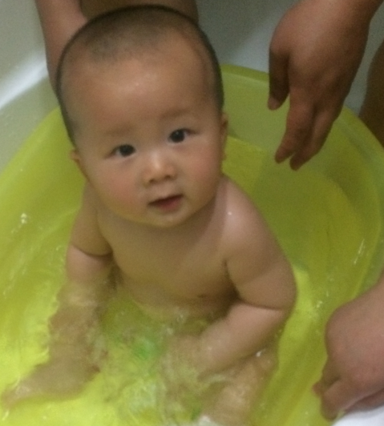
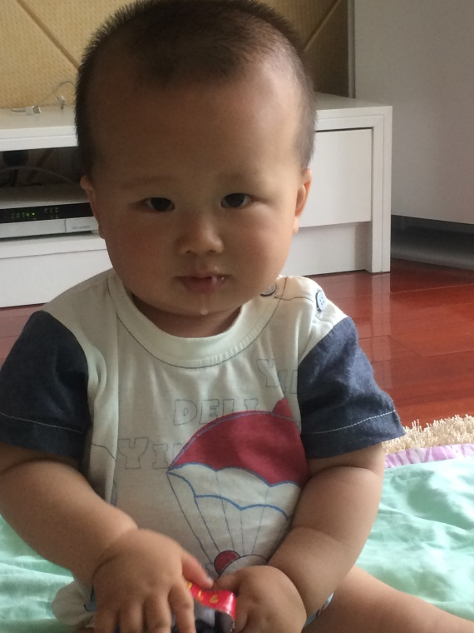
Thanks
Evolution not revolution, No one will ‘fail’ new standards.

