Slide 1



Genetic Code Expansion in Natural Propagation for Site-Specific Engineering and Tracking of Adeno-Associated Viruses
Oct. 6-8, 2014
Chuanling Zhang
Assistant professor
School of Pharmaceutical Science, Peking University

Slide 2

Personal information
Chuanling, Zhang
Assistant professor
Stake Key Laboratory Of Natural and Biomimetic Drugs,
school of Pharmaceutical Sciences,
Peking University,
China.
EDUCATION:
Ph.D. in Genetics, Peking Union Medical College, July, 2010
RESEARCH INTERESTS:
Main research is based on genetic code expansion technology to establish a new method of protein labeling, and then use this method in targeting gene therapy, long-acting protein drugs, discovery and validation of drug targets .

Slide 3
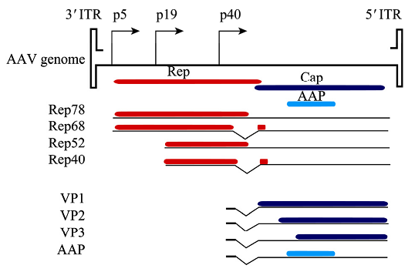
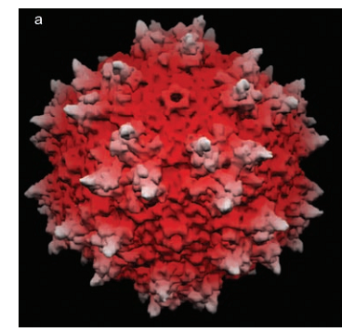
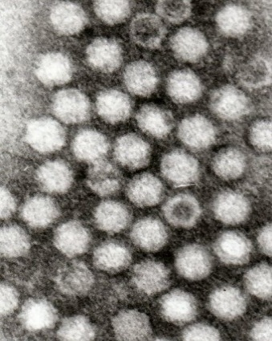
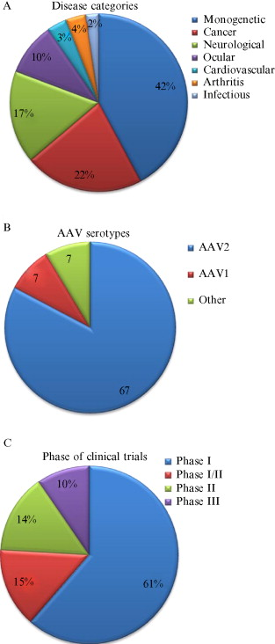
Adeno-Associated Viruses (AAV)
Genome
Virus Capsid
4.7 kb Single-stranded DNA
Diameter:26nm
Vector for gene therapy

Slide 4
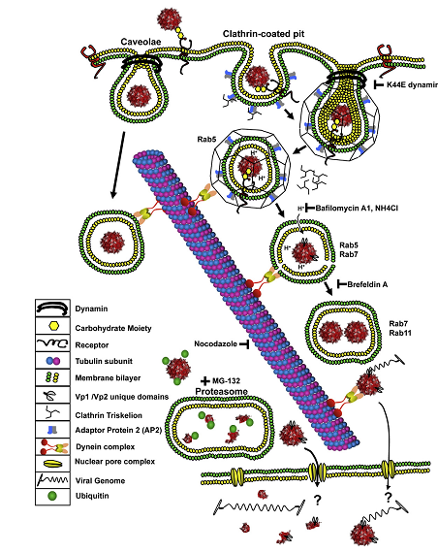
The process of AAV transduced host cell
How to track the great detail process in real time?

Slide 5
Current research in AAV labeling for tracking
1. Quantum dots (QDs) labeling strategy
Advantages: Higher fluorescence intensity;
Disadvantages: diameter of QD is larger than AAV ;
2. Chemical dyes strategy
Advantages: low molecule weight,
Disadvantages: non specific; toxicity of catalyst
We need a new viral labeling method which could site-specific without intervening viral activity!

Slide 6
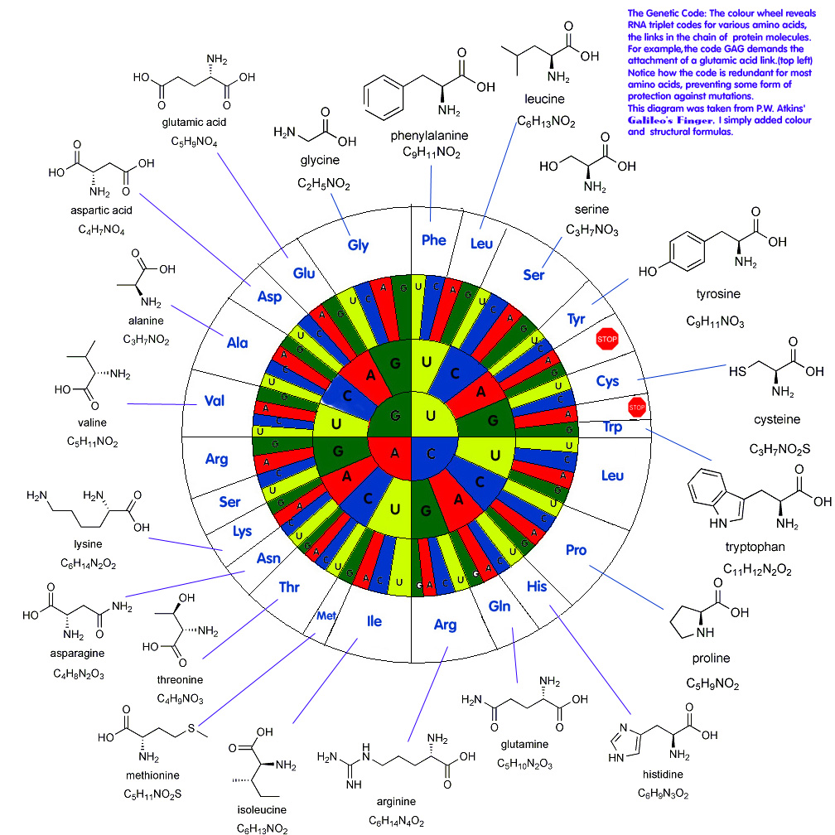
Opal
Almost all proteins made of these 20 amino acids
amber
Stop codon:
UAG
UAA
UGA
ochre
Notes:
首先介绍下我课题的大背景，在自然界一般情况下，蛋白质是由20种天然氨基酸组成的，这20种天然氨基酸则是由64种密码子中的61种来编码，剩下的这三种密码子（激光笔指）则是起到终止翻译的作用

Slide 7
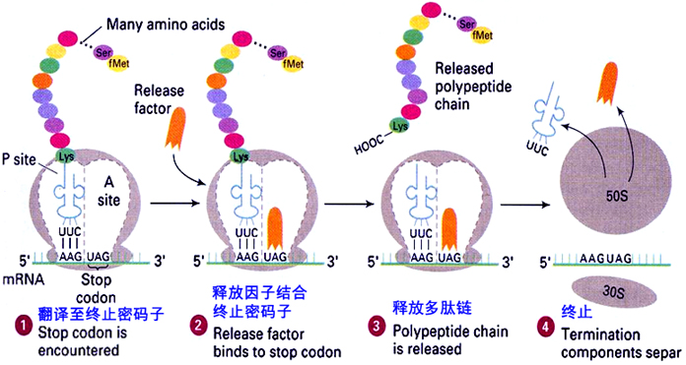
Stop codon play a role in terminating protein translation：
Notes:
看genes的书：翻译终止的机理 真核细胞的正常蛋白质翻译遇到终止密码子时，没有相应的携带氨基酸的tRNA进入到A位点，而是由释放因子结合在该位点，并在一系列因子的作用下释放多肽链从而终止翻译过程

Slide 8
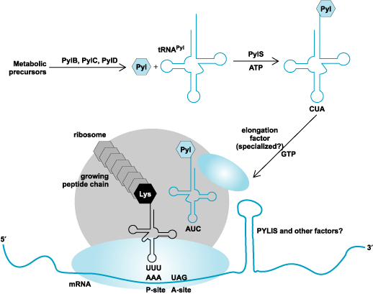
A few bacteria encode special amino acid using stop codon UAG in nature
Pyrrolysine, 22 nd amino acid, was incorporated into methylamine methyl transferase
in methanogens
Anirban Mahapatra, Joseph A. Krzycki, "Genetic code research," in AccessScience, ©McGraw-Hill Companies, 2007
Notes:
但这一过程在自然界中也不是一尘不变的。由于结构的类似性，在自然界也存在着利用终止密码子编码特殊氨基酸的现象。例如在谷胱甘肽过氧化物酶等一些酶中发现的可直接利用终止密码子编码的第21种氨基酸硒代半胱氨酸，以及在产甲烷的古细菌及细菌中发现的吡咯赖氨酸由特殊的可识别UAG密码子的tRNA插入蛋白质：这一切发现都提醒我们，如果我们可以认为的利用终止密码子向蛋白质中编码添加人工合成的具有各种特殊性质的非天然氨基酸，赋予蛋白质心的理化性质，便于人们研究和利用

Slide 9
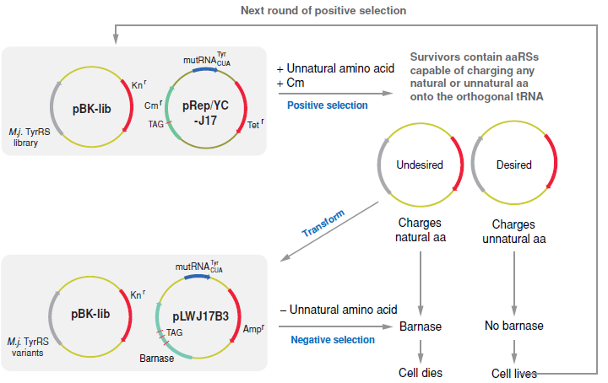
Bioorthogonal tRNA/aaRS pair
Positive and negative screening
Notes:
？？提出效率问题？？
而要筛选出这样的Trna/RS对，需要对构建的突变tRNA及RS库进行多轮的正负筛选从而得到具有生物正交性的tRNA/RS

Slide 10
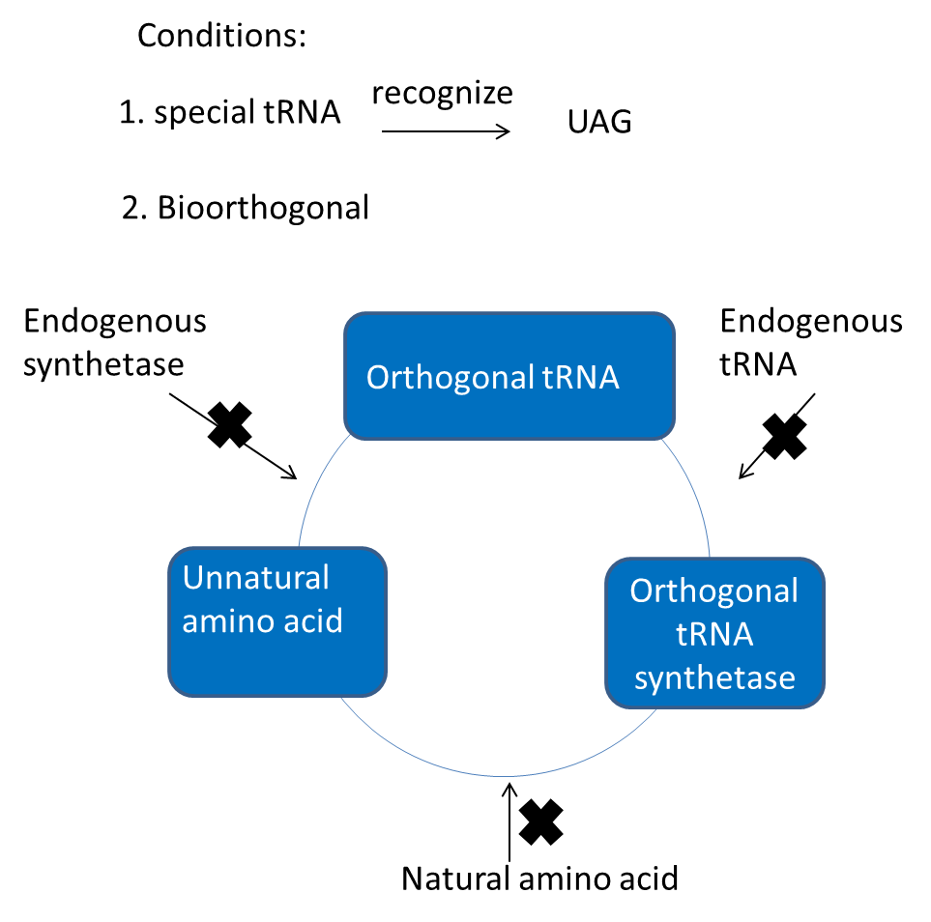
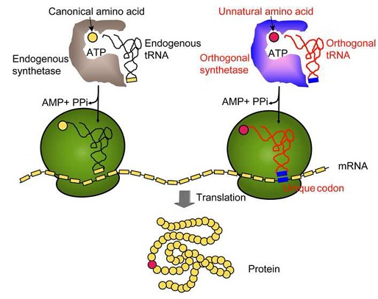
Genetic code expansion technology
= natural amino acid
= unnatural amino acid
Notes:
这就使得利用终止密码子编码氨基酸成为一种可能，近年来，PG schultz组开发的基因密码子扩展技术实现了这种可能。（也就有了我们实验室现在正在使用的这项基因密码子扩展技术）。该技术的原理如图所示。在正常的蛋白质翻译过程中，由tRNA特异性的识别与其对应的三联密码子，并在相应的氨酰-tRNA合成酶的共同作用下，将氨基酸插入到蛋白序列中。而基因密码子扩展技术则是人工合成具有特殊理化性质的非天然氨基酸，并利用与其正交的Trna/tRNA合成酶，在特定的位点实现非天然氨基酸的定点插入，从而赋予蛋白质新的理化性质

Slide 11
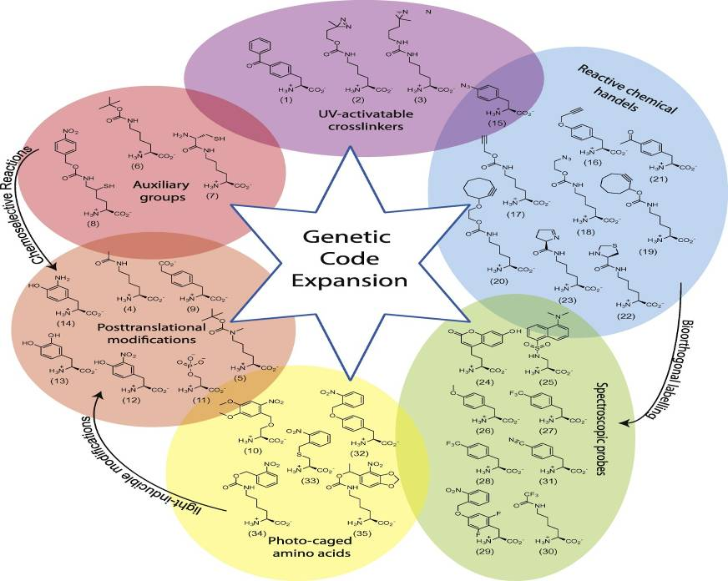
More than 100 unnatural amino acid were incorporated into proteins
Notes:
目前，利用基因密码子扩展技术，已经将约70多种具有不同功能的非天然氨基酸插入到蛋白质中。其中我们比较关注的是一类有光交联性质的非天然氨基酸
11

Slide 12
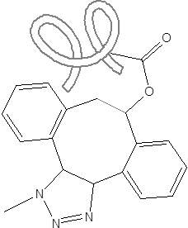
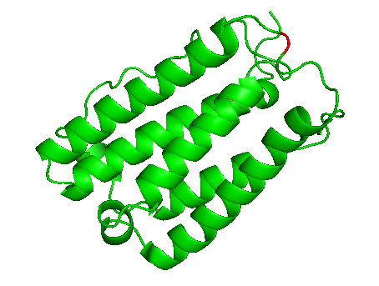
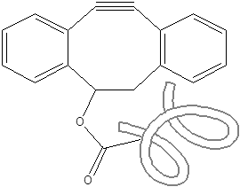
Unnatural amino acid and click-chemistry reaction
Unnatural amino acid
Nε-2-azideoethyloxycarbonyl-L-lysine (NAEK)
click-chemistry reaction
N₃
RT 2h
＋
Without any catalyst

Slide 13
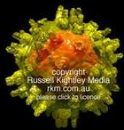
Our Topics
Site-specific labeling AAV by azido bearing amino acid, and then the fluorescence/targeting molecules were ligated through click reaction.
N3
+ DIBO-Fluorescence
Click chemistry
+ DIBO-folate
Research purposes
Superiority of our method:
1、 real-time imaging of a single virus;
2、Improve the viral targeting;
3、Enhance viral transduction;
1、Site-Specific ;
2、 Little effect on virus;
3、 High efficient and non-toxic of click reaction;

Slide 14
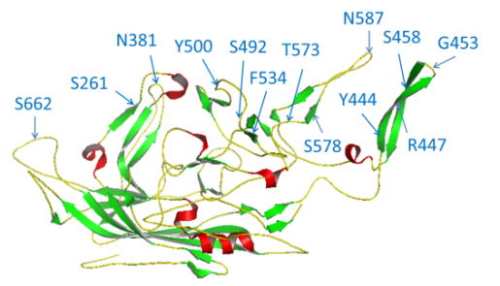
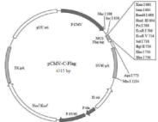
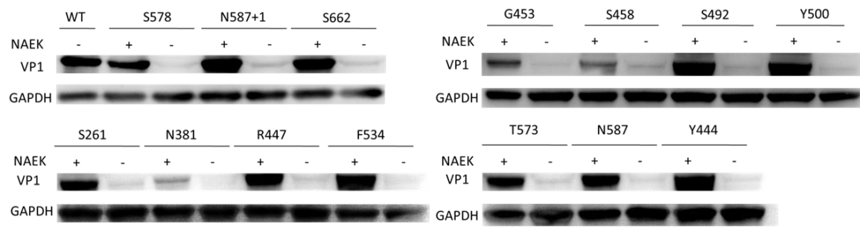
Genetic incorporation of the NAEK in AAV capsid protein VP1
Process of NAEK incorporated into VP1
pCMV- VP1-TAG Flag
TAG
+
Co- transfection
293T cell
1mM NAEK
MbPylRS/tRNA_{CUA}
Western-blot analysis the mutant VP1:
Anti- FLAG

Slide 15
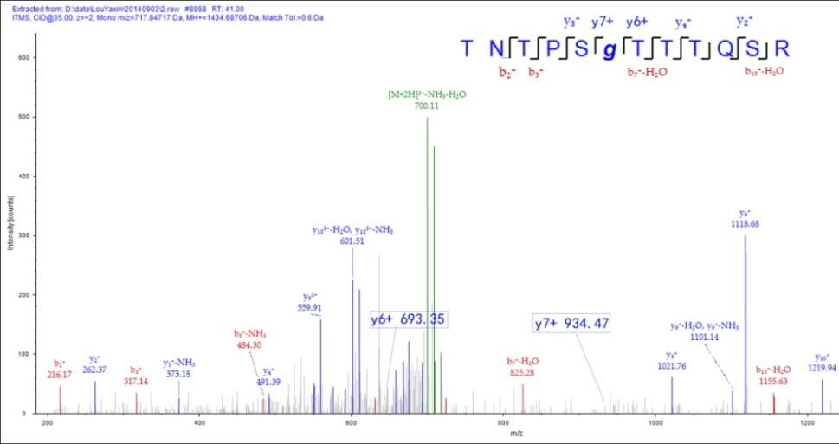
Verification of NAEK incorporation at the defined site by LC-MS/MS peptide sequencing.
G453 as a representative

Slide 16
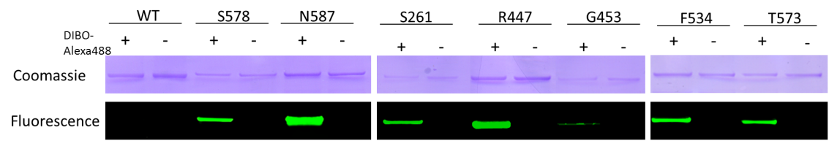
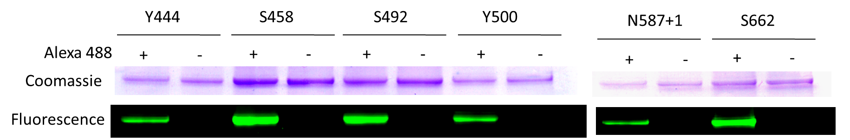
Identification of the NAEK bearing VP1 protein
Reaction between NAEK-VP1 protein and DIBO- Alexa 488

Slide 17
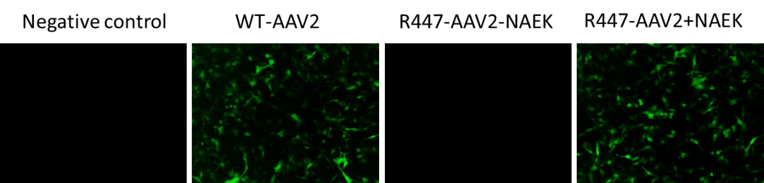
Genetic incorporation of the NAEK on AAV live capsid
Package of azido-modified AAV2-GFP
Identification of the NAEK bearing AAV2-GFP

Slide 18
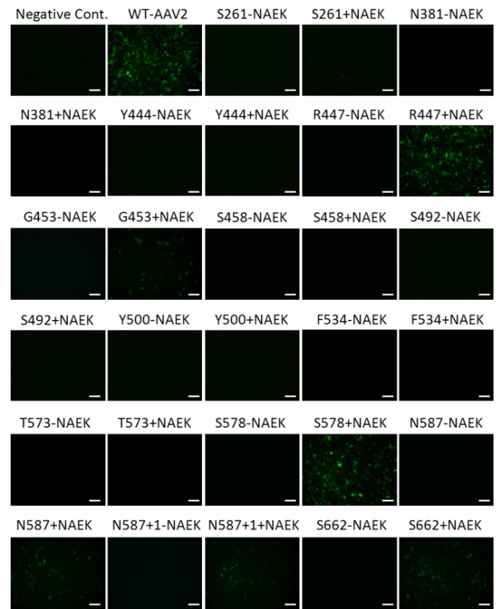
AAV2 nanoparticles can be site-specifically modified by genetically encoded azido tags
Functional titer
Genome titer

Slide 19
Fluorescence were site-specifically conjugated to azido-tagged AAV2
Click chemistry

Slide 20
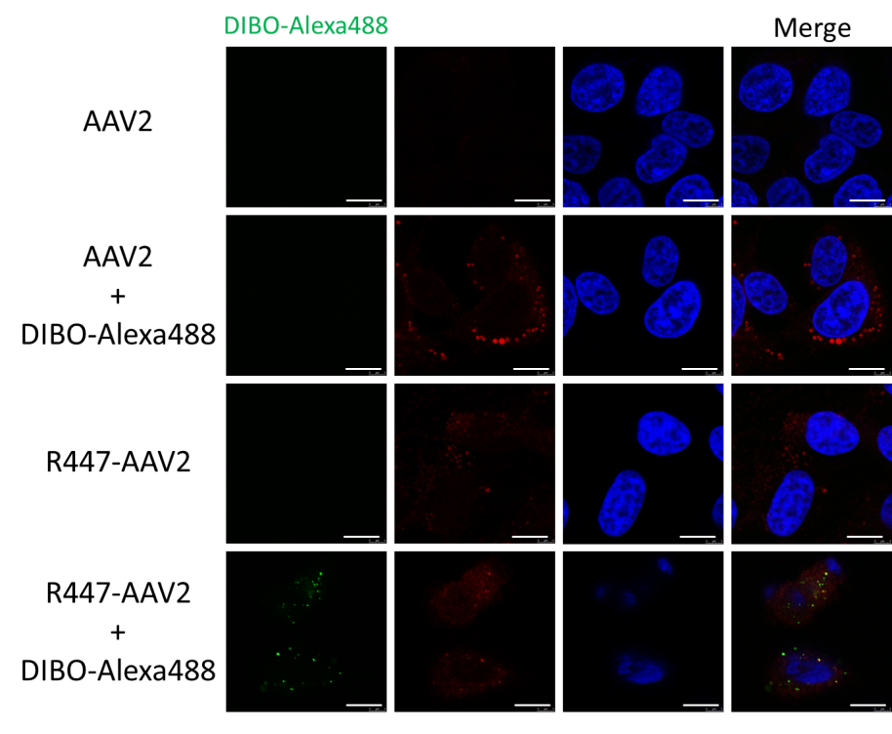
Alexa 488 was successfully labeled onto the virus surface

Slide 21
Quantitative analysis of the intracellular viral motility of Alexa488-labeled AAV2
(A, B,C) Representative trajectories of Alexa488- labeled AAV2 trafficking in HeLa cells. HeLa cells were incubated with Alexa488-labeled AAV2 for 30 min at 4°C, after which confocal time-lapse images were then recorded. Typical trajectories for Alexa488-AAV2 labeled AAV2 are presented (D), and the time trajectories of the viral velocity are shown (E, F, G). (H)The fraction of trajectories of Alexa488-AAV2 that are categorized as “slow undirected”, “fast undirected”, and “fast directed” as defined in the text. The scale bar equals 10 μm.

Slide 22
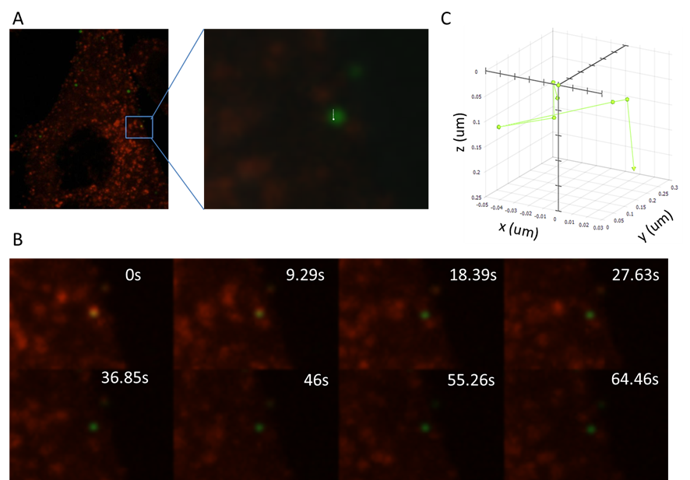
Real-time monitoring of Alexa 488-AAV2 internalization through the clathrin-coated pit.
At 24 h post-transfection, the cells were incubated with Alexa488-labeled AAV2 (green) for 30 min at 4°C, and were then warmed to 37°C to initiate virus internalization. Confocal time-lapse images were then recorded. A representative trajectory of Alexa488-AAV2 in HeLa cells expressing mRFP-clathrin (A) and the selected frames of the real-time imaging (B) are presented. C, The three-dimensional trajectory (green) of a single AAV2 was tracked in HeLa cells expressed with mRFP-clathrin.

Slide 23
Conclusion
Our present study demonstrates the potential of this site-specific labelling method for monitoring the dynamic interactions between AAV2 and the target cell structures in greater details. The facile and mild realization of site-specific engineering of AAV by natural propagation is of considerable interest to both basic research and for therapeutic applications.

Slide 24
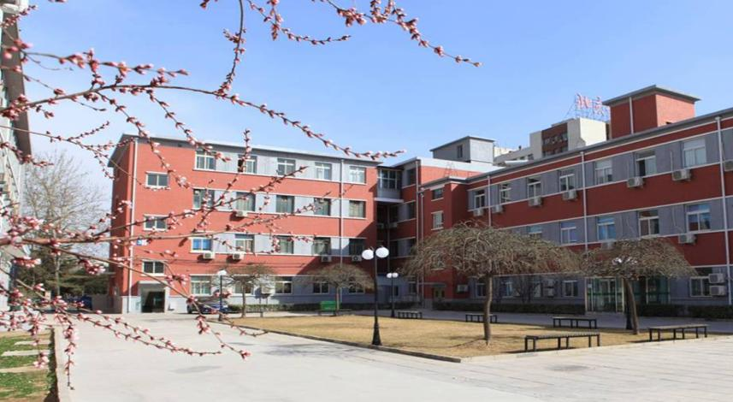
Thank you for your attention !
Notes:
24

