Slide 1
The Breast Cancer Epidemic: Evidence for a Radiogenic Cause
Christopher Busby
Environmental Research SIA
Riga, Latvia
European Committee on Radiation Risk
ECRR Brussels

Slide 2
Cancer is a genetic disease expressed at the cellular level. More than 80% of all cancers are the result of damage to genetic material from environmental carcinogens. Other components of risk are inherited genetic predispositions which themselves may be environmental in origin.
If there is a sudden increase in cancer in a population with a stable cancer rate over time, then it is evidence for previous exposure to such a carcinogen/ mutagen.
The lag period between exposure and clinical expression varies between cancer sites and has been shown to be some function of (a) the natural replication rate of the target cells and (b) the level of exposure. For breast cancer, based on the increases in the Hiroshima A-Bomb series, the time lag is between 10 and 25 years, and is a function of the age at exposure and the level of exposure (the “external dose”).

Slide 3
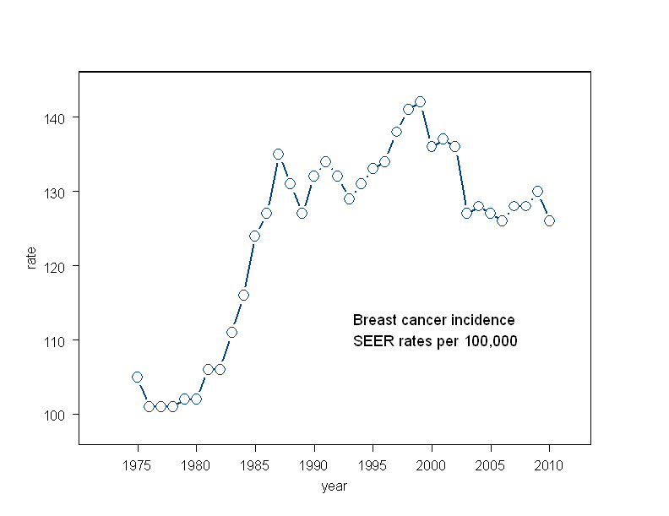
In the USA breast cancer annual incidence rate was fairly stable at about 100 per 100,000 until 1982 when it suddenly rose steeply. Why?

Slide 4
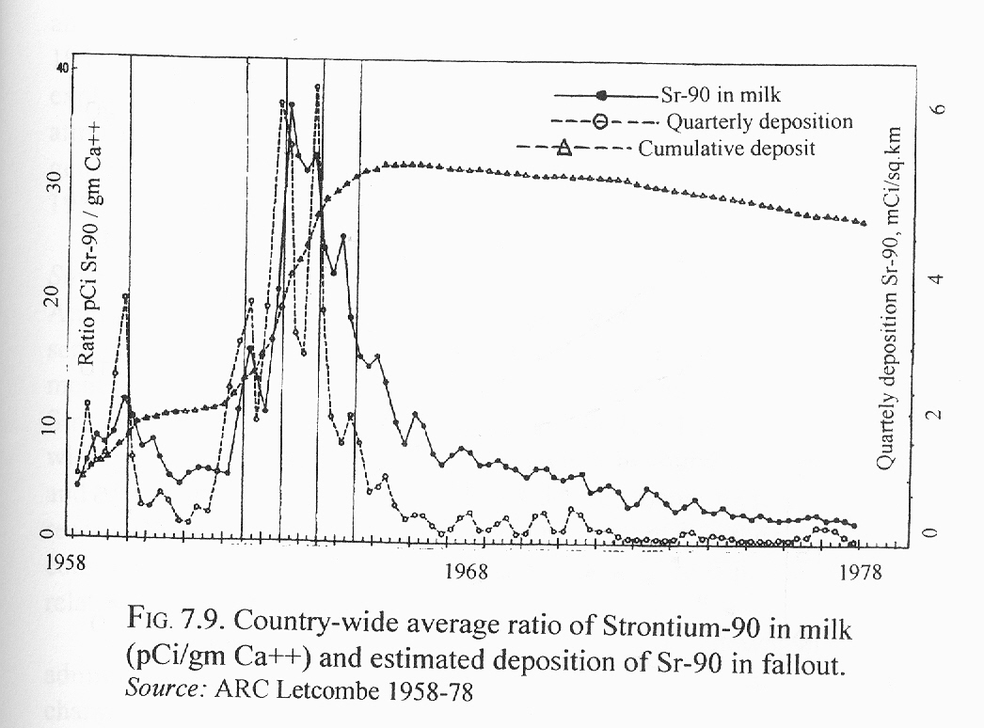
Is it possible that the cause of the increase was exposure of the most sensitive cohort age 10-14 to Strontium-90 and Uranium-238/ Uranium-234 in Atmospheric Nuclear Test fallout? How could we see?

Slide 5
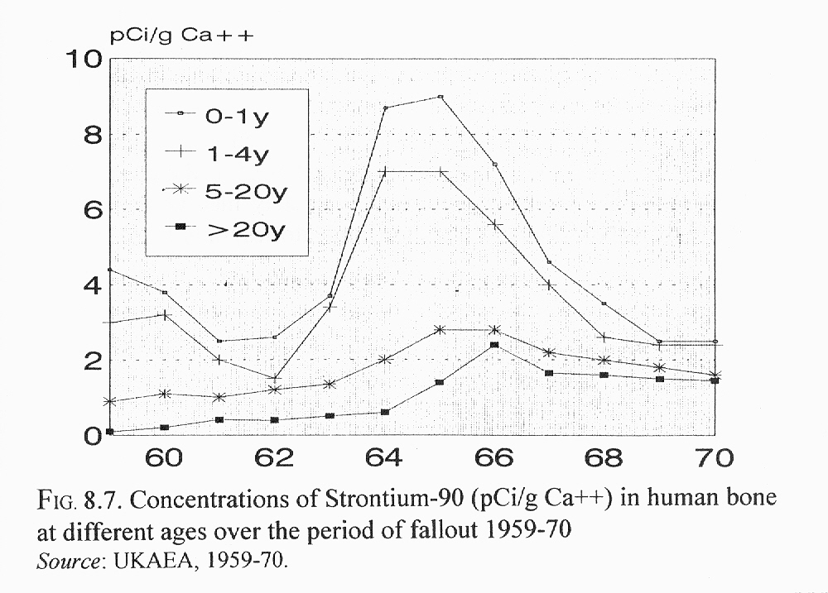
Strontium-90 was measured, though Uranium was not. Nevertheless, they will both seek bone and the phosphate backbone of DNA. There were peaks in 1959 and 1964.

Slide 6
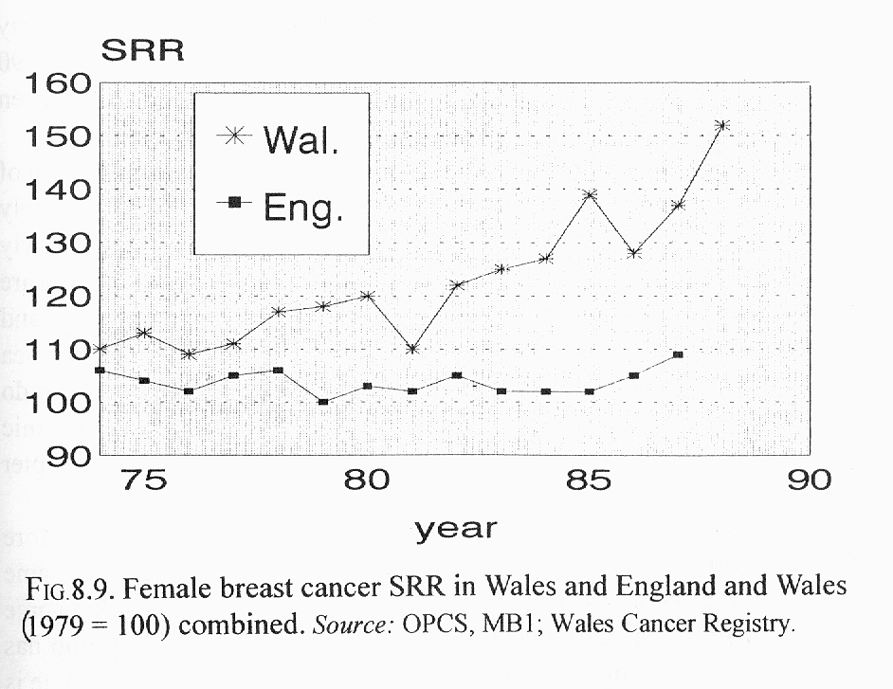
In 1994 I suggested in a letter in the British Medical Journal that the weapons test fallout was the origin of the cancer epidemic. This epidemic began in Wales, a country with high rainfall and 3-fold higher fallout than England. The England rates began to rise in 1986, but the Wales rates began to rise in 1979. The graphs show age standardised index SRR 1979 = 100

Slide 7
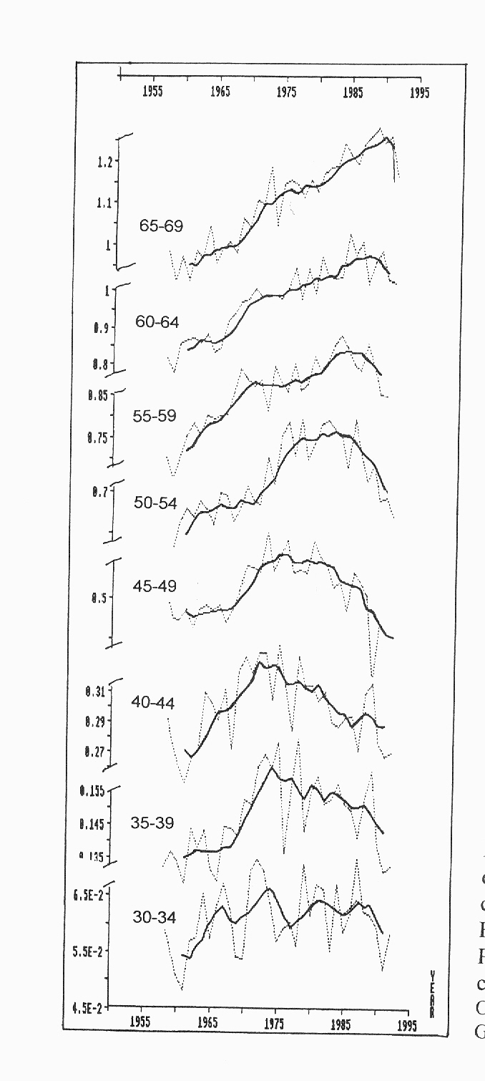
Breast cancer mortality, England and Wales 1958-1992 If the breast cancer increase is a consequence of the exposure between 1959 and 1963 of young girls at puberty, which we know from the Hiroshima studies, we would expect a cohort effect. There is a cohort effect. The peak rates in the 5-year age groups move to the right over the period. [Busby 1997]

Slide 8
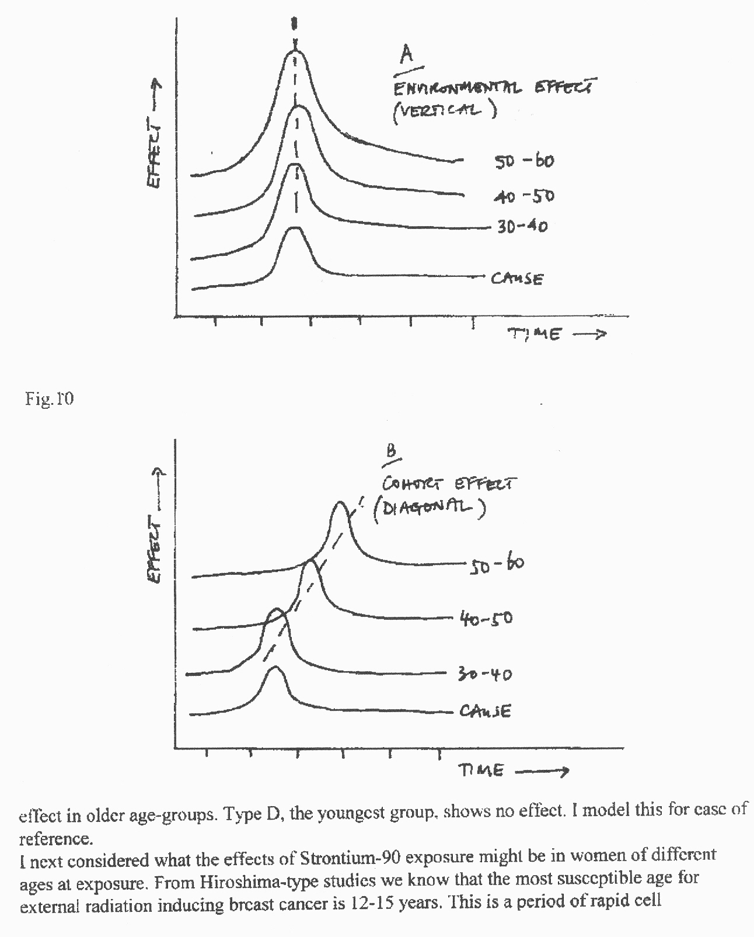
Cohort and environmental effects If all women were equally affected by the radioactivity in the fallout, there would be an environmental effect, the rates would rise together and then fall. But if one group were more sensitive there would be a cohort effect, and the rates would peak in a diagonal sequence with time for different age groups

Slide 9
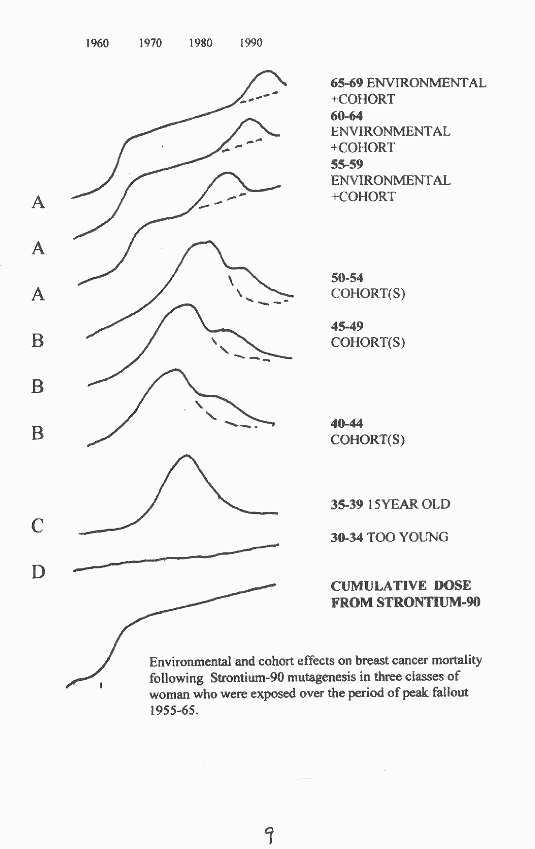
In fact we see both.

Slide 10
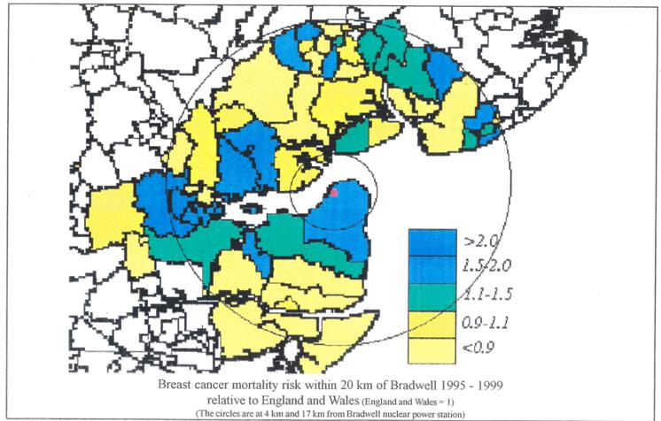
Other evidence; Mortality RR = 2 near nuclear sites in England 1. Bradwell Nuclear power station and estuary contamination. Busby C. Breast cancer mortality in Estuary Wards near Bradwell Nuclear Power Station Essex, 1995-2001 J.J Epidemiol. Prevent. 2015(1) 006

Slide 11
Breast cancer mortality near nuclear sites [2] 2-fold excess in estuary wards and in Burnham on Sea North, downwind of Hinkley Point Nuclear Power Station in Somerset 1995-2001. Busby C, de Messieres M and Morgan M. See www.greenaudit.org also currently submitted to J.J Epidemiol. Prevent [3]. 5-fold excess in Llan Ffestiniog 2km downwind from Trawsfynydd Nuclear Power Station in women < 60yr. Overall 2-fold. Busby C and de Messieres M Cancer near Trawsfynydd Nuclear Power Station in Wales- A cross sectional cohort study JJ Epidemiol. Prevent 2015; 1(1) 008 [4] Gould Jay M. The enemy within; the high cost of living near nuclear reactors. Breast Cancer, low birth weights and other radiation induced immune deficiency effects. New York: Four Walls Eight Windows . US Nation-wide study of breast cancer in downwind counties

Slide 12
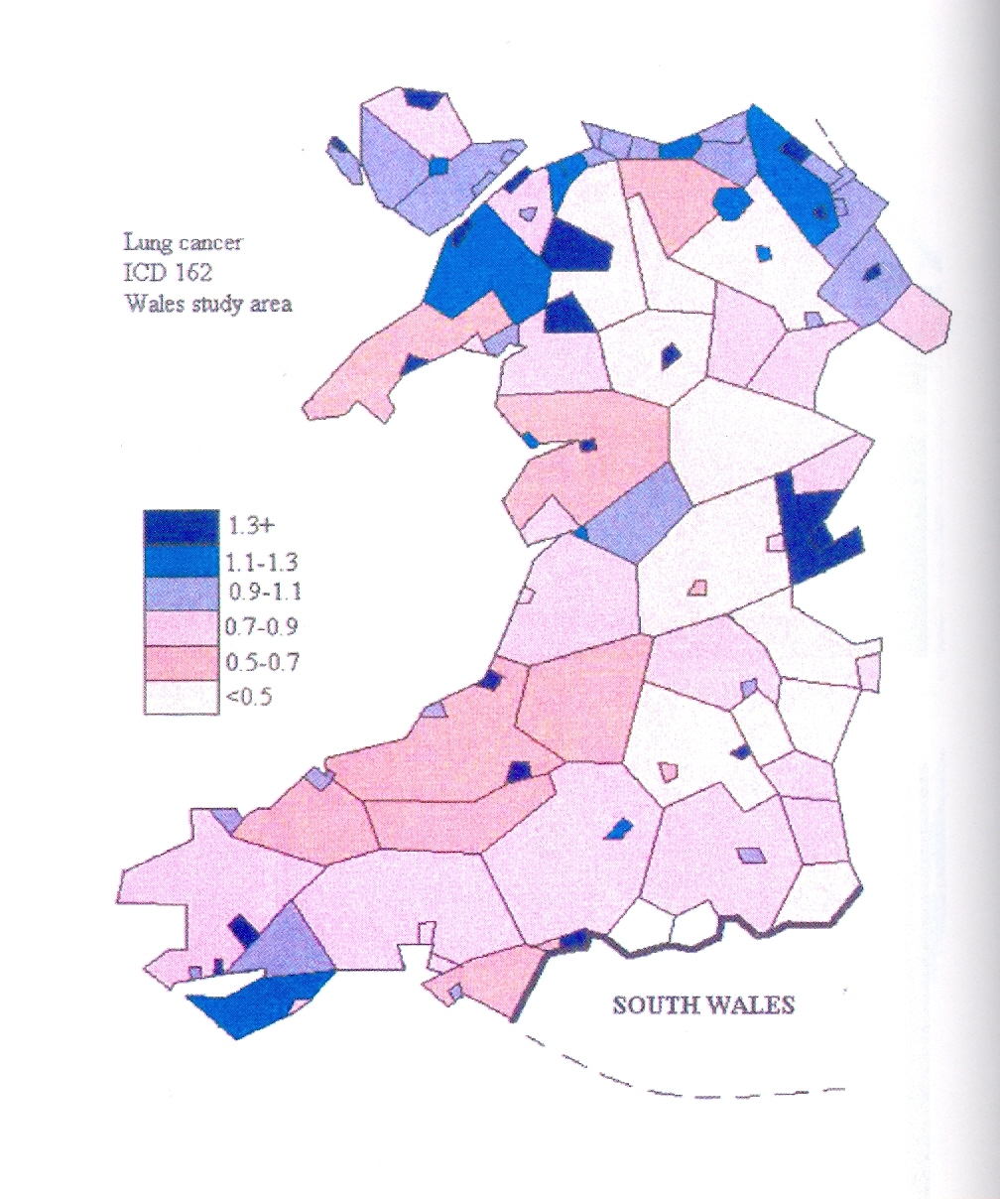
Contaminated sea-coast and estuary effects 1. Irish Sea Wales Cancer Registry Small areas study 1974-90 Busby C Wolves of Water 2007 Contamination is measured and reported; from Sellafield and Chernobyl, mostly in North West

Slide 13
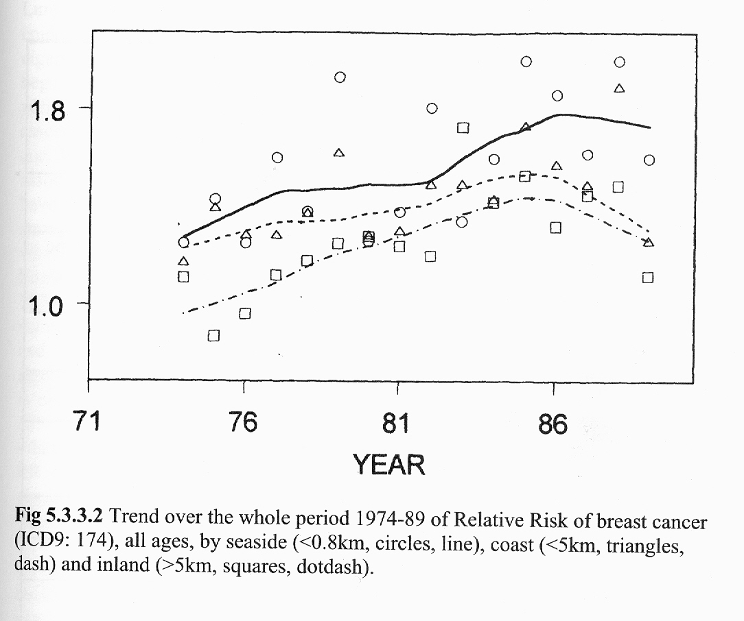
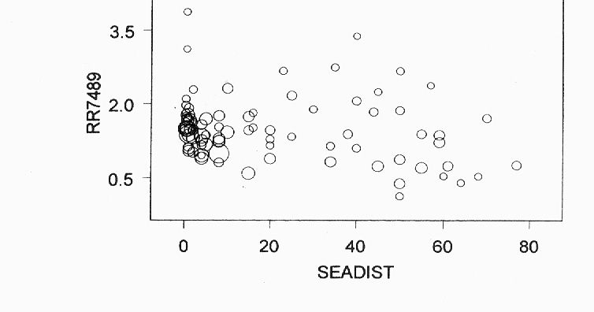
Contaminated sea-coast and estuary effects 1. Irish Sea Wales Cancer Registry Small areas 1974-90 Breast Cancer

Slide 14
Contaminated sea-coast and estuary effects 1. Irish Sea Wales Cancer Registry Small areas 1974-90 Busby C Wolves of Water 2007
Km from Sea | Mean (SD) | (N) AORs | Observed 74-89 | Expected 74-89 | Relative Risk
<0.8 | 0.56 (0.17) | 16 | 1646 | 1035 | 1.59
0.9<d<2 | 1.38 (0.51) | 13 | 1372 | 972 | 1.41
2.1<d<5 | 4.27 (0.47) | 11 | 995 | 777 | 1.28
5.1<d<11 | 8.44 (0.88) | 10 | 1045 | 188 | 1.32
11.1<d<20 | 17.5 (2.32) | 10 | 456 | 374 | 1.22
21-80 | 54.3 (8.5) | 33 | 1120 | 901 | 1.24
South Wales |  | 62 | 10907 | 9274 | 1.18
All Wales |  | 189 | 23333 | 18421 | 1.27

Slide 15
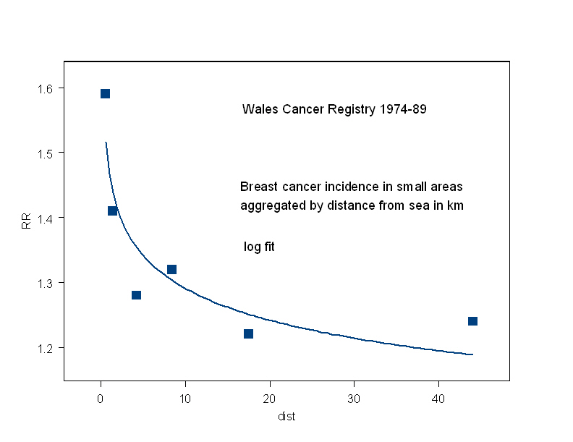
Log fit of RR in aggregated small areas by distance from sea

Slide 16
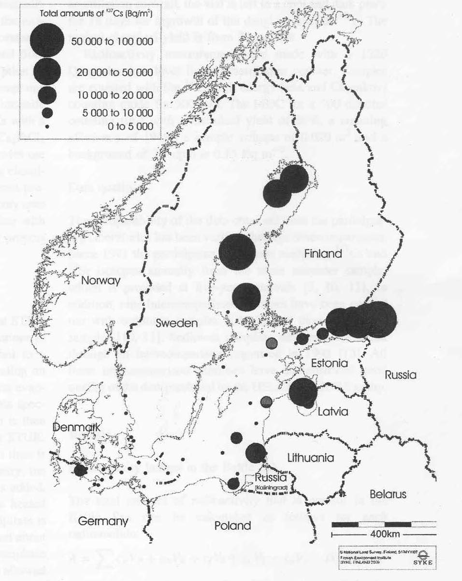
The Baltic Sea is now the most radioactive in the world
This map is from a
recent peer-reviewed paper by HELCOM and STUK personnel with whom we discussed this issue in Helsinki. Note the level of Cs-137 in the Gulf of Riga. Levels in sediment are as high as 50,000Bq/sq metre. There is also Strontium-90 and there are other radionuclides.
Uranium is not measured

Slide 17
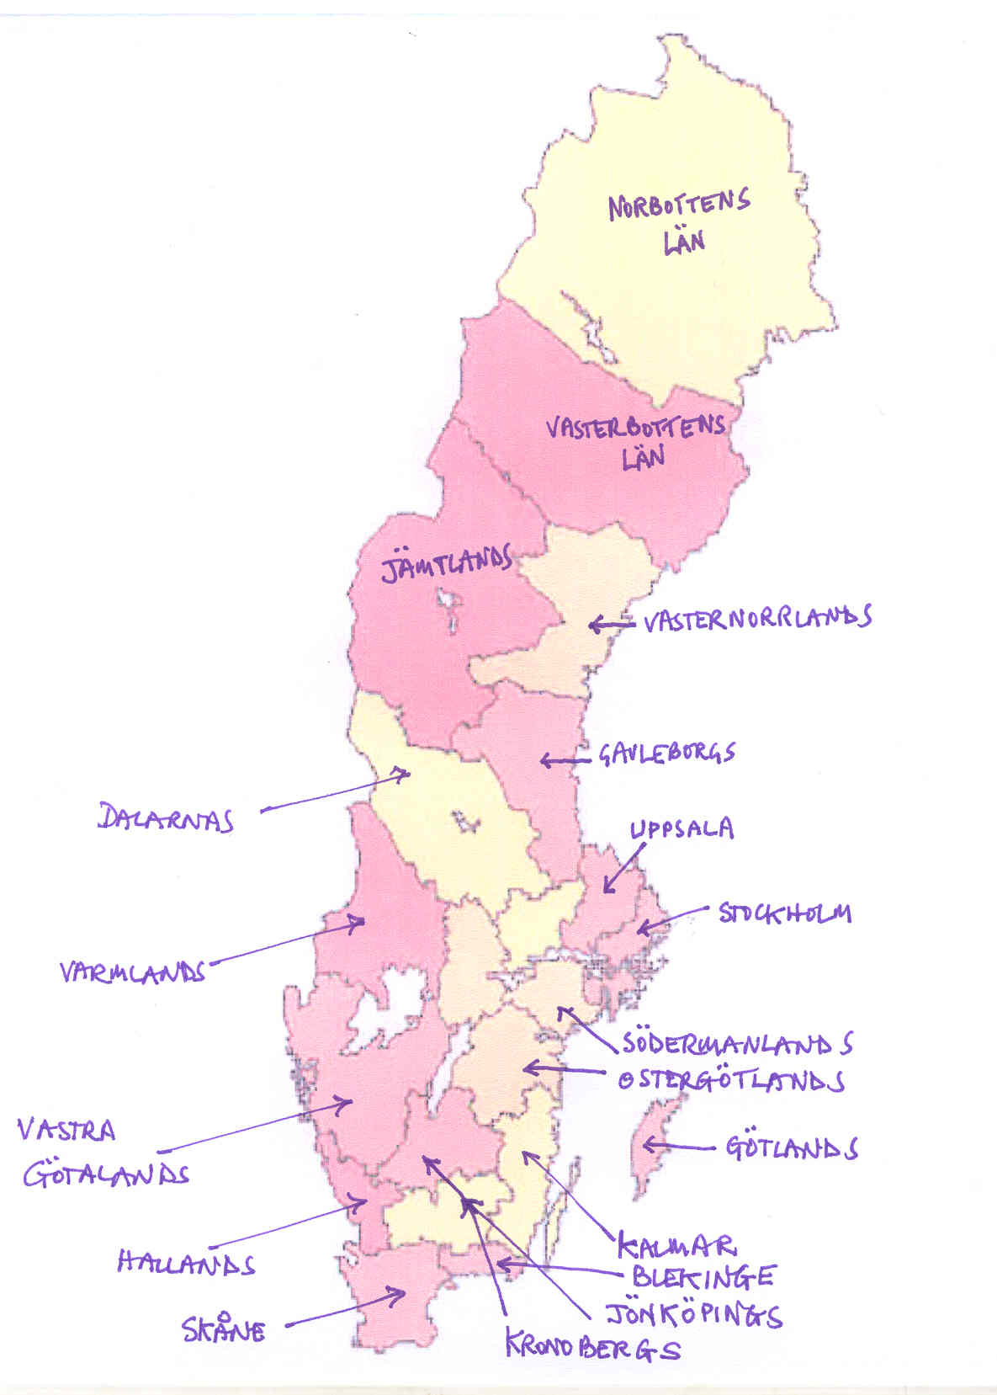
In 2010 we carried out a preliminary investigation of breast cancer incidence rates in the Swedish Counties before and after Chernobyl, comparing 1984-85 with 1988-91 by coastal (Baltic Sea, exposed) and inland (Norway non-exposed) counties. The presentation was criticised by pro-nuclear groups for not having employed earlier data. Inclusion of earlier data made the effects more pronounced.

Slide 18
Sweden standardised Breast Cancer rates/10⁵
County | 84 | 85 | mean | 88 | 89 | 90 | 91 | mean | %Δ
BALTIC
Stockholm | 110 | 118 | 114 | 119 | 124 | 141 | 141 | 131 | +15
Blekinge | 87 | 117 | 103 | 131 | 120 | 145 | 131 | 132 | +28
Kalmar | 103 | 103 | 103 | 130 | 107 | 103 | 107 | 112 | +9
Uppsala | 106 | 114 | 110 | 112 | 119 | 142 | 125 | 125 | +13
Gavleborgs | 81 | 79 | 80 | 80 | 86 | 100 | 101 | 92 | +15
VasterN | 102 | 96 | 99 | 86 | 99 | 142 | 134 | 115 | +16
Skane | 106 | 114 | 110 | 112 | 119 | 142 | 125 | 125 | +13
Hallands | 92 | 106 | 99 | 98 | 130 | 141 | 104 | 118 | +19
VasterG | 104 | 105 | 105 | 116 | 123 | 133 | 133 | 126 | +21
INLAND
Varmlands | 90 | 96 | 93 | 82 | 99 | 87 | 103 | 93 | 0
Dalarnas | 113 | 114 | 114 | 93 | 115 | 95 | 100 | 101 | -11
Jamtlands | 103 | 119 | 111 | 98 | 77 | 79 | 106 | 90 | -19

Slide 19
In addition, very high rates of breast cancer occur in Iraqi populations following the use of Depleted Uranium weapons. See: Busby, Chris, Hamdan, Malak; Ariabi, Entesar. (2010) Cancer, Infant Mortality and Birth Sex-Ratio in Fallujah, Iraq 2005–2009. Int. J. Environ. Res. Public Health 7, no. 7: 2828-2837. Relative Risk for breast cancer was greater than 9. Uranium was measured in the hair of the mothers of children with congenital birth defects. The huge difference between relative risks for external doses (mammograms, radiotherapy) and internal doses (fallout, nuclear source releases) is due to the way in which “dose” is averaged over kilograms of tissue. It is dose at the cell and DNA level which is the quantity which should be correlated, not average dose.

Slide 20
For a discussion of the issue see: Busby Christopher (2013). Aspects of DNA Damage from Internal Radionuclides, New Research Directions in DNA Repair, Prof. Clark Chen (Ed.), ISBN: 978-953-51-1114-6, InTech, DOI: 10.5772/53942. Available from: http://www.intechopen.com/books/new-research-directions-in-dna-repair/aspects-of-dna-damage-from-internal-radionuclides

Slide 21
Other studies referred to: Busby Christopher (2015) Editorial: Uranium Epidemiology. J.J. Epidemiology Prev. Med. 1(2)- 009 Busby Christopher (2015) Editorial: Epidemiology and the Effects of Radioactive Contamination: Time for a New Approach. J.J. Epidemiology Prev. Med. 1(1)- 02; Busby Christopher (2015) Breast Cancer Mortality in Estuary Wards near Bradwell Nuclear Power Station, Essex, UK 2001-1995 . J.J. Epidemiology Prev. Med. 1(1)- 06; Busby, Christopher, de Messieres, Mireille (2015) Cancer near Trawsfynydd Nuclear Power Station in Wales, UK: A Cross Sectional Cohort Study. J.J. Epidemiology Prev. Med. 1(1)- 08; Busby C. (2007) Wolves of Water. Aberystwyth: Green Audit.

