Slide 1
About OMICS Group
OMICS Group International is an amalgamation of Open Access publications and worldwide international science conferences and events. Established in the year 2007 with the sole aim of making the information on Sciences and technology ‘Open Access’, OMICS Group publishes 400 online open access scholarly journals in all aspects of Science, Engineering, Management and Technology journals. OMICS Group has been instrumental in taking the knowledge on Science & technology to the doorsteps of ordinary men and women. Research Scholars, Students, Libraries, Educational Institutions, Research centers and the industry are main stakeholders that benefitted greatly from this knowledge dissemination. OMICS Group also organizes 300 International conferences annually across the globe, where knowledge transfer takes place through debates, round table discussions, poster presentations, workshops, symposia and exhibitions.

Slide 2
About OMICS Group Conferences
OMICS Group International is a pioneer and leading science event organizer, which publishes around 400 open access journals and conducts over 300 Medical, Clinical, Engineering, Life Sciences, Phrama scientific conferences all over the globe annually with the support of more than 1000 scientific associations and 30,000 editorial board members and 3.5 million followers to its credit.
OMICS Group has organized 500 conferences, workshops and national symposiums across the major cities including San Francisco, Las Vegas, San Antonio, Omaha, Orlando, Raleigh, Santa Clara, Chicago, Philadelphia, Baltimore, United Kingdom, Valencia, Dubai, Beijing, Hyderabad, Bengaluru and Mumbai.

Slide 3
Targeted analysis of biomarkers for the screening of botanicals in herbal food supplements
Philippe Christen, Caroline Mathon, Stefan Bieri
School of Pharmaceutical Sciences, University of Geneva, Switzerland
Official Food Control Authority of Geneva, Switzerland
SCAHT, Swiss Centre of Applied Human Toxicology
philippe.christen@unige.ch

Slide 4
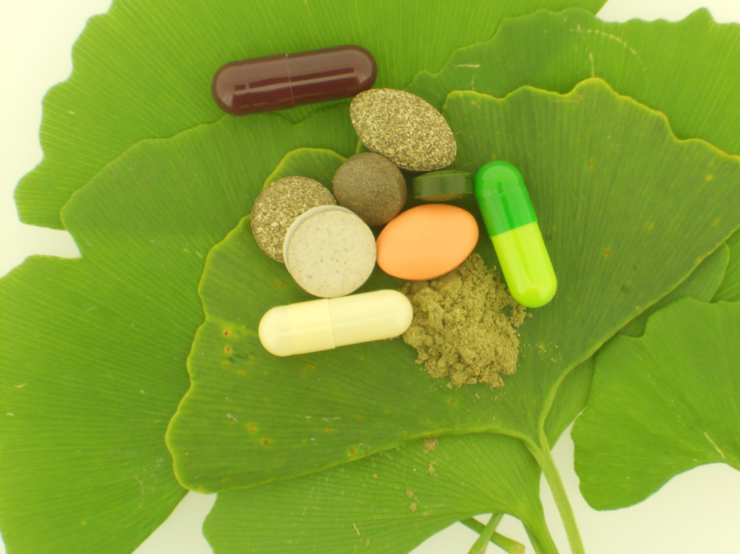
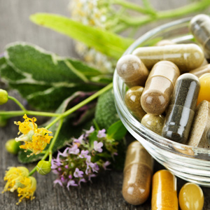
Introduction
Botanicals and botanical preparations intended as food supplements are widely marketed with various health claims.
Consumption of herbal food supplements (HFS) is increasing all over the world.
This commercial success is
largely due to a growing interest in
natural ingredients.
The preparations are easily
available to consumers through
several distribution channels: as OTC medicines in pharmacies, in supermarkets, herbalist’s shops and via the Internet.
http://images.elephantjournal.com/wpcontent/uploads/2013/05/4e67f86371bf14227407792901281ef9.jpg

Slide 5

Definition of a food supplement
European Food Safety Authority (EFSA)
  "Food supplements are concentrated sources of nutrients or other substances with a nutritional or physiological effect, whose purpose is to supplement the normal diet." ^{[1]}
  [1] Directive 2002/46/EC

Slide 6


Definition of a food supplement
A dietary supplement is a product intended for ingestion that contains a "dietary ingredient" intended to add further nutritional value to (supplement) the diet.

Slide 7
HFS must not have any therapeutical activity and therefore are regulated differently than pharmaceutical drugs.
To check the composition of food supplements to protect consumers.
Public health : ensure product safety and quality. Does this food supplement contain any "undesirable" plant or chemical ?
Fraud : is the composition consistent with the labelling and current legislation on herbal food supplements ?

Slide 8


Some problems encountered with HFS
When labelling is not in accordance with the regulation
  illegal health claims
  HFS contain unauthorized ingredients
When labelling does not correspond
to the composition
  Absence of a plant: omission, mistake, … or fraud
  Presence of a plant not listed: adulteration or contamination
  Addition of synthetic chemicals to 100% natural preparation: adulteration

Slide 9

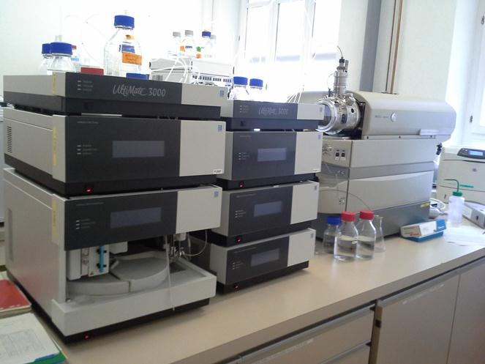
Analytical approaches
Literature search
Instrumentation
Analytical methods already exist for the detection
of plants but they are usually specific for 1 compound
or a class of compounds.

Slide 10
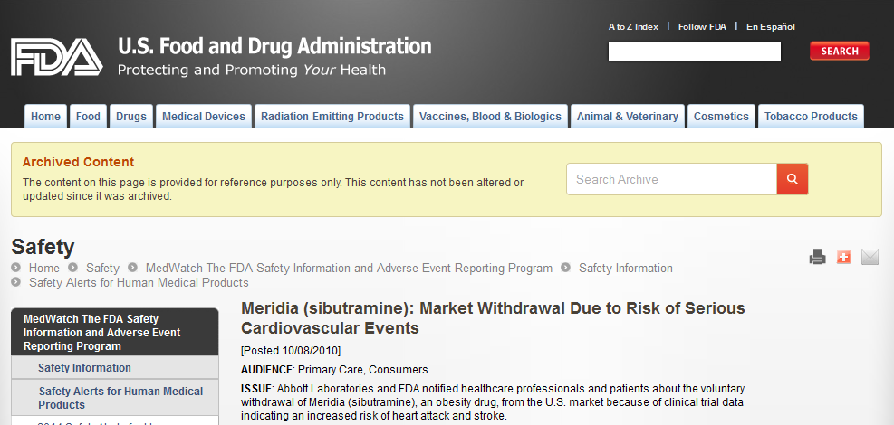

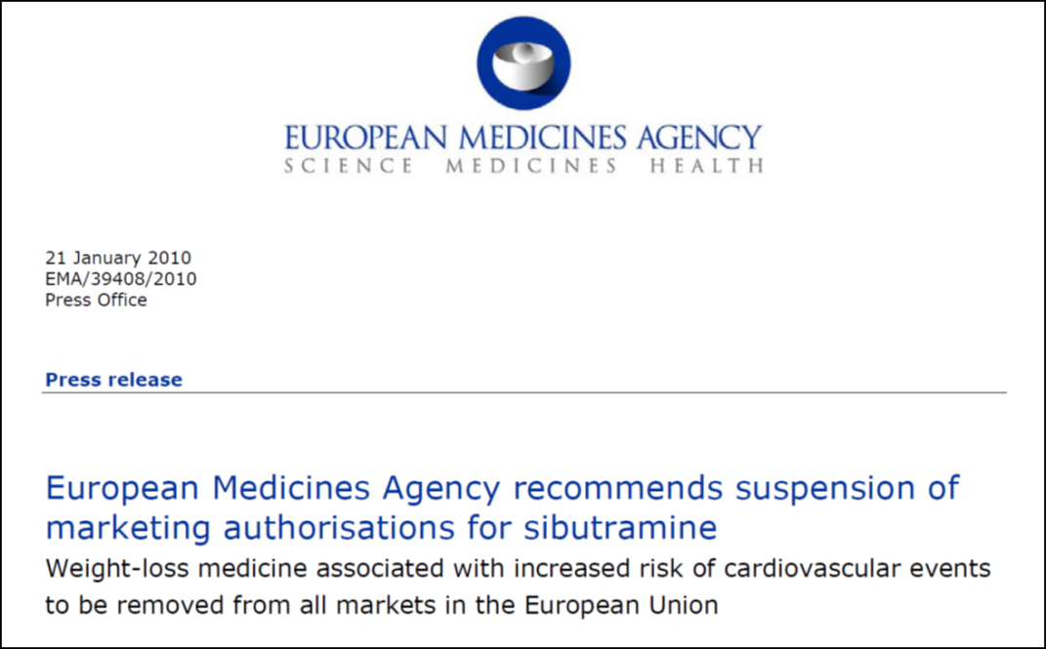
100% natural slimming capsules adulterated with sibutramine
Case study 1
Sibutramine

Slide 11
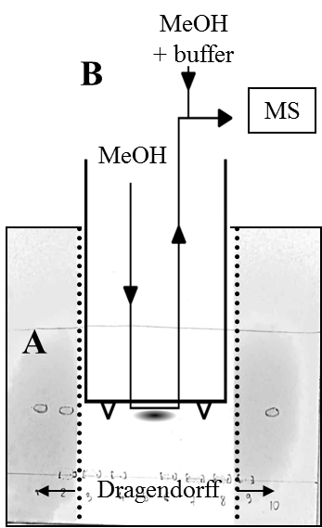
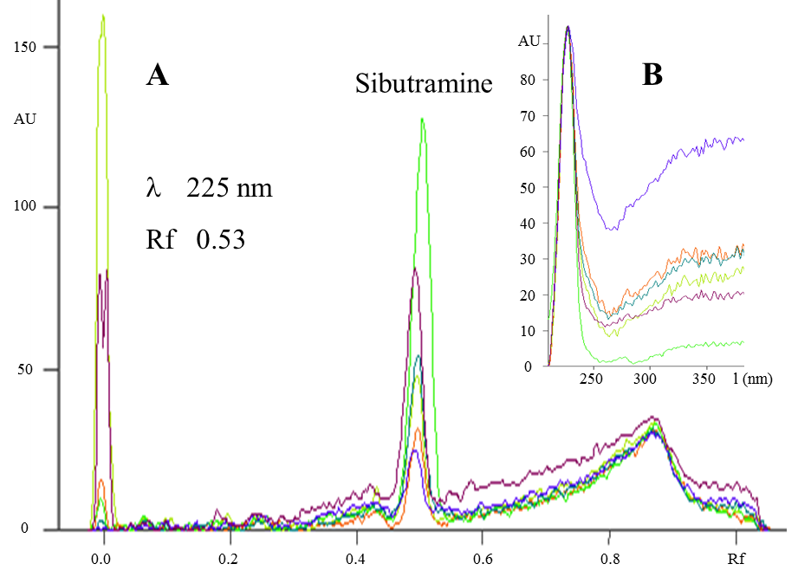
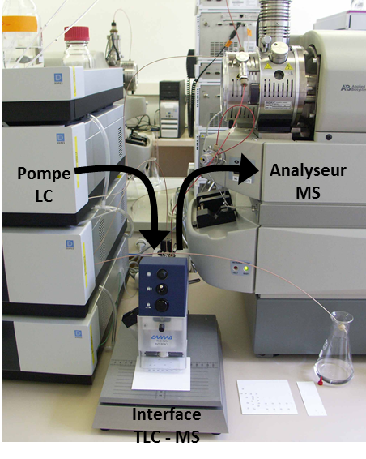
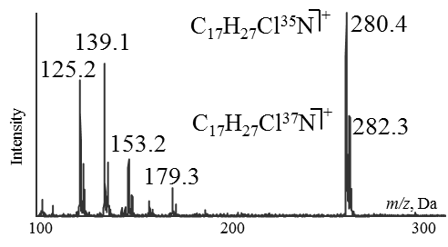
HPTLC-UV/MS
HPTLC-UV
MS INTERFACE

Slide 12
HPTLC-UV/MS
52 diet food supplements analyzed
  half of the samples were adulterated with sibutramine
  amounts ranged between trace levels to 35 mg per capsule
45
40
35
30
25
Sibutramine amounts (mg/capsule)
20
Range of
medical dosage:
10/15 mg/day
15
10
5
< LOQ
0
1
2
3
4
5
6
7
8
9
10
11
12
13
14
15
16
17
18
19
20
21
22
23
24
25
26
Adulterated samples

Slide 13

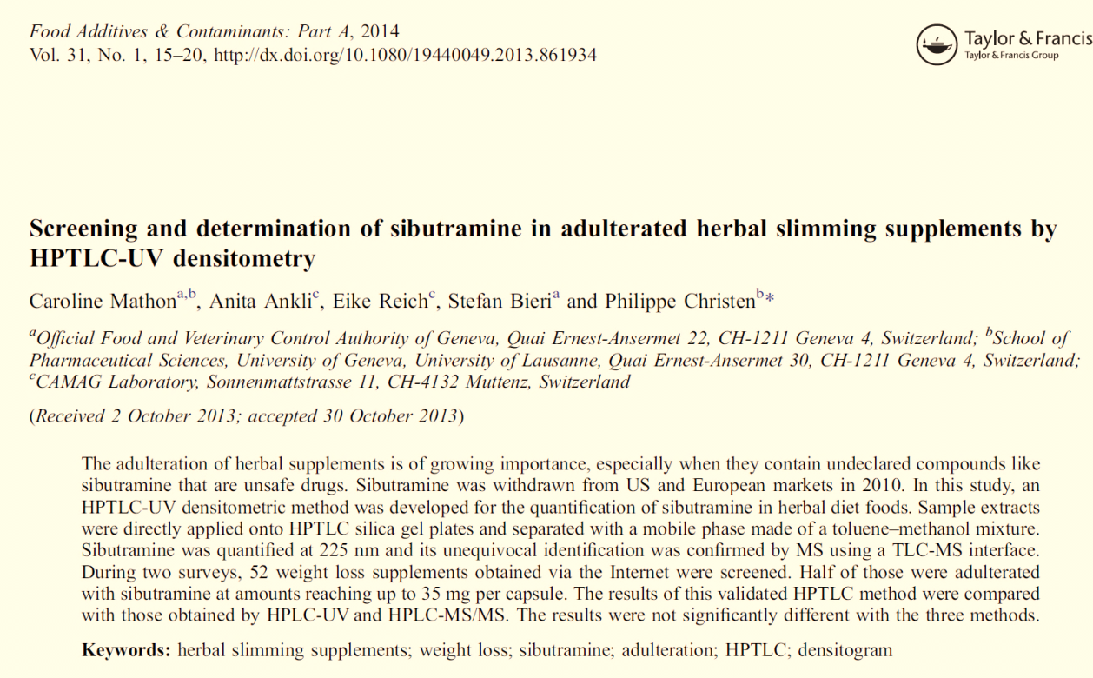
HPTLC-UV/MS

Slide 14

Chinese star anise is prone to contamination with Japanese star anise, a toxic species containing high concentrations of anisatin, resulting in cases of neurological problems in infants
Case study 2
Confusion or contamination
Neurotoxicities in Infants Seen With the Consumption of Star Anise Tea.
Diego Ize-Ludlow et al. (2004) Pediatrics 114:e653-e656
Neurotoxicities in Infants Seen With the Consumption of Star Anise Tea.

Slide 15
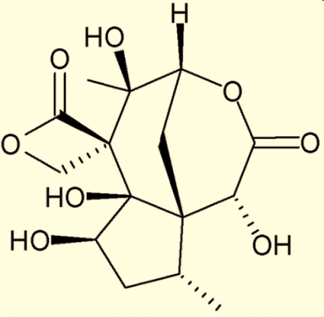
Confusion or contamination
A
A: Chinese star anise (Illicium verum Hook. f.)
B: Japanese star anise (Illicium anisatum L.)
contains a high concentration of
the neurotoxin anisatin
B
Anisatin

Slide 16
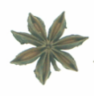
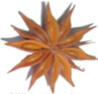

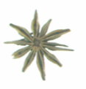
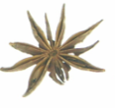
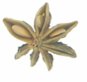
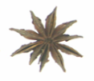
Anisatin concentration in different Illicium species
Sample preparation
  500 mg of sample + sand
  Defatting step with ≈ 15 mL of cyclohexane
  Extraction of anisatin: 2 cycles with 8 mL H₂O-MeOH (9:1,v/v) made up to 20 mL
Extraction
ASE
1000
447
566
  1 mL extract on EXtrelut®
  10 min equilibration time
  Elution with 3×2 mL of MTBE
100
69
Purification
EXtrelut®
Anisatin concentration (mg kg⁻¹)
- log scale -
10
5.1
A
B
C
D
  Evaporation under N₂
  Recovery in 0.2 mL H₂O-MeCN (9:1,v/v)
1
2.0
2.1
1.4
1.2
Concentration
< LOQ
< LOQ
0.4
n.d.
0
I. henryi
I. majus
I. verum
I. verum
I. verum
I. verum
Pimpinella
  Porous graphitic carbon column
  Eluent: H₂O-MeCN (5 to 97%)
  SRM in negative ionization mode
I. anisatum
I. micrantum
I .simonsii
anisum
I. brevistylum
I. lanceolatum
Analysis
LC-MS/MS
Samples
 | 1 | 2 | 3 | 4 | 5 | 6 | 7 | 8 | 9 | 10 | 11 | 12
Anisatin (mg kg⁻¹) | <0.2 | <0.2 | 0.23 | 0.41 | 0.42 | 0.44 | 0.65 | 0.80 | 1.32 | 1.50 | 1.92 | 39.00

Slide 17
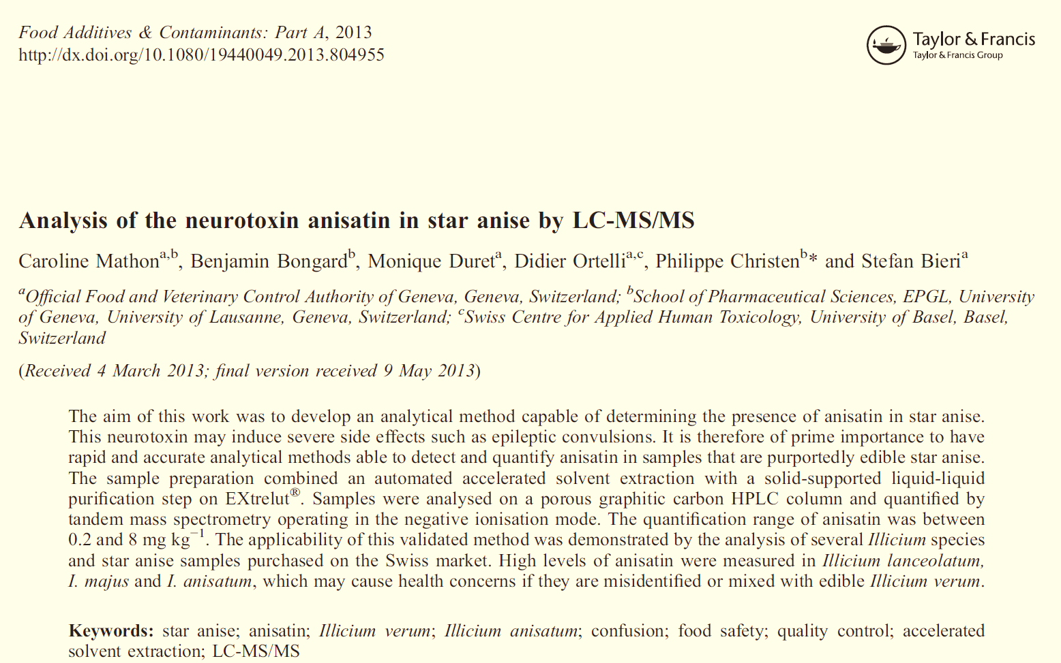

Slide 18
Presence of hepatotoxic pyrrolizidine alkaloids in herbal teas
Case study 3
C
H
C
H
O
H
C
H
H
C
H
H
H
O
C
H
H
O
3
S
3
3
H
H
O
H
O
3
C
H
Z
3
H
C
O
H
H
C
S
C
H
S
O
H
S
3
H
C
R
R
O
3
R
3
S
3
H
C
Z
R
O
M
e
O
R
O
3
H
C
H
C
H
O
H
O
O
3
H
3
O
3
C
H
O
Z
H
O
3
O
H
C
H
O
O
H
H
C
O
O
O
O
O
H
3
3
O
O
H
H
O
H
H
H
R
R
R
R
R
R
R
R
S
R
N
N
N
N
N
O
Echimidine
Lycopsamine
Retrorsine
Heliotrine
Senecionine N-oxide
520-68-3
10285-07-1
480-54-6
303-33-3
13268-67-2
H
O
C
H
O
H
H
H
O
C
H
H
H
O
C
H
3
C
H
3
3
H
C
3
Z
Z
H
3
R
R
O
H
C
R
O
H
C
R
R
O
R
3
C
H
O
3
H
C
H
O
O
O
O
2
O
3
O
H
O
H
O
H
R
R
R
R
R
R
N
N
N
Monocrotaline
Seneciphylline
Senecionine
315-22-0
480-81-9
130-01-8
H
C
O
H
H
H
H
O
3
C
H
H
O
C
H
C
H
3
Z
R
3
Z
M
3
R
O
H
C
R
O
H
C
e
O
S
3
H
C
H
3
H
C
H
O
3
O
O
O
3
O
O
O
H
S
R
R
N
N
C
H
Lasiocarpine
3
303-34-4
Senkirkine
2318-18-5

Slide 19
Sample preparation
  Herbal tea (2g or a tea bag)
  200 mL of boiling water
  10 min of shaking
  Aliquot of 1.5 mL
  15 µL of standards (for spiking or calibration)
Infusion
  100 mg of Zn powder
  30 min in ultrasonic bath at RT
Reduction
N-oxides
  30 µL of NH₃ 6M
  1 mL of basified extract on EXtrelut®
  10 min equilibration time
  Elution with 3×2 mL of ethyl acetate
Purification
EXtrelut®
  Evaporation under N₂
  Recovery in 0.1 mL NH₄CO₂H-Methanol (1:1,V/V)
Concentration
HPLC-MS/MS

Slide 20
Pyrrolizidine alkaloid content in 70 samples
 | Fennel | Black tea | Green tea | Mixture | Linden | Mint | Camomile | Verbena | Rooibos
Samples analyzed | 5 | 10 | 6 | 15 | 6 | 8 | 10 | 1 | 9
Samples with PAs | 0 | 0 | 0 | 2 | 1 | 4 | 7 | 1 | 9
% samples with PAs | 0% | 0% | 0% | 13% | 17% | 50% | 70% | 100% | 100%
Min | 0.000 | 0.000 | 0.000 | 0.000 | 0.000 | 0.000 | 0.000 | 0.106 | 0.047
Max | 0.000 | 0.000 | 0.000 | 0.032 | 0.054 | 0.954 | 0.788 | 0.106 | 0.771
Mean | 0.000 | 0.000 | 0.000 | 0.004 | 0.009 | 0.202 | 0.381 | 0.106 | 0.293
Mediane | 0.000 | 0.000 | 0.000 | 0.000 | 0.000 | 0.030 | 0.447 | 0.106 | 0.125
Sum of 9 PAs in µg per cup of infusions (200mL)
Max. recommended daily PA value: 1 µg (Ger.; CH) or 0.1 µg if consumption exceeds 6 weeks

Slide 21
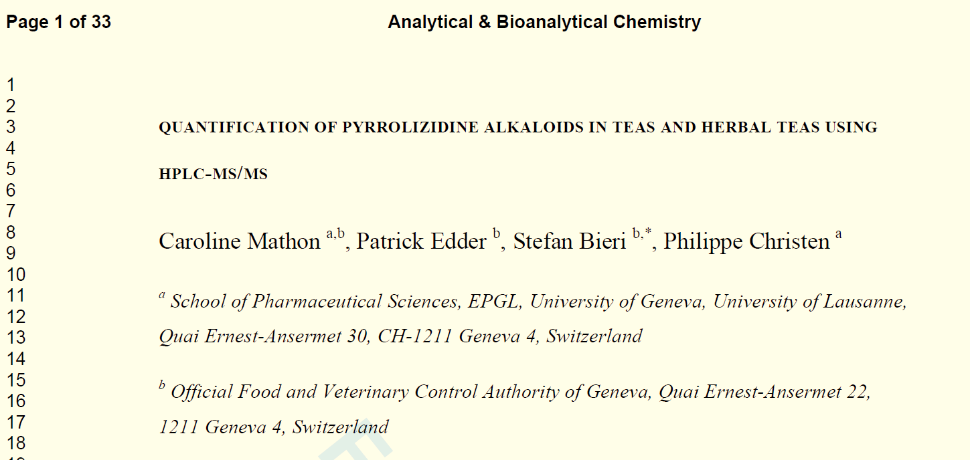
Submitted

Slide 22
Multi-targeted analysis
Analytical methods exist. They are generally specific for a particular compound or dedicated to a class of compounds and not well adapted for screening plant mixtures.
Develop an efficient generic multi-targeted method to screen simultaneously several selected plants of interest in HFS by means of adequate biomarkers.

Slide 23
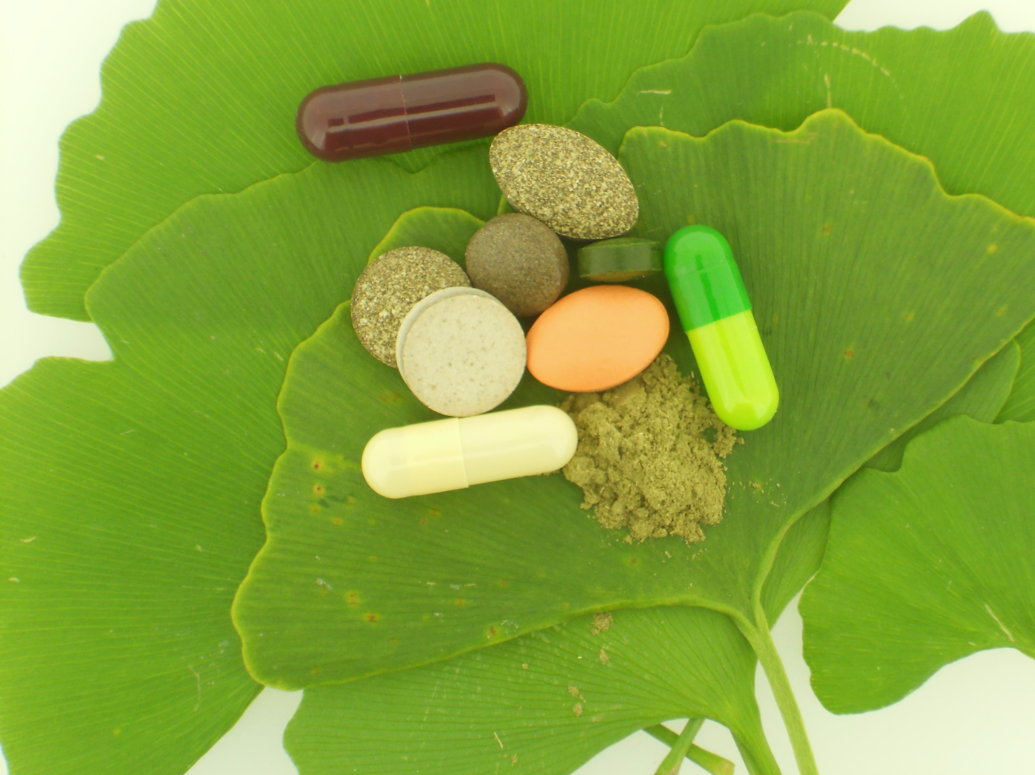
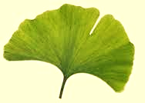
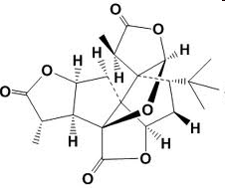
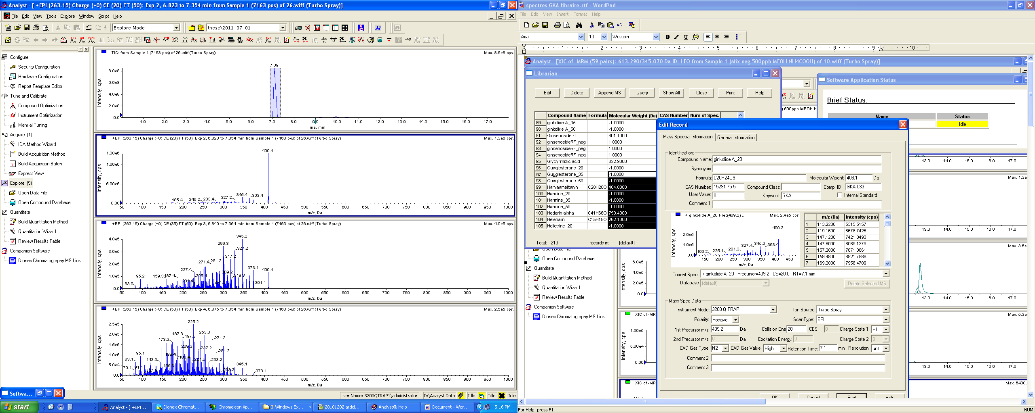
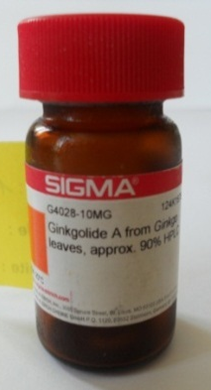
Methodology
Ginkgo biloba L.
Plant
Specific
Biomarker(s)
Concentration
Ginkgolide A
0.2-0.02% in Ginkgo
Ginkgolide A
3 MS/MS spectra
Commercially
available
Analysable
by LC-MS/MS
Intensity
7.17 min
106 € / 10 mg
LOD 33 ng/mL
1.0
3.0
5.0
7.0
9.0
11.0
13.0
Time, min

Slide 24
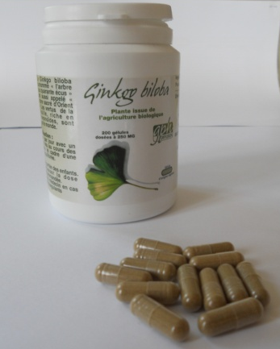
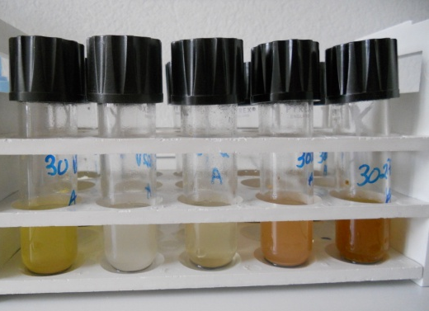
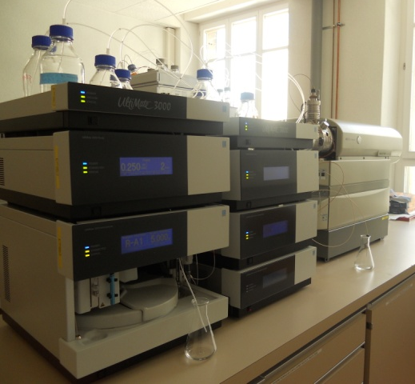
Analytical approach
Sample preparation
200 mg of food supplements
MeOH-H₂O (1-1)
10' sonication at RT
Dilution with buffer solution
Filtration 0.45 µm
Ready for analysis by LC-MS/MS

Slide 25
MS detection and identification
  MRM (Multiple Reaction Monitoring) :
  one transition is targeted for each biomarker
IDA (Information Dependent Acquisition)
Threshold : 1500 cps
MS/MS spectrum
CE : 20V
MS/MS spectrum
CE : 35V
MS/MS spectrum
CE : 50V
  Comparison with an in-house library of mass spectra

Slide 26
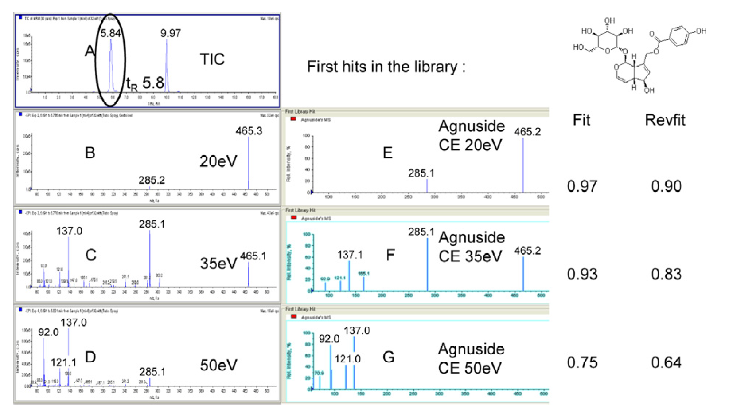
Comparison with an in-house library of MS/MS spectra

Slide 27
Chromatograms with biomarkers
Intensity, cps
HAR
4.0e5
LAS
CAP
VIC
3.0e5
HEL
MET
YOH
CHE
Chromatogram in positive ESI
BEB
SNT
RUC
SCH
2.0e5
ATR
BOL
SKK
PAM
EPH
GUG
MEZ
CIM
LOB
COL
VIN
VIT
DOS
1.0e5
SMI
LOB
MEZ
0.0
1.0
3.0
5.0
7.0
9.0
11.0
13.0
Time, min
ALL
HTP
CYT
CAF
EMT
DIM
SPT
ALA
GUA
PAR
CLO
OLE
ATO
TAX
THC
THE
AMY
RET
SEN
COU
GKA
DAI
QIN
QID
SOL
SIL
COC
STY
GEN
FOR
KAW
CHE
Intensity, cps
SPO
POD
GAR
3.0e4
FIP
Chromatogram in negative ESI
EMO
2.0e4
LEO
QRC
HPF
1.0e4
AGN
ALI
ECH
HOM
VEB
ASI
RHE
CYN
ANI
SCD
SNA
0.0
1.0
3.0
5.0
7.0
9.0
11.0
13.0
15.0
Time, min
Column : Synergi polar RP 50 x 2 mm, 2.5 mm particle size

Slide 28
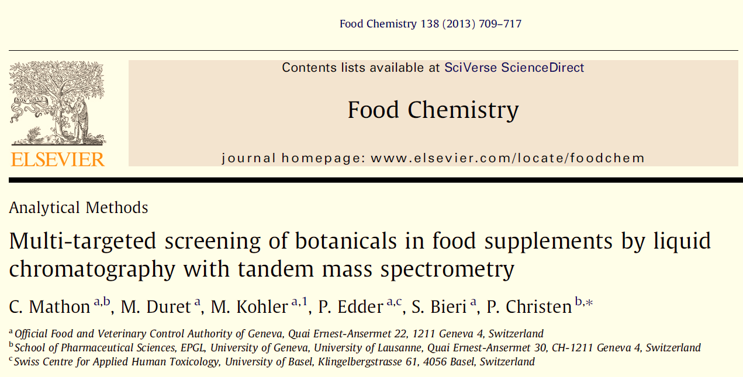

Slide 29
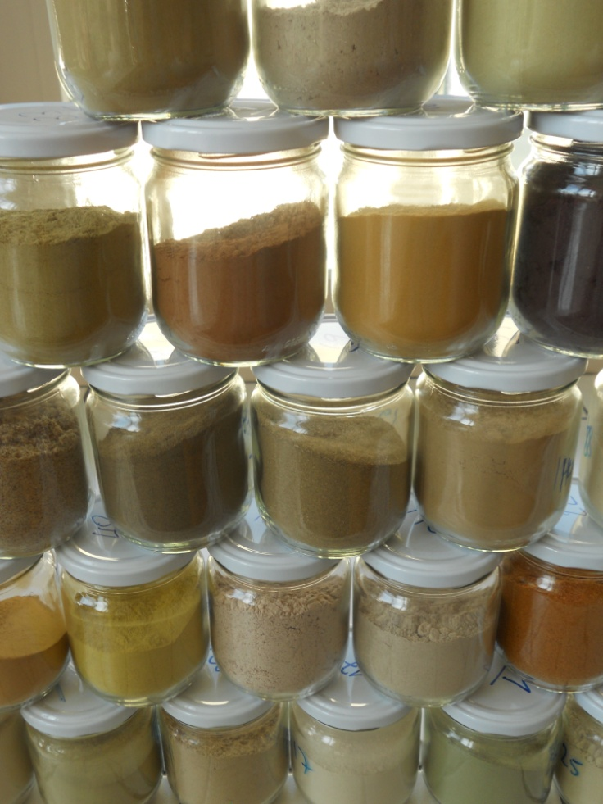
State of the current method
retrorsine
amygdalin
lasiocarpine
vincamine
schizandrin
agnuside
procyanidin
sinensetin
berberine
5 HTP
stevioside
garcinol
leiocarposide
sesamin
chelidonine
heliotrine
parthenolide
atropine
kawaine
ruscin
115 biomarkers are targeted and registered
in the MS/MS library
harmine
chelerythrine
theanine-Ll
boldine
digitoxin
Hyperforin
coumarin
ruscogenin
taxol
kaempferol
quercitrin
3,5-dimethoxyphenol
curcumin
bilobalide
vinpocetine
capsaicin
echinacoside
smilagenin
strychine
rhein
ginkgolide A
cynarin
senecionine
lobeline
vitexicarpin
colchicine
senkirkin
Allow to screen 90 plants and among them
    - some are toxic plants
    - some are authorized in HFS with limitations
daidzein
coumestrol
THC
allantoine
cytisine
cimifugin
Gugglesterone
ginsenoside
Aloin A
caffeine
sennoside
silybin
asiaticoside
alliin
nordihydroguaiaretic acid
yohimbin
hydroxyvalerenic
palmatine
diosgenin
quinidine
aconitine
quinine
mezerein
alantolactone
formononetin
scopolamine
emetine
emodin
sparteine
cinnamaldehyde
podophyllotoxin
melatonine
ephedrine
genistein
acteoside
convallatoxin
helenalin

Slide 30
Conclusion
Analytical methods for HFS are necessary for food safety and quality control to avoid economically
motivated adulterations
LC-MS/MS spectra offer powerful identification capabilities for HFS
This generic method can easily
  integrate new biomarkers
  be incremented with new plants on a regular basis
The method should be improved by complementary processes such as TOF-MS (exact mass), HPTLC fingerprinting or microscopy.

Slide 31

Thank you for your attention!
Acknowledgements
Caroline Mathon, PhD student

Slide 32
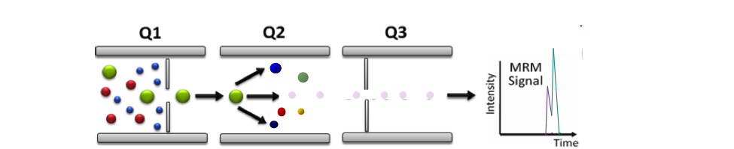
Multiple Reaction Monitoring
Precursor
selection
Collisional
excitation
Transition
ions

Slide 33
Lets Meet again at Pharmacognosy-2015
3rd International Conference and Exhibition on Pharmacognosy, Phytochemistry and Natural Products
October 26-28, 2015 Hyderabad, India
Theme: Advanced trends for the future of Herbal Drugs and Products
Website: http://pharmacognosy-phytochemistry-natural-products.pharmaceuticalconferences.com/

