Slide 1
An overview of mercury speciation measurements and analysis at high latitudes
Chris Moore¹, Daniel Obrist¹ , Steve Brooks²,
William R. Simpson³, Peter Peterson³, and Alexandra Steffen⁴
¹Desert Research Institute, Division of Atmospheric Sciences, Reno, Nevada, USA
²University of Tennessee Space Institute, Tullahoma, Tennessee, USA
³University of Alaska Fairbanks, Fairbanks, Alaska, USA
⁴Air Quality Research Division, Environment Canada, Toronto, Ontario, Canada

Slide 2
Focus
Quest to understand atmospheric mercury depletion events (AMDEs)
Where we are in our understanding of the chemistry of AMDEs
Importance of collocated Hg and halogens

Slide 3
The Journey Begins – Alert Canada
Site where Atmospheric Mercury Depletion Events were first identified (Schroeder et al. 1998 Nature)
Measurements of TGM began in 1995
Full speciation measurements began in 2002
One of the longest continuously operating mercury speciation measurement sites
Photo courtesy of Alexandra Steffen

Slide 4
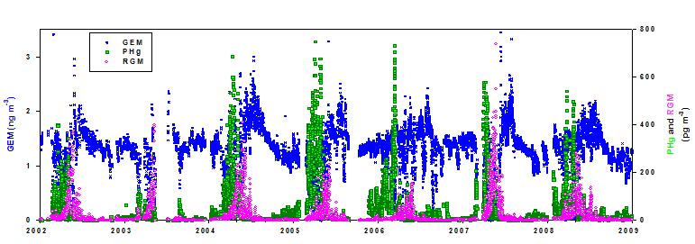
The journey begins - Alert
Hg⁰ (ng m⁻³)

Slide 5
Arctic Ground Measurements
Notes:
How is this (AMDE) linked to sea ice? Only occurring along coast? Need sea ice? BrO maps? Where is the BrO? Alert – depletion ends when sea ice ends? We need to look in more depth at sites that have dynamic sea ice…Focus talk around sea ice…

Slide 6
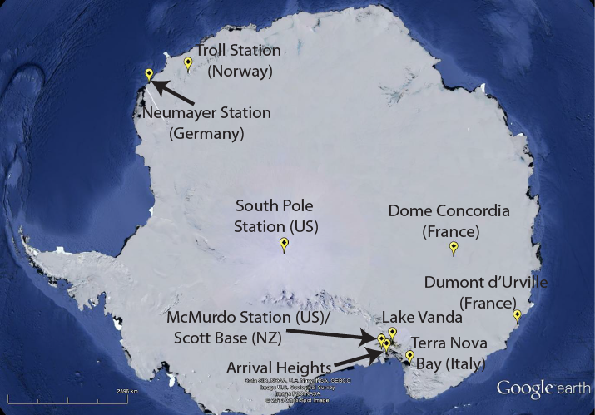
Antarctic Ground Measurements

Slide 7
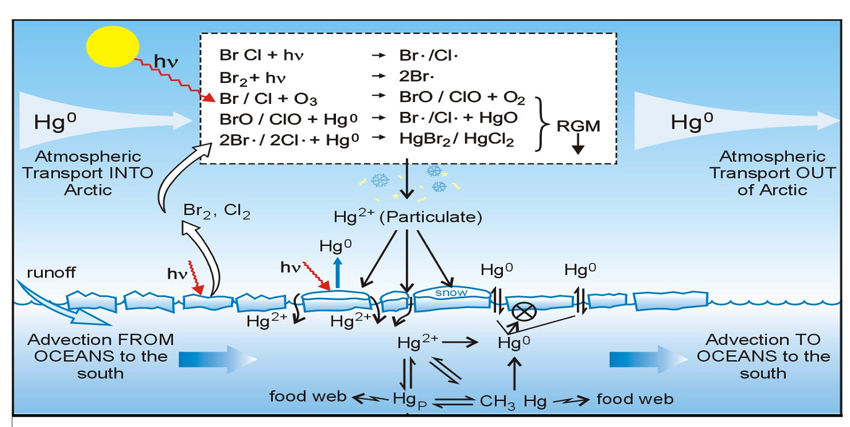
Atmospheric Mercury Depletion Events
GEM
Hg(II)
gaseous
GEM
Surface Layer
GEM
GEM
GEM
From Steffen et al. 2008 ACP

Slide 8
Importance of BrO
From Lindberg et al. 2002 ES&T

Slide 9
Measurements of Hg and Bromine

Slide 10
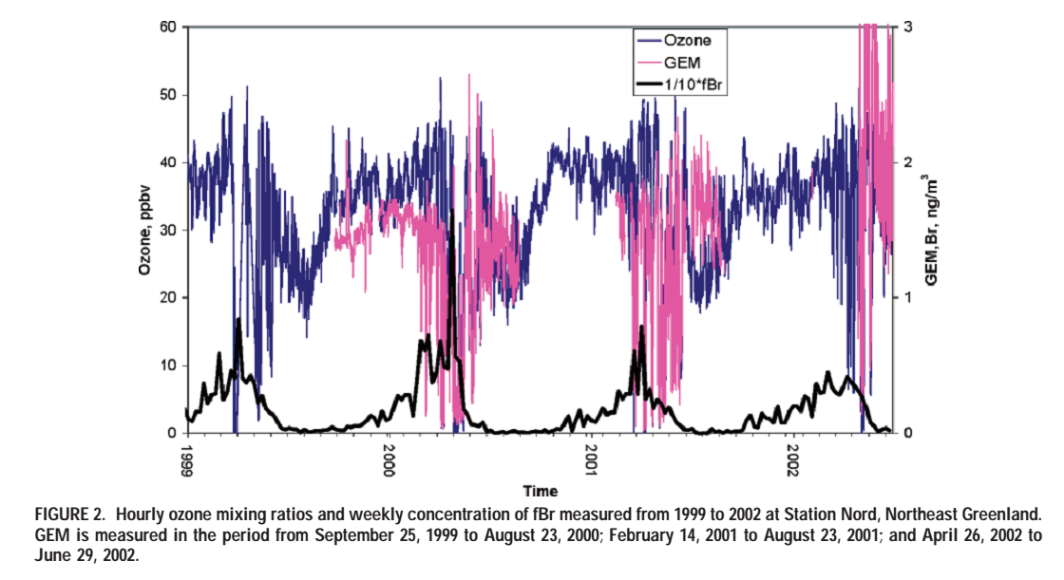
Station Nord, Greenland
From Skov et al. 2004 ES&T

Slide 11
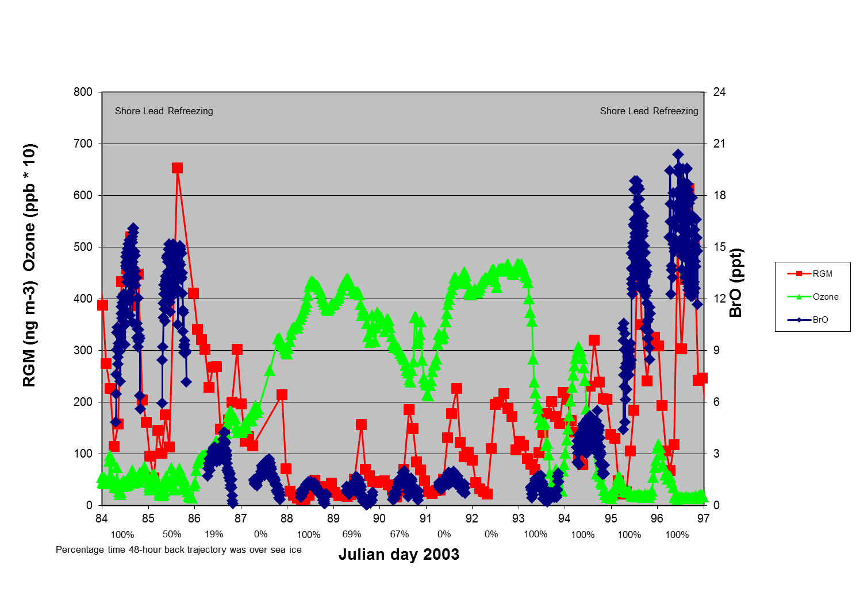
Barrow 2003
Adapted from Brooks et al. 2006 GRL

Slide 12
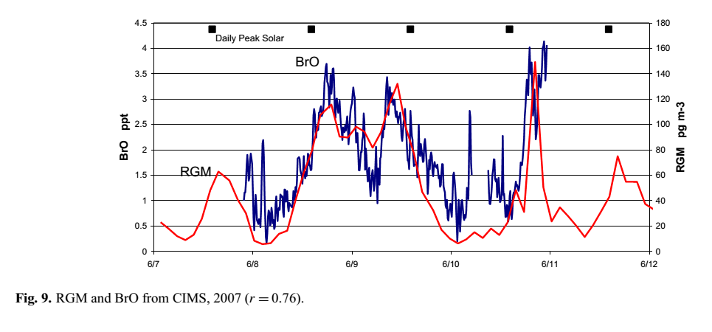
Summit Greenland
From Brooks et al. 2011 ACP

Slide 13
Hg and Bromine Measurements
Notes:
How is this (AMDE) linked to sea ice? Only occurring along coast? Need sea ice? BrO maps? Where is the BrO? Alert – depletion ends when sea ice ends? We need to look in more depth at sites that have dynamic sea ice…Focus talk around sea ice…

Slide 14
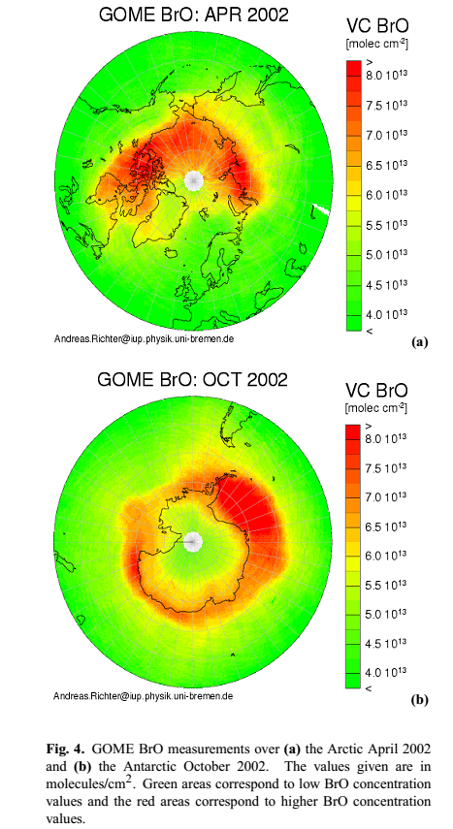
BrO Satellite Measurements
Satellite images are used to identify “bromine explosions”
Polar coastal areas are hot spots for bromine activity
From Steffen et al. 2008

Slide 15
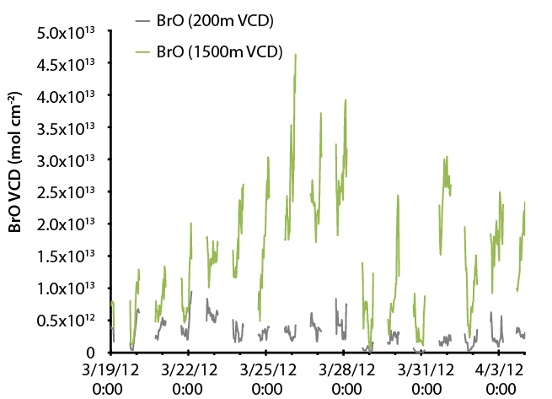
BrO Satellite and Ground Measurements

Slide 16
BrO Satellite and Ground Measurements

Slide 17
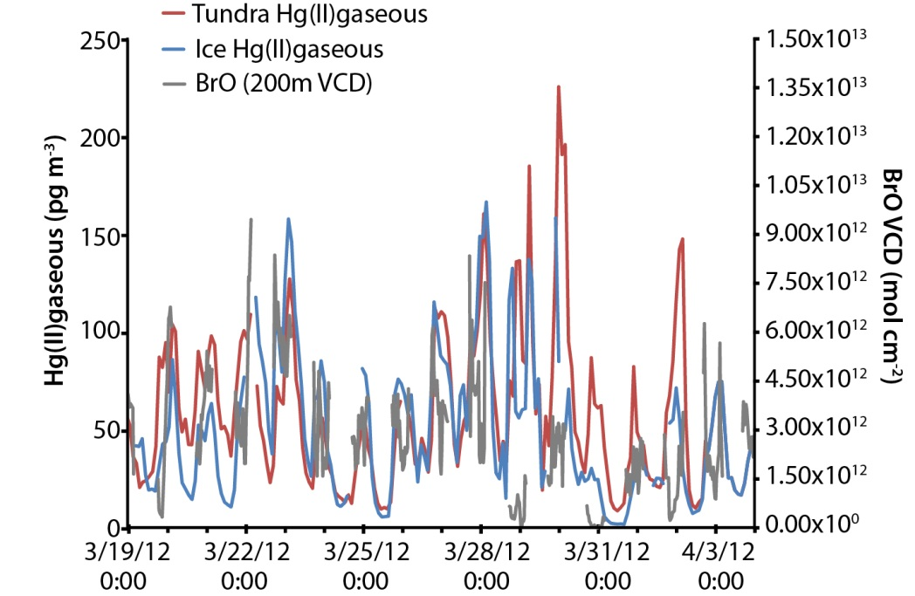
Barrow 2012
Hg(II)gaseous formation corresponds with BrO within the first 200m

Slide 18
GEM depletion with BrO
GEM depletion and recovery controlled by physical and chemical mechanisms

Slide 19
Summary
RGM nicely corresponds to BrO at Polar sites
Need to use surface BrO not total column
Major challenge for scaling to entire Arctic
GEM depletion
Poor correlation to BrO
Concentrations driven both by chemistry and atmospheric boundary layer mixing behavior
Need better spatial and temporal coverage of Bromine chemistry measurement co-located with Hg measurements
Hg measurements need to be involved as advances in halogen techniques are made
Notes:
Are denuders really that bad? Without the technology we wouldn’t be this far in our understanding…

Slide 20
Thank you!

Slide 21
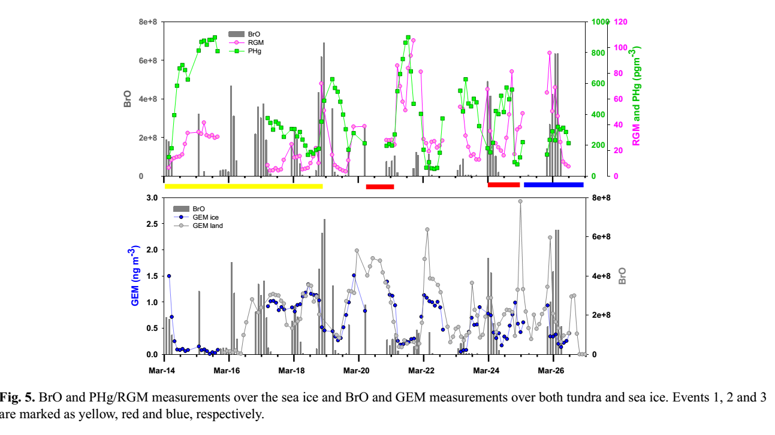
Barrow 2009
From Steffen et al. 2013 ACP

Slide 22
BrO Satellite Measurements
Moore et al. 2014 Nature

Slide 23
Leads

