Slide 1
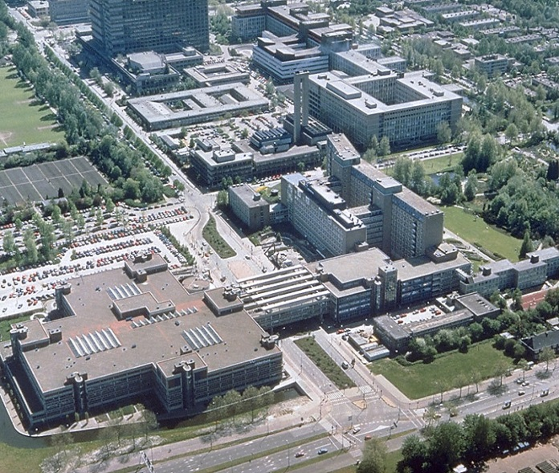

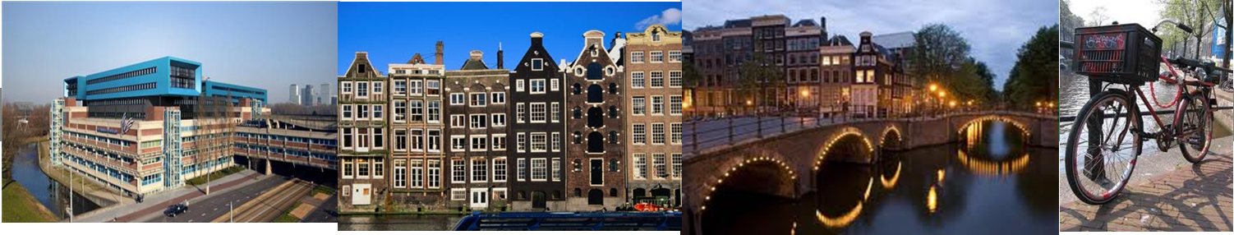
From cytology to full molecular cervical screening
Chris JLM.Meijer Dept of Pathology
Vrije Universiteit Medical Center
Amsterdam
The Netherlands
cjlm.meijer@vumc.nl

Slide 2
Cervical cancer worldwide
Worldwide:
  New cervical cancer cases 530.000/year
  3rd cancer in women
  275.000 women/year are dying of cervical cancer
  80% of cases in low resource countries: Africa, Mid- and south America and Eastern Europe
Netherlands
  Incidence: ASR/100.000 Mortality: ASR/100.000
  6.9 1.6
  Absolute figures:
~700 new cases/year 220 Death/year
Globocan IARC-WHO 2012

Slide 3
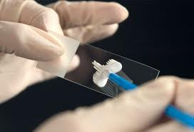
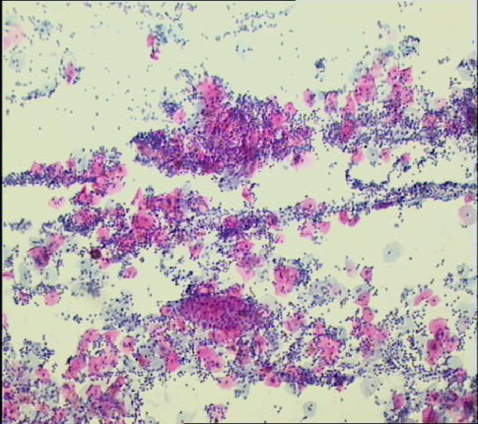
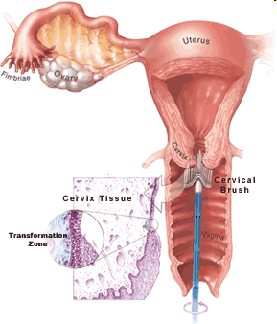
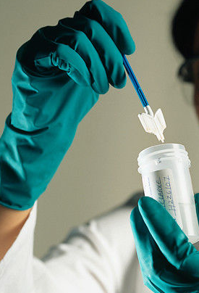
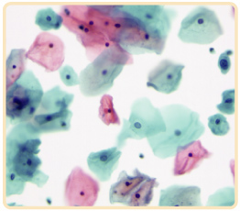
Current cervical screening tool in many countries: Pap test (cytology)
Pap smear
Liquid-based cytology (LBC)

Slide 4
Why should we change from cytology?

Slide 5
Problems in cervical screening by cytology
Low sensitivity: many false pos. and false neg smears
Frequent repeat testing necessary
Subjective; moderate reproducibility
Require good training of technicians and strong QC
Not all women are reached for cervical screening

Slide 6
Problems cytology-based cervical cancer screening programmes:
1. Suboptimal sensitivity of the Pap test for cervical precancer
CIN2+
HART
STUDY SITE
Tuebingen
Hannover
Jena
French Public
French Private
Seattle
Canada
Combined
0%
10%
30%
50%
70%
90%
100%
CYTOLOGY POSITIVITY
(ASCUS threshold)
Cuzick et al. Int J Cancer. 2006

Slide 7
2. Not all women are reached for cervical screening
In the Netherlands: 75% of women is protected (programmed & opportunistic)
25% is not screened at all (non-responders)
  57% of carcinomas in this group
Non-responders
Opportunistic
Responders

Slide 8
Novel opportunity for cervical screening:
Testing for hrHPV presence
Q: Role of HPV in cervical carcinogenesis?
Notes:
8

Slide 9
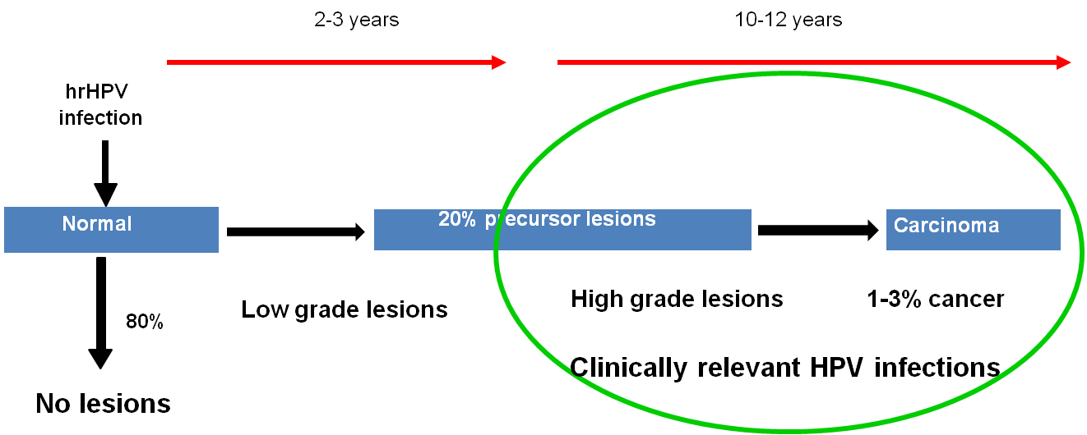
Role of HPV in cervical carcinogenesis
2-5years
12-20years
Persistent HPV infection
Productive infections
Transforming infections
CIN1, part CIN2
Part CIN2 and CIN3
1. Persistent infection with hrHPV necessary for cervical carcinogenesis
2. No HPV, no cancer
3. 14 hrHPV types responsible for >99% of allCxCa:
HPV 16 and 18 cause ~70% of all CxCa

Slide 10
HPV testing vs cytology
Take home message
HPV testing is more sensitive for CIN2+ detection than cytology; more objective
HPV provides better protection against CIN3 and cancer than cytology after a screen negative test
For screening purposes HPV testing is as good as
HPV & cytology (Combo)
Cuzick 2006 IJC; Bulkmans 2007 Lancet; Rijkaart 2012 Lancet oncology; Ronco 2013 Lancet,
Arbyn 2012 Vaccine, Cage 2014 JNCI

Slide 11
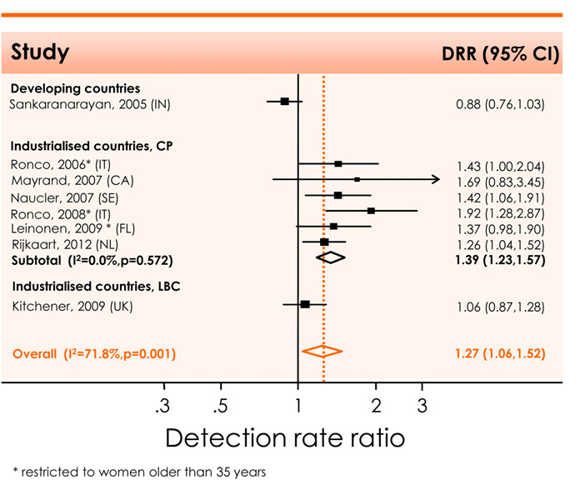
The HPV test is a more sensitive screening tool than the Pap test
CIN2+
Pap test
HPV test
HPV testing detects more CIN2+ than the Pap test
Arbyn et al., Vaccine 2012

Slide 12
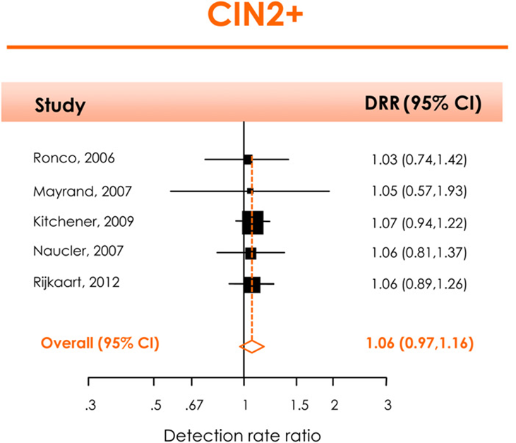

Performance HPV & Pap (combo) vs HPV test alone
HPV alone
HPV&cytology
Sole HPV testing is nearly as sensitive as HPV&Pap:
For screening use sole HPV testing
Arbyn et al., Vaccine 2012

Slide 13
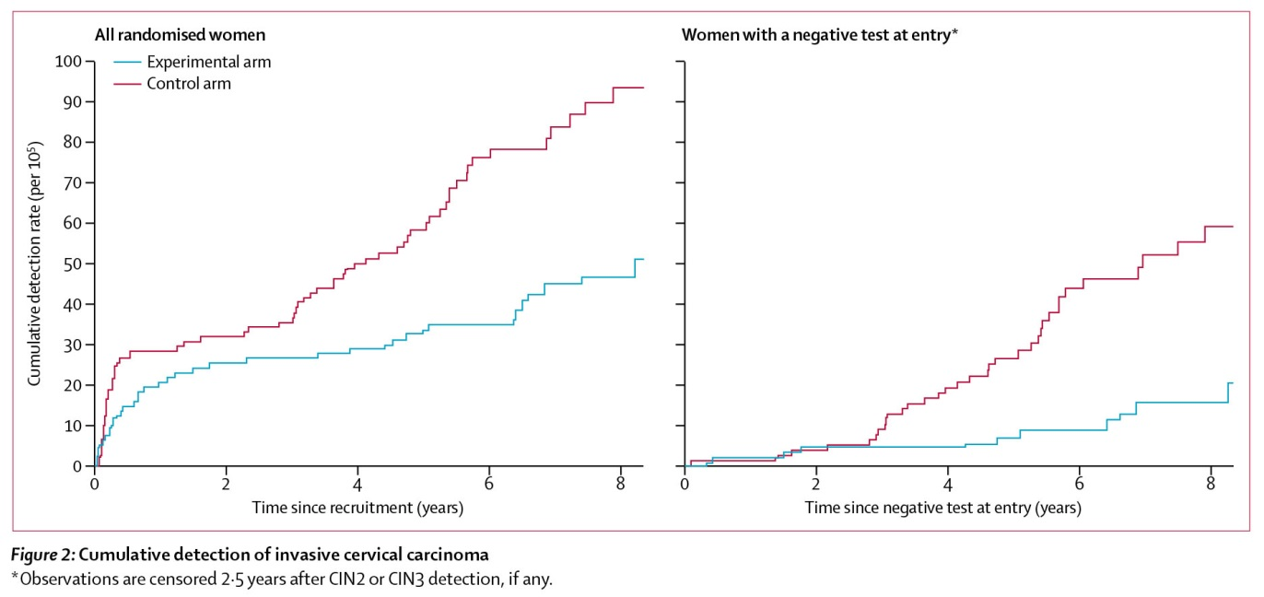
Cumulative detection of invasive carcinoma
Pooled data from POBASCAM, NTCC, Artistic and Swedescreen (>160.000 women)
HPV arm
Cytology arm
Ronco et al., Lancet 2013
A negative HPV test provides better protection against cancer than cytology

Slide 14
Take home messages
Women who were at enrolment HPV screen neg, have in the second round 50% less CIN3+ and significantly less cancer compared to women who were cytology screen negative at enrolment
HPV testing provides better protection against CIN3+ and CxCa than cytology

Slide 15
Other advantage of HPV testing
HPV testing can be done on self-collected cervico/vaginal material

Slide 16
Offering self-sampling for HPV testing to non-attendees
1. Can offering self-sampling for HPV testing increase compliance to screening?
2. Is this approach effective in detecting CIN2+?
Notes:
16

Slide 17
Offering self-sampling for HPV testing re-attracts non-attendees
Reference | Study design | Method (self vs clinician) | Attendance rate
Gok et al. (2010) | Self-sampling vs recall letter (99:1) 28,073 non-responders | Self-sampling (Delphi Screener) vs cervical smear | Self: 27.7% Recall letter: 16.6% P<0.001
Gok et al. (2011) | Self-sampling vs recall letter (99:1) 26,409 non-responders | Self-sampling (VibaBrush) vs cervical smear | Self: 30.8% Recall letter: 6.5% P<0.001
Bais et al. (2007) | Self-sampling vs recall letter (9:1) 2830 non-responders | Self-sampling (VibaBrush) vs cervical smear | Self: 34.2% Recall letter: 17.6% P<0.001
Sanner et al. (2009) | Self-sampling (no control group) 2829 non-responders | Self-sampling (Qvintip) on demand | Self: 39.1%
Virtanen et al. (2011) | Self-sampling vs recall letter (1:2.7) 4160 non-responders | Self-sampling (Delphi Screener) vs cervical smear | Self: 29.8% Recall letter: 26.2% P = 0.02
Virtanen et al. (2011) | Self-sampling vs recall letter (1:2.7) 8699 non-responders | Self-sampling (Delphi Screener) vs cervical smear | Self: 31.5% Recall letter: 25.9% P<0.001
Szarewski et al. (2011) | Self-sampling vs recall letter (1:1) 3000 non-responders | Self-sampling (cotton swab, Qiagen) vs cervical smear | Self: 10.2% Recall letter: 4.5% P<0.001
Giorgi Rossi et al. (2011) | Self-sampling vs recall letter. 2480 non-responders | Self-sampling (Delphi Screener) vs cervical smear | Self: 19.6% Recall letter: 13.7% P=0.007
Wikström et al. (2011) | Self-sampling (n=2000) vs recall letter (n=2060) | Self-sampling (Qvintip) vs cervical smear | Self: 39.0% Recall letter: 9.0% P<0.001
Snijders et al Int J Cancer 2012

Slide 18
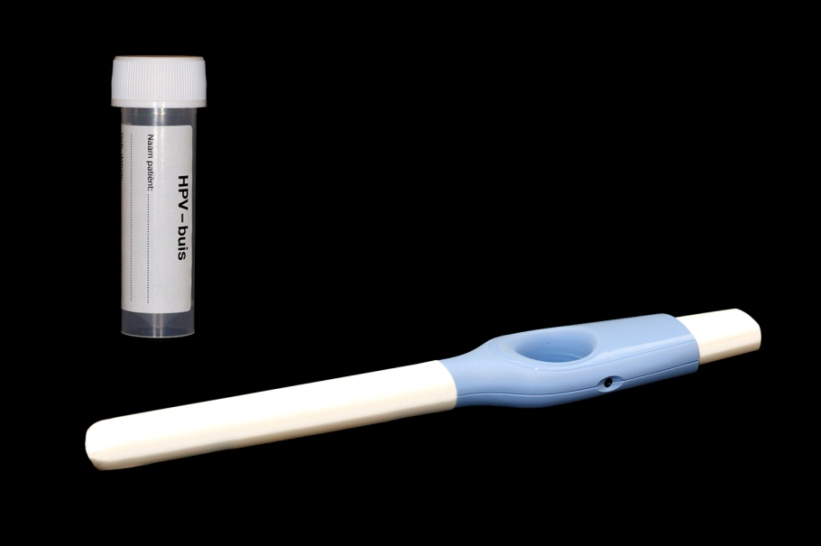
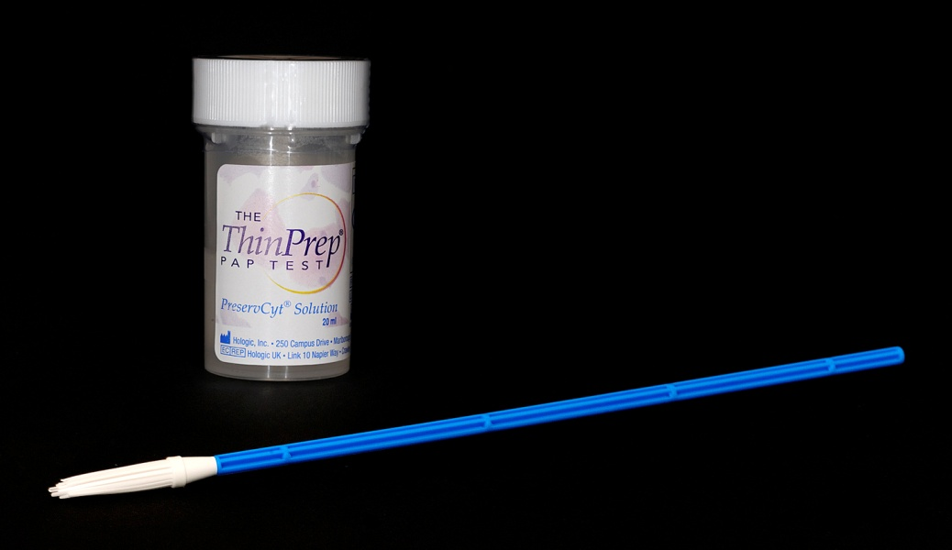
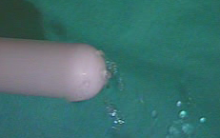
Two different self-sampling devices
(used for hrHPV testing)
PROHTECT 1
N=~ 28,703 (age: 29-60 years)
Year of non-attendance: 2005
PROHTECT 2
N=~ 26,409 (age: 29-60 years)
Year of non-attendance: 2006
Delphi screener (cervico-vaginal lavage)
Viba brush (vaginal brush)
Gök et al., BMJ 2010
Gök et al., IntJCancer 2011
Notes:
18

Slide 19
HPV self-sampling: a feasible and effective tool to screen non-attendees
CIN2+ 1.4%
CIN2+ 0.8 %

Slide 20
HPV testing in cervical screening
HPV testing on self-collected c/v specimen is more sensitive than cytology in detecting CIN2+
HPV testing on self-collected c/v specimen is as sensitive as HPV testing on physician taken smears, provided a clinically validated combination of a self-sampling device and a hrHPV test is used
Snijders Int J Cancer 2013;Arbyn Lancet oncology 2014

Slide 21
HPV testing in cervical screening
HPV vs cytology
Clinical validation of HPV tests
Triage of HPV pos women

Slide 22
HPV tests vary in their property to detect the various types of HPV infections
Important distinctions:
Analytical sensitivity and specificity
  Detect all hrHPV infections: both transient (irrelevant) and transforming infections
Clinical sensitivity and specificity
  Detect mainly HPV infections associated with CIN2+/3+ (clinically relevant hrHPV infections):
Notes:
22

Slide 23
For HPV testing in cervical screening clinical validation is necessary
For screening purposes it is imperative to detect transforming HPV infections associated with (pre)cancer i.e CIN2,CIN3,CxCa and ignore the transient HPV infections
Otherwise too many women without lesions enter into diagnostic evaluation. Increase COSTS!
Clinical validation of HPV tests obligatory!
International guidelines have been formulated

Slide 24
Example: Case-control study: women with CIN3 vs women with normal cytology (≥30 years) and no CIN2+ in next 2 years
Screening cohort
Cases: CIN3
Controls: ≤CIN1
%
p<0.001
Clinically validated:
HC2 and GP5+/6+
N=25
N=193
In women with normal cytology false positivity rate of a clinically non-validated test was significantly higher than that of a clinically validated test; true positive CIN3+ rate is similar
Result: Unnecessary F-up, expensive, harmful, and overtreatment of women
Hesselink et al., 2008

Slide 25
Clinical validation of other HPV assays
In order to become validated for use in cervical screening candidate HPV assays should prove:
  their value in large prospective screening studies
  or
  non-inferiority to validated reference assays (HC2 or GP5+/6+-PCR) in cross-sectional clinical equivalence studies
  Consensus guidelines for test requirements have been developed by an international consortium
  (Meijer et al. : Int J Cancer, 2009)
Notes:
25

Slide 26
Clinically validated HPV assays for cervical screening
Avaliable HPV
detection assays
Many (>40)
Hybrid Capture 2
Diassay (GP5+/6+-PCR)
COBAS4800
APTIMA
HPV RealTime
SPF10
Amplicor
Cervista
PapilloCheck
PGMY
… (and so on)
HPV tests validated
for cervical screening (cervical scrapings)
- Hybrid Capture 2*
- Diassay (GP5+/6+-PCR)*
- COBAS4800**
HPV RealTime**
PapilloCheck**
APTIMA**#
HPV-Risk assay**
HPV tests validated for cervical vaginal
lavages (Delphi-
screener)
Diassay (GP5+/6+-PCR)
HPV-Risk assay
*Based on longitudinal studies
**Based on equivalence analysis according to guidelines
# Provided that data of long term NPV of mRNA testing become available

Slide 27
HPV testing in cervical screening
HPV vs cytology
Clinical validation of HPV tests
Triage of HPV pos women

Slide 28
HPV testing recognizes viral infection, but we need to detect disease
HPV Testing (risk population)
Detection women at RISK
Even a clinically validated HPV test detects still both transient and clinically relevant infections
We are only interested in HPV infections associated with disease: high grade lesions and cancer
Women
HPV DNA test
HPV + Women
Population at risk CxCa

Slide 29
HPV testing recognizes viral infection, but we need to detect disease:
triage testing necessary
HPV Testing (risk population)
TRIAGE (disease)
Detection women at RISK
Detection of women with disease in need of Referral
Women
HPV DNA test
HPV + Women
TRIAGE
Population at risk CxCa
Population with disease

Slide 30
Evaluation of triage tests in longitudinal studies (VUSA-Screen and POBASCAM)
  Cytology
  HPV 16/18 genotyping
  Combinations of these tests
Aim to increase specificity without loosing sensitivity
Rijkaart et al Int.J Cancer 2011; Dijkstra et al CEBP 2013
Katki et al Lancet oncology 2013

Slide 31
Adopted triage strategies for HPV pos. women
Presently two triage strategies have been adopted, because they are easy to implement and fullfill CIN3+ risk requirements (NPV>98%)
A) Baseline cytology and cytology in follow-up (6 or 12 months)
B) Baseline cytology & HPV16/18 genotyping and cytology in follow-up (6 or 12 months)
The exact algorithm to be used for triage depends on the quality of cytology and the minimum positive predictive value for CIN3+ referral acceptable by local health decision makers (resources available)
Take home message
Notes:
31

Slide 32
alternative triage tests
p16^{INK4A}/Ki67 dual staining
Analysis Chromosomal alterations (eg 3q gain)
Methylation analysis viral DNA
Methylation analysis host cell genes

Slide 33
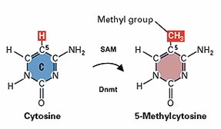
Methylation and Cancer
Promoter methylation common event in cancer development to silence genes
Promoter methylation of three tumor suppressor genes is functionally involved in cervical carcinogenesis
-CADM1
-MAL
-miR-124-2
Methylation levels of these genes increase with disease progression and are extremely high in CxCa
Bierkens et al. IJC 2013
Steenbergen et al. 2004; Overmeer et al. 2008, 2009, 2010; Wilting 2010, et al.
Notes:
33

Slide 34
Methylation assay detects cervical cancer and advanced CIN2/3 lesions
Methylation levels increase with the severity of the lesion and duration of HPV infection
Bierkens et al. IJC 2013
Methylation levels are extremely high in cervical cancer: no cancers missed
De Strooper JCP 2014
Cin2/3 lesions detected by methylation are complementary to Lesions detected by cytology or HPV 16/18 genotyping
Verhoef Gyn.Oncology2014 Methylation markers: CADM1/Mal and MAL/miR

Slide 35
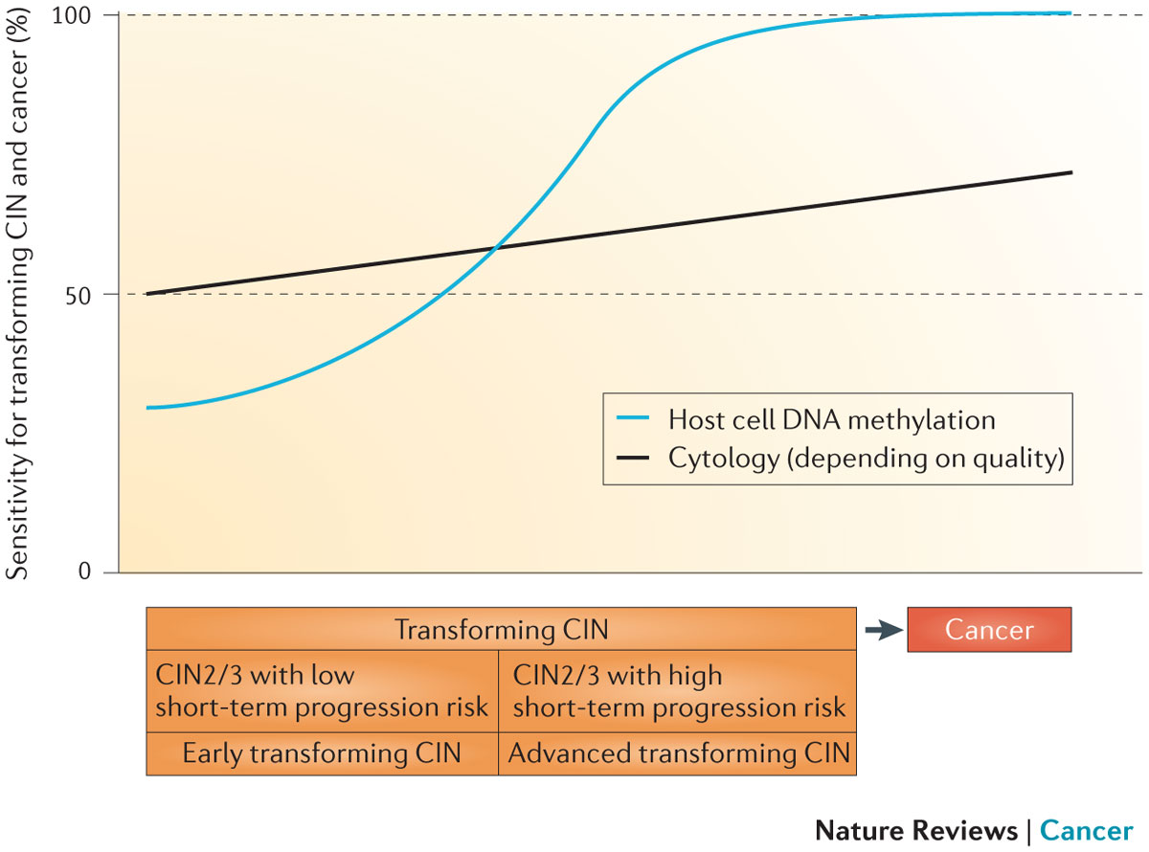
Advanced leions
Early
lesions
Steenbergen et al 2014
Methylation levels increase with the severity of the lesion and duration of HPV infection
Methylation levels are extremely high in cervical cancer: no cancers missed
  ¹Soutter, Int J Cancer 2006; ²Kocken, Lancet Oncol 2011; ³Overmeer, J Pathol 2008;
  ⁴Overmeer, J Pathol 2009; ⁵Bierkens, Int J Cancer 2013; ⁶ Steenbergen, NRC 2014..
Notes:
Background:
Women treated for high-grade CIN-lesions have an increased risk for developing post-treatment disease for at least 10-20 years after treatment.
Post-treatment disease represents either persistent lesions, resulting from incompletely treated disease, or incident lesions, resulting from a new HPV infection with either a genotype different from the original lesion or a re-infection with the same HPV-type.
Because of the long-term high risk, surveillance strategies for early detection of post-treatment disease are of importance.
Studies on biomarkers that improve distinction between persistent CIN2/3-lesions and incident, early CIN2/3-lesions can be of value for detection of post-treatment disease.
DNA methylation, which reflects DNA promotor methylation of host cell genes, shows a high sensitivity for advanced high-grade CIN-lesions and cancer, and therefore might be helpful in detecting post-treatment disease.
Aim of the study:
The aim of the study was to evaluate the bi-marker CADM1/MAL methylation assay as a potential tool for monitoring women for post-treatment disease.
Methods:
364 women were included in a multicenter prospective clinical cohort study.
Cervical scrapes were taken prior to treatment and 6 and 12 months post-treatment, and were tested for cytology, hrHPV and CADM1/MAL methylation.
An hrHPV infection was called persistent when the hrHPV type at baseline and at time of post-treatment disease were the same. An hrHPV infection was called incident when a genotype switch had occurred between treatment and post-treatment disease.
In case at 6 months either of these tests was positive, a colposcopy with biopsy was performed. As an exit test at 12 months a colposcopy with biopsy was performed.

Slide 36
Methylation marker of TSGs involved in cervical carcinogenesis
Concept supported by data:
Cytology:
Detects prevalent lesions (early and advanced) with reduced sensitivity for CIN3 and CxCa (sensitivity~65% at best)
Methylation marker panel:
Detects advanced CIN lesions with high sensitivity: carcinoma proof (n=144)
Methylation marker analysis (cut-off 70% specificity for CN3) and cytology are complementary in detection CIN3+ in hrHPV pos women : high sensitivity (~90%), low referral rate (~50%)
Bierkens et al Int.J.Cancer 2013; Hesselink et al : submitted
Notes:
36

Slide 37
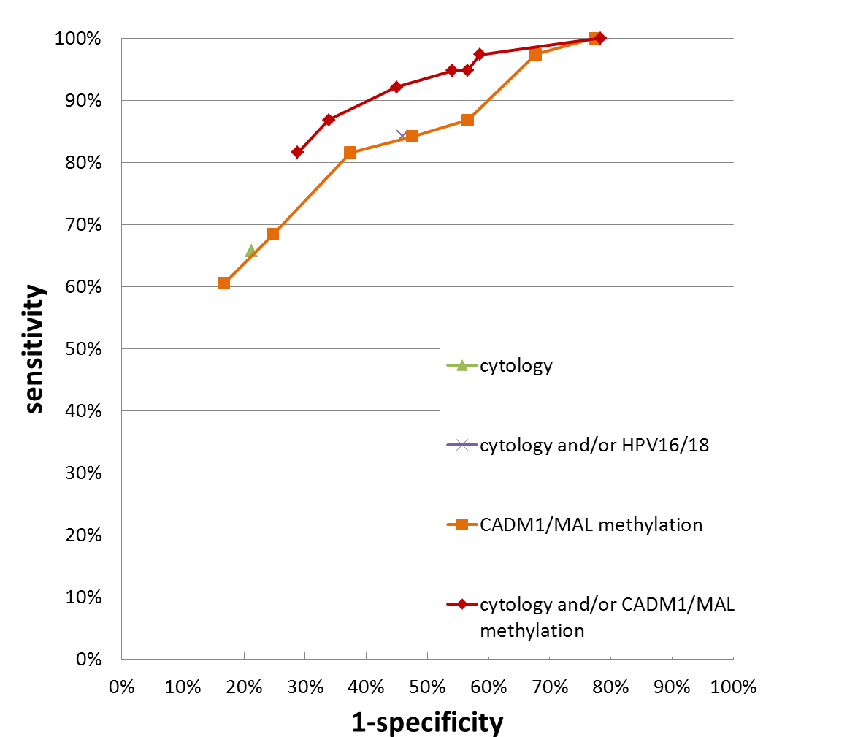
CADM1/MAL methylation analysis and cytology combined (CIN3+ outcome, physician taken scrapes )

Slide 38
PreCursor-M kit
PreCursor-M kit (CE/IVD certified):
quantitative multiplex methylation-specific PCR for CADM1, MAL, and miR-124-2 Snellenberg et al., 2012
In cervical scrapes the PreCursor-M kit
detects all carcinomas
Notes:
38
38

Slide 39
Summary on physician taken smears
CADM1 and MAL (miR124-2) methylation analysis is an alternative or complementary triage tool to cytology for HPV positive women
Sensitivity particularly high for advanced CIN2/3 and cervical cancer in need of treatment

Slide 40
Performance PreCursor-M kit in lavage self-samples
Positivity PreCursor-M kit
Also in lavage self-samples the PreCursor-M kit detects all carcinomas

Slide 41
Take home messages
Direct triage of HPV-positive women by PreCursor-M test
makes objective and full molecular cervical screening
possible

Slide 42
Present International situation cervical screening by HPV
  Primary HPV Screening will be implemented in
  The Netherlands: Jan 2016
  - Women 30-60 years, 30,35,40, 50,60y. Triage with cytology at baseline and 6 months.
  -If HPV screen pos and triage test neg at 40,50, or 60y: repeat testing after 5 years
  -Non-responder women are offered opt-in for HPV self-sampling
  Australia: advice medical services advisory committee 4/04/2014:
  -Start primary HPV screening
  -Women: 25-69 years, 5 years interval, Triage by cytology and HPV 16/18 genotyping at baseline and cytology at 12 month
  Italy: 5 regions start HPV screening in 2015
  women 25-65 y, 5 years interval, Triage by cytology and HPV 16/18 genotyping
  Nordic countries: are considering or doing implementation pilot studies
www.gr.nl;
www.msac.gov.au
Notes:
42

Slide 43
Acknowledgements
VU University Medical Center (VUmc)
Department of Pathology
P.Snijders
D. Heideman
F. van Kemenade
L. Rozendaal
M. Gök
B. Hesselink
R. Steenbergen
S. Wilting
V. Verhoef
M.Uijterwaal
M.dijkstra
Department of clinical epidemiology and biostatistics
  H. Berkhof
  B.witte
  Gynaecologic Oncology
  G. Kenter
  EEC consortia
  PreHDICT
  CoHeaHr
  Mass-care
  Dutch Cancer foundation
  ZON-MW
N. Fransen
M. Verkuyten
D. Boon
M. Lettink
F. Topal
D. Buma
M. Bogaarts
R. van Andel
R. Pol
M. Doeleman
Notes:
43

Slide 44

Notes:
44

