Slide 1
Multimetric Phytoplankton Index (MPI): description of the method and study cases in Mediterranean Sea.
Chiara Facca¹, Fabrizio Bernardi Aubry², Stefania Finotto², Emanuele Ponis³, Francesco Acri², Adriano SFRISO¹, Antonella LUGLIE’⁴, Anna Maria Bazzoni⁵
2
3
4
1
5

Slide 2
Multimetric Phytoplankton Index (MPI)
Literature proposes several formulations based on phytoplankton metrics but most indices don’t completely fulfill the WFD requirements, above all in the case of transitional waters.
To be compliant with the Water Framework Directive (WFD – 2000/60/EC) requirements, phytoplankton taxonomic composition, abundance and biomass must be used to assess transitional water ecological quality.

Slide 3
Water Framework Directive (2000/60/EC)
Objectives:
The protection of inland surface waters, transitional waters, coastal waters and groundwater
Member States shall implement the necessary measures to prevent deterioration of the status of all bodies of surface water
Member States shall protect, enhance and restore all bodies of surface water with the aim of achieving good surface water status by 2015 (Ecological status: expression of the quality of the structure and functioning of aquatic ecosystems)
ANNEX V
Biological Quality elements for the classification of ecological status
Composition, abundance and biomass of phytoplankton
Composition and abundance of other aquatic flora
Composition and abundance of benthic invertebrate fauna
Composition and abundance of fish fauna

Slide 4
Description of the Multimetric Phytoplankton Index
Results of the set up
New results for the validation phase

Slide 5
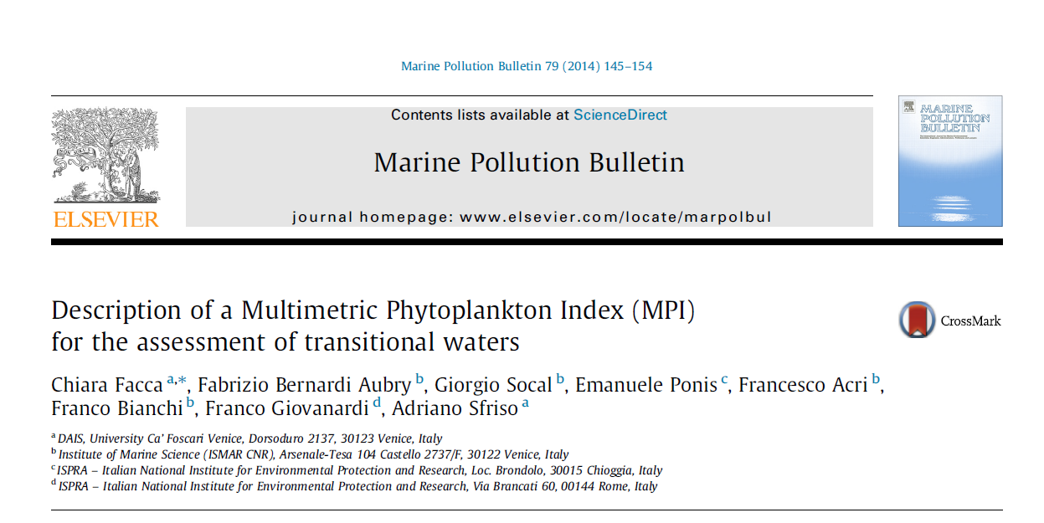
Multimetric Phytoplankton Index (MPI)
Paper describing the index set up

Slide 6
Multimetric Phytoplankton Index (MPI)
The dataset to calculate the four metrics must contain data of chlorophyll a concentrations, phytoplankton cell abundances and taxonomic composition, collected seasonally (feb, may, aug, nov) at surface.
Achnantes brevipes | Yes
Achnantes longipes | Yes
Achnantes microcephala | Yes
Achnantes sp. 1 | Yes
Navicula spp. | No
Und. Euglenophyceae | No
Dictyocha fibula | Yes
Dictyocha speculum | Yes
Octactis octonaria | Yes
Nanoflagellates | No
Und. Cyanophyceae | No
The taxonomic list of each sample has to contain only determined species (also as Genus sp. 1 or Class sp. 1) as in the table on the right.

Slide 7
Multimetric Phytoplankton Index (MPI)
1. First metric (Hulburt index)
The first metric is the dominance Hulburt’s index:
δ= 100(n₁+n₂)/N
n₁: abundance of the dominant species
n₂: abundance of the second most abundant species
N: total abundance
To asses water quality the value 100- δ is used as indicator of high water quality.
Theory: dominance phenomena occur in impacted areas

Slide 8
Multimetric Phytoplankton Index (MPI)
2. Second metric (Blooms)
The second metric is the dominant species frequency:
how many times in the dataset of each station the dominant species abundance was >50%.
To asses water quality the value “100 - frequency” is used as indicator of high water quality.

Slide 9
Multimetric Phytoplankton Index (MPI)
3. Third metric (Menhinick index)
The third metric is the Menhinick index:
S/√N
S : number of species
N: total abundance
To reduce the error caused by deletion of multiple indeterminate taxa, a correction factor was introduced. For each sample D was multiplied by the taxa)correction factor: determinate/(determinate + indeterminate).

Slide 10
Multimetric Phytoplankton Index (MPI)
4. Fourth metric (Chlorophyll a geometric mean )
Original data were log-transformed.
Outliers (mean±2.5std.dev.) were deleted and the mean recalculated.
The final values were re-transformed.
Lowest average Chl a value (reference value)
EQR=---------------------------------------------------------------------
Chl a average value for each sampling site

Slide 11
Multimetric Phytoplankton Index (MPI)
Reference conditions are set considering the best conditions of considered water bodies.
to calculate the Ecological Quality Ratio (EQR).
1-year average value
EQR= --------------------------
Reference value
MPI = mean of the 4 EQRs
Notes:
11

Slide 12
Multimetric Phytoplankton Index (MPI)
Ecological Quality Ratio ranges between 0 and 1 and class boundaries are set as equidistant division of the EQR gradient
High 0.81-1
Good 0.61-0.8
Moderate 0.41-0.6
Poor 0.21-0.4
Bad 0-0.2
Italian transitional systems were classified in the following typologies :
restricted ;
choked;
Notes:
12

Slide 13
GEOGRAPHIC AND HYDRODYNAMIC CHARACTERISTICS OF SHALLOW COASTAL LAGOONS
Björn Kjerfve and K.E. Magill, 1989
Source: MARINE GEOLOGY Volume: 88 Issue: 3-4 Pages: 187-199
DOI: 10.1016/0025-3227(89)90097-2 Published: AUG 1989
Choked lagoons are characterized by one or more long and narrow entrance channels, long residence times, and dominant wind forcing.
Restricted lagoons usually exhibit two or more entrance channels or inlets, have a well-defined tidal circulation, are strongly influenced by winds, and are usually vertically mixed. Residence time are shorter than in choked lagoons.

Slide 14
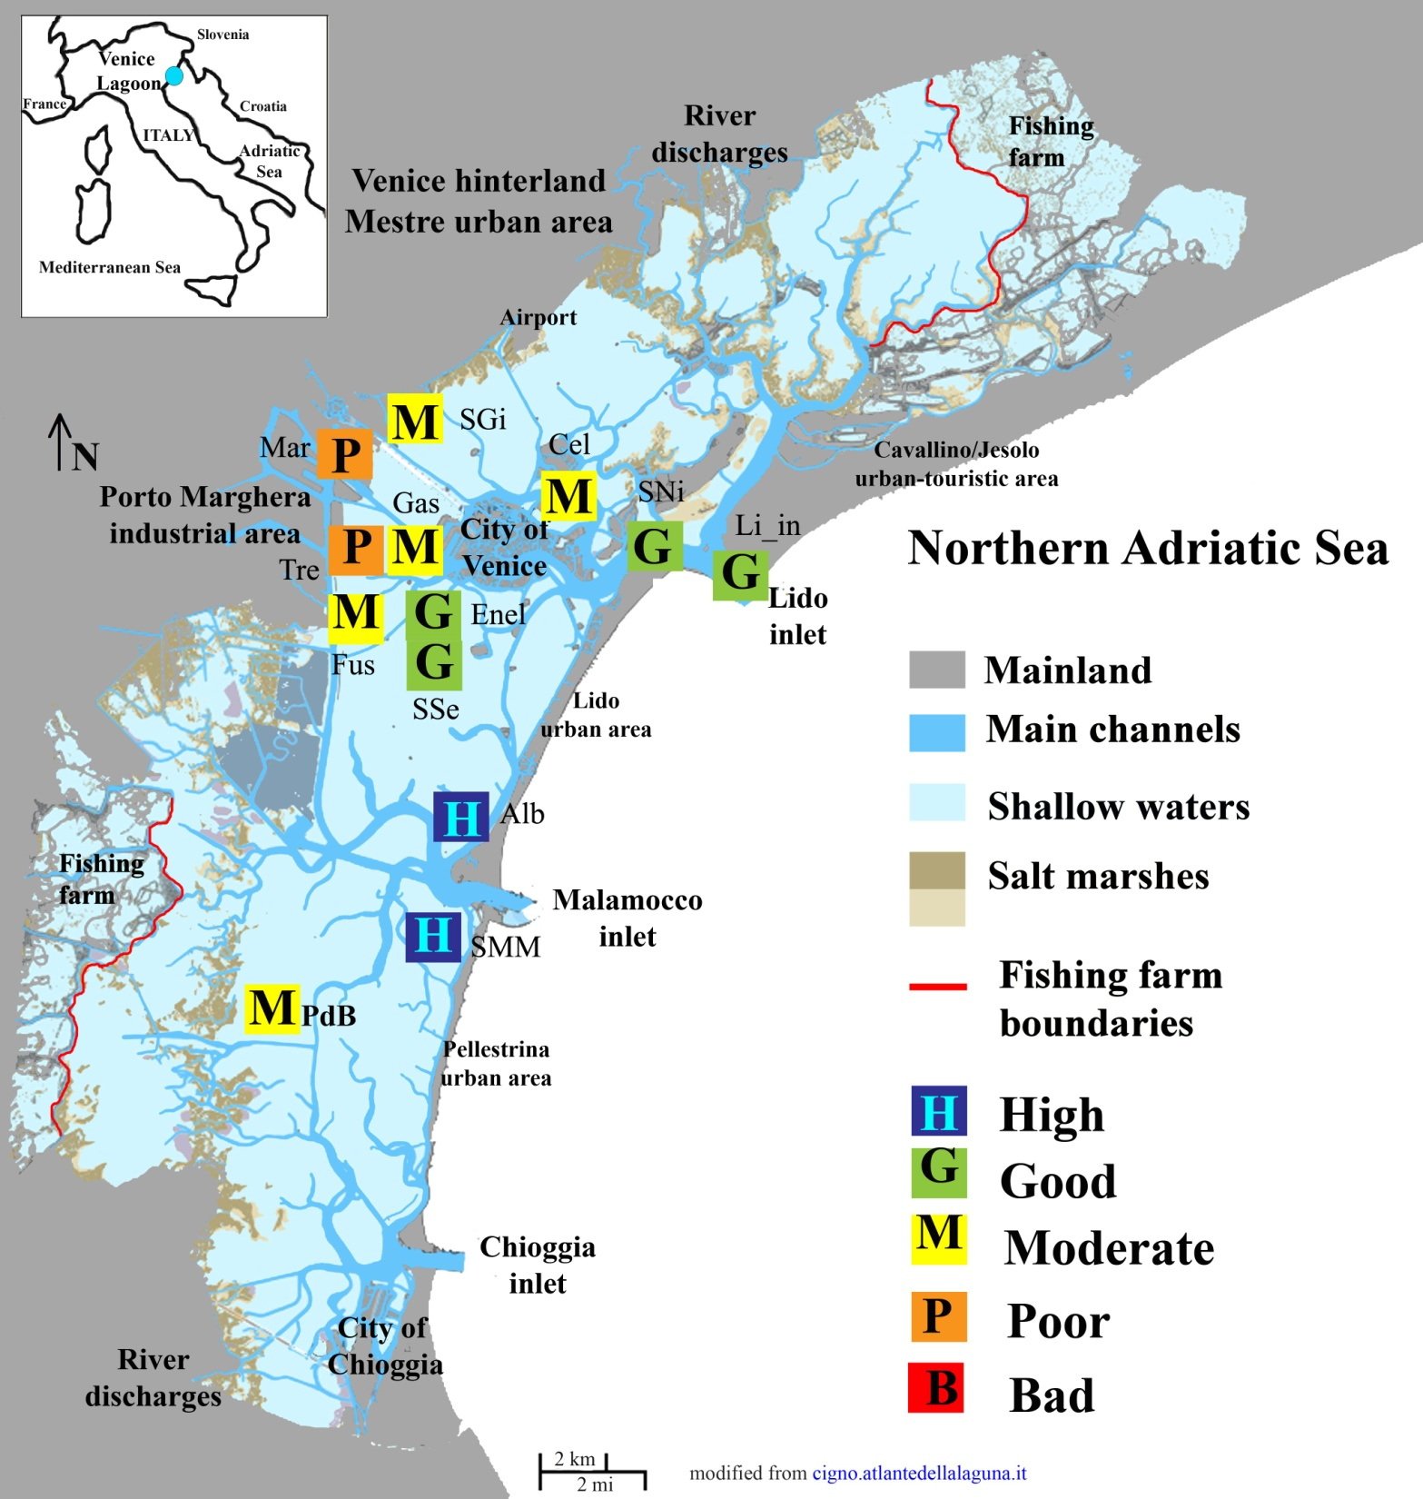
Set up
From Facca et al., 2014
Venice Lagoon
Surface 550 kmq
high spatial heterogeneity,
various anthropogenic stressors:
industrial, agricultural discharges, tourism, fishing, hydro-morphological intervention, naval traffic

Slide 15
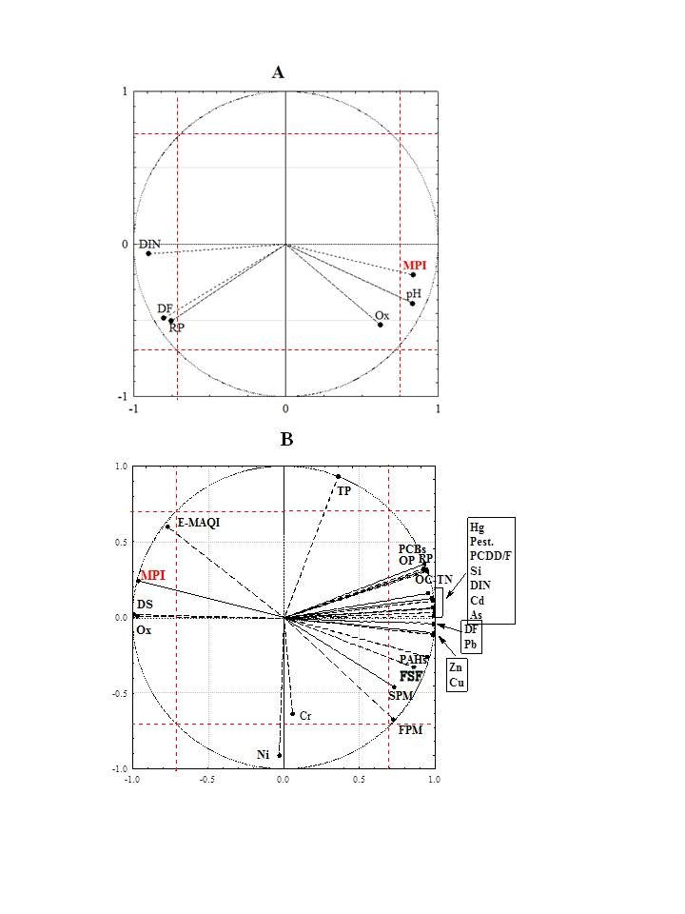
Set up
From Facca et al., 2014
All stations with nutrients
Statistical results
of the index set up
4 stations with contaminants

Slide 16
Dataset
Validation
Venice lagoon
Monthly samples in 8 stations in choked and restricted areas
Sardinia ponds
Monthly samples in 11 stations in choked basins
For all observations phytoplankton taxonomic composition, salinity and nutrient and chlorophyll concentrations are available

Slide 17
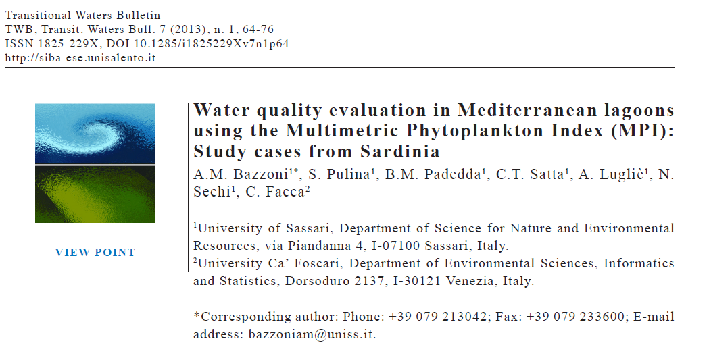

Slide 18
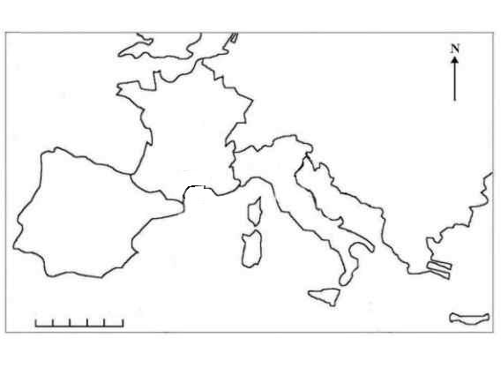
France
Italy
Venice
Spain
Adriatic Sea
Sardinia
600 km
Mediteranean Sea

Slide 19
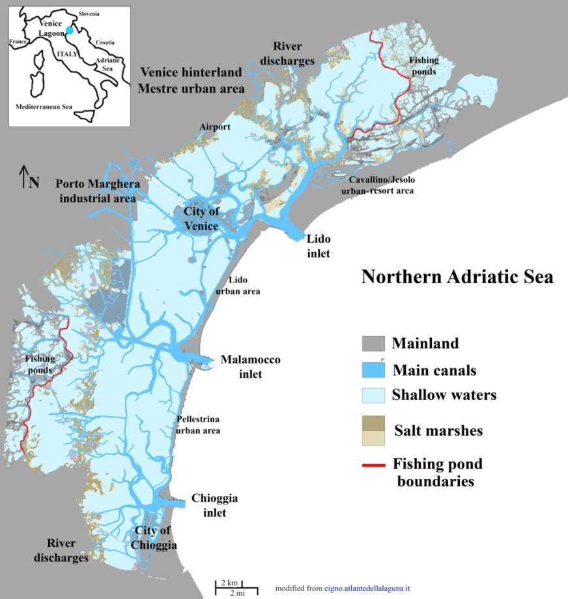
Validation
Venice Lagoon

Slide 20
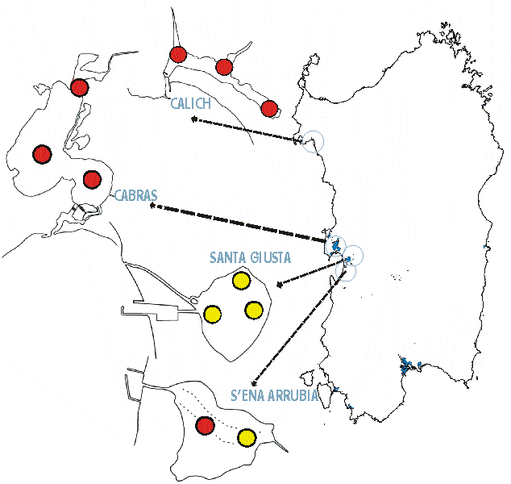
Validation
Sardinia ponds
Surface from 0.87 to 27.8 kmq
Direct:
Fishing and aquaculture
Indirect:
Agriculture and zootechnics

Slide 21
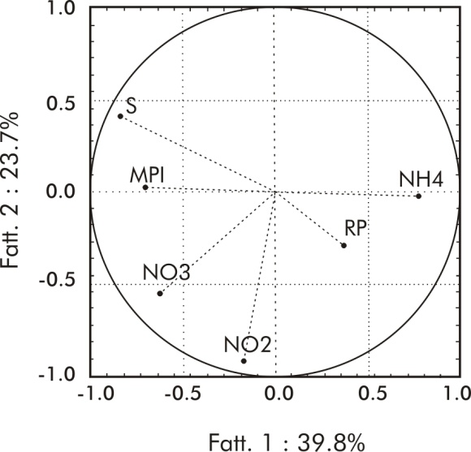
Validation
 | MPI
SALINITY | 0,46*
REACTIVE PHOSPHORUS | -0,52*

Slide 22
Conclusion
In restricted zones, water exchanges favour good conditions, whereas in industrial and urban areas moderate conditions were recorded.
In choked zones, water conditions were more uniform.
Sardinia ponds had bad/poor conditions.
Salinity and reactive phosphorus appeared to be the main drivers.

Slide 23
Thank you for the attention
facca@unive.it

