Slide 1


Oxidative Inhibition of Erythrocyte Na⁺-K⁺ Pump:
A Functionally Relevant Circulating Marker of Oxidative Stress
Dr. Chia-chi Liu
Molecular Cardiac Research Unit
Sydney Medical School
University of Sydney
Australia

Slide 2
Outline
Cardiovascular disease (CVD)
CVD and Na pump
Background of Na pump
Oxidative regulation of the pump
Measurement of oxidative damage of Na pump- a potential biomarker

Slide 3
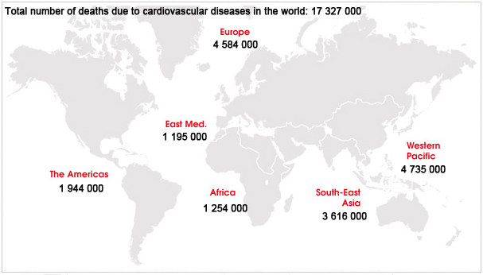
Cardiovascular disease (CVD)
the number 1 cause of death globally
accounting for 17.3 million deaths per year
a number that is expected to grow to >23.6 million by 2030
http://www.who.int/cardiovascular_diseases/en/

Slide 4
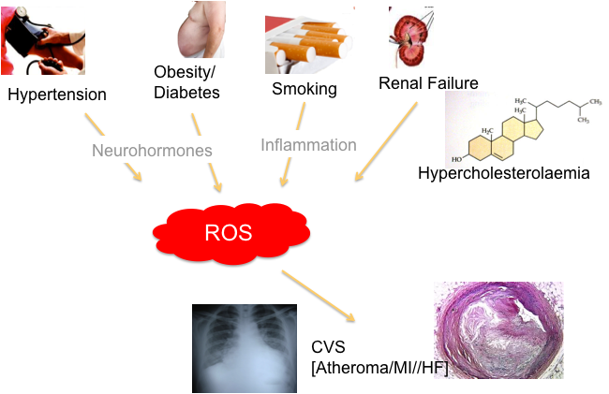

Overview
Reactive oxygen species: key feature of cardiovascular disease
Antioxidants fail to prevent cardiovascular morbidity and mortality
Complexity of ROS signalling

Slide 5
Raised levels of cardiac myocyte Na⁺

Slide 6
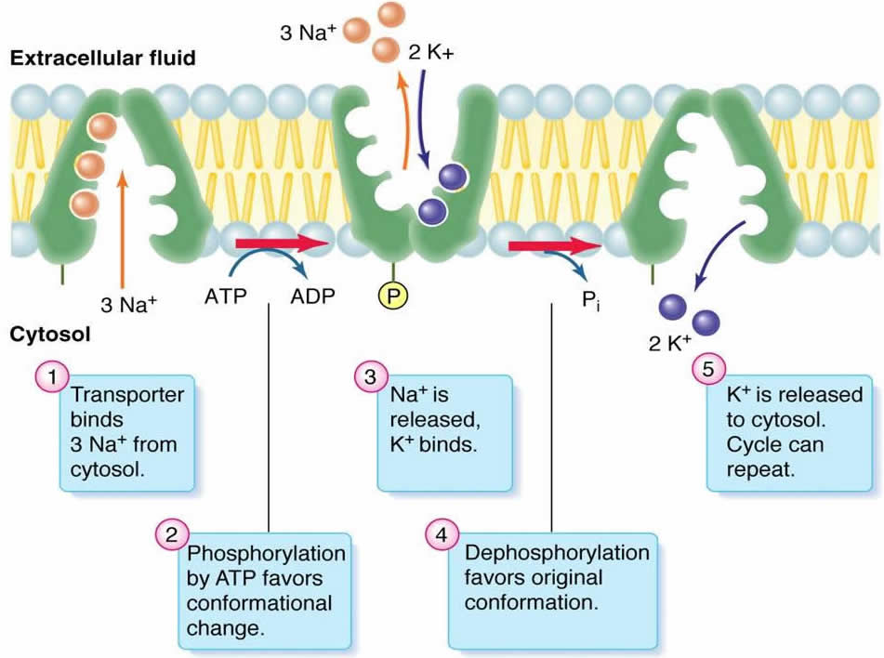
The Na⁺-K⁺ pump
Plasma membrane ion transporter
Transports 3Na⁺ out- and 2K⁺ into cells
Uses ~20% of all energy (ATP) in body
Crucial for normal function and survival of all cells, especially for cardiac myocytes

Slide 7
3D structure of the Na⁺-K⁺ pump
α
FXYD
β
Nature 459:446-50, 2009
Notes:
7

Slide 8
Na⁺-K⁺ pump Regulation
Kinases mediate Na⁺-K⁺ pump regulation
- however, kinases have poor access to phosphorylation sites on the pump molecule
Chemical oxidants decrease Na⁺-K⁺ pump activity
-Bibert S & Geering K. J Biol Chem 2008
-Sweadner & Feschenko. Am J Physiol Cell Physiol 2001
-Cornelius, et al. J Bioenerg Biomembr 2001
-Ellis DZ, Rabe J, Sweadner KJ. J Neurosci 2003
-White CN et al. Am J Physiol Cell Physiol 2008

Slide 9
Oxidative protein modifications
Trends in Cardiovascular Medicine. 20(3):85-90, 2010

Slide 10
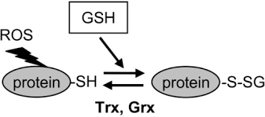
Protein Glutathionylation
Protein glutathionylation -
  adduct with –ve charge
  is stable but reversible
Liu, C.C. Circ Res 105, 693-700; 2009
Notes:
10

Slide 11
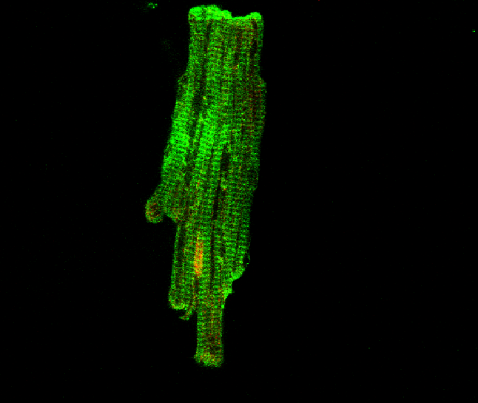
Glutathionylation of Na⁺-K⁺ pump
Baseline
Liu, C.C. Circ Res 105, 693-700; 2009
Notes:
11

Slide 12
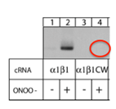
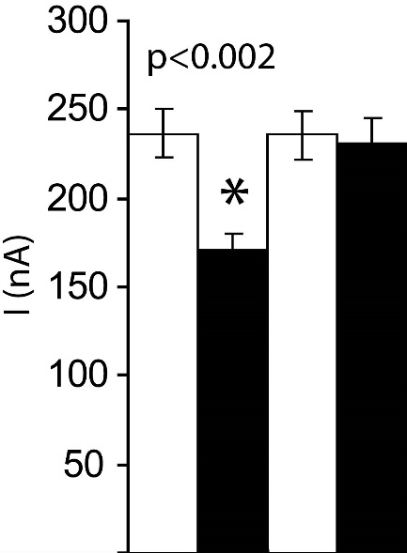
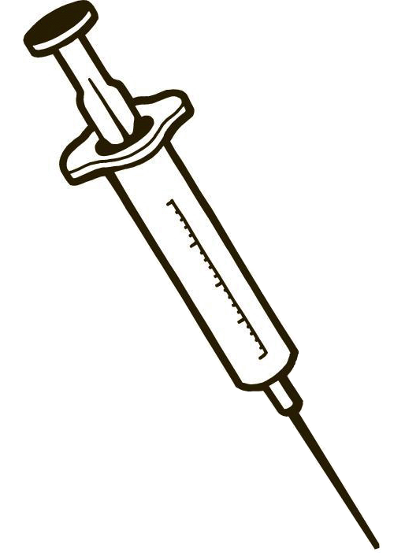
Mutation of Cys45 in β₁ subunit
Cys→Trp mutation eliminates ONOO⁻-induced pump inhibition
Overexpression of
Xenopus α₁/β₁ by cRNA
injection in oocytes
Two–electrode
voltage-clamp
for measurement
of pump current
vs.
Control
ONOO⁻
Liu, C.C. Circ Res 105, 693-700; 2009
Notes:
12

Slide 13
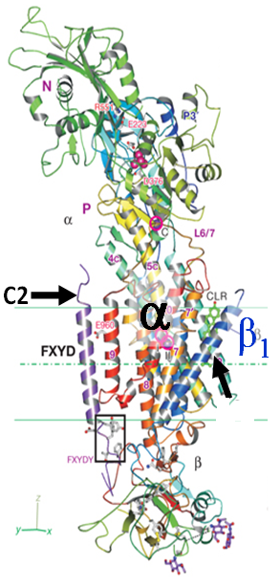
Only Cys 45 in β₁ subunit
C45
Notes:
13

Slide 14
Would knowing the degree of oxidative inhibition of the Na⁺-K⁺ pump in erythrocytes help to monitor the heart disease progress?

Slide 15

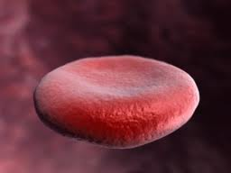


β1 subunit is detectable in erythrocytes, and is glutathionylated
TL IP: β1 + DTT IP: β1 IP: IgG
IB: β1
~55 kDa
IB: GSH
~55 kDa
Notes:
Figure 2- rabbit stuff

Slide 16
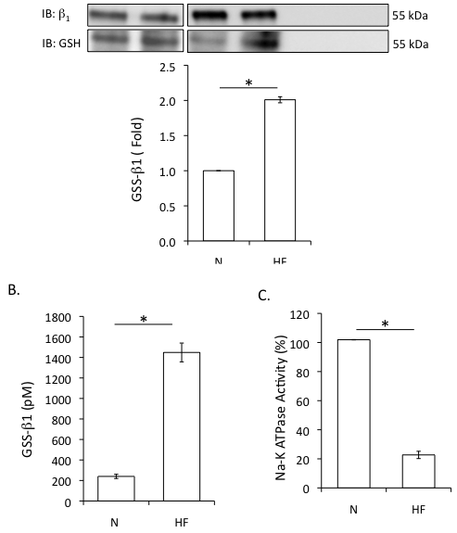
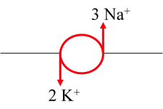
Total Lysate
IP: b1
IP: IgG
Sham HF
Sham HF
Sham HF
Natasha Fry PhD in progress; Unpublished, 2014

Slide 17
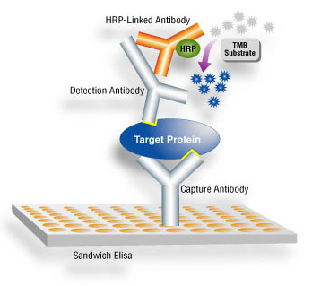
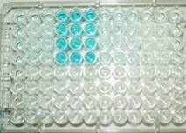
Enzyme Linked Immunosorbent Assay - to quantify eβ1-GSS
A. Method
B. Plate assay
Patient A
Patient B
β1 subunit-
RBC membrane proteins
-GSH

Slide 18
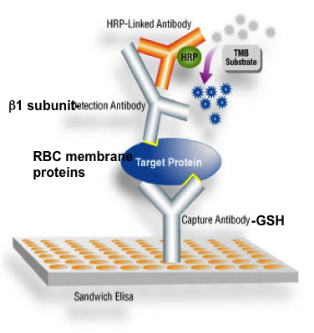
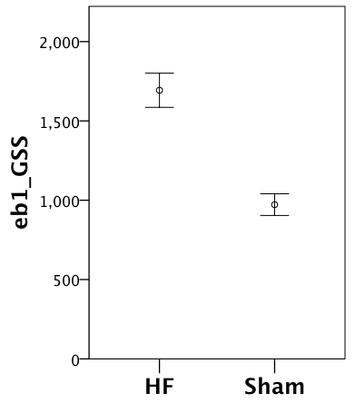
eβ1-GSS in HF vs sham rabbits

Slide 19
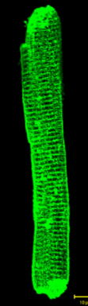
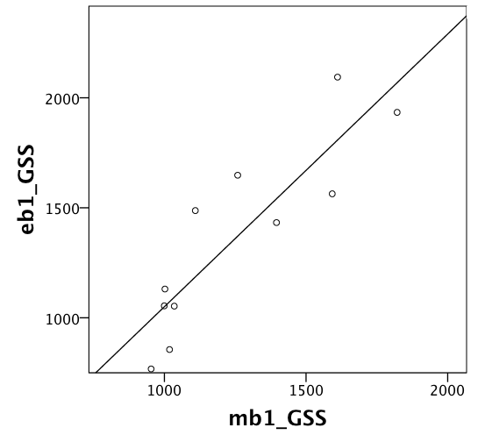
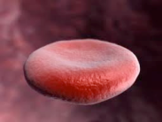
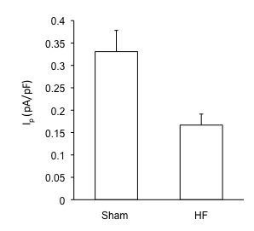
How does eβ1-GSS relate to what’s happening in the heart?
Correlation of eβ1-GSS with β1 subunit glutathionylation in cardiac myocytes
r=0.851; p<0.001
Liu, Unpublished, 2014

Slide 20
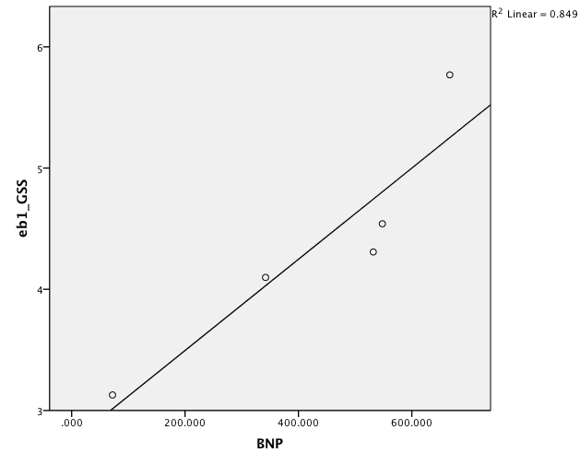
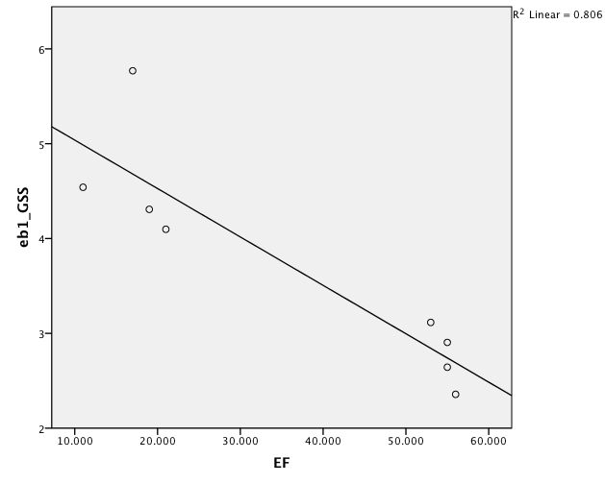
How does eβ1-GSS relate to what’s happening in the heart?
B-type Natriuretic Peptide (BNP)
LV systolic function
Natasha Fry PhD in progress; Unpublished, 2014

Slide 21
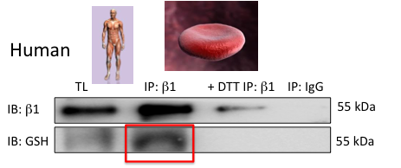
What about in humans?
Detection of eβ1-GSS in humans

Slide 22
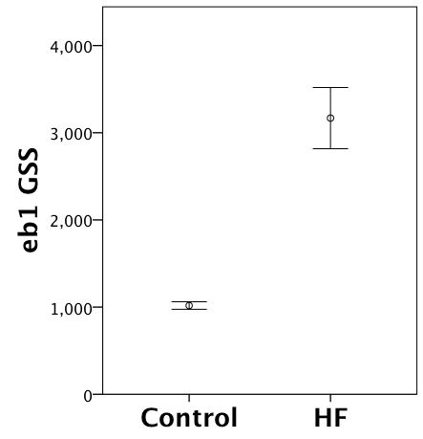
What about in humans?......eβ1-GSS
eβ1-GSS HF patients vs. control
3167 ± 164 U vs 1018 ± 20 U; n=16; p<0.001
Independent of age, gender, bmi.

Slide 23
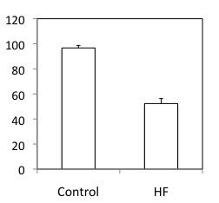
What about in humans?......Na⁺-K⁺-ATPase activity
Na-K ATPase activity in erythrocytes from HF patients vs. control

Slide 24
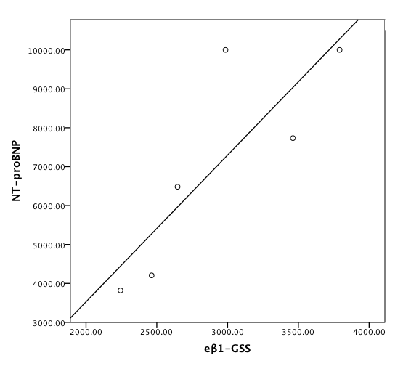
What about in humans? BNP

Slide 25
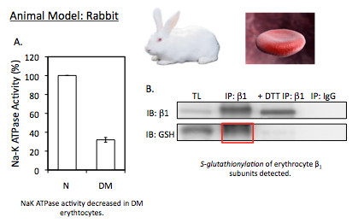
Diabetes and eb1-GSS in animal models

Slide 26
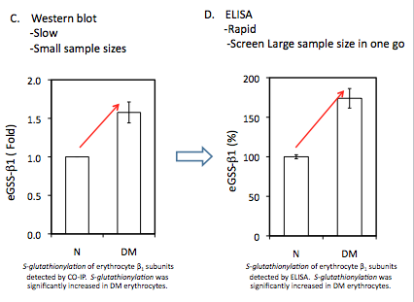
Diabetes and animal models

Slide 27
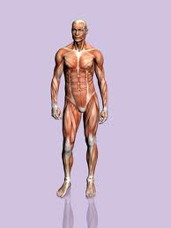


Diabetes and eb1-GSS in humans
Human Model:
TL IP: β1 + DTT IP: β1 IP: IgG
IB: β1
IB: GSH
S-glutathionylation of erythrocyte β₁ subunits detected in human.
S-glutathionylation of erythrocyte β₁ subunits detected by ELISA. S-glutathionylation of erythrocytes was significantly increased in DM patients compared to Normal .)

Slide 28
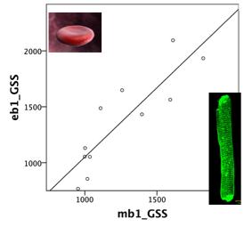
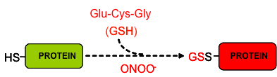
Summary: eβ1-GSS
occurs and is detectable!
ELISA assay is rapid and quantitative
parallels oxidative inhibition of cardiac Na⁺-K⁺ pump
increases in patients with HF and reflects severity
increases in diabetics
Liu, Unpublished, 2014

Slide 29

Potential prognostic value of eβ1-GSS?
For HF: important if being used as diagnostic tool, but less so if combined with clinical and laboratory biomarkers for prognostic purposes
Ongoing work:
  Prognostic significance of eβ1-GSS over conventional biomarkers and risk factors:
    in hospitalized HF/DM
    in community subjects at high risk of HF (SCREEN-HF ~ 4000 subjects)

Slide 30
Special Thanks
North Shore Heart Research Group
Prof Helge Rasmussen
Prof Gemma Figtree
Dr Elisha Hamilton
Molecular Cardiac Research Unit
-Miss Chris Mozar
PHD students
-Miss. Natasha Fry
-Dr. Keyvan Karimi Galougahi
-Mr. Alvaro Garcia
Honours student
-Mr. William Hannam
International
Prof Kaethi Geering (Switzerland)
Dr Stephanie Bibert (Switzerland)
A/Prof Francesca Marassi USA)
A/Prof Kathy Sweadner (USA)
A/Prof Flemming Cornelius (Demark)
-Dr Henning Bundgaard (Denmark)
-Astellas Pharma company (Japan)
Australia
Prof Robert Baxter
A/Prof Jan Gebicki
A/Prof Ronald J. Clarke
A/Prof Richard Payne
Funded by :
National Heart Foundation Australia
Heart Research Australia

