Slide 1


Slide 2

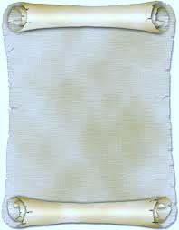
LEVETIRACITAM & cognition in sporadic dementia of Alzheimer’s type in rats
AA Nawar, IE Darwish, CA Ismail
Notes:
Dear professors, colleagues, and Mr Chairman,
I’m delighted for this kind introduction and for being with u right now. Let me present a resume on my research article entitled:” Levetracetam and cognition in sporadic dementia of Alzheimer’s Type in rats

Slide 3
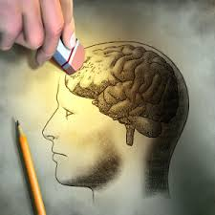
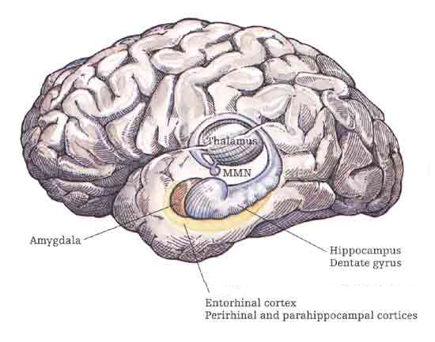
Alzheimer’s disease (AD)
Progressive neurodegenerative disorder
Most common dementia in elderly (70 – 80 %)
Irreversible loss of neurons, mainly in neocortex & hippocampus
Notes:
Despite the increasing prevalence of AD as the most common type of dementia in elderly accounting for about 70 to 80% of cases
Alzheimer’s disease is associated with microtubule dysfunction & characterized by appearance of specific cytoskeletal cellular abnormalities, which are associated with cognitive impairment

Slide 4
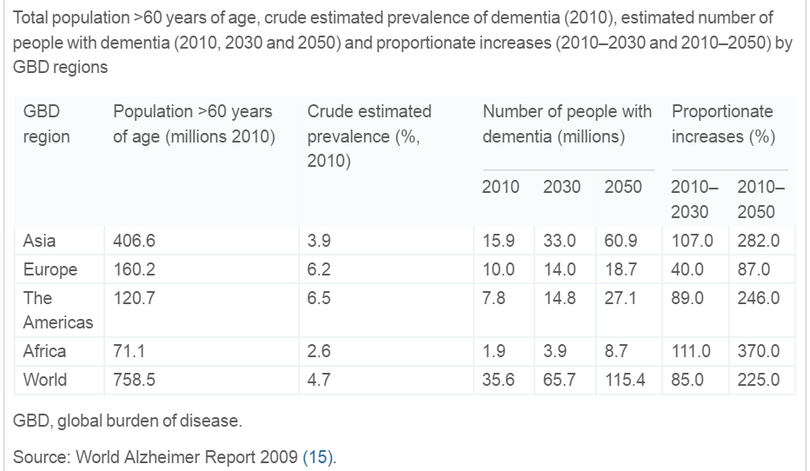
Prevalence rates
Notes:
Deapite the increasing of its worldwide prevalence as its estimates in year 2010 were expected to be doubled every 20 years.
In fact, This table shows a crude estimated prevalence of dementia worldwide 2010 and these numbers were expected to nearly double every 20 years, to 65.7 million in 2030, and 115.4 million in 2050
ADI
World Alzheimer Report 2009
Alzheimer’s Disease International, London, UK (2009)

Slide 5
Alzheimer’s disease (AD)
Progressive neurodegenerative disorder
Most common dementia in elderly (70 – 80 %)
Irreversible loss of neurons, mainly in neocortex & hippocampus
AD is a leading cause of death
Sepsis, Pneumonia, Nutritional deficiencies & Trauma
AD disabilities & patient’s care lead to high socioeconomic burden
Notes:
Also, despite its increasing socioeconomic burden ,

Slide 6
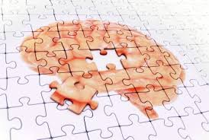
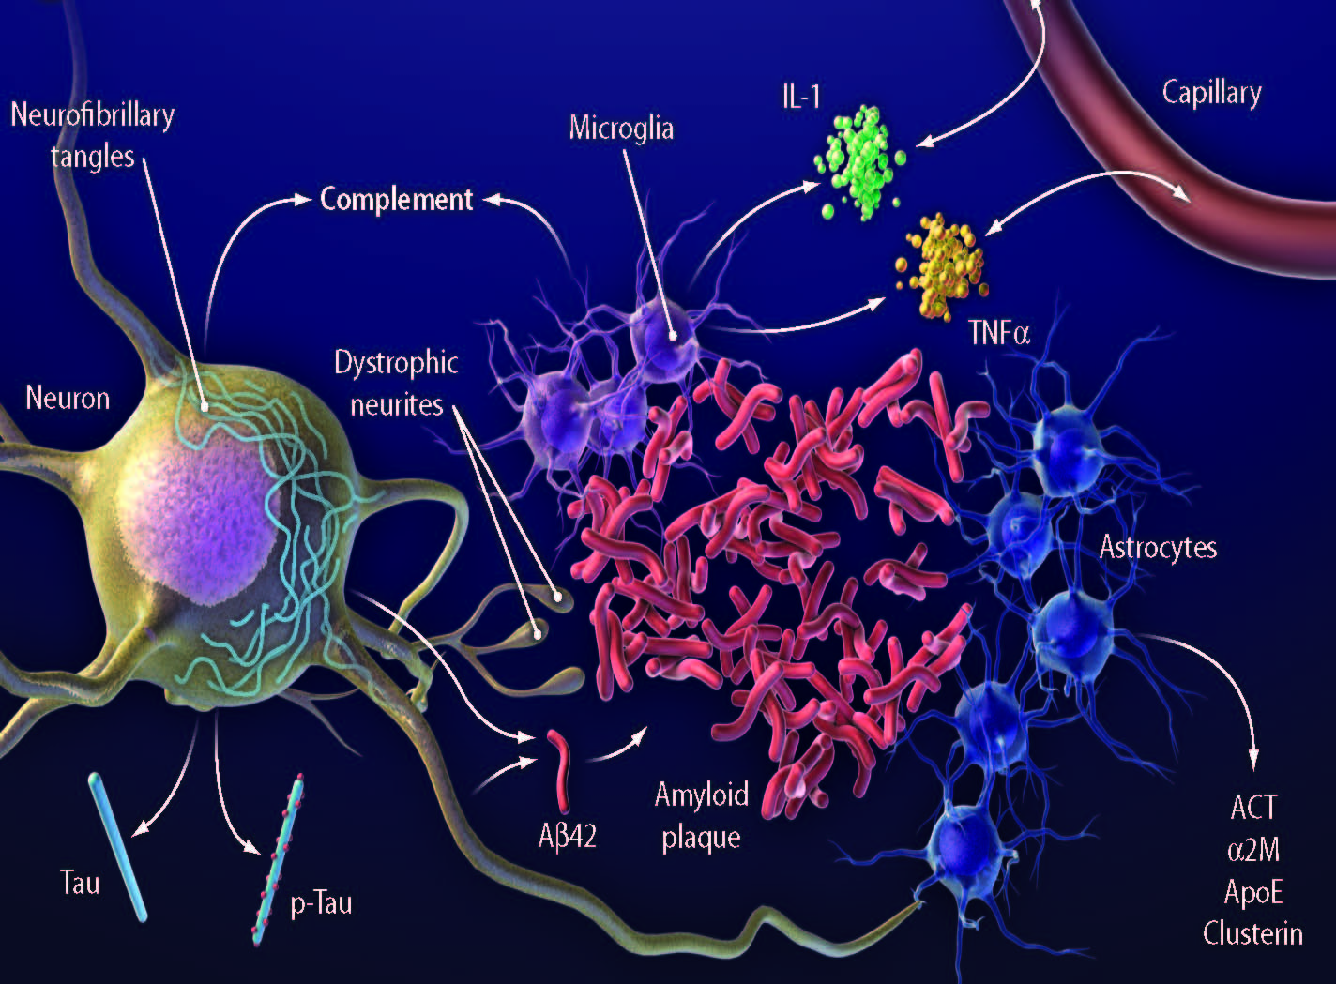
Pathogenesis
Inflammation & Oxidative stress
βAP aggregation
Hyper-phosphorylation of tau protein
Notes:
the available therapeutics are still deficient and can only slow down functional decline rather than attacking the on-going neurodegeneration and pathology. That’s why an effective interventions to prevent, delay, and treat Alzheimer’s disease are urgently needed

Slide 7

Epilepsy
&
Alzheimer’s
Notes:
There is a growing evidence about an intimate relation between AD and epilepsy .

Slide 8



AD patients have an increased risk of developing seizures
An estimated 10 to 22 % of AD patients develop unprovoked seizures
About 21% of sporadic AD patients have at least one unprovoked clinically apparent seizure
In sporadic AD, the presence of ApoE4 allele, predisposes non-demented carriers for epileptogenesis (two-fold increase risk)
with higher rates in familial & early-onset cases
Notes:
Alzheimer’s Patients have an increased risk of developing seizures. An estimated 10 % to 22 % of patients with AD develop unprovoked seizures, with higher rates in familial and early-onset cases. Lire……………., particularly with the presence of ApoE4 allele

Slide 9


Marker of more severe or aggressive AD
Causal relationship
High levels of Aβ were sufficient to elicit epileptiform activity & seizures
  Greater seizures duration & severity increase the chance of impaired cognition
Can occur early, or even coincide with onset of cognitive decline
Seizures can be correlated with more severe dementia
Notes:
It s still debatable whether there is a causal relationship between seizures & AD or the presence of seizures is just a marker of more severe or aggressive AD: .
Experimentally, in hAPP transgenic mice, high levels of Aβ were sufficient to elicit epileptiform activity & seizures through Alteration of synaptic transmission; Modulation of NMDA receptors and α7 nicotinic ACh r
Alterations in several calcium- & activity-regulated proteins; calbindin, Fos, Arc
At early stages of disease process & in absence of overt neuronal loss
Manipulations that prevent seizure activity in hAPP mice also prevent cognitive deficits

Slide 10

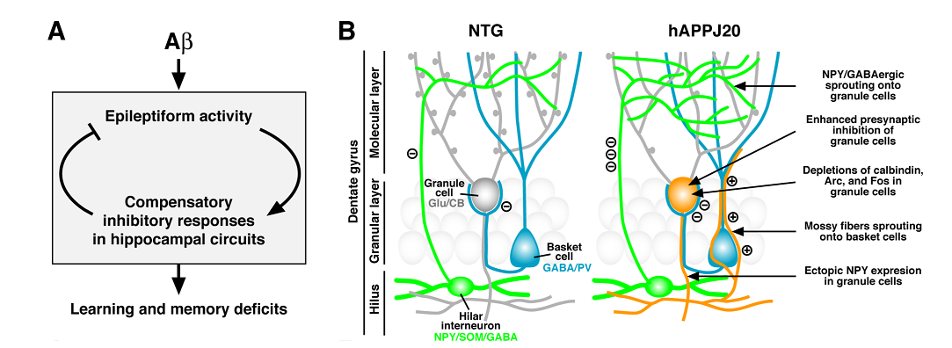
Aβ peptide
Learning & memory deficits
Notes:
On the contrary, epileptic activity triggers a variety of inhibitory compensatory responses in hippocampal circuits that may interfere with normal neuronal and synaptic functions required for learning and memory

Slide 11


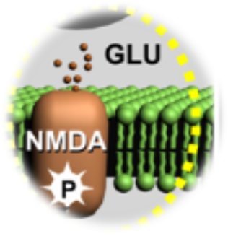
Neuronal hyper-excitability
Cell death
& cognitive decline
Activity-dependant amyloid plaque
Cyclical model
of excitotoxic
neurodegeneration
Seizures
Excess synaptic Glutamate release
Facilitating Aβ release
Shift from α- to β-secretase cleavage of APP
Notes:
Globaly, Seizures can elicit neuronal hyperexcitability, leading to ……… and eventually, ……… as a part of for excitoxic neurodegeneration

Slide 12
Seisure treatment in AD
Seizure treatment is mandatory
Antiepileptic drugs (AEDs)
vary in their effect on cognition
  AEDs can affect cognition either
  positively or negatively
Responsive
to monotherapy
treatment
Notes:
Seizures treatment in AD is mandatory and is response to monotherapy. However, no study compared the effectiveness and safety of antiepileptic drugs (AEDs) in AD in respect to the cognitive function. AEDs vary in their effect on cognition

Slide 13


AED s & cognitive impairment
AEDs can reduce cognitive dysfunction by controlling seizures
Patients with existing cognitive problems, like AD patients, may be at greater risk using drugs with adverse cognitive effects
  Some effective AEDs are associated with a considerable degree of cognitive impairment
Notes:
Either they reduce cognitive dysfunction by controlling seizures or are associated with a considerable degree of cognitive impairment, thus Patients with existing cognitive problems, like AD patients, may be at greater risk using drugs with adverse cognitive effects

Slide 14
AED s & cognitive impairment
That is why the choice of AEDs in AD patients is of utmost importance
Prompt seizure control with AEDs would influence cognitive functions & AD progression
Notes:
Lire

Slide 15
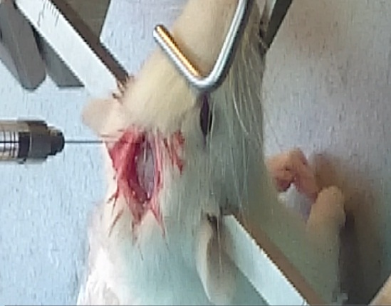

Aim of Study
&
Levetiracetam
Gabapentin
Their possible utility to modulate cognitive performance
versus
?
Old AEDs
Carbamazepine
ON
Colchicine
The possible mechanism of action underlying this modulation
in reference to
SDAT
Donepezil
Notes:
This work was designed to investigate 2 AEDs namely, levetiracetam & gabapentin versus an old one carbamazepine in a SDAT model induced by ICV injection of colchicine in reference to donepezil in order to assess …………………………………

Slide 16
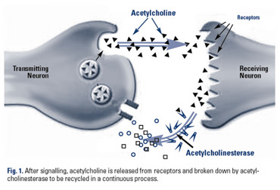
Levetiracetam promising effect
AChE is Marker of extended cholinergic neuron loss
AChE activity in AD
Non-cholinergic/ non-catalytic function
Cholinergic/ catalytic function
Peripheral anionic site
Main target
Cholinesterase inhibitors
ACh hydrolysis
Future target
Promotes amyloid fibril aggregation
Decrease ACh level
Notes:
Why levetiracetam and its derivatives are promising???? Based on the imp role of central cholinergic neurons in storage and retrieval of memory, AChE is being considered as a ………………………………and its activity had been reported to be decreased in AD patients. Recently, another function of AChE has been discovered besides its well known catalytic function, which forms the basis of the actual AD therapy, ………… The new function is known as ………………….., which promotes……………………. It constitutes a future target for AD therapy through the PAS of the enzyme

Slide 17


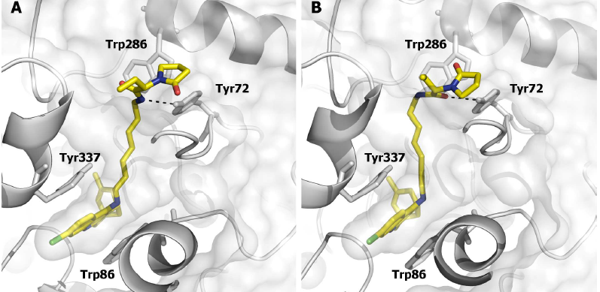
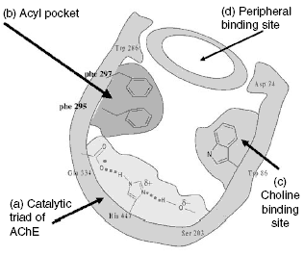
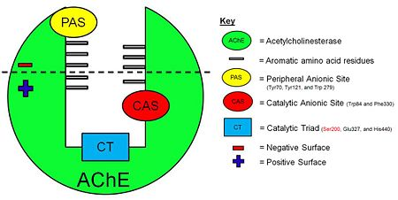
Levetiracetam promising effect
Levetiracitam
Pyrrolidine molecules
AD
Epilepsy
Notes:
Levetiracetam through its pyrrolidine molecules is thought to bind to the PAS (another catalytic site of the AChE) and thus promotes enzyme inhibition. This hypothesis could make levetiracetam targets AD therapy besides its antiepileptic action

Slide 18
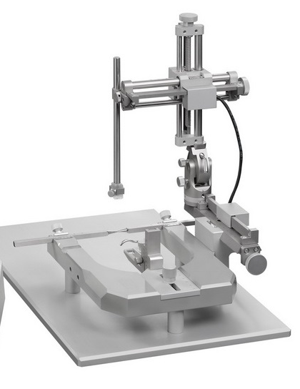
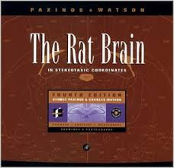
Materials & Methods
Notes:
With the help of Paxinos & Watson ‘s atlas, the stereotaxic coordinates were fixed for the icv injection of 15 Ul colchicine

Slide 19
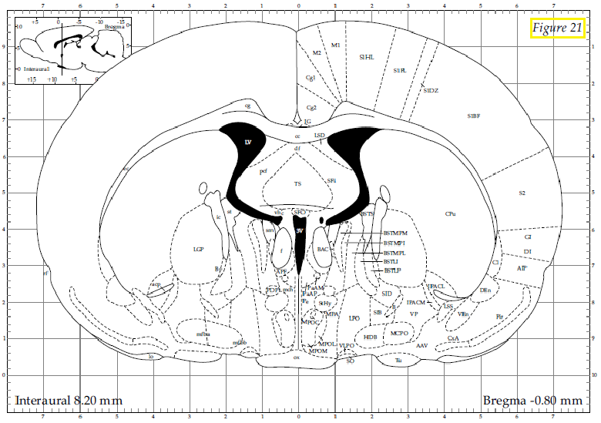
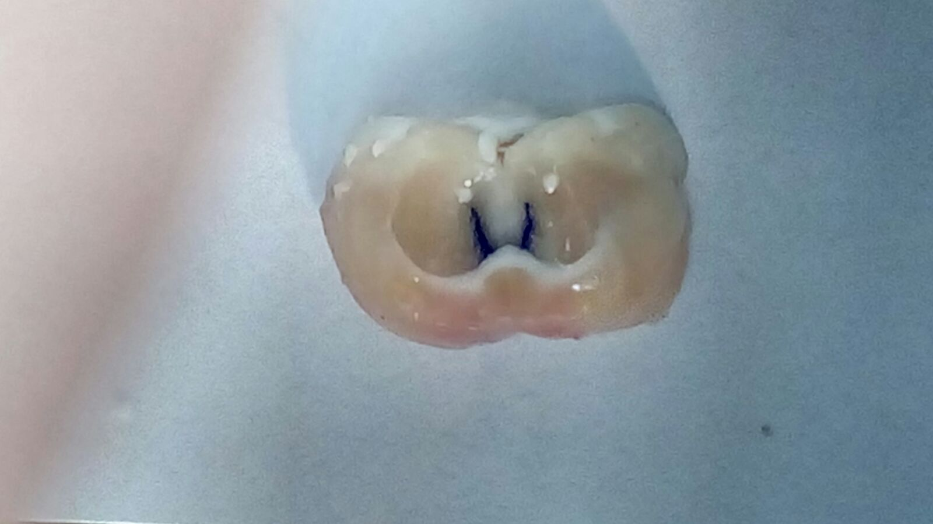
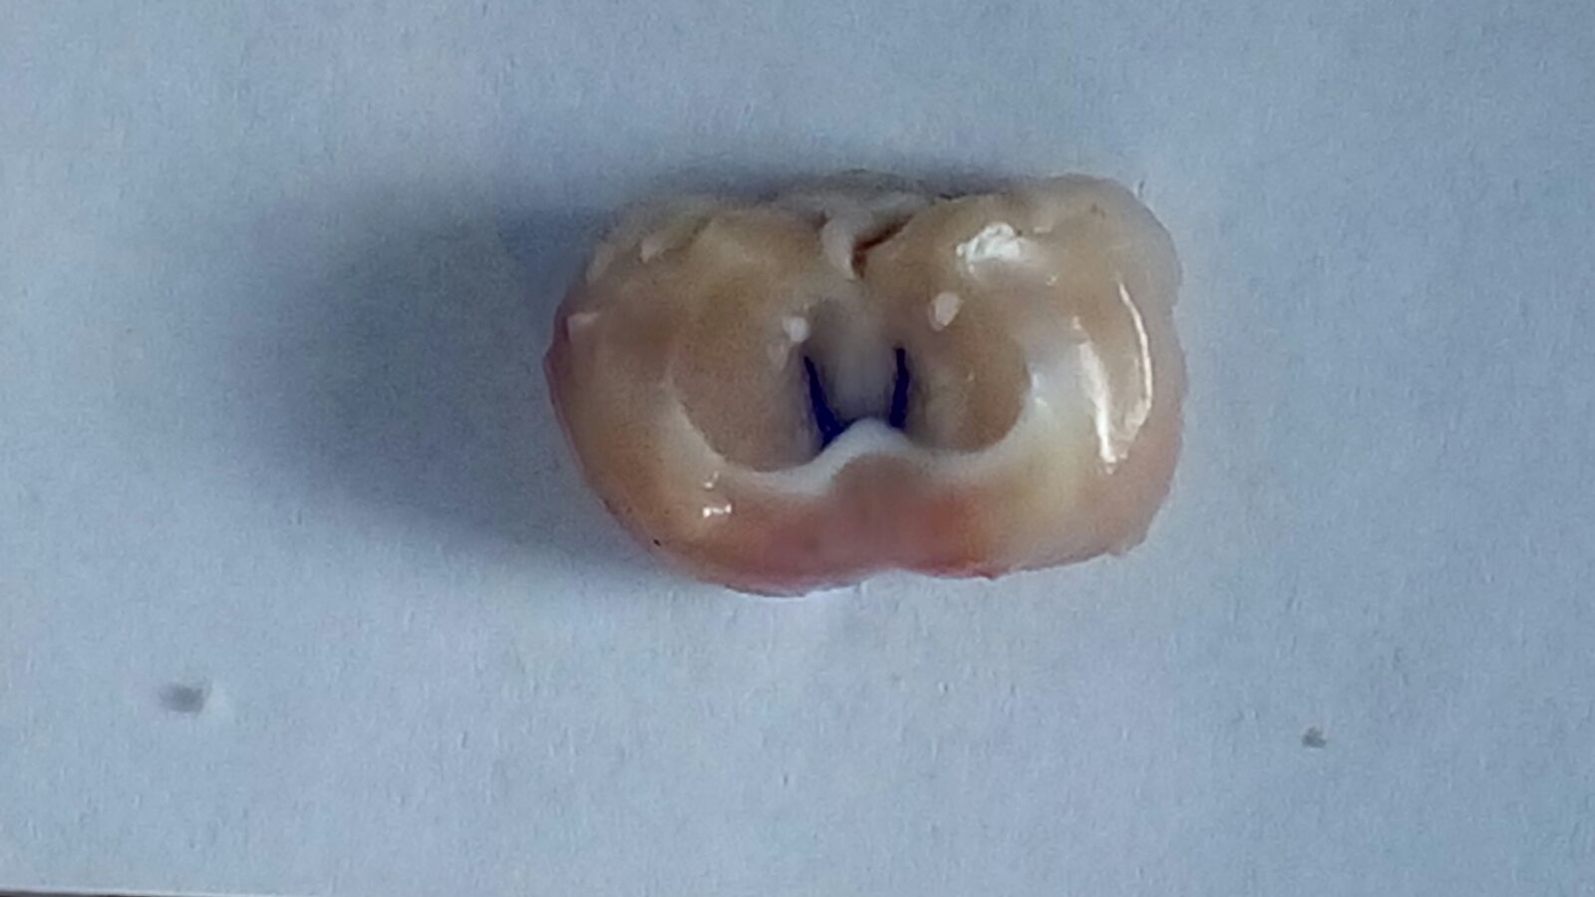
Paxinos and Watson atlas
1.8 mm lateral to sagittal suture
Stereotaxic Coordinates
3.6 mm beneath cortical surface
0.8 mm posterior to bregma
Notes:
Colchicine is a microtubule-disrupting agent and Colchicine-induced cognitive impairment has been
established as an animal model of sporadic dementia of Alzheimer’s type
Colchicine produces marked destruction of hippocampal granule cells, mossy fibers & septo-hippocampal pathways. It induces neurofibrillary degeneration by binding to tubulin, which is associated with loss of cholinergic neurons & decrease in ACh transferase, thereby, resulting in impairment of learning & memory

Slide 20

Experimental Design
Control-non treated group
Treated group
Levetiracetam
Normal Control
Gabapentin
100 mg/kg/day
aCSF-injected
Untreated AD
Carbamazepine
60 mg/kg/day
1ml of 1%
vehicle
Donepezil
icv injection of
10 μl aCSF
100 mg/kg/day
icv injection of
10 μl of colchicine
8
2 mg/kg/day
Notes:
Rats were randomly divided into 2 main groups; a control non-treated group and a treated group. In the control non-treated, rats were subdivided into normal control that were not subjected to surgery and they only received the vehicle, the aCSF-injected rats that were subjected to surgery with icv injection of 10 Ul aCSF instead to colchicine that was injected in the untreated AD rats.
While after surgery & the icv injection of colchicine, rats in the treated group, were subjected to treatment with the tested drugs in their individual doses.

Slide 21

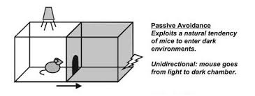
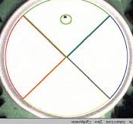
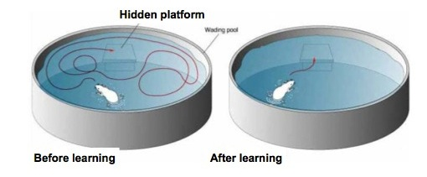

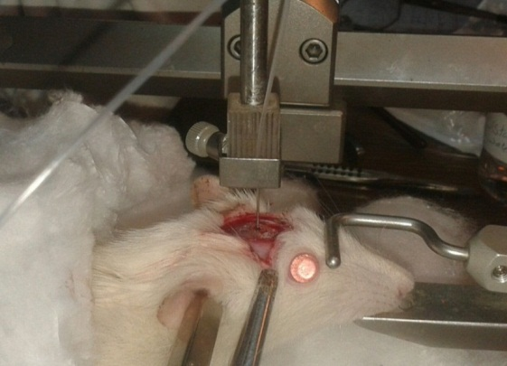

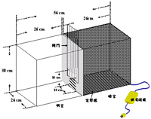
Induction of Sporadic dementia of Alzheimer’s type
Days
1
13
14
21
22
25
26
Maze retention test 1st RL
Maze retention test 2nd RL
Probe (Retrieval) Trial
Maze acquisition test (IAL)
Step-through passive avoidance task
ISTL
STRL
anesthetized i.p with thiopental sodium
15 μg of colchicine dissolved in 5 μl aCSF was injected bilaterally into the lateral ventricle (5 μl/side)
Notes:
The study was conducted in 26 days, on day 1 after anesthesia, rats were subjected to surgery for the icv injection of 15 Ul of colchicine dissolved in aCSF, then on day 13 after surgery, spatial memory was tested by MWM task starting by measuring the IAL, which is the time taken by rats to reach to the hidden platform in the water maze after training. On day 14, and 21, The 1st and 2nd retention latency were measured to test the retention of spatial memory and on day 22, probe test was conducted as another way to investigate the retrieval of memory by measuring the time spent in the target quadrant after removal of the platform. After 2 days of rest, rats were subjected to PA task, where on day 26 the ISTL time is measured, which is the time taken by rats to enter the dark chamber where they r subjected to brief electric shock, in the next day, the retention of this aversive memory was measured by assessment of the STRL

Slide 22
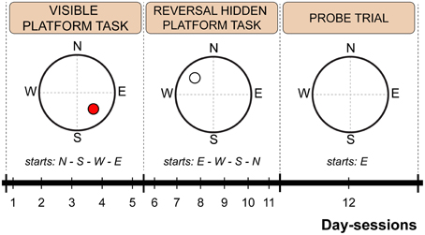
MWM task
Hidden platform test (testing for retention of learned tasks)
Probe test (second estimate of strength & accuracy of spatial memory)
Visible platform test (testing rats’ visual acuity)
Notes:
Here we see the 3 different tests in WM task : a visible task where the platform was made visible to test the visual acuity of rats, the hidden platform test where this shelter was hidden in one quadrant with visual cues were put in the surrounding to help rats to localize it, and the probe trial where the platform is removed to test how much rats ll remain in the target quadrant

Slide 23
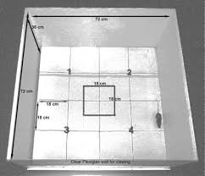
Open field arena
Gross behavioural & locomotor activities
Immediately before the MWM task, the
rats’ spontaneous motor activities were assessed in an open
field arena
Notes:
The gross behaviour and locomotor activity were assessed by the open field chamber to exclude any motor deficit.
is a wooden box
(72 × 72 cm2× 36 cm height) with one glass wall, and its floor is divided into equal-sized squares. Each animal was observed for 5 min; then it was given a score for total locomotor activity calculated as the sum of line crosses and number of rears

Slide 24

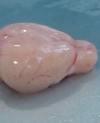
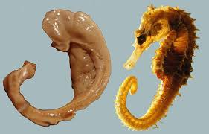
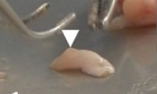
On day 27, animals were sacrificed
Days
1
13
14
21
22
25
26
27
Malondialdehyde
(MDA)
Reduced Glutathione (GSH)
Acetylcholinesterase enzyme (AChE) specific activity
Prefrontal Cortex
Hippocampus
Brain-derived neurotrophic factor (BDNF )
Notes:
And the brain were dissected and Both hippocampi and prefrontal cortices were isolated and kept in iced PBS at -80 ⁰ for measurement of parameters of lipid peroxidation as MDA and antioxidant potential in the form of GSH and …………………………………………………

Slide 25
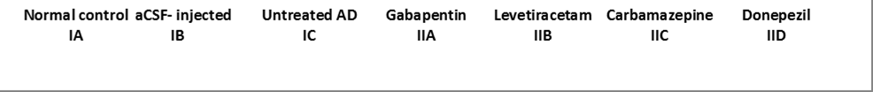
Effect of studied drugs on IAL in MWM in icv-colchicine injected rats (second)
Notes:
This graph demonstrates that the untreated AD rats showed an increase IAL versus normal control. Levetiracitam was comparable to donepezil in decreasing this IAL versus untreated AD rats

Slide 26

Effect of studied drugs on 1st RL in MWM in icv-colchicine injected rats (second)
Notes:
The same was observed in the 1st RL. Again, Levetiracitam was the best among the AEDs to retain this spatial memory, yet donepezil retained memory was the highest on day 14 after colchicine injection

Slide 27

Effect of studied drugs on 2nd RL in MWM in icv-colchicine injected rats (second)
Notes:
on day 21 after colchicine injection, Levetiracetam memory restoration was getting more closer to that of donepezil in the 2nd RL

Slide 28
Effect of studied drugs on escape latency to the hidden platform in MWM during the three days of training sessions in icv-colchicine injected (second)
Notes:
This linear graph shows the progression of the spatial learning process throughout the 3 days of the MWM test, it reveals that all groups had learnt to reach to the platform in shorter time but at the end the learning process of the rats treated with levetiracteam was nearly comparable to donepezil-treated group

Slide 29
Effect of studied drugs on percent of time spent in target quadrant (N-W) in MWM in icv-colchicine injected rats
Notes:
In the probe trial, levetiracetam-treated rats spent more time in the target quadrant to the contrast to carbamazepine

Slide 30
Effect of studied drugs on RL in the step-through passive avoidance task in icv-colchicine injected rats
Notes:
In PA task, both levetiracetam and gabapentin–treated rats were comparable to donepezil in retention of aversive memory

Slide 31
Effect of studied drugs on hippocampal and PFC MDA in icv-colchicine injected rats (nmol/g tissue)
Notes:
MDA as a marker of Lipid peroxidation was highest in untreated rats versus normal in both hippocampal and prefrontal cortex and was mostly decreased with levetiracetam treatment

Slide 32
Effect of studied drugs on hippocampal and PFC GSH in icv-colchicine injected rats
Notes:
The antioxidant capacity of levetiracetam was comparable to that of donepezil and it was evident by increasing GSH level to the contrary to carbamazepine

Slide 33

Effect of studied drugs on hippocampal and PFC AChE activity in icv-colchicine injected rats
Notes:
Icv injection of colchicine decreased AchE specific activity due to cholinergic damage. Gabapentin treatment restored the enzyme activity almost to the normal level, particularly in the hippocampus, which could be due its neurotrophic action, to the contrary levetiracetam decreased the enzyme activity to slightly little extent than donepezil, which could explain its cognitive ameliorative effect

Slide 34
Effect of studied drugs on hippocampal and PFC BDNF in icv-colchicine injected rats
Notes:
BDNF level was lowest in both untreated AD and carbamazepine treated rats, although its level was more or less increased in hippocampus but it didn’t significantly improve the memory impairment and was mostly increased by levetiracetam followed by gabapentin even exceeding the level of donepezil, particularly in the hippocampus that could be behind the memory improvement effect of these 2 AEDs.

Slide 35
Conclusions
Levetiracetam & gabapentin improved cognitive function & obviously protected both hippocampus & PFC from the deleterious effects of colchicine in rat model of SDAT to the contrary to carbamazepine
This might be mainly due to their cholinergic neurotrophic modulation, and antioxidant potential, although their effect on AChE activity was variable
Notes:
Based on data presented in this work, it can be concluded that

Slide 36
Conclusions
Levetiracetam cognitive improvement was nearly comparable to that of donepezil making it the most favourable AED to be used in AD-like dementia

Slide 37

THANK YOU

