Slide 1

Novel Signal Transduction Therapeutic Strategies
for Paralysis and Pain After Spinal Cord Injury (SCI)
Chen Guang Yu, Ph.D., M.D.
Assistant Professor
Spinal Cord and Brain Injury Research Center
Department of Anatomy and Neurobiology
University of Kentucky College of Medicine
Lexington, KY, USA

Slide 2
          OUTLINE
          (Therapeutic Strategies)
Targeting Individual ERK Isoform and Its Cross-talk with Calpain 1 for Neuroprotection
FluBZ Therapy Targeting Multiple Signal Pathways for SCI

Slide 3
Traumatic Spinal Cord Injury (SCI)
    Permanent locomotor disability
    11,000 new cases occur each year in USA
      Over 2.5 million SCI patients with paralysis in the world
    SCI-pain (a common complication, 70-90%)
    refractory to conventional analgesic treatment
    Sustained activation of multiple signal pathways after SCI
    No effective treatments for Paralysis and Pain after SCI
Yu, et al., 2005, 2010; Crown et al., 2006; Zhao et al., 2007, We, et al. 2011
Activation of the ERK1/2 signaling cascade by excitotoxic spinal cord injury. Yu CG, Yezierski RP. 2005
Calpain in the CNS: from synaptic function to neurotoxicity.
Liu J, Liu MC, Wang KK. 2008
Cell cycle activation and spinal cord injury.
Wu J, Stoica BA, Faden AI. 2011

Slide 4
Part 1: Targeting Individual ERK and Its Cross-talk
with Calpain 1 for Treating paralysis and SCI-pain
Eur. J. Biochem. (Review) 271, 2050–2055 (2004)
Role of ERK 1 and 2 in neuronal survival
Michal Hetman1,2,3 and Agata Gozdz1
J Pharmacol Exp Ther. (Review) 2006 Dec;319(3):991-7.
A death-promoting role for ERK1/2.
Zhuang S, Schnellmann RG.
Hypothesis: reducing ERK2, while sparing ERK1, protects against SCI

Slide 5
Lentiviral-ERK2 shRNA intraspinal injection 1 wk preinjury improves locomotor function and tissue sparing following SCI
The role of ERK2 in locomotor function after SCI
Locomotor function Test
Spinal ERK2 Knockdown
At 2 wks post-injury in rats
T10
230 kdyn
IH SCI Device
L-E Rats
n=7/group
Viral titer:
5X10⁷ to 1X10⁸
Tissue Sparing Assessment
Yu et al., J Neurochemistry 2010

Slide 6
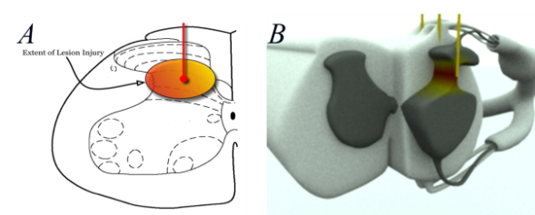
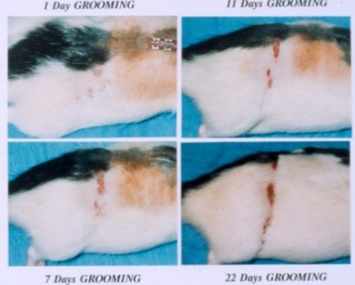
Contributions of ERK1/2 to pain behaviors after excitotoxic SCI
QUIS: Quisqualic acid
an AMPA receptor agonist
ERK1/2 activation after Excitotoxic SCI
_________________________________________
Group n Grooming Behavior Incidence
____________________________________
PD98059 4 0 0%
Vehicle 6 5 83%
_________________________________________
Self-injurious over-grooming
of the affected dermatome
(PD98059 1 μg/15μl delivered to surface of the cord
For 1 h pre and immediately post-injection of QUIS)
pERK2, but not pERK1, contributes to the complete Freund’s Adjvant-induced and formalin-induced pain (Xu Q, et al, 2008; Alter BJ et al., 2010)

Slide 7
Determination of targets of ERK1/2 activation after SCI
ERK1/2 inhibition (U0126) down-regulates
calpain 1 expression 4h after SCI in rats
U0126 iv (2mg/kg) and ip (10mg/kg) pretreatment

Slide 8
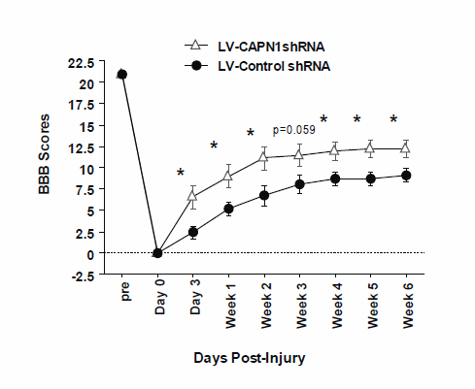
LV-Capn1shRNA intraspinal injection 1 wk preinjury improves locomotor function and tissue sparing following moderate SCI in rats
Role of calpain 1 in SCI
Spinal CAPN1 knockdown
At 2 wks post-injury in rats
Locomotor Function Test
T10
180 kdyn
IH SCI Device
L-E Rats
Viral titer:
5X10⁷ to 1X10⁸
Tissue Sparing Assessment
Eriochrome cyanine (EC) staining
Yu et al., Journal Neurotrauma, 2012
n=10 per group, ANOVA followed by the Bonferroni post hoc test

Slide 9
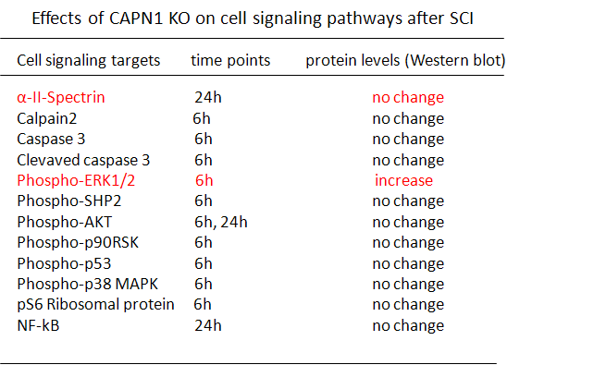
Determination of CAPN1 targets
CAPN1 deletion increased ERK1/2
activation after acute SCI in mice

Slide 10
CAPN1 deletion exacerbated SCI-pain after acute SCI in mice
CAPN1 deletion showed
earlier onset of grooming
CAPN1 deletion worsened
SCI-pain after SCI in mice
CAPN1 deletion exacerbated
SCI-pain after SCI in mice
——————————————————————————
Group n Grooming Behavior Incidence Onset
____________________________________________________
CAPN-KO 5 4 80% 6
WT 4 3 75% 12.5
____________________________________________________

Slide 11
Summary for Part 1: Targeting calpain 1 and ERK2
Cross-talk may provide synergistic effects after SCI
CAPN1reduction
or deletion
ERK2reduction
ERK1 Activation
ERK2
Activation
ERK2
Inhibition
Spared
ERK1
Neuroprotective
Neuroprotective
Improves
Locomotion
Worsens SCI-Pain
Improves locomotion
Reduces pain
ERK1-/- mice exhibit exacerbated paralysis in EAE. (Agrawal A, 2006)
ERK1 plays a critical protective role against NMDA injury. (Nakazawa T, 2008)

Slide 12
Part 2: FBZ/FluBZ Therapy Targeting Multiple Signal Pathways for SCI
          Fenbendazole (FBZ)
A benzimidazole anthelminth for animal use only
FBZ inhibits microtubule formations, and thereby blocking mitosis in nematodes
FBZ has greater sensitivity for nematodes as compared to mammalian tubulin
Its influence on the outcomes of ongoing experiments are a concern
Villar et al., 2007; Friedman et al., 1978

Slide 13
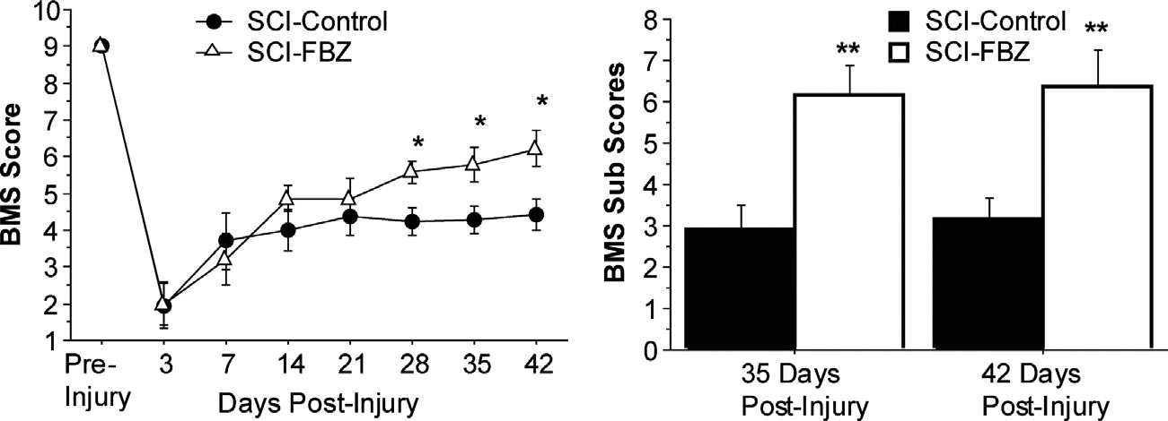
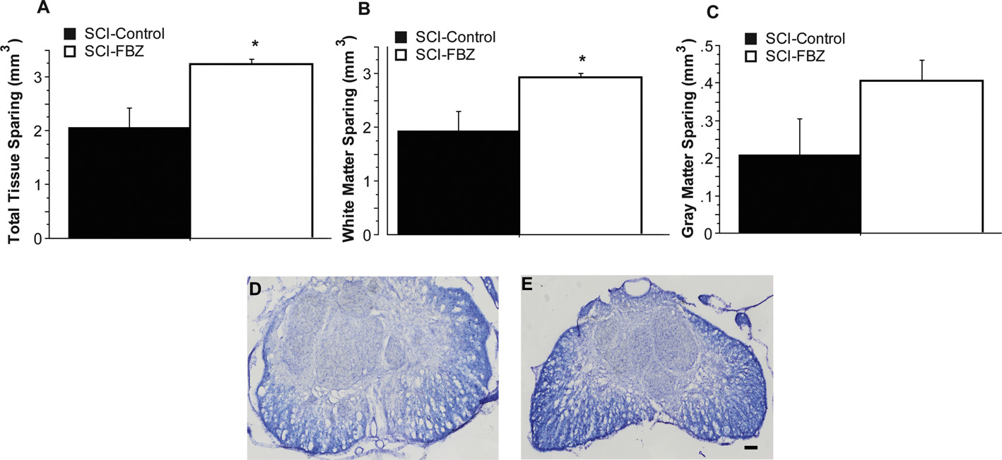
FBZ improves locomotor function and
tissue sparing after moderate SCI in mice
T9
50 kdyn
IH SCI Device
C57BL/6 mice
Locomotor
Function
Tissue Sparing
Eriochrome cyanine
(EC) staining for myelin
Yu CG et al., 2014
FBZ-medicated feed (8 mg/kg/day) for 4 wks prior to SCI, n=7/group

Slide 14
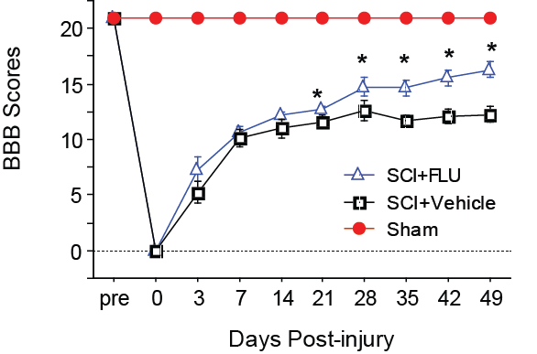
FluBZ improved locomotor function
And tissue sparing after SCI in rats
Approved for human use,
Long term treatment without
adverse effects
Locomotor Function
T10
180 kdyn
IH SCI Device
SD rats
Total Tissue Sparing
SCI+Vehicle
SCIFluBZ+
Total Tissue Sparing
White Matter Sparing
Gray Matter Sparing
FluBZ IP treatment, 3 hrs post-injury for 2 wks (10 mg/kg/day, n=10 per group)

Slide 15
J Clin Invest. 2009 Oct;119(10):2990-9.
B cells produce pathogenic antibodies and impair recovery after spinal cord injury in mice.
Ankeny DP, Guan Z, Popovich PG.
J Am Assoc Lab Anim Sci. 2009 May;48(3):251-7.
Effects of fenbendazole on the murine humoral immune system.
Landin AM, Frasca D, Zaias J, Van der Put E, Riley RL, Altman NH, Blomberg BB.
FBZ suppresses B cell proliferation and production of antibodies.
Microtubule inhibitors (Colchicine, vinblastine):
Cell cycle inhibition, antiinflammation, antiproliferation, and inhibition of pERK1/2 (Gaba, 2014, Spagnuolo, 2010)

Slide 16
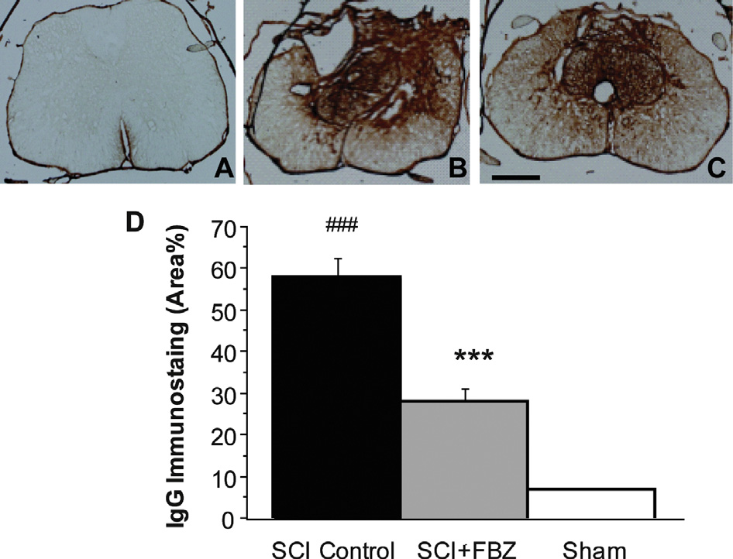
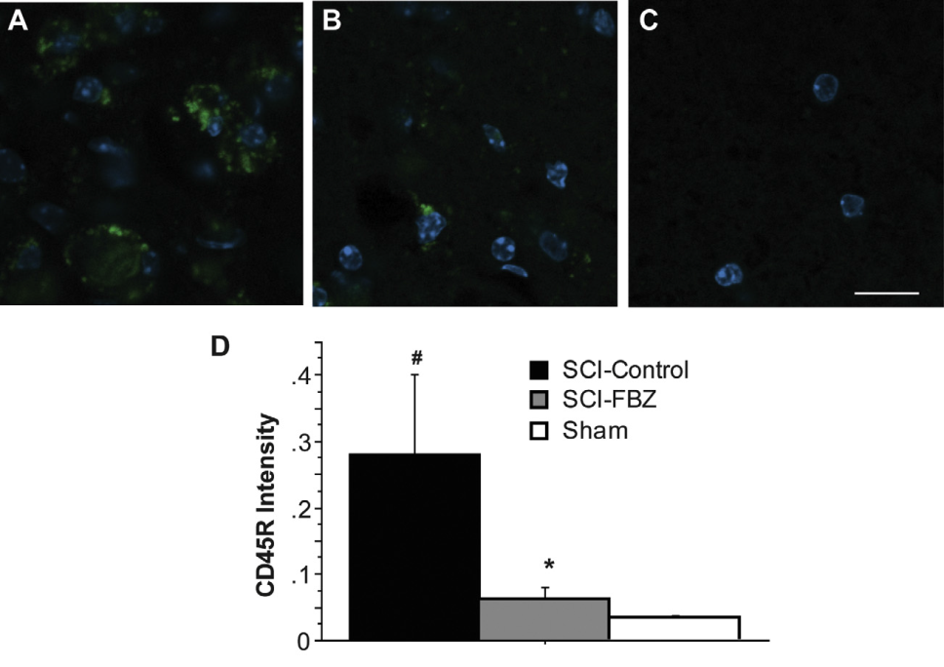
FBZ reduced IgG levels and CD45R-positive B cells
at lesion site six weeks after SCI in mice
Immunohistochemistry for IgG
Immunofluorescence staining for CD45R-B cells
CD45R DAPI
Sham
SCI-Control
SCI+FBZ
SCI-Control
SCI-FBZ
Sham
Yu CG et al., 2014
16
Yu CG et al., 2014

Slide 17
FLuBZ improves recovery of B cell population 4 weeks after SCI
Sham
SCI+Vehicle
SCI+FluBZ
Flow cytometry analysis for CD45RA-positive B cell population

Slide 18
FluBZ inhibited ERK1/2, cyclin B1, and
astroglial activation 4 wks after SCI
ERK1/2 Activation
Cyclin B1 upregulation
Astroglial Activation

Slide 19
Brain Res Rev. 2009 Apr;60(1):135-48. doi: 10.1016/j.brainresrev.2008.12.011. Epub 2008 Dec 25.
MAP kinase and pain.
Ji RR¹, Gereau RW 4th, Malcangio M, Strichartz GR.
Life Sci. 2004 Apr 9;74(21):2643-53.
MAPK activation in nociceptive neurons and pain hypersensitivity.
Obata K¹, Noguchi K.
Rev Med Suisse. 2013 Jun 26;9(392):1342-5.
[Glial cells and chronic pain: from the laboratory to clinical hope].
[Article in French]
Clarke CB¹, Suter MR, Gosselin RD.
Eur J Pharmacol. 2013 Sep 15;716(1-3):120-8. doi: 10.1016/j.ejphar.2013.03.023. Epub 2013 Mar 22.
Astrocytes--multitaskers in chronic pain.
Hansen RR¹, Malcangio M.

Slide 20
FluBZ attenuates pain behaviors
after excitotoxic SCI in rats
Grooming Onset
Grooming Area
Grooming Severity
Vehicle-treated
FluBZ-treated
Grooming incidence 75% 40%
Onset grooming (days) 11 19

Slide 21
          Summary for Part 2
          (FBZ/FluBZ therapy)
Fenbendazole and flubendazole Improve experimental outcomes following SCI
Flubendazole inhibits
    pERK1/2
cyclin B1
B-cell response
astroglial activation
Flubendazole is clinically approved and could easily be translated to human clinical trials.

Slide 22
Future Direction

Slide 23
ACKNOWLEDGEMENTS
Dr. James W. Geddes, Ph.D.
University of Kentucky
Dr. Hall’s lab
Dr. Rabchevsky’s lab
Dr. Saatman’s lab
Dr. Springer’s lab
Dr. Sullivan’s lab
Dr. Snow’s lab
Dr. Smith’s lab
Dr. Bondada’s lab
Dr. Gensel’s lab
Ms. Zel Frye,
Ms. Liz Jones,
Ms. Julie Combs
Dr. Jeanie F. Kincer
Drs. Yu/James W. Geddes’s lab
Vimala Bondada
Carolyn Crowdus
Colin Rogers, Ph.D.
Kashif Raza
Sarbani Ghoshal, Ph.D.
Ranjana Singh, Ph.D.
Brantley Graham
Charles Mashburn, Ph.D.
Lauren Thompson
Allie Zeller
Lauren Power
Mackenzie Jones
Jessica Jones
Funding Sources
University of Florida Seed Grant:
“Effects of ERK1/ERK2 siRNA on Spinal Injury Pain”
PI: Chen Guang Yu, 2004-2005
Paralysis Project of America Grant:
“Inhibition of ERK1/2 for treatment for spinal cord injury
PI: Chen Guang Yu/James Geddes, 2006-2007
KSCHIRT Grant 7-6A:
“Inhibition of ERK2 with lentiviral ERK2-shRNA for SCI”
PI: James Geddes/Chen Guang Yu, 2008-2014
KSCHIRT Grant 11-19A:
“Calpain knockdown minimize damage and deficits after SCI”
PI: Chen Guang Yu/James Geddes, 2012-2015
NIH CTSA Grant: ULTR000117
PI: Chen Guang Yu, 2014-2016
Dr. Robert P. Yezierski, Ph.D.
University of Florida

