Slide 1
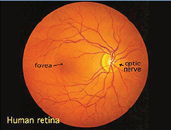
Perioperative Cosopt for Rising Intraocular Pressure
During Steep Trendelenburg Position Surgery
Bonnie Lee Molloy, CRNA, APRN, PHD
Bridgeport Anesthesia/ UCONN
A series of these studies was partially
funded by a postdoctoral fellowship grant
from the AANA Foundation
Acknowledgements:
Charles Watson, MD, FCCM Chairman Anesthesia, BAA
Mentors:
Bruce Shields, MD Past Chairman Ophthalmology Yale NHHS
Xiaomei Cong, PhD Statistician & Professor UCONN
Anthony Musto, MD Chief of Ophthalmology Bridgeport Hospital
Notes:
***I am asking you now to visualize yourselves in the robotic room or during a lower abdominal laparoscopic procedure when the patient is placed in the steep trendelenburg position- Sometimes greater than 40 degrees head down towards the OR floor. I completed my PhD at UCONN in 2010 after researching POVL for 5 years following a case where a 63 year old healthy ASA 2 male awakened blind never to see again

Slide 2
Research Purpose
After observing this case of postoperative visual loss (POVL) following a lengthy surgery (7.5 hours) in the steep Trendelenburg (ST) position, we investigated effects and causal relationship between duration of time in the ST position on intraocular pressure (IOP) resulting in a decreased ophthalmic perfusion pressure (OPP)
MAP – IOP = OPP
We observed gross orbital and facial edema
A review of 17 POVL patients
showed findings of eyelid edema, conjunctival edema and ecchymosis.
Delattre 2007
Measuring IOP intraoperatively requires costly tonometers
and credentialed personnel
Notes:
***Delattre studied 17 patients who had awakened blind following spine and head down positioned procedures. These same observations were made by myself & my colleagues. Our focus today is watching the monitors. We often as anesthesia providers are taping the eyes shut and placing foam around them
Thus… not observing the gross orbital changes that are occurring while the patient is placed in this extreme ST position.

Slide 3
Hypothesis & Goals
The eyelid edema, conjunctival edema (chemosis) and, ecchymosis that we observed would correlate to significant increases in IOP and could assist us as a measure of when (> 40 mmHg) critical threshold IOP levels were reached
Pillunat 1997 / Harris 1998
The aim of our series of studies was to link gold standard IOP tonometry measurements to an observation scale enabling caregivers to determine when to institute preventive and interventive measures to optimize ocular perfusion.
Notes:
3
Remember normal IOP is 10-12 **Upon completion of my courses involving retinal perfusion I studied
Pilunat & Harris findings: they observed flow interruptions in patients whose pressure exceeded 45 to 55 mmHg. Thus we look at 40 as a critical threshold to be preventive

Slide 4
Initial Study Results
N = 37 patients
Measurement of IOP over a 3-hour duration in laparoscopic procedures (prostatectomy, bowel and hysterectomy) while mean MAP was maintained
optimally at greater than 60 mmHg
Starting | 120 min | Ending
13 mmHg (9-20) | 32 mmHg (25-54) | 20 mmHg (10-42)
65 mmHg (50-82) | 45 mmHg (21-75) | 56 mmHg (29-75)
IOP
OPP
What happened to the autoregulation system?
Notes:
Literature had shown that autoregulation in yoga studies maintained a normal IOP while subjects stood on their heads for 2 hours.
So *Anesthetic management was controlled maintaining PIP and CO2
and any triggers of increased IOP were avoided such as Succinylcholine or excessive pressor interventions. IOP was measured every 30 minutes thereafter and Final readings were obtained prior to reversal agents
Our conclusion was that the autoregulation process that maintains flow was impaired in the ST position

Slide 5
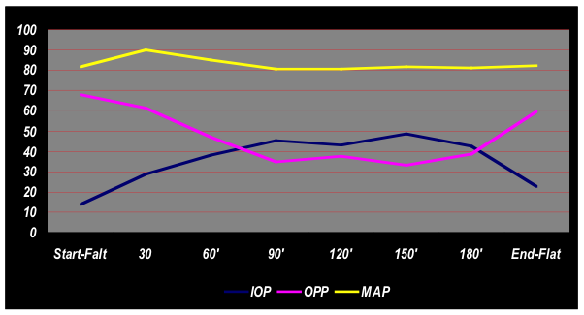
Results
26% of subjects’ IOPs tripled within two hours after institution of ST position, OPP dropped below IOP in this subset, thus recognizing a potential low perfusion state
Notes:
Identification of a direct correlation between the duration of surgery spent in ST with increases in IOP resulting in critical reductions in ophthalmic perfusion pressure (OPP)

Slide 6
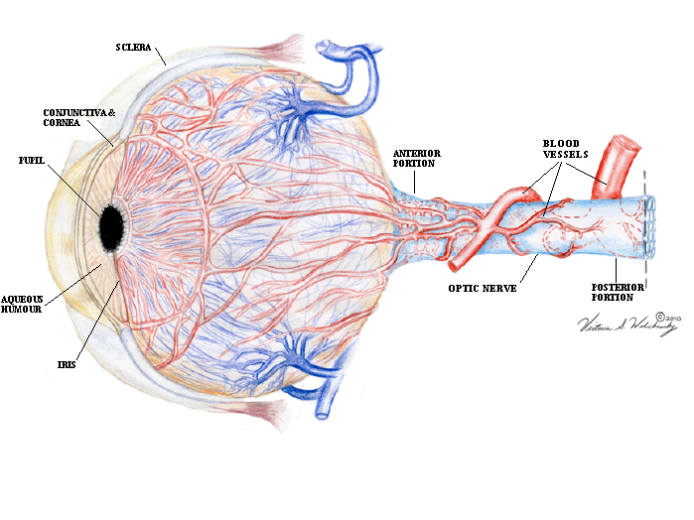
Types of Perioperative Vision Loss
Anterior Ischemic Optic Neuropathy (AION) : flow related - damage
to the anterior optic nerve secondary to a decreased blood supply
Posterior Ischemic Optic Neuropathy (PION): also proposed flow
related - ischemic event secondary to damage to the
retrobulbar portion of the optic nerve
Central Retinal Artery and
Vein Occlusion:
(CRAO & CRVO)
Ischemic & non-ischemic
can be a result of globe
compression as well as increased IOP
Notes:
6

Slide 7
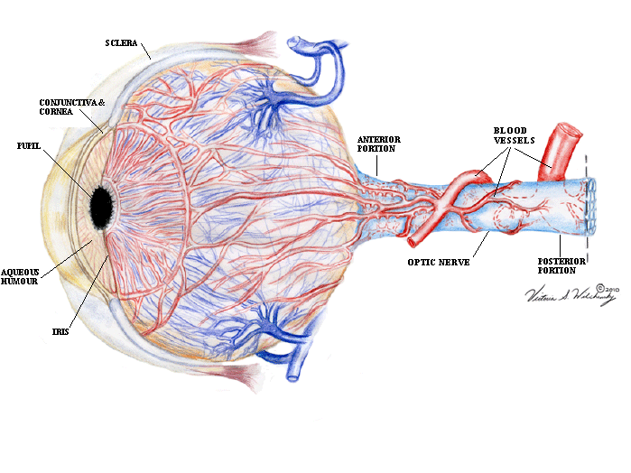
Neuro-ophthalmology Literature
Gilbert - any interference with a patient’s ophthalmic blood flow
autoregulation system can lead to a POVL event.
Savitsky - irreversible optic and retinal nerve damage may occur within 90
minutes of ↓ OPP
Baig - secondary to a compartment syndrome mechanism: the posterior
optic nerve susceptible to ↓ perfusion.
Blood supply via arterial vessels - only small terminal pial vessels
penetrating to the central core of posterior optic nerve .
Optic nerve passes through bony tunnel leading to the brain (optic canal)
Swelling in this inelastic space may cause compression on the nerve.
*** Individual watershed zones & Marked
individual variation of outflow
Notes:
7
nerve___ We do not know why one person may wake up blind and another does not because there is marked interindividual variation in patient vascularity- so much so that some patients have awakened blinded only in one eye- Flow thus perfusion is key…
Additionally we have individual Watershed ZONES ***OUTFLOW-variations are key ie glaucoma patients.

Slide 8
Zheng, Biu, et. al.- Rodent models - confirming that even brief acute rises in IOP can “lead to cumulative dysfunction in the inner retina”
Doppler flow -Ischemia causing retinal structural damage.
(30-45 minutes)
Dysregulation of trabecular meshwork drainage secondary to high IOP & orthostatic pressure changes there is dysregulated pressure dependent outflow. (Rhee)
The Schlemm’s canal that lies below the trabecular meshwork can collapse during prolonged ST position secondary to high IOP and the orthostatic changes: causing occlusion of the lumen and obstruction to outflow
1) increasing potentials for compression of these vessels in the posterior chamber and 2) directly prevents reflux of blood into the anterior chamber**
(Johnstone & Grant)
Pertinent Current Literature
Notes:
** the Rhee studies from Harvard state that pressure is the culprit in the dysruption of aqueous humour dynamics and outflow. The bottom line is that the increased IOP disrupts the protein molecules and cells that regulate the trabecular meshwork drainage system. Thus we visualize gross orbital and conjunctival edema/chemosis Furthermore…
*** At the most recent International Ophthalmology symposium I presented our findings. Abbot Clarke from Texas Institute and Dr. Roy from Boston University Conferred with our hypotheses and explained that the Schlemm……………………………could not understand why physicians were not aware of these orthostatic pressure change effects .
THEY SAID THAT Education is key. Over duration of time we are in fact inducing an acute glaucoma like state. IMPAIRED OUTFLOW..

Slide 9
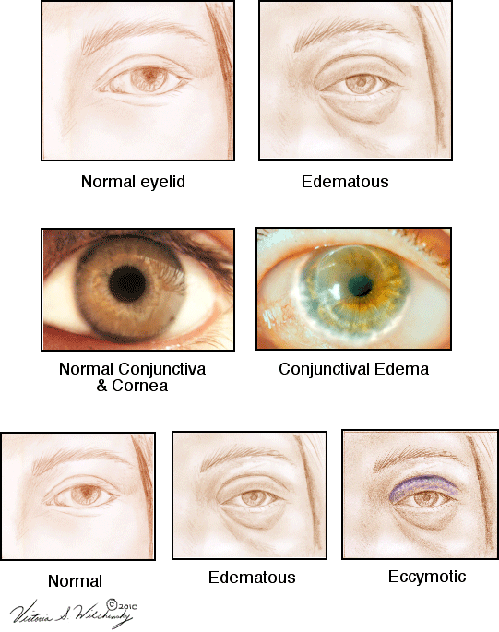
A Preventive Intervention For Rising Intraocular Pressure
Development of the Molloy/ BAA Observation Scale
“The MBOS”
VISUALS OF EYELID EDEMA, CORNEAL EDEMA / CHEMOSIS AND ECCHYMOSIS
Eyelid Edema
2.5 times >baseline IOP incidence
Chemosis
3.4 times IOP
Ecchymosis
4.6 times IOP
Notes:
9
We correlated this raise in IOP to what we were observing. When eyelid edema was seen we became vigilant in our observations because the correlation was 2.5 times the patients baseline IOP
Eyelid edema was always a precursor to chemosis-conjunctival edema which correlated to 3.4 times baseline IOP ( so you have a normal of 12 therefore when you see chemosis youre approaching 40 mmHg THE CRITICAL THRESHOLD
I WILL DISCUSS THIS IN DETAIL TOMORROW

Slide 10
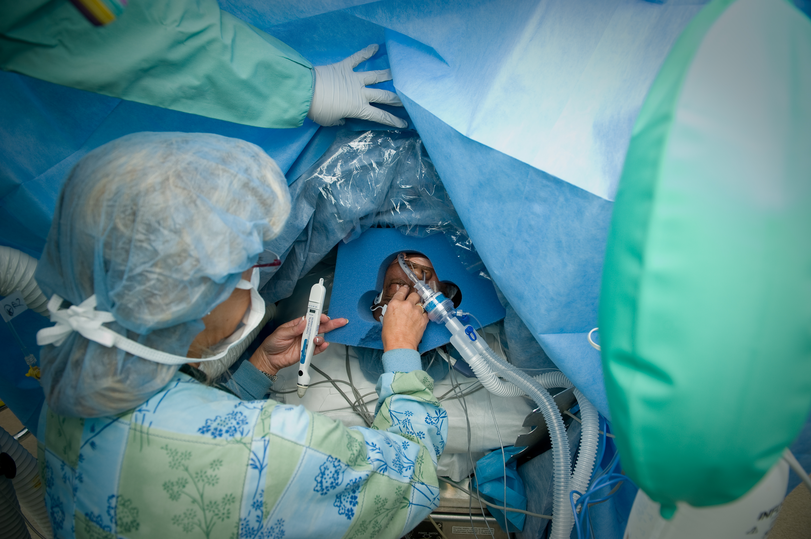
ccc
Notes:
These are the visuals of eyelid and orbital edema during robotic surgery

Slide 11
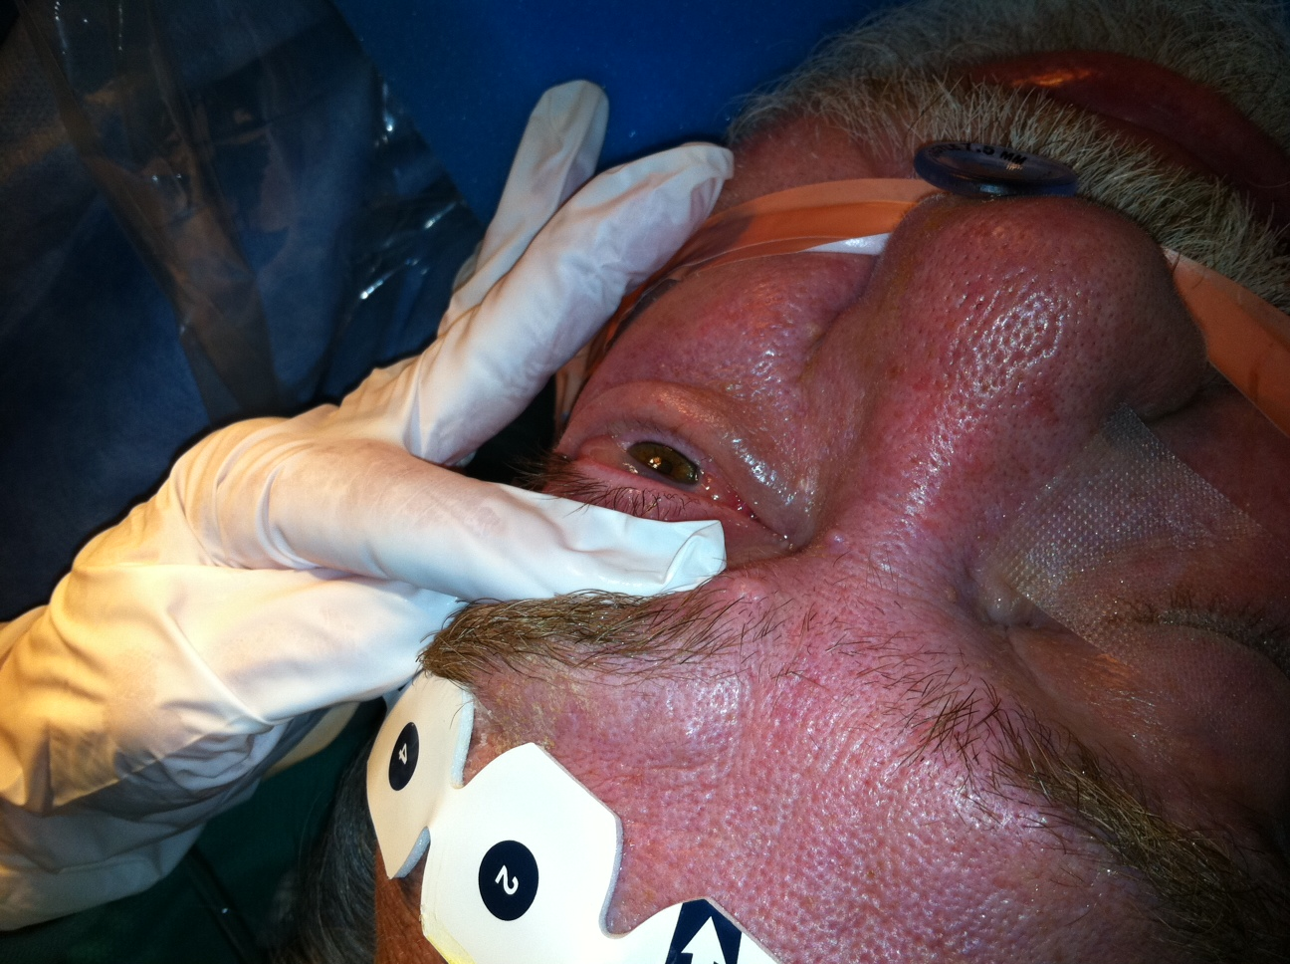
Notes:
Moderate chemosis

Slide 12
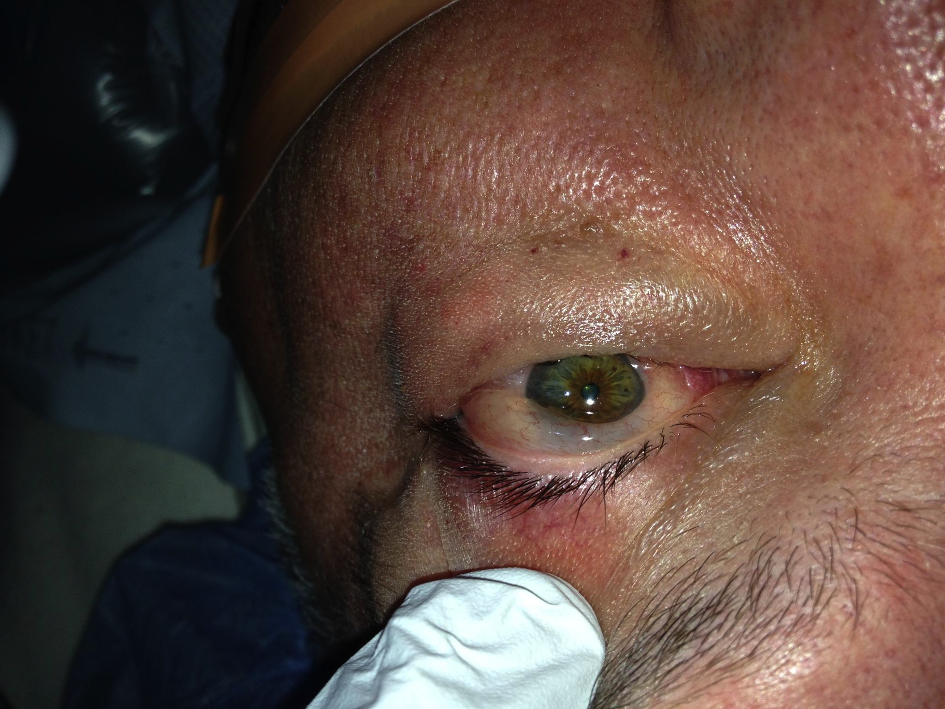
Notes:
Billowing chemosis

Slide 13
Suggested Treatment Interventions
For Elevated IOP
Baig et al. suggest that a treatment measure would be to place the orbit above the level of the heart. They have advised the need to prevent venous pooling in the orbit and recommend rest stops to elevate the head.
Porciatti studied Reverse Trendelenburg positioning and saw an improvement in RCG function.
Grover et al. reviewed the use of beta adrenergic blocker eye drops in
general anesthesia and concluded that Timolol acts by decreasing
the production of aqueous humour and demonstrated a decrease in
IOP .
CosoptTM Trials: A Beta-Adrenergic Blocker/ Carbonic Anhydrase Inhibitor Combination (Dorzolamide and Timolol)
Notes:
13
Yet in the OR surgeons are reticent about repositioning once they are docked
WE EMBARKED ON A SERIES OF STUDIES –OUR GOAL WAS TO NORMALIZE IOP AND PRESERVE OCCULAR PERFUSION… Grover..
*** It is important to note that Cosopt was a recommendation of our ophthalmology mentors because the carbonic anhydrase inhibiting effects further decreased the aqueous humour production and edema- a localized effect was desired.

Slide 14
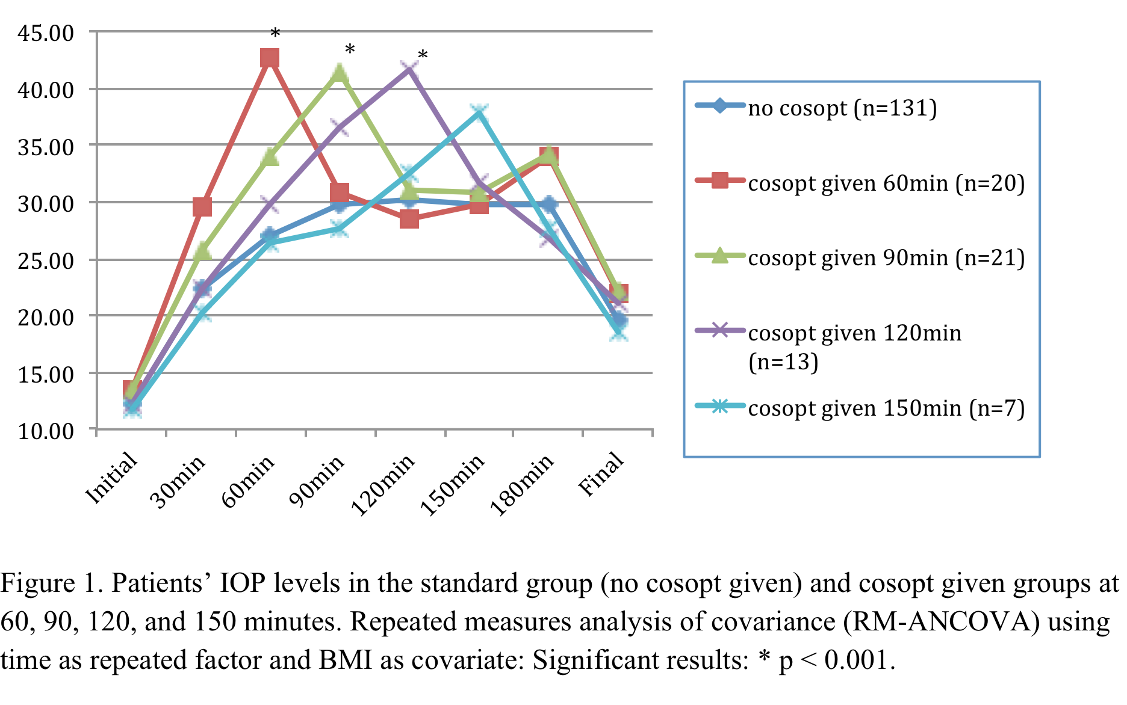
Perioperative Cosopt Intervention
Published AANA J June 2012
Notes:
In our second study we administered Cosopt whenever IOP approached 40 mmHg. Results showed that at all time points there was a statistcally significant decrease in IOP
Its important to note that the cosopt effect remained strong for a 2 hour period after treatment but by the 3rd hour the treatment effects appeared to wane.
Take note that A second drop can be administered if the chemosis effect remains strong.

Slide 15
Preventive Cosopt™ Study partially funded by the AANA Foundation Research Fellowship Grant
90 patients were enrolled
Double-blinded, randomized study where vial A or vial B* was administered following baseline IOP measurement.
*Balanced Salt Solution vs. Cosopt™
Research assistant is blinded as to which is being administered.
Procedures are the same thereafter.
Notes:
Our question now is since we can administer a second drop of Cosopt within the procedure why not preventatively administer prior to placing the patient in the ST position and for those who are at high risk prior to even entering the OR? Remember this can even be given to prone position cases where the highest incident of visual loss has been noted.

Slide 16
Indications
Beneficial in high risk population where history of glaucoma, diabetes or vascular disease is noted
Prolonged case duration in ST position or prone
Results of subjects:
42 (47%) males and 48 females (53%) were recruited in the study. 46 patients received Cosopt™ treatment and 44 patients were in the control group. There were no statistical differences in baseline IOP levels between the Cosopt™ and control groups.
Notes:
High BMI and advanced age were seen to be strong covariates in high IOP measurements in our first 2 studies

Slide 17
Results
Throughout the surgery, patients’ IOP levels were significantly lower in the Cosopt™ group than the control group
Time | Cosopt (mmHg) | Control (mmHg) | p value
IOP initial | 12.61 ± 5.32 | 12.00 ± 4.05 | < 0.05
30 min | 19.83 ± 5.50 | 22.80 ± 5.51 | < 0.05
60 min | 23.15 ± 5.48 | 27.41 ± 6.47 | < 0.01
90 min | 22.89 ± 5.14 | 28.30 ± 6.08 | < 0.001
120 min | 24.11 ± 6.53 | 30.88 ± 7.48 | < 0.001
150 min | 25.00 ± 7.50 | 31.21 ± 7.76 | < 0.01
180 min | 26.06 ± 8.06 | 35.00 ± 8.80 | < 0.05

Slide 18
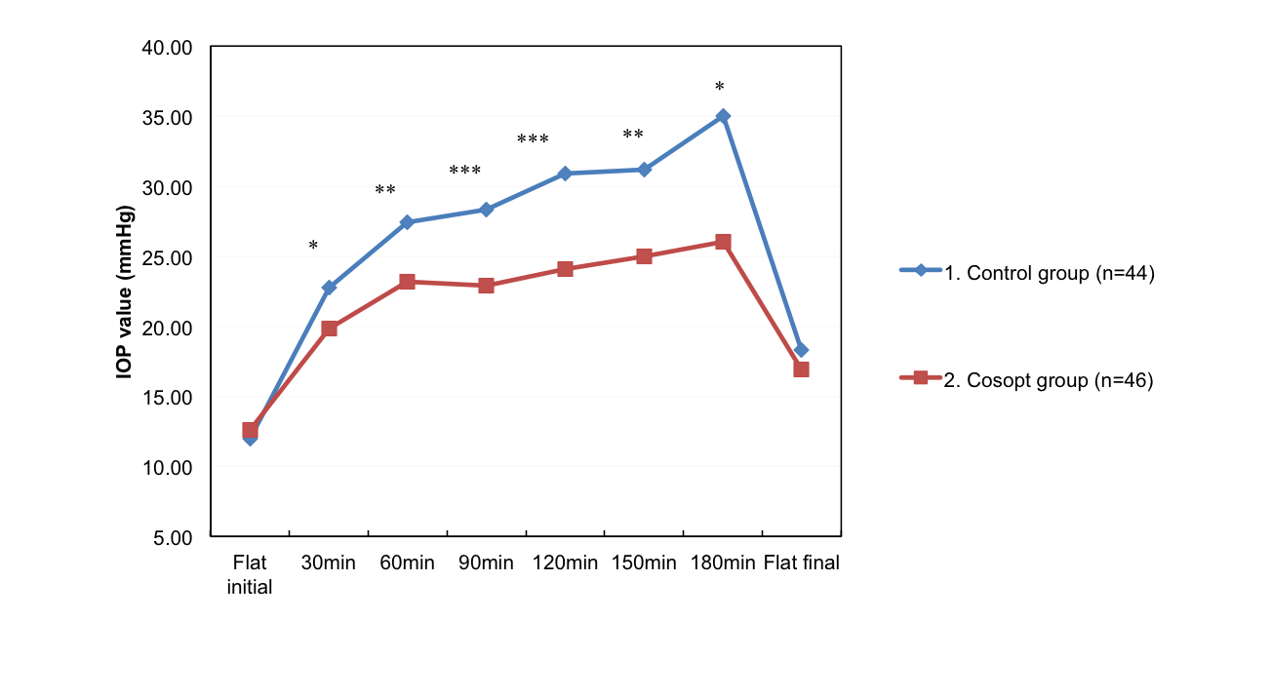
Preventive Cosopt Profile Plot
Conclusion: Cosopt™ drops significantly reduce IOP of patients who undergo lengthy laparoscopic surgery in the ST position when given preventively before the surgery for a two-hour duration of time.
Notes:
Our Conclusion is- There is statistical signficance of the benefit of administering preventive drops in robotics as well as spine cases that are scheduled for longer than 4 hours. TO NOTE-we always have our glaucoma patients use their prescribed drugs the morning of surgery.

Slide 19
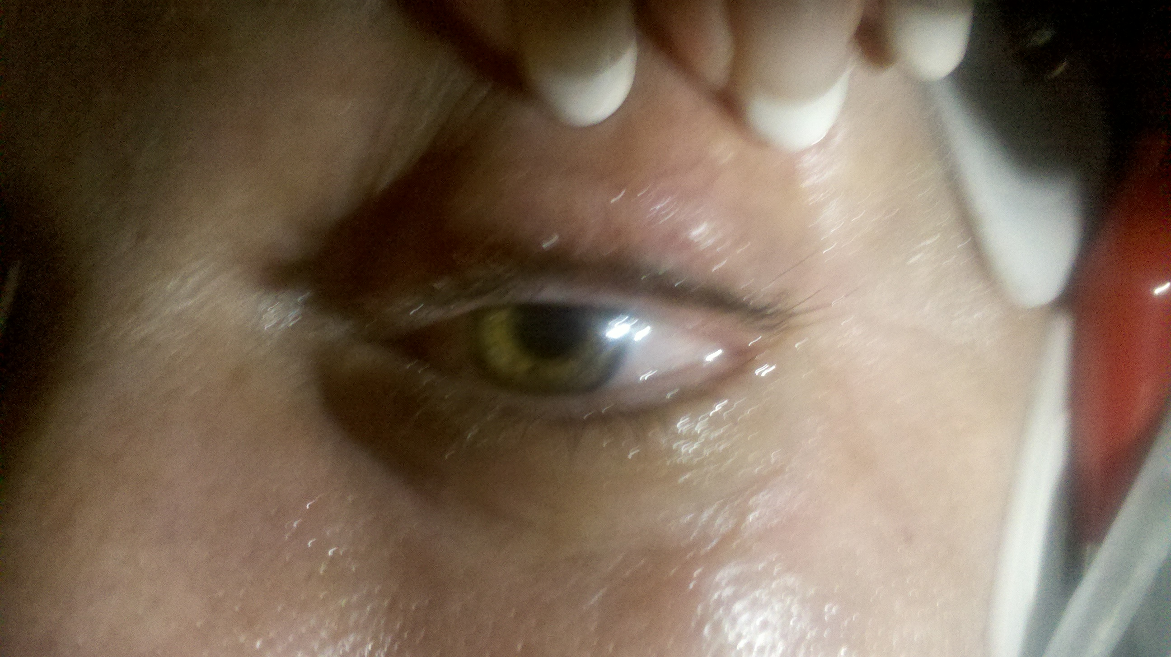
Cosopt Group: Visuals Eyelid Edema & absence of chemosis 2.5hrs
Notes:
This is one visual example showing the variation in chemosis levels when Cosopt is administered preventively.
Key notation of visuals:
When Cosopt™ is given preventively the chemosis effect is blunted. When given interventionally, once chemosis is already visualized, the Cosopt™ effect only stops the escalating trend of chemosis. Thus, the conjunctival edema does not disperse until the head is elevated- Supine intervention is needed at that time.

Slide 20
A Comparative Assessment of IOP during Prolonged Laparoscopy in
ST Position vs. Supine Position Intervention Group
70- 90 min
Published in Journal of Anesthesiology & Clinical Research June 2012
Presented at AANA August 2010 and at the PGA in NYC December 2010
Notes:
Finally -APSF RECOMMENDS REST STOPS SO OUR flat supine positioning study where we introduced a 5-7 minute reversre TBURG at the 60 minute timeframe was seen to be extremely beneficial in prolonged cases
OUR RESULTS: the ST positioned patients mean IOP at 2 hours was 36.1 and the intervention group mean was 19.4 while their baseline IOP’s were statistically comparible. ****The ophthalmology researchers agreed that raising the head above the level of the heart for a period of time may allow trabecular meshwork drainage regulation and outflow and could potentially allow the Schlemm’s canal lumen to reopen
I WILL ALSO REVIEW THIS TOMORROW ENABLING YOU THE PRACTITIONER TO IMPLEMENT A PROTOCOL
We now Ask our surgeons how much longer they may have at our 4 hour time out and since it takes only 10 minutes to undock reverse tburg the patient and redock this would be a suggested protocol if the surgeon does not see an immediate end in sight

Slide 21
Bridgeport Hospital Recommended Protocol
Preventive Cosopt™ for high risk population & Intervention at time point when IOP reaches 40 mmHg (or Billowing chemosis is present)
Four hour “Time Out” where Anesthesia discusses intended completion of procedure.
Cosopt™ may be repeated one additional time during procedure if chemosis effect is strong.
If extended surgery time needed a supine rest stop for 10 minutes is introduced. Undocking of robot and redocking occurs at 4 hour time frame
Notes:
OUR FINAL PROTOCOL .
****Pinkney and associates agree with us and in fact cite our publications in london
They have just conducted a review of all literature involving surgical procedures in the prone and ST position the title----- Raised intraocular pressure and perioperative visual loss in laparoscopic colorectal surgery: a catastrophe waiting to happen? A systematic review of evidence from other surgical specialties. BOTTOM LINE TONOMETRY and/or assessment of chemosis (>40mmHG IOP) is necessary

Slide 22
QUESTIONS ??

